Slide 1
Data Structure101
Byoung Kang & Jack Araz & Li Sun
These slides has been extracted, modified and updated from original slides of : Comp 352 Aiman Hanna
Copyright © 2011-2016 Aiman Han

Slide 2
Topics
> Data Structure
1. Introduction of Data Structure
1-a Array
1-b Linked List
1-c Basic operation in data Structure
2. non-linear Data Structure
2-a Tree
2-b Binary Search Tree

Slide 3
Introduction of Data Structure
- What is Data Structure?
any kind of arrangement or rules to ‘organize’ and ‘store’ information.
- Linear Data Structure
Array
Linked List
Stack
Queue
Non-Linear Data Structure
Tree
Graph
Notes:
To ‘organize’ and ‘store’ information.
It is a logical way of storing data, hence every data structure has its unique ‘logical mechanism’ to retrieve data.
its simply to help people to capture/ access the information easily.
For example, we want to ‘organize’ 10 numbers. Create 10 boxes!
that’s why index number is important.
In computer Science, we call this storing boxes as ‘array’.

Slide 4
Introduction of Data Structure
- What is Data Structure?
any kind of arrangement or rules to ‘organize’ and ‘store’ information.
- Linear Data Structure
Array
Linked List
Stack
Queue
Non-Linear Data Structure
Tree
Graph
Notes:
To ‘organize’ and ‘store’ information.
It is a logical way of storing data, hence every data structure has its unique ‘logical mechanism’ to retrieve data.
its simply to help people to capture/ access the information easily.
For example, we want to ‘organize’ 10 numbers. Create 10 boxes!
that’s why index number is important.
In computer Science, we call this storing boxes as ‘array’.

Slide 5
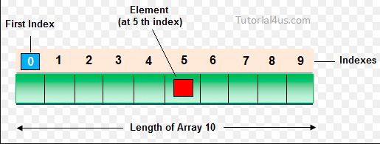
Array
Notes:
An array is a container object that holds a fixed number of values of a single type.
The length of an array is established when the array is created. After creation, its length is fixed.

Slide 6
Introduction of Data Structure (in Array)
Basic Data Structure operations:
Traversing: accessing each record exactly once so that certain item in the record can be processed
Searching: finding the location of the record with a given key value
Insertion: add a new record to the structure
Deletion: removing a record from the structure

Slide 7
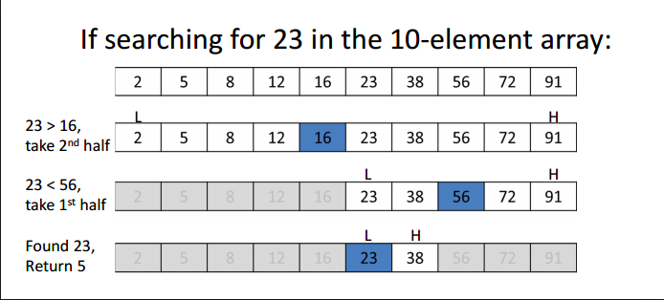
What if we do not know the index number of the target value?
- We can search the index number by target value!
Figure 1-1: Binary Search
A.K.A “Half Interval Search” or “Logarithmic Search”
Notes:
Binary search compares the target value to the middle element of the array; if they are unequal, the half in which the target cannot lie is eliminated and the search continues on the remaining half until the middle value of the array fragment is equal to the target value. If the search ends with the remaining half being empty, the target is not in the array.
To maintain the time efficiency, placing the data in ascending or descending order is critical
Therefore, search algorithm and sorting algorithm goes hand in hand to maximize this time efficiency
However, sorting algorithm is not part of data structure, so I will not explain sorting algorithm today. So we will presume every data structure we deal today is sorted in order.
if the data does not have any integer index, but only a string value, a sorting algorithm establishes an index order based on its index type. Let say, the data has string values only, it should place all the data based on ‘alphabet order’ before we implement the search algorithm.

Slide 8
Introduction of Data Structure
- What is Data Structure?
any kind of arrangement or rules to ‘organize’ and ‘store’ information.
- Linear Data Structure
Array
Linked List
Stack
Queue
Non-Linear Data Structure
Tree
Graph
Notes:
To ‘organize’ and ‘store’ information.
It is a logical way of storing data, hence every data structure has its unique ‘logical mechanism’ to retrieve data.
its simply to help people to capture/ access the information easily.
For example, we want to ‘organize’ 10 numbers. Create 10 boxes!
that’s why index number is important.
In computer Science, we call this storing boxes as ‘array’.

Slide 9
Singly Linked List
A singly linked list is a concrete data structure consisting of a sequence of nodes
Each node stores
element
link to the next node
next
elem
node
∅
A
B
C
D

Slide 10
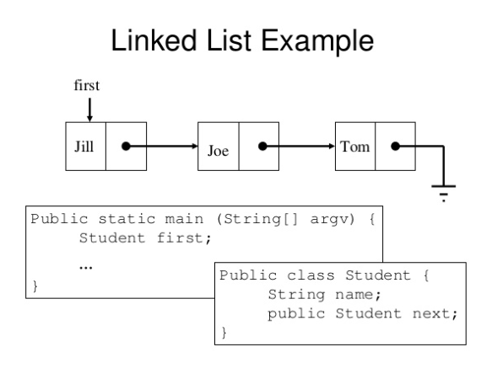
Figure 1-2: Linked List implementation in Java

Slide 11
public class Node {
// Instance variables:
private Object element;
private Node next;
/** Creates a node with null references to its element and next node. */
public Node() {
this(null, null);
}
/** Creates a node with the given element and next node. */
public Node(Object e, Node n) {
element = e;
next = n;
}
// Accessor methods:
public Object getElement() {
return element;
}
public Node getNext() {
return next;
}
// Modifier methods:
public void setElement(Object newElem) {
element = newElem;
}
public void setNext(Node newNext) {
next = newNext;
}
}

Slide 12
Introduction of Data Structure (in Linked List)
Basic Data Structure operations:
Traversing: accessing each record exactly once so that certain item in the record can be processed
Searching: finding the location of the record with a given key value
Insertion: add a new record to the structure
Deletion: removing a record from the structure

Slide 13
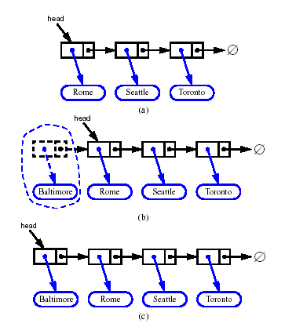
Inserting at the Head
Allocate a new node
Insert new element
Have new node point to old head
Update head to point to new node

Slide 14
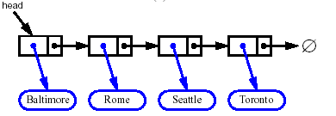


Removing at the Head
Update head to point to next node in the list
Allow garbage collector to reclaim the former first node

Slide 15
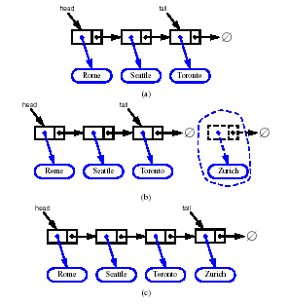
Inserting at the Tail
Allocate a new node
Insert new element
Have new node point to null
Have old last node point to new node
Update tail to point to new node

Slide 16
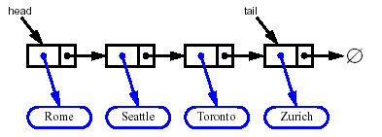
Removing at the Tail
Removing at the tail of a singly linked list is not efficient!
There is no constant-time way to update the tail to point to the previous node

Slide 17
(Recap)Pros & Cons
Array
Linked List
Memory consumption is minimal
Insertion and deletion is complicated
Fast access
Extra space is needed for the links
Insertions and deletions are easy
Finding a specific data is slow
Binary Search can NOT be used. But…
Notes:
Size of an array must be predetermined.
Inserting new information may erase pre-existing data or take long time
Finding a specific data is easy when the index is known
(each node has pointer to the next node)
(modification of previous/ next node’s pointer is required)
(needs to go through each node until the right node is found, or search algorithm is needed)

Slide 18
Introduction of Data Structure
- What is Data Structure?
any kind of arrangement or rules to ‘organize’ and ‘store’ information.
- Linear Data Structure
Array
Linked List
Stack
Queue
Non-Linear Data Structure
Tree
Graph
Notes:
To ‘organize’ and ‘store’ information.
It is a logical way of storing data, hence every data structure has its unique ‘logical mechanism’ to retrieve data.
its simply to help people to capture/ access the information easily.
For example, we want to ‘organize’ 10 numbers. Create 10 boxes!
that’s why index number is important.
In computer Science, we call this storing boxes as ‘array’.

Slide 19
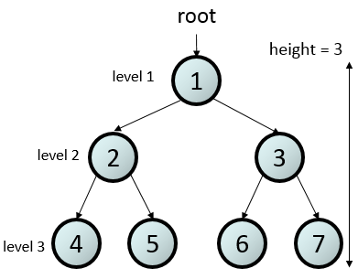
Tree
Tree Terminologies:
Root: node without parent (1)
Internal node: node with at least one child (1,2,3)
External node (leaf ): node without children (4,5,6,7)
Height of a tree: maximum depth of any node (3, in the shown tree)
Subtree: tree consisting of a node and its descendants.(in the bracket)
Notes:
Linked List can allow non-linear structure as to each node can have more than one pointer.
Using this structural flexibility, binary search mechanism can be implemented on Linked List
Left node and right node

Slide 20
Binary Trees
A binary tree is a tree with the following properties:
Each internal node has at most two children (exactly two for proper binary trees; otherwise the tree is improper )
We call the children of an internal node left child and right child
The children of a node are an ordered pair, where the left child precedes the right one
A binary tree can be defined recursively as either
a tree consisting of a single node, or
a tree whose root has an ordered pair of children, each of which is a binary tree
Applications:
arithmetic expressions
decision processes
searching
A
B
C
D
E
F
G
H
I

Slide 21
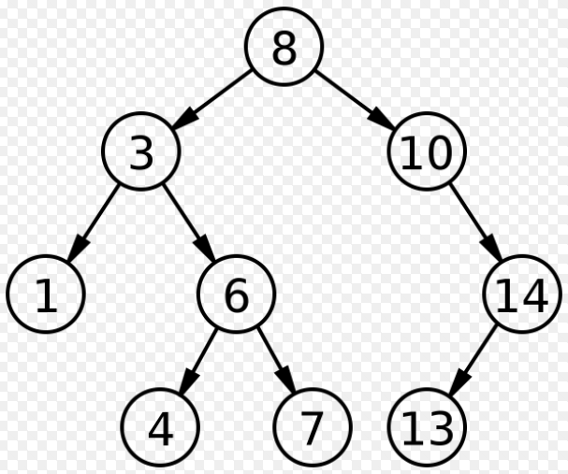
In computer science, a tree is an abstract model of hierarchical structure
A tree consists of nodes with a parent-child relation
A binary search tree is a rooted binary tree, whose internal nodes each store a key( and each have two distinguished sub-trees, commonly denoted left and right.
The tree additionally staisfies the binary search tree property, which states that the key in each node must be greater than or equal to any key stored in the left sub-tree, and less than or equal to an key stored in the right sub-tree
Applications include:
Organization charts
File systems
Arithmetic expressions
Searching
Notes:
Binary search algorithm can be brought into linked list. Thanks to structural modification of linked list, which is binary tree!
Let say, each node has its index value, and based on the binary search tree, characteristic
Left must be smaller than the root, right node must be bigger,
In other words, the ultimate root node must be the middle index node in this data structure
It guarantees the binary search mechanism.

Slide 22
Introduction of Data Structure (Binary Search Tree)
Basic Data Structure operations:
Traversing: accessing each record exactly once so that certain item in the record can be processed
Searching: finding the location of the record with a given key value
Insertion: add a new record to the structure
Deletion: removing a record from the structure

Slide 23
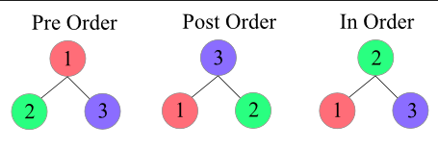
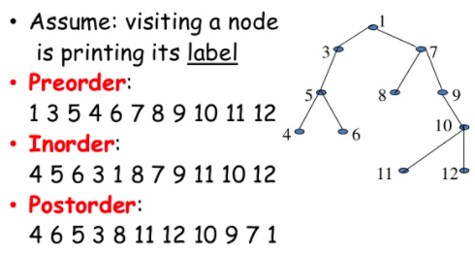
Traversing in Binary Search Tree
Notes:
Thanks to its non-linear structure of data, we can have more than one way to traverse the data.

Slide 24
Preorder Traversal
A traversal visits the nodes of a tree in a systematic manner
In a preorder traversal, the root is visited first and then subtrees rooted as its children are traversed recursively in the same manner.
That is, a node is visited before its descendants.
Algorithm preOrder(v)
visit(v)
for each child w of v
preorder (w)
1
Make Money Fast!
2
5
9
1. Motivations
2. Methods
References
3
4
6
7
8
1.1 Greed
1.2 Avidity
2.1 Stock Fraud
2.2 Ponzi Scheme
2.3 Bank Robbery

Slide 25
iterativePreorder(node)
if (node = null)
return
s ← empty stack
s.push(node)
while (not s.isEmpty())
node ← s.pop()
visit(node)
//right child is pushed first
so that left is processed first
if (node.right ≠ null)
s.push(node.right)
if (node.left ≠ null)
s.push(node.left)

Slide 26
Postorder Traversal
In a postorder traversal, a node is visited after its descendants
Application: compute space used by files in a directory and its subdirectories
Algorithm postOrder(v)
for each child w of v
postOrder (w)
visit(v)
9
cs16/
8
3
7
homeworks/
programs/
todo.txt 1K
1
2
4
5
6
h1c.doc 3K
h1nc.doc 2K
DDR.java 10K
Stocks.java 25K
Robot.java 20K

Slide 27
iterativePostorder(node)
s ← empty stack
lastNodeVisited ← null
while (not s.isEmpty() or node ≠ null)
if (node ≠ null)
s.push(node)
node ← node.left
else
peekNode ← s.peek()
// if right child exists and traversing node
// from left child, then move right
if (peekNode.right ≠ null and lastNodeVisited ≠ peekNode.right)
node ← peekNode.right
else
visit(peekNode)
lastNodeVisited ← s.pop()

Slide 28
Other Traversals
Preorder and Postorder traversals are common but other traversals are possible.
For instance, we can visit all the nodes at depth d before visiting the ones at depth d + 1.
Numbering the nodes as we visit them in such fashion is called level numbering.
1
cs16/
4
2
3
homeworks/
programs/
todo.txt 1K
5
6
7
8
9
h1c.doc 3K
h1nc.doc 2K
DDR.java 10K
Stocks.java 25K
Robot.java 20K

Slide 29
Introduction of Data Structure (Binary Search Tree)
Basic Data Structure operations:
Traversing: accessing each record exactly once so that certain item in the record can be processed
Searching: finding the location of the record with a given key value
Insertion: add a new record to the structure
Deletion: removing a record from the structure

Slide 30
Binary Search Trees
A binary search tree is a binary tree storing keys (or key-value entries) at its internal nodes and satisfying the following property:
Let u, t, and w be three nodes such that u is in the left subtree of t and w is in the right subtree of t. We have key(u) ≤ key(t) ≤ key(w)
External nodes do not store items. They are there to guarantees that the tree is a proper binary tree, which simplifies other operations.

Slide 31
Search
Algorithm TreeSearch(k, w)
if T.isExternal (w)
return null
if k < key(w)
return TreeSearch(k, T.left(w))
else if k = key(w)
return w
else { k > key(w) }
return TreeSearch(k, T.right(w))
To search for a key k, we trace a downward path starting at the root
The next node visited depends on the comparison of k with the key of the current node
If we reach a leaf, the key is not found
Example: get(4):
Call TreeSearch(4,root)
The algorithms for floorEntry and ceilingEntry are similar
<
6
2
>
9
1
4
=
8

Slide 32
Insertion
<
6
To perform operation put(k, o), we search for key k (using TreeSearch)
Assume k is not already in the tree, and let w be the leaf reached by the search
We insert k at node w and expand w into an internal node
Example: insert (5)
2
>
9
1
4
>
8
w
6
2
9
1
4
8
w
5

Slide 33
Deletion
To perform operation remove(k), we search for key k
Assume key k is in the tree, and let v be the node storing k
If node v has a leaf child w, we remove v and w from the tree with operation removeExternal(w), which removes w and its parent
Example: remove (4)
<
6
2
>
9
1
4
v
8
w
5
6
2
9
1
5
8

Slide 34
https://www.cs.usfca.edu/~galles/visualization/BST.html

