Slide 1
Your Shop
The place to buy your phones and tablets
By Johannes Herbert, Florian Bayer and Patrick Zinẞer

Slide 2
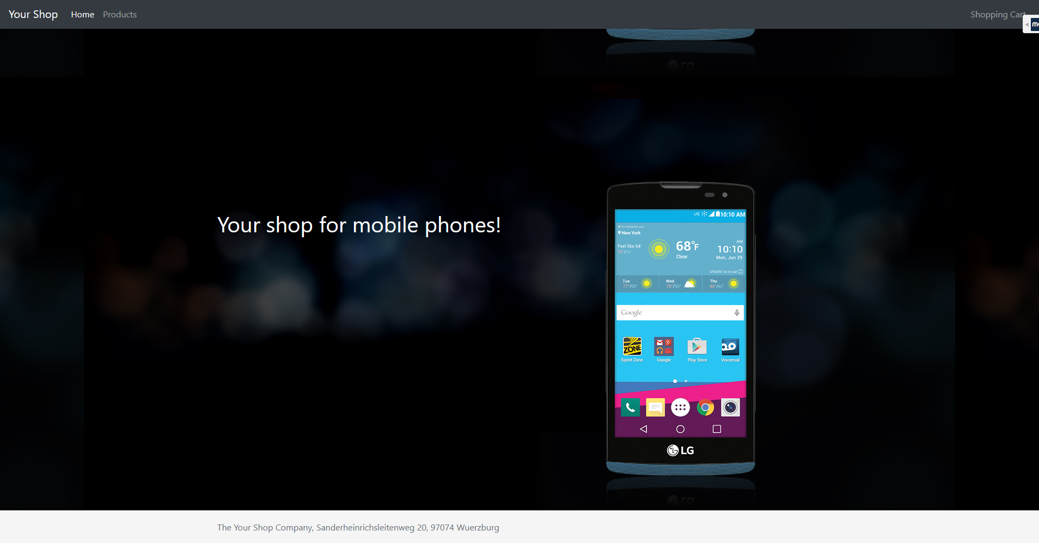
Your Shop

Slide 3
Goals
To build a website where:
  User can sign up
  User can search for phones and tablets
  User can filter for manufacturer or category
  User can put products into a shopping cart

Slide 4
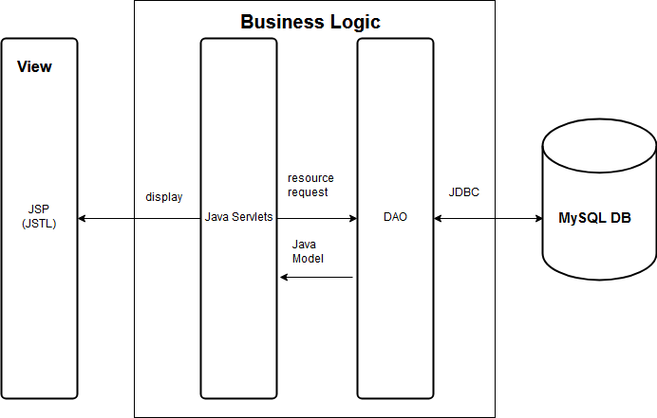
Structure

Slide 5
Database structure

Slide 6
DAO and models

Slide 7
Servlets

Slide 8
JSP

