Slide 1
Actor Concurrency Model
GEDex Day (Dec 2)
Bill Cheung
Brilly Tsang
Group Technology

Slide 2
What is Actor?
1973 Historical Paper
Popularize by Erlang
Scala and JVM
http://doc.akka.io/docs/akka/snapshot/general/actors.html (draw the diagram for this)

Slide 3
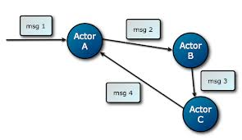
Actor
Actors talks to each other using IMMUTABLE message
Notes:
Immutable Objects!

Slide 4
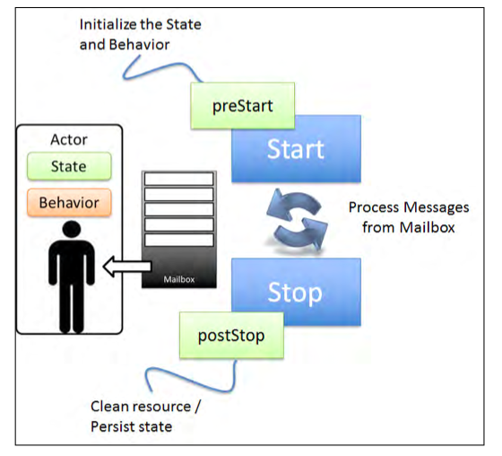
Actor
Actor
State & Behavior
Life Cycle of Actor
Prestart -> Start ->Stop -> PostStop
Mail Box
To store incoming message
Notes:
Immutable Objects!

Slide 5
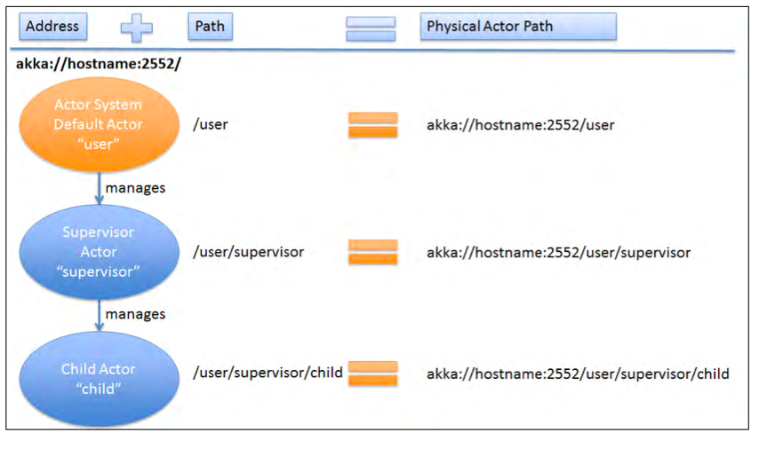
Actor
How to identify an actor in a system?
Each Actor – Address + Path
Remote Actors!
Notes:
Immutable Objects!

Slide 6
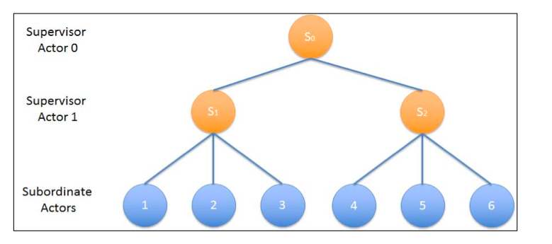
Actor
Hierarchy of actors
Supervisor + Children
Notes:
Immutable Objects!

Slide 7
Akka provides and guarantee
The actor send rule: the send of the message to an actor happens before the receive of that message by the same actor.
The actor subsequent processing rule: processing of one message happens before processing of the next message by the same actor.

Slide 8
Design Pre-requisite
Immutable messaging
Remote to local with optimization instead of local to remote generalization (http://labs.oracle.com/techrep/1994/smli_tr-94-29.pdf); hence no remote/local distinction and most are driven by configuration
Messages must be serializable including the setup in Prop
Async and data lost
Don’t expect the same thread will process two different messages

Slide 9
Scenarios
Computational intensive – Monte Carlo Simulation for Option TV
I/O Intensive – Calculate the portfolio value with fetching price from Yahoo

Slide 10
Scenarios
I/O Intensive
A portfolio
40 stocks with different shares
Get the price from Yahoo!
Calculate the total value

Slide 11
Scenarios
Y! Actor
Stock: APPLE
Price: 500
stocks
Main Actor
Stock: GOOGLE
Total Value =
( Stock * share * price )
Price: 600
Y! Actor

Slide 12
Scenarios
Computational intensive
Monte Carlo Simulation for Option TV

Slide 13
Fault- Tolerance
Two Strategies
All-For-One strategy
applies to all children
One-For-One strategy
applies to the failed one

Slide 14
Fault- Tolerance
restart()
terminate()
Resume()
Exception!

Slide 15
Code
private static SupervisorStrategy strategy = new AllForOneStrategy(
3,
Duration.parse("5 seconds"),
new Function<Throwable, SupervisorStrategy.Directive>() {
@Override
public SupervisorStrategy.Directive apply(Throwable t) {
if (t instanceof StockDataNotFoundException) {
return terminate();
} else {
return escalate();
}
}
});

Slide 16
Akka – The Good, the Bad and the Ugly
Mature, good documentation
Paddling their ware such as installing their whole stack
Clumsy tutorial
Not really design for Java as a fundamental lang in mind

Slide 17
What you need to be aware of?
Test the scalability of different vendors
What hardware, software and language requirements are
How do they perform in WAN/LAN when someone kick the network cable and separated the cluster?
Requirements for object to be store in the grid
Supporting frameworks such as analytics, monitoring, transaction management and events processing

Slide 18

General Discussion
Any war stories related to In Memory Data Grid?
Do you think this is relevant to your project?
How can this simplify single application, distributed data and infrastructure setup?

