Slide 1
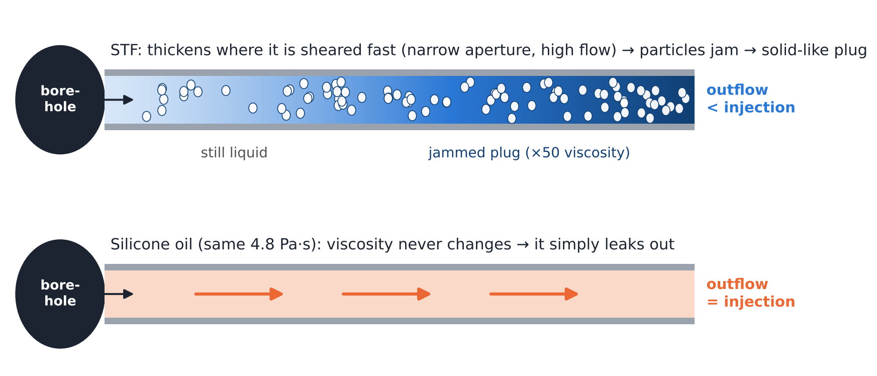
Does STF jam inside the fracture?
Predicting borehole-pressure rebuild in STF fracturing from the measured viscosity curve
Analysis of the Mukuhira et al. (2025) experiments
Watanabe Lab, Tohoku University · November 2026
Notes:
Goal: explain, with a simple physics model, why the borehole pressure rebuilds after breakdown when the fracturing fluid is STF, but not when it is a Newtonian fluid of the same viscosity. The prediction uses the measured STF viscosity curve and the measured breakdown pressure as inputs.

Slide 2
The answer in one slide
7 / 7
Π_{J} > 1
≈ 14 MPa
tests where the pressure rebuild (yes / no) is predicted correctly
jamming criterion: the injection rate exceeds what jammed STF can pass through the fracture
predicted re-peak pressure when the jammed STF plug yields (measured re-peaks 5–28 MPa)
Inputs: measured STF viscosity curve · injection rate · specimen geometry · applied stresses · rock stiffness. One calibration: the fracture aperture, taken from the silicone-oil control test (STF4).
Notes:
7/7 includes the calibration test STF4; the independent checks are the five granite STF tests and the PMMA STF test. Pi_J is the injection rate divided by the largest flow that jammed STF can pass through the narrowest part of the fracture. The 14 MPa is the borehole pressure at which the jammed plug flows at the yield stress measured in the rheometer, so it is a lower bound.

Slide 3
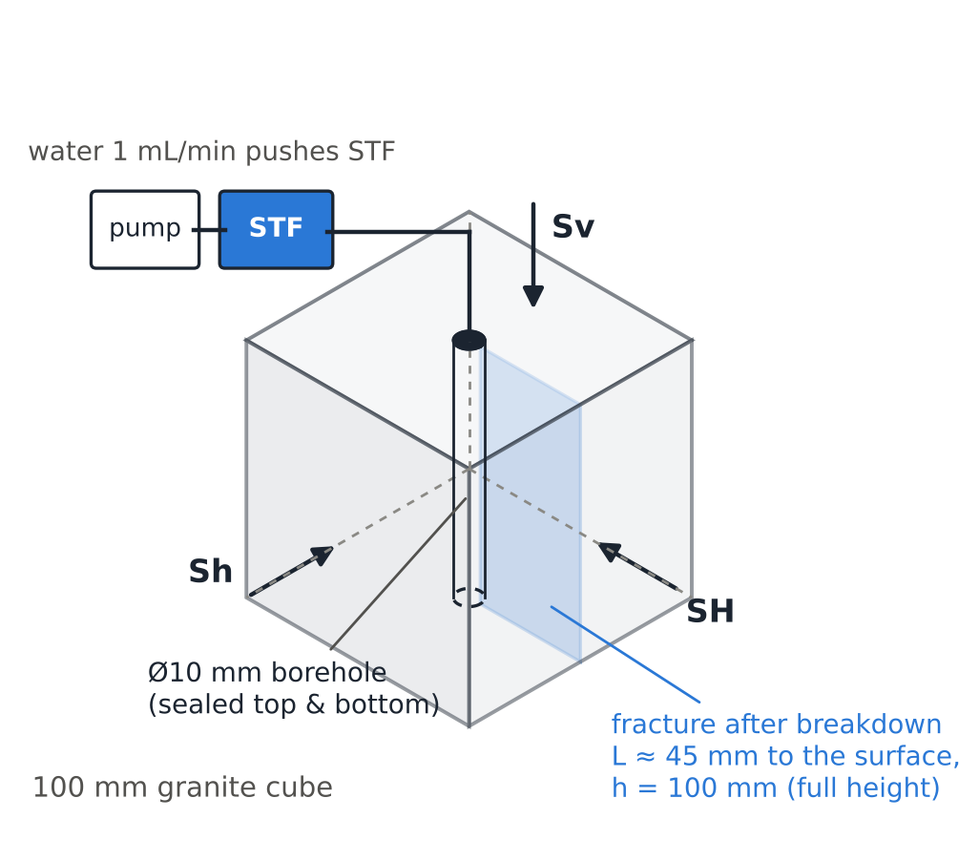
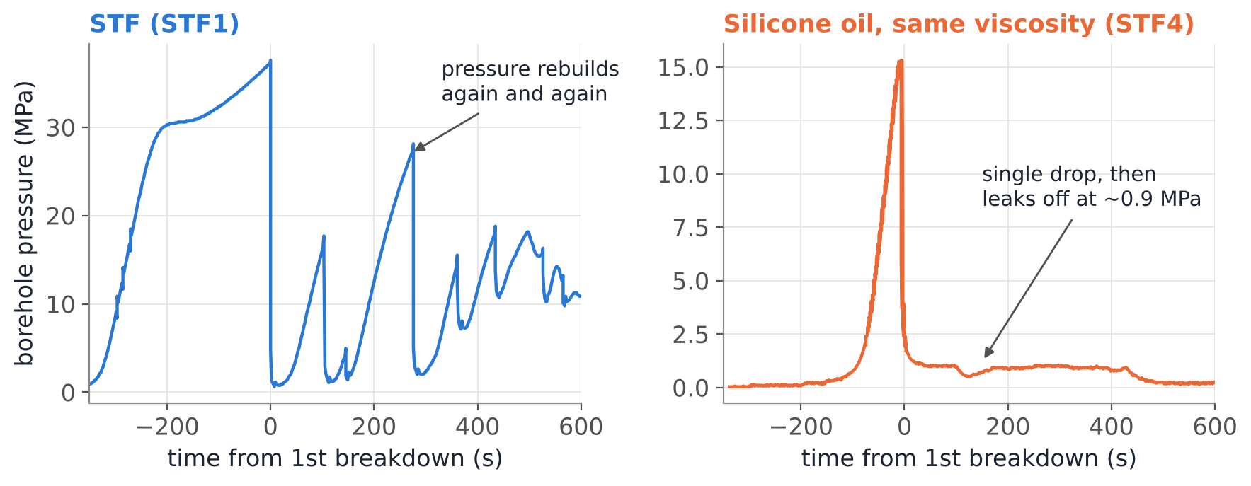
What we want to explain
Same rock, same low-shear viscosity (4.8 Pa·s).
Only the STF makes the borehole pressure rebuild after breakdown — again and again — and this gives the multidirectional fractures.
Can the measured viscosity curve alone predict this?
Notes:
Experimental system of Mukuhira et al. (2025): 100 mm Inada granite cubes with a 10 mm through borehole, true-triaxial cell, water pumped at 1 mL/min pushes STF from a reservoir into the borehole. Left of the plot: STF1, uniaxial Sv = 50 MPa, five rebuilds. Right: STF4, dimethylpolysiloxane with the same low-shear viscosity, single drop.

Slide 4
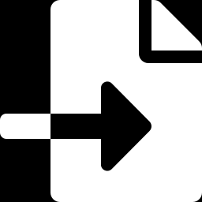

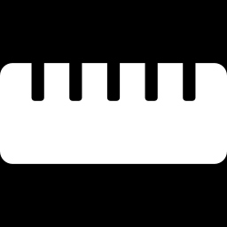
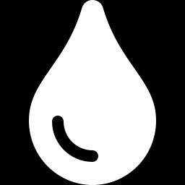
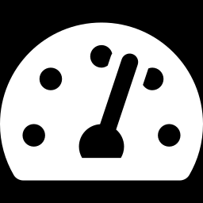
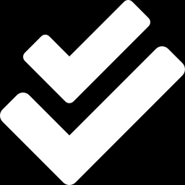
Analysis procedure in six steps
1 Digitize the data
2 From viscosity to flow law
3 Calibrate the aperture
Viscosity curve, breakdown pressures and P(t) of 7 tests from the open-access paper
Exact slot-flow integral of the measured viscosity curve: flux through a fracture of aperture w
Silicone-oil leak-off plateau (STF4) + cubic law → w ≈ 76 µm
4 Outflow vs pressure
5 Jamming number & P(t)
6 Compare with 7 tests
How much fluid each fracture passes at every borehole pressure
Π_{J} = Q_{inj} / Q_{cap} and the borehole pressure history after breakdown
Rebuild yes / no, re-peak pressure, rebuild rate, timing
Notes:
Everything runs from stf_jamming_sim/run_all.py in about 40 s. Step 3 is the only calibration. The breakdown pressure is not predicted: the simulation starts from the state just after the first breakdown pressure drop.

Slide 5
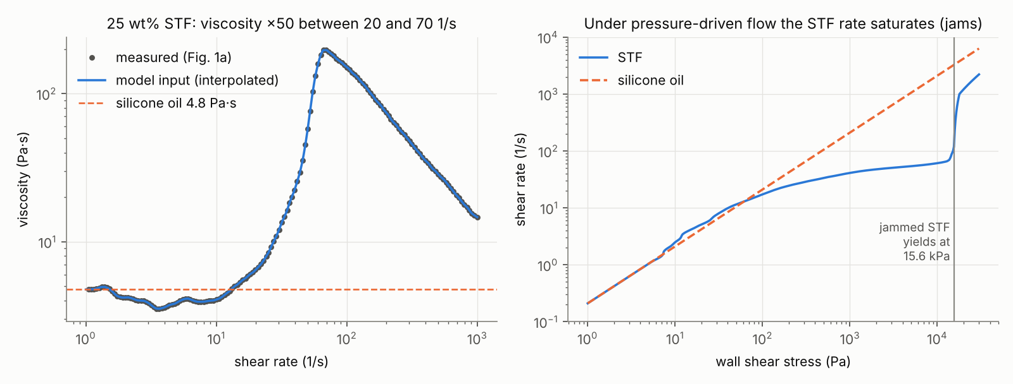
Step 2 · The viscosity curve becomes a fracture flow law
Flux per unit height: q = (w²/2)·Φ(τ_{w}), Φ = (1/τ_{w}²) ∫ τ·γ̇(τ) dτ (Newtonian → cubic law). Jammed STF cannot be sheared faster than ~60–140 1/s; above 15.6 kPa the plug yields.
Notes:
Left: digitized Fig. 1a and the interpolation used as model input (no rheological model is assumed). Right: the same curve as shear rate versus imposed stress, which is what matters in pressure-driven flow. The shear rate saturates between ~20 and ~140 1/s while the stress rises 100-fold: this is jamming. The stress maximum of the measured curve, 15.6 kPa, is taken as the yield stress of the jammed STF.

Slide 6
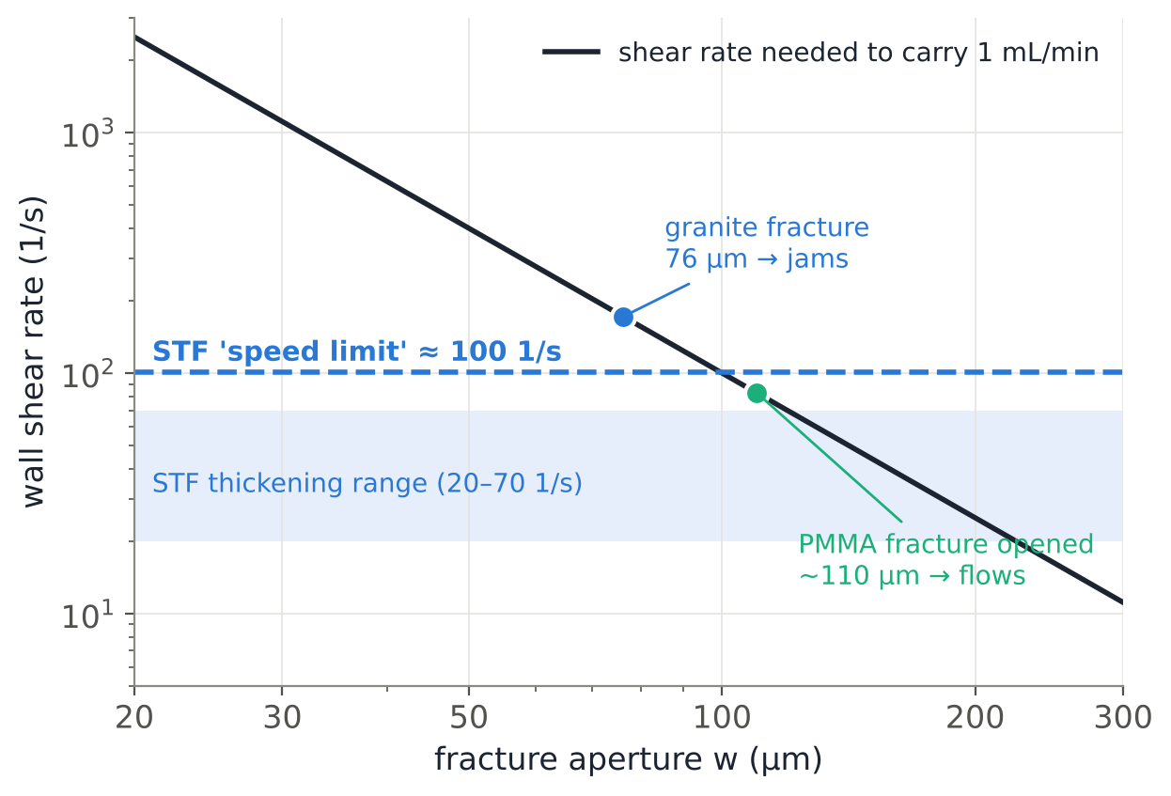
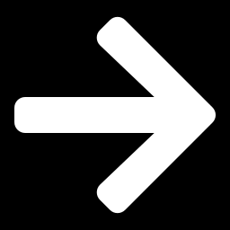
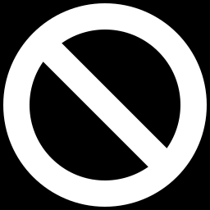
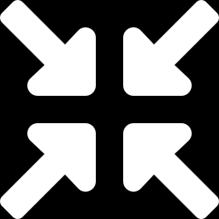
Why it jams: the STF has a speed limit
Needed
Carrying 1 mL/min through a 76 µm fracture needs a wall shear rate of ~170 1/s
Possible
Jammed STF passes at most the equivalent of ~100 1/s
Result
The fracture throttles the flow: the borehole pressure must rebuild
Silicone oil
No speed limit, so it leaks off at 0.9 MPa
Notes:
Black line: Newtonian-equivalent wall shear rate 6Q/(h w^2) needed to push the injection rate through one fracture of height 100 mm. Dashed line: the largest equivalent shear rate jammed STF can sustain, 3*Phi(tau_max) = 100 1/s, from the measured curve. Where the black line is above the dashed one, the STF jams. In granite the fracture is narrow enough (76 um); in PMMA the soft specimen lets the fracture open to ~110 um already at 2 MPa, so the STF flows.

Slide 7
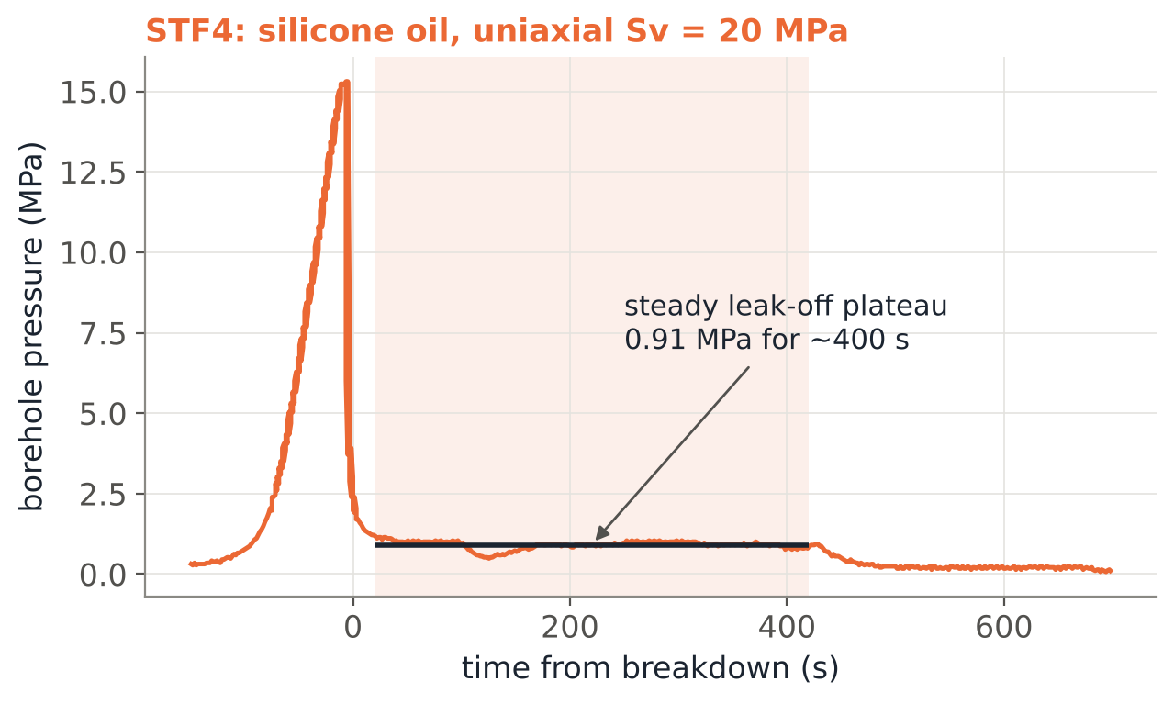
Step 3 · One calibration from the silicone-oil test
Steady plateau
outflow = injection = 1 mL/min at 0.91 MPa
Cubic law (Newtonian)
Q = h·w³·ΔP / (12 µ L), µ = 4.8 Pa·s, L = 45 mm
w ≈ 76 µm
Used unchanged for every STF test
Notes:
The silicone oil sat on a steady 0.9 MPa plateau for ~400 s after breakdown: the oil flowed out through the fracture as fast as it was injected. With the cubic law this gives a hydraulic aperture of 76 um for one fracture running from the borehole wall to the specimen surface. This is the only number taken from the experiments to build the model; the breakdown pressure is only the starting point.

Slide 8
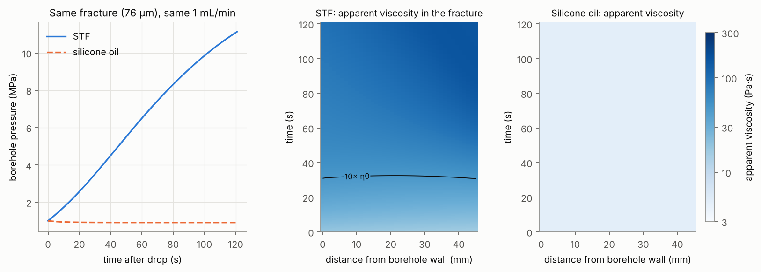
Inside the fracture: STF jams within ~30 s
STF: viscosity > 10× its liquid value along the whole fracture after ~30 s, highest near the outlet → pressure rebuilds
Silicone oil: stays at 4.8 Pa·s everywhere → pressure stays at 0.9 MPa
Notes:
Transient 1D lubrication model of the fracture coupled to the borehole compliance, same 76 um fracture, starting 1 MPa after the drop. The colour is the apparent viscosity (Newtonian viscosity giving the same flux). The black contour marks 10 times the low-shear viscosity.

Slide 9
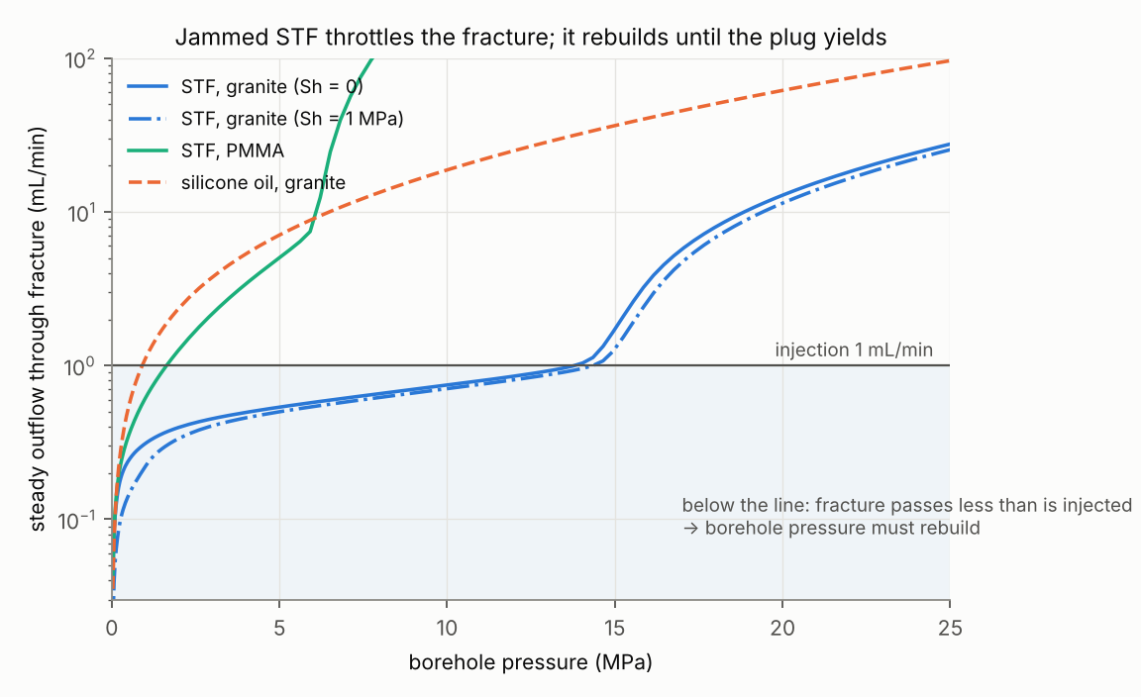
Step 4 · The outflow curve decides: rebuild or leak-off
Silicone oil
crosses 1 mL/min at 0.9 MPa → leaks off, no rebuild
STF in PMMA
the soft specimen lets the fracture open: crosses at 1.6 MPa → no rebuild
STF in granite
stays below 1 mL/min up to ~14 MPa, where the plug yields → rebuild, drop, rebuild…
Notes:
For each borehole pressure, the steady flux through the fracture is computed with the full flow curve (including yield above 15.6 kPa) and an aperture that closes under the normal stress and opens elastically with pressure. Where a curve is below the 1 mL/min line, more is injected than leaves, so the pressure rises. The pressure levels off where the curve crosses the line.

Slide 10
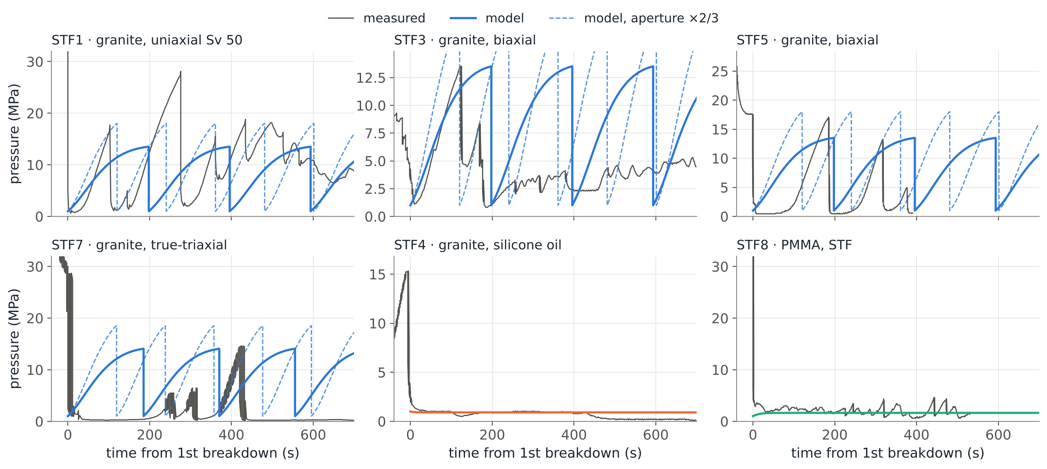
Step 6 · Predicted vs measured pressure histories
Model starts 1 MPa after the first breakdown (the breakdown pressure is input data). Solid: aperture from STF4; dashed: aperture × 2/3.
Notes:
Good: STF3 first rebuild (shape and 13.5 MPa peak), STF4 and STF8 plateaus. STF1 and STF5 rebuild faster and higher than predicted (narrower fracture? the dashed x2/3 aperture brackets them). STF6/STF7 do jam, but only after 250-650 s at ~0 MPa, which the model does not reproduce.

Slide 11
Rebuild predicted correctly for 7 of 7 tests
Test | Specimen / fluid | Stress (MPa) | 1st BP (MPa) | Π_{J} | Model: STF jams & P rebuilds? | Observed
STF1 | granite / STF | Sv 50 | 36.7 | 1.71 | yes | yes
STF3 | granite / STF | Sv 20, SH 2 | 22.0 | 1.71 | yes | yes
STF5 | granite / STF | Sv 20, SH 5 | 35.8 | 1.71 | yes | yes
STF6 | granite / STF | Sv 20, SH 5, Sh 1 | 45.0 | 2.91 | yes | yes (after ~650 s)
STF7 | granite / STF | Sv 20, SH 5, Sh 1 | 34.3 | 2.91 | yes | yes (after ~250 s)
STF4 | granite / silicone oil | Sv 20 | 15.0 | 0 (Newtonian) | no | no
STF8 | PMMA / STF | Sv 12 | 60.4 | 1.71* | no | no
Π_{J} = injection rate ÷ largest flow jammed STF can pass; > 1 → jams. * PMMA: the fracture opens with pressure, so jamming holds only below 1.3 MPa. STF4 is the calibration; the independent checks are the five granite STF tests and PMMA.
Notes:
Pi_J for the true-triaxial tests is larger because Sh = 1 MPa closes the fracture outlet a little (58 um instead of 76 um). Observed re-peaks: STF1 17.5-28, STF3 9-13.5, STF5 5-17, STF6 14.5-15, STF7 5-14.5 MPa; model level ~14 MPa.

Slide 12
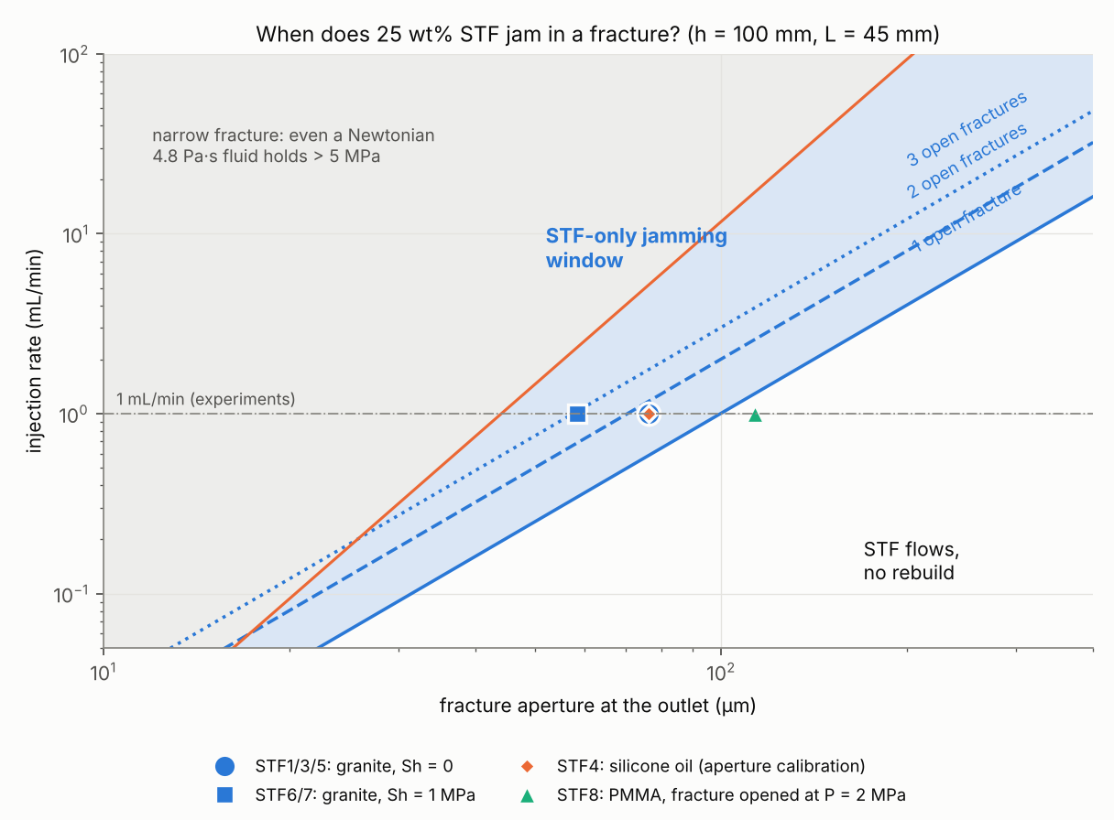
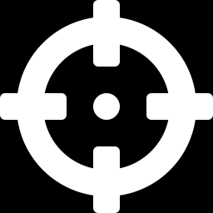
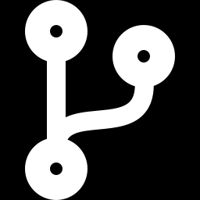
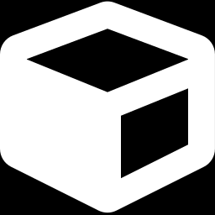
Design map: the STF-only jamming window
At 1 mL/min, one open fracture
STF jams for apertures of 43–100 µm — where a Newtonian fluid would just leak off
Faster injection
widens the window (Π_{J} grows with Q): jamming becomes easier
More open fractures
share the flow, so each needs a narrower aperture to jam
Softer specimen (PMMA)
opens past the window → no rebuild, single fracture
Notes:
Blue lines: Q = n_f h (w^2/2) Phi(tau_max) for 1, 2, 3 open fractures; above a line the STF jams. Orange line: above it, even a 4.8 Pa s Newtonian fluid would hold more than 5 MPa. The blue band between them is where jamming is specific to the STF; the granite tests sit inside it.

Slide 13


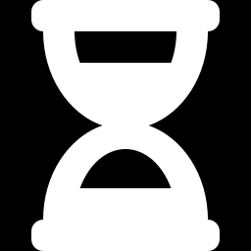
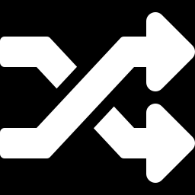
What the model does not capture (yet)
Breakdown and drops are input
Plug strength is a lower bound
Rock-fracturing events are not simulated; after the plug yields the pressure is reset to 1 MPa.
The yield stress is the unconfined rheometer value (15.6 kPa); squeezed in a fracture the STF is likely stronger — peaks up to 28 MPa.
Rebuild ~2× too slow for STF1/5/7
Delays in STF6 / STF7
Points to narrower fractures than the silicone-oil test; silica residue sealing fractures is seen in thin sections. Aperture × 2/3 matches.
250–650 s near 0 MPa: probably several paths open at first (Π_{J} < 1); jamming once paths close or clog. Clogging is not modelled.
Notes:
Also not included: friction at the loading platens in uniaxial tests. Higher Sv could clamp the fracture shut (narrower aperture, easier jamming), which would fit the ARMA 2025 observation that multidirectional fracturing is favoured at high vertical stress. To be tested with the Tokutake data.

Slide 14
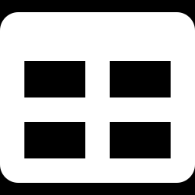
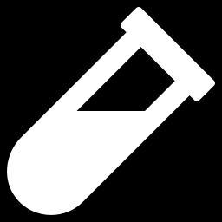

Next steps
Apply to Tokutake (MSc) and my JSRM52 tests
Test the predictions
Fracture patterns in 2D / 3D
Per test: stresses, breakdown pressure, injection rate, P(t), STF curve. Add one row to experiments.py and run run_all.py.
Vary the injection rate (Π_{J} grows with Q), STF concentration, and Sv in uniaxial tests (platen-clamping hypothesis).
Use this flow law in the lab DEM (Wada et al., 2024), a cohesive-zone FEM or a phase-field model.
Code and data: stf_jamming_sim/ (python run_all.py). Data digitized from Mukuhira et al. (2025), Int J Rock Mech Min Sci 188:106051, CC BY-NC 4.0.
Notes:
The model is general: any STF viscosity curve, injection rate, specimen size and stress state can be entered. Only the fracture aperture needs a calibration, ideally from a Newtonian control test in the same set-up.

