Slide 1
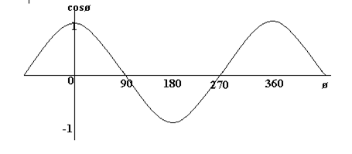



Inner Product
$$\overset{⃑}{V_{1}}∙\overset{⃑}{V_{2}}=|\overset{⃑}{V_{1}}||\overset{⃑}{V_{2}}|\cos{θ}$$
$\cos{θ}=\frac{\overset{⃑}{V_{1}}∙\overset{⃑}{V_{2}}}{|\overset{⃑}{V_{1}}||\overset{⃑}{V_{2}}|}$
$$\overset{⃑}{V_{1}}=(x_{1},y_{1})$$
$$\overset{⃑}{V_{2}}=(x_{2},y_{2})$$
$$\cos{θ}=\frac{x_{1}x_{2}+y_{1}y_{2}}{\sqrt[2]{x_{1}^{2}+y_{1}^{2}} \sqrt[2]{x_{2}^{2}+y_{2}^{2}}}$$

Slide 2
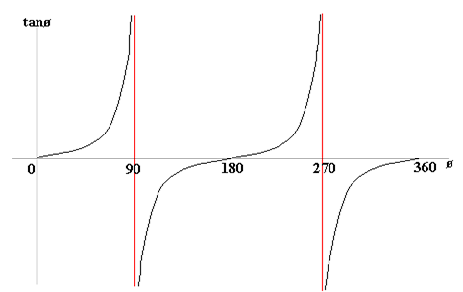

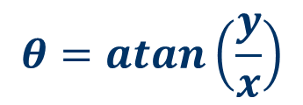

atan( )
(x,y)
$$tanθ=\frac{y}{x}$$
But, x=0?
y
$$θ=atan\left(\frac{y}{x}\right)$$
$$θ$$
(0,0)
x

Slide 3
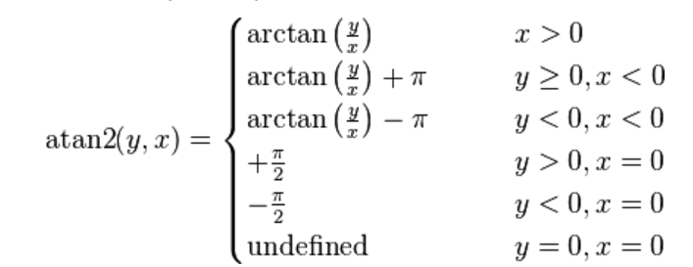
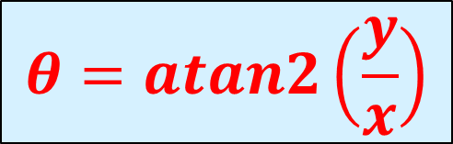



atan2( )
(x<0,y>0)
$$θ2$$
(x>0,y>0)
(x,y)
$$θ3$$
y
$θ$1
x
$$θ=atan2\left(\frac{y}{x}\right)$$

Slide 4
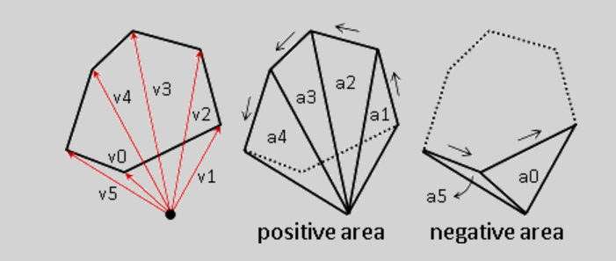
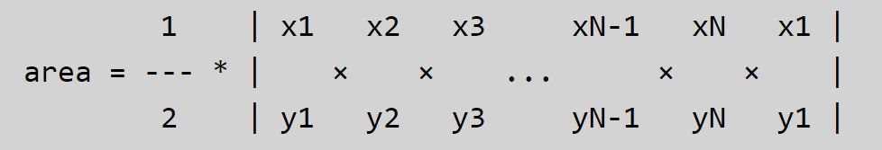
Area of polygon
(0,0)
_
+

Slide 5
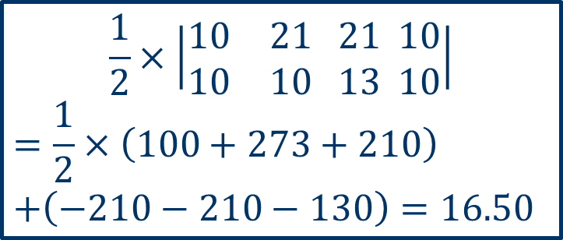
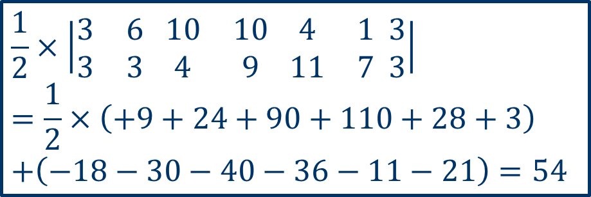

Area of Polygon
(4,11)
(1,7)
(21,13)
(10,9)
(10,10)
(10,4)
(3,3)
(6,3)
(21,10)
$$\frac{1}{2}×\left|\begin{matrix}3 & 6 \\ 3 & 3\end{matrix} \begin{matrix}10 & 10 \\ 4 & 9\end{matrix} \begin{matrix}4 & 1 \\ 11 & 7\end{matrix} \begin{matrix}3 \\ 3\end{matrix}\right|$$
$$=\frac{1}{2}×\left(+9+24+90+110+28+3\right)$$
$$+\left(−18−30−40−36−11−21\right)=54$$
$$\frac{1}{2}×\left|\begin{matrix}10 & 21 \\ 10 & 10\end{matrix} \begin{matrix}21 \\ 13\end{matrix} \begin{matrix}10 \\ 10\end{matrix}\right|$$
$$=\frac{1}{2}×\left(100+273+210\right)$$
$$+\left(−210−210−130\right)=16.50$$
$$54+16.50=70.50$$

Slide 6
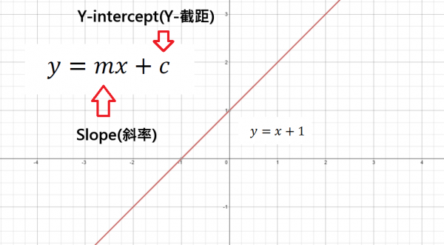
Slope-Intercept Formula
y-x-1=0
(2,0)→0-2-1<0
(3,1)→1-3-1<0
(-2,0)→0+2-1>0
(-4,3)→3+4+1>0

Slide 7
Inside a Polygon ?

Slide 8




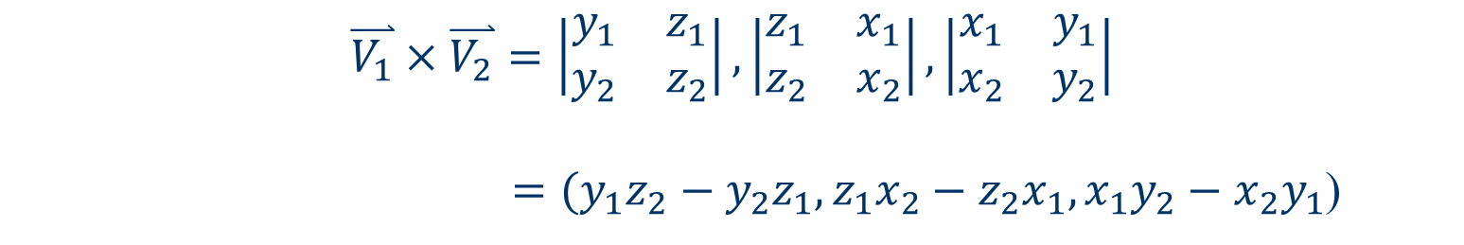

Cross Product
$$\overset{⃑}{V_{1}}=(x_{1},y_{1},z_{1})$$
$$\overset{⃑}{V_{2}}=(x_{2},y_{2},z_{2})$$
$$\overset{⃑}{V_{1}}×\overset{⃑}{V_{2}}=\left|\begin{matrix}y_{1} & z_{1} \\ y_{2} & z_{2}\end{matrix}\right|,\left|\begin{matrix}z_{1} & x_{1} \\ z_{2} & x_{2}\end{matrix}\right|,\left|\begin{matrix}x_{1} & y_{1} \\ x_{2} & y_{2}\end{matrix}\right|$$
$=(y_{1}z_{2}−y_{2}z_{1},z_{1}x_{2}−z_{2}x_{1},x_{1}y_{2}−x_{2}y_{1}$)
$$\overset{⃑}{V_{1}}=(x_{1},y_{1},0)$$
$$\overset{⃑}{V_{2}}=(x_{2},y_{2},0)$$
$$\overset{⃑}{V_{1}}×\overset{⃑}{V_{2}}=\left|\begin{matrix}y_{1} & 0 \\ y_{2} & 0\end{matrix}\right|,\left|\begin{matrix}0 & x_{1} \\ 0 & x_{2}\end{matrix}\right|,\left|\begin{matrix}x_{1} & y_{1} \\ x_{2} & y_{2}\end{matrix}\right|$$
$=(0,0,x_{1}y_{2}−x_{2}y_{1}$)

