Slide 1
2023.03.08 과제
김진우

Slide 2
목차
1. Project03_08.java
2. ArrayCalculation.java
3. Countingofnumber.java
① Main
② P6
③ P7
④ P8
⑤ P11
⑥ P12
⑦ p13
⑧ P14
⑨ p15
⑩ a1
⑪ a2
⑫a3
2

Slide 3
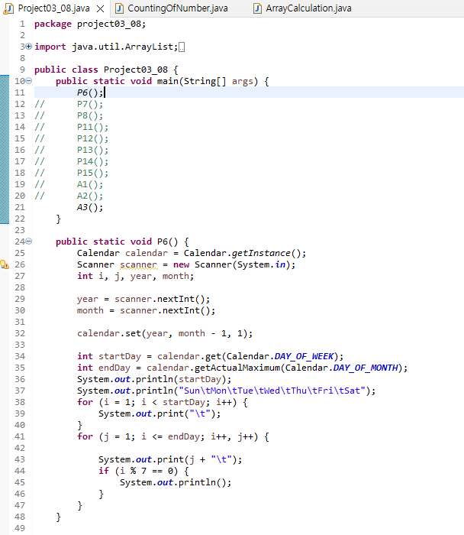
Project03_08.java-Main
3

Slide 4
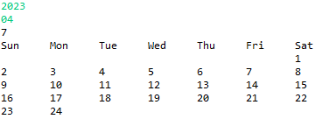
Project03_08.java-P6
Code
Result
4

Slide 5
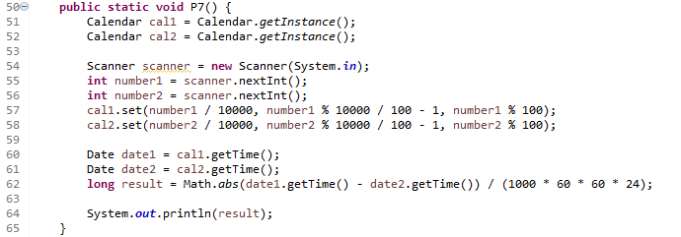

Project03_08.java-P7
Code
Result
5

Slide 6
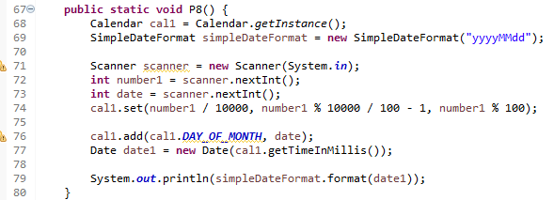

Project03_08.java-P8
Code
Result
6

Slide 7
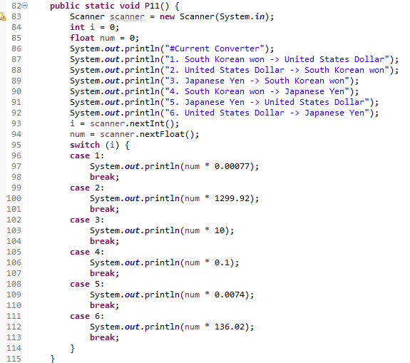
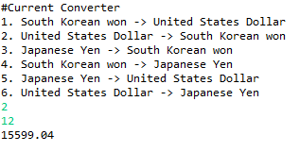
Project03_08.java-P11
Code
Result
7

Slide 8
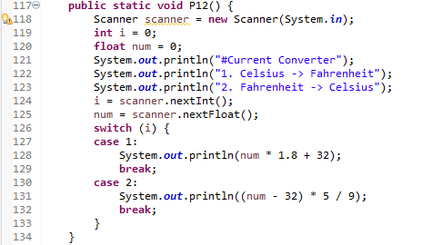
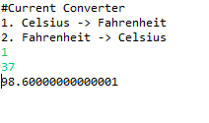
Project03_08.java-P12
Code
Result
8

Slide 9
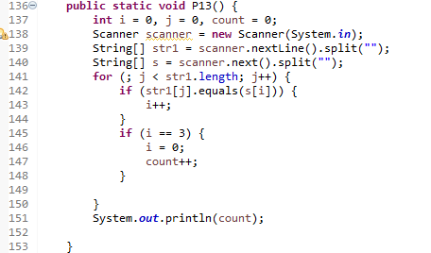

Project03_08.java-P13
Code
Result
9

Slide 10
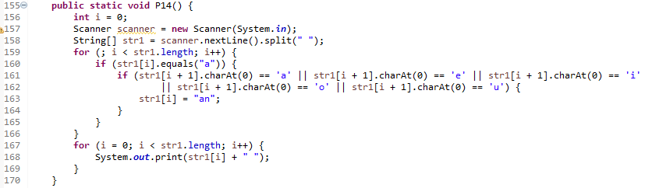

Project03_08.java-P14
Code
Result
10

Slide 11
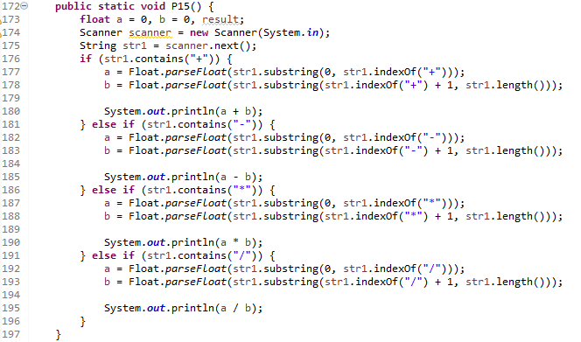
Project03_08.java-P15
Code
Result
11

Slide 12
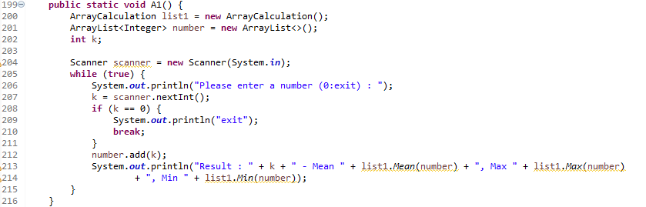
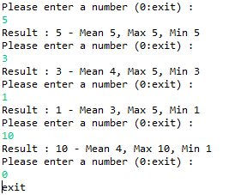
Project03_08.java-A1
Code
Result
# ArrayCalculation.java은 15p에 있습니다
12

Slide 13
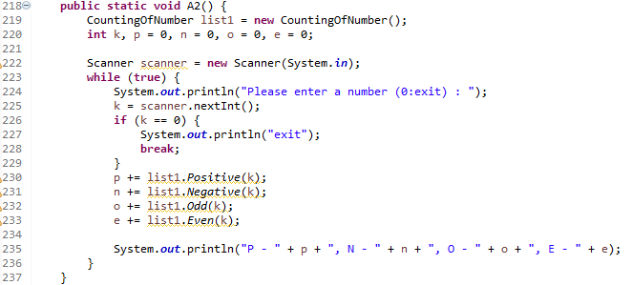
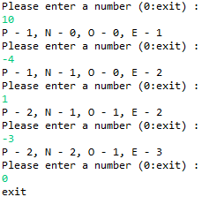
Project03_08.java-A2
Code
Result
# CountingOfNumber.java은 15p에 있습니다
13

Slide 14
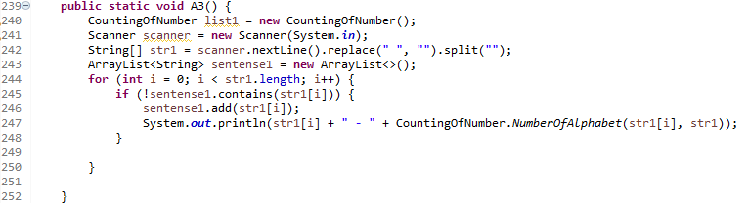
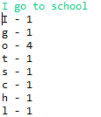
Project03_08.java-A3
Code
Result
# CountingOfNumber.java은 15p에 있습니다
14

Slide 15
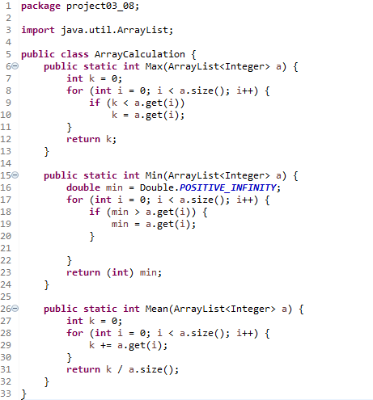
ArrayCalculation.java
15

Slide 16
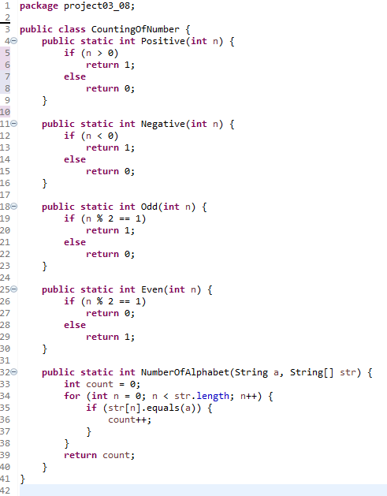
CountingOfNumber.java
16

