Slide 1
2023.03.10 과제
김진우

Slide 2
목차
A9
A10
A11
2

Slide 3
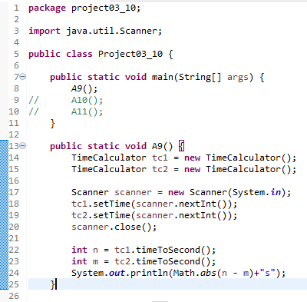
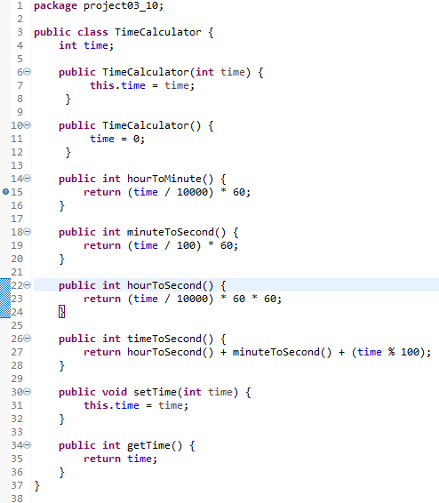




A9
Project03_10
TimeCalculator
Result

Slide 4
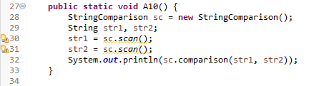
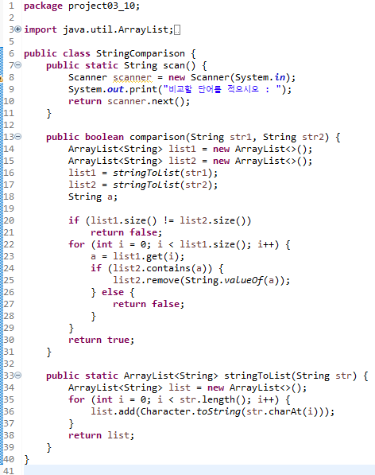


A10
Project03_10
StringComparison
Result

Slide 5
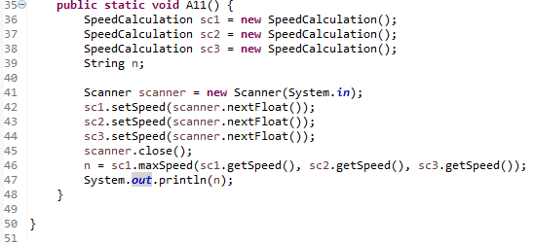
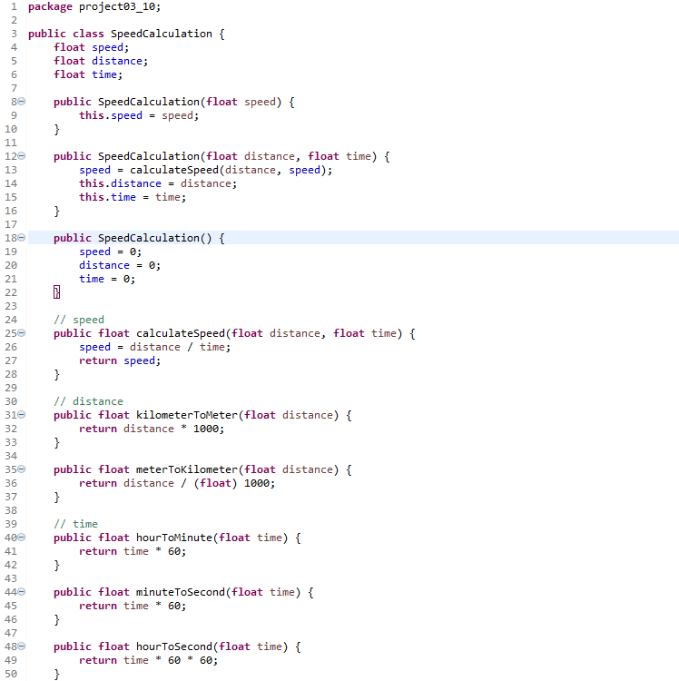
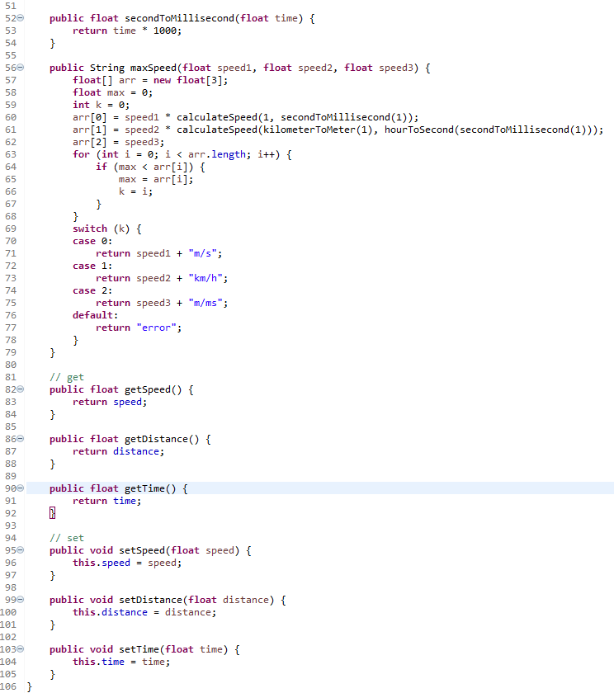


A11
Project03_10
SpeedCalculation
Result

