Slide 1
2023.03.13 과제
김진우

Slide 2
목차
A6
A5
A4
A3
A2
A1
Main.java
DescriptiveStatistics.java
Main.java
SpecifiedCharacter.java
Main.java
Main.java
Main.java
Main.java
EncryptionDecryption.java
EncryptionDecryption.java
SplitAndSort.java
FibonacciNumbers.java

Slide 3
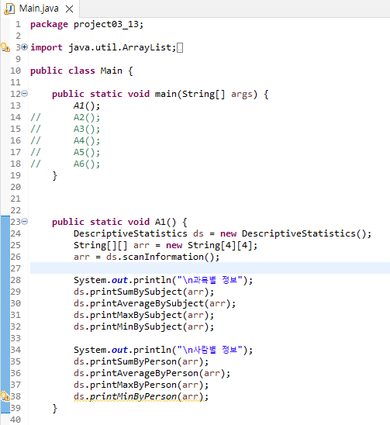
A1
Main.java

Slide 4
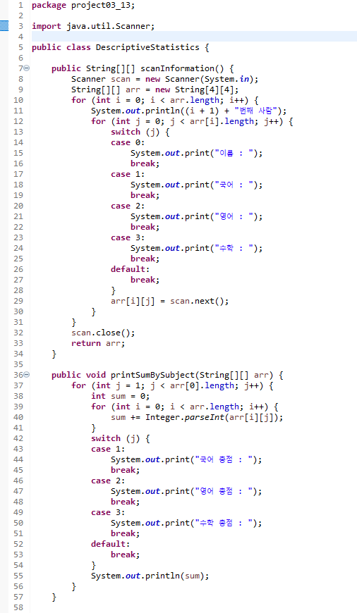
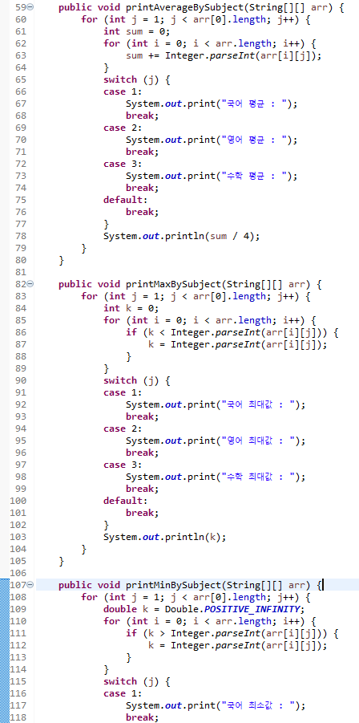
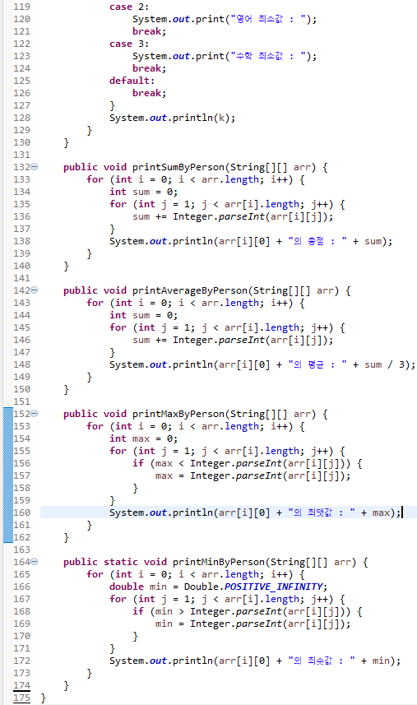
A1
DescriptiveStatistics.java

Slide 5
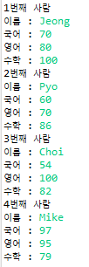
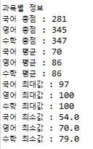
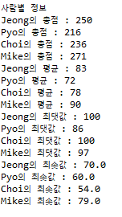
A1
Result

Slide 6
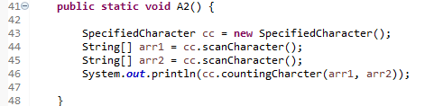
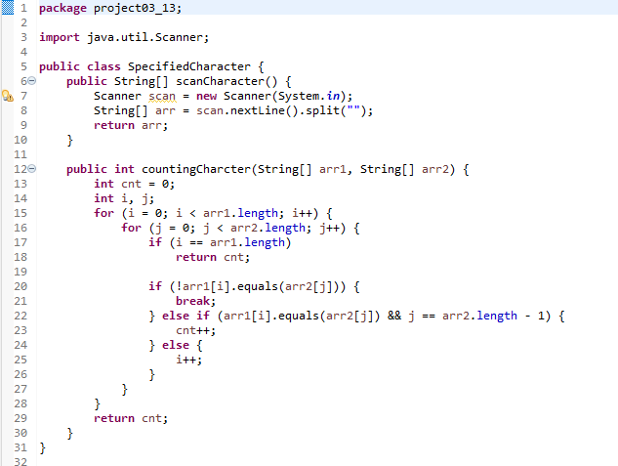

A2
Main.java
SpecifiedCharacter.java
Result

Slide 7
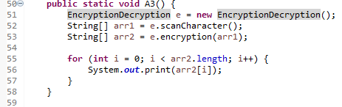
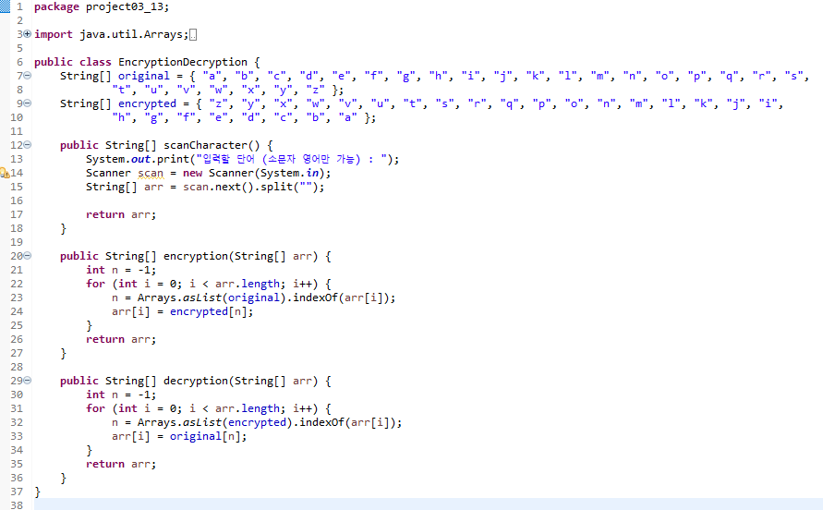

A3
Main.java
EncryptionDecryption.java
Result

Slide 8
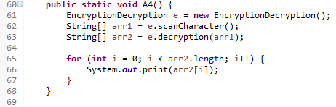

A4
Main.java
EncryptionDecryption.java
Result

Slide 9
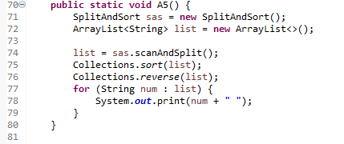
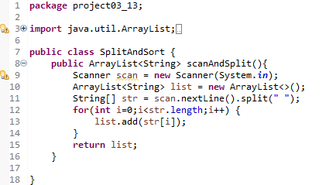

A5
Main.java
SplitAndSort.java
Result

Slide 10
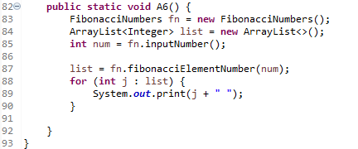
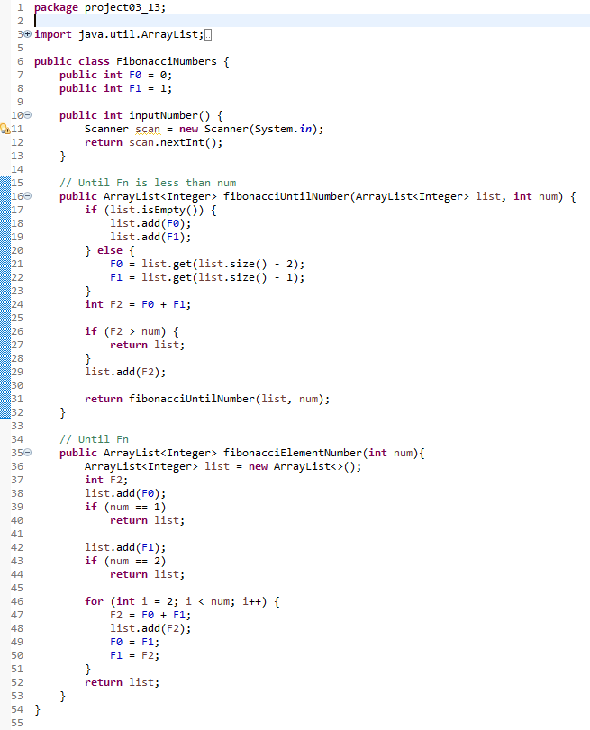

A6
Main.java
FibonacciNumbers.java
Result

