Slide 1
Transforming & Analyzing Data with SQL
Korinne Angela White
View this repo on github
Notes:
Good Afternoon. My name is Angela and today I will be presenting my SQL project.

Slide 2
Project & Goals
The project involves a comprehensive analysis of sales and web analytics data to uncover insights about customer behavior and sales performance across various geographic locations.
Identifying top-performing locations by transaction revenue
Summarizing the revenue impact of each city and country
Identifying customer purchasing behaviors by location
Identifying loyal customer locations
Notes:
A significant part of the project was dedicated to understanding and addressing data quality issues, and ensuring that the User Defined Functions I was using and the materialized views were accurate before I started on the questions. This, for me, reduced the need for extensive QA processes on the questions I was trying to answer.

Slide 3
Process
Exploring each table’s CSV & Loading the data into the DB
Getting general overviews of the columns in each table
UDF: overview_of_each_column(‘tablename’)
UDF: numbers_summary(‘tablename’)
Created the following materialized views:
unique_fullvisitorids
analytics_revenue_table
Cleaning processes
UDF: dividebymil(columnname)
Created new tables for formatted time.
Notes:
I created a few UDFs to get an overview of each column in a table.
One shows the total number of rows, null values and distinct values.
And another giving me the five number summary for each column in a table.
I also created dividebymil function for price-related columns, it returns the value after it’s been divided by 1M and rounds it to 2 decimal places.
I updated the necessary tables to show a more standardized time.

Slide 4
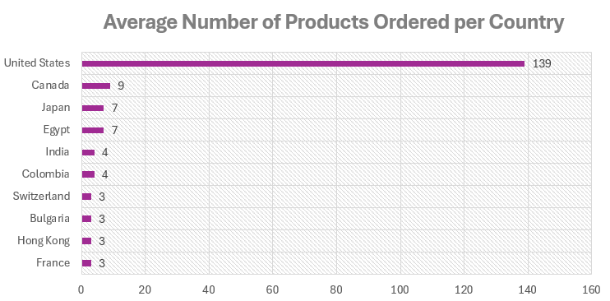
Results
We've identified where majority of transactions are coming from per country
Notes:
Going over the results,
The data tells us which locations generate the most transactions on our site to prioritize marketing efforts and resource allocation effectively in these key locations.
We can see here that on average, majority of the orders are coming from United States.

Slide 5
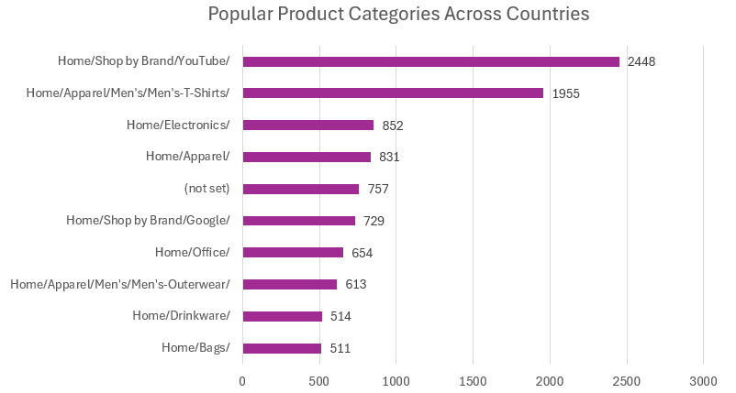
Results
Notes:
With majority of the products coming from Youtube or Google and Men’s apparel.

Slide 6
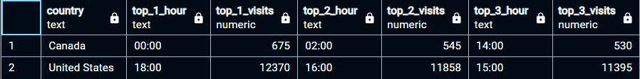
Results
We've identified the peak site visit hours per country.
For example, in Canada and United States:
Notes:
It’s especially important in the US, because majority of site traffic and revenues are coming from there. We need 100% up time during high-traffic periods.

Slide 7
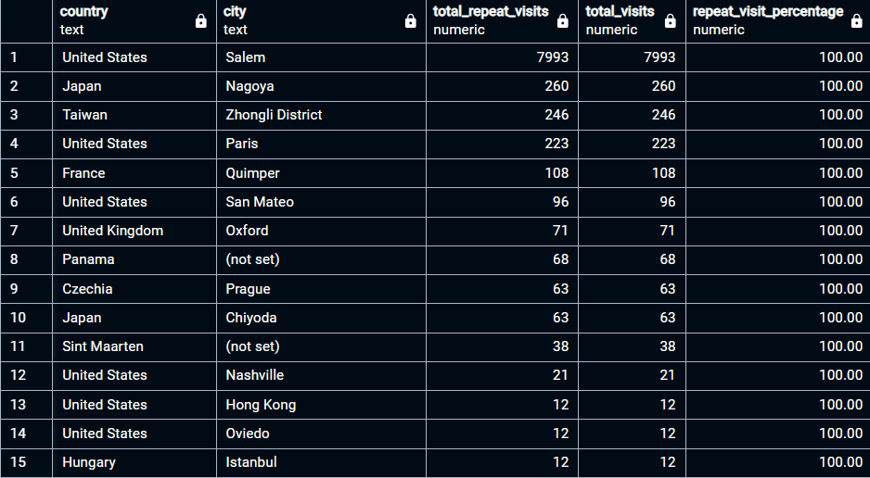
Results
We've identified the locations of our most loyal customers.
Notes:
This information helps in tailoring marketing strategies, offering targeted promotions, and improving customer retention.
So from this, we have 15 locations with 100% customer loyalty or repeat visits, but we’ve also identified 85 locations with a visit record but 0 repeats.

Slide 8
Conclusion
Notes:
Overall, the data provided us with valuable insights into customer behavior, transaction trends, peak activity times, and loyalty patterns in different cities and countries. From there, we can make data-driven decisions on where to focus marketing efforts, how to allocate resources, and find ways to enhance customer engagement based on where they are.

Slide 9
Challenges
I forgot my psql passphrase.
Disabled & Re-enabled authentication requirements
Inefficiencies of using UDFs repeatedly.
Materialized view of calling the ‘overview_of_each_column’ function on every table
Notes:
I disabled the authentication requirements temporarily, added a new password and put the authentication requirements back.
Calling the overview_of_each_column function on analytics table takes about a minute. It has 4.3M rows to go through, and it’s my most used table in this project. So I created a materialized view of it.
There were lots of missing data and duplicates, but I dealt with it before I delved into the questions, so I was pretty confident with the insights that I was able to get.

Slide 10
Future Goals
Deeper Customer Segmentation Analysis
Create customer personas and target marketing campaigns tailored to different segments
Location-based Consumer Behavior Analysis
Develop location-specific strategies and adapt the user experience and marketing messages to fit better in that market
Analyzing Referral Sources and Influences
Identifying where to spend more or less in marketing
Conversion Rate Analysis
Here is where we identify how long (time) an average visitor spends on the site, and how much (revenue) they are buying
Notes:
For customer segmentation and location-based analysis…
If we had more details about the site visitors, we could do a deep dive on which products are popular among specific age groups in each location, and pinpoint where else we could find more of these users and how to reach them.
For analyzing referral sources and influences…
Some marketing channels could be costing us more than it's worth to maintain, like they’re not giving us enough site traffic or revenue to justify paying the customer acquisition or retention costs from these channels.

Slide 11
THANK YOU!
Korinne Angela White
View this repo on Github
Let’s connect on Linked In!
Notes:
That’s it. Do you have any questions for me or feedback?

