Slide 1


LLM Project
Beyond Sentiment:
Turning Negative Reviews into Actionable Insights
Korinne Angela White

Slide 2
Project Goals
This project creates a language model capable of efficiently analyzing negative feedback and turning it into actionable tasks, enabling businesses to quickly identify and address areas for service improvement.
Notes:
This will be especially useful for Small and Medium Businesses who often lack dedicated data teams and automated feedback analysis tools. Businesses rely on feedback not just to improve their services but also to sort of speak or do the marketing of their product and services for them. So, this would help streamline that process effectively.

Slide 3
Resources
Dataset:
YELP's Full Review Dataset
Pre-trained Models:
SamLowe/roberta-base-go_emotions
Mistral-7B-Instruct-v0.1
Microsoft/phi-2
Notes:
Here’s the dataset and the pre-trained models I used. In the dataset, there was about 650k rows. It was fairly balanced in terms of labels, but I was only interested in negative reviews, which I considered were 1-3 stars, so I dropped 4 and 5.

Slide 4
Process Overview
Use SamLowe’s RoBERTa-base GoEmotions multi-class classification model on the reviews
Use Mistral 7B to generate constructive feedback (Gold Standard)
Benchmark base phi-2 to track progress
Quantize and fine-tune phi-2 to generate constructive feedback
Evaluation of the fine-tuned model
Notes:
It’s fairly straight forward. The main things I had issues with were setting up the environment, figuring out the dependencies, and batch sizes that would fit in my GPU. I wanted to make it work, because if it requires high-end hardware to work, I see it as barrier to entry for everyone who may want to use it.

Slide 5
RESULTS
Notes:
Let’s go straight to the results.

Slide 6
Metrics Overview
BLEURT -- Bilingual Evaluation Understudy with Representations from Transformers
BERTScore -- Bidirectional Encoder Representations from Transformers
METEOR Score -- Metric for Evaluation of Translation with Explicit Ordering
Notes:
But first, a quick overview of the metrics we’re evaluating the model with…
BLEURT is best for capturing meaning.
BERTScore is for semantic similarity, or capturing the context.
METEOR is for n-gram & synonym matching, or capturing paraphrased-responses.
We want values higher than 0.5 for all of them.
All these scores require a gold standard for computation, which is what we have mistral’s responses for. This is basically knowledge distillation from mistral and letting phi-2 learn from that.

Slide 7
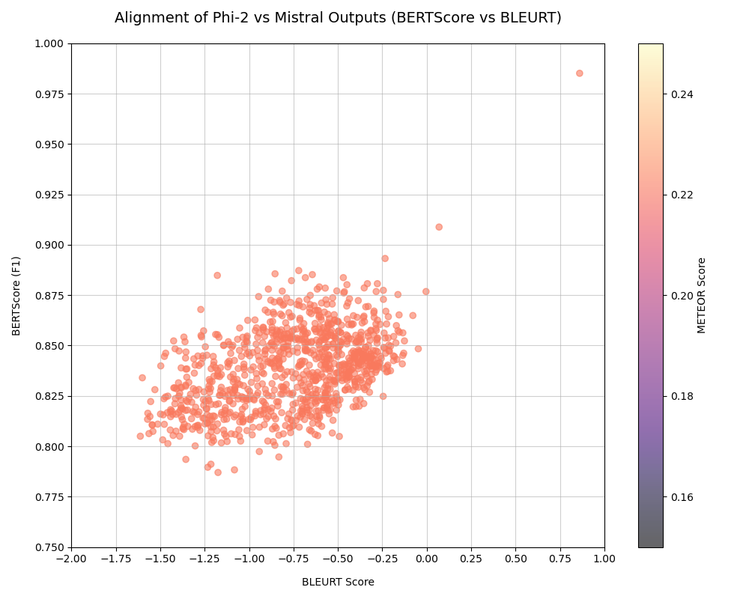
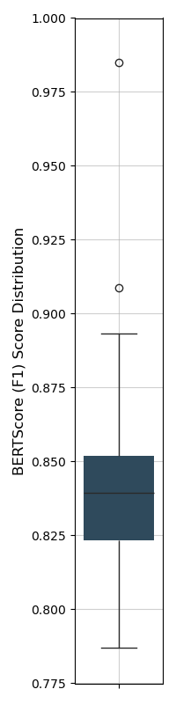
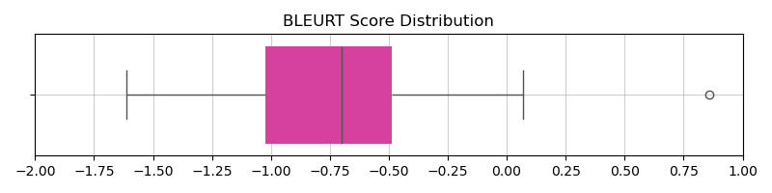
Initial Performance
Notes:
For the initial performance:
BLEURT’s mean is -0.75 with its median around 0.70 so phi-2 by itself failed to stay true to the meaning of what we asked it to do.
BERTScore is 0.83 on both mean and median. It’s really good, but all it’s telling us is that phi-2 understood what we’re talking about.
For METEOR, the mean and median is 0.2, which indicates a weak similarity.
The key point here is, phi-2 was unable to follow our specific instructions. I’ve read the responses and most of the time it’s just trying to tell stories about the review and the business owner. So, phi-2 was definitely missing the point.

Slide 8
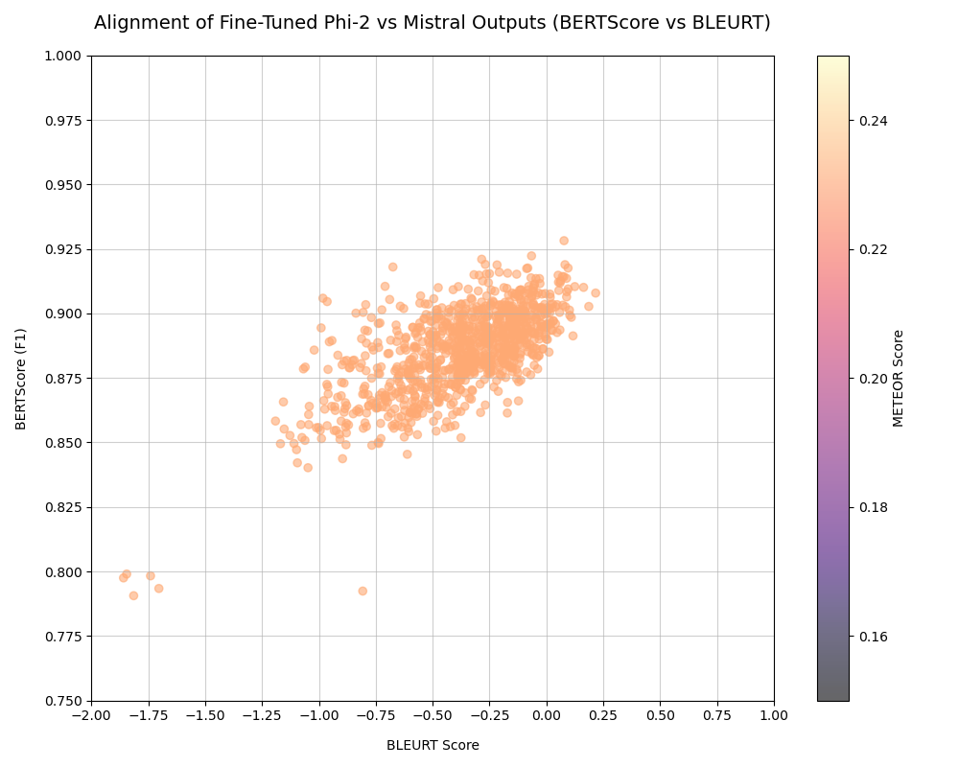
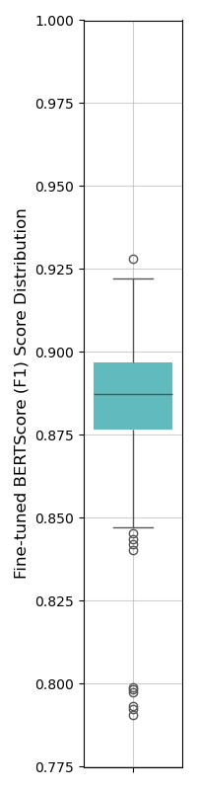
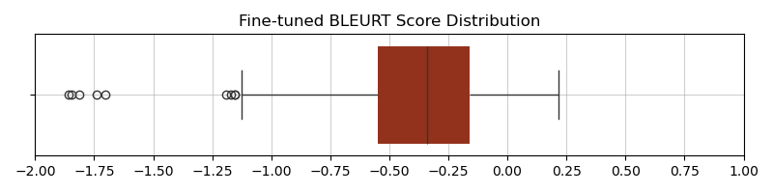
Fine-Tuned Model Performance
Notes:
So, as you can see here, the fine-tuned model’s performance is a bit more clustered together and a little higher on the alignment.
We got the BLEURT’s mean and median at -0.37 and -.33, it’s still pretty bad, but it’s an improvement.
Of course, BERTScore improved from 0.83 to 0.88
As you can see, they seem to have some positive correlation there.
For the METEOR, it’s 0.23, and it’s barely an improvement, a slightly different color, but we’ll take it.
As for the responses though, it was generating a bunch of generic responses, but we’re seeing the story-telling habit way less. Probably 8-10 out of 1000.

Slide 9
HYPERPARAMETERS

Slide 10
Hyperparameters
During Training:
learning_rate=2e-5
metric_for_best_model="loss“ + greater_is_better=False
num_train_epochs=3
weight_decay=0.01
optim="adamw_torch_fused"
During Generation/Inference:
temperature=0.5
top_p=0.9
no_repeat_ngram_size=3
Notes:
So, these were the hyperparameters I found most useful for the model.
I’ve tried other learning rates, but 2e-5 worked best, we were minimizing loss in 3 epochs, we regularized the weights to prevent overfitting and used an optimizer for CUDA-enabled GPUs.
During inference, I’ve only done it for testing
These 3 made the most difference. The model had a tendency to go off topic, like I said, the story-telling part, and if not, it keeps repeating the same sentence until it ran out of tokens.

Slide 11
DEPLOYMENT
Notes:
So, you’ve seen the results. It’s nowhere near ready for deployment, but I’m pretty happy with that slight improvement considering it only trained on 999 rows of data. I have more rows I could train it with and it’ll be about on par with Mistral’s.
My end-goal is for this is an API I could call with a web app.

Slide 12
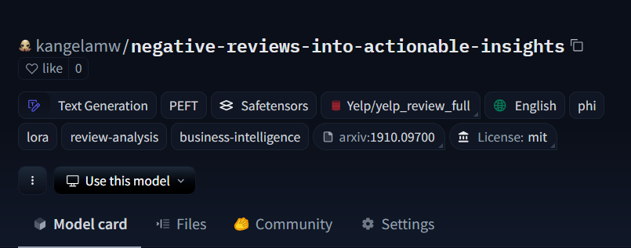
It’s on Hugging Face!
https://huggingface.co/kangelamw/negative-reviews-into-actionable-insights
Notes:
It’s on huggingface! There’s the link to it and a screenshot of the model itself.

Slide 13
Technical Approach/Requirements
Quantization Method
QLoRA 4-bit quantization
Hardware
12GB VRAM recommended
Library
PEFT (Parameter-Efficient Fine-tuning)
Notes:
For the quantization method, I have it quantized to 4bit and I used LoRa to target only specific layers to finetune, which were the self-attention layers and the feedforward ones.
For hardware, I used NVIDIA RTX 3060TI.
The model used ~10.02GB during training and ~7.02GB during inference, so it fit comfortably with some room for small spikes, but no spikes.
8-bit also works for inference, but not for training. It needed about 16GB to fine-tune in 8-bit even with LoRA. The full model is 32-bit.
It can be accessed from the transformers library. Hugging-face categorized it under PEFT. So, the model is a Parameter Efficient Fine-tuned Causal Language Model for Review Analysis.

Slide 14
References
Readings:
Enable your device for Development
GoEmotions (Github/Hugging Face)
Leveraging LLM-as-a-Judge for Automated and Scalable Evaluation
Reliable Confidence Intervals for Information Retrieval Evaluation Using Generative A.I.
Judging LLM-as-a-Judge with MT-Bench and Chatbot Arena
BLEURT: a Transfer Learning-Based Metric for Natural Language Generation
BERTScore
METEOR Score
Hugging Face Inference Providers
Hugging Face Docs (Evaluate, PEFT/LoRA, BitsAndBytes, Trainers)
Videos:
LoRA & QLoRA Fine-tuning Explained In-Depth
Simple Training with the Transformers Trainer
The Trainer API
Fine-Tuning Large Language Models (LLMs) | w/ Example Code
What is LoRA? Low-Rank Adaptation for finetuning LLMs EXPLAINED
What is a Context Window?

