Slide 2

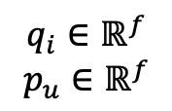
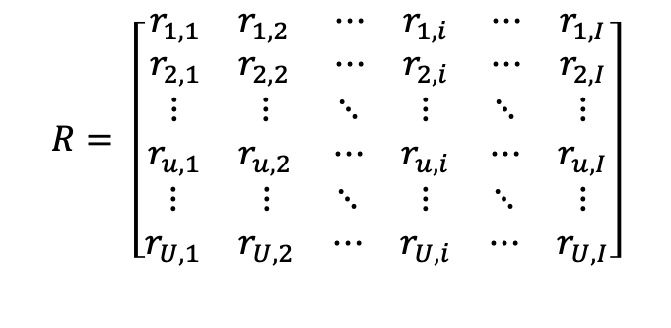

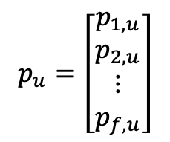
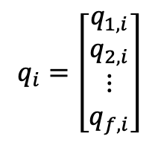
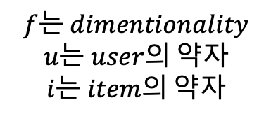
Explicit feedback case
$$q_{i}∈ℝ^{f}$$
$$p_{u}∈ℝ^{f}$$
$$f는 dimentionality$$
$$u는 user의 약자$$
$$i는 item의 약자$$
$$p_{u}=\left[\begin{matrix}p_{1,u} \\ p_{2,u} \\ \begin{aligned}⋮ \\ p_{f,u}\end{aligned}\end{matrix}\right]$$
$${\hat{r}}_{ui}=q_{i}^{T}p_{u}$$
$${\hat{r}}_{ui}=p_{u}^{T}q_{i}$$
$$R= \left[\begin{matrix}\begin{matrix}r_{1,1} & r_{1,2} \\ r_{2,1} & r_{2,2}\end{matrix} & \begin{matrix}⋯ & r_{1,i} \\ ⋯ & r_{2,i}\end{matrix} & \begin{matrix}⋯ & r_{1,I} \\ ⋯ & r_{2,I}\end{matrix} \\ \begin{matrix}⋮ & ⋮ \\ r_{u,1} & r_{u,2}\end{matrix} & \begin{matrix}⋱ & ⋮ \\ ⋯ & r_{u,i}\end{matrix} & \begin{matrix}⋱ & ⋮ \\ ⋯ & r_{u,I}\end{matrix} \\ \begin{matrix}⋮ & ⋮ \\ r_{U,1} & r_{U,2}\end{matrix} & \begin{matrix}⋱ & ⋮ \\ ⋯ & r_{U,i}\end{matrix} & \begin{matrix}⋱ & ⋮ \\ ⋯ & r_{U,I}\end{matrix}\end{matrix}\right]$$
$$q_{i}=\left[\begin{matrix}q_{1,i} \\ q_{2,i} \\ \begin{aligned}⋮ \\ q_{f,i}\end{aligned}\end{matrix}\right]$$

Slide 3
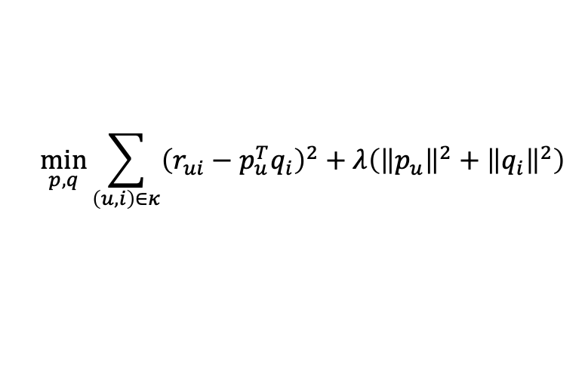
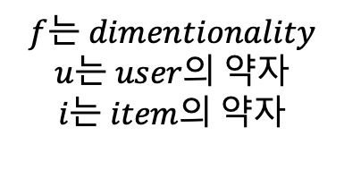

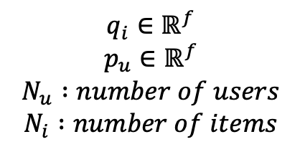
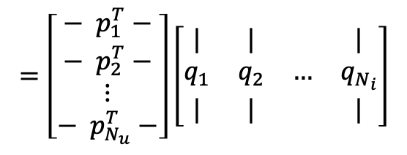
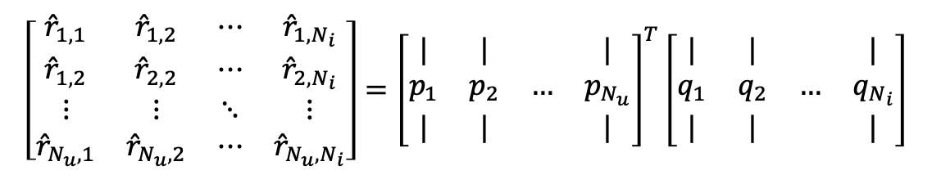
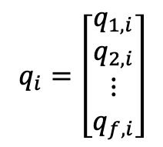

$$q_{i}∈ℝ^{f}$$
$$p_{u}∈ℝ^{f}$$
$$N_{u} :number of users$$
$$N_{i} :number of items$$
$$f는 dimentionality$$
$$u는 user의 약자$$
$$i는 item의 약자$$
Explicit feedback case
$$p_{u}=\left[\begin{matrix}p_{1,u} \\ p_{2,u} \\ \begin{aligned}⋮ \\ p_{f,u}\end{aligned}\end{matrix}\right]$$
$$q_{i}=\left[\begin{matrix}q_{1,i} \\ q_{2,i} \\ \begin{aligned}⋮ \\ q_{f,i}\end{aligned}\end{matrix}\right]$$
$${\hat{r}}_{ui}=p_{u}^{T}q_{i}$$
$$\hat{R}=P^{T}Q$$
$$\left[\begin{matrix}{\hat{r}}_{1,1} & {\hat{r}}_{1,2} & ⋯ & {\hat{r}}_{1,N_{i}} \\ {\hat{r}}_{1,2} & {\hat{r}}_{2,2} & ⋯ & {\hat{r}}_{2,N_{i}} \\ ⋮ & ⋮ & ⋱ & ⋮ \\ {\hat{r}}_{N_{u},1} & {\hat{r}}_{N_{u},2} & ⋯ & {\hat{r}}_{N_{u},N_{i}}\end{matrix}\right]={\left[\begin{matrix}| & | & & | \\ p_{1} & p_{2} & … & p_{N_{u}} \\ | & | & & |\end{matrix}\right]}^{T}\left[\begin{matrix}| & | & & | \\ q_{1} & q_{2} & … & q_{N_{i}} \\ | & | & & |\end{matrix}\right]$$
$$=\left[\begin{aligned}\begin{matrix}− p_{1}^{T}− \\ − p_{2}^{T}− \\ ⋮\end{matrix} \\ − p_{N_{u}}^{T}−\end{aligned}\right]\left[\begin{matrix}| & | & & | \\ q_{1} & q_{2} & … & q_{N_{i}} \\ | & | & & |\end{matrix}\right]$$
$$\min_{p,q}{\sum_{\left(u,i\right)∈κ}{{\left(r_{ui}−p_{u}^{T}q_{i}\right)}^{2}+λ\left({\left\|p_{u}\right\|}^{2}+{\left\|q_{i}\right\|}^{2}\right)}}$$
$$κ is the set of the \left(u,i\right) pairs for which r_{ui}is known the traing set$$

Slide 4




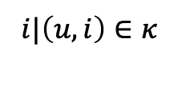




Alternating least squares
참고 : https://soojishin.com/archives/essential-elements-of-set-theory/
$$\left\{i^{∗} | \left(u,i^{∗}\right)∈κ\right\}$$
$$κ is the set of the \left(u,i\right) pairs for which r_{ui}is known (the traing set)$$
$$\left(u,i\right)∈κ$$
$$\left\{조건에 만족하는 원소 | 조건\right\}$$
$$r_{ui}∈r_{u∗}$$
$$\left\{u^{∗} | \left(u^{∗},i\right)∈κ\right\}$$
$$u|\left(u,i\right)∈κ$$
$$r_{ui}∈r_{i∗}$$
$$\left\{i^{∗} | \left(u,i^{∗}\right)∈κ\right\}$$
$$i|\left(u,i\right)∈κ$$

Slide 5
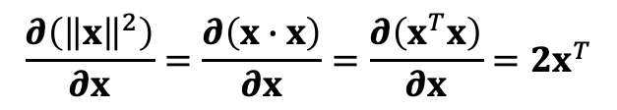
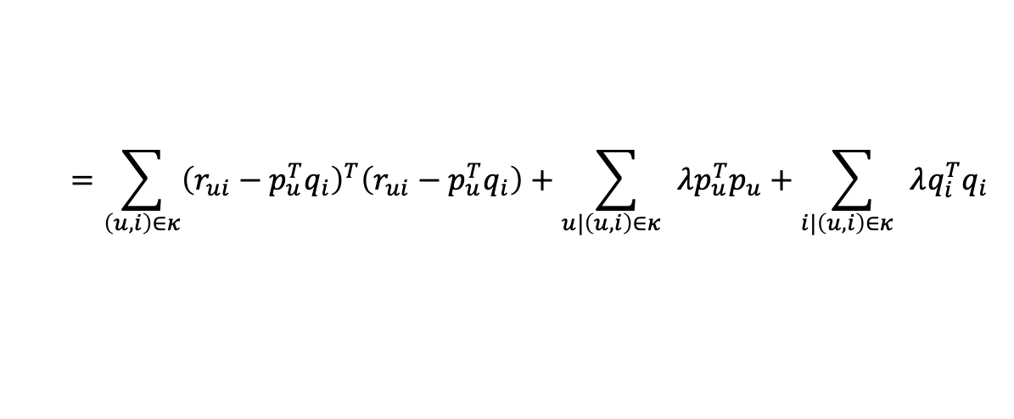

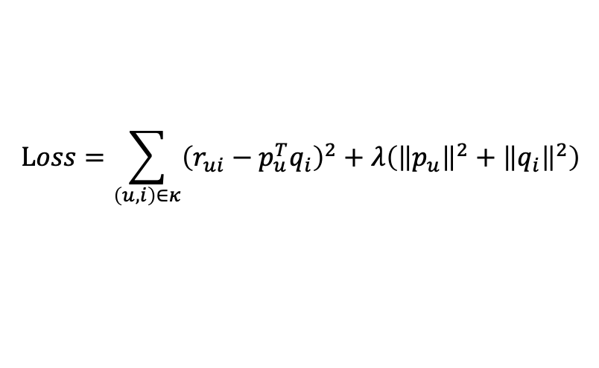

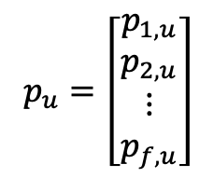
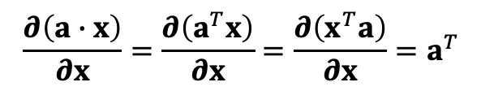
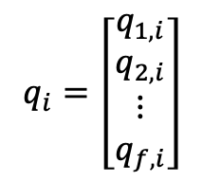
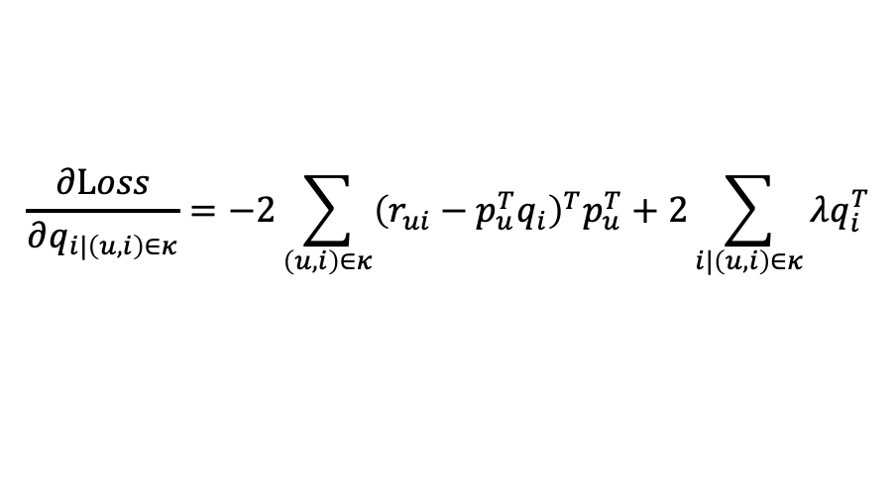
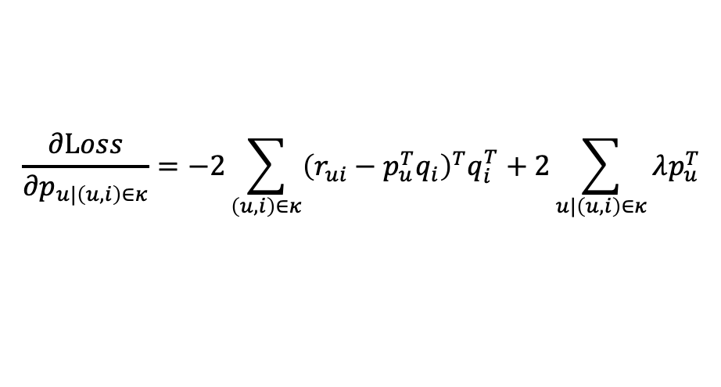
Alternating least squares
Explicit feedback case
$$p_{u}=\left[\begin{matrix}p_{1,u} \\ p_{2,u} \\ \begin{aligned}⋮ \\ p_{f,u}\end{aligned}\end{matrix}\right]$$
$$q_{i}=\left[\begin{matrix}q_{1,i} \\ q_{2,i} \\ \begin{aligned}⋮ \\ q_{f,i}\end{aligned}\end{matrix}\right]$$
$$Loss=\sum_{\left(u,i\right)∈κ}{{\left(r_{ui}−p_{u}^{T}q_{i}\right)}^{2}+λ\left({\left\|p_{u}\right\|}^{2}+{\left\|q_{i}\right\|}^{2}\right)}$$
$$=\sum_{\left(u,i\right)∈κ}{{\left(r_{ui}−p_{u}^{T}q_{i}\right)}^{T}\left(r_{ui}−p_{u}^{T}q_{i}\right)}+\sum_{u|\left(u,i\right)∈κ }{λp_{u}^{T}p_{u}}+\sum_{i|\left(u,i\right)∈κ }{λq_{i}^{T}q_{i}}$$
$$a :상수벡터$$
$$x :변수벡터$$
$$\frac{∂Loss}{∂q_{i|\left(u,i\right)∈κ}}=−2\sum_{\left(u,i\right)∈κ}{{\left(r_{ui}−p_{u}^{T}q_{i}\right)}^{T}p_{u}^{T}}+2\sum_{i|\left(u,i\right)∈κ}{λq_{i}^{T}}$$
$$\frac{∂\left(a∙x\right)}{∂x}=\frac{∂\left(a^{T}x\right)}{∂x}=\frac{∂\left(x^{T}a\right)}{∂x}=a^{T}$$
$$\frac{∂\left({\left\|x\right\|}^{2}\right)}{∂x}=\frac{∂\left(x∙x\right)}{∂x}=\frac{∂\left(x^{T}x\right)}{∂x}={2x}^{T}$$
$$\frac{∂Loss}{∂p_{u|\left(u,i\right)∈κ}}=−2\sum_{\left(u,i\right)∈κ}{{\left(r_{ui}−p_{u}^{T}q_{i}\right)}^{T}q_{i}^{T}}+2\sum_{u|\left(u,i\right)∈κ}{λp_{u}^{T}}$$

Slide 6
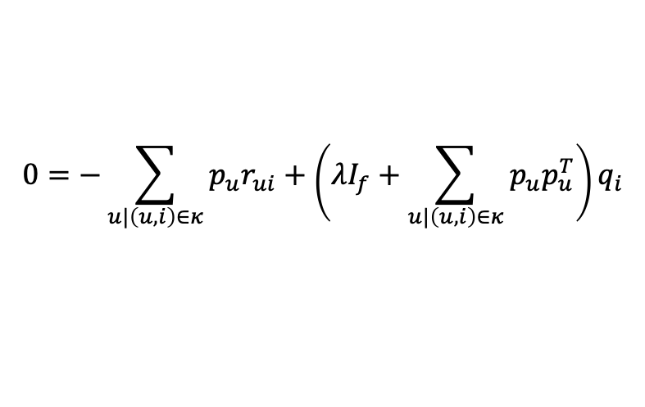
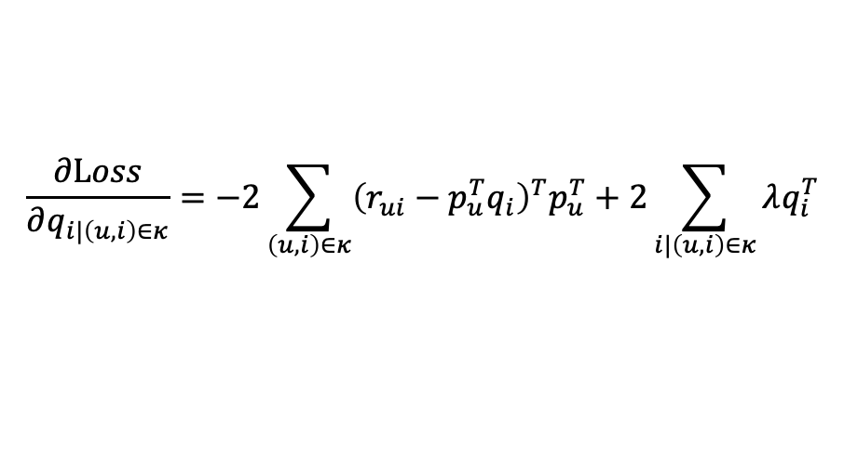
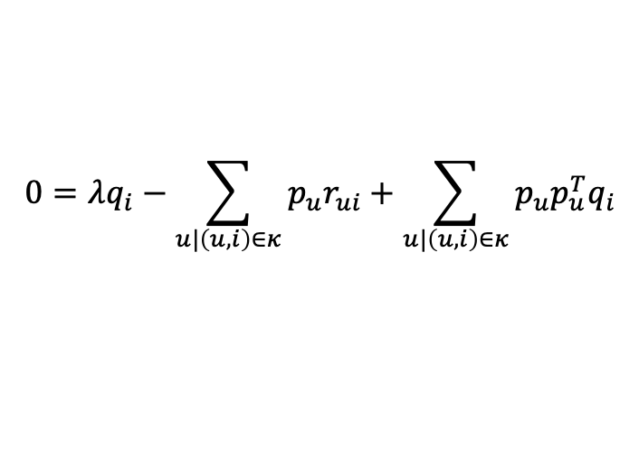
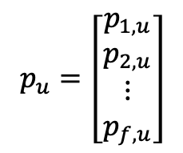
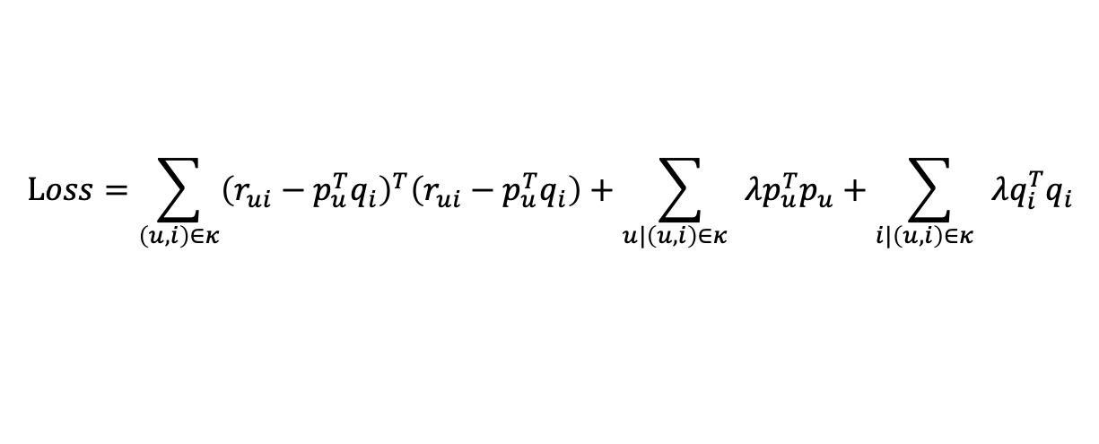

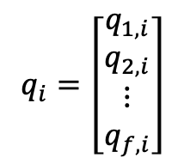

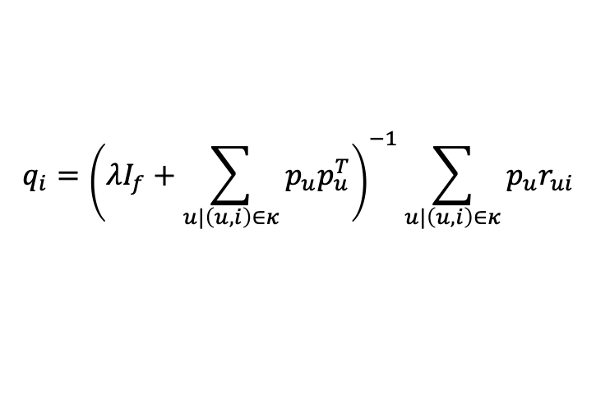
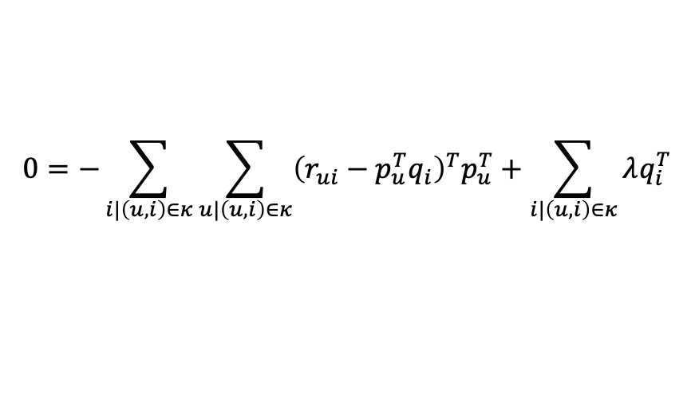
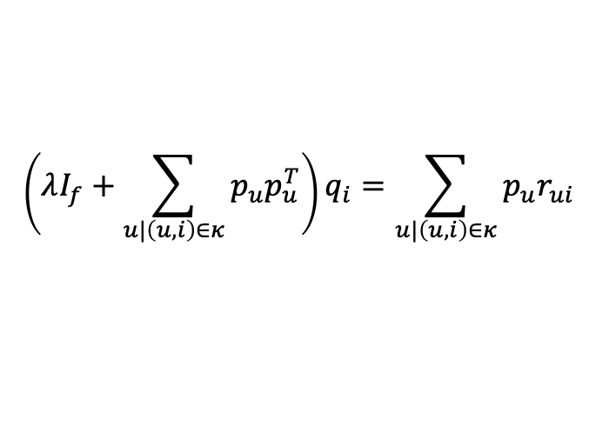
Alternating least squares
Explicit feedback case
$$p_{u}=\left[\begin{matrix}p_{1,u} \\ p_{2,u} \\ \begin{aligned}⋮ \\ p_{f,u}\end{aligned}\end{matrix}\right]$$
$$q_{i}=\left[\begin{matrix}q_{1,i} \\ q_{2,i} \\ \begin{aligned}⋮ \\ q_{f,i}\end{aligned}\end{matrix}\right]$$
$$Loss=\sum_{\left(u,i\right)∈κ}{{\left(r_{ui}−p_{u}^{T}q_{i}\right)}^{T}\left(r_{ui}−p_{u}^{T}q_{i}\right)}+\sum_{u|\left(u,i\right)∈κ }{λp_{u}^{T}p_{u}}+\sum_{i|\left(u,i\right)∈κ }{λq_{i}^{T}q_{i}}$$
$$\frac{∂Loss}{∂q_{i|\left(u,i\right)∈κ}}=−2\sum_{\left(u,i\right)∈κ}{{\left(r_{ui}−p_{u}^{T}q_{i}\right)}^{T}p_{u}^{T}}+2\sum_{i|\left(u,i\right)∈κ}{λq_{i}^{T}}$$
$$0=−\sum_{u|\left(u,i\right)∈κ}{p_{u}r_{ui}}+\left(λI_{f}+\sum_{u|\left(u,i\right)∈κ}{p_{u}p_{u}^{T}}\right)q_{i}$$
$$0=−\sum_{i|\left(u,i\right)∈κ}{\sum_{u|\left(u,i\right)∈κ}{{\left(r_{ui}−p_{u}^{T}q_{i}\right)}^{T}p_{u}^{T}}}+\sum_{i|\left(u,i\right)∈κ}{λq_{i}^{T}}$$
$$\left(λI_{f}+\sum_{u|\left(u,i\right)∈κ}{p_{u}p_{u}^{T}}\right)q_{i}=\sum_{u|\left(u,i\right)∈κ}{p_{u}r_{ui}}$$
$$0=λq_{i}^{T}−\sum_{u|\left(u,i\right)∈κ}{{\left(r_{ui}−p_{u}^{T}q_{i}\right)}^{T}p_{u}^{T}}$$
$$0=λq_{i}−\sum_{u|\left(u,i\right)∈κ}{p_{u}\left(r_{ui}−p_{u}^{T}q_{i}\right)}$$
$$q_{i}={\left(λI_{f}+\sum_{u|\left(u,i\right)∈κ}{p_{u}p_{u}^{T}}\right)}^{−1}\sum_{u|\left(u,i\right)∈κ}{p_{u}r_{ui}}$$
$$0=λq_{i}−\sum_{u|\left(u,i\right)∈κ}{p_{u}r_{ui}}+\sum_{u|\left(u,i\right)∈κ}{p_{u}p_{u}^{T}q_{i}}$$

Slide 7
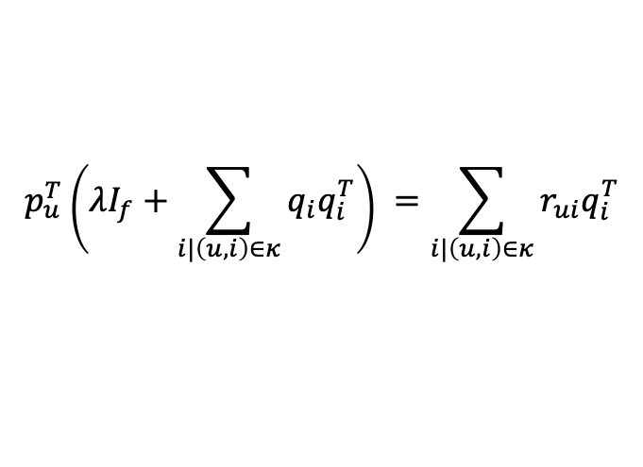
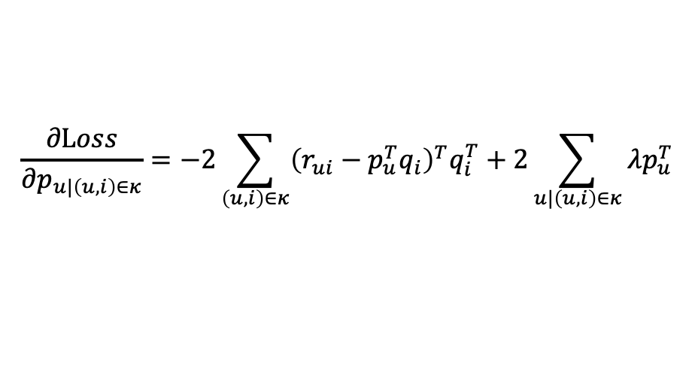
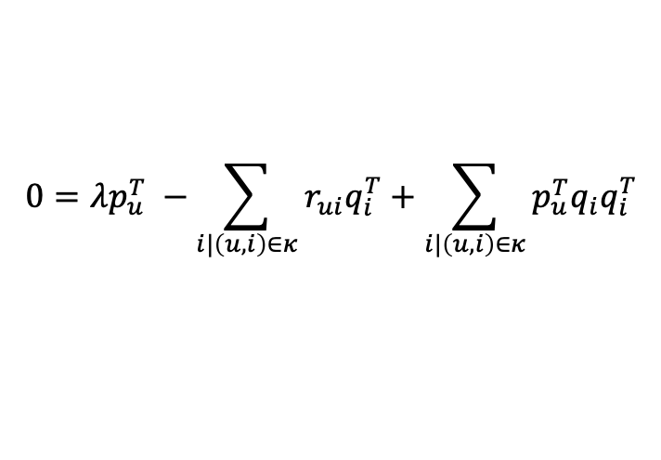
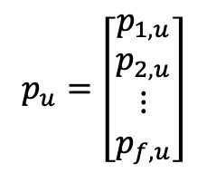
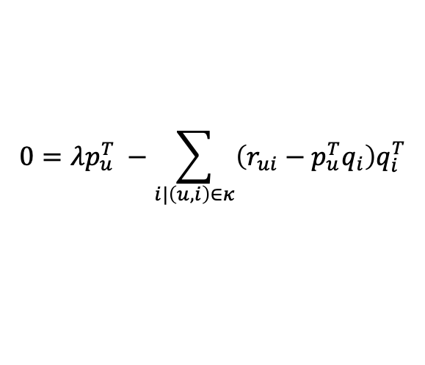
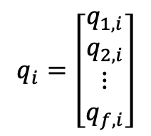

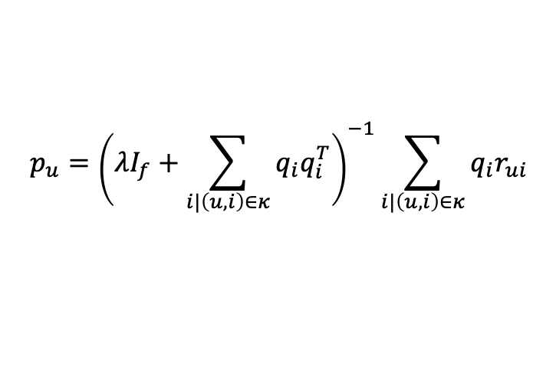
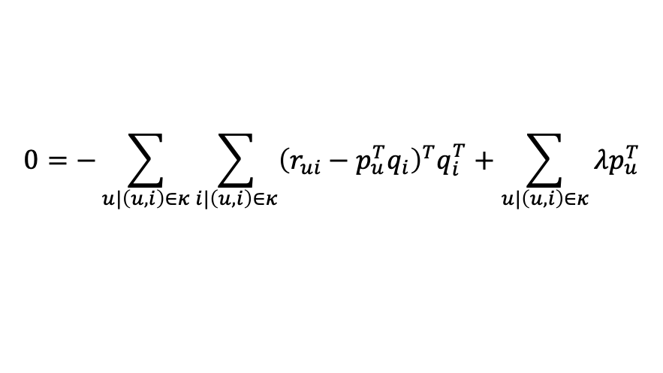
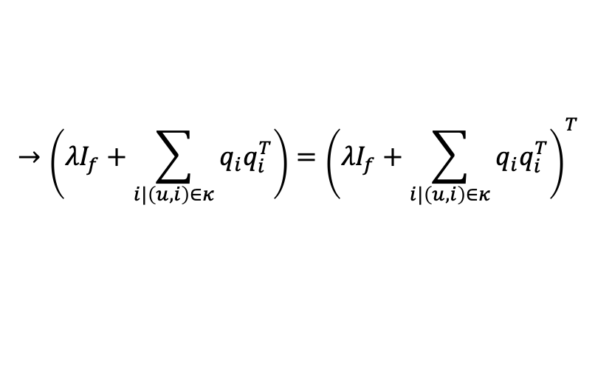
Alternating least squares
Explicit feedback case
$$p_{u}=\left[\begin{matrix}p_{1,u} \\ p_{2,u} \\ \begin{aligned}⋮ \\ p_{f,u}\end{aligned}\end{matrix}\right]$$
$$q_{i}=\left[\begin{matrix}q_{1,i} \\ q_{2,i} \\ \begin{aligned}⋮ \\ q_{f,i}\end{aligned}\end{matrix}\right]$$
$$Loss=\sum_{\left(u,i\right)∈κ}{{\left(r_{ui}−p_{u}^{T}q_{i}\right)}^{T}\left(r_{ui}−p_{u}^{T}q_{i}\right)}+\sum_{u|\left(u,i\right)∈κ }{λp_{u}^{T}p_{u}}+\sum_{i|\left(u,i\right)∈κ }{λq_{i}^{T}q_{i}}$$
$$\frac{∂Loss}{∂p_{u|\left(u,i\right)∈κ}}=−2\sum_{\left(u,i\right)∈κ}{{\left(r_{ui}−p_{u}^{T}q_{i}\right)}^{T}q_{i}^{T}}+2\sum_{u|\left(u,i\right)∈κ}{λp_{u}^{T}}$$
$$0=λp_{u}^{T} −\sum_{i|\left(u,i\right)∈κ}{r_{ui}q_{i}^{T}}+\sum_{i|\left(u,i\right)∈κ}{p_{u}^{T}q_{i}q_{i}^{T}}$$
$$p_{u}^{T}\left({λI}_{f}+\sum_{i|\left(u,i\right)∈κ}{q_{i}q_{i}^{T}}\right) =\sum_{i|\left(u,i\right)∈κ}{r_{ui}q_{i}^{T}}$$
$$0=−\sum_{u|\left(u,i\right)∈κ}{\sum_{i|\left(u,i\right)∈κ}{{\left(r_{ui}−p_{u}^{T}q_{i}\right)}^{T}q_{i}^{T}}}+\sum_{u|\left(u,i\right)∈κ}{λp_{u}^{T}}$$
$$→\left({λI}_{f}+\sum_{i|\left(u,i\right)∈κ}{q_{i}q_{i}^{T}}\right)={\left({λI}_{f}+\sum_{i|\left(u,i\right)∈κ}{q_{i}q_{i}^{T}}\right)}^{T}$$
$$0=λp_{u}^{T} −\sum_{i|\left(u,i\right)∈κ}{{\left(r_{ui}−p_{u}^{T}q_{i}\right)}^{T}q_{i}^{T}}$$
$$0=λp_{u}^{T} −\sum_{i|\left(u,i\right)∈κ}{\left(r_{ui}−p_{u}^{T}q_{i}\right)q_{i}^{T}}$$
$$p_{u}={\left(λI_{f}+\sum_{i|\left(u,i\right)∈κ}{q_{i}q_{i}^{T}}\right)}^{−1}\sum_{i|\left(u,i\right)∈κ}{q_{i}r_{ui}}$$

Slide 8
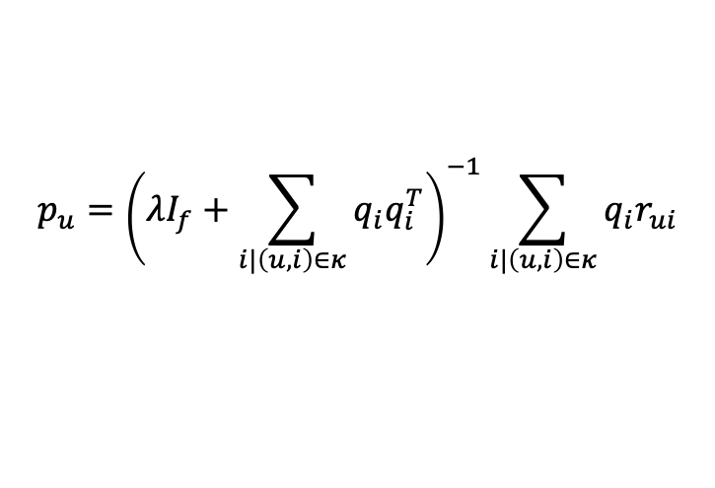
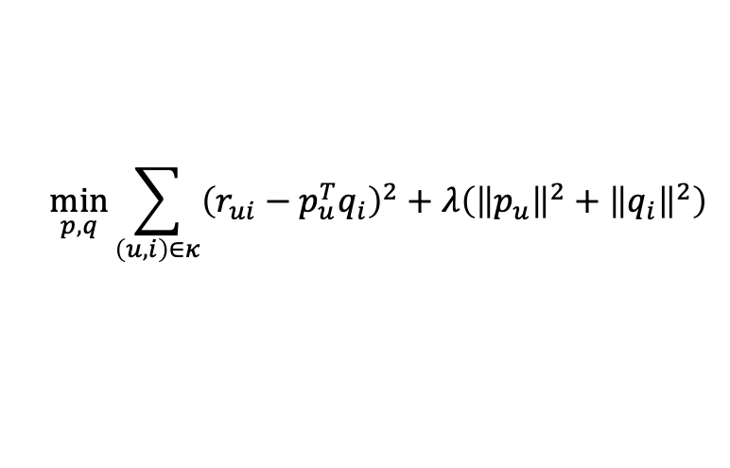
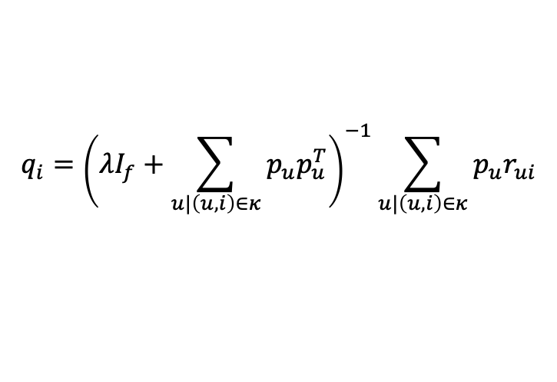
$$q_{i}∈ℝ^{f}$$
$$p_{u}∈ℝ^{f}$$
$$N_{u} :number of users$$
$$N_{i} :number of items$$
$$f는 dimentionality$$
$$u는 user의 약자$$
$$i는 item의 약자$$
Explicit feedback case
$$p_{u}=\left[\begin{matrix}p_{1,u} \\ p_{2,u} \\ \begin{aligned}⋮ \\ p_{f,u}\end{aligned}\end{matrix}\right]$$
$$q_{i}=\left[\begin{matrix}q_{1,i} \\ q_{2,i} \\ \begin{aligned}⋮ \\ q_{f,i}\end{aligned}\end{matrix}\right]$$
$$\min_{p,q}{\sum_{\left(u,i\right)∈κ}{{\left(r_{ui}−p_{u}^{T}q_{i}\right)}^{2}+λ\left({\left\|p_{u}\right\|}^{2}+{\left\|q_{i}\right\|}^{2}\right)}}$$
$$κ is the set of the \left(u,i\right) pairs for which r_{ui}is known the traing set$$
$$q_{i}={\left(λI_{f}+\sum_{u|\left(u,i\right)∈κ}{p_{u}p_{u}^{T}}\right)}^{−1}\sum_{u|\left(u,i\right)∈κ}{p_{u}r_{ui}}$$
$$p_{u}={\left(λI_{f}+\sum_{i|\left(u,i\right)∈κ}{q_{i}q_{i}^{T}}\right)}^{−1}\sum_{i|\left(u,i\right)∈κ}{q_{i}r_{ui}}$$

Slide 10
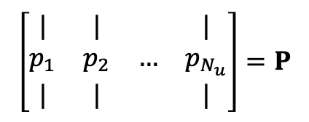
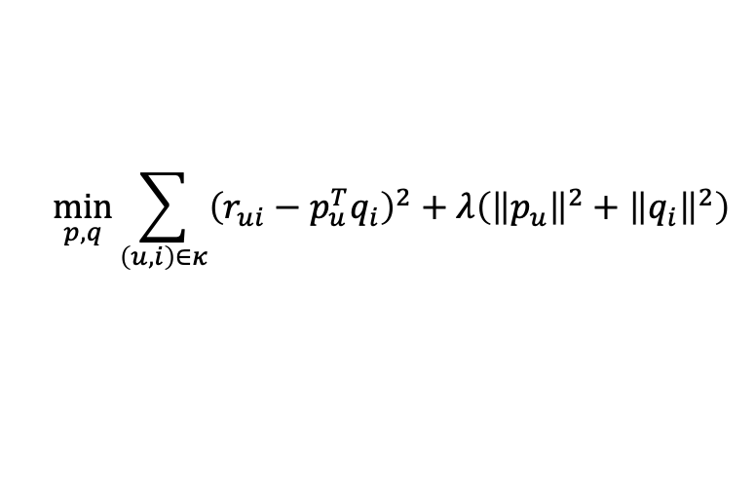
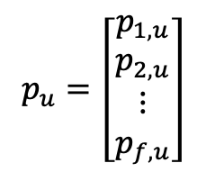
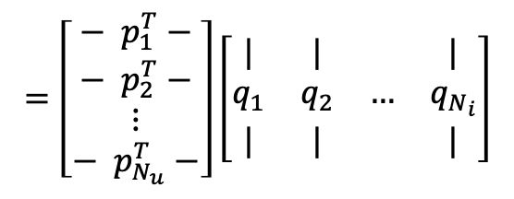
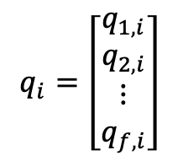
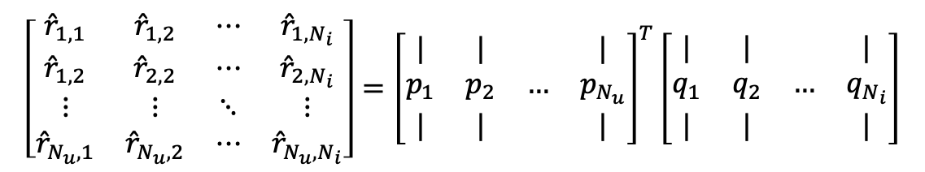

$$q_{i}∈ℝ^{f}$$
$$p_{u}∈ℝ^{f}$$
$$N_{u} :number of users$$
$$N_{i} :number of items$$
$$f는 dimentionality$$
$$u는 user의 약자$$
$$i는 item의 약자$$
Explicit feedback case
$$p_{u}=\left[\begin{matrix}p_{1,u} \\ p_{2,u} \\ \begin{aligned}⋮ \\ p_{f,u}\end{aligned}\end{matrix}\right]$$
$$q_{i}=\left[\begin{matrix}q_{1,i} \\ q_{2,i} \\ \begin{aligned}⋮ \\ q_{f,i}\end{aligned}\end{matrix}\right]$$
$$\left[\begin{matrix}{\hat{r}}_{1,1} & {\hat{r}}_{1,2} & ⋯ & {\hat{r}}_{1,N_{i}} \\ {\hat{r}}_{1,2} & {\hat{r}}_{2,2} & ⋯ & {\hat{r}}_{2,N_{i}} \\ ⋮ & ⋮ & ⋱ & ⋮ \\ {\hat{r}}_{N_{u},1} & {\hat{r}}_{N_{u},2} & ⋯ & {\hat{r}}_{N_{u},N_{i}}\end{matrix}\right]={\left[\begin{matrix}| & | & & | \\ p_{1} & p_{2} & … & p_{N_{u}} \\ | & | & & |\end{matrix}\right]}^{T}\left[\begin{matrix}| & | & & | \\ q_{1} & q_{2} & … & q_{N_{i}} \\ | & | & & |\end{matrix}\right]$$
$$\left[\begin{matrix}| & | & & | \\ p_{1} & p_{2} & … & p_{N_{u}} \\ | & | & & |\end{matrix}\right]=P$$
$$=\left[\begin{aligned}\begin{matrix}− p_{1}^{T}− \\ − p_{2}^{T}− \\ ⋮\end{matrix} \\ − p_{N_{u}}^{T}−\end{aligned}\right]\left[\begin{matrix}| & | & & | \\ q_{1} & q_{2} & … & q_{N_{i}} \\ | & | & & |\end{matrix}\right]$$
$$\left[\begin{matrix}| & | & & | \\ q_{1} & q_{2} & … & q_{N_{i}} \\ | & | & & |\end{matrix}\right]=Q$$
$$\min_{p,q}{\sum_{\left(u,i\right)∈κ}{{\left(r_{ui}−p_{u}^{T}q_{i}\right)}^{2}+λ\left({\left\|p_{u}\right\|}^{2}+{\left\|q_{i}\right\|}^{2}\right)}}$$
$$κ is the set of the \left(u,i\right) pairs for which r_{ui}is known the traing set$$

Slide 11








벡터 행렬 미분 참고 : https://en.wikipedia.org/wiki/Matrix_calculus
$$x^{T}=\left[\begin{matrix}x_{1} & x_{2} & x_{3}\end{matrix}\right]$$
$$x=\left[\begin{matrix}x_{1} \\ x_{3} \\ x_{3}\end{matrix}\right]$$
$$\frac{∂}{∂x}\left(x^{T}x\right){=2x}^{T}$$
$$x^{T}x={\left(x_{1}\right)}^{2}+{\left(x_{2}\right)}^{2}+{\left(x_{3}\right)}^{2}$$
$$\frac{∂y}{∂x}=\left[\begin{matrix}\frac{∂y}{∂x_{1}} & \frac{∂y}{∂x_{2}} & \frac{∂y}{∂x_{3}}\end{matrix}\right]$$
$$\frac{∂}{∂x_{i}}\left(x^{T}x\right)=2x_{i}$$
$$\frac{∂}{∂x}\left(x^{T}x\right)=2\left[\begin{matrix}x_{1} & x_{2} & x_{3}\end{matrix}\right]$$
$${=2x}^{T}$$

Slide 12







$$X^{T}=\left[\begin{matrix}x_{11} & x_{21} & x_{31} \\ x_{12} & x_{22} & x_{32} \\ x_{13} & x_{23} & x_{33}\end{matrix}\right]$$
$$X=\left[\begin{matrix}x_{11} & x_{12} & x_{13} \\ x_{21} & x_{22} & x_{23} \\ x_{31} & x_{32} & x_{33}\end{matrix}\right]$$
$$\frac{∂}{∂X}Tr\left(X^{T}X\right)=2X^{T}$$
$$X^{T}X=\left[\begin{matrix}{\left(x_{11}\right)}^{2}+{\left(x_{21}\right)}^{2}+{\left(x_{31}\right)}^{2} & … & … \\ … & {\left(x_{12}\right)}^{2}+{\left(x_{22}\right)}^{2}+{\left(x_{32}\right)}^{2} & … \\ … & … & {\left(x_{13}\right)}^{2}+{\left(x_{23}\right)}^{2}+{\left(x_{33}\right)}^{2}\end{matrix}\right]$$
$$Tr\left(X^{T}X\right)={\left(x_{11}\right)}^{2}+{\left(x_{21}\right)}^{2}+{\left(x_{31}\right)}^{2}+{\left(x_{12}\right)}^{2}+{\left(x_{22}\right)}^{2}+{\left(x_{32}\right)}^{2}+{\left(x_{13}\right)}^{2}+{\left(x_{23}\right)}^{2}+{\left(x_{33}\right)}^{2}$$
$$Tr\left(X\right)=x_{11}+x_{22}+x_{33}$$
$$\frac{∂}{∂x_{ij}}Tr\left(X^{T}X\right)=2x_{ij}$$
$$\frac{∂y}{∂X}=\left[\begin{matrix}\frac{∂y}{∂x_{11}} & \frac{∂y}{∂x_{21}} & \frac{∂y}{∂x_{31}} \\ \frac{∂y}{∂x_{12}} & \frac{∂y}{∂x_{22}} & \frac{∂y}{∂x_{32}} \\ \frac{∂y}{∂x_{13}} & \frac{∂y}{∂x_{23}} & \frac{∂y}{∂x_{33}}\end{matrix}\right]$$

Slide 13








$$\frac{∂}{∂X}Tr\left\{{\left(Y−W^{T}X\right)}^{T}\left(Y−W^{T}X\right)\right\}=?$$
$$Y=\left[\begin{matrix}y_{11} & y_{12} \\ y_{21} & y_{22} \\ y_{31} & y_{32}\end{matrix}\right]$$
$$W^{T}=\left[\begin{matrix}w_{11} & w_{21} & w_{31} \\ w_{12} & w_{22} & w_{32} \\ w_{13} & w_{23} & w_{33}\end{matrix}\right]$$
$$X=\left[\begin{matrix}x_{11} & x_{12} \\ x_{21} & x_{22} \\ x_{31} & x_{32}\end{matrix}\right]$$
$$W^{T}X=\left[\begin{matrix}w_{11}x_{11}+w_{21}x_{21}+w_{31}x_{31} & w_{11}x_{12}+w_{21}x_{22}+w_{31}x_{32} \\ w_{12}x_{11}+w_{22}x_{21}+w_{32}x_{31} & w_{12}x_{12}+w_{22}x_{22}+w_{32}x_{32} \\ w_{13}x_{11}+w_{23}x_{21}+w_{33}x_{31} & w_{13}x_{12}+w_{23}x_{22}+w_{33}x_{32}\end{matrix}\right]$$
$$\left(Y−W^{T}X\right)=\left[\begin{matrix}y_{11}−w_{11}x_{11}−w_{21}x_{21}−w_{31}x_{31} & y_{12}−w_{11}x_{12}−w_{21}x_{22}−w_{31}x_{32} \\ y_{21}−w_{12}x_{11}−w_{22}x_{21}−w_{32}x_{31} & y_{22}−w_{12}x_{12}−w_{22}x_{22}−w_{32}x_{32} \\ y_{31}−w_{13}x_{11}−w_{23}x_{21}−w_{33}x_{31} & y_{32}−w_{13}x_{12}−w_{23}x_{22}−w_{33}x_{32}\end{matrix}\right]$$
$$=\left[\begin{matrix}r_{11} & r_{12} \\ r_{21} & r_{22} \\ r_{31} & r_{32}\end{matrix}\right]$$
$${\left(Y−W^{T}X\right)}^{T}=\left[\begin{matrix}y_{11}−w_{11}x_{11}−w_{21}x_{21}−w_{31}x_{31} & y_{21}−w_{12}x_{11}−w_{22}x_{21}−w_{32}x_{31} & y_{31}−w_{13}x_{11}−w_{23}x_{21}−w_{33}x_{31} \\ y_{12}−w_{11}x_{12}−w_{21}x_{22}−w_{31}x_{32} & y_{22}−w_{12}x_{12}−w_{22}x_{22}−w_{32}x_{32} & y_{32}−w_{13}x_{12}−w_{23}x_{22}−w_{33}x_{32}\end{matrix}\right]$$
$$=\left[\begin{matrix}r_{11} & r_{21} & r_{31} \\ r_{12} & r_{22} & r_{32}\end{matrix}\right]$$
$${\left(Y−W^{T}X\right)}^{T}\left(Y−W^{T}X\right)=\left[\begin{matrix}{\left(r_{11}\right)}^{2}+{\left(r_{21}\right)}^{2}+{\left(r_{31}\right)}^{2} & … \\ … & {\left(r_{12}\right)}^{2}+{\left(r_{22}\right)}^{2}+{\left(r_{32}\right)}^{2}\end{matrix}\right]$$

Slide 14



$$\frac{∂}{∂X}Tr\left\{{\left(Y−W^{T}X\right)}^{T}\left(Y−W^{T}X\right)\right\}=?$$
$$\left(Y−W^{T}X\right)=\left[\begin{matrix}y_{11}−w_{11}x_{11}−w_{21}x_{21}−w_{31}x_{31} & y_{12}−w_{11}x_{12}−w_{21}x_{22}−w_{31}x_{32} \\ y_{21}−w_{12}x_{11}−w_{22}x_{21}−w_{32}x_{31} & y_{22}−w_{12}x_{12}−w_{22}x_{22}−w_{32}x_{32} \\ y_{31}−w_{13}x_{11}−w_{23}x_{21}−w_{33}x_{31} & y_{32}−w_{13}x_{12}−w_{23}x_{22}−w_{33}x_{32}\end{matrix}\right]$$
$$=\left[\begin{matrix}r_{11} & r_{12} \\ r_{21} & r_{22} \\ r_{31} & r_{32}\end{matrix}\right]$$
$$Tr\left\{{\left(Y−W^{T}X\right)}^{T}\left(Y−W^{T}X\right)\right\}={\left(r_{11}\right)}^{2}+{\left(r_{21}\right)}^{2}+{\left(r_{31}\right)}^{2}+{\left(r_{12}\right)}^{2}+{\left(r_{22}\right)}^{2}+{\left(r_{32}\right)}^{2}$$
$$\frac{∂}{∂x_{11}}Tr\left\{{\left(Y−W^{T}X\right)}^{T}\left(Y−W^{T}X\right)\right\}=2r_{11}\frac{∂r_{11}}{∂x_{11}}+2r_{21}\frac{∂r_{21}}{∂x_{11}}+2r_{31}\frac{∂r_{31}}{∂x_{11}}=2r_{11}w_{11}+2r_{21}w_{12}+2r_{31}w_{13}$$
$$\frac{∂}{∂x_{21}}Tr\left\{{\left(Y−W^{T}X\right)}^{T}\left(Y−W^{T}X\right)\right\}=2r_{11}\frac{∂r_{11}}{∂x_{21}}+2r_{21}\frac{∂r_{21}}{∂x_{21}}+2r_{31}\frac{∂r_{31}}{∂x_{21}}=2r_{11}w_{21}+2r_{21}w_{22}+2r_{31}w_{23}$$
$$\frac{∂}{∂x_{31}}Tr\left\{{\left(Y−W^{T}X\right)}^{T}\left(Y−W^{T}X\right)\right\}=2r_{11}\frac{∂r_{11}}{∂x_{31}}+2r_{21}\frac{∂r_{21}}{∂x_{31}}+2r_{31}\frac{∂r_{31}}{∂x_{31}}=2r_{11}w_{31}+2r_{21}w_{32}+2r_{31}w_{33}$$

Slide 15

$$\frac{∂}{∂X}Tr\left\{{\left(Y−W^{T}X\right)}^{T}\left(Y−W^{T}X\right)\right\}=?$$
$$\left(Y−W^{T}X\right)=\left[\begin{matrix}y_{11}−w_{11}x_{11}−w_{21}x_{21}−w_{31}x_{31} & y_{12}−w_{11}x_{12}−w_{21}x_{22}−w_{31}x_{32} \\ y_{21}−w_{12}x_{11}−w_{22}x_{21}−w_{32}x_{31} & y_{22}−w_{12}x_{12}−w_{22}x_{22}−w_{32}x_{32} \\ y_{31}−w_{13}x_{11}−w_{23}x_{21}−w_{33}x_{31} & y_{32}−w_{13}x_{12}−w_{23}x_{22}−w_{33}x_{32}\end{matrix}\right]$$
$$=\left[\begin{matrix}r_{11} & r_{12} \\ r_{21} & r_{22} \\ r_{31} & r_{32}\end{matrix}\right]$$
$$Tr\left\{{\left(Y−W^{T}X\right)}^{T}\left(Y−W^{T}X\right)\right\}={\left(r_{11}\right)}^{2}+{\left(r_{21}\right)}^{2}+{\left(r_{31}\right)}^{2}+{\left(r_{12}\right)}^{2}+{\left(r_{22}\right)}^{2}+{\left(r_{32}\right)}^{2}$$
$$\frac{∂}{∂x_{12}}Tr\left\{{\left(Y−W^{T}X\right)}^{T}\left(Y−W^{T}X\right)\right\}=2r_{12}\frac{∂r_{12}}{∂x_{12}}+2r_{22}\frac{∂r_{22}}{∂x_{12}}+2r_{32}\frac{∂r_{32}}{∂x_{12}}=2r_{12}w_{11}+2r_{22}w_{12}+2r_{32}w_{13}$$
$$\frac{∂}{∂x_{22}}Tr\left\{{\left(Y−W^{T}X\right)}^{T}\left(Y−W^{T}X\right)\right\}=2r_{12}\frac{∂r_{12}}{∂x_{22}}+2r_{22}\frac{∂r_{22}}{∂x_{22}}+2r_{32}\frac{∂r_{32}}{∂x_{22}}=2r_{12}w_{21}+2r_{22}w_{22}+2r_{32}w_{23}$$
$$\frac{∂}{∂x_{32}}Tr\left\{{\left(Y−W^{T}X\right)}^{T}\left(Y−W^{T}X\right)\right\}=2r_{12}\frac{∂r_{12}}{∂x_{32}}+2r_{22}\frac{∂r_{22}}{∂x_{32}}+2r_{32}\frac{∂r_{32}}{∂x_{32}}=2r_{12}w_{31}+2r_{22}w_{32}+2r_{32}w_{33}$$

Slide 16





$$\left(Y−W^{T}X\right)=\left[\begin{matrix}r_{11} & r_{12} \\ r_{21} & r_{22} \\ r_{31} & r_{32}\end{matrix}\right]$$
$$\frac{∂}{∂X}Tr\left\{{\left(Y−W^{T}X\right)}^{T}\left(Y−W^{T}X\right)\right\}={2\left(Y−W^{T}X\right)}^{T}W^{T}$$
$$=\left[\begin{matrix}2r_{11}w_{11}+2r_{21}w_{12}+2r_{31}w_{13} & 2r_{11}w_{21}+2r_{21}w_{22}+2r_{31}w_{23} & 2r_{11}w_{31}+2r_{21}w_{32}+2r_{31}w_{33} \\ 2r_{12}w_{11}+2r_{22}w_{12}+2r_{32}w_{13} & 2r_{12}w_{21}+2r_{22}w_{22}+2r_{32}w_{23} & 2r_{12}w_{31}+2r_{22}w_{32}+2r_{32}w_{33}\end{matrix}\right]$$
$$=2\left[\begin{matrix}r_{11} & r_{21} & r_{31} \\ r_{12} & r_{22} & r_{32}\end{matrix}\right]\left[\begin{matrix}w_{11} & w_{21} & w_{31} \\ w_{12} & w_{22} & w_{32} \\ w_{13} & w_{23} & w_{33}\end{matrix}\right]$$
$${=2\left(Y−W^{T}X\right)}^{T}W^{T}$$
$${2\left(Y−W^{T}X\right)}^{T}W^{T}$$

Slide 17

$$\frac{∂}{∂W}Tr\left\{{\left(Y−W^{T}X\right)}^{T}\left(Y−W^{T}X\right)\right\}=?$$
$$\left(Y−W^{T}X\right)=\left[\begin{matrix}y_{11}−w_{11}x_{11}−w_{21}x_{21}−w_{31}x_{31} & y_{12}−w_{11}x_{12}−w_{21}x_{22}−w_{31}x_{32} \\ y_{21}−w_{12}x_{11}−w_{22}x_{21}−w_{32}x_{31} & y_{22}−w_{12}x_{12}−w_{22}x_{22}−w_{32}x_{32} \\ y_{31}−w_{13}x_{11}−w_{23}x_{21}−w_{33}x_{31} & y_{32}−w_{13}x_{12}−w_{23}x_{22}−w_{33}x_{32}\end{matrix}\right]$$
$$=\left[\begin{matrix}r_{11} & r_{12} \\ r_{21} & r_{22} \\ r_{31} & r_{32}\end{matrix}\right]$$
$$Tr\left\{{\left(Y−W^{T}X\right)}^{T}\left(Y−W^{T}X\right)\right\}={\left(r_{11}\right)}^{2}+{\left(r_{21}\right)}^{2}+{\left(r_{31}\right)}^{2}+{\left(r_{12}\right)}^{2}+{\left(r_{22}\right)}^{2}+{\left(r_{32}\right)}^{2}$$
$$\frac{∂}{∂w_{11}}Tr\left\{{\left(Y−W^{T}X\right)}^{T}\left(Y−W^{T}X\right)\right\}=2r_{11}\frac{∂r_{11}}{∂w_{11}}+2r_{12}\frac{∂r_{12}}{∂w_{11}}=2r_{11}x_{11}+2r_{12}x_{12}$$
$$\frac{∂}{∂w_{21}}Tr\left\{{\left(Y−W^{T}X\right)}^{T}\left(Y−W^{T}X\right)\right\}=2r_{11}\frac{∂r_{11}}{∂w_{21}}+2r_{21}\frac{∂r_{12}}{∂w_{21}}=2r_{11}x_{21}+2r_{12}x_{22}$$
$$\frac{∂}{∂w_{31}}Tr\left\{{\left(Y−W^{T}X\right)}^{T}\left(Y−W^{T}X\right)\right\}=2r_{11}\frac{∂r_{11}}{∂w_{31}}+2r_{21}\frac{∂r_{12}}{∂w_{31}}=2r_{11}x_{31}+2r_{12}x_{32}$$

Slide 18
$$\frac{∂}{∂W}Tr\left\{{\left(Y−W^{T}X\right)}^{T}\left(Y−W^{T}X\right)\right\}=?$$
$$\left(Y−W^{T}X\right)=\left[\begin{matrix}y_{11}−w_{11}x_{11}−w_{21}x_{21}−w_{31}x_{31} & y_{12}−w_{11}x_{12}−w_{21}x_{22}−w_{31}x_{32} \\ y_{21}−w_{12}x_{11}−w_{22}x_{21}−w_{32}x_{31} & y_{22}−w_{12}x_{12}−w_{22}x_{22}−w_{32}x_{32} \\ y_{31}−w_{13}x_{11}−w_{23}x_{21}−w_{33}x_{31} & y_{32}−w_{13}x_{12}−w_{23}x_{22}−w_{33}x_{32}\end{matrix}\right]$$
$$=\left[\begin{matrix}r_{11} & r_{12} \\ r_{21} & r_{22} \\ r_{31} & r_{32}\end{matrix}\right]$$
$$Tr\left\{{\left(Y−W^{T}X\right)}^{T}\left(Y−W^{T}X\right)\right\}={\left(r_{11}\right)}^{2}+{\left(r_{21}\right)}^{2}+{\left(r_{31}\right)}^{2}+{\left(r_{12}\right)}^{2}+{\left(r_{22}\right)}^{2}+{\left(r_{32}\right)}^{2}$$
$$\frac{∂}{∂w_{12}}Tr\left\{{\left(Y−W^{T}X\right)}^{T}\left(Y−W^{T}X\right)\right\}=2r_{21}\frac{∂r_{21}}{∂w_{12}}+2r_{22}\frac{∂r_{22}}{∂w_{12}}=2r_{21}x_{11}+2r_{22}x_{12}$$
$$\frac{∂}{∂w_{22}}Tr\left\{{\left(Y−W^{T}X\right)}^{T}\left(Y−W^{T}X\right)\right\}=2r_{21}\frac{∂r_{21}}{∂w_{22}}+2r_{22}\frac{∂r_{22}}{∂w_{22}}=2r_{21}x_{21}+2r_{22}x_{22}$$
$$\frac{∂}{∂w_{32}}Tr\left\{{\left(Y−W^{T}X\right)}^{T}\left(Y−W^{T}X\right)\right\}=2r_{21}\frac{∂r_{21}}{∂w_{32}}+2r_{22}\frac{∂r_{22}}{∂w_{32}}=2r_{21}x_{31}+2r_{22}x_{32}$$

Slide 19
$$\frac{∂}{∂W}Tr\left\{{\left(Y−W^{T}X\right)}^{T}\left(Y−W^{T}X\right)\right\}=?$$
$$\left(Y−W^{T}X\right)=\left[\begin{matrix}y_{11}−w_{11}x_{11}−w_{21}x_{21}−w_{31}x_{31} & y_{12}−w_{11}x_{12}−w_{21}x_{22}−w_{31}x_{32} \\ y_{21}−w_{12}x_{11}−w_{22}x_{21}−w_{32}x_{31} & y_{22}−w_{12}x_{12}−w_{22}x_{22}−w_{32}x_{32} \\ y_{31}−w_{13}x_{11}−w_{23}x_{21}−w_{33}x_{31} & y_{32}−w_{13}x_{12}−w_{23}x_{22}−w_{33}x_{32}\end{matrix}\right]$$
$$=\left[\begin{matrix}r_{11} & r_{12} \\ r_{21} & r_{22} \\ r_{31} & r_{32}\end{matrix}\right]$$
$$Tr\left\{{\left(Y−W^{T}X\right)}^{T}\left(Y−W^{T}X\right)\right\}={\left(r_{11}\right)}^{2}+{\left(r_{21}\right)}^{2}+{\left(r_{31}\right)}^{2}+{\left(r_{12}\right)}^{2}+{\left(r_{22}\right)}^{2}+{\left(r_{32}\right)}^{2}$$
$$\frac{∂}{∂w_{13}}Tr\left\{{\left(Y−W^{T}X\right)}^{T}\left(Y−W^{T}X\right)\right\}=2r_{31}\frac{∂r_{31}}{∂w_{13}}+2r_{32}\frac{∂r_{32}}{∂w_{13}}=2r_{31}x_{11}+2r_{32}x_{12}$$
$$\frac{∂}{∂w_{23}}Tr\left\{{\left(Y−W^{T}X\right)}^{T}\left(Y−W^{T}X\right)\right\}=2r_{31}\frac{∂r_{31}}{∂w_{23}}+2r_{32}\frac{∂r_{32}}{∂w_{23}}=2r_{31}x_{21}+2r_{32}x_{22}$$
$$\frac{∂}{∂w_{33}}Tr\left\{{\left(Y−W^{T}X\right)}^{T}\left(Y−W^{T}X\right)\right\}=2r_{31}\frac{∂r_{31}}{∂w_{33}}+2r_{32}\frac{∂r_{32}}{∂w_{33}}=2r_{31}x_{31}+2r_{32}x_{32}$$

Slide 20






$$\frac{∂}{∂W}Tr\left\{{\left(Y−W^{T}X\right)}^{T}\left(Y−W^{T}X\right)\right\}=2\left(Y−W^{T}X\right)X^{T}$$
$$X=\left[\begin{matrix}x_{11} & x_{12} \\ x_{21} & x_{22} \\ x_{31} & x_{32}\end{matrix}\right]$$
$$=\left[\begin{matrix}2r_{11}x_{11}+2r_{12}x_{12} & 2r_{11}x_{21}+2r_{12}x_{22} & 2r_{11}x_{31}+2r_{12}x_{32} \\ 2r_{21}x_{11}+2r_{22}x_{12} & 2r_{21}x_{21}+2r_{22}x_{22} & 2r_{21}x_{31}+2r_{22}x_{32} \\ 2r_{31}x_{11}+2r_{32}x_{12} & 2r_{31}x_{21}+2r_{32}x_{22} & 2r_{31}x_{31}+2r_{32}x_{32}\end{matrix}\right]$$
$$\left(Y−W^{T}X\right)=\left[\begin{matrix}r_{11} & r_{12} \\ r_{21} & r_{22} \\ r_{31} & r_{32}\end{matrix}\right]$$
$$=2\left[\begin{matrix}r_{11} & r_{12} \\ r_{21} & r_{22} \\ r_{31} & r_{32}\end{matrix}\right]\left[\begin{matrix}x_{11} & x_{21} & x_{31} \\ x_{12} & x_{22} & x_{32}\end{matrix}\right]$$
$$=2\left(Y−W^{T}X\right)X^{T}$$

Slide 21














$$p_{u}=\left[\begin{matrix}p_{1,u} \\ p_{2,u} \\ \begin{aligned}⋮ \\ p_{f,u}\end{aligned}\end{matrix}\right]$$
$$q_{i}=\left[\begin{matrix}q_{1,i} \\ q_{2,i} \\ \begin{aligned}⋮ \\ q_{f,i}\end{aligned}\end{matrix}\right]$$
$$\left[\begin{matrix}| & | & & | \\ p_{1} & p_{2} & … & p_{N_{u}} \\ | & | & & |\end{matrix}\right]=P$$
$$\left[\begin{matrix}| & | & & | \\ q_{1} & q_{2} & … & q_{N_{i}} \\ | & | & & |\end{matrix}\right]=Q$$
$$\frac{∂}{∂A}Tr\left(AB\right)=B^{T}$$
$$\min_{p,q}{\sum_{\left(u,i\right)∈κ}{{\left(r_{ui}−p_{u}^{T}q_{i}\right)}^{2}+λ\left({\left\|p_{u}\right\|}^{2}+{\left\|q_{i}\right\|}^{2}\right)}}$$
$$\frac{∂}{∂A}Tr\left(A^{T}B\right)=B$$
$$\frac{∂}{∂A}Tr\left(AB^{T}\right)=B$$
$$κ is the set of the \left(u,i\right) pairs for which r_{ui}is known the traing set$$
$$\frac{∂}{∂X}Tr\left(X^{T}X\right)=2X^{T}$$
$$\frac{∂}{∂A}Tr\left(A\right)=I$$
$$\min_{P,Q}{Tr\left\{{\left(R−P^{T}Q\right)}^{T}\left(R−P^{T}Q\right)\right\}+λ∙Tr\left(P^{T}P\right)+λ∙Tr\left(Q^{T}Q\right)}$$
$$loss=Tr\left\{{\left(R−P^{T}Q\right)}^{T}\left(R−P^{T}Q\right)\right\}+λ∙Tr\left(P^{T}P\right)+λ∙Tr\left(Q^{T}Q\right)$$
$$\frac{∂loss}{∂P}=−2{\left(R−P^{T}Q\right)Q}^{T}+2λP^{T}$$
$$\frac{∂}{∂W}Tr\left\{{\left(Y−W^{T}X\right)}^{T}\left(Y−W^{T}X\right)\right\}=2\left(Y−W^{T}X\right)X^{T}$$
$$\frac{∂loss}{∂Q}=−2{\left(R−P^{T}Q\right)}^{T}P^{T}+2λQ^{T}$$
$$\frac{∂}{∂X}Tr\left\{{\left(Y−W^{T}X\right)}^{T}\left(Y−W^{T}X\right)\right\}={2\left(Y−W^{T}X\right)}^{T}W^{T}$$

Slide 22








$$loss=Tr\left\{{\left(R−P^{T}Q\right)}^{T}\left(R−P^{T}Q\right)\right\}+λ∙Tr\left(P^{T}P\right)+λ∙Tr\left(Q^{T}Q\right)$$
$$\frac{∂loss}{∂P}=−2{\left(R−P^{T}Q\right)Q}^{T}+2λP^{T}$$
$$\left(QQ^{T}+λI\right)P={QR}^{T}$$
$$0=−{\left(R−P^{T}Q\right)Q}^{T}+λP^{T}$$
$$P={\left(QQ^{T}+λI_{f}\right)}^{−1}{QR}^{T}$$
$$0=−{RQ}^{T}+P^{T}QQ^{T}+λP^{T}$$
$${RQ}^{T} =P^{T}\left(QQ^{T}+λI_{f}\right)$$
$${RQ}^{T} =P^{T}\left(QQ^{T}+λI_{f}\right)$$
$$→\left(QQ^{T}+λI_{f}\right)={\left(QQ^{T}+λI_{f}\right)}^{T}$$

Slide 23






$$loss=Tr\left\{{\left(R−P^{T}Q\right)}^{T}\left(R−P^{T}Q\right)\right\}+λ∙Tr\left(P^{T}P\right)+λ∙Tr\left(Q^{T}Q\right)$$
$$\frac{∂loss}{∂Q}=−2{\left(R−P^{T}Q\right)}^{T}P^{T}+2λQ^{T}$$
$$Q ={\left(PP^{T}+λI_{f}\right)}^{−1}PR$$
$$0=−{\left(R−P^{T}Q\right)}^{T}P^{T}+λQ^{T}$$
$$0=−P\left(R−P^{T}Q\right)+λQ$$
$$0=−PR+PP^{T}Q+λQ$$
$$PR =\left(PP^{T}+λI_{f}\right)Q$$

Slide 24




$$p_{u}=\left[\begin{matrix}p_{1,u} \\ p_{2,u} \\ \begin{aligned}⋮ \\ p_{f,u}\end{aligned}\end{matrix}\right]$$
$$q_{i}=\left[\begin{matrix}q_{1,i} \\ q_{2,i} \\ \begin{aligned}⋮ \\ q_{f,i}\end{aligned}\end{matrix}\right]$$
$$\left[\begin{matrix}| & | & & | \\ p_{1} & p_{2} & … & p_{N_{u}} \\ | & | & & |\end{matrix}\right]=P$$
$$\left[\begin{matrix}| & | & & | \\ q_{1} & q_{2} & … & q_{N_{i}} \\ | & | & & |\end{matrix}\right]=Q$$
$$\min_{p,q}{\sum_{\left(u,i\right)∈κ}{{\left(r_{ui}−p_{u}^{T}q_{i}\right)}^{2}+λ\left({\left\|p_{u}\right\|}^{2}+{\left\|q_{i}\right\|}^{2}\right)}}$$
$$κ is the set of the \left(u,i\right) pairs for which r_{ui}is known the traing set$$
$$\frac{∂loss}{∂P}=−2{\left(R−P^{T}Q\right)Q}^{T}+2λP^{T}$$
$$\min_{P,Q}{Tr\left\{{\left(R−P^{T}Q\right)}^{T}\left(R−P^{T}Q\right)\right\}+λ∙Tr\left(P^{T}P\right)+λ∙Tr\left(Q^{T}Q\right)}$$
$$\frac{∂loss}{∂Q}=−2{\left(R−P^{T}Q\right)}^{T}P^{T}+2λQ^{T}$$
$$loss=Tr\left\{{\left(R−P^{T}Q\right)}^{T}\left(R−P^{T}Q\right)\right\}+λ∙Tr\left(P^{T}P\right)+λ∙Tr\left(Q^{T}Q\right)$$
$$P={\left(QQ^{T}+λI_{f}\right)}^{−1}{QR}^{T}$$
$$Q ={\left(PP^{T}+λI_{f}\right)}^{−1}PR$$

Slide 25
https://yeomko.tistory.com/4?category=805638

Slide 26





MF implicit feedback datasets
$user → u$
$item → i$
$implicit feedback rating : r_{ui}$
$binary preference : p_{ui}$
$$p_{ui}=\left\{\begin{aligned}1 r_{ui}>0 \\ 0 r_{ui}=0\end{aligned}\right.$$
If a user $u$ consumed item $i(r_{ui}>0)$, then we have an indication that $u$ like $i(p_{ui}=1)$.
If $u$ never consumed $i$, we believe no preference($p_{ui}=0$)
$$condence :c_{ui}$$
$$c_{ui}=1+αr_{ui}, α is constant$$

