Slide 2











$$a$$
$$p\left(a, b c\right)=p\left(c | a,b\right)p\left(a,b\right)$$
$$=p\left(c | a,b\right)p\left(b | a\right)p\left(a\right)$$
$$c$$
$$b$$
$$c$$
$$p\left(a, b c\right)=p\left(a | c\right)p\left(b | c\right)p\left(c\right)$$
$$a$$
$$b$$
$$p\left(a, b\right)=\sum_{c}{p\left(a | c\right)p\left(b | c\right)p\left(c\right)}$$
$$⫫⊨$$

Slide 3










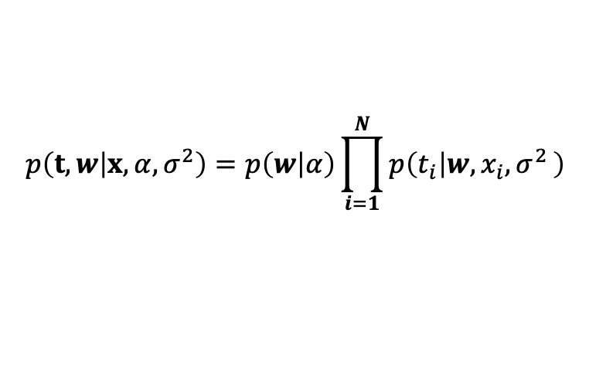



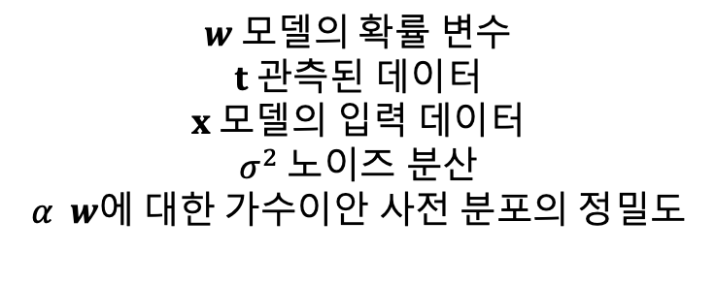



$$x_{i}는 1차원 변수$$
$$w 모델의 확률 변수$$
$$t 관측된 데이터$$
$$x 모델의 입력 데이터$$
$$σ^{2} 노이즈 분산$$
$$α w에 대한 가수이안 사전 분포의 정밀도$$
$$x={\left[x_{1},x_{2},⋯,x_{N}\right]}^{T}$$
$$t={\left[t_{1},t_{2},⋯,t_{N}\right]}^{T}$$
$$p\left(t,w\right)=p\left(w\right)\prod_{i=1}^{N}{p\left(t_{i} | w\right)}$$
$$p\left(t,w | x,α,σ^{2}\right)=p\left(w | α\right)\prod_{i=1}^{N}{p\left(t_{i} | w,x_{i}{,σ}^{2}\right)}$$
$$w$$
$$x_{i}$$
$$α$$
$$w$$
$$t_{1}$$
$$t_{N}$$
$$t_{i}$$
$$σ^{2}$$
$$t_{i}$$
$$w$$
$$N$$
$$N$$

Slide 4

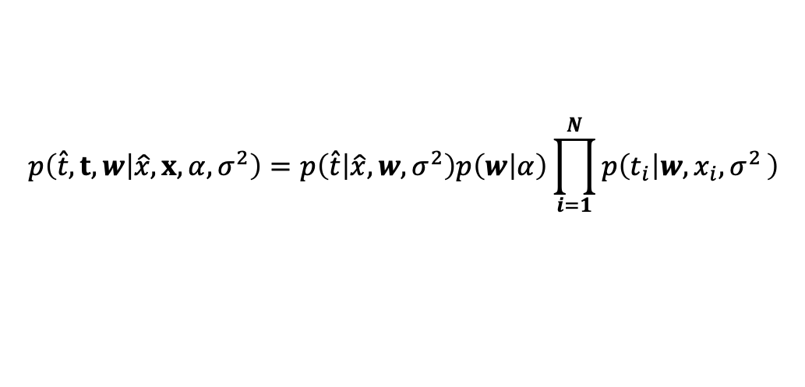









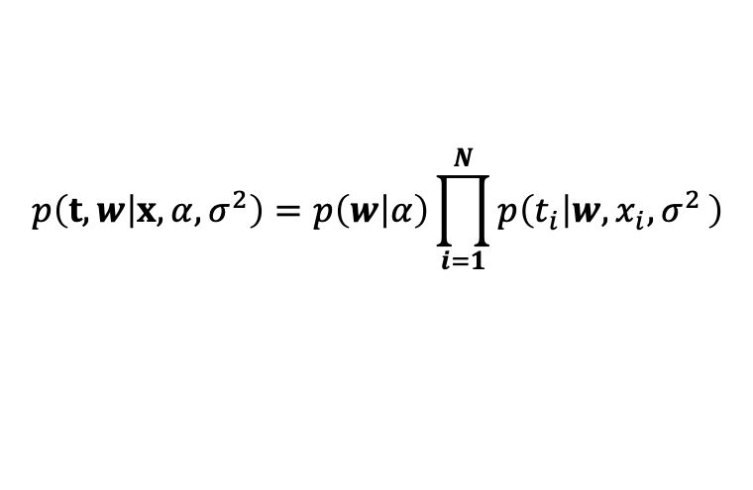





$$x_{i}는 1차원 변수$$
$w :모델의 확률 변수$
$t :관측된 데이터$
$x :모델의 입력 데이터$
$σ^{2} :노이즈 분산$
$α : w에 대한 가수이안 사전 분포의 정밀도$
$\hat{x} : 새로운 입력 변수$
$\hat{t} : 새로운 입력 변수가 주어질 때, 관측 데이터$
$$x={\left[x_{1},x_{2},⋯,x_{N}\right]}^{T}$$
$$t={\left[t_{1},t_{2},⋯,t_{N}\right]}^{T}$$
$$p\left(t,w | x,α,σ^{2}\right)=p\left(w | α\right)\prod_{i=1}^{N}{p\left(t_{i} | w,x_{i}{,σ}^{2}\right)}$$
$$p\left(\hat{t},t,w | \hat{x},x,α,σ^{2}\right)=p\left(\hat{t} | \hat{x},w,σ^{2}\right)p\left(w | α\right)\prod_{i=1}^{N}{p\left(t_{i} | w,x_{i}{,σ}^{2}\right)}$$
$$x_{i}$$
$$α$$
$$x_{i}$$
$$α$$
$$σ^{2}$$
$$t_{i}$$
$$w$$
$$t_{i}$$
$$w$$
$$N$$
$$N$$
$$σ^{2}$$
$$\hat{t}$$
$$\hat{x}$$

Slide 5





















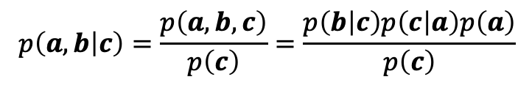
$$p\left(a, b, c\right)=p\left(a | c\right)p\left(b | c\right)p\left(c\right)$$
$$p\left(a, b c\right)=p\left(b | c\right)p\left(c | a\right)p\left(a\right)$$
$$p\left(a, b\right)=\sum_{c}{p\left(a | c\right)p\left(b | c\right)p\left(c\right)}$$
$$p\left(a, b\right)=p\left(a\right)\sum_{c}{p\left(b | c\right)p\left(c | a\right)}$$
$$=\sum_{i=1}^{K}{p\left(a | c_{i}\right)p\left(b | c_{i}\right)p\left(c_{i}\right)}$$
$$=p\left(a\right)\sum_{i=1}^{K}{p\left(b | c_{i}\right)p\left(c_{i} | a\right)}$$
$$c$$
$$a$$
$$c$$
$$b$$
$$a$$
$$b$$
$$c는 머리 대 꼬리(head−to−tail) 노드$$
$$c는 꼬리 대 꼬리(tail−to−tail) 노드$$
$$p\left(a,b | c\right)=\frac{p\left(a, b, c\right)}{p\left(c\right)}=\frac{p\left(b | c\right)p\left(c | a\right)p\left(a\right)}{p\left(c\right)}$$
$$p\left(a,b | c\right)= p\left(a | c\right)p\left(b | c\right)$$
$$= p\left(a | c\right)p\left(b | c\right)$$
$$c$$
$$a$$
$$c$$
$$b$$
$$a$$
$$b$$

Slide 6








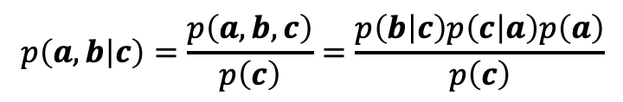







$$c는 머리 대 꼬리(head−to−tail) 노드$$
$$c는 꼬리 대 꼬리(tail−to−tail) 노드$$
$$p\left(a,b | c\right)=\frac{p\left(a, b, c\right)}{p\left(c\right)}=\frac{p\left(b | c\right)p\left(c | a\right)p\left(a\right)}{p\left(c\right)}$$
$$p\left(a,b | c\right)= p\left(a | c\right)p\left(b | c\right)$$
$$c$$
$$= p\left(a | c\right)p\left(b | c\right)$$
$$a$$
$$b$$
$$a$$
$$c$$
$$b$$
$$p\left(a, b, c\right)=p\left(a\right)p\left(b\right)p\left(a,b | c\right)$$
$$p\left(a,b\right)=p\left(a\right)p\left(b\right)$$
$$a$$
$$b$$
$$c$$

Slide 7
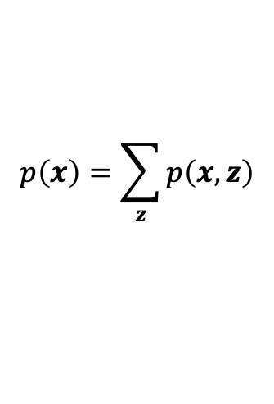
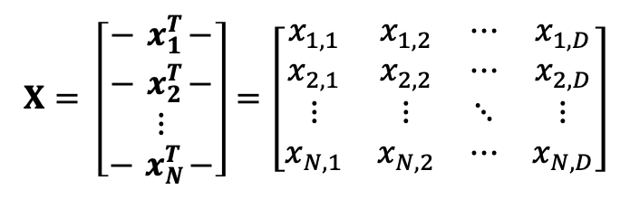




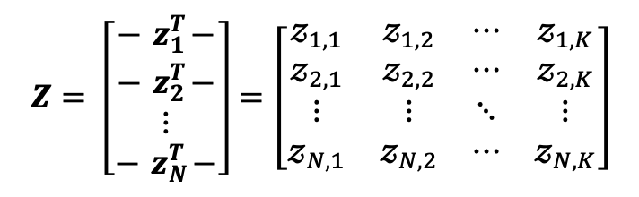


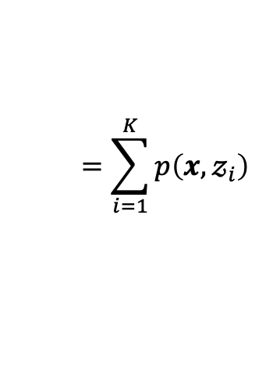
$$X= \left[\begin{matrix}−{ x}_{1}^{T}− \\ −{ x}_{2}^{T}− \\ \begin{aligned}⋮ \\ −{ x}_{N}^{T}−\end{aligned}\end{matrix}\right]=\left[\begin{matrix}x_{1,1} & x_{1,2} & ⋯ & x_{1,D} \\ x_{2,1} & x_{2,2} & ⋯ & x_{2,D} \\ ⋮ & ⋮ & ⋱ & ⋮ \\ x_{N,1} & x_{N,2} & ⋯ & x_{N,D}\end{matrix}\right]$$
$$Z= \left[\begin{matrix}−{ z}_{1}^{T}− \\ −{ z}_{2}^{T}− \\ \begin{aligned}⋮ \\ −{ z}_{N}^{T}−\end{aligned}\end{matrix}\right]=\left[\begin{matrix}𝓏_{1,1} & 𝓏_{1,2} & ⋯ & 𝓏_{1,K} \\ 𝓏_{2,1} & 𝓏_{2,2} & ⋯ & 𝓏_{2,K} \\ ⋮ & ⋮ & ⋱ & ⋮ \\ 𝓏_{N,1} & 𝓏_{N,2} & ⋯ & 𝓏_{N,K}\end{matrix}\right]$$
$$p\left(x\right)=\sum_{z}{p\left(x,z\right)}$$
$$=\sum_{i=1}^{K}{p\left(x,𝓏_{i}\right)}$$
$$x_{n}={\left[x_{n,1},x_{n,2},⋯,x_{n,D}\right]}^{T}$$
$$z_{n}={\left[𝓏_{n,1},𝓏_{n,2},⋯,𝓏_{n,K}\right]}^{T}$$
$$x={\left[x_{1},x_{2},⋯,x_{D}\right]}^{T}$$
$$z={\left[𝓏_{1},𝓏_{2},⋯,𝓏_{K}\right]}^{T}$$
$$p\left(X\right)=p\left(x_{1},x_{2},⋯,x_{N}\right)$$
$$p\left(Z\right)=p\left(z_{1},z_{2},⋯,z_{K}\right)$$

Slide 8
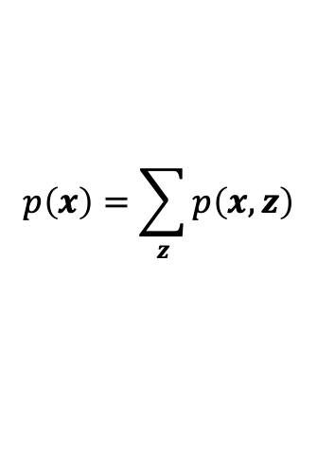

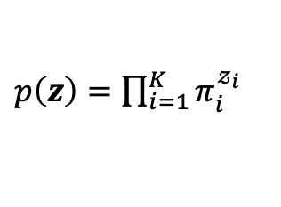
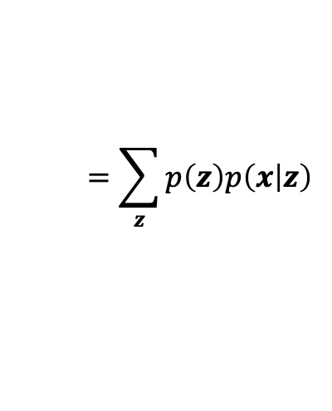


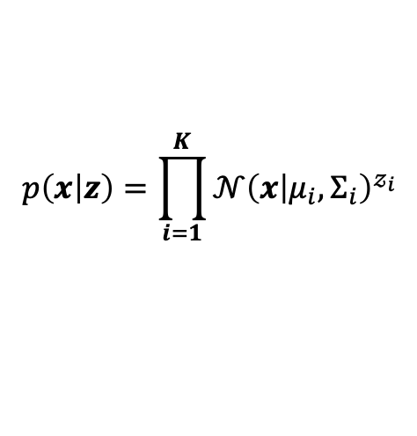
$$X= \left[\begin{matrix}−{ x}_{1}^{T}− \\ −{ x}_{2}^{T}− \\ \begin{aligned}⋮ \\ −{ x}_{N}^{T}−\end{aligned}\end{matrix}\right]=\left[\begin{matrix}x_{1,1} & x_{1,2} & ⋯ & x_{1,D} \\ x_{2,1} & x_{2,2} & ⋯ & x_{2,D} \\ ⋮ & ⋮ & ⋱ & ⋮ \\ x_{N,1} & x_{N,2} & ⋯ & x_{N,D}\end{matrix}\right]$$
$$Z= \left[\begin{matrix}−{ z}_{1}^{T}− \\ −{ z}_{2}^{T}− \\ \begin{aligned}⋮ \\ −{ z}_{N}^{T}−\end{aligned}\end{matrix}\right]=\left[\begin{matrix}𝓏_{1,1} & 𝓏_{1,2} & ⋯ & 𝓏_{1,K} \\ 𝓏_{2,1} & 𝓏_{2,2} & ⋯ & 𝓏_{2,K} \\ ⋮ & ⋮ & ⋱ & ⋮ \\ 𝓏_{N,1} & 𝓏_{N,2} & ⋯ & 𝓏_{N,K}\end{matrix}\right]$$
$$x_{n}={\left[x_{n,1},x_{n,2},⋯,x_{n,D}\right]}^{T}$$
$$z_{n}={\left[𝓏_{n,1},𝓏_{n,2},⋯,𝓏_{n,K}\right]}^{T}$$
$$x={\left[x_{1},x_{2},⋯,x_{D}\right]}^{T}$$
$$z={\left[𝓏_{1},𝓏_{2},⋯,𝓏_{K}\right]}^{T}$$
$$p\left(X\right)=p\left(x_{1},x_{2},⋯,x_{N}\right)$$
$$p\left(Z\right)=p\left(z_{1},z_{2},⋯,z_{K}\right)$$
$$p\left(x\right)=\sum_{z}{p\left(x,z\right)}$$
$$p\left(x | 𝓏_{i}\right)=𝒩\left(x | μ_{i},Σ_{i}\right)$$
$$=\sum_{z}{p\left(z\right)p\left(x | z\right)}$$
$$p\left(x | z\right)=\prod_{i=1}^{K}{{𝒩\left(x | μ_{i},Σ_{i}\right)}^{𝓏_{i}}}$$
$p\left(z\right)=\prod_{i=1}^{K}{π_{i}^{𝓏_{i}}}$

Slide 9


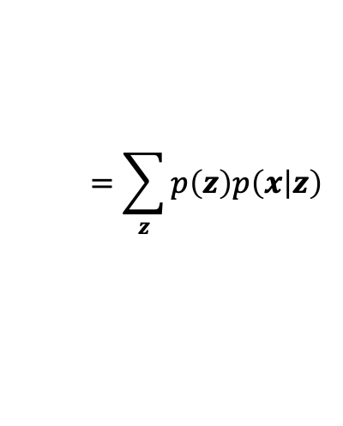

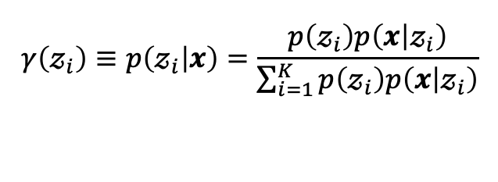
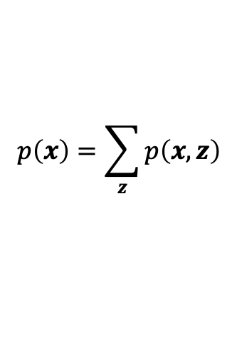

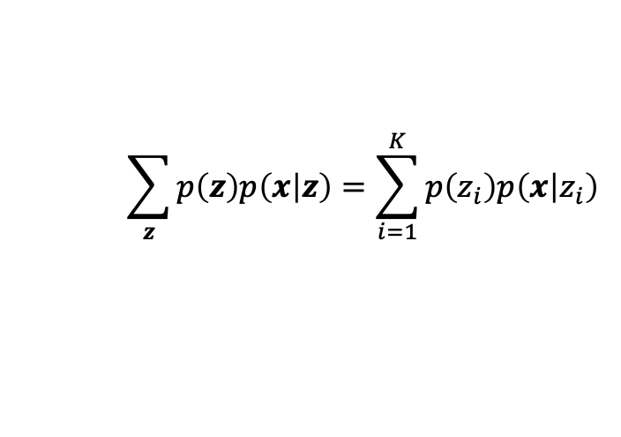


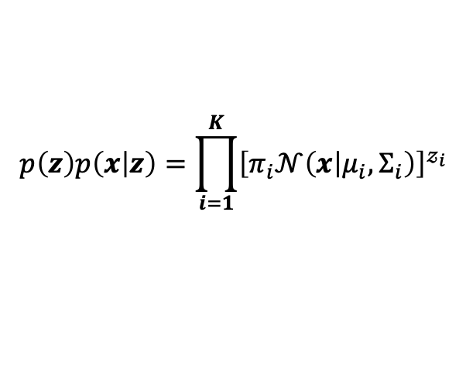
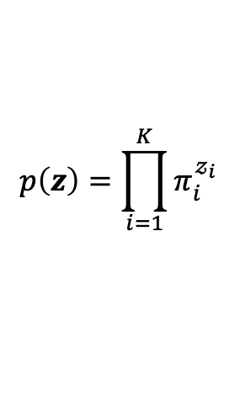


$$p\left(x\right)=\sum_{z}{p\left(x,z\right)}$$
$$p\left(x\right)=\sum_{i=1}^{K}{π_{i}}𝒩\left(x | μ_{i},Σ_{i}\right)$$
$$=\sum_{z}{p\left(z\right)p\left(x | z\right)}$$
$$γ\left(𝓏_{i}\right)≡p\left(𝓏_{i} | x\right)=\frac{p\left(𝓏_{i}\right)p\left(x | 𝓏_{i}\right)}{\sum_{i=1}^{K}{p\left(𝓏_{i}\right)p\left(x | 𝓏_{i}\right)}}$$
$$p\left(z\right)=\prod_{i=1}^{K}{π_{i}^{𝓏_{i}}}$$
$$p\left(x | 𝓏_{i}\right)=𝒩\left(x | μ_{i},Σ_{i}\right)$$
$$γ\left(𝓏_{i}\right)는관즉값 x를 ′설명′하는 데 있어서 i 성분이 어느정도의 책임을 가지고$$
$$p\left(𝓏_{i}\right)=π_{i}$$
$$p\left(x | z\right)=\prod_{i=1}^{K}{{𝒩\left(x | μ_{i},Σ_{i}\right)}^{𝓏_{i}}}$$
$$p\left(𝓏_{i}\right)p\left(x | 𝓏_{i}\right)=π_{i}𝒩\left(x | μ_{i},Σ_{i}\right)$$
$$z$$
$$p\left(z\right)p\left(x | z\right)=\prod_{i=1}^{K}{{\left[π_{i}𝒩\left(x | μ_{i},Σ_{i}\right)\right]}^{𝓏_{i}}}$$
$$\sum_{z}{p\left(z\right)p\left(x | z\right)}=\sum_{i=1}^{K}{p\left(z_{i}\right)p\left(x | z_{i}\right)}$$
$$x$$

Slide 10
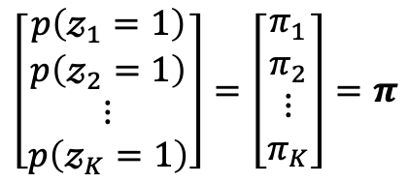

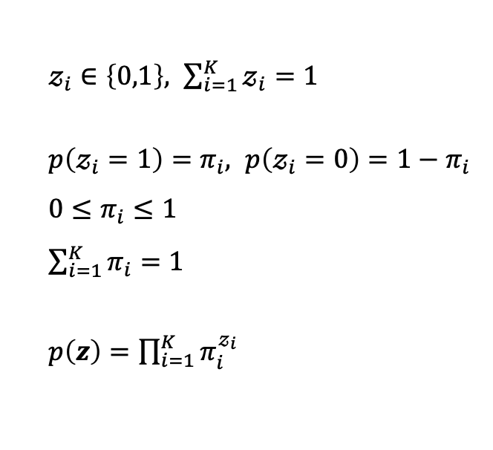
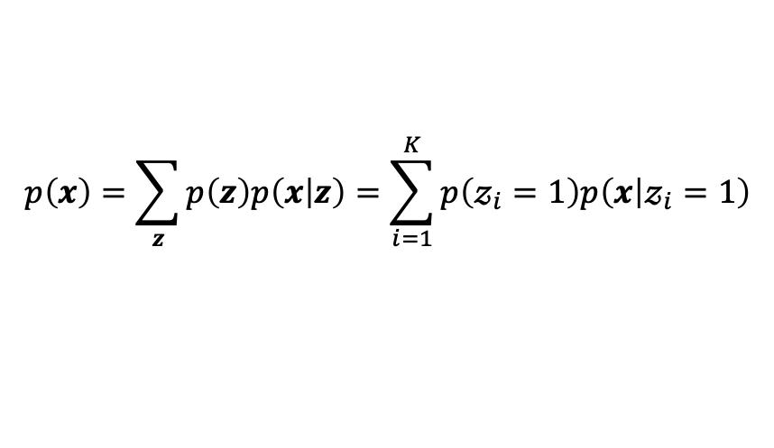
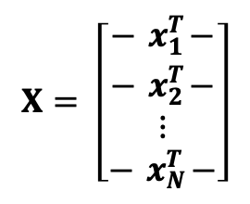
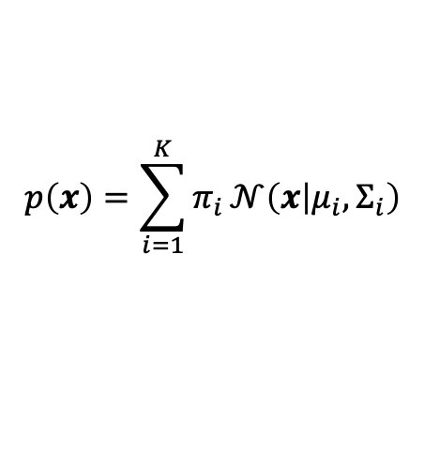
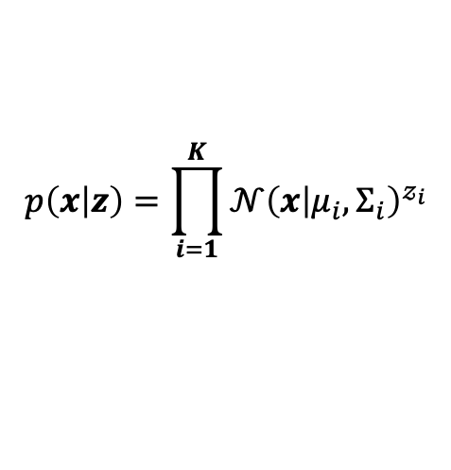

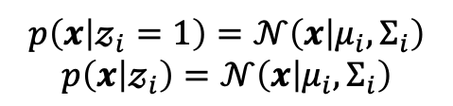
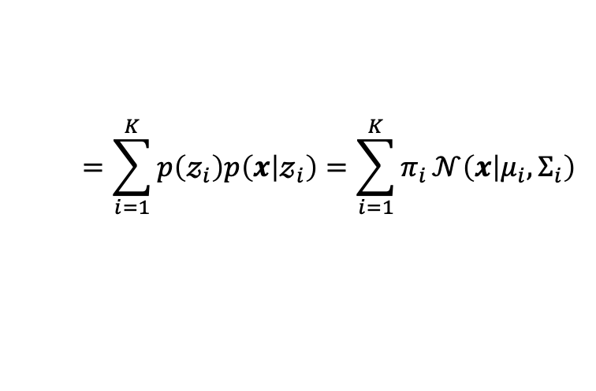

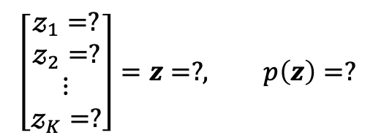
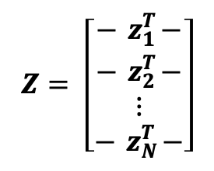
$$p\left(x\right)=\sum_{i=1}^{K}{π_{i}}𝒩\left(x | μ_{i},Σ_{i}\right)$$
$$X= \left[\begin{matrix}−{ x}_{1}^{T}− \\ −{ x}_{2}^{T}− \\ \begin{aligned}⋮ \\ −{ x}_{N}^{T}−\end{aligned}\end{matrix}\right]$$
$$Z= \left[\begin{matrix}−{ z}_{1}^{T}− \\ −{ z}_{2}^{T}− \\ \begin{aligned}⋮ \\ −{ z}_{N}^{T}−\end{aligned}\end{matrix}\right]$$
$𝓏_{i}∈\left\{0,1\right\}, \sum_{i=1}^{K}{𝓏_{i}}=1$
$p\left(𝓏_{i}=1\right)=π_{i}, p\left(𝓏_{i}=0\right)={1−π}_{i}$
$0≤π_{i}≤1$
$\sum_{i=1}^{K}{π_{i}}=1$
$p\left(z\right)=\prod_{i=1}^{K}{π_{i}^{𝓏_{i}}}$
$$x={\left[x_{1},x_{2},⋯,x_{D}\right]}^{T}$$
$$z={\left[𝓏_{1},𝓏_{2},⋯,𝓏_{K}\right]}^{T}$$
$$p\left(x,z\right)=p\left(x\right)p\left(x | z\right)$$
$$p\left(x | 𝓏_{i}=1\right)=𝒩\left(x | μ_{i},Σ_{i}\right)$$
$$p\left(x | 𝓏_{i}\right)=𝒩\left(x | μ_{i},Σ_{i}\right)$$
$$p\left(x | z\right)=\prod_{i=1}^{K}{{𝒩\left(x | μ_{i},Σ_{i}\right)}^{𝓏_{i}}}$$
$$\left[\begin{aligned}p\left(𝓏_{1}=1\right) \\ p\left(𝓏_{2}=1\right) \\ ⋮ \\ p\left(𝓏_{K}=1\right)\end{aligned}\right]=\left[\begin{aligned}π_{1} \\ π_{2} \\ ⋮ \\ π_{K}\end{aligned}\right]=π$$
$$p\left(x\right)=\sum_{z}{p\left(z\right)p\left(x | z\right)}=\sum_{i=1}^{K}{p\left(𝓏_{i}=1\right)p\left(x | 𝓏_{i}=1\right)}$$
$$\left[\begin{aligned}𝓏_{1}=? \\ 𝓏_{2}=? \\ ⋮ \\ 𝓏_{K}=?\end{aligned}\right]=z=?, p\left(z\right)=?$$
$$=\sum_{i=1}^{K}{p\left(𝓏_{i}\right)p\left(x | 𝓏_{i}\right)}=\sum_{i=1}^{K}{π_{i}}𝒩\left(x | μ_{i},Σ_{i}\right)$$

Slide 11
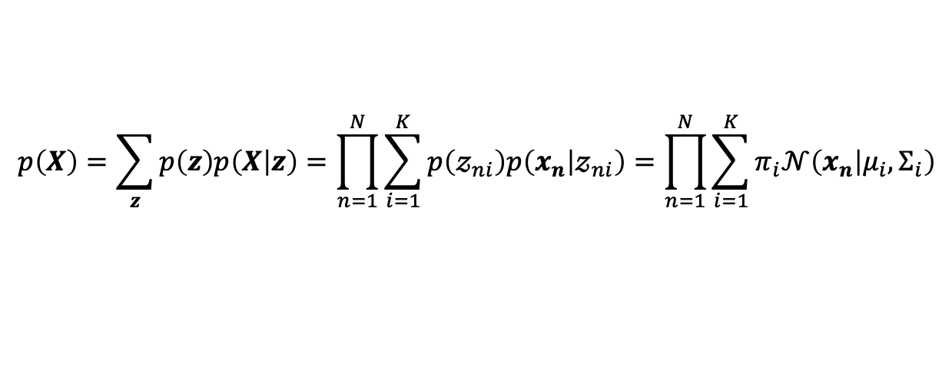
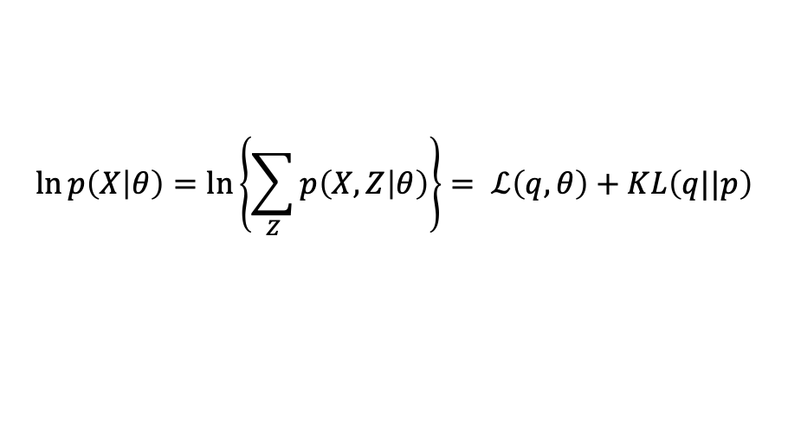
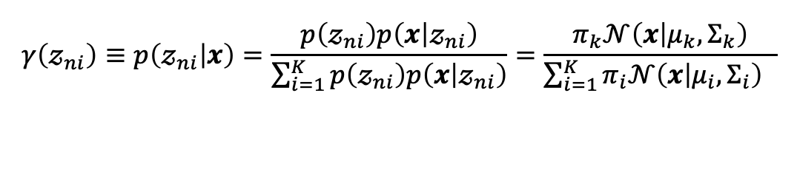

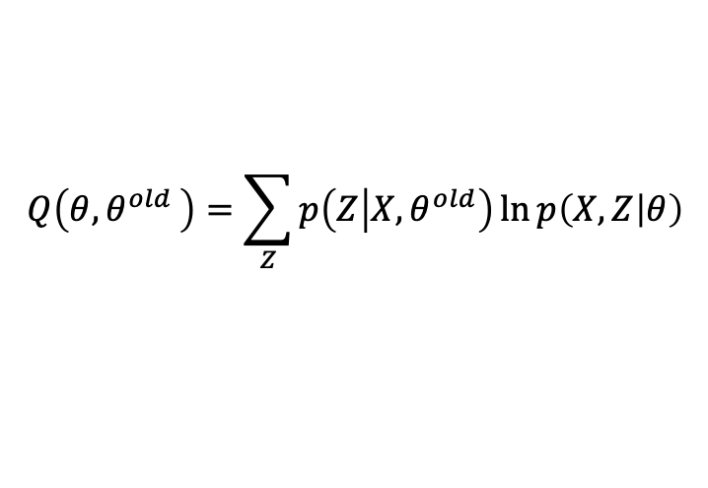

$$p\left(X\right)=\sum_{z}{p\left(z\right)p\left(X | z\right)}=\prod_{n=1}^{N}{\sum_{i=1}^{K}{p\left(𝓏_{ni}\right)p\left(x_{n} | 𝓏_{ni}\right)}}=\prod_{n=1}^{N}{\sum_{i=1}^{K}{π_{i}𝒩\left(x_{n} | μ_{i},Σ_{i}\right)}}$$
$$γ\left(𝓏_{ni}\right)≡p\left(𝓏_{ni} | x\right)=\frac{p\left(𝓏_{ni}\right)p\left(x | 𝓏_{ni}\right)}{\sum_{i=1}^{K}{p\left(𝓏_{ni}\right)p\left(x | 𝓏_{ni}\right)}}=\frac{π_{k}𝒩\left(x | μ_{k},Σ_{k}\right)}{\sum_{i=1}^{K}{π_{i}𝒩\left(x | μ_{i},Σ_{i}\right)} }$$
$$\ln{p\left(X | θ\right)}=\ln\left\{\sum_{Z}{p\left(X,Z | θ\right)}\right\}= ℒ\left(q,θ\right)+KL\left(q||p\right)$$
E-step
$$q\left(Z\right)=p\left(Z | X,θ^{old}\right)$$
M-step
$$θ^{new}=\underset{θ}{arg max}{Q\left(θ{,θ}^{old}\right) }$$
$$Q\left(θ{,θ}^{old}\right)=\sum_{Z}{p\left(Z | X,θ^{old}\right)\ln{p\left(X,Z | θ\right)}}$$

Slide 13
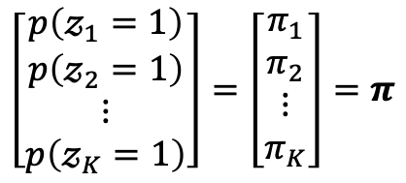
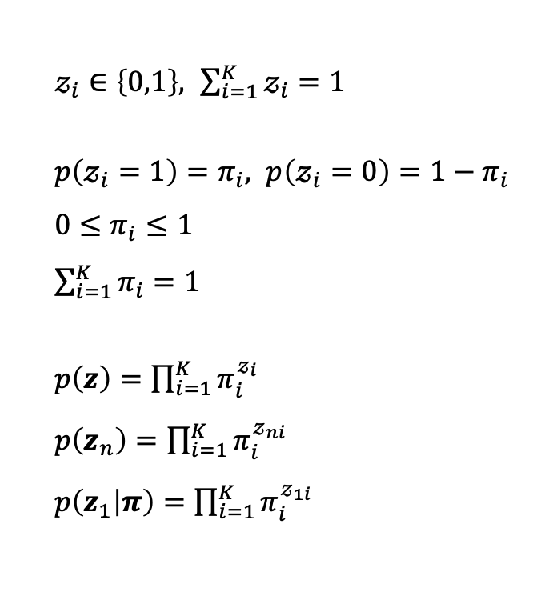

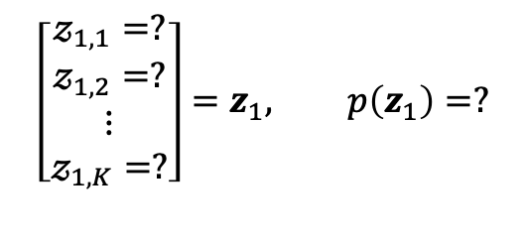
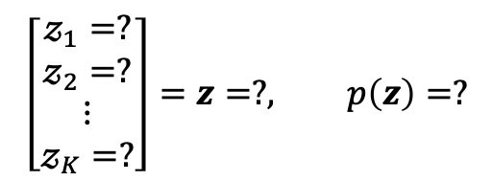
K차원의 이상 확률 변수 z
원 핫 인코딩
$π$ 초기 확률
$𝓏_{i}∈\left\{0,1\right\}, \sum_{i=1}^{K}{𝓏_{i}}=1$
$p\left(𝓏_{i}=1\right)=π_{i}, p\left(𝓏_{i}=0\right)={1−π}_{i}$
$0≤π_{i}≤1$
$\sum_{i=1}^{K}{π_{i}}=1$
$p\left(z\right)=\prod_{i=1}^{K}{π_{i}^{𝓏_{i}}}$
$p\left(z_{n}\right)=\prod_{i=1}^{K}{π_{i}^{𝓏_{ni}}}$
$p\left(z_{1} | π\right)=\prod_{i=1}^{K}{π_{i}^{𝓏_{1i}}}$
$$\left[\begin{aligned}p\left(𝓏_{1}=1\right) \\ p\left(𝓏_{2}=1\right) \\ ⋮ \\ p\left(𝓏_{K}=1\right)\end{aligned}\right]=\left[\begin{aligned}π_{1} \\ π_{2} \\ ⋮ \\ π_{K}\end{aligned}\right]=π$$
$$\left[\begin{aligned}𝓏_{1}=? \\ 𝓏_{2}=? \\ ⋮ \\ 𝓏_{K}=?\end{aligned}\right]=z=?, p\left(z\right)=?$$
$$\left[\begin{aligned}𝓏_{1,1}=? \\ 𝓏_{1,2}=? \\ ⋮ \\ 𝓏_{1,K}=?\end{aligned}\right]=z_{1}, p\left(z_{1}\right)=?$$

Slide 14
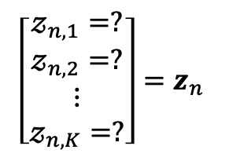
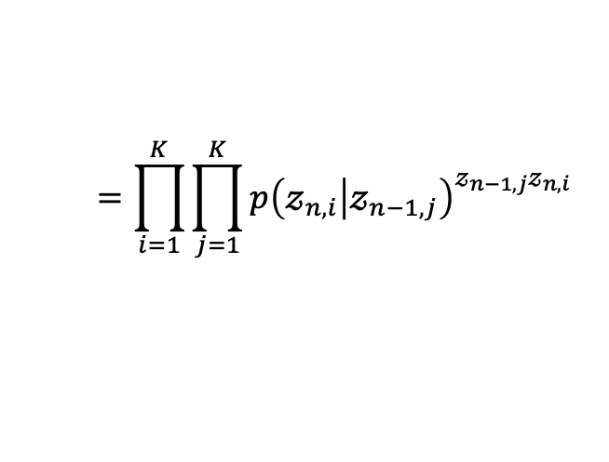
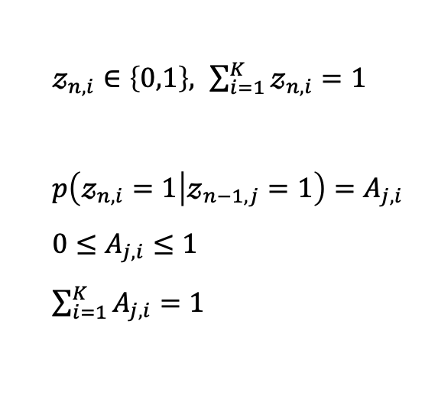
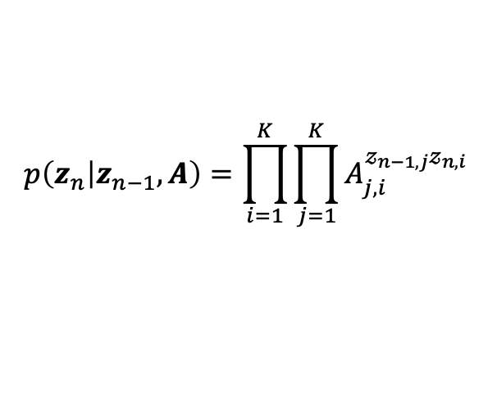


K차원의 이상 확률 변수 z
원 핫 인코딩
$A$ 상태 전이 확률
$𝓏_{n,i}∈\left\{0,1\right\}, \sum_{i=1}^{K}{𝓏_{n,i}}=1$
$p\left(𝓏_{n,i}=1 | 𝓏_{n−1,j}=1\right)=A_{j,i}$
$0≤A_{j,i}≤1$
$\sum_{i=1}^{K}{A_{j,i}}=1$
$$p\left(z_{n} | z_{n−1},A\right)=\prod_{i=1}^{K}{\prod_{j=1}^{K}{A_{j,i}^{𝓏_{n−1,j}𝓏_{n,i}}} }$$
$$\left[\begin{aligned}𝓏_{n,1}=? \\ 𝓏_{n,2}=? \\ ⋮ \\ 𝓏_{n,K}=?\end{aligned}\right]=z_{n}$$
$$=\prod_{i=1}^{K}{\prod_{j=1}^{K}{{p\left(𝓏_{n,i} | 𝓏_{n−1,j}\right)}^{𝓏_{n−1,j}𝓏_{n,i}}} }$$
$$A=\left[\begin{matrix}A_{1,1} & A_{1,2} & ⋯ & A_{1,i} & ⋯ & A_{1,K} \\ A_{2,1} & A_{2,2} & ⋯ & A_{2,i} & ⋯ & A_{2,K} \\ ⋮ & ⋮ & ⋱ & ⋮ & ⋱ & ⋮ \\ A_{j,1} & A_{j,2} & ⋯ & A_{j,i} & ⋯ & A_{j,K} \\ ⋮ & ⋮ & ⋱ & ⋮ & ⋱ & ⋮ \\ A_{K,1} & A_{K,2} & ⋯ & A_{K,i} & ⋯ & A_{K,K}\end{matrix}\right]=\left[\begin{matrix}p\left(𝓏_{n,1} | 𝓏_{n−1,1}\right) & p\left(𝓏_{n,2} | 𝓏_{n−1,1}\right) & ⋯ & p\left(𝓏_{n,i} | 𝓏_{n−1,1}\right) & ⋯ & p\left(𝓏_{n,K} | 𝓏_{n−1,1}\right) \\ p\left(𝓏_{n,1} | 𝓏_{n−1,2}\right) & p\left(𝓏_{n,2} | 𝓏_{n−1,2}\right) & ⋯ & p\left(𝓏_{n,i} | 𝓏_{n−1,2}\right) & ⋯ & p\left(𝓏_{n,K} | 𝓏_{n−1,2}\right) \\ ⋮ & ⋮ & ⋱ & ⋮ & ⋱ & ⋮ \\ p\left(𝓏_{n,1} | 𝓏_{n−1,j}\right) & p\left(𝓏_{n,2} | 𝓏_{n−1,j}\right) & ⋯ & p\left(𝓏_{n,i} | 𝓏_{n−1,j}\right) & ⋯ & p\left(𝓏_{n,K} | 𝓏_{n−1,j}\right) \\ ⋮ & ⋮ & ⋱ & ⋮ & ⋱ & ⋮ \\ p\left(𝓏_{n,1} | 𝓏_{n−1,K}\right) & p\left(𝓏_{n,2} | 𝓏_{n−1,K}\right) & ⋯ & p\left(𝓏_{n,i} | 𝓏_{n−1,K}\right) & ⋯ & p\left(𝓏_{n,K} | 𝓏_{n−1,K}\right)\end{matrix}\right]$$

Slide 15







K차원의 이상 확률 변수 z
원 핫 인코딩
$φ$ 방사 확률
$$\left[\begin{aligned}𝓏_{n,1}=? \\ 𝓏_{n,2}=? \\ ⋮ \\ 𝓏_{n,K}=?\end{aligned}\right]=z_{n}$$
$𝓏_{n,i}∈\left\{0,1\right\}, \sum_{i=1}^{K}{𝓏_{n,i}}=1$
$x_{n,i}∈\left\{0,1\right\}, \sum_{i=1}^{D}{x_{n,i}}=1$
$p\left(x_{n,i}=1 | 𝓏_{n,j}=1\right)=φ_{j,k}$
$0≤φ_{j,i}≤1$
$\sum_{i=1}^{D}{φ_{j,i}}=1$
$$p\left(x_{n} | z_{n},φ\right)=\prod_{i=1}^{D}{\prod_{j=1}^{K}{φ_{j,i}^{𝓏_{n,j}x_{n,i}}} }$$
$$\left[\begin{aligned}x_{n,1}=? \\ x_{n,2}=? \\ ⋮ \\ x_{n,D}=?\end{aligned}\right]=x_{n}$$
$$p\left(x_{n,i} | 𝓏_{n,j}\right)=φ_{j,i}$$
$$φ=\left[\begin{matrix}φ_{1,1} & φ_{1,2} & ⋯ & φ_{1,i} & ⋯ & φ_{1,D} \\ φ_{2,1} & φ_{2,2} & ⋯ & φ_{2,i} & ⋯ & φ_{2,D} \\ ⋮ & ⋮ & ⋱ & ⋮ & ⋱ & ⋮ \\ φ_{j,1} & φ_{j,2} & ⋯ & φ_{j,i} & ⋯ & φ_{j,D} \\ ⋮ & ⋮ & ⋱ & ⋮ & ⋱ & ⋮ \\ φ_{K,1} & φ_{K,2} & ⋯ & φ_{K,i} & ⋯ & φ_{K,D}\end{matrix}\right]=\left[\begin{matrix}p\left(x_{n,1} | 𝓏_{n,1}\right) & p\left(x_{n,2} | 𝓏_{n,1}\right) & ⋯ & p\left(x_{n,i} | 𝓏_{n,1}\right) & ⋯ & p\left(x_{n,D} | 𝓏_{n,1}\right) \\ p\left(x_{n,1} | 𝓏_{n,2}\right) & p\left(x_{n,2} | 𝓏_{n,2}\right) & ⋯ & p\left(x_{n,i} | 𝓏_{n,2}\right) & ⋯ & p\left(x_{n,D} | 𝓏_{n,2}\right) \\ ⋮ & ⋮ & ⋱ & ⋮ & ⋱ & ⋮ \\ p\left(x_{n,1} | 𝓏_{n,j}\right) & p\left(x_{n,2} | 𝓏_{n,j}\right) & ⋯ & p\left(x_{n,i} | 𝓏_{n,j}\right) & ⋯ & p\left(x_{n,D} | 𝓏_{n,j}\right) \\ ⋮ & ⋮ & ⋱ & ⋮ & ⋱ & ⋮ \\ p\left(x_{n,1} | 𝓏_{n,K}\right) & p\left(x_{n,2} | 𝓏_{n,K}\right) & ⋯ & p\left(x_{n,i} | 𝓏_{n,K}\right) & ⋯ & p\left(x_{n,D} | 𝓏_{n,K}\right)\end{matrix}\right]$$

Slide 16






K차원의 이상 확률 변수 z
원 핫 인코딩
$φ$ 방사 확률
$𝓏_{n,i}∈\left\{0,1\right\}, \sum_{i=1}^{K}{𝓏_{n,i}}=1$
$x_{n,i}∈\left\{0,1\right\}, \sum_{i=1}^{D}{x_{n,i}}=1$
$p\left(x_{n,i}=1 | 𝓏_{n,j}=1\right)=φ_{j,i}$
$0≤φ_{j,i}≤1$
$\sum_{i=1}^{D}{φ_{j,i}}=1$
$p\left(x_{n,i} | 𝓏_{n,j}\right)=φ_{j,i}$
$$p\left(x_{n} | z_{n},φ\right)=\prod_{i=1}^{D}{\prod_{j=1}^{K}{φ_{j,i}^{𝓏_{n,j}x_{n,i}}} }$$
$$\left[\begin{aligned}𝓏_{n,1}=? \\ 𝓏_{n,2}=? \\ ⋮ \\ 𝓏_{n,K}=?\end{aligned}\right]=z_{n}$$
$$\prod_{j=1}^{K}{{p\left(x_{n} | φ_{j}\right)}^{𝓏_{n,j}}}$$
$$\left[\begin{aligned}x_{n,1}=? \\ x_{n,2}=? \\ ⋮ \\ x_{n,D}=?\end{aligned}\right]=x_{n}$$
$p\left(x_{n} | 𝓏_{n,j}=1\right)=φ_{j}$
$0≤φ_{j}≤1$
$$φ=\left[\begin{aligned}φ_{1} \\ φ_{2} \\ ⋮ \\ φ_{K}\end{aligned}\right]=\left[\begin{aligned}p\left(x_{n} | 𝓏_{n,1}\right) \\ p\left(x_{n} | 𝓏_{n,2}\right) \\ ⋮ \\ p\left(x_{n} | 𝓏_{n,K}\right)\end{aligned}\right]$$

Slide 17















$$z_{1}$$
$$z_{2}$$
$$z_{3}$$
$$z_{i}$$
$$z_{i+1}$$
$$p\left(z_{1}\right)p\left(z_{2} | z_{1}\right)p\left(z_{3} | z_{2}\right)⋯p\left(z_{i+1} | z_{i}\right)⋯p\left(z_{N} | z_{N−1}\right)$$
$$x_{1}$$
$$x_{2}$$
$$x_{3}$$
$$x_{i}$$
$$x_{i+1}$$
$$p\left(x_{1} | z_{1}\right)p\left(x_{2} | z_{2}\right)⋯p\left(x_{i} | z_{i}\right)⋯p\left(x_{N} | z_{N}\right)$$
$$p\left({x_{1},⋯,x_{N},z}_{1},⋯,z_{N}\right)=p\left(z_{1}\right)\left[\prod_{i=2}^{N}{p\left(z_{i} | z_{i−1}\right)}\right]\left[\prod_{i=1}^{N}{p\left(x_{i} | z_{i}\right)}\right]$$
$$p\left(X,Z\right)=p\left(z_{1}\right)\left[\prod_{i=2}^{N}{p\left(z_{i} | z_{i−1}\right)}\right]\left[\prod_{j=1}^{N}{p\left(x_{j} | z_{j}\right)}\right]$$
$$p\left(X,Z | θ\right)=p\left(z_{1} | π\right)\left[\prod_{i=2}^{N}{p\left(z_{i} | z_{i−1},A\right)}\right]\left[\prod_{j=1}^{N}{p\left(x_{j} | z_{j},φ\right)}\right]$$
$$θ=\left\{π,A,φ\right\}$$

Slide 18
















HMM EM 알고리즘
$$z_{1}$$
$$z_{2}$$
$$z_{3}$$
$$z_{i}$$
$$z_{i+1}$$
$$\ln{p\left(X | θ\right)=}\sum_{n=1}^{N}{\ln{p\left(x_{n} | θ\right)}}=\sum_{n=1}^{N}{\ln{\sum_{z_{n}}{p\left(x_{n},z_{n} | θ\right)}}}$$
$$x_{1}$$
$$x_{2}$$
$$x_{3}$$
$$x_{i}$$
$$x_{i+1}$$
$$=\sum_{n=1}^{N}{\sum_{z_{n}}{q\left(z_{n}\right)\ln\left\{\frac{p\left(x_{n},z_{n} | θ\right)}{q\left(z_{n}\right)}\right\}}}−\sum_{z_{n}}{\sum_{n=1}^{N}{q\left(z_{n}\right)\ln\left\{\frac{p\left(z_{n} | x_{n},θ\right)}{q\left(z_{n}\right)}\right\}}}$$
$$p\left(X,Z\right)=p\left(z_{1}\right)\left[\prod_{i=2}^{N}{p\left(z_{i} | z_{i−1}\right)}\right]\left[\prod_{j=1}^{N}{p\left(x_{j} | z_{j}\right)}\right]$$
$$ln\left\{\sum_{Z}{p\left(X,Z | θ\right)}\right\}{=\ln\left\{\sum_{Z}{p\left(x_{1},x_{2},⋯,x_{N},z_{1},z_{2},⋯,z_{N} | θ\right)}\right\}}$$
$$=\ln\left\{\sum_{z_{1}}{\sum_{z_{2}}{⋯\sum_{z_{N}}{p\left(x_{1},x_{2},⋯,x_{N},z_{1},z_{2},⋯,z_{N} | θ\right)}}}\right\}$$
$$\ln{p\left(X,Z\right)}=\ln{p\left(z_{1}\right)}+\sum_{i=2}^{N}{\ln{p\left(z_{i} | z_{i−1}\right)}}+\sum_{j=1}^{N}{\ln{p\left(x_{j} | z_{j}\right)}}$$

Slide 19




HMM EM 알고리즘
$$z_{1}$$
$$z_{2}$$
$$z_{3}$$
$$z_{i}$$
$$z_{i+1}$$
$$x_{1}$$
$$x_{2}$$
$$x_{3}$$
$$x_{i}$$
$$x_{i+1}$$
$$p\left(X,Z\right)=p\left(z_{1}\right)\left[\prod_{i=2}^{N}{p\left(z_{i} | z_{i−1}\right)}\right]\left[\prod_{j=1}^{N}{p\left(x_{j} | z_{j}\right)}\right]$$
$$ln\left\{\sum_{Z}{p\left(X,Z | θ\right)}\right\}{=\ln\left\{\sum_{Z}{p\left(x_{1},x_{2},⋯,x_{N},z_{1},z_{2},⋯,z_{N} | θ\right)}\right\}}=\ln\left\{\sum_{z_{1}}{\sum_{z_{2}}{⋯\sum_{z_{N}}{p\left(x_{1},x_{2},⋯,x_{N},z_{1},z_{2},⋯,z_{N} | θ\right)}}}\right\}$$
$$Q\left(θ{,θ}^{old}\right)=\sum_{Z}{p\left(Z | X,θ^{old}\right)\ln{p\left(X,Z | θ\right)}}$$
$$Q\left(θ{,θ}^{old}\right)=\sum_{z_{1}}{\sum_{z_{2}}{⋯\sum_{z_{N}}{p\left(Z | X,θ^{old}\right)\ln\left\{p\left(z_{1} | θ\right)\left[\prod_{i=2}^{N}{p\left(z_{i} | z_{i−1},θ\right)}\right]\left[\prod_{j=1}^{N}{p\left(x_{j} | z_{j},θ\right)}\right]\right\}}}}$$

Slide 20






HMM EM 알고리즘
$$z_{1}$$
$$z_{2}$$
$$z_{3}$$
$$z_{i}$$
$$z_{i+1}$$
$$γ\left(z_{n}\right)=p\left(z_{n} | X,θ^{old}\right)$$
$$x_{1}$$
$$x_{2}$$
$$x_{3}$$
$$x_{i}$$
$$x_{i+1}$$
$$ξ\left(z_{n−1},z_{n}\right)=p\left(z_{n−1},z_{n} | X,θ^{old}\right)$$
$$Q\left(θ{,θ}^{old}\right)=\sum_{z_{1}}{\sum_{z_{2}}{⋯\sum_{z_{N}}{p\left(z_{1},z_{2},⋯,z_{N} | X,θ^{old}\right)\ln\left\{p\left(z_{1} | θ\right)\left[\prod_{i=2}^{N}{p\left(z_{i} | z_{i−1},θ\right)}\right]\left[\prod_{j=1}^{N}{p\left(x_{j} | z_{j},θ\right)}\right]\right\}}}}$$
$$=\sum_{z_{1}}{\sum_{z_{2}}{⋯\sum_{z_{N}}{p\left(z_{1},z_{2},⋯,z_{N} | X,θ^{old}\right)\left\{\ln{p\left(z_{1} | θ\right)}+\sum_{i=2}^{N}{\ln{p\left(z_{i} | z_{i−1},θ\right)}}+\sum_{j=1}^{N}{\ln{p\left(x_{j} | z_{j},θ\right)}}\right\}}}}$$
$$=\sum_{z_{1}}{\sum_{z_{2}}{⋯\sum_{z_{N}}{p\left(z_{1},z_{2},⋯,z_{N} | X,θ^{old}\right)\ln{p\left(z_{1} | θ\right)}}}}+\sum_{z_{1}}{\sum_{z_{2}}{⋯\sum_{z_{N}}{p\left(z_{1},z_{2},⋯,z_{N} | X,θ^{old}\right)\sum_{i=2}^{N}{\ln{p\left(z_{i} | z_{i−1},θ\right)}}}}}$$
$$+\sum_{z_{1}}{\sum_{z_{2}}{⋯\sum_{z_{N}}{p\left(z_{1},z_{2},⋯,z_{N} | X,θ^{old}\right)\sum_{j=1}^{N}{\ln{p\left(x_{j} | z_{j},θ\right)}}}}}$$

Slide 21



$$\sum_{z_{1}}{\sum_{z_{2}}{⋯\sum_{z_{N}}{p\left(z_{1},z_{2},⋯,z_{N} | X,θ^{old}\right)\ln{p\left(z_{1} | θ\right)}}}}$$
$$=\sum_{z_{1}}{\ln{p\left(z_{1} | θ\right)}\sum_{z_{2}}{⋯\sum_{z_{N}}{p\left(z_{1},z_{2},⋯,z_{N} | X,θ^{old}\right)}}}$$
$$=\sum_{z_{1}}{p\left(z_{1} | X,θ^{old}\right)\ln{p\left(z_{1} | θ\right)}}$$

Slide 22






$$\sum_{z_{1}}{\sum_{z_{2}}{⋯\sum_{z_{N}}{p\left(z_{1},z_{2},⋯,z_{N} | X,θ^{old}\right)\sum_{i=2}^{N}{\ln{p\left(z_{i} | z_{i−1},θ\right)}}}}}$$
$$=\sum_{z_{1}}{\sum_{z_{2}}{⋯\sum_{z_{N}}{p\left(z_{1},z_{2},⋯,z_{N} | X,θ^{old}\right)\left\{\ln{p\left(z_{2} | z_{1},θ\right)}+\ln{p\left(z_{3} | z_{2},θ\right)}+⋯+\ln{p\left(z_{N} | z_{N−1},θ\right)}\right\}}}}$$
$$=\sum_{z_{1}}{\sum_{z_{2}}{⋯\sum_{z_{N}}{p\left(z_{1},z_{2},⋯,z_{N} | X,θ^{old}\right)\ln{p\left(z_{2} | z_{1},θ\right)}}}}+⋯+\sum_{z_{1}}{\sum_{z_{2}}{⋯\sum_{z_{N}}{p\left(z_{1},z_{2},⋯,z_{N} | X,θ^{old}\right)\ln{p\left(z_{N} | z_{N−1},θ\right)}}}}$$
$$=\sum_{z_{1}}{\sum_{z_{2}}{p\left(z_{1},z_{2} | X,θ^{old}\right)\ln{p\left(z_{2} | z_{1},θ\right)}}}+\sum_{z_{2}}{\sum_{z_{3}}{p\left(z_{2},z_{3} | X,θ^{old}\right)\ln{p\left(z_{3} | z_{2},θ\right)}}}+$$
$$⋯+\sum_{z_{N−1}}{\sum_{z_{N}}{p\left(z_{N−1},z_{N} | X,θ^{old}\right)\ln{p\left(z_{N} | z_{N−1},θ\right)}}}$$
$$=\sum_{n=2}^{N}{\sum_{z_{n−1}}{\sum_{z_{n}}{p\left(z_{n−1},z_{n} | X,θ^{old}\right)\ln{p\left(z_{n} | z_{n−1},θ\right)}}}}$$

Slide 23





$$\sum_{z_{1}}{\sum_{z_{2}}{⋯\sum_{z_{N}}{p\left(z_{1},z_{2},⋯,z_{N} | X,θ^{old}\right)\sum_{j=1}^{N}{\ln{p\left(x_{j} | z_{j},θ\right)}}}}}$$
$$=\sum_{z_{1}}{\sum_{z_{2}}{⋯\sum_{z_{N}}{p\left(z_{1},z_{2},⋯,z_{N} | X,θ^{old}\right)\left\{\ln{p\left(x_{1} | z_{1},θ\right)}+\ln{p\left(x_{2} | z_{2},θ\right)}+⋯+\ln{p\left(x_{N} | z_{N},θ\right)}\right\}}}}$$
$$=\sum_{z_{1}}{\sum_{z_{2}}{⋯\sum_{z_{N}}{p\left(z_{1},z_{2},⋯,z_{N} | X,θ^{old}\right)\ln{p\left(x_{1} | z_{1},θ\right)}}}}+⋯+\sum_{z_{1}}{\sum_{z_{2}}{⋯\sum_{z_{N}}{p\left(z_{1},z_{2},⋯,z_{N} | X,θ^{old}\right)\ln{p\left(x_{N} | z_{N},θ\right)}}}}$$
$$=\sum_{z_{1}}{p\left(z_{1} | X,θ^{old}\right)\ln{p\left(x_{1} | z_{1},θ\right)}}+\sum_{z_{2}}{p\left(z_{2} | X,θ^{old}\right)\ln{p\left(x_{2} | z_{2},θ\right)}}+⋯+\sum_{z_{N}}{p\left(z_{N} | X,θ^{old}\right)\ln{p\left(x_{N} | z_{N},θ\right)}}$$
$$=\sum_{n=1}^{N}{\sum_{z_{n}}{p\left(z_{n} | X,θ^{old}\right)\ln{p\left(x_{n} | z_{n},θ\right)}}}$$

Slide 24





HMM EM 알고리즘
$$z_{1}$$
$$z_{2}$$
$$z_{3}$$
$$z_{i}$$
$$z_{i+1}$$
$$γ\left(z_{n}\right)=p\left(z_{n} | X,θ^{old}\right)$$
$$x_{1}$$
$$x_{2}$$
$$x_{3}$$
$$x_{i}$$
$$x_{i+1}$$
$$ξ\left(z_{n−1},z_{n}\right)=p\left(z_{n−1},z_{n} | X,θ^{old}\right)$$
$$Q\left(θ{,θ}^{old}\right)=\sum_{z_{1}}{\sum_{z_{2}}{⋯\sum_{z_{N}}{p\left(z_{1},z_{2},⋯,z_{N} | X,θ^{old}\right)\ln\left\{p\left(z_{1} | θ\right)\left[\prod_{i=2}^{N}{p\left(z_{i} | z_{i−1},θ\right)}\right]\left[\prod_{j=1}^{N}{p\left(x_{j} | z_{j},θ\right)}\right]\right\}}}}$$
$$=\sum_{z_{1}}{p\left(z_{1} | X,θ^{old}\right)\ln{p\left(z_{1} | θ\right)}}+\sum_{n=2}^{N}{\sum_{z_{n−1}}{\sum_{z_{n}}{p\left(z_{n−1},z_{n} | X,θ^{old}\right)\ln{p\left(z_{n} | z_{n−1},θ\right)}}}}+\sum_{n=1}^{N}{\sum_{z_{n}}{p\left(z_{n} | X,θ^{old}\right)\ln{p\left(x_{n} | z_{n},θ\right)}}}$$
$$=\sum_{z_{1}}{γ\left(z_{1}\right)\ln{p\left(z_{1} | θ\right)}}+\sum_{n=2}^{N}{\sum_{z_{n−1}}{\sum_{z_{n}}{ξ\left(z_{n−1},z_{n}\right)\ln{p\left(z_{n} | z_{n−1},θ\right)}}}}+\sum_{n=1}^{N}{\sum_{z_{n}}{γ\left(z_{n}\right)\ln{p\left(x_{n} | z_{n},θ\right)}}}$$

Slide 25





HMM EM 알고리즘
$$z_{1}$$
$$z_{2}$$
$$z_{3}$$
$$z_{i}$$
$$z_{i+1}$$
$$γ\left(z_{n}\right)=p\left(z_{n} | X,θ^{old}\right)$$
$$x_{1}$$
$$x_{2}$$
$$x_{3}$$
$$x_{i}$$
$$x_{i+1}$$
$$ξ\left(z_{n−1},z_{n}\right)=p\left(z_{n−1},z_{n} | X,θ^{old}\right)$$
$$p\left(z_{1} | π\right)=\prod_{i=1}^{K}{π_{i}^{𝓏_{ni}}}$$
$$p\left(z_{n} | z_{n−1},A\right)=\prod_{i=1}^{K}{\prod_{j=1}^{K}{A_{j,i}^{𝓏_{n−1,j}𝓏_{n,i}}} }$$
$$p\left(x_{n} | z_{n},φ\right)=\prod_{i=1}^{K}{{p\left(x_{n} | φ_{i}\right)}^{𝓏_{n,i}}}$$
$$Q\left(θ{,θ}^{old}\right)=\sum_{z_{1}}{γ\left(z_{1}\right)\ln{p\left(z_{1} | θ\right)}}+\sum_{n=2}^{N}{\sum_{z_{n−1}}{\sum_{z_{n}}{ξ\left(z_{n−1},z_{n}\right)\ln{p\left(z_{n} | z_{n−1},θ\right)}}}}+\sum_{n=1}^{N}{\sum_{z_{n}}{γ\left(z_{n}\right)\ln{p\left(x_{n} | z_{n},θ\right)}}}$$
$$=\sum_{i=1}^{K}{\left\{\sum_{z_{1}}{γ\left(z_{1}\right)𝓏_{1i}}\right\}\ln{π_{i}}}+\sum_{n=2}^{N}{\sum_{i=1}^{K}{\sum_{j=1}^{K}{\left\{\sum_{z_{n−1}}{\sum_{z_{n}}{ξ\left(z_{n−1},z_{n}\right)𝓏_{n−1,j}𝓏_{n,i}}}\right\}}\ln{A_{j,i}}}}+\sum_{n=1}^{N}{\sum_{i=1}^{K}{\left\{\sum_{z_{n}}{γ\left(z_{n}\right)𝓏_{n,i}}\right\}}\ln{p\left(x_{n} | φ_{i}\right)}}$$

Slide 26




HMM EM 알고리즘
$$z_{1}$$
$$z_{2}$$
$$z_{3}$$
$$z_{i}$$
$$z_{i+1}$$
$$γ \left(𝓏_{n,i}\right)=𝔼\left[𝓏_{n,i}\right]=\sum_{z_{n}}{γ\left(z_{n}\right)𝓏_{n,i}}$$
$$x_{1}$$
$$x_{2}$$
$$x_{3}$$
$$x_{i}$$
$$x_{i+1}$$
$$ξ\left(𝓏_{n−1,j}𝓏_{n,i}\right)=𝔼\left[𝓏_{n−1,j}𝓏_{n,i}\right]=\sum_{z_{n−1}}{\sum_{z_{n}}{ξ\left(z_{n−1},z_{n}\right)𝓏_{n−1,j}𝓏_{n,i}}}$$
$$Q\left(θ{,θ}^{old}\right)=\sum_{i=1}^{K}{\left\{\sum_{z_{1}}{γ\left(z_{1}\right)𝓏_{1i}}\right\}\ln{π_{i}}}+\sum_{n=2}^{N}{\sum_{i=1}^{K}{\sum_{j=1}^{K}{\left\{\sum_{z_{n−1}}{\sum_{z_{n}}{ξ\left(z_{n−1},z_{n}\right)𝓏_{n−1,j}𝓏_{n,i}}}\right\}}\ln{A_{j,i}}}}+\sum_{n=1}^{N}{\sum_{i=1}^{K}{\left\{\sum_{z_{n}}{γ\left(z_{n}\right)𝓏_{n,i}}\right\}}\ln{p\left(x_{n} | φ_{i}\right)}}$$
$$=\sum_{i=1}^{K}{γ \left(𝓏_{1,i}\right)\ln{π_{i}}}+\sum_{n=2}^{N}{\sum_{i=1}^{K}{\sum_{j=1}^{K}{ξ\left(𝓏_{n−1,j}𝓏_{n,i}\right)}\ln{A_{j,i}}}}+\sum_{n=1}^{N}{\sum_{i=1}^{K}{γ \left(𝓏_{n,i}\right)}\ln{p\left(x_{n} | φ_{i}\right)}}$$

Slide 27





HMM EM 알고리즘
$$z_{1}$$
$$z_{2}$$
$$z_{3}$$
$$z_{i}$$
$$z_{i+1}$$
$$p\left(X,Z | θ\right)=p\left(z_{1} | π\right)\left[\prod_{i=2}^{N}{p\left(z_{i} | z_{i−1},A\right)}\right]\left[\prod_{j=1}^{N}{p\left(x_{j} | z_{j},φ\right)}\right]$$
$$x_{1}$$
$$x_{2}$$
$$x_{3}$$
$$x_{i}$$
$$x_{i+1}$$
$$θ=\left\{π,A,φ\right\}$$
$$γ \left(𝓏_{n,i}\right)=𝔼\left[𝓏_{n,i}\right]=\sum_{z_{n}}{γ\left(z_{n}\right)𝓏_{n,i}}=p\left(𝓏_{n,i} | X,θ^{old}\right)$$
E-step :
$$ξ\left(𝓏_{n−1,j},𝓏_{n,i}\right)=𝔼\left[𝓏_{n−1,j},𝓏_{n,i}\right]=\sum_{z_{n−1}}{\sum_{z_{n}}{ξ\left(z_{n−1},z_{n}\right)𝓏_{n−1,j}𝓏_{n,i}=p\left(𝓏_{n−1,j},𝓏_{n,i} | X,θ^{old}\right)}}$$
$$Q\left(θ{,θ}^{old}\right)=\sum_{i=1}^{K}{γ \left(𝓏_{1,i}\right)\ln{π_{i}}}+\sum_{n=2}^{N}{\sum_{i=1}^{K}{\sum_{j=1}^{K}{ξ\left(𝓏_{n−1,j}𝓏_{n,i}\right)}\ln{A_{j,i}}}}+\sum_{n=1}^{N}{\sum_{i=1}^{K}{γ \left(𝓏_{n,i}\right)}\ln{p\left(x_{n} | φ_{i}\right)}}$$
M-step :

Slide 28









알파 베타 알고리즘
$$z_{i}$$
$$z_{i+1}$$
$$z_{1}$$
$$z_{2}$$
$$z_{3}$$
$$c는 머리 대 꼬리(head−to−tail) 노드$$
$$p\left(a,b | c\right)=\frac{p\left(a, b, c\right)}{p\left(c\right)}=\frac{p\left(b | c\right)p\left(c | a\right)p\left(a\right)}{p\left(c\right)}$$
$$x_{1}$$
$$x_{2}$$
$$x_{3}$$
$$x_{i}$$
$$x_{i+1}$$
$$= p\left(a | c\right)p\left(b | c\right)$$
$$a$$
$$c$$
$$b$$
$$p\left(x_{1},x_{2},⋯,x_{n},x_{n+1}⋯,x_{N} | z_{n}\right)=p\left(x_{1},x_{2},⋯,x_{n} | z_{n}\right)p\left(x_{n+1}⋯,x_{N} | z_{n}\right)$$
$$γ\left(z_{n}\right)=p\left(z_{n} | X \right)=\frac{p\left(X | z_{n}\right)p\left(z_{n}\right)}{p\left(X\right)}=\frac{p\left(x_{1},x_{2},⋯,x_{n} | z_{n}\right)p\left(x_{n+1}⋯,x_{N} | z_{n}\right)p\left(z_{n}\right)}{p\left(X\right)}$$
$$=\frac{p\left(x_{1},x_{2},⋯,x_{n},z_{n}\right)p\left(x_{n+1}⋯,x_{N} | z_{n}\right)}{p\left(X\right)}=\frac{α\left(z_{n}\right)β\left(z_{n}\right)}{p\left(X\right)}$$
$$α\left(z_{n}\right)≡p\left(x_{1},x_{2},⋯,x_{n},z_{n}\right)$$
$$β\left(z_{n}\right)≡p\left(x_{n+1}⋯,x_{N} | z_{n}\right)$$

Slide 29











알파 베타 알고리즘
$$z_{i}$$
$$z_{i+1}$$
$$z_{1}$$
$$z_{2}$$
$$z_{3}$$
$$α\left(z_{n}\right)≡p\left(x_{1},x_{2},⋯,x_{n},z_{n}\right)$$
$$β\left(z_{n}\right)≡p\left(x_{n+1}⋯,x_{N} | z_{n}\right)$$
$$x_{1}$$
$$x_{2}$$
$$x_{3}$$
$$x_{i}$$
$$x_{i+1}$$
$$γ\left(z_{n}\right)=p\left(z_{n} | X \right)=\frac{p\left(X | z_{n}\right)p\left(z_{n}\right)}{p\left(X\right)}==\frac{α\left(z_{n}\right)β\left(z_{n}\right)}{p\left(X\right)}$$
$$=p\left(x_{n} | z_{n}\right)\sum_{z_{n−1}}{p\left(x_{1},x_{2},⋯,x_{n−1},z_{n−1} \right)p\left(z_{n} | z_{n−1}\right)}$$
$$α\left(z_{n}\right)=p\left(x_{1},x_{2},⋯,x_{n},z_{n}\right)$$
$$=p\left(x_{1},x_{2},⋯,x_{n} | z_{n}\right)p\left(z_{n}\right)$$
$$α\left(z_{n}\right)=p\left(x_{n} | z_{n}\right)\sum_{z_{n−1}}{α\left(z_{n−1}\right)p\left(z_{n} | z_{n−1}\right)}$$
$$=p\left(x_{n} | z_{n}\right)p\left(x_{1},x_{2},⋯,x_{n−1} | z_{n}\right)p\left(z_{n}\right)→d분리이용$$
$$=p\left(x_{n} | z_{n}\right)p\left(x_{1},x_{2},⋯,x_{n−1},z_{n}\right)$$
$$=p\left(x_{n} | z_{n}\right)\sum_{z_{n−1}}{p\left(x_{1},x_{2},⋯,x_{n−1},z_{n−1},z_{n}\right)}$$
$$=p\left(x_{n} | z_{n}\right)\sum_{z_{n−1}}{p\left(x_{1},x_{2},⋯,x_{n−1},z_{n} | z_{n−1}\right)p\left(z_{n−1}\right)}$$
$$=p\left(x_{n} | z_{n}\right)\sum_{z_{n−1}}{p\left(x_{1},x_{2},⋯,x_{n−1} | z_{n−1}\right)p\left(z_{n} | z_{n−1}\right)p\left(z_{n−1}\right)}→d분리이용$$

Slide 30

















알파 베타 알고리즘
$$z_{i}$$
$$z_{i+1}$$
$$z_{1}$$
$$z_{2}$$
$$z_{3}$$
$$α\left(z_{n}\right)≡p\left(x_{1},x_{2},⋯,x_{n},z_{n}\right)$$
$$β\left(z_{n}\right)≡p\left(x_{n+1}⋯,x_{N} | z_{n}\right)$$
$$x_{1}$$
$$x_{2}$$
$$x_{3}$$
$$x_{i}$$
$$x_{i+1}$$
$$γ\left(z_{n}\right)=p\left(z_{n} | X \right)=\frac{p\left(X | z_{n}\right)p\left(z_{n}\right)}{p\left(X\right)}=\frac{α\left(z_{n}\right)β\left(z_{n}\right)}{p\left(X\right)}$$
$$α\left(z_{n}\right)=p\left(x_{n} | z_{n}\right)\sum_{z_{n−1}}{α\left(z_{n−1}\right)p\left(z_{n} | z_{n−1}\right)}$$
$$α\left(𝓏_{n−1,1}\right)$$
$$p\left(𝓏_{n,1} | 𝓏_{n−1,1}\right)$$
$$p\left(x_{n} | 𝓏_{n,1}\right)$$
$$α\left(𝓏_{n,1}\right)$$
$$α\left(z_{1}\right)=p\left(x_{1}, z_{1}\right)$$
$$p\left(𝓏_{n,1} | 𝓏_{n−1,2}\right)$$
$$α\left(𝓏_{n,i}\right)=p\left(x_{n} | 𝓏_{n,i}\right)\sum_{j=1}^{K}{α\left(𝓏_{n−1,j}\right)p\left(𝓏_{n,i} | 𝓏_{n−1,j}\right)}$$
$$α\left(𝓏_{n−1,2}\right)$$
$$p\left(x_{n} | 𝓏_{n,2}\right)$$
$$α\left(𝓏_{n,2}\right)$$
$$p\left(𝓏_{n,1} | 𝓏_{n−1,3}\right)$$
$$α\left(𝓏_{n−1,3}\right)$$
$$p\left(x_{n} | 𝓏_{n,3}\right)$$
$$α\left(𝓏_{n,3}\right)$$

Slide 31
















알파 베타 알고리즘
$$z_{n}$$
$$z_{n+1}$$
$$z_{N−1}$$
$$z_{N}$$
$$α\left(z_{n}\right)≡p\left(x_{1},x_{2},⋯,x_{n},z_{n}\right)$$
$$β\left(z_{n}\right)≡p\left(x_{n+1}⋯,x_{N} | z_{n}\right)$$
$$x_{n}$$
$$x_{N−1}$$
$$x_{N}$$
$$γ\left(z_{n}\right)=p\left(z_{n} | X \right)=\frac{p\left(X | z_{n}\right)p\left(z_{n}\right)}{p\left(X\right)}=\frac{α\left(z_{n}\right)β\left(z_{n}\right)}{p\left(X\right)}$$
$$p\left(x_{n+1}⋯,x_{N} | z_{n},z_{n+1}\right)=\frac{p\left(x_{n+1}, ⋯,x_{N},z_{n},z_{n+1}\right)}{p\left(z_{n},z_{n+1}\right)}$$
$$β\left(z_{n}\right)=p\left(x_{n+1}⋯,x_{N} | z_{n}\right)=\sum_{z_{n+1}}{p\left(x_{n+1}⋯,x_{N},z_{n+1} | z_{n}\right)}$$
$$=\frac{\frac{p\left(x_{n+1}, ⋯,x_{N},z_{n},z_{n+1}\right)}{p\left(z_{n+1}\right)}}{\frac{p\left(z_{n},z_{n+1}\right)}{p\left(z_{n+1}\right)}}$$
$$=\sum_{z_{n+1}}{p\left(x_{n+1}⋯,x_{N} | z_{n},z_{n+1}\right)p\left(z_{n+1} | z_{n}\right)}→d분리이용$$
$$=\sum_{z_{n+1}}{p\left(x_{n+2}⋯,x_{N} | z_{n+1}\right)p\left(x_{n+1} | z_{n+1}\right)p\left(z_{n+1} | z_{n}\right)}$$
$$=\frac{p\left(x_{n+1}⋯,x_{N},z_{n} | z_{n+1}\right)}{p\left(z_{n} | z_{n+1}\right)}$$
$$β\left(z_{n}\right)=\sum_{z_{n+1}}{β\left(z_{n+1}\right)p\left(x_{n+1} | z_{n+1}\right)p\left(z_{n+1} | z_{n}\right)}$$
$$=\frac{p\left(x_{n+1}⋯,x_{N} | z_{n+1}\right)p\left(z_{n} | z_{n+1}\right)}{p\left(z_{n} | z_{n+1}\right)}$$

Slide 32

알파 베타 알고리즘
$$z_{n}$$
$$z_{n+1}$$
$$z_{N−1}$$
$$z_{N}$$
$$α\left(z_{n}\right)≡p\left(x_{1},x_{2},⋯,x_{n},z_{n}\right)$$
$$β\left(z_{n}\right)≡p\left(x_{n+1}⋯,x_{N} | z_{n}\right)$$
$$x_{n}$$
$$x_{N−1}$$
$$x_{N}$$
$$γ\left(z_{n}\right)=p\left(z_{n} | X \right)=\frac{p\left(X | z_{n}\right)p\left(z_{n}\right)}{p\left(X\right)}=\frac{α\left(z_{n}\right)β\left(z_{n}\right)}{p\left(X\right)}$$
$$β\left(z_{n}\right)=p\left(x_{n+1}⋯,x_{N} | z_{n}\right)=\sum_{z_{n+1}}{p\left(x_{n+1}⋯,x_{N},z_{n+1} | z_{n}\right)}$$
$$=\sum_{z_{n+1}}{p\left(x_{n+1}⋯,x_{N} | z_{n},z_{n+1}\right)p\left(z_{n+1} | z_{n}\right)}→d분리$$
$$=\sum_{z_{n+1}}{p\left(x_{n+2}⋯,x_{N} | z_{n+1}\right)p\left(x_{n+1} | z_{n+1}\right)p\left(z_{n+1} | z_{n}\right)}$$
$$β\left(z_{n}\right)=\sum_{z_{n+1}}{β\left(z_{n+1}\right)p\left(x_{n+1} | z_{n+1}\right)p\left(z_{n+1} | z_{n}\right)}$$

Slide 33



$$p\left(z_{n}\right)=\prod_{i=1}^{K}{π_{i}^{𝓏_{ni}}}$$
$$p\left(z_{n} | z_{n−1},A\right)=\prod_{i=1}^{K}{\prod_{j=1}^{K}{A_{j,i}^{𝓏_{n−1,j}𝓏_{n,i}}} }$$
$$p\left(x_{n} | z_{n},φ\right)=\prod_{i=1}^{K}{{p\left(x_{n} | φ_{i}\right)}^{𝓏_{n,i}}}$$

Slide 34
$$p\left(z_{n}\right)=\prod_{i=1}^{K}{π_{i}^{𝓏_{ni}}}$$
$$p\left(z_{n} | z_{n−1},A\right)=\prod_{i=1}^{K}{\prod_{j=1}^{K}{A_{j,i}^{𝓏_{n−1,j}𝓏_{n,i}}} }$$
$$p\left(x_{n} | z_{n},φ\right)=\prod_{i=1}^{K}{{p\left(x_{n} | φ_{i}\right)}^{𝓏_{n,i}}}$$

