Slide 1
강희용

Slide 3



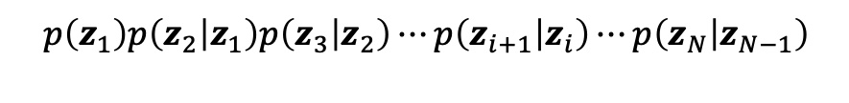


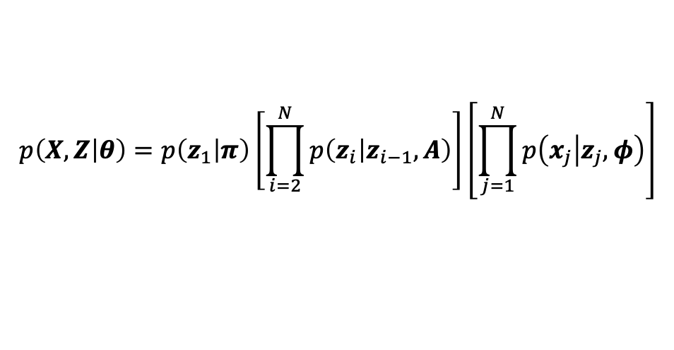



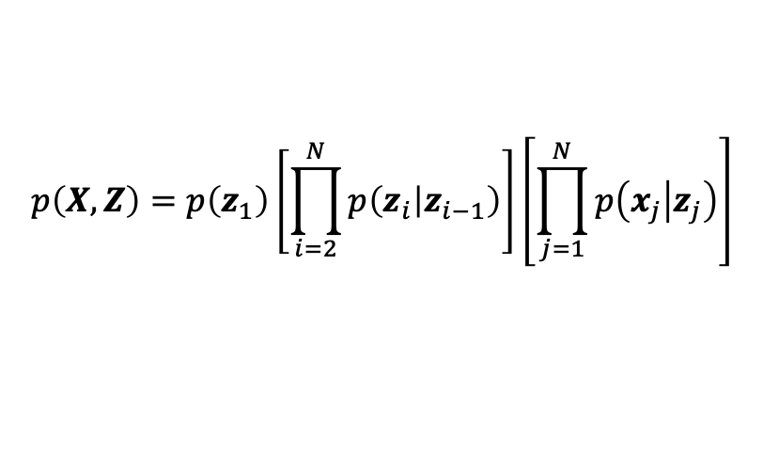



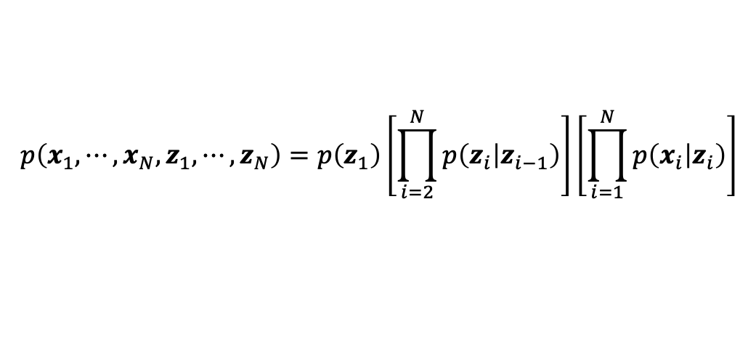
$$z_{1}$$
$$z_{2}$$
$$z_{3}$$
$$z_{i}$$
$$z_{i+1}$$
$$p\left(z_{1}\right)p\left(z_{2} | z_{1}\right)p\left(z_{3} | z_{2}\right)⋯p\left(z_{i+1} | z_{i}\right)⋯p\left(z_{N} | z_{N−1}\right)$$
$$x_{1}$$
$$x_{2}$$
$$x_{3}$$
$$x_{i}$$
$$x_{i+1}$$
$$p\left(x_{1} | z_{1}\right)p\left(x_{2} | z_{2}\right)⋯p\left(x_{i} | z_{i}\right)⋯p\left(x_{N} | z_{N}\right)$$
$$p\left({x_{1},⋯,x_{N},z}_{1},⋯,z_{N}\right)=p\left(z_{1}\right)\left[\prod_{i=2}^{N}{p\left(z_{i} | z_{i−1}\right)}\right]\left[\prod_{i=1}^{N}{p\left(x_{i} | z_{i}\right)}\right]$$
$$p\left(X,Z\right)=p\left(z_{1}\right)\left[\prod_{i=2}^{N}{p\left(z_{i} | z_{i−1}\right)}\right]\left[\prod_{j=1}^{N}{p\left(x_{j} | z_{j}\right)}\right]$$
$$p\left(X,Z | θ\right)=p\left(z_{1} | π\right)\left[\prod_{i=2}^{N}{p\left(z_{i} | z_{i−1},A\right)}\right]\left[\prod_{j=1}^{N}{p\left(x_{j} | z_{j},φ\right)}\right]$$
$$θ=\left\{π,A,φ\right\}$$

Slide 4

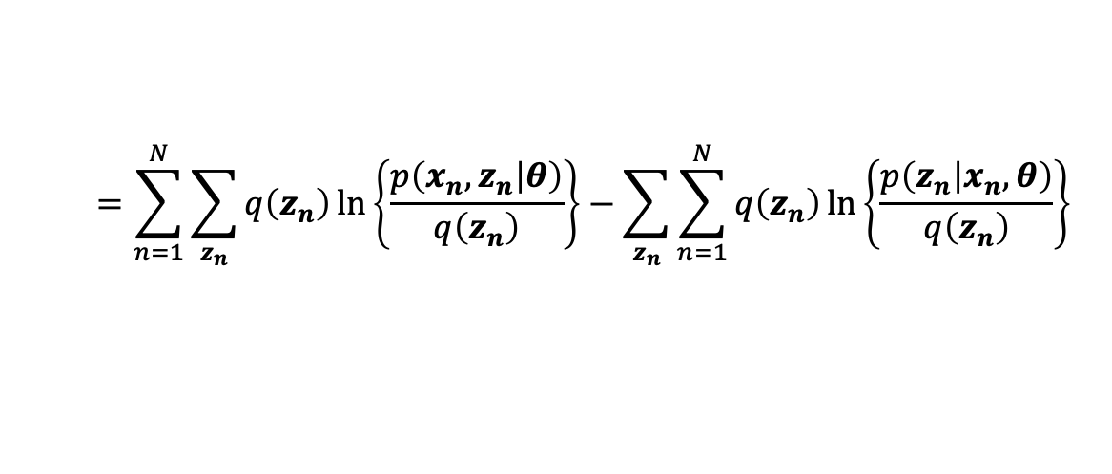
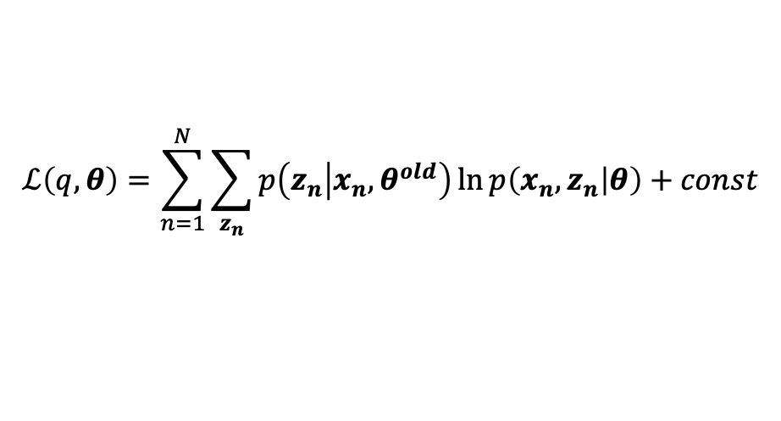













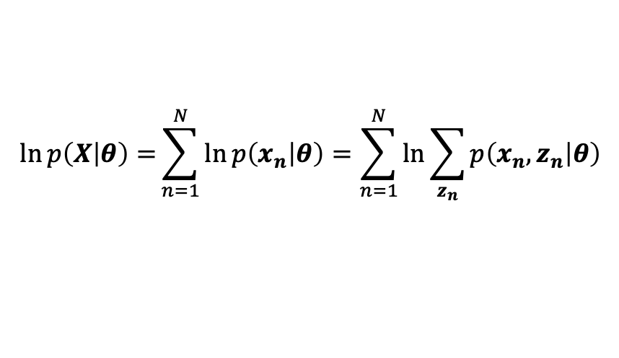
HMM EM 알고리즘
$$z_{1}$$
$$z_{2}$$
$$z_{3}$$
$$z_{i}$$
$$z_{i+1}$$
$$\ln{p\left(X | θ\right)=}\sum_{n=1}^{N}{\ln{p\left(x_{n} | θ\right)}}=\sum_{n=1}^{N}{\ln{\sum_{z_{n}}{p\left(x_{n},z_{n} | θ\right)}}}$$
$$x_{1}$$
$$x_{2}$$
$$x_{3}$$
$$x_{i}$$
$$x_{i+1}$$
$$=\sum_{n=1}^{N}{\sum_{z_{n}}{q\left(z_{n}\right)\ln\left\{\frac{p\left(x_{n},z_{n} | θ\right)}{q\left(z_{n}\right)}\right\}}}−\sum_{z_{n}}{\sum_{n=1}^{N}{q\left(z_{n}\right)\ln\left\{\frac{p\left(z_{n} | x_{n},θ\right)}{q\left(z_{n}\right)}\right\}}}$$
E-step :
$$KL\left(q||p\right)=0$$
$$q\left(z_{n}\right)=p\left(z_{n} | x_{n}, θ^{old}\right)$$
$$q\left(z_{n}\right)를 정의?$$
$$ℒ\left(q,θ\right)=\sum_{n=1}^{N}{\sum_{z_{n}}{p\left(z_{n} | x_{n}, θ^{old}\right)\ln{p\left(x_{n},z_{n} | θ\right)}}}+const$$
M-step :
$$θ^{new}=\underset{θ}{arg max}{ℒ\left(q,θ\right)}$$

Slide 5
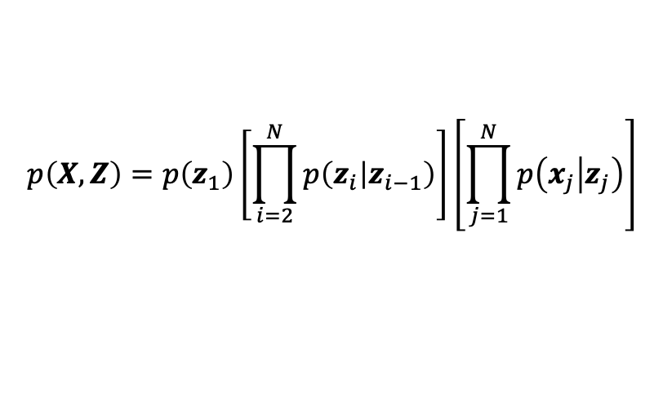
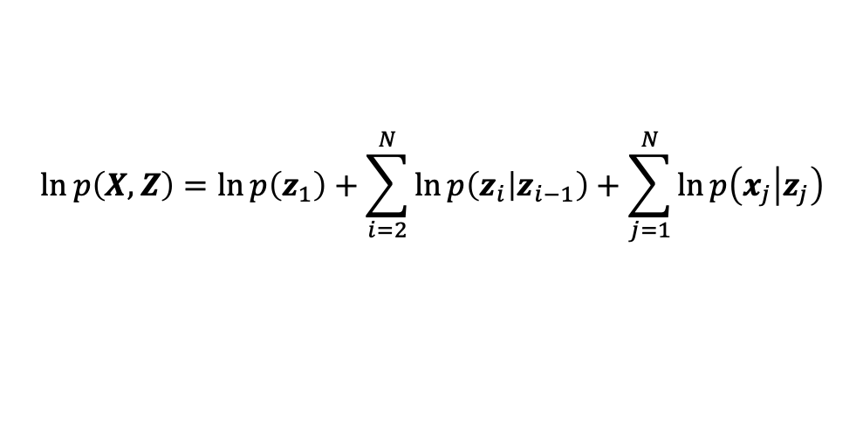
HMM EM 알고리즘
$$z_{1}$$
$$z_{2}$$
$$z_{3}$$
$$z_{i}$$
$$z_{i+1}$$
$$\ln{p\left(X | θ\right)=}\sum_{n=1}^{N}{\ln{p\left(x_{n} | θ\right)}}=\sum_{n=1}^{N}{\ln{\sum_{z_{n}}{p\left(x_{n},z_{n} | θ\right)}}}$$
$$x_{1}$$
$$x_{2}$$
$$x_{3}$$
$$x_{i}$$
$$x_{i+1}$$
$$=\sum_{n=1}^{N}{\sum_{z_{n}}{q\left(z_{n}\right)\ln\left\{\frac{p\left(x_{n},z_{n} | θ\right)}{q\left(z_{n}\right)}\right\}}}−\sum_{z_{n}}{\sum_{n=1}^{N}{q\left(z_{n}\right)\ln\left\{\frac{p\left(z_{n} | x_{n},θ\right)}{q\left(z_{n}\right)}\right\}}}$$
$$p\left(X,Z\right)=p\left(z_{1}\right)\left[\prod_{i=2}^{N}{p\left(z_{i} | z_{i−1}\right)}\right]\left[\prod_{j=1}^{N}{p\left(x_{j} | z_{j}\right)}\right]$$
$$\ln{p\left(X,Z\right)}=\ln{p\left(z_{1}\right)}+\sum_{i=2}^{N}{\ln{p\left(z_{i} | z_{i−1}\right)}}+\sum_{j=1}^{N}{\ln{p\left(x_{j} | z_{j}\right)}}$$

Slide 6
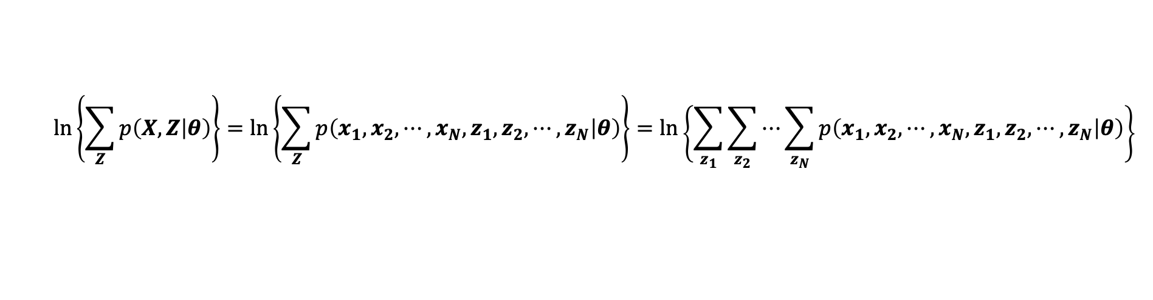
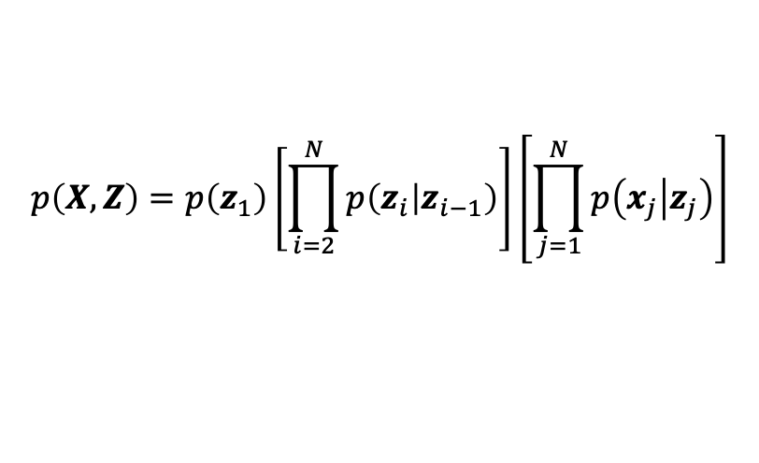
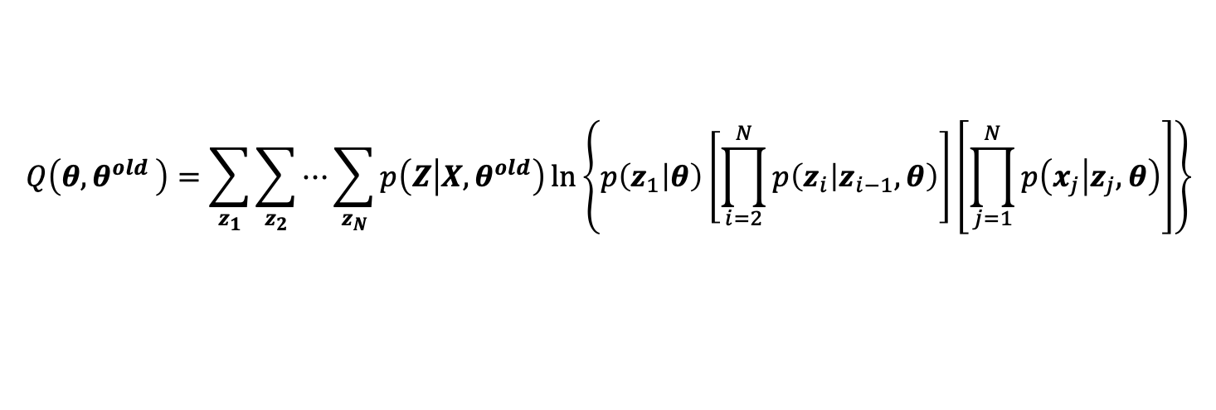
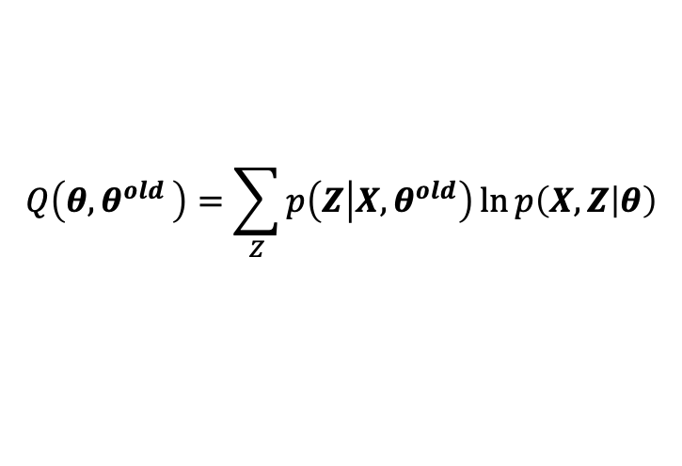
HMM EM 알고리즘
$$z_{1}$$
$$z_{2}$$
$$z_{3}$$
$$z_{i}$$
$$z_{i+1}$$
$$x_{1}$$
$$x_{2}$$
$$x_{3}$$
$$x_{i}$$
$$x_{i+1}$$
$$p\left(X,Z\right)=p\left(z_{1}\right)\left[\prod_{i=2}^{N}{p\left(z_{i} | z_{i−1}\right)}\right]\left[\prod_{j=1}^{N}{p\left(x_{j} | z_{j}\right)}\right]$$
$$ln\left\{\sum_{Z}{p\left(X,Z | θ\right)}\right\}{=\ln\left\{\sum_{Z}{p\left(x_{1},x_{2},⋯,x_{N},z_{1},z_{2},⋯,z_{N} | θ\right)}\right\}}=\ln\left\{\sum_{z_{1}}{\sum_{z_{2}}{⋯\sum_{z_{N}}{p\left(x_{1},x_{2},⋯,x_{N},z_{1},z_{2},⋯,z_{N} | θ\right)}}}\right\}$$
$$Q\left(θ{,θ}^{old}\right)=\sum_{Z}{p\left(Z | X,θ^{old}\right)\ln{p\left(X,Z | θ\right)}}$$
$$Q\left(θ{,θ}^{old}\right)=\sum_{z_{1}}{\sum_{z_{2}}{⋯\sum_{z_{N}}{p\left(Z | X,θ^{old}\right)\ln\left\{p\left(z_{1} | θ\right)\left[\prod_{i=2}^{N}{p\left(z_{i} | z_{i−1},θ\right)}\right]\left[\prod_{j=1}^{N}{p\left(x_{j} | z_{j},θ\right)}\right]\right\}}}}$$

Slide 7
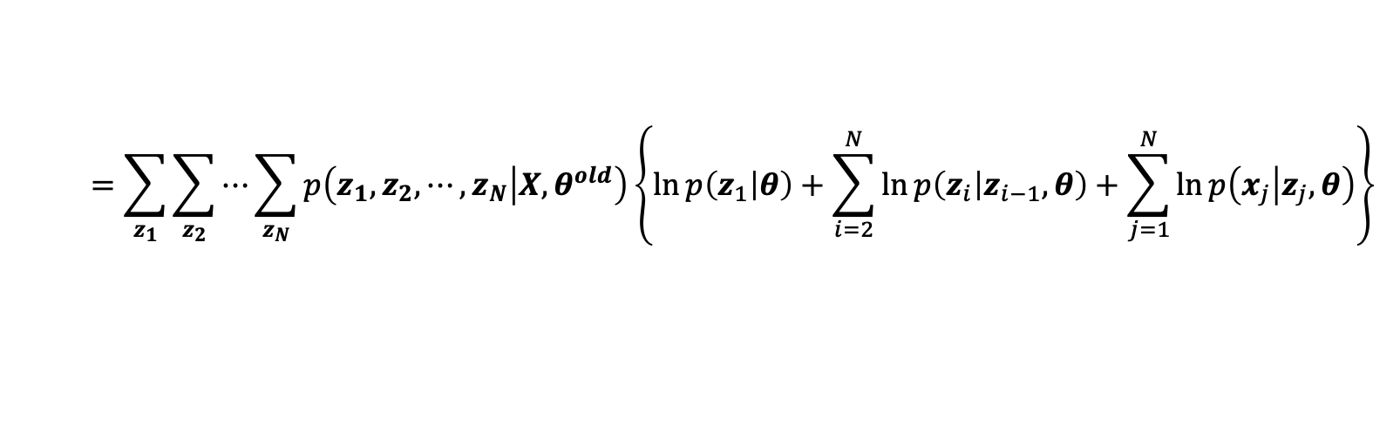
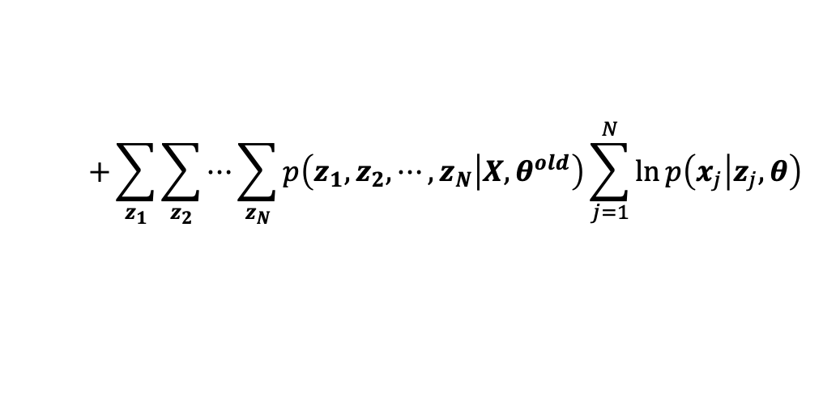
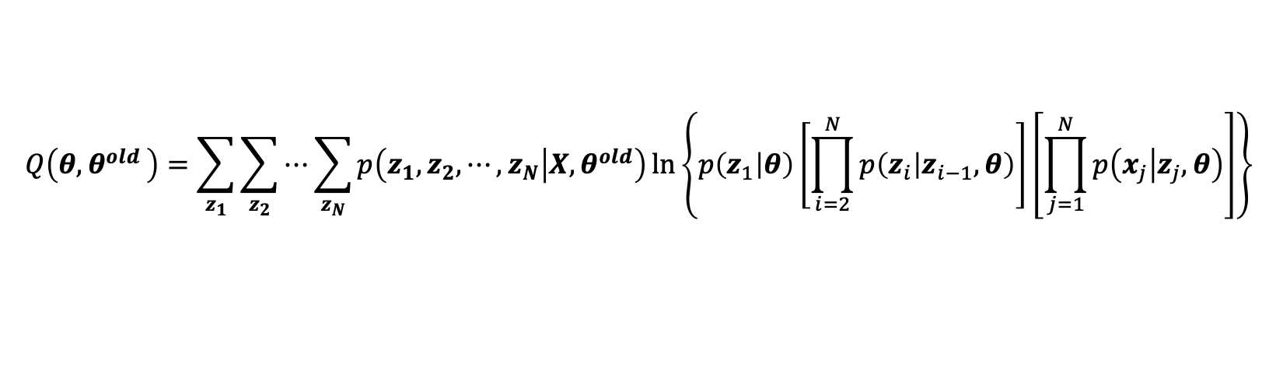
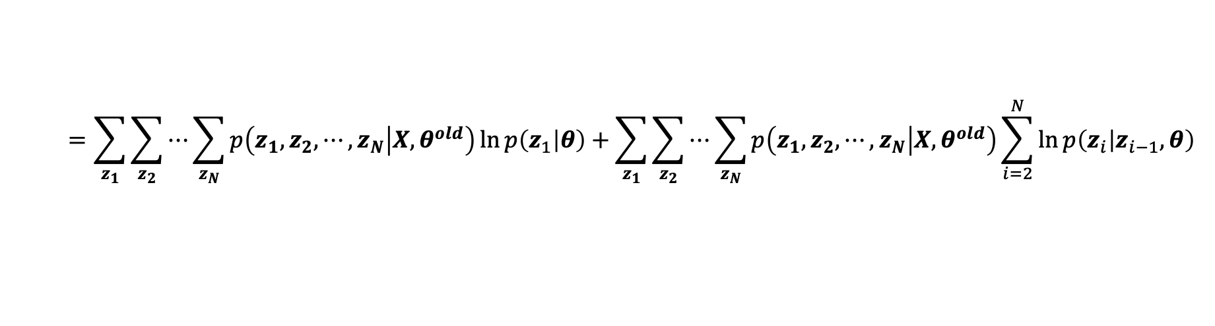


HMM EM 알고리즘
$$z_{1}$$
$$z_{2}$$
$$z_{3}$$
$$z_{i}$$
$$z_{i+1}$$
$$γ\left(z_{n}\right)=p\left(z_{n} | X,θ^{old}\right)$$
$$x_{1}$$
$$x_{2}$$
$$x_{3}$$
$$x_{i}$$
$$x_{i+1}$$
$$ξ\left(z_{n−1},z_{n}\right)=p\left(z_{n−1},z_{n} | X,θ^{old}\right)$$
$$Q\left(θ{,θ}^{old}\right)=\sum_{z_{1}}{\sum_{z_{2}}{⋯\sum_{z_{N}}{p\left(z_{1},z_{2},⋯,z_{N} | X,θ^{old}\right)\ln\left\{p\left(z_{1} | θ\right)\left[\prod_{i=2}^{N}{p\left(z_{i} | z_{i−1},θ\right)}\right]\left[\prod_{j=1}^{N}{p\left(x_{j} | z_{j},θ\right)}\right]\right\}}}}$$
$$=\sum_{z_{1}}{\sum_{z_{2}}{⋯\sum_{z_{N}}{p\left(z_{1},z_{2},⋯,z_{N} | X,θ^{old}\right)\left\{\ln{p\left(z_{1} | θ\right)}+\sum_{i=2}^{N}{\ln{p\left(z_{i} | z_{i−1},θ\right)}}+\sum_{j=1}^{N}{\ln{p\left(x_{j} | z_{j},θ\right)}}\right\}}}}$$
$$=\sum_{z_{1}}{\sum_{z_{2}}{⋯\sum_{z_{N}}{p\left(z_{1},z_{2},⋯,z_{N} | X,θ^{old}\right)\ln{p\left(z_{1} | θ\right)}}}}+\sum_{z_{1}}{\sum_{z_{2}}{⋯\sum_{z_{N}}{p\left(z_{1},z_{2},⋯,z_{N} | X,θ^{old}\right)\sum_{i=2}^{N}{\ln{p\left(z_{i} | z_{i−1},θ\right)}}}}}$$
$$+\sum_{z_{1}}{\sum_{z_{2}}{⋯\sum_{z_{N}}{p\left(z_{1},z_{2},⋯,z_{N} | X,θ^{old}\right)\sum_{j=1}^{N}{\ln{p\left(x_{j} | z_{j},θ\right)}}}}}$$

Slide 8
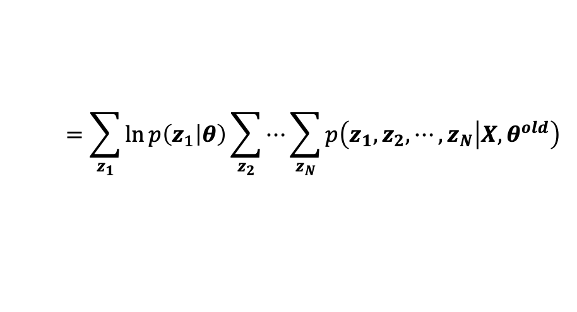
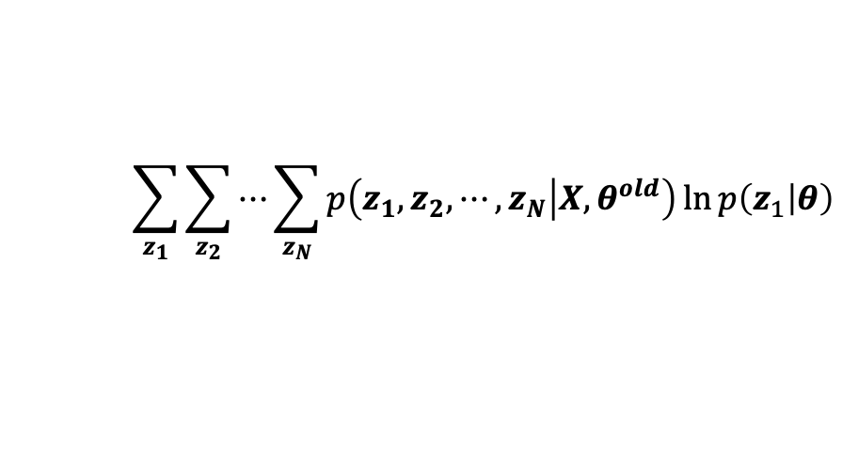
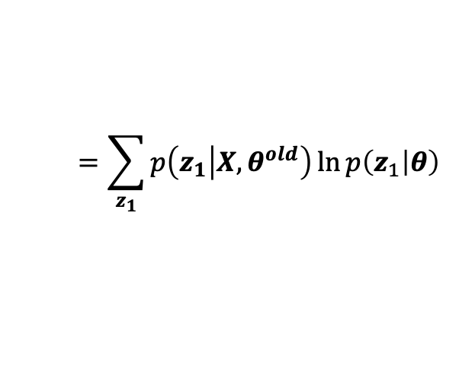
$$\sum_{z_{1}}{\sum_{z_{2}}{⋯\sum_{z_{N}}{p\left(z_{1},z_{2},⋯,z_{N} | X,θ^{old}\right)\ln{p\left(z_{1} | θ\right)}}}}$$
$$=\sum_{z_{1}}{\ln{p\left(z_{1} | θ\right)}\sum_{z_{2}}{⋯\sum_{z_{N}}{p\left(z_{1},z_{2},⋯,z_{N} | X,θ^{old}\right)}}}$$
$$=\sum_{z_{1}}{p\left(z_{1} | X,θ^{old}\right)\ln{p\left(z_{1} | θ\right)}}$$

Slide 9
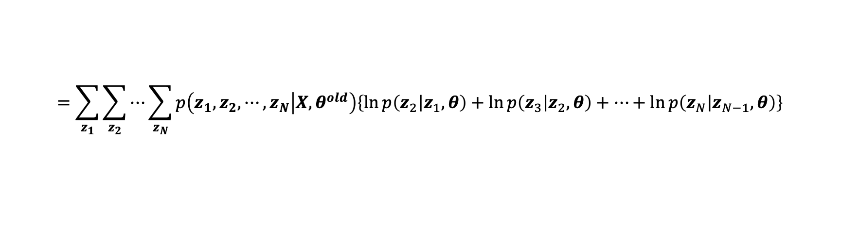
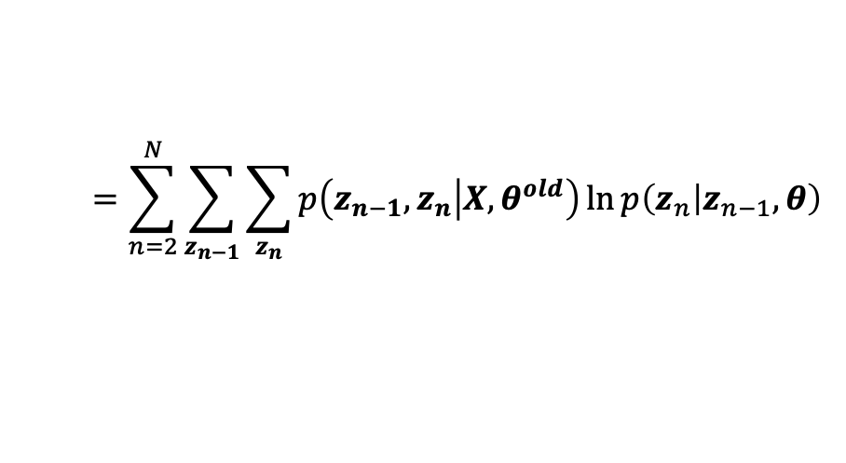
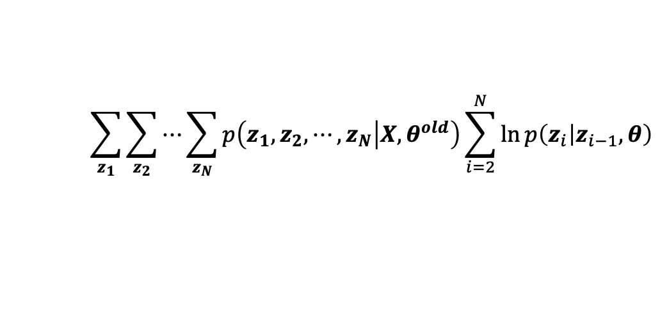
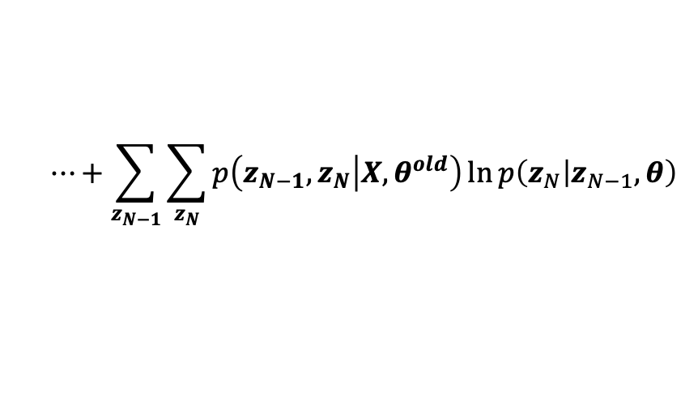
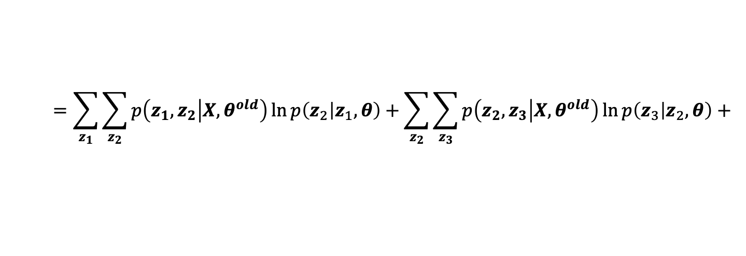
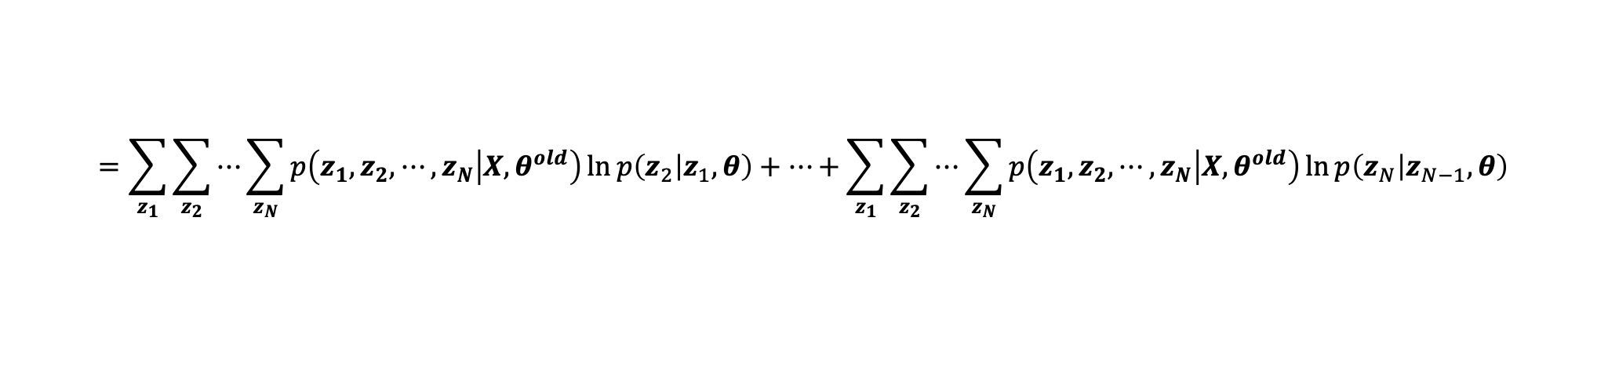
$$\sum_{z_{1}}{\sum_{z_{2}}{⋯\sum_{z_{N}}{p\left(z_{1},z_{2},⋯,z_{N} | X,θ^{old}\right)\sum_{i=2}^{N}{\ln{p\left(z_{i} | z_{i−1},θ\right)}}}}}$$
$$=\sum_{z_{1}}{\sum_{z_{2}}{⋯\sum_{z_{N}}{p\left(z_{1},z_{2},⋯,z_{N} | X,θ^{old}\right)\left\{\ln{p\left(z_{2} | z_{1},θ\right)}+\ln{p\left(z_{3} | z_{2},θ\right)}+⋯+\ln{p\left(z_{N} | z_{N−1},θ\right)}\right\}}}}$$
$$=\sum_{z_{1}}{\sum_{z_{2}}{⋯\sum_{z_{N}}{p\left(z_{1},z_{2},⋯,z_{N} | X,θ^{old}\right)\ln{p\left(z_{2} | z_{1},θ\right)}}}}+⋯+\sum_{z_{1}}{\sum_{z_{2}}{⋯\sum_{z_{N}}{p\left(z_{1},z_{2},⋯,z_{N} | X,θ^{old}\right)\ln{p\left(z_{N} | z_{N−1},θ\right)}}}}$$
$$=\sum_{z_{1}}{\sum_{z_{2}}{p\left(z_{1},z_{2} | X,θ^{old}\right)\ln{p\left(z_{2} | z_{1},θ\right)}}}+\sum_{z_{2}}{\sum_{z_{3}}{p\left(z_{2},z_{3} | X,θ^{old}\right)\ln{p\left(z_{3} | z_{2},θ\right)}}}+$$
$$⋯+\sum_{z_{N−1}}{\sum_{z_{N}}{p\left(z_{N−1},z_{N} | X,θ^{old}\right)\ln{p\left(z_{N} | z_{N−1},θ\right)}}}$$
$$=\sum_{n=2}^{N}{\sum_{z_{n−1}}{\sum_{z_{n}}{p\left(z_{n−1},z_{n} | X,θ^{old}\right)\ln{p\left(z_{n} | z_{n−1},θ\right)}}}}$$

Slide 10
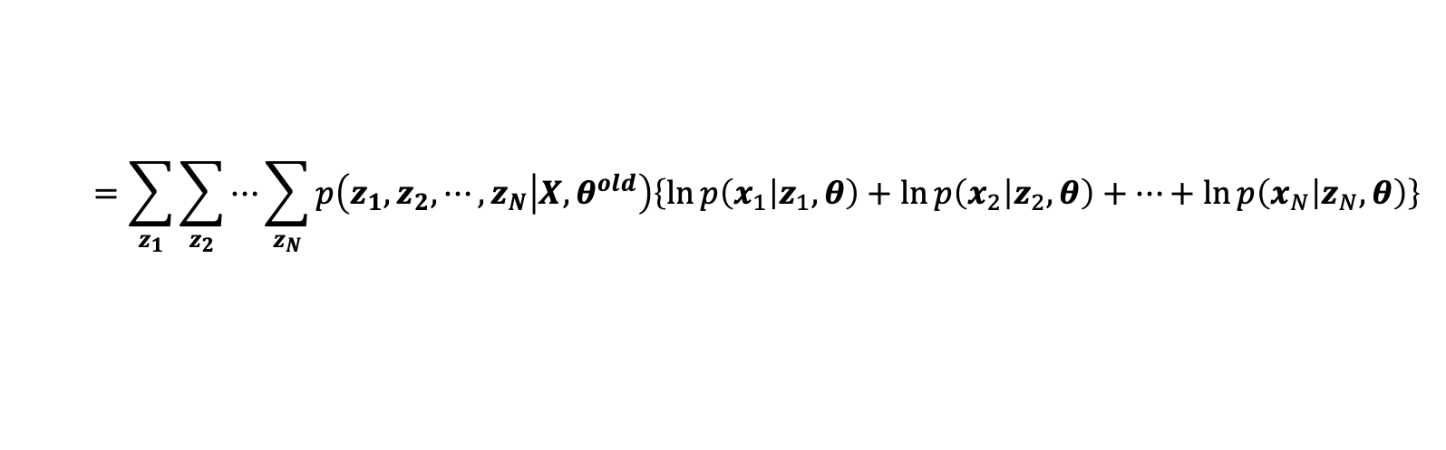
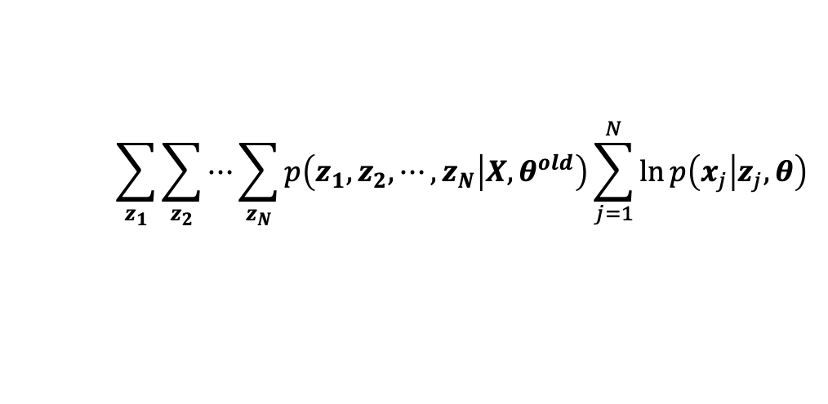
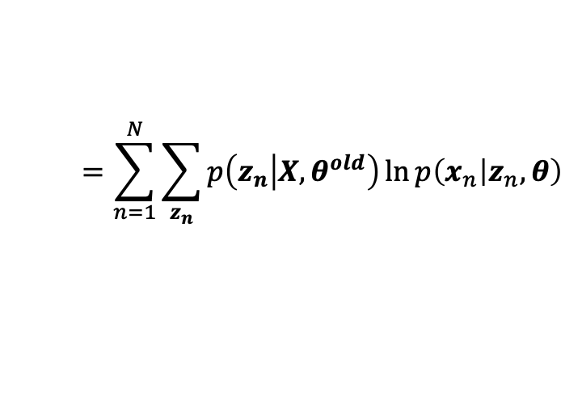
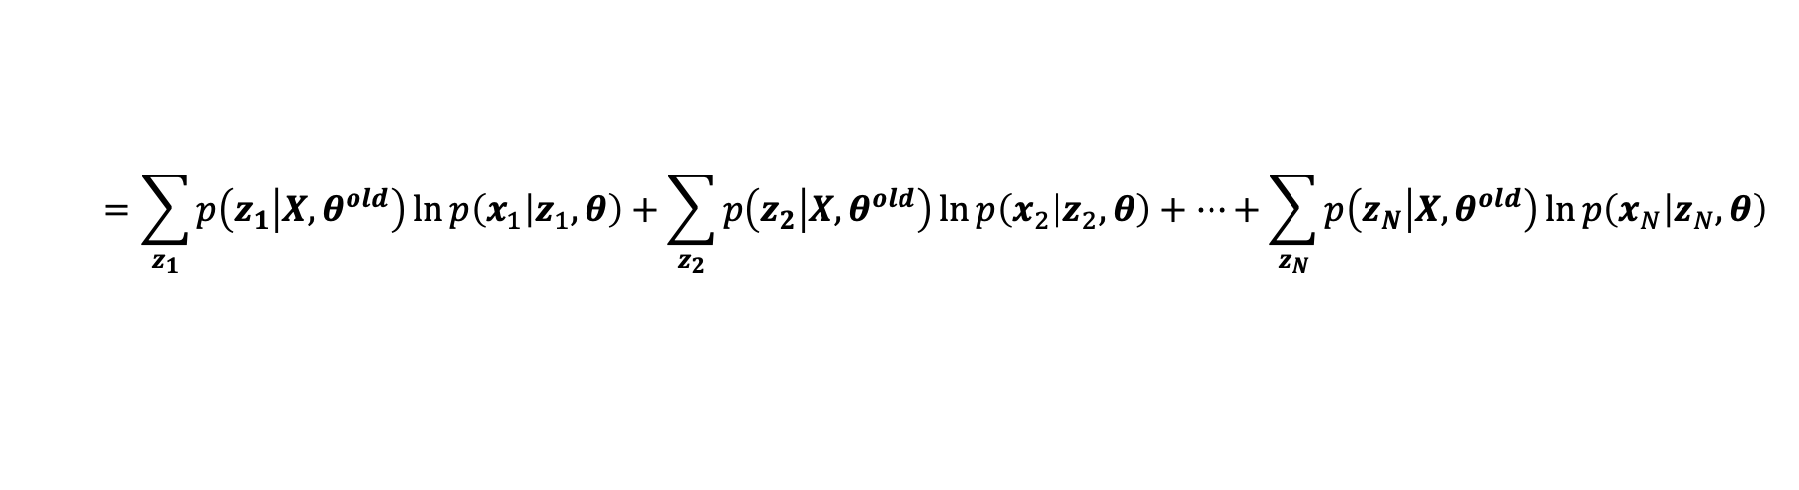
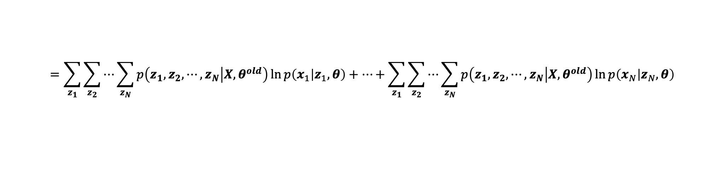
$$\sum_{z_{1}}{\sum_{z_{2}}{⋯\sum_{z_{N}}{p\left(z_{1},z_{2},⋯,z_{N} | X,θ^{old}\right)\sum_{j=1}^{N}{\ln{p\left(x_{j} | z_{j},θ\right)}}}}}$$
$$=\sum_{z_{1}}{\sum_{z_{2}}{⋯\sum_{z_{N}}{p\left(z_{1},z_{2},⋯,z_{N} | X,θ^{old}\right)\left\{\ln{p\left(x_{1} | z_{1},θ\right)}+\ln{p\left(x_{2} | z_{2},θ\right)}+⋯+\ln{p\left(x_{N} | z_{N},θ\right)}\right\}}}}$$
$$=\sum_{z_{1}}{\sum_{z_{2}}{⋯\sum_{z_{N}}{p\left(z_{1},z_{2},⋯,z_{N} | X,θ^{old}\right)\ln{p\left(x_{1} | z_{1},θ\right)}}}}+⋯+\sum_{z_{1}}{\sum_{z_{2}}{⋯\sum_{z_{N}}{p\left(z_{1},z_{2},⋯,z_{N} | X,θ^{old}\right)\ln{p\left(x_{N} | z_{N},θ\right)}}}}$$
$$=\sum_{z_{1}}{p\left(z_{1} | X,θ^{old}\right)\ln{p\left(x_{1} | z_{1},θ\right)}}+\sum_{z_{2}}{p\left(z_{2} | X,θ^{old}\right)\ln{p\left(x_{2} | z_{2},θ\right)}}+⋯+\sum_{z_{N}}{p\left(z_{N} | X,θ^{old}\right)\ln{p\left(x_{N} | z_{N},θ\right)}}$$
$$=\sum_{n=1}^{N}{\sum_{z_{n}}{p\left(z_{n} | X,θ^{old}\right)\ln{p\left(x_{n} | z_{n},θ\right)}}}$$

Slide 11


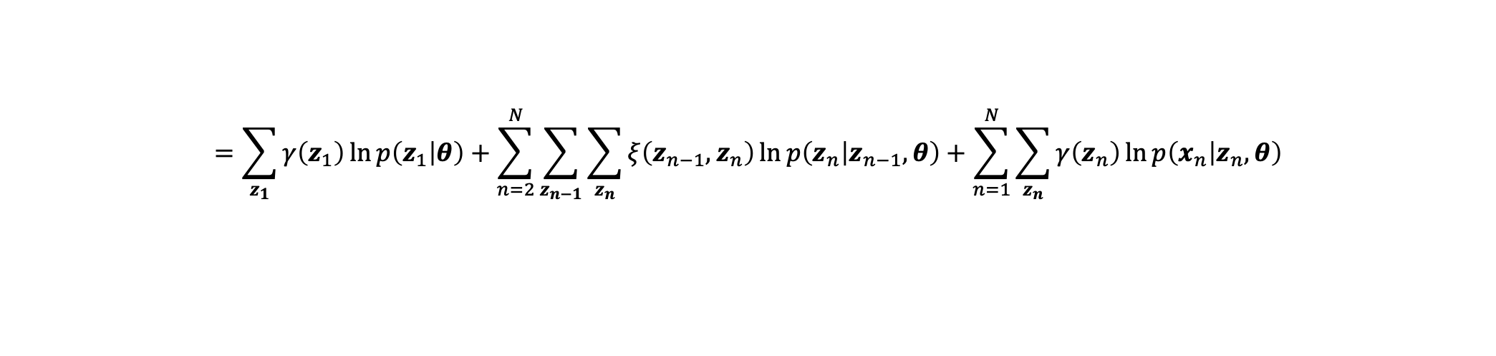
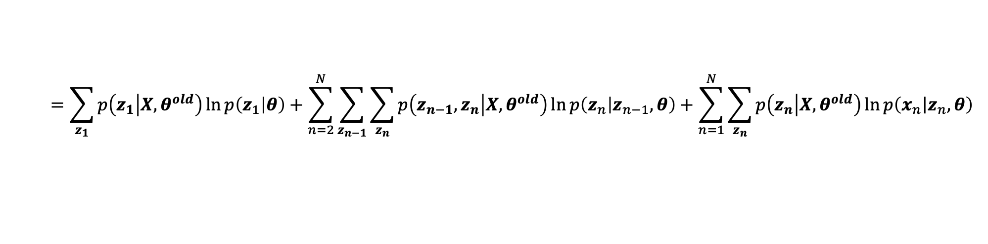
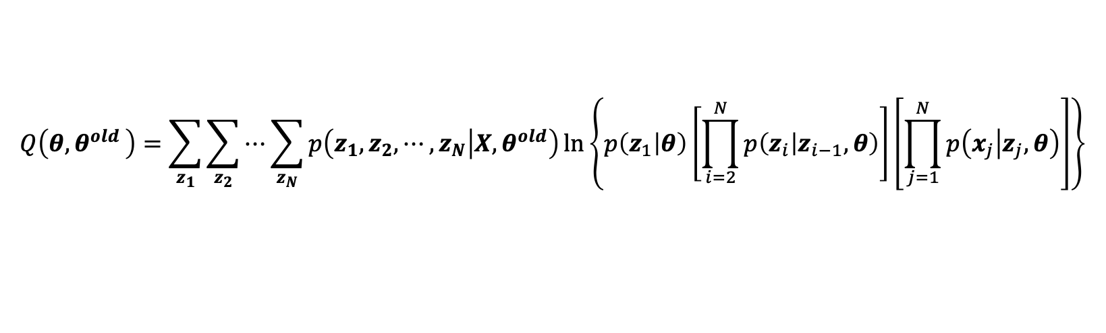
HMM EM 알고리즘
$$z_{1}$$
$$z_{2}$$
$$z_{3}$$
$$z_{i}$$
$$z_{i+1}$$
$$γ\left(z_{n}\right)=p\left(z_{n} | X,θ^{old}\right)$$
$$x_{1}$$
$$x_{2}$$
$$x_{3}$$
$$x_{i}$$
$$x_{i+1}$$
$$ξ\left(z_{n−1},z_{n}\right)=p\left(z_{n−1},z_{n} | X,θ^{old}\right)$$
$$Q\left(θ{,θ}^{old}\right)=\sum_{z_{1}}{\sum_{z_{2}}{⋯\sum_{z_{N}}{p\left(z_{1},z_{2},⋯,z_{N} | X,θ^{old}\right)\ln\left\{p\left(z_{1} | θ\right)\left[\prod_{i=2}^{N}{p\left(z_{i} | z_{i−1},θ\right)}\right]\left[\prod_{j=1}^{N}{p\left(x_{j} | z_{j},θ\right)}\right]\right\}}}}$$
$$=\sum_{z_{1}}{p\left(z_{1} | X,θ^{old}\right)\ln{p\left(z_{1} | θ\right)}}+\sum_{n=2}^{N}{\sum_{z_{n−1}}{\sum_{z_{n}}{p\left(z_{n−1},z_{n} | X,θ^{old}\right)\ln{p\left(z_{n} | z_{n−1},θ\right)}}}}+\sum_{n=1}^{N}{\sum_{z_{n}}{p\left(z_{n} | X,θ^{old}\right)\ln{p\left(x_{n} | z_{n},θ\right)}}}$$
$$=\sum_{z_{1}}{γ\left(z_{1}\right)\ln{p\left(z_{1} | θ\right)}}+\sum_{n=2}^{N}{\sum_{z_{n−1}}{\sum_{z_{n}}{ξ\left(z_{n−1},z_{n}\right)\ln{p\left(z_{n} | z_{n−1},θ\right)}}}}+\sum_{n=1}^{N}{\sum_{z_{n}}{γ\left(z_{n}\right)\ln{p\left(x_{n} | z_{n},θ\right)}}}$$

Slide 12
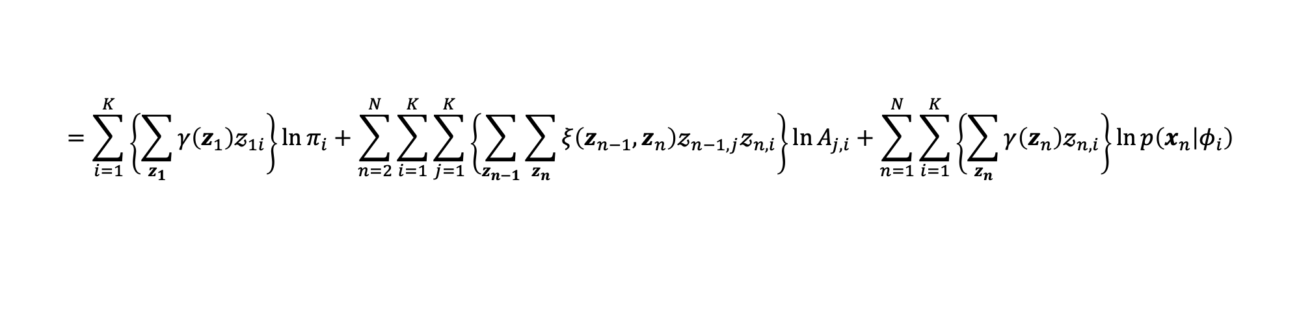
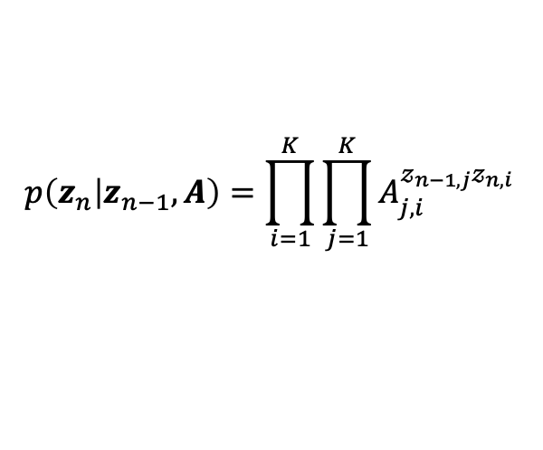
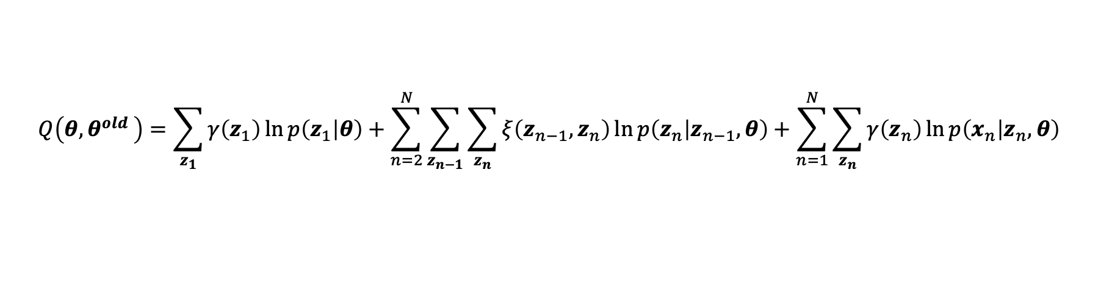
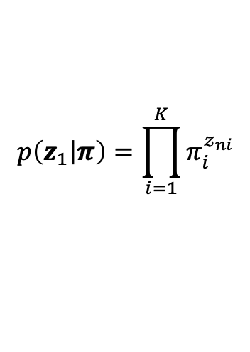
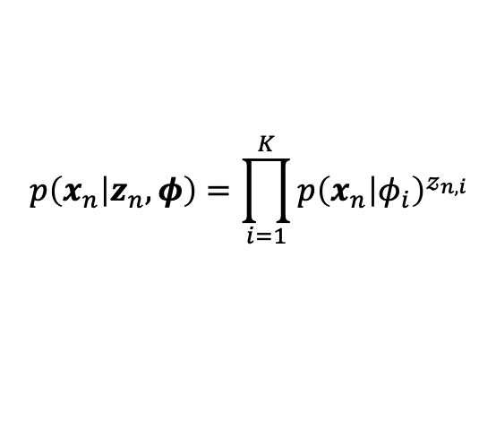
HMM EM 알고리즘
$$z_{1}$$
$$z_{2}$$
$$z_{3}$$
$$z_{i}$$
$$z_{i+1}$$
$$γ\left(z_{n}\right)=p\left(z_{n} | X,θ^{old}\right)$$
$$x_{1}$$
$$x_{2}$$
$$x_{3}$$
$$x_{i}$$
$$x_{i+1}$$
$$ξ\left(z_{n−1},z_{n}\right)=p\left(z_{n−1},z_{n} | X,θ^{old}\right)$$
$$p\left(z_{1} | π\right)=\prod_{i=1}^{K}{π_{i}^{𝓏_{ni}}}$$
$$p\left(z_{n} | z_{n−1},A\right)=\prod_{i=1}^{K}{\prod_{j=1}^{K}{A_{j,i}^{𝓏_{n−1,j}𝓏_{n,i}}} }$$
$$p\left(x_{n} | z_{n},φ\right)=\prod_{i=1}^{K}{{p\left(x_{n} | φ_{i}\right)}^{𝓏_{n,i}}}$$
$$Q\left(θ{,θ}^{old}\right)=\sum_{z_{1}}{γ\left(z_{1}\right)\ln{p\left(z_{1} | θ\right)}}+\sum_{n=2}^{N}{\sum_{z_{n−1}}{\sum_{z_{n}}{ξ\left(z_{n−1},z_{n}\right)\ln{p\left(z_{n} | z_{n−1},θ\right)}}}}+\sum_{n=1}^{N}{\sum_{z_{n}}{γ\left(z_{n}\right)\ln{p\left(x_{n} | z_{n},θ\right)}}}$$
$$=\sum_{i=1}^{K}{\left\{\sum_{z_{1}}{γ\left(z_{1}\right)𝓏_{1i}}\right\}\ln{π_{i}}}+\sum_{n=2}^{N}{\sum_{i=1}^{K}{\sum_{j=1}^{K}{\left\{\sum_{z_{n−1}}{\sum_{z_{n}}{ξ\left(z_{n−1},z_{n}\right)𝓏_{n−1,j}𝓏_{n,i}}}\right\}}\ln{A_{j,i}}}}+\sum_{n=1}^{N}{\sum_{i=1}^{K}{\left\{\sum_{z_{n}}{γ\left(z_{n}\right)𝓏_{n,i}}\right\}}\ln{p\left(x_{n} | φ_{i}\right)}}$$

Slide 13
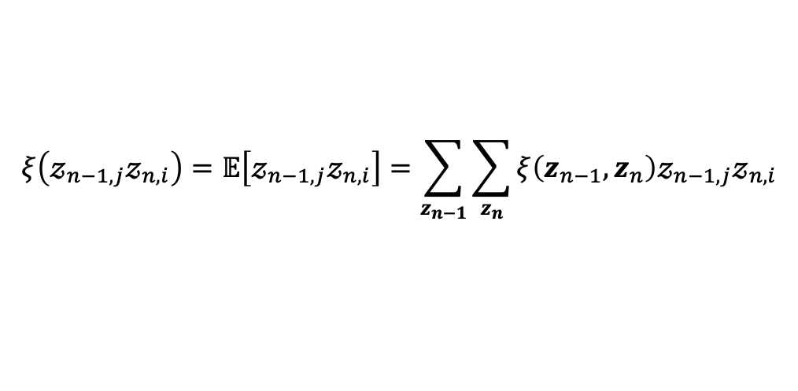
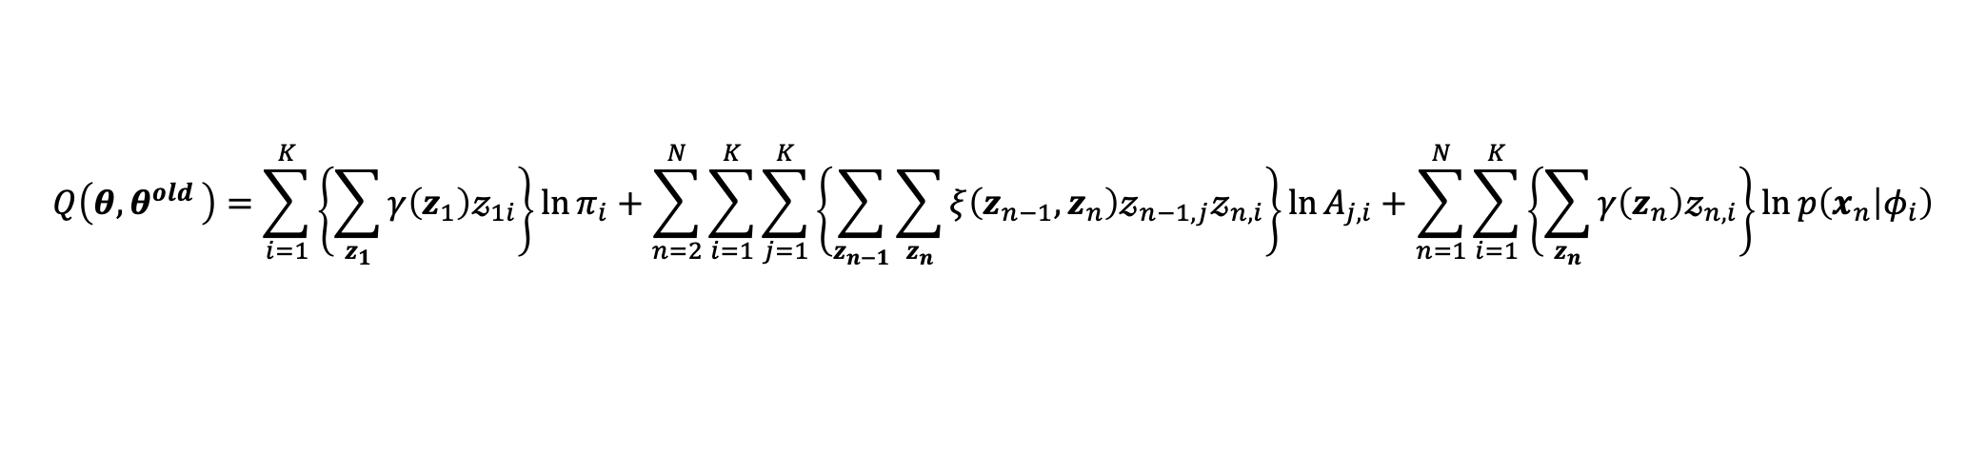
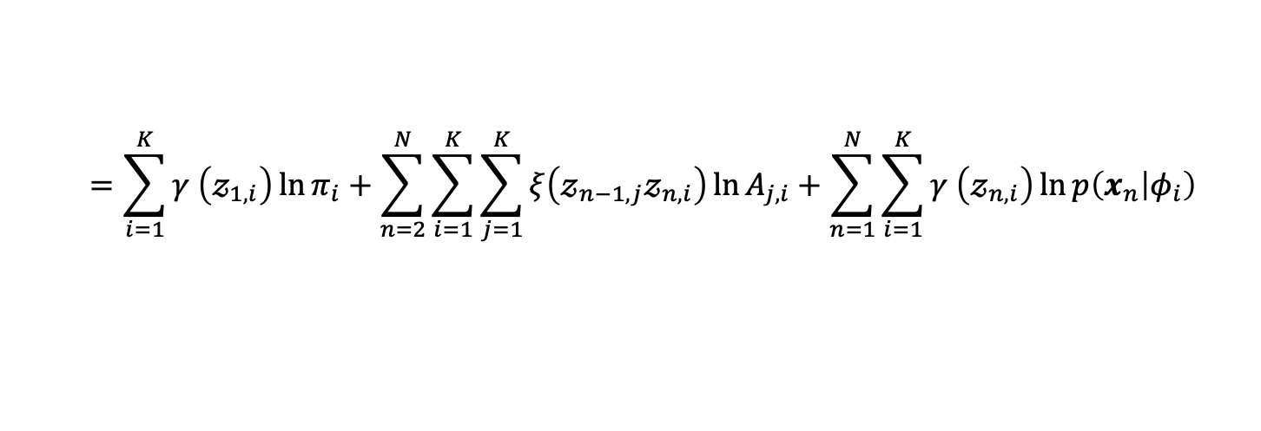
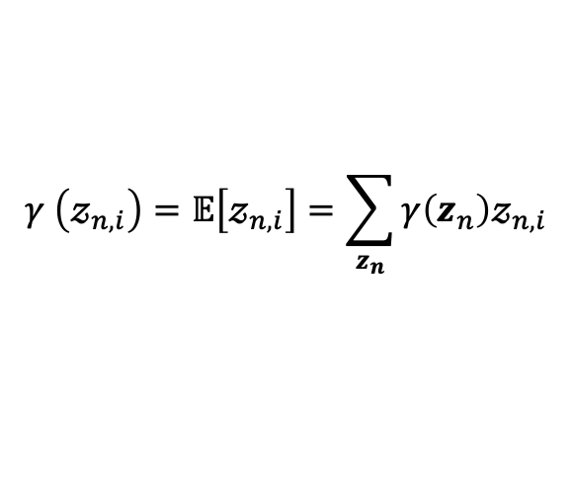
HMM EM 알고리즘
$$z_{1}$$
$$z_{2}$$
$$z_{3}$$
$$z_{i}$$
$$z_{i+1}$$
$$γ \left(𝓏_{n,i}\right)=𝔼\left[𝓏_{n,i}\right]=\sum_{z_{n}}{γ\left(z_{n}\right)𝓏_{n,i}}$$
$$x_{1}$$
$$x_{2}$$
$$x_{3}$$
$$x_{i}$$
$$x_{i+1}$$
$$ξ\left(𝓏_{n−1,j}𝓏_{n,i}\right)=𝔼\left[𝓏_{n−1,j}𝓏_{n,i}\right]=\sum_{z_{n−1}}{\sum_{z_{n}}{ξ\left(z_{n−1},z_{n}\right)𝓏_{n−1,j}𝓏_{n,i}}}$$
$$Q\left(θ{,θ}^{old}\right)=\sum_{i=1}^{K}{\left\{\sum_{z_{1}}{γ\left(z_{1}\right)𝓏_{1i}}\right\}\ln{π_{i}}}+\sum_{n=2}^{N}{\sum_{i=1}^{K}{\sum_{j=1}^{K}{\left\{\sum_{z_{n−1}}{\sum_{z_{n}}{ξ\left(z_{n−1},z_{n}\right)𝓏_{n−1,j}𝓏_{n,i}}}\right\}}\ln{A_{j,i}}}}+\sum_{n=1}^{N}{\sum_{i=1}^{K}{\left\{\sum_{z_{n}}{γ\left(z_{n}\right)𝓏_{n,i}}\right\}}\ln{p\left(x_{n} | φ_{i}\right)}}$$
$$=\sum_{i=1}^{K}{γ \left(𝓏_{1,i}\right)\ln{π_{i}}}+\sum_{n=2}^{N}{\sum_{i=1}^{K}{\sum_{j=1}^{K}{ξ\left(𝓏_{n−1,j}𝓏_{n,i}\right)}\ln{A_{j,i}}}}+\sum_{n=1}^{N}{\sum_{i=1}^{K}{γ \left(𝓏_{n,i}\right)}\ln{p\left(x_{n} | φ_{i}\right)}}$$

Slide 14
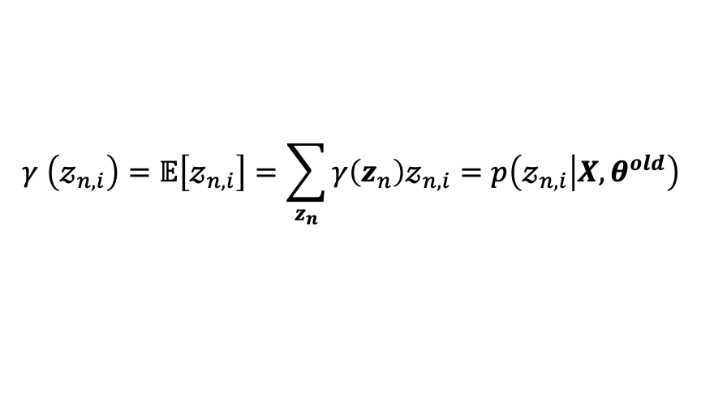
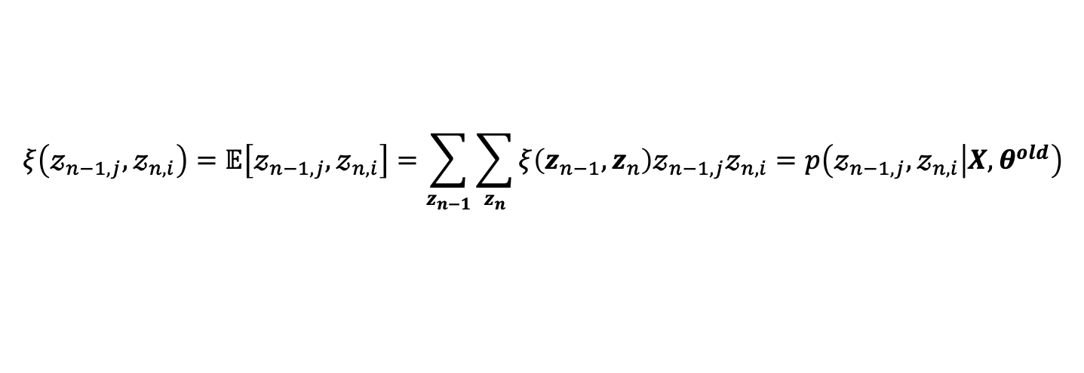
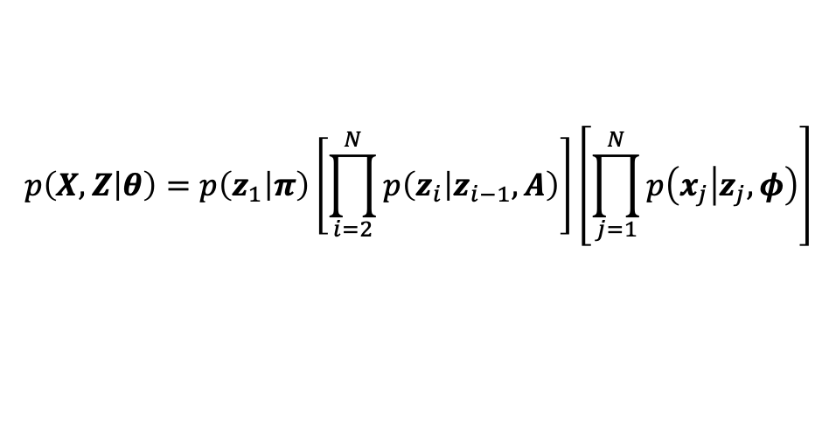

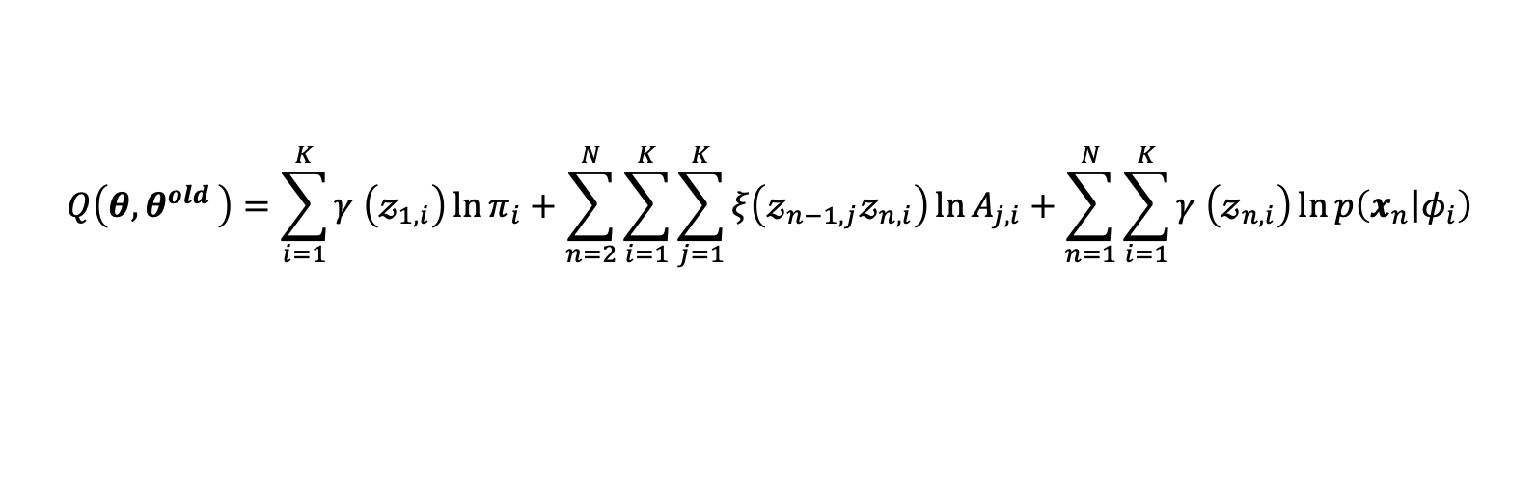
HMM EM 알고리즘
$$z_{1}$$
$$z_{2}$$
$$z_{3}$$
$$z_{i}$$
$$z_{i+1}$$
$$p\left(X,Z | θ\right)=p\left(z_{1} | π\right)\left[\prod_{i=2}^{N}{p\left(z_{i} | z_{i−1},A\right)}\right]\left[\prod_{j=1}^{N}{p\left(x_{j} | z_{j},φ\right)}\right]$$
$$x_{1}$$
$$x_{2}$$
$$x_{3}$$
$$x_{i}$$
$$x_{i+1}$$
$$θ=\left\{π,A,φ\right\}$$
$$γ \left(𝓏_{n,i}\right)=𝔼\left[𝓏_{n,i}\right]=\sum_{z_{n}}{γ\left(z_{n}\right)𝓏_{n,i}}=p\left(𝓏_{n,i} | X,θ^{old}\right)$$
E-step :
$$ξ\left(𝓏_{n−1,j},𝓏_{n,i}\right)=𝔼\left[𝓏_{n−1,j},𝓏_{n,i}\right]=\sum_{z_{n−1}}{\sum_{z_{n}}{ξ\left(z_{n−1},z_{n}\right)𝓏_{n−1,j}𝓏_{n,i}=p\left(𝓏_{n−1,j},𝓏_{n,i} | X,θ^{old}\right)}}$$
$$Q\left(θ{,θ}^{old}\right)=\sum_{i=1}^{K}{γ \left(𝓏_{1,i}\right)\ln{π_{i}}}+\sum_{n=2}^{N}{\sum_{i=1}^{K}{\sum_{j=1}^{K}{ξ\left(𝓏_{n−1,j}𝓏_{n,i}\right)}\ln{A_{j,i}}}}+\sum_{n=1}^{N}{\sum_{i=1}^{K}{γ \left(𝓏_{n,i}\right)}\ln{p\left(x_{n} | φ_{i}\right)}}$$
M-step :

Slide 15




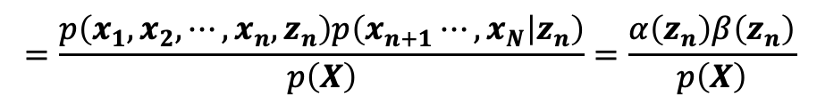
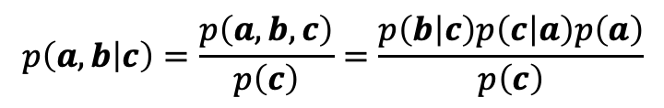



알파 베타 알고리즘
$$z_{i}$$
$$z_{i+1}$$
$$z_{1}$$
$$z_{2}$$
$$z_{3}$$
$$c는 머리 대 꼬리(head−to−tail) 노드$$
$$p\left(a,b | c\right)=\frac{p\left(a, b, c\right)}{p\left(c\right)}=\frac{p\left(b | c\right)p\left(c | a\right)p\left(a\right)}{p\left(c\right)}$$
$$x_{1}$$
$$x_{2}$$
$$x_{3}$$
$$x_{i}$$
$$x_{i+1}$$
$$= p\left(a | c\right)p\left(b | c\right)$$
$$a$$
$$c$$
$$b$$
$$p\left(x_{1},x_{2},⋯,x_{n},x_{n+1}⋯,x_{N} | z_{n}\right)=p\left(x_{1},x_{2},⋯,x_{n} | z_{n}\right)p\left(x_{n+1}⋯,x_{N} | z_{n}\right)$$
$$γ\left(z_{n}\right)=p\left(z_{n} | X \right)=\frac{p\left(X | z_{n}\right)p\left(z_{n}\right)}{p\left(X\right)}=\frac{p\left(x_{1},x_{2},⋯,x_{n} | z_{n}\right)p\left(x_{n+1}⋯,x_{N} | z_{n}\right)p\left(z_{n}\right)}{p\left(X\right)}$$
$$=\frac{p\left(x_{1},x_{2},⋯,x_{n},z_{n}\right)p\left(x_{n+1}⋯,x_{N} | z_{n}\right)}{p\left(X\right)}=\frac{α\left(z_{n}\right)β\left(z_{n}\right)}{p\left(X\right)}$$
$$α\left(z_{n}\right)≡p\left(x_{1},x_{2},⋯,x_{n},z_{n}\right)$$
$$β\left(z_{n}\right)≡p\left(x_{n+1}⋯,x_{N} | z_{n}\right)$$

Slide 16


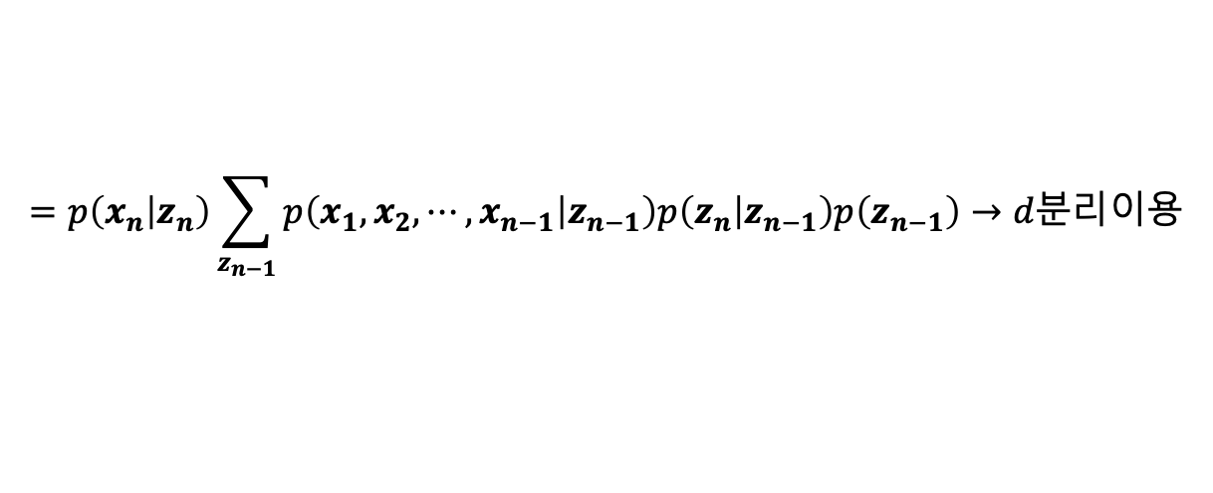








알파 베타 알고리즘
$$z_{i}$$
$$z_{i+1}$$
$$z_{1}$$
$$z_{2}$$
$$z_{3}$$
$$α\left(z_{n}\right)≡p\left(x_{1},x_{2},⋯,x_{n},z_{n}\right)$$
$$β\left(z_{n}\right)≡p\left(x_{n+1}⋯,x_{N} | z_{n}\right)$$
$$x_{1}$$
$$x_{2}$$
$$x_{3}$$
$$x_{i}$$
$$x_{i+1}$$
$$γ\left(z_{n}\right)=p\left(z_{n} | X \right)=\frac{p\left(X | z_{n}\right)p\left(z_{n}\right)}{p\left(X\right)}==\frac{α\left(z_{n}\right)β\left(z_{n}\right)}{p\left(X\right)}$$
$$=p\left(x_{n} | z_{n}\right)\sum_{z_{n−1}}{p\left(x_{1},x_{2},⋯,x_{n−1},z_{n−1} \right)p\left(z_{n} | z_{n−1}\right)}$$
$$α\left(z_{n}\right)=p\left(x_{1},x_{2},⋯,x_{n},z_{n}\right)$$
$$=p\left(x_{1},x_{2},⋯,x_{n} | z_{n}\right)p\left(z_{n}\right)$$
$$α\left(z_{n}\right)=p\left(x_{n} | z_{n}\right)\sum_{z_{n−1}}{α\left(z_{n−1}\right)p\left(z_{n} | z_{n−1}\right)}$$
$$=p\left(x_{n} | z_{n}\right)p\left(x_{1},x_{2},⋯,x_{n−1} | z_{n}\right)p\left(z_{n}\right)→d분리이용$$
$$=p\left(x_{n} | z_{n}\right)p\left(x_{1},x_{2},⋯,x_{n−1},z_{n}\right)$$
$$=p\left(x_{n} | z_{n}\right)\sum_{z_{n−1}}{p\left(x_{1},x_{2},⋯,x_{n−1},z_{n−1},z_{n}\right)}$$
$$=p\left(x_{n} | z_{n}\right)\sum_{z_{n−1}}{p\left(x_{1},x_{2},⋯,x_{n−1},z_{n} | z_{n−1}\right)p\left(z_{n−1}\right)}$$
$$=p\left(x_{n} | z_{n}\right)\sum_{z_{n−1}}{p\left(x_{1},x_{2},⋯,x_{n−1} | z_{n−1}\right)p\left(z_{n} | z_{n−1}\right)p\left(z_{n−1}\right)}→d분리이용$$

Slide 17

















알파 베타 알고리즘
$$z_{i}$$
$$z_{i+1}$$
$$z_{1}$$
$$z_{2}$$
$$z_{3}$$
$$α\left(z_{n}\right)≡p\left(x_{1},x_{2},⋯,x_{n},z_{n}\right)$$
$$β\left(z_{n}\right)≡p\left(x_{n+1}⋯,x_{N} | z_{n}\right)$$
$$x_{1}$$
$$x_{2}$$
$$x_{3}$$
$$x_{i}$$
$$x_{i+1}$$
$$γ\left(z_{n}\right)=p\left(z_{n} | X \right)=\frac{p\left(X | z_{n}\right)p\left(z_{n}\right)}{p\left(X\right)}=\frac{α\left(z_{n}\right)β\left(z_{n}\right)}{p\left(X\right)}$$
$$α\left(z_{n}\right)=p\left(x_{n} | z_{n}\right)\sum_{z_{n−1}}{α\left(z_{n−1}\right)p\left(z_{n} | z_{n−1}\right)}$$
$$α\left(𝓏_{n−1,1}\right)$$
$$p\left(𝓏_{n,1} | 𝓏_{n−1,1}\right)$$
$$p\left(x_{n} | 𝓏_{n,1}\right)$$
$$α\left(𝓏_{n,1}\right)$$
$$α\left(z_{1}\right)=p\left(x_{1}, z_{1}\right)$$
$$p\left(𝓏_{n,1} | 𝓏_{n−1,2}\right)$$
$$α\left(𝓏_{n,i}\right)=p\left(x_{n} | 𝓏_{n,i}\right)\sum_{j=1}^{K}{α\left(𝓏_{n−1,j}\right)p\left(𝓏_{n,i} | 𝓏_{n−1,j}\right)}$$
$$α\left(𝓏_{n−1,2}\right)$$
$$p\left(x_{n} | 𝓏_{n,2}\right)$$
$$α\left(𝓏_{n,2}\right)$$
$$p\left(𝓏_{n,1} | 𝓏_{n−1,3}\right)$$
$$α\left(𝓏_{n−1,3}\right)$$
$$p\left(x_{n} | 𝓏_{n,3}\right)$$
$$α\left(𝓏_{n,3}\right)$$

Slide 18
















알파 베타 알고리즘
$$z_{n}$$
$$z_{n+1}$$
$$z_{N−1}$$
$$z_{N}$$
$$α\left(z_{n}\right)≡p\left(x_{1},x_{2},⋯,x_{n},z_{n}\right)$$
$$β\left(z_{n}\right)≡p\left(x_{n+1}⋯,x_{N} | z_{n}\right)$$
$$x_{n}$$
$$x_{N−1}$$
$$x_{N}$$
$$γ\left(z_{n}\right)=p\left(z_{n} | X \right)=\frac{p\left(X | z_{n}\right)p\left(z_{n}\right)}{p\left(X\right)}=\frac{α\left(z_{n}\right)β\left(z_{n}\right)}{p\left(X\right)}$$
$$p\left(x_{n+1}⋯,x_{N} | z_{n},z_{n+1}\right)=\frac{p\left(x_{n+1}, ⋯,x_{N},z_{n},z_{n+1}\right)}{p\left(z_{n},z_{n+1}\right)}$$
$$β\left(z_{n}\right)=p\left(x_{n+1}⋯,x_{N} | z_{n}\right)=\sum_{z_{n+1}}{p\left(x_{n+1}⋯,x_{N},z_{n+1} | z_{n}\right)}$$
$$=\frac{\frac{p\left(x_{n+1}, ⋯,x_{N},z_{n},z_{n+1}\right)}{p\left(z_{n+1}\right)}}{\frac{p\left(z_{n},z_{n+1}\right)}{p\left(z_{n+1}\right)}}$$
$$=\sum_{z_{n+1}}{p\left(x_{n+1}⋯,x_{N} | z_{n},z_{n+1}\right)p\left(z_{n+1} | z_{n}\right)}→d분리이용$$
$$=\sum_{z_{n+1}}{p\left(x_{n+2}⋯,x_{N} | z_{n+1}\right)p\left(x_{n+1} | z_{n+1}\right)p\left(z_{n+1} | z_{n}\right)}$$
$$=\frac{p\left(x_{n+1}⋯,x_{N},z_{n} | z_{n+1}\right)}{p\left(z_{n} | z_{n+1}\right)}$$
$$β\left(z_{n}\right)=\sum_{z_{n+1}}{β\left(z_{n+1}\right)p\left(x_{n+1} | z_{n+1}\right)p\left(z_{n+1} | z_{n}\right)}$$
$$=\frac{p\left(x_{n+1}⋯,x_{N} | z_{n+1}\right)p\left(z_{n} | z_{n+1}\right)}{p\left(z_{n} | z_{n+1}\right)}$$

Slide 19















알파 베타 알고리즘
$$z_{n}$$
$$z_{n+1}$$
$$z_{N−1}$$
$$z_{N}$$
$$α\left(z_{n}\right)≡p\left(x_{1},x_{2},⋯,x_{n},z_{n}\right)$$
$$β\left(z_{n}\right)≡p\left(x_{n+1}⋯,x_{N} | z_{n}\right)$$
$$x_{n}$$
$$x_{N−1}$$
$$x_{N}$$
$$γ\left(z_{n}\right)=p\left(z_{n} | X \right)=\frac{p\left(X | z_{n}\right)p\left(z_{n}\right)}{p\left(X\right)}=\frac{α\left(z_{n}\right)β\left(z_{n}\right)}{p\left(X\right)}$$
$$β\left(z_{n}\right)=\sum_{z_{n+1}}{β\left(z_{n+1}\right)p\left(x_{n+1} | z_{n+1}\right)p\left(z_{n+1} | z_{n}\right)}$$
$$β\left(z_{N}\right)=1$$
$$β\left(𝓏_{n,1}\right)$$
$$p\left(𝓏_{n+1,1} | 𝓏_{n,1}\right)$$
$$p\left(x_{n} | 𝓏_{n+1,1}\right)$$
$$β\left(𝓏_{n+1,1}\right)$$
$$β\left(𝓏_{n,i}\right)=\sum_{j=1}^{K}{β\left(𝓏_{n+1,j}\right)p\left(x_{n+1} | 𝓏_{n+1,j}\right)p\left(𝓏_{n+1,j} | 𝓏_{n,i}\right)}$$
$$p\left(𝓏_{n+1,1} | 𝓏_{n,2}\right)$$
$$β\left(𝓏_{n−1,2}\right)$$
$$p\left(x_{n} | 𝓏_{n+1,2}\right)$$
$$β\left(𝓏_{n+1,2}\right)$$
$$p\left(𝓏_{n+1,1} | 𝓏_{n,3}\right)$$
$$β\left(𝓏_{n,3}\right)$$
$$p\left(x_{n} | 𝓏_{n+1,3}\right)$$
$$β \left(𝓏_{n+1,3}\right)$$

Slide 20




알파 베타 알고리즘
$$α\left(z_{n}\right)≡p\left(x_{1},x_{2},⋯,x_{n},z_{n}\right)$$
$$β\left(z_{n}\right)≡p\left(x_{n+1}⋯,x_{N} | z_{n}\right)$$
$$ξ\left(z_{n−1},z_{n}\right)=p\left(z_{n−1},z_{n} | X \right)=\frac{p\left(X,z_{n−1},z_{n}\right)}{p\left(X\right)}=\frac{p\left(X | z_{n−1},z_{n}\right)p\left(z_{n−1},z_{n}\right)}{p\left(X\right)}$$
$$=\frac{p\left(X | z_{n−1},z_{n}\right)p\left(z_{n} | z_{n−1} \right)p\left(z_{n−1} \right)}{p\left(X\right)}$$
$$=\frac{p\left(x_{1},x_{2},⋯,x_{n−1} | z_{n−1} \right)p\left(x_{n} | z_{n} \right)p\left(x_{n+1},x_{n+2},⋯,x_{N} | z_{n} \right)p\left(z_{n} | z_{n−1} \right)p\left(z_{n−1} \right)}{p\left(X\right)}$$
$$=\frac{α\left(z_{n−1}\right)p\left(x_{n} | z_{n} \right)p\left(z_{n} | z_{n−1} \right)β\left(z_{n}\right)}{p\left(X\right)}$$

Slide 21
참고0

Slide 22













$$z_{1}$$
$$z_{2}$$
$$z_{3}$$
$$z_{n−1}$$
$$z_{n}$$
참고1
$$→p\left(x_{1},x_{2},⋯,x_{n} | z_{n−1},z_{n}\right)$$
$$x_{1}$$
$$x_{2}$$
$$x_{3}$$
$$x_{n−1}$$
$$x_{n}$$
$$=p\left(x_{1},x_{2},⋯,x_{n−1} | z_{n−1},z_{n}\right)p\left( x_{n} | z_{n−1},z_{n}\right)$$
$$→d분리이용$$
$$=\frac{p\left(x_{1},x_{2},⋯,x_{n−1},z_{n−1},z_{n}\right)}{p\left(z_{n−1},z_{n}\right)}\frac{p\left(x_{n},z_{n−1},z_{n}\right)}{p\left(z_{n−1},z_{n}\right)}$$
$$=\frac{\frac{p\left(x_{1},x_{2},⋯,x_{n−1},z_{n−1},z_{n}\right)}{p\left(z_{n−1}\right)}}{\frac{p\left(z_{n−1},z_{n}\right)}{p\left(z_{n−1}\right)}}\frac{\frac{p\left(x_{n},z_{n−1},z_{n}\right)}{p\left(z_{n}\right)}}{\frac{p\left(z_{n−1},z_{n}\right)}{p\left(z_{n}\right)}}=\frac{p\left(x_{1},x_{2},⋯,x_{n−1} ,z_{n} | z_{n−1} \right)}{p\left(z_{n} | z_{n−1} \right)}\frac{p\left(x_{n} ,z_{n−1} | z_{n} \right)}{p\left(z_{n−1} | z_{n} \right)}$$
$$=\frac{p\left(x_{1},x_{2},⋯,x_{n−1} | z_{n−1} \right)p\left(z_{n} | z_{n−1} \right)}{p\left(z_{n} | z_{n−1} \right)}\frac{p\left(x_{n} | z_{n} \right)\left(z_{n−1} | z_{n} \right)}{p\left(z_{n−1} | z_{n} \right)}$$
$$=p\left(x_{1},x_{2},⋯,x_{n−1} | z_{n−1} \right)p\left(x_{n} | z_{n} \right)$$

Slide 23





$$z_{1}$$
$$z_{2}$$
$$z_{3}$$
$$z_{n−1}$$
$$z_{n}$$
참고2
$$→p\left(x_{n+1},x_{n+2},⋯,x_{N} | z_{n−1},z_{n}\right)$$
$$x_{1}$$
$$x_{2}$$
$$x_{3}$$
$$x_{n−1}$$
$$x_{n}$$
$$=\frac{p\left(x_{n+1},x_{n+2},⋯,x_{N},z_{n−1},z_{n}\right)}{p\left(z_{n−1},z_{n}\right)}$$
$$→d분리이용$$
$$=\frac{\frac{p\left(x_{n+1},x_{n+2},⋯,x_{N},z_{n−1},z_{n}\right)}{p\left(z_{n}\right)}}{\frac{p\left(z_{n−1},z_{n}\right)}{p\left(z_{n}\right)}}$$
$$=\frac{p\left(x_{n+1},x_{n+2},⋯,x_{N},z_{n−1} | z_{n} \right)}{p\left(z_{n+1} | z_{n} \right)}=\frac{p\left(x_{n+1},x_{n+2},⋯,x_{N} | z_{n} \right)p\left(z_{n−1} | z_{n} \right)}{p\left(z_{n+1} | z_{n} \right)}$$
$$=p\left(x_{n+1},x_{n+2},⋯,x_{N} | z_{n} \right)$$

Slide 24






$$α\left(z_{N}\right)=p\left(X_{N},z_{N}\right)$$
$$p\left(x_{N+1} | X\right)=\sum_{z_{N+1}}{p\left(x_{N+1},z_{N+1} | X\right)}=\sum_{z_{N+1}}{\frac{p\left(X,x_{N+1},z_{N+1}\right)}{p\left(X\right)}\frac{p\left(X,z_{N+1}\right)}{p\left(X,z_{N+1}\right)}=\sum_{z_{N+1}}{\frac{p\left(X,x_{N+1},z_{N+1}\right)}{p\left(X,z_{N+1}\right)}\frac{p\left(X,z_{N+1}\right)}{p\left(X\right)}}}$$
$$=\sum_{z_{N+1}}{\frac{\frac{p\left(X,x_{N+1},z_{N+1}\right)}{p\left(z_{N+1}\right)}}{\frac{p\left(X, z_{N+1}\right)}{p\left(z_{N+1}\right)}}\frac{p\left(X,z_{N+1}\right)}{p\left(X\right)}}=\sum_{z_{N+1}}{\frac{p\left(X,x_{N+1} | z_{N+1}\right)}{p\left(X | z_{N+1}\right)}p\left(z_{N+1} | X\right)}=\sum_{z_{N+1}}{\frac{p\left(X | z_{N+1}\right)p\left(x_{N+1} | z_{N+1}\right)}{p\left(X | z_{N+1}\right)}p\left(z_{N+1} | X\right)}$$
$$=\sum_{z_{N+1}}{p\left(x_{N+1} | z_{N+1}\right)p\left(z_{N+1} | X\right)}=\sum_{z_{N+1}}{p\left(x_{N+1} | z_{N+1}\right)\sum_{z_{N}}{p\left(z_{N},z_{N+1} | X\right)}}=\sum_{z_{N+1}}{p\left(x_{N+1} | z_{N+1}\right)\sum_{z_{N}}{p\left(z_{N+1} | z_{N}\right)p\left(z_{N} | X\right)}}$$
$$=\sum_{z_{N+1}}{p\left(x_{N+1} | z_{N+1}\right)\sum_{z_{N}}{p\left(z_{N+1} | z_{N}\right)\frac{p\left(X,z_{N}\right)}{p\left(X\right)}}}=\sum_{z_{N+1}}{p\left(x_{N+1} | z_{N+1}\right)\sum_{z_{N}}{p\left(z_{N+1} | z_{N}\right)\frac{α\left(z_{N}\right)}{p\left(X\right)}}}$$
$$c_{N+1}≡p\left(x_{N+1} | X\right)=\frac{1}{p\left(X\right)}\sum_{z_{N+1}}{p\left(x_{N+1} | z_{N+1}\right)\sum_{z_{N}}{p\left(z_{N+1} | z_{N}\right)α\left(z_{N}\right)}}$$

Slide 25











$$\hat{α}\left(z_{n}\right)=p\left(z_{n} | x_{1},x_{2},⋯,x_{n}\right)=\frac{α\left(z_{n}\right)}{p\left(x_{1},x_{2},⋯,x_{n} \right)}$$
$$c_{1}=p\left(x_{1}\right)$$
$$α\left(z_{n}\right)=p\left(x_{n} | z_{n}\right)\sum_{z_{n−1}}{α\left(z_{n−1}\right)p\left(z_{n} | z_{n−1}\right)}$$
$$c_{2}=p\left(x_{2} | x_{1}\right)$$
$$c_{3}=p\left(x_{3} | x_{1},x_{2} \right)$$
$$=p\left(x_{1},x_{2},⋯,x_{n},z_{n}\right)$$
$$c_{4}=p\left(x_{4} | x_{1},x_{2}, x_{3}\right)$$
$$\frac{α\left(z_{n}\right)}{p\left(x_{1},x_{2},⋯,x_{n−1} \right)}=p\left(x_{n} | z_{n}\right)\sum_{z_{n−1}}{\frac{α\left(z_{n−1}\right)}{p\left(x_{1},x_{2},⋯,x_{n−1} \right)}p\left(z_{n} | z_{n−1}\right)}$$
$$c_{n}=p\left(x_{n} | x_{1},x_{2},⋯,x_{n−1}\right)$$
$$\frac{\frac{α\left(z_{n}\right)}{p\left(x_{1},x_{2},⋯,x_{n} \right)}}{\frac{p\left(x_{1},x_{2},⋯,x_{n−1} \right)}{p\left(x_{1},x_{2},⋯,x_{n−1},x_{n} \right)}}=p\left(x_{n} | z_{n}\right)\sum_{z_{n−1}}{\frac{α\left(z_{n−1}\right)}{p\left(x_{1},x_{2},⋯,x_{n−1} \right)}p\left(z_{n} | z_{n−1}\right)}$$
$$c_{n}\hat{α}\left(z_{n}\right)=p\left(x_{n} | z_{n}\right)\sum_{z_{n−1}}{\hat{α}\left(z_{n−1}\right)p\left(z_{n} | z_{n−1}\right)}$$

Slide 27






알려지지 않은 수량 $z_{n}$의 값을 노이즈가 포함되는 센서를 이용해서 측정해야 한다.
$$z_{n}→n번째 추정값$$
$$z_{n}=Az_{n−1}+noise$$
$$z_{n−1}→n−1번째 추정값$$
센서로부터 주어진 관측값 $x_{n}$은 $z_{n}$의 값에 0평균 가우시안 노이즈를 더한 것이다.
$$x_{n}=Cz_{n}+noise$$
$$x_{n}→n번째 측정값$$

Slide 28










$$z_{1}$$
$$z_{2}$$
$$z_{n−1}$$
$$z_{n}$$
$$z_{N}$$
$$x_{1}$$
$$x_{2}$$
$$x_{n−1}$$
$$x_{n}$$
$$x_{N}$$
알려지지 않은 수량 $z_{n}$의 값을 노이즈가 포함되는 센서를 이용해서 측정해야 한다.
$$z_{n}→n번째 추정값$$
$$z_{n}=Az_{n−1}+noise$$
$$z_{n−1}→n−1번째 추정값$$
센서로부터 주어진 관측값 $x_{n}$은 $z_{n}$의 값에 0평균 가우시안 노이즈를 더한 것이다.
$$x_{n}=Cz_{n}+noise$$
$$x_{n}→n번째 측정값$$

Slide 29






선형 동적 시스템에서의 추론
$$z_{1}$$
$$z_{2}$$
$$z_{n−1}$$
$$z_{n}$$
$$z_{N}$$
$$x_{1}$$
$$x_{2}$$
$$x_{n−1}$$
$$x_{n}$$
$$x_{N}$$
$$p\left(z_{n} | z_{n−1}\right)=𝓝\left(z_{n} | Az_{n−1},Γ\right) →전이 확률$$
$$p\left(x_{n} | z_{n}\right)=𝓝\left(x_{n} | {Cz}_{n},Σ \right)→방사확률$$
알려지지 않은 수량 $z_{n}$
$$p\left(z_{1}\right)=𝓝\left(z_{1} | μ_{n},Ρ_{0} \right)→초기값$$
$$p\left(z_{n} | x_{1},x_{2},⋯,x_{n}\right)$$
센서로부터 주어진 관측값 $x_{1},x_{2},⋯,x_{n}$
$$θ=\left\{A,Γ,C,Σ,μ_{n},Ρ_{0}\right\}$$

Slide 30







선형 동적 시스템에서의 추론
$$p\left(z_{n} | z_{n−1}\right)=𝓝\left(z_{n} | Az_{n−1},Γ\right) →전이 확률$$
$$p\left(x_{n} | z_{n}\right)=𝓝\left(x_{n} | {Cz}_{n},Σ \right)→방사확률$$
$$p\left(z_{1}\right)=𝓝\left(z_{1} | μ_{n},Ρ_{0} \right)→초기값$$
센서로부터 주어진 관측값 $x_{1},x_{2},⋯,x_{n}$
$$\hat{α}\left(z_{n}\right)=p\left(z_{n} | x_{1},x_{2},⋯,x_{n}\right)=𝓝\left(z_{n} | μ_{n},V_{n} \right)$$
알려지지 않은 수량 $z_{n}$
$$c_{n}=p\left(x_{n} | x_{1},x_{2},⋯,x_{n−1}\right)$$
$$c_{n}\hat{α}\left(z_{n}\right)=p\left(x_{n} | z_{n}\right)\sum_{z_{n−1}}{\hat{α}\left(z_{n−1}\right)p\left(z_{n} | z_{n−1}\right)}$$
$$c_{n}\hat{α}\left(z_{n}\right)=p\left(x_{n} | z_{n}\right)\int{\hat{α}\left(z_{n−1}\right)p\left(z_{n} | z_{n−1}\right)dz_{n−1}}$$

Slide 31



선형 동적 시스템에서의 추론
$$p\left(z_{n} | z_{n−1}\right)=𝓝\left(z_{n} | Az_{n−1},Γ\right) →전이 확률$$
$$p\left(x_{n} | z_{n}\right)=𝓝\left(x_{n} | {Cz}_{n},Σ \right)→방사확률$$
$$\hat{α}\left(z_{n}\right)=p\left(z_{n} | x_{1},x_{2},⋯,x_{n}\right)=𝓝\left(z_{n} | μ_{n},V_{n} \right)$$
$$p\left(z_{1}\right)=𝓝\left(z_{1} | μ_{0},Ρ_{0} \right)→초기값$$
센서로부터 주어진 관측값 $x_{1},x_{2},⋯,x_{n}$
알려지지 않은 수량 $z_{n}$
$$c_{n}\hat{α}\left(z_{n}\right)=p\left(x_{n} | z_{n}\right)\int{\hat{α}\left(z_{n−1}\right)p\left(z_{n} | z_{n−1}\right)dz_{n−1}}$$
$$c_{n}𝓝\left(z_{n} | μ_{n},V_{n} \right)=𝓝\left(x_{n} | {Cz}_{n},Σ \right)\int{𝓝\left(z_{n−1} | μ_{n−1},V_{n−1} \right)𝓝\left(z_{n} | Az_{n−1},Γ\right)dz_{n−1}}$$

Slide 32













선형 동적 시스템에서의 추론
$$z_{1}$$
$$z_{2}$$
$$z_{3}$$
$$z_{n−1}$$
$$z_{n}$$
$$c_{n}\hat{α}\left(z_{n}\right)=p\left(x_{n} | z_{n}\right)\int{\hat{α}\left(z_{n−1}\right)p\left(z_{n} | z_{n−1}\right)dz_{n−1}}$$
$$x_{1}$$
$$x_{2}$$
$$x_{3}$$
$$x_{n−1}$$
$$x_{n}$$
$$c_{n}p\left(z_{n} | x_{1},x_{2},⋯,x_{n}\right)=p\left(x_{n} | z_{n}\right)\int{p\left(z_{n} | z_{n−1}\right)p\left(z_{n−1} | x_{1},x_{2},⋯,x_{n−1}\right)dz_{n−1}}$$
$$→p\left(z_{n−1},z_{n} | x_{1},x_{2},⋯,x_{n−1}\right)=p\left(z_{n} | z_{n−1}\right)p\left(z_{n−1} | x_{1},x_{2},⋯,x_{n−1}\right)$$
$$c_{n}p\left(z_{n} | x_{1},x_{2},⋯,x_{n}\right)=p\left(x_{n} | z_{n}\right)\int{p\left(z_{n−1},z_{n} | x_{1},x_{2},⋯,x_{n−1}\right)dz_{n−1}}$$
$$c_{n}p\left(z_{n} | x_{1},x_{2},⋯,x_{n}\right)=p\left(x_{n} | z_{n}\right)p\left(z_{n} | x_{1},x_{2},⋯,x_{n−1}\right)$$

Slide 33


선형 동적 시스템에서의 추론
$$z_{1}$$
$$z_{2}$$
$$z_{3}$$
$$z_{n−1}$$
$$z_{n}$$
$$x_{1}$$
$$x_{2}$$
$$x_{3}$$
$$x_{n−1}$$
$$x_{n}$$
$$p\left(z_{n−1},z_{n} | x_{1},x_{2},⋯,x_{n−1}\right)=p\left(z_{n} | z_{n−1},x_{1},x_{2},⋯,x_{n−1}\right)p\left(z_{n−1} | x_{1},x_{2},⋯,x_{n−1}\right)$$
$$x_{1},x_{2},⋯,x_{n−1}⫫z_{n}{|z}_{n−1}$$
$$→p\left(z_{n−1},z_{n} | x_{1},x_{2},⋯,x_{n−1}\right)=p\left(z_{n} | z_{n−1}\right)p\left(z_{n−1} | x_{1},x_{2},⋯,x_{n−1}\right)$$
$$c_{n}p\left(z_{n} | x_{1},x_{2},⋯,x_{n}\right)=p\left(x_{n} | z_{n},x_{1},x_{2},⋯,x_{n−1}\right)p\left(z_{n} | x_{1},x_{2},⋯,x_{n−1}\right)$$
$$x_{1},x_{2},⋯,x_{n−1}⫫x_{n}{|z}_{n}$$
$$c_{n}p\left(z_{n} | x_{1},x_{2},⋯,x_{n}\right)=p\left(x_{n} | z_{n}\right)p\left(z_{n} | x_{1},x_{2},⋯,x_{n−1}\right)$$

Slide 34


선형 동적 시스템에서의 추론
$$p\left(z_{n} | z_{n−1}\right)=𝓝\left(z_{n} | Az_{n−1},Γ\right) →전이 확률$$
$$p\left(x_{n} | z_{n}\right)=𝓝\left(x_{n} | {Cz}_{n},Σ \right)→방사확률$$
$$\hat{α}\left(z_{n}\right)=p\left(z_{n} | x_{1},x_{2},⋯,x_{n}\right)=𝓝\left(z_{n} | μ_{n},V_{n} \right)$$
$$p\left(z_{1}\right)=𝓝\left(z_{1} | μ_{n},Ρ_{0} \right)→초기값$$
$$c_{n}\hat{α}\left(z_{n}\right)=p\left(x_{n} | z_{n}\right)\int{\hat{α}\left(z_{n−1}\right)p\left(z_{n} | z_{n−1}\right)dz_{n−1}}$$
센서로부터 주어진 관측값 $x_{1},x_{2},⋯,x_{n}$
알려지지 않은 수량 $z_{n}$
$$c_{n}𝓝\left(z_{n} | μ_{n},V_{n} \right)=𝓝\left(x_{n} | {Cz}_{n},Σ \right)\int{𝓝\left(z_{n−1} | μ_{n−1},V_{n−1} \right)𝓝\left(z_{n} | Az_{n−1},Γ\right)dz_{n−1}}$$
식 2.113~2.115 참고

Slide 35







선형 동적 시스템에서의 추론
식 2.113
$p\left(x\right)=𝓝\left(x | μ,Λ^{−1} \right)$
$$p\left(z_{n−1} | x_{1},x_{2},⋯,x_{n−1}\right)=𝓝\left(z_{n−1} | μ_{n−1},V_{n−1} \right)$$
식 2.114
$$p\left(y | x\right)=𝓝\left(y | Ax,L^{−1} \right)$$
$$p\left(z_{n} | z_{n−1}\right)=𝓝\left(z_{n} | Az_{n−1},Γ\right)$$
식 2.115
$$p\left(y\right)=𝓝\left(y | Aμ,{ L}^{−1}+AΛ^{−1}A^{T} \right)$$
$$p\left(z_{n} | x_{1},x_{2},⋯,x_{n−1}\right)=𝓝\left(z_{n} | Aμ_{n−1},P_{n−1}\right)$$
$$P_{n−1}=Γ+AV_{n−1}A^{T}$$
$$p\left(y\right)=\int{p\left(y | x\right)}p\left(x\right)dx$$
$$p\left(z_{n} | x_{1},x_{2},⋯,x_{n−1}\right)=\int{p\left(z_{n} | z_{n−1}\right)p\left(z_{n−1} | x_{1},x_{2},⋯,x_{n−1}\right)dz_{n−1}}$$

Slide 36

선형 동적 시스템에서의 추론
$$p\left(z_{n} | z_{n−1}\right)=𝓝\left(z_{n} | Az_{n−1},Γ\right) →전이 확률$$
$$p\left(x_{n} | z_{n}\right)=𝓝\left(x_{n} | {Cz}_{n},Σ \right)→방사확률$$
$$\hat{α}\left(z_{n}\right)=p\left(z_{n} | x_{1},x_{2},⋯,x_{n}\right)=𝓝\left(z_{n} | μ_{n},V_{n} \right)$$
$$p\left(z_{1}\right)=𝓝\left(z_{1} | μ_{n},Ρ_{0} \right)→초기값$$
$$c_{n}\hat{α}\left(z_{n}\right)=p\left(x_{n} | z_{n}\right)\int{\hat{α}\left(z_{n−1}\right)p\left(z_{n} | z_{n−1}\right)dz_{n−1}}$$
센서로부터 주어진 관측값 $x_{1},x_{2},⋯,x_{n}$
알려지지 않은 수량 $z_{n}$
$$c_{n}𝓝\left(z_{n} | μ_{n},V_{n} \right)=𝓝\left(x_{n} | {Cz}_{n},Σ \right)\int{𝓝\left(z_{n−1} | μ_{n−1},V_{n−1} \right)𝓝\left(z_{n} | Az_{n−1},Γ\right)dz_{n−1}}$$
식 2.113~2.115 참고
$c_{n}𝓝\left(z_{n} | μ_{n},V_{n} \right)=𝓝\left(x_{n} | {Cz}_{n},Σ \right)$ $𝓝\left(z_{n} | Aμ_{n−1},P_{n−1}\right)$
$$P_{n−1}=Γ+AV_{n−1}A^{T}$$

Slide 37










선형 동적 시스템에서의 추론
$$P_{n−1}=Γ+AV_{n−1}A^{T}$$
$$p\left(z_{n} | x_{1},x_{2},⋯,x_{n−1}\right)=𝓝\left(z_{n} | Aμ_{n−1},P_{n−1} \right)$$
식 2.113
$$p\left(x\right)=𝓝\left(x | μ,Λ^{−1} \right)$$
식 2.114
$$p\left(y | x\right)=𝓝\left(y | Ax,L^{−1} \right)$$
$$p\left(x_{n} | z_{n}\right)=𝓝\left(x_{n} | {Cz}_{n},Σ \right)$$
식 2.115
$$p\left(y\right)=𝓝\left(y | Aμ,{ L}^{−1}+AΛ^{−1}A^{T} \right)$$
$c_{n}$=?
식 2.116
$$p\left(x | y\right)=𝓝\left(x | Σ\left(A^{T}Ly+Aμ\right) , Σ\right)$$
$p\left(z_{n} | x_{1},x_{2},⋯,x_{n}\right)=𝓝\left(z_{n} | μ_{n},V_{n} \right)$=?
$Σ=$ ${\left(Λ+A^{T}LA\right)}^{−1}$
$p\left(y\right)p\left(x | y\right)$= $p\left(y | x\right)p\left(x\right)$
$$c_{n}p\left(z_{n} | x_{1},x_{2},⋯,x_{n}\right)=p\left(x_{n} | z_{n}\right)p\left(z_{n} | x_{1},x_{2},⋯,x_{n−1}\right)$$

Slide 38





선형 동적 시스템에서의 추론
$$P_{n−1}=Γ+AV_{n−1}A^{T}$$
$$p\left(z_{n} | x_{1},x_{2},⋯,x_{n−1}\right)=𝓝\left(z_{n} | Aμ_{n−1},P_{n−1} \right)$$
식 2.113
$$p\left(x\right)=𝓝\left(x | μ,Λ^{−1} \right)$$
식 2.114
$$p\left(y | x\right)=𝓝\left(y | Ax,L^{−1} \right)$$
$$p\left(x_{n} | z_{n}\right)=𝓝\left(x_{n} | {Cz}_{n},Σ \right)$$
식 2.115
$$p\left(y\right)=𝓝\left(y | Aμ,{ L}^{−1}+AΛ^{−1}A^{T} \right)$$
$c_{n}$= $𝓝\left(x_{n} | CAμ_{n−1},Σ +CP_{n−1}C^{T}\right)$
식 2.116
$$p\left(x | y\right)=𝓝\left(x | Σ\left(A^{T}Ly+Λμ\right) , Σ\right)$$
$$p\left(z_{n} | x_{1},x_{2},⋯,x_{n}\right)→$$
$Σ=$ ${\left(Λ+A^{T}LA\right)}^{−1}$
$$𝓝\left(z_{n} | μ_{n},V_{n} \right)=𝓝\left(z_{n} | V_{n}\left(C^{T}Σ^{−1}x_{n}+P_{n−1}^{−1}Aμ_{n−1}\right),V_{n} \right)$$
$V_{n}$= ${\left(P_{n−1}^{−1}+{C^{T}Σ}^{−1}C\right)}^{−1}$

Slide 39







선형 동적 시스템에서의 추론
$$μ_{n}=V_{n}\left(C^{T}Σ^{−1}x_{n}+P_{n−1}^{−1}Aμ_{n−1}\right)$$
$${\left(P^{−1}+B^{T}R^{−1}B\right)}^{−1}B^{T}R^{−1}=PB^{T}{\left(BPB^{T}+R\right)}^{−1} (식 C.5)$$
$$V_{n}={\left(P_{n−1}^{−1}+{C^{T}Σ}^{−1}C\right)}^{−1}$$
$${\left(A+BD^{−1}C\right)}^{−1}=A^{−1}−A^{−1}B{\left(D+CA^{−1}B\right)}^{−1}CA^{−1} (식 C.7)$$
$c_{n}$= $𝓝\left(x_{n} | CAμ_{n−1},Σ +CP_{n−1}C^{T}\right)$
$$V_{n}={\left(P_{n−1}^{−1}+{C^{T}Σ}^{−1}C\right)}^{−1}=P_{n−1}− P_{n−1}C^{T}{\left(Σ+CP_{n−1}C^{T}\right)}^{−1}CP_{n−1}$$
$(식 C.7)$ 이용
$$=P_{n−1}−K_{n}CP_{n−1}$$
$$V_{n}={\left(I−K_{n}C\right)P}_{n−1}$$
$$K_{n}{=P}_{n−1}C^{T}{\left(CP_{n−1}C^{T}+Σ\right)}^{−1}$$

Slide 40







선형 동적 시스템에서의 추론
$$μ_{n}=V_{n}\left(C^{T}Σ^{−1}x_{n}+P_{n−1}^{−1}Aμ_{n−1}\right)$$
$${\left(P^{−1}+B^{T}R^{−1}B\right)}^{−1}B^{T}R^{−1}=PB^{T}{\left(BPB^{T}+R\right)}^{−1} (식 C.5)$$
$$V_{n}=\left(I−K_{n}C\right)P_{n−1}$$
$${\left(A+BD^{−1}C\right)}^{−1}=A^{−1}−A^{−1}B{\left(D+CA^{−1}B\right)}^{−1}CA^{−1} (식 C.7)$$
$$K_{n}{=P}_{n−1}C^{T}{\left(CP_{n−1}C^{T}+Σ\right)}^{−1}$$
$c_{n}$= $𝓝\left(x_{n} | CAμ_{n−1},Σ+CP_{n−1}C^{T}\right)$
$$V_{n}{C^{T}Σ}^{−1}={\left(P_{n−1}^{−1}+{C^{T}Σ}^{−1}C\right)}^{−1}{C^{T}Σ}^{−1}{=P}_{n−1}C^{T}{\left(CP_{n−1}C^{T}+Σ\right)}^{−1}$$
$$μ_{n}=V_{n}C^{T}Σ^{−1}x_{n}+V_{n}CAμ_{n−1}$$
$$V_{n}P_{n−1}^{−1}Aμ_{n−1}=\left(I−K_{n}C\right)P_{n−1}P_{n−1}^{−1}Aμ_{n−1}$$
$$=K_{n}x_{n}+Aμ_{n−1} −K_{n}CAμ_{n−1}$$
$$=Aμ_{n−1}+K_{n}\left(x_{n}−K_{n}CAμ_{n−1}\right)$$

Slide 41







선형 동적 시스템에서의 추론
$$p\left(z_{n} | z_{n−1}\right)=𝓝\left(z_{n} | Az_{n−1},Γ\right) →전이 확률$$
$$p\left(x_{n} | z_{n}\right)=𝓝\left(x_{n} | {Cz}_{n},Σ \right)→방사확률$$
$$μ_{n}=Aμ_{n−1}+K_{n}\left(x_{n}−CAμ_{n−1}\right)$$
$$p\left(z_{1}\right)=𝓝\left(z_{1} | μ_{n},Ρ_{0} \right)→초기값$$
$$V_{n}=\left(I−K_{n}C\right)P_{n−1}$$
센서로부터 주어진 관측값 $x_{1},x_{2},⋯,x_{n}$
$$K_{n}{=P}_{n−1}C^{T}{\left(CP_{n−1}C^{T}+Σ\right)}^{−1}$$
알려지지 않은 수량 $z_{n}$
$$P_{n−1}=Γ+AV_{n−1}A^{T}$$
$$c_{n}=p\left(x_{n} | x_{1},x_{2},⋯,x_{n−1}\right)$$
$$\hat{α}\left(z_{n}\right)=p\left(z_{n} | x_{1},x_{2},⋯,x_{n}\right)$$
$c_{n}$= $𝓝\left(x_{n} | CAμ_{n−1},Σ +CP_{n−1}C^{T}\right)$
$$\hat{α}\left(z_{n}\right)=p\left(z_{n} | x_{1},x_{2},⋯,x_{n}\right)=𝓝\left(z_{n} | μ_{n},V_{n} \right)$$
$$c_{n}\hat{α}\left(z_{n}\right)=p\left(x_{n} | z_{n}\right)\int{\hat{α}\left(z_{n−1}\right)p\left(z_{n} | z_{n−1}\right)dz_{n−1}}$$

Slide 42




선형 동적 시스템에서의 추론
$$p\left(z_{n} | x_{1},x_{2},⋯,x_{n}\right)$$
$$p\left(z_{n} | x_{1},x_{2},⋯,x_{n−1}\right)=\int{p\left(z_{n} | z_{n−1}\right)p\left(z_{n−1} | x_{1},x_{2},⋯,x_{n−1}\right)dz_{n−1}}$$
$$p\left(x_{n} | z_{n}\right)$$
$$c_{n}p\left(z_{n} | x_{1},x_{2},⋯,x_{n}\right)=p\left(x_{n} | z_{n}\right)p\left(z_{n} | x_{1},x_{2},⋯,x_{n−1}\right)$$

