Slide 2
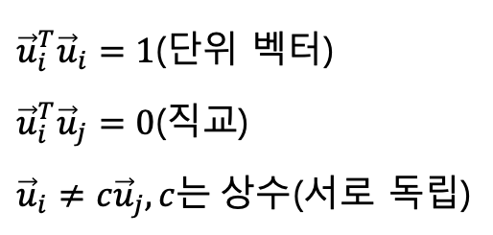
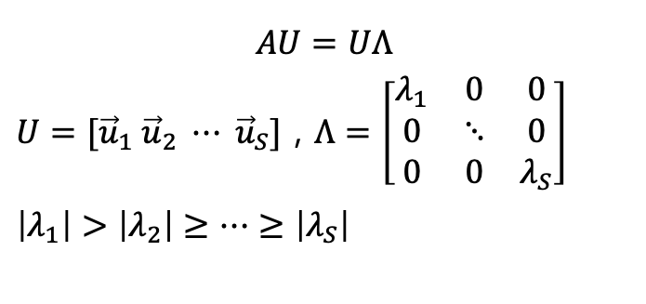
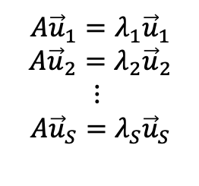
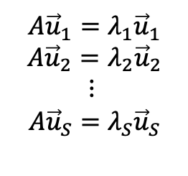
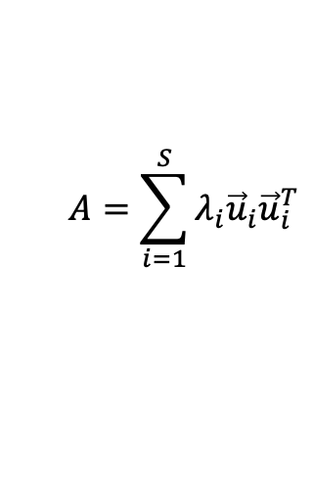
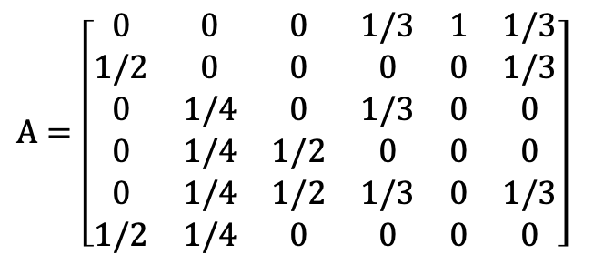
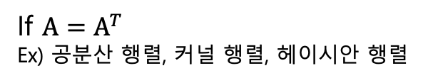

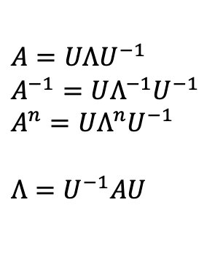
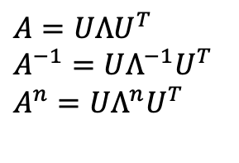
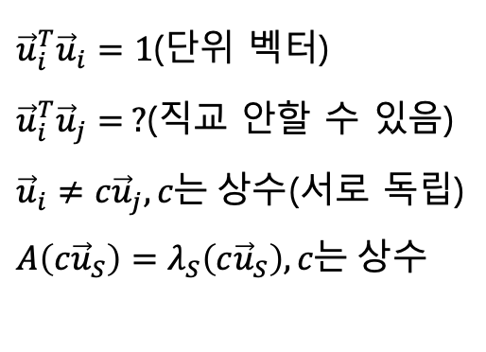
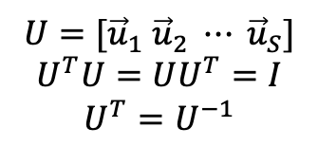
$A=\left[\begin{matrix}0 & 0 & 0 & 1/3 & 1 & 1/3 \\ 1/2 & 0 & 0 & 0 & 0 & 1/3 \\ 0 & 1/4 & 0 & 1/3 & 0 & 0 \\ 0 & 1/4 & 1/2 & 0 & 0 & 0 \\ 0 & 1/4 & 1/2 & 1/3 & 0 & 1/3 \\ 1/2 & 1/4 & 0 & 0 & 0 & 0\end{matrix}\right]$
If $A=A^{T}$
Ex) 공분산 행렬, 커널 행렬, 헤이시안 행렬
${\vec{u}}_{i}^{T}{\vec{u}}_{i}=1$(단위 벡터)
${\vec{u}}_{i}^{T}{\vec{u}}_{j}=0$(직교)
${\vec{u}}_{i}≠{c\vec{u}}_{j},c는 상수$(서로 독립)
$$A{\vec{u}}_{1}=λ_{1}{\vec{u}}_{1}$$
$$A{\vec{u}}_{2}=λ_{2}{\vec{u}}_{2}$$
$$⋮$$
$$A{\vec{u}}_{S}=λ_{S}{\vec{u}}_{S}$$
${\vec{u}}_{i}^{T}{\vec{u}}_{i}=1$(단위 벡터)
${\vec{u}}_{i}^{T}{\vec{u}}_{j}= ?$(직교 안할 수 있음)
${\vec{u}}_{i}≠{c\vec{u}}_{j},c는 상수$(서로 독립)
$A\left(c{\vec{u}}_{S}\right)=λ_{S}\left(c{\vec{u}}_{S}\right),c는 상수$
$$A{\vec{u}}_{1}=λ_{1}{\vec{u}}_{1}$$
$$A{\vec{u}}_{2}=λ_{2}{\vec{u}}_{2}$$
$$⋮$$
$$A{\vec{u}}_{S}=λ_{S}{\vec{u}}_{S}$$
$$U=[{\vec{u}}_{1} {\vec{u}}_{2} ⋯ {\vec{u}}_{S}]$$
$$U^{T}U=UU^{T}=I$$
$$U^{T}=U^{−1}$$
$A=UΛU^{−1}$
$A^{−1}=UΛ^{−1}U^{−1}$
$A^{n}=UΛ^{n}U^{−1}$
$Λ=U^{−1}AU$
$A=UΛU^{T}$
$A^{−1}=UΛ^{−1}U^{T}$
$A^{n}=UΛ^{n}U^{T}$
$$AU=UΛ$$
$U=[{\vec{u}}_{1} {\vec{u}}_{2} ⋯ {\vec{u}}_{S}]$ , $Λ=\left[\begin{matrix}λ_{1} & 0 & 0 \\ 0 & ⋱ & 0 \\ 0 & 0 & λ_{S}\end{matrix}\right]$
$\left|λ_{1}\right|>\left|λ_{2}\right|≥⋯≥\left|λ_{S}\right|$
$$Λ=U^{T}AU$$
$$A=\sum_{i=1}^{S}{λ_{i}{\vec{u}}_{i}{\vec{u}}_{i}^{T}}$$

Slide 3
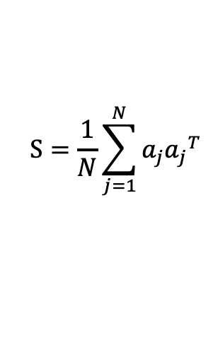
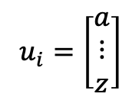

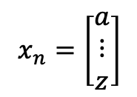
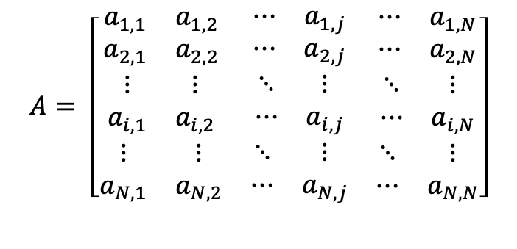
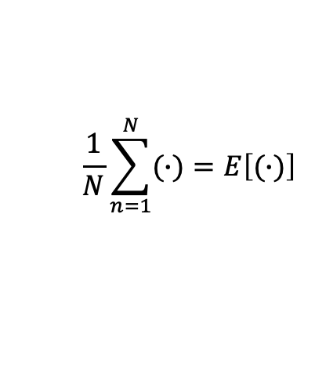
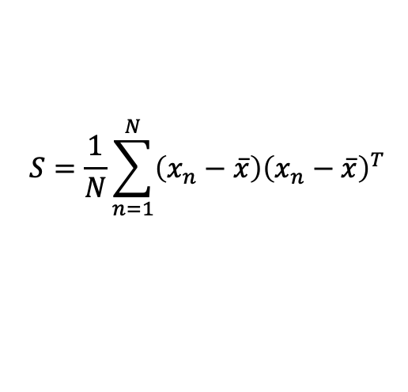

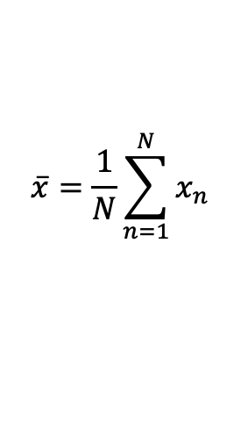
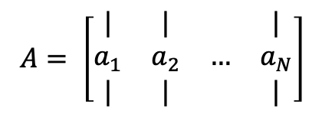
$$A= \left[\begin{matrix}\begin{matrix}a_{1,1} & a_{1,2} \\ a_{2,1} & a_{2,2}\end{matrix} & \begin{matrix}⋯ & a_{1,j} \\ ⋯ & a_{2,j}\end{matrix} & \begin{matrix}⋯ & a_{1,N} \\ ⋯ & a_{2,N}\end{matrix} \\ \begin{matrix}⋮ & ⋮ \\ a_{i,1} & a_{i,2}\end{matrix} & \begin{matrix}⋱ & ⋮ \\ ⋯ & a_{i,j}\end{matrix} & \begin{matrix}⋱ & ⋮ \\ ⋯ & a_{i,N}\end{matrix} \\ \begin{matrix}⋮ & ⋮ \\ a_{N,1} & a_{N,2}\end{matrix} & \begin{matrix}⋱ & ⋮ \\ ⋯ & a_{N,j}\end{matrix} & \begin{matrix}⋱ & ⋮ \\ ⋯ & a_{N,N}\end{matrix}\end{matrix}\right]$$
$$x_{n}=\left[\begin{matrix}a \\ ⋮ \\ z\end{matrix}\right]$$
$$u_{i}=\left[\begin{matrix}a \\ ⋮ \\ z\end{matrix}\right]$$
$$\overline{x}=\frac{1}{N}\sum_{n=1}^{N}{x_{n}}$$
$$A= \left[\begin{matrix}| & | & & | \\ a_{1} & a_{2} & … & a_{N} \\ | & | & & |\end{matrix}\right]$$
$$S=\frac{1}{N}\sum_{n=1}^{N}{\left(x_{n}−\overline{x}\right){\left(x_{n}−\overline{x}\right)}^{T}}$$
$$S=N^{−1}AA^{T}$$
$$S=\frac{1}{N}\sum_{j=1}^{N}{a_{j}{a_{j}}^{T}}$$
$$S=E\left[\left(x_{n}−\overline{x}\right){\left(x_{n}−\overline{x}\right)}^{T}\right]$$
$$\frac{1}{N}\sum_{n=1}^{N}{(∙)}=E\left[(∙)\right]$$

Slide 4
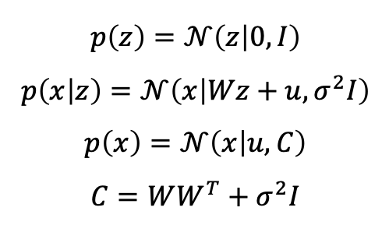

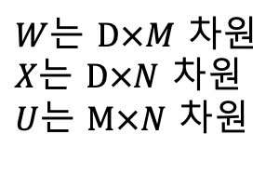


$D$는 데이터 차원
$M$은 줄이고 싶은 데이터 차원
$N$은 데이터 수
$$x=Wz+u+ε$$
$M<D$가 목적
$$p\left(z\right)=𝒩\left(z | 0, I\right)$$
$$p\left(x | z\right)=𝒩\left(x | Wz+u, σ^{2}I\right)$$
$$p\left(x\right)=𝒩\left(x | u, C\right)$$
$$C=WW^{T}+σ^{2}I$$
$W$는 $D×M$ 차원
$X$는 $D×N$ 차원
$U$는 $M×N$ 차원

Slide 5



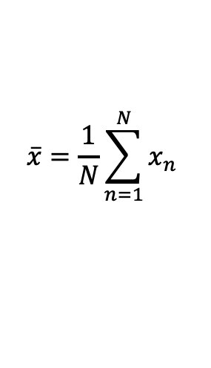

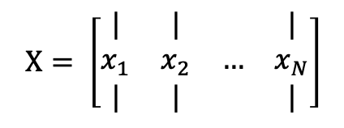
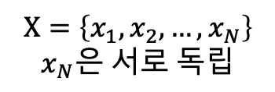
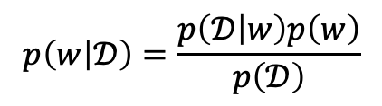
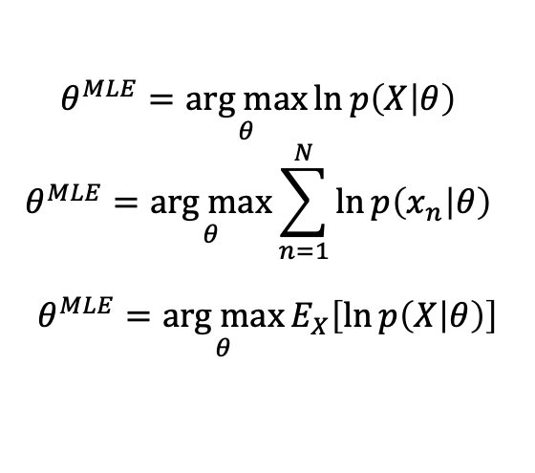

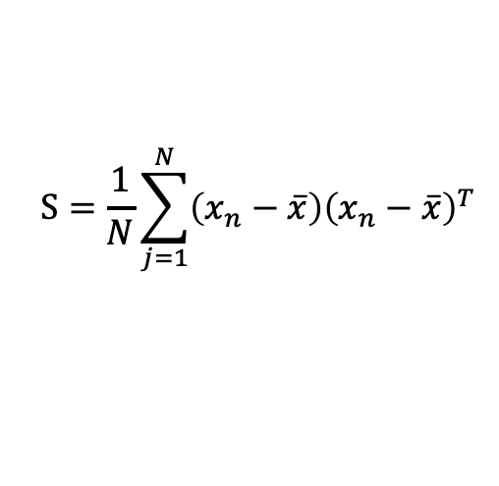
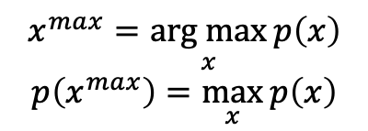

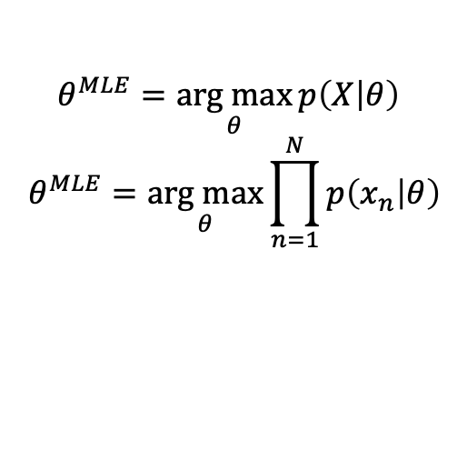
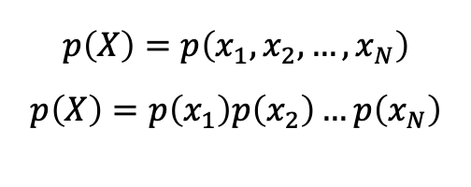

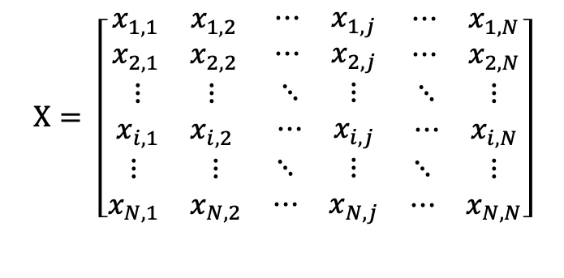
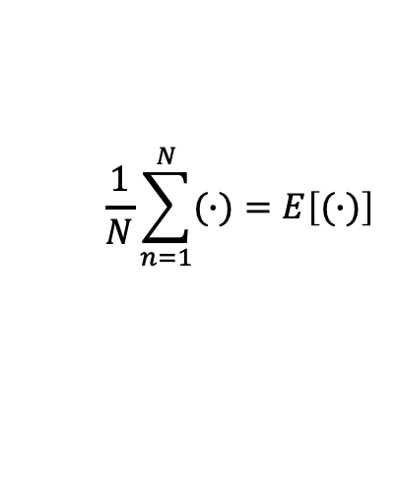

$$X= \left[\begin{matrix}\begin{matrix}x_{1,1} & x_{1,2} \\ x_{2,1} & x_{2,2}\end{matrix} & \begin{matrix}⋯ & x_{1,j} \\ ⋯ & x_{2,j}\end{matrix} & \begin{matrix}⋯ & x_{1,N} \\ ⋯ & x_{2,N}\end{matrix} \\ \begin{matrix}⋮ & ⋮ \\ x_{i,1} & x_{i,2}\end{matrix} & \begin{matrix}⋱ & ⋮ \\ ⋯ & x_{i,j}\end{matrix} & \begin{matrix}⋱ & ⋮ \\ ⋯ & x_{i,N}\end{matrix} \\ \begin{matrix}⋮ & ⋮ \\ x_{N,1} & x_{N,2}\end{matrix} & \begin{matrix}⋱ & ⋮ \\ ⋯ & x_{N,j}\end{matrix} & \begin{matrix}⋱ & ⋮ \\ ⋯ & x_{N,N}\end{matrix}\end{matrix}\right]$$
$$x^{max}=\underset{x}{arg max}{p\left(x\right)}$$
$$p\left(x^{max}\right)=\max_{x}{p\left(x\right)}$$
$$\frac{1}{N}\sum_{n=1}^{N}{(∙)}=E\left[(∙)\right]$$
$$\overline{x}=\frac{1}{N}\sum_{n=1}^{N}{x_{n}}$$
$$p\left(X\right)=p\left(x_{1},x_{2},…,x_{N}\right)$$
$$p\left(X\right)=p\left(x_{1}\right)p\left(x_{2}\right)…p\left(x_{N}\right)$$
$$X=\left\{x_{1},x_{2},…,x_{N}\right\}$$
$$x_{N}은 서로 독립$$
$$X= \left[\begin{matrix}| & | & & | \\ x_{1} & x_{2} & … & x_{N} \\ | & | & & |\end{matrix}\right]$$
$$p\left(X | θ\right)$$
$$θ는 모델 매개변수$$
$$θ^{MLE}=\underset{θ}{arg max}{\ln{p\left(X | θ\right)} }$$
$$θ^{MLE}=\underset{θ}{arg max}{\sum_{n=1}^{N}{\ln{p\left(x_{n} | θ\right)}} }$$
$$θ^{MLE}=\underset{θ}{arg max}{E_{X}\left[\ln{p\left(X | θ\right)}\right]}$$
$$S=N^{−1}\left(X−\overline{x}\right){\left(X−\overline{x}\right)}^{T}$$
$$θ^{MLE}=\underset{θ}{arg max}{p\left(X | θ\right) }$$
$$θ^{MLE}=\underset{θ}{arg max}{\prod_{n=1}^{N}{p\left(x_{n} | θ\right)}}$$
$$S=\frac{1}{N}\sum_{j=1}^{N}{\left(x_{n}−\overline{x}\right){\left(x_{n}−\overline{x}\right)}^{T}}$$
$$S=E\left[\left(x_{n}−\overline{x}\right){\left(x_{n}−\overline{x}\right)}^{T}\right]$$
$$p\left(w | 𝒟\right) posterior$$
$$p\left(w\right) :prior$$
$$p\left(w | 𝒟\right)=\frac{p\left(𝒟 | w\right)p\left(w\right)}{p\left(𝒟\right)}$$
$$𝒟는 데이터 집합$$
$$w는 모델 매개변수$$
$$p\left(𝒟 | w\right) :likelihood$$
Notes:
https://datascienceschool.net/view-notebook/864a2cc43df44531be32e3fa48769501/

Slide 6

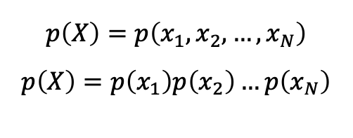


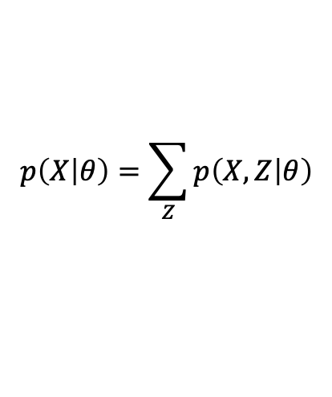
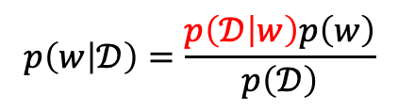
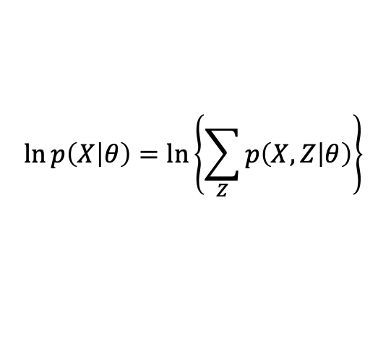
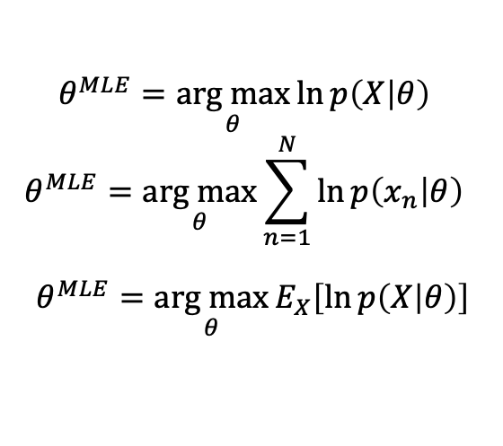
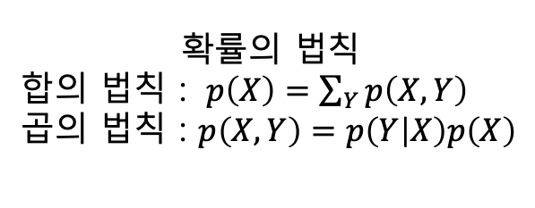



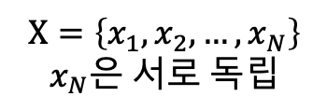
$$p\left(X\right)=p\left(x_{1},x_{2},…,x_{N}\right)$$
$$p\left(X\right)=p\left(x_{1}\right)p\left(x_{2}\right)…p\left(x_{N}\right)$$
$$X=\left\{x_{1},x_{2},…,x_{N}\right\}$$
$$x_{N}은 서로 독립$$
$$𝒟는 데이터 집합$$
$$w는 모델 매개변수$$
$$p\left(w | 𝒟\right) : posterior$$
$$p\left(w | 𝒟\right)=\frac{p\left(𝒟 | w\right)p\left(w\right)}{p\left(𝒟\right)}$$
$$p\left(w\right) :prior$$
$$p\left(𝒟 | w\right) :likelihood$$
$$p\left(X | θ\right)$$
$$θ는 모델 매개변수$$
$$θ^{MLE}=\underset{θ}{arg max}{\ln{p\left(X | θ\right)} }$$
$$θ^{MLE}=\underset{θ}{arg max}{\sum_{n=1}^{N}{\ln{p\left(x_{n} | θ\right)}} }$$
$$θ^{MLE}=\underset{θ}{arg max}{E_{X}\left[\ln{p\left(X | θ\right)}\right]}$$
$$p\left(X | θ\right)=\sum_{Z}{p\left(X,Z | θ\right)}$$
확률의 법칙
합의 법칙 : $p\left(X\right)=\sum_{Y}{p\left(X,Y\right)}$
곱의 법칙 : $p\left(X,Y\right)=p\left(Y | X\right)p\left(X\right)$
EM Algorithm
$$\ln{p\left(X | θ\right)=\ln\left\{\sum_{Z}{p\left(X,Z | θ\right)}\right\} }$$
Notes:
http://sanghyukchun.github.io/70/

Slide 7
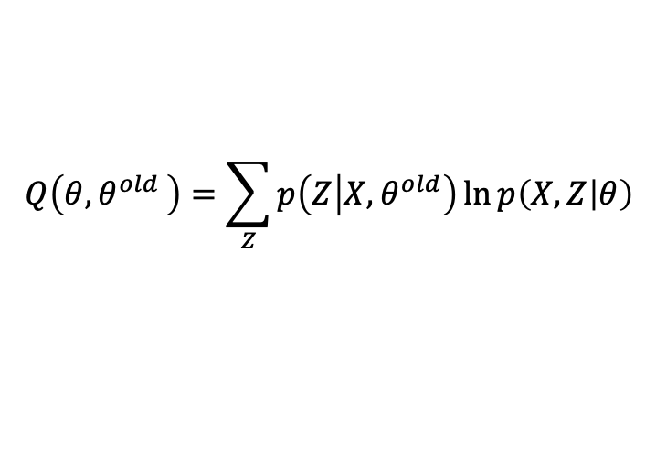


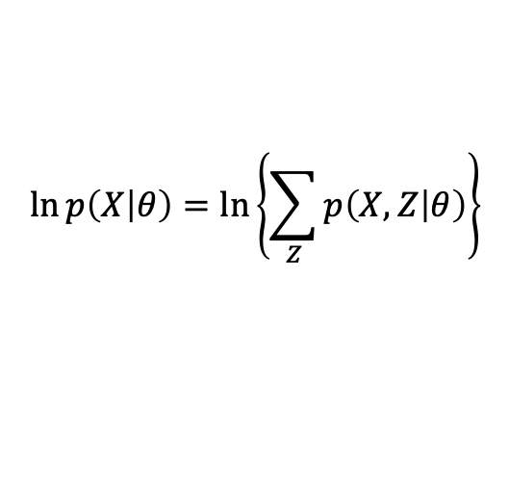

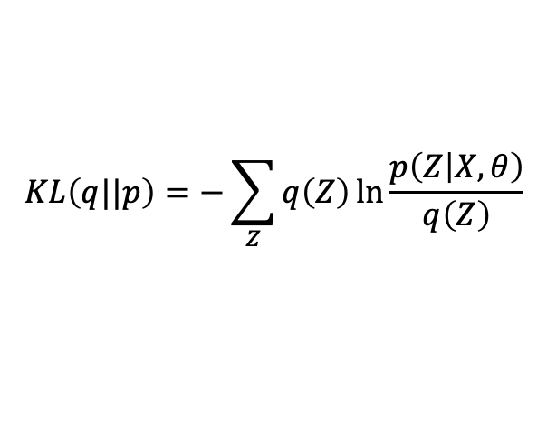
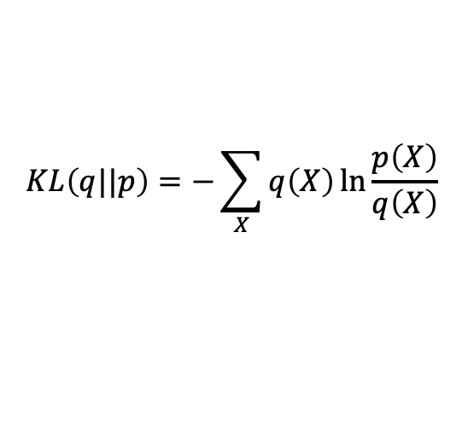
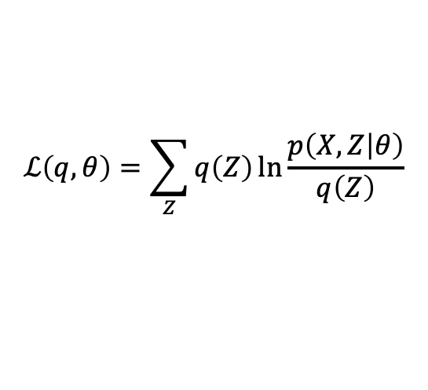

EM Algorithm
$$\ln{p\left(X | θ\right)}=\ln\left\{\sum_{Z}{p\left(X,Z | θ\right)}\right\}$$
$\ln{p\left(X | θ\right)}= ℒ\left(q,θ\right)+KL\left(q||p\right)$
$$q\left(Z\right)=p\left(Z | X,θ^{old}\right)$$
$$ℒ\left(q,θ\right)=\sum_{Z}{q\left(Z\right)\ln{\frac{p\left(X,Z | θ\right)}{q\left(Z\right)}}}$$
E-step
$$p\left(Z | X,θ^{old}\right)$$
M-step
$$θ^{new}=\underset{θ}{arg max}{Q\left(θ{,θ}^{old}\right) }$$
$$KL\left(q||p\right)=−\sum_{Z}{q\left(Z\right)\ln{\frac{p\left(Z | X,θ\right)}{q\left(Z\right)}}}$$
$$Q\left(θ{,θ}^{old}\right)=\sum_{Z}{p\left(Z | X,θ^{old}\right)\ln{p\left(X,Z | θ\right)}}$$
$$KL\left(q||p\right)=−\sum_{X}{q\left(X\right)\ln{\frac{p\left(X\right)}{q\left(X\right)}}}$$

Slide 8
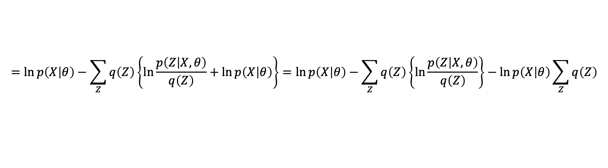
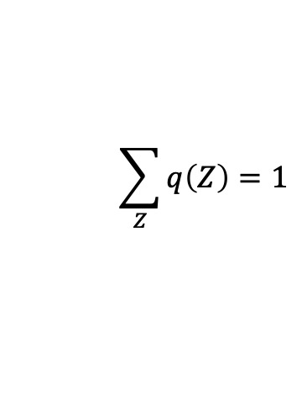
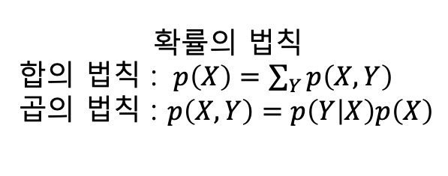
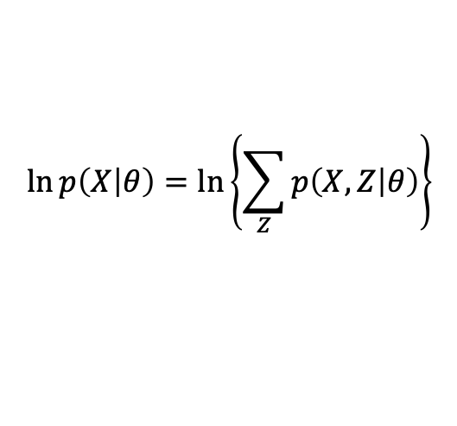
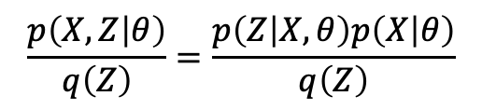
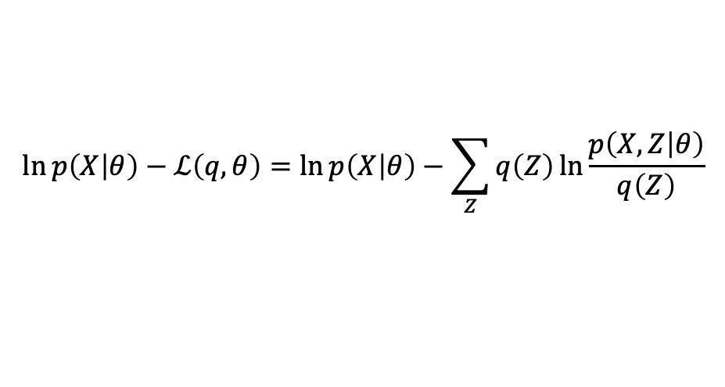


EM Algorithm 수식 유도
$$\ln{p\left(X | θ\right)}=\ln\left\{\sum_{Z}{p\left(X,Z | θ\right)}\right\}$$
$$\sum_{Z}{q\left(Z\right)}=1$$
$$\ln\left\{\sum_{Z}{p\left(X,Z | θ\right)}\right\}=\ln\left\{\sum_{Z}{q\left(Z\right)\frac{p\left(X,Z | θ\right)}{q\left(Z\right)}}\right\}≥\sum_{Z}{q\left(Z\right)\ln{\frac{p\left(X,Z | θ\right)}{q\left(Z\right)}}}=ℒ\left(q,θ\right)$$
확률의 법칙
합의 법칙 : $p\left(X\right)=\sum_{Y}{p\left(X,Y\right)}$
곱의 법칙 : $p\left(X,Y\right)=p\left(Y | X\right)p\left(X\right)$
$$\ln{p\left(X | θ\right)}−ℒ\left(q,θ\right)=\ln{p\left(X | θ\right)}−\sum_{Z}{q\left(Z\right)\ln{\frac{p\left(X,Z | θ\right)}{q\left(Z\right)}}}$$
$$\frac{p\left(X,Z | θ\right)}{q\left(Z\right)}=\frac{p\left(Z | X,θ\right)p\left(X | θ\right)}{q\left(Z\right)}$$
$$=\ln{p\left(X | θ\right)}−\sum_{Z}{q\left(Z\right)\left\{\ln{\frac{p\left(Z | X,θ\right)}{q\left(Z\right)}}+\ln{p\left(X | θ\right)}\right\}}=\ln{p\left(X | θ\right)}−\sum_{Z}{q\left(Z\right)\left\{\ln{\frac{p\left(Z | X,θ\right)}{q\left(Z\right)}}\right\}}−\ln{p\left(X | θ\right)}\sum_{Z}{q\left(Z\right)}$$
$$=−\sum_{Z}{q\left(Z\right)\ln{\frac{p\left(Z | X,θ\right)}{q\left(Z\right)}}}$$

Slide 9







EM Algorithm 수식 유도
$$\sum_{n=1}^{N}{\ln{p\left(x_{n} | θ\right)}} =\sum_{n=1}^{N}{\ln\left\{\sum_{i}{p\left(x_{n},z_{i} | θ\right)}\right\}}$$
$$\sum_{i}{q\left(z_{i}\right)}=1$$
$$\frac{p\left(x_{n},z_{i} | θ\right)}{q\left(z_{i}\right)}=\frac{p\left(z_{i} | x_{n},θ\right)p\left(x_{n} | θ\right)}{q\left(z_{i}\right)}$$
$$\sum_{n=1}^{N}{\ln\left\{\sum_{i}{p\left(x_{n},z_{i} | θ\right)}\right\}}=\sum_{n=1}^{N}{\ln\left\{\sum_{i}{q\left(z_{i}\right)\frac{p\left(x_{n},z_{i} | θ\right)}{q\left(z_{i}\right)}}\right\}}≥\sum_{n=1}^{N}{\sum_{i}{q\left(z_{i}\right)\ln{\frac{p\left(x_{n},z_{i} | θ\right)}{q\left(z_{i}\right)}}}}=\sum_{n=1}^{N}{ℒ\left(q,θ\right)}$$
$$\sum_{n=1}^{N}{\ln{p\left(x_{n} | θ\right)}}−\sum_{n=1}^{N}{ℒ\left(q,θ\right)}=\sum_{n=1}^{N}{\ln{p\left(x_{n} | θ\right)}}−\sum_{n=1}^{N}{\sum_{i}{q\left(z_{i}\right)\ln{\frac{p\left(x_{n},z_{i} | θ\right)}{q\left(z_{i}\right)}}}}$$
$$=\sum_{n=1}^{N}{\ln{p\left(x_{n} | θ\right)}}−\sum_{n=1}^{N}{\sum_{i}{q\left(z_{i}\right)\left\{\ln{\frac{p\left(z_{i} | x_{n},θ\right)}{q\left(z_{i}\right)}}+\ln{p\left(x_{n} | θ\right)}\right\}}}=\ln{p\left(X | θ\right)}−\sum_{Z}{q\left(Z\right)\left\{\ln{\frac{p\left(Z | X,θ\right)}{q\left(Z\right)}}\right\}}−\ln{p\left(X | θ\right)}\sum_{Z}{q\left(Z\right)}$$
$$=\sum_{n=1}^{N}{\ln{p\left(x_{n} | θ\right)}}−\sum_{n=1}^{N}{\sum_{i}{q\left(z_{i}\right)\left\{\ln{\frac{p\left(z_{i} | x_{n},θ\right)}{q\left(z_{i}\right)}}\right\}}}−\sum_{n=1}^{N}{\ln{p\left(x_{n} | θ\right)}}$$

Slide 10








EM Algorithm
$$\ln{p\left(X | θ\right)}=\ln\left\{\sum_{Z}{p\left(X,Z | θ\right)}\right\}$$
$\ln{p\left(X | θ\right)}= ℒ\left(q,θ\right)+KL\left(q||p\right)$
E-step
$$q\left(Z\right)=p\left(Z | X,θ^{old}\right)$$
$$KL\left(q||p\right)=−\sum_{Z}{q\left(Z\right)\ln{\frac{p\left(Z | X,θ\right)}{q\left(Z\right)}}}$$
$KL\left(q||p\right)$ 최소화
대입
$$ℒ\left(q,θ\right)=\sum_{Z}{q\left(Z\right)\ln{\frac{p\left(X,Z | θ\right)}{q\left(Z\right)}}}$$
M-step
$$θ^{new}=\underset{θ}{arg max}{Q\left(θ{,θ}^{old}\right) }$$
$$\sum_{Z}{p\left(Z | X,θ^{old}\right)\ln{\frac{p\left(X,Z | θ\right)}{p\left(Z | X,θ^{old}\right)}}}$$
$$Q\left(θ{,θ}^{old}\right)=\sum_{Z}{p\left(Z | X,θ^{old}\right)\ln{p\left(X,Z | θ\right)}}$$
계산
$$=\sum_{Z}{p\left(Z | X,θ^{old}\right)\ln{p\left(X,Z | θ\right)}}−\sum_{Z}{p\left(Z | X,θ^{old}\right)\ln{p\left(Z | X,θ^{old}\right)}}$$

Slide 11








$$θ^{MLE}=\underset{θ}{arg max}{\sum_{n=1}^{N}{\ln{p\left(x_{n} | θ\right)}} }$$
$$\sum_{n=1}^{N}{\ln\left\{\sum_{i}{p\left(x_{n},z_{i} | θ\right)}\right\}}≥\sum_{n=1}^{N}{\sum_{i}{q\left(z_{i}\right)\ln{\frac{p\left(x_{n},z_{i} | θ\right)}{q\left(z_{i}\right)}}}}$$
$$\sum_{n=1}^{N}{\ln{p\left(x_{n} | θ\right)}} =\sum_{n=1}^{N}{\ln\left\{\sum_{i}{p\left(x_{n},z_{i} | θ\right)}\right\}}=\sum_{n=1}^{N}{\sum_{i}{q\left(z_{i}\right)\ln{\frac{p\left(x_{n},z_{i} | θ\right)}{q\left(z_{i}\right)}}}} −\sum_{n=1}^{N}{\sum_{i}{q\left(z_{i}\right)\ln{\frac{p\left(z_{i} | x_{n},θ\right)}{q\left(z_{i}\right)}}}}$$
E step
$$q\left(z_{i}\right)=p\left(z_{i} | x_{n}{,θ}^{old}\right)$$
$$p\left(x_{n} | θ\right) 정의 어려움?$$
$$p\left(x_{n},z_{i} | θ\right) 정의 쉬움?$$
$$θ^{new}=\underset{θ}{arg max}{\sum_{n=1}^{N}{\sum_{i}{p\left(z_{i} | x_{n}{,θ}^{old}\right)\ln{p\left(x_{n},z_{i} | θ\right)}}}}$$
$$p\left(z_{i} | x_{n},θ\right) 정의 쉬움?$$
M step

