Slide 1

When Should Humans Overrule A.I.? An Ethics & Communication Project
Name: Kang Hin Lee
Cohort: D-12

Slide 2
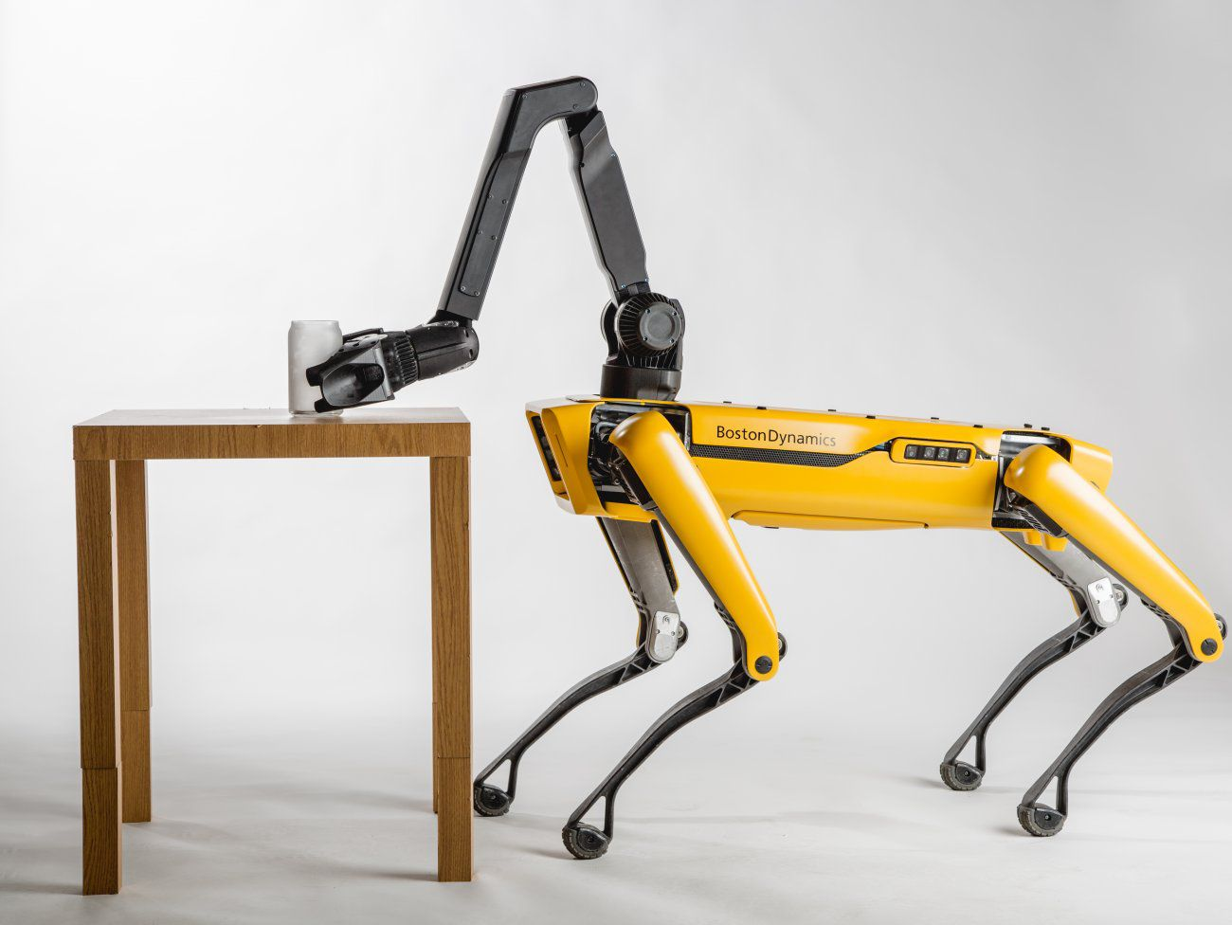
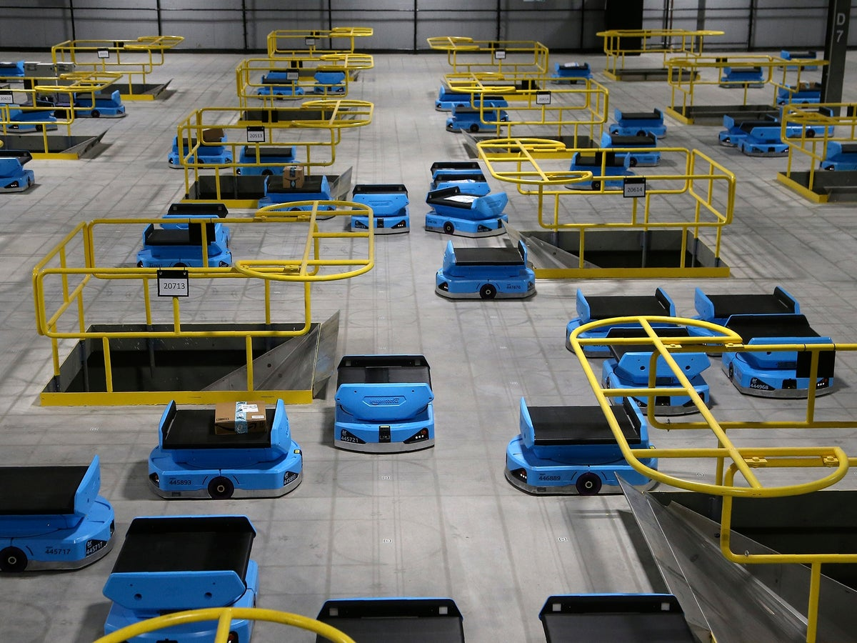
Introduction
Notes:
Artificial intelligence is a branch of computer science that has the ability to simulate and learn from the dataset to mimic simple intelligent behaviour.
AI industry has been growing exponentially in the past decade, and has been adapted in different industries to optimise process, increase efficiency or embedded in commercial products to predict user behaviour.
With this favourable technologies also induced catastrophic accidents. Some of the accidents could be easily prevented it is being handled by human, and
That brings us to today’s topics which is when should humans overrule A.I…

Slide 3
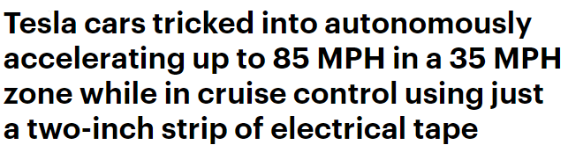
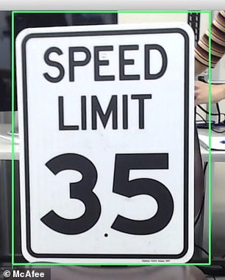
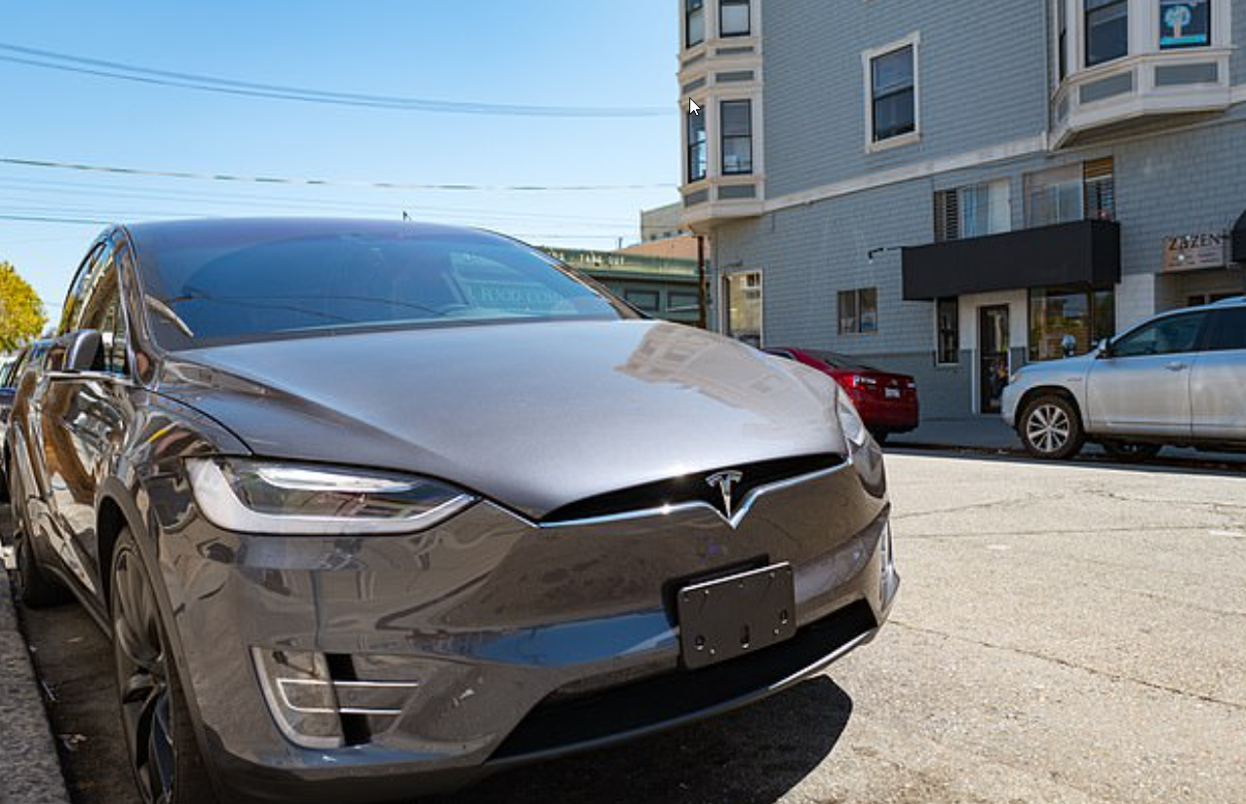
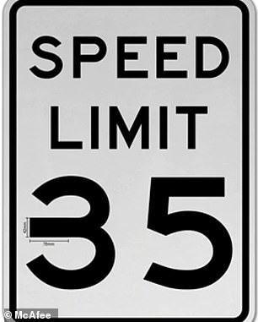
Case Study
Notes:
In 2020….
A group of McAfee researchers conducted an 18-month test on the autonomous functions from Tesla Model X and Model S.
In the final test, they have placed a tape across the middle of the 3 on a 35 mph speed limit sign and trick the system to misread and accelerated the car to 85mphs.
The test was done under controlled environment and fed back to Tesla for corrective actions.
The corrective solution is to use GPS
Or feeding in more data to improve the recognition system.
The case study highlighted the weakness of this autonomous function that is the function doesn’t know its competency.
The user cannot foresee when this will happen.
This points towards my answer of when should humans overrule the A.I.

Slide 4
When Should Humans Overrule A.I.? Answer: Always
Notes:
Its favourable self-learning ability can be misleading that people think it can displace their complex workload,
But in reality it should be used as a guidance to compensate what human can’t do and provide extra precaution or warnings for the users to interpret and avoid any potential hazards and to reduce risk.
In addition, there should be stand-alone function to unplug the AI when it is malfunctioning to prevent any further interference.

Slide 5
The End

Slide 6
Reference:
https://www.zdnet.com/article/ai-needs-to-be-controlled-but-lazy-humans-may-not-be-up-to-the-job/
https://www.nature.com/articles/s41599-020-0501-9
https://www.dailymail.co.uk/sciencetech/article-8021567/Tesla-cars-tricked-accelerating-85-MPH-35-MPH-zone-using-just-strip-tape.html
https://news.harvard.edu/gazette/story/2020/10/ethical-concerns-mount-as-ai-takes-bigger-decision-making-role/

