Slide 1
K-mean Cluster

Slide 2
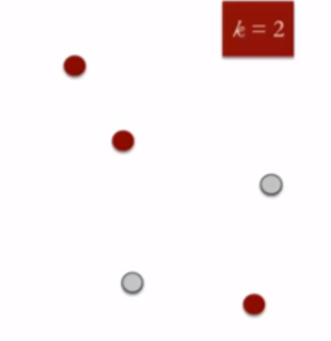
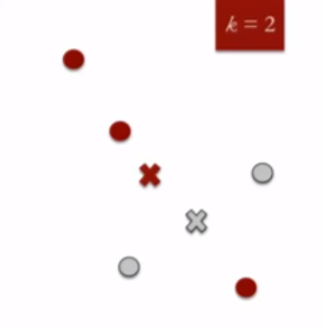
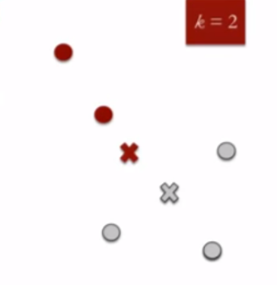


K-Mean-Cluster: How it works
Cluster location selection:
Iterate k-cluster(s) and return lowest variance per cluster.

Slide 3

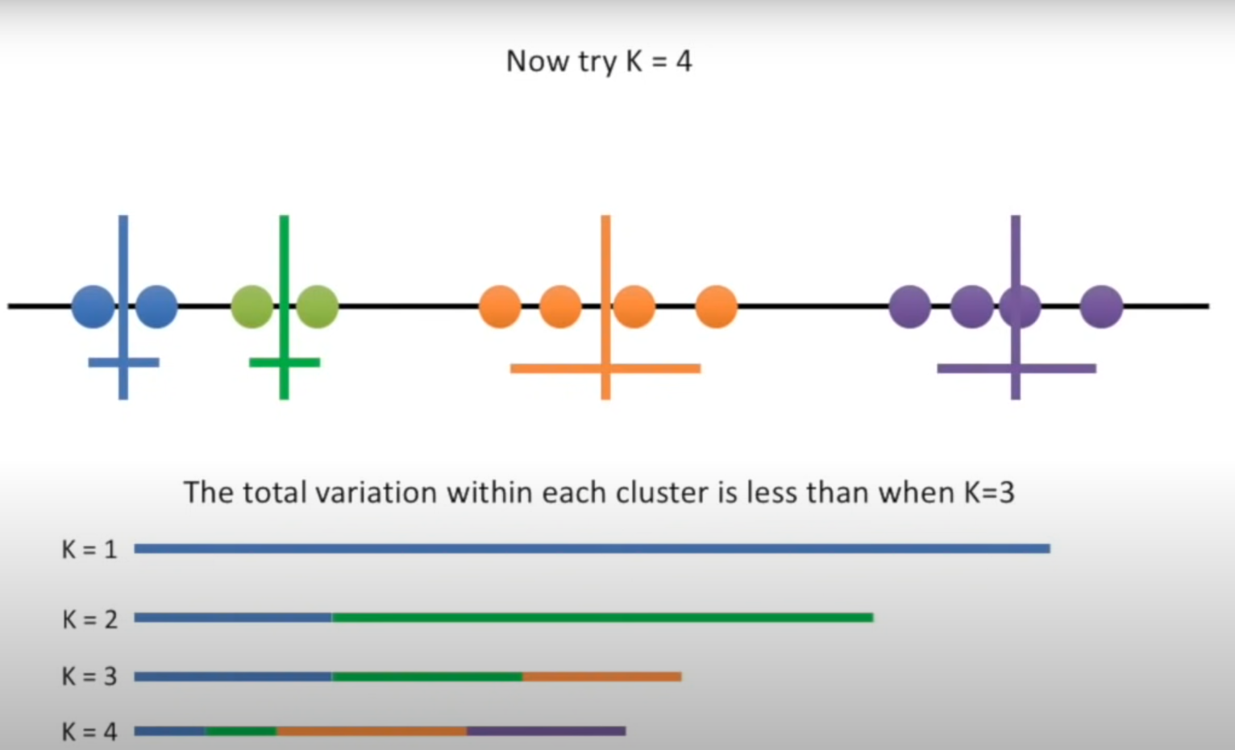
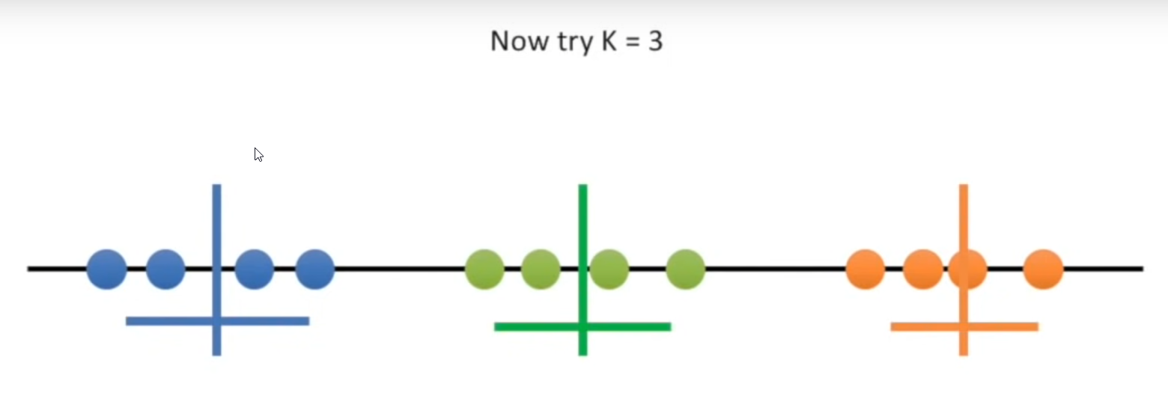
Automated-K-Mean-Cluster

Slide 4
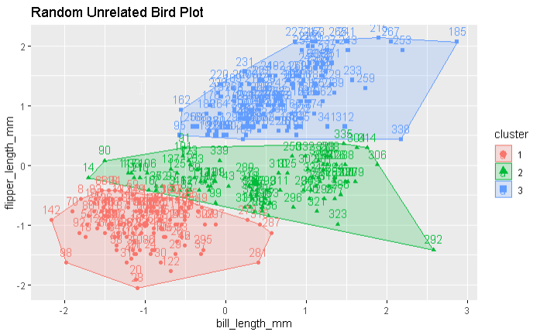
Example

