Slide 1
Pearson Education Tech Presetation
Data n

Slide 2
01: Introduction
Dataset Format: .xlsx (Excel)
Software Used for Data Analysis: R / R Studio
Control Version: Github
Presentation: Power point

Slide 3
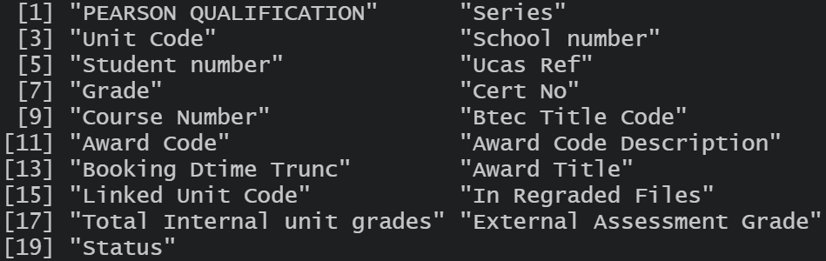
02: Dataset: BTEC Tech Awards (June 2020)
Pearson BTEC Level 1 / Level 2 Tech Award (Award Code: Y6)
Series: 01 – June - 2020
Dataframe Size: 19 variables with 6518 rows
Data Type: Character, Numeric, Boolean, Time Series

Slide 4
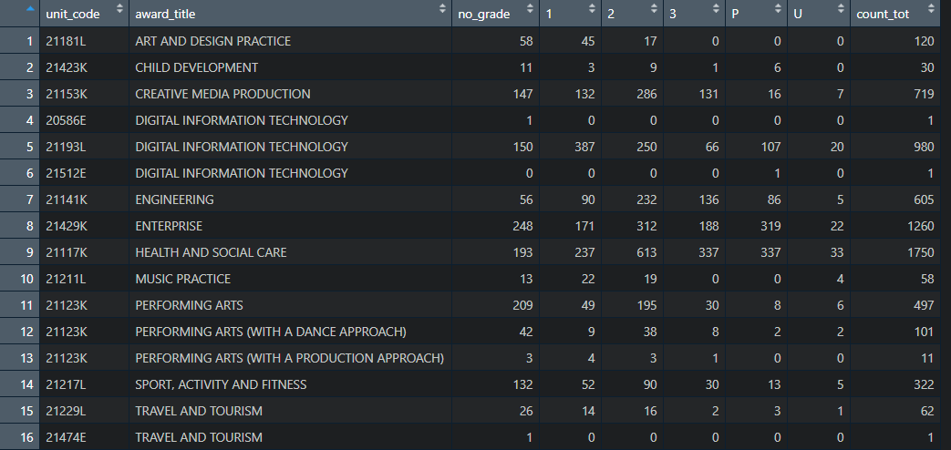
02: Dataset: BTEC Tech Awards (June 2020)
Notes:
6518 records in total
13 Award Titles
1243 Schools
175 candidates missing student number
1290 candidates missing grade
Text in red:
Award Title contains 2 or more unit code
Text in green:
Unit Code contains 2 or more award title

Slide 5
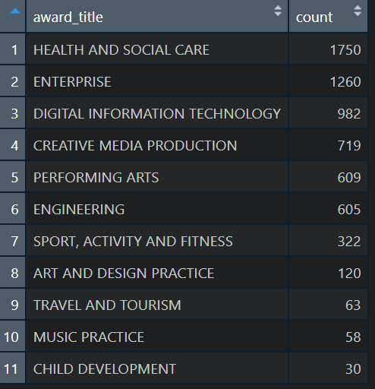
03: Data Analysis: Award Count

Slide 6
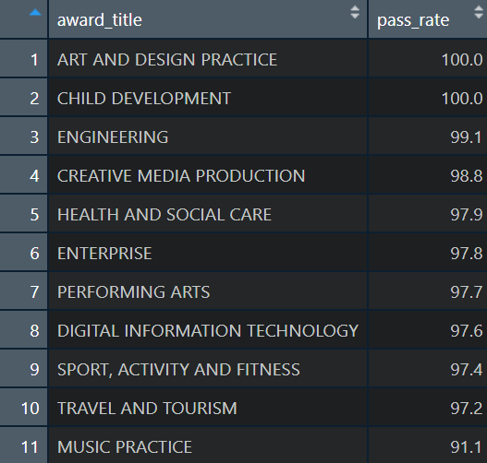
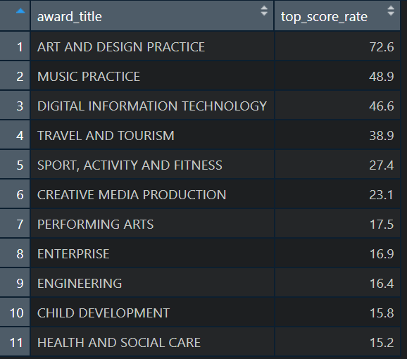
Data Analysis Pass Rate (%)
03: Data Analysis: Pass & Top Score Rate
Data Analysis Top Score Rate (%)

Slide 7
Any Issues Encountered

Slide 9
Static columns
Pearson Qualification: BTEC Tech Awards
Series: 2020-06-01
ucas_ref: N/A
cert_no: N/A
award_code: Y6
award_code_desciprtion: PEARSON BTEC LEVEL 1/LEVEL 2 TECH AWARD (120 GLH)
in_regraded_files: 0
external_assessment_grade: N/A
status: Unknown anomalie

