Slide 1

Technical Data Analysis Presentation
By Kang Hin Lee

Slide 2
00: Introduction

Slide 3




00: Introduction
Presentation is separated into 3 parts:
01: The Dataset
02: Data Analysis
03: Issue(s) Encountered
Dataset Format: .xlsx (Excel)
Data Processing Language: R
Software for Data Processing: R Studio
Presentation: Powerpoint
Control Version: Github
Script can be viewed from: https://github.com/kanghinlee/interview_prep/tree/main/pearson_edu_presentation
Notes:
The aim of the presentation is to provide an understanding to the dataset

Slide 4
01: The Dataset

Slide 5
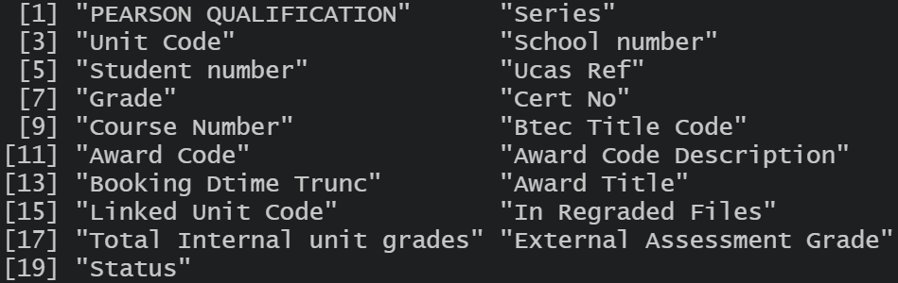
01: Dataset: BTEC Tech Awards
Dataframe Size: 6518 rows with 19 variables
Data Type: Character, Numeric, Boolean, Time Series
Records are for Pearson BTEC Level 1 / Level 2 Tech Award (Award Code: Y6)
Series: 01 – June - 2020

Slide 6
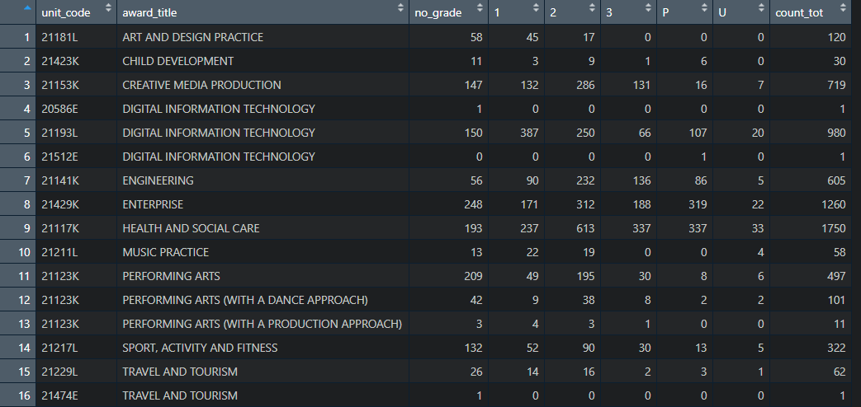
01: Dataset: BTEC Tech Awards
Notes:
6518 records in total
1243 Schools
16 Unit Codes with 13 Award Titles
175 candidates missing student number
1290 candidates missing grade
Text in red:
Award Title contains 2 or more unit code
Text in green:
Unit Code contains 2 or more award title

Slide 7
02: Data Analysis

Slide 8
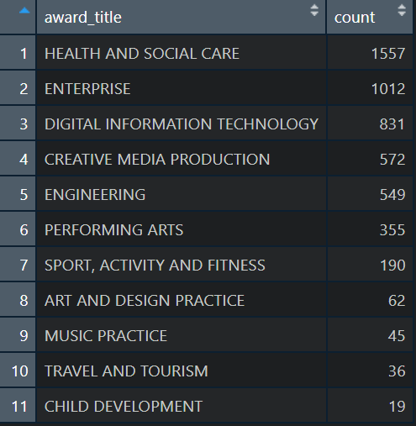
02: Data Analysis: Award Count
Assumptions:
Combined “Digital information Tech” categories into single category.
Combined “Performing Arts” categories into single category.
Removed 1290 records with missing Grades
Notes:
Instead of summarised them via unit codes, I have summarised them via award_title
Removed 1290 Missing Grades

Slide 9
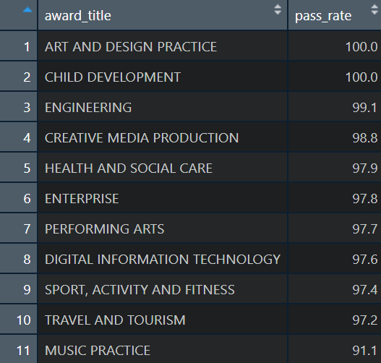
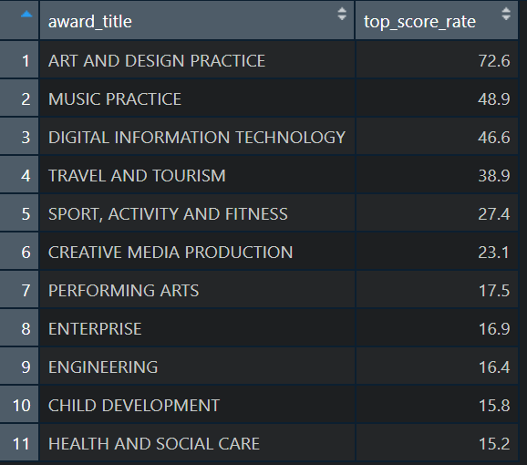
Data Analysis Pass Rate (%)
02: Data Analysis: Pass & Top Score Rate
Data Analysis Top Score Rate (%)

Slide 10
Data Analysis Pass Rate (%)
02: Data Analysis: Pass & Top Score Rate
Data Analysis Top Score Rate (%)
Notes:
Art, has the highest Pass & top score rate, missing grades

Slide 11
03: Any Issues Encountered?

Slide 12
Any Questions?

Slide 13
The End

Slide 14
Appendix: Static Columns
Pearson Qualification: BTEC Tech Awards
Series: 2020-06-01
ucas_ref: N/A
cert_no: N/A
award_code: Y6
award_code_desciprtion: PEARSON BTEC LEVEL 1/LEVEL 2 TECH AWARD (120 GLH)
in_regraded_files: 0
external_assessment_grade: N/A
status: Unknown anomalie

