Slide 1
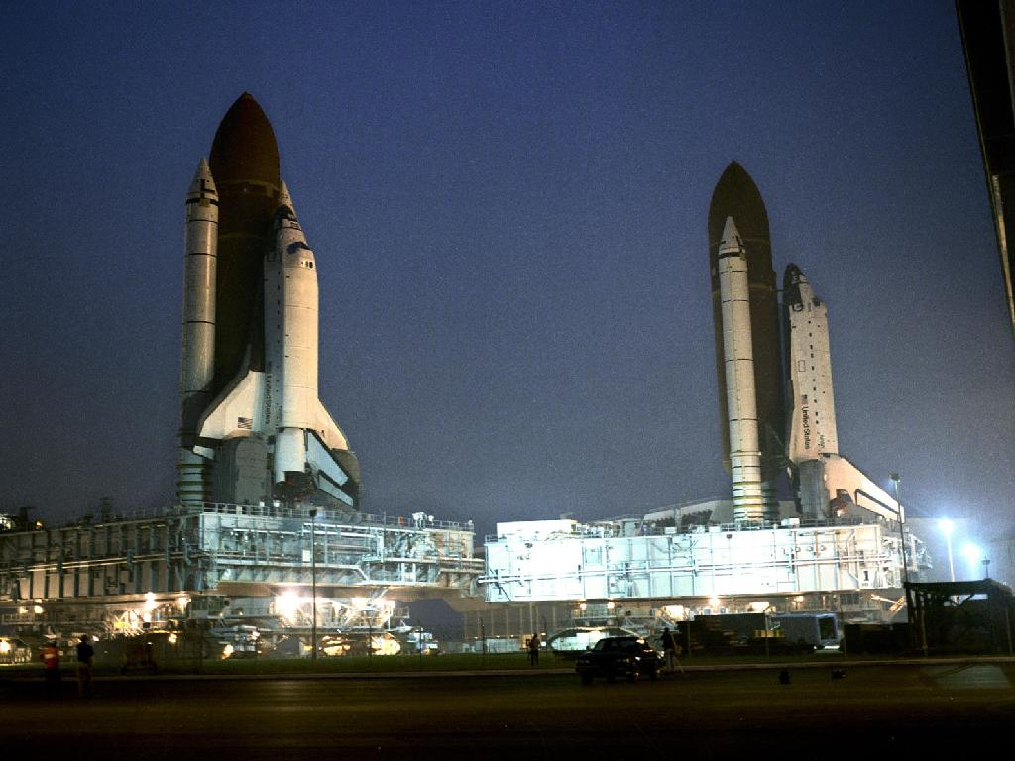
Login

Slide 2
By participating in the partner matching scheme, the data you provide to the system will be made available for viewing by other students who also register for matching.
The system is restricted for use to NUS students.
You may de-register at any time, removing your data from the system.
All student data will be removed 2 weeks after Lift-off.

Slide 3
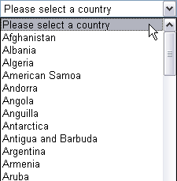
Name:
Sex:  Male  Female
Facebook:
LinkedIn:
Orbital Level:
Восто́к (Vostok) (Easy/Beginner)
Project Gemini (Intermediate)
Appollo 11 (Advanced/Difficult)
I will be doing Orbital mostly from:
Describe your skill set, preferences and other constraints
Submit

Slide 4
Name:
Lee Wee Sun
Sex:  Male  Female
Facebook:
https://www.facebook.com/weesun.lee
LinkedIn:
http://sg.linkedin.com/pub/wee-sun-lee /3b/344/96
Orbital Level:
Восто́к (Vostok) (Easy/Beginner)
Project Gemini (Intermediate)
◉ Appollo 11 (Advanced/Difficult)
I will be doing Orbital mostly from:
Describe your skill set, preferences and other constraints
Familiar with python and jinja2. See http://orbitalpartner.appspot.com/ for an example of my work. Prefer a partner who will be overseas to practice remote pair programming.
Delete Profile:  No  Yes
and de-register
Submit

Slide 5
Search parameters
Sex:
Orbital Level:
Country:
Submit

Slide 6


Search results
Name | Sex | FB/LinkedIn | Orbital Level | Working From
Lee Wee Sun More | M |  | Apollo 11 | Singapore
Nguyen Viet Cuong More | M |  | Apollo 11 | Vietnam

Slide 7
Search results
Name | Sex | FB/LinkedIn | Orbital Level | Working From
Lee Wee Sun leews@comp.nus.edu.sg Familiar with python and jinja2. See http://orbitalpartner.appspot.com/ for an example of my work. Prefer a partner who will be overseas to practice remote pair programming. | M |  | Apollo 11 | Singapore
Nguyen Viet Cuong More | M |  | Apollo 11 | Vietnam

Slide 8
Action:  Delete  Ban from system
Select all ☐ | Name | Email
☑ | Lee Wee Sun | leews@comp.nus.edu.sg
☐ | Kan Min-Yen | kanmy@comp.nus.edu.sg
Submit

