Slide 1
3.4 수평 하중

Slide 2
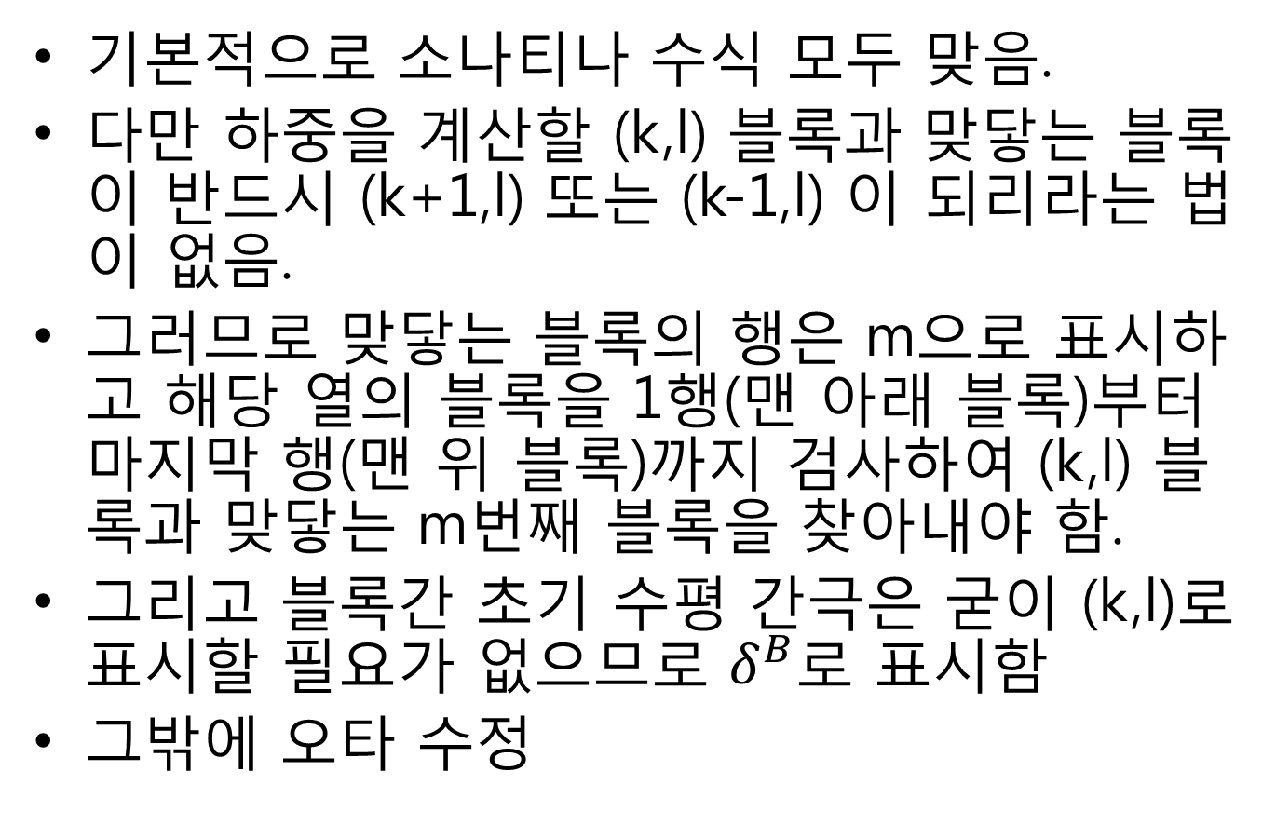
수평 하중
기본적으로 소나티나 수식 모두 맞음.
다만 하중을 계산할 (k,l) 블록과 맞닿는 블록이 반드시 (k+1,l) 또는 (k-1,l) 이 되리라는 법이 없음.
그러므로 맞닿는 블록의 행은 m으로 표시하고 해당 열의 블록을 1행(맨 아래 블록)부터 마지막 행(맨 위 블록)까지 검사하여 (k,l) 블록과 맞닿는 m번째 블록을 찾아내야 함.
그리고 블록간 초기 수평 간극은 굳이 (k,l)로 표시할 필요가 없으므로 $δ^{B}$로 표시함
그밖에 오타 수정

Slide 3
































Force SuperScript 정의
$$w_{k,l}^{}$$
<1st Character>
- Horizontal
T : Top
M : Upper-Middle
N : Lower-Middle
B : Bottom
Vertical
V : Vertical
Friction
F : Friction
- Dowel
D : Dowel
Fluid
P : Pressure Drop
<2nc Character>
L : Left
R : Right
$$Dowel$$
$$F_{k,l+1}^{VL}$$
$${μF}_{k,l+1}^{DL}$$
$${μF}_{k,l+1}^{DR}$$
$$F_{k,l+1}^{DL}$$
$$F_{k,l+1}^{VR}$$
$$F_{k,l}^{TL}$$
$$F_{k,l+1}^{F}$$
$$F_{k,l+1}^{DR}$$
$$F_{k,l}^{ML}$$
$$θ_{k,l}^{}$$
$$F_{k,l}^{TR}$$
$$F_{k,l}^{MR}$$
$$h_{k,l}^{}$$
$$u_{k,l}^{}$$
$$F_{k,l}^{NL}$$
$m_{k,l}^{}$g + $F_{k,l}^{P}$
$$b_{k,l}^{}$$
$$h_{k,l}^{}$$
$$a_{k,l}^{}$$
$$F_{k,l}^{NR}$$
$$F_{k,l}^{BL}$$
$$d_{k,l}^{}$$
$$F_{k,l}^{DL}$$
$$F_{k,l}^{DR}$$
$$F_{k,l}^{BR}$$
$$F_{k,l}^{F}$$
$$F_{k,l}^{VL}$$
$${μF}_{k,l}^{DL}$$
$$F_{k,l}^{VR}$$
$${μF}_{k,l}^{DR}$$
하중 방향은 보기 좋게 하기 위해
힘의 방향을 임의로 그림.
실제 수식에서는 힘과 모멘트는 모두
좌표축 방향을 (+)로 함.

Slide 4
Z의 정의
Top
Left
Right
Z_{lt}
Z_{rt}
Bottom
Z_{lb}
Z_{rb}
Z=0

Slide 5

하중 정의
F^{TR}
F^{ML}
F^{BL}
F^{NR}
Lower left corner
Upper right corner
Upper-middle
left corner
Lower-middle
right corner
F^{TL}
F^{MR}
F^{BR}
F^{NL}
Upper left corner
Lower right corner
Lower-middle
left corner
Upper-middle
right corner

Slide 6
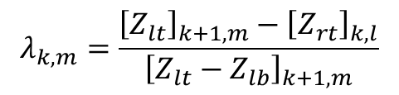
Lambda 접촉조건1
UR
$$λ_{k,m}=\frac{{\left[Z_{lt}\right]}_{k+1,m}−{\left[Z_{rt}\right]}_{k,l}}{{\left[Z_{lt}−Z_{lb}\right]}_{k+1,m}}$$
k+1
λ=1
k+1
1<λ
$$λ_{k,m}=\frac{{\left[Z_{rt}\right]}_{k−1,m}−{\left[Z_{lt}\right]}_{k,l}}{{\left[Z_{rt}−Z_{rb}\right]}_{k−1,m}}$$
0≤λ<1
(1이 되는 순간 m-1과 매치)
k
k+1
λ=0
k+1
0<λ<1
UL도 마찬가지로
0≤λ<1
k
k+1
λ<0
k+1
λ<0
U-M R
$$λ_{k,m}=\frac{{\left[Z_{rt}\right]}_{k,l}−{\left[Z_{lt}\right]}_{k+1,m}}{{\left[Z_{rt}−Z_{rb}\right]}_{k,l}}$$
k+1
λ<0
k+1
λ<0
$$λ_{k,m}=\frac{{\left[Z_{lt}\right]}_{k,l}−{\left[Z_{rt}\right]}_{k−1,m}}{{\left[Z_{lt}−Z_{lb}\right]}_{k,l}}$$
0<λ<1
(λ=0,1은 UR,LR과 중복됨)
k
k+1
λ=0
UR 중복
k+1
0<λ<1
U-M L도 마찬가지로
0<λ<1
k
k+1
λ=1
LR 중복
k+1
1<λ

Slide 7
Lambda 접촉조건2
L-M R
$$λ_{k,m}=\frac{{\left[Z_{rt}\right]}_{k,l}−{\left[Z_{lb}\right]}_{k+1,m}}{{\left[Z_{rt}−Z_{rb}\right]}_{k,l}}$$
k+1
λ=0
UR 중복
k+1
λ<0
$$λ_{k,m}=\frac{{\left[Z_{lt}\right]}_{k,l}−{\left[Z_{rb}\right]}_{k−1,m}}{{\left[Z_{lt}−Z_{lb}\right]}_{k,l}}$$
0<λ<1
(λ=0,1은 UR,LR과 중복됨)
k
k+1
λ=1
LR 중복
k+1
0<λ<1
L-M L도 마찬가지로
0<λ<1
k
k+1
1<λ
k+1
1<λ
LR
$$λ_{k,m}=\frac{{\left[Z_{rt}\right]}_{k−1,m}−{\left[Z_{lb}\right]}_{k,l}}{{\left[Z_{rt}−Z_{rb}\right]}_{k−1,m}}$$
$$λ_{k,m}=\frac{{\left[Z_{lt}\right]}_{k+1,m}−{\left[Z_{rb}\right]}_{k,l}}{{\left[Z_{lt}−Z_{lb}\right]}_{k+1,m}}$$
k+1
1<λ
k+1
1<λ
k
LL도 마찬가지로
0<λ≤1
0<λ≤1
(0이 되는 순간 m+1과 매치)
k
k+1
λ=1
k+1
0<λ<1
k+1
λ=0
k+1
λ<0

Slide 8
Lambda 접촉조건1
UR
$$λ_{k,m}=\frac{{\left[Z_{lt}\right]}_{k+1,m}−{\left[Z_{rt}\right]}_{k,l}}{{\left[Z_{lt}−Z_{lb}\right]}_{k+1,m}}$$
(k+1,m)
λ=0
0<λ<1
(k+1,m)
λ=1
0≤λ<1
(k,l)
(k+1,m)
(k,l)
(k,l)
λ=0 (Match)
0<λ<1 (Match)
λ=1
(Match to (k+1,m-1))
U-M R
$$λ_{k,m}=\frac{{\left[Z_{rt}\right]}_{k,l}−{\left[Z_{lt}\right]}_{k+1,m}}{{\left[Z_{rt}−Z_{rb}\right]}_{k,l}}$$
(k,l)
0<λ<1
(λ=0,1은 UR,LR과 중복됨)
λ=0
(k,l)
0<λ<1
λ=1
(k,l)
(k+1,m)
(k+1,m)
(k+1,m)
λ=0 (Same to UR)
0<λ<1 (Match)
λ=1 (Same to LR)

Slide 9
Lambda 접촉조건2
L-M R
$$λ_{k,m}=\frac{{\left[Z_{rt}\right]}_{k,l}−{\left[Z_{lb}\right]}_{k+1,m}}{{\left[Z_{rt}−Z_{rb}\right]}_{k,l}}$$
(k+1,m)
(k+1,m)
(k,l)
(k+1,m)
(k,l)
(k,l)
0<λ<1
(λ=0,1은 UR,LR과 중복됨)
λ=0
0<λ<1
λ=1
λ=0
(Match to (k+1,m-1))
0<λ<1 (Match)
λ=1
(Same to LR)
LR
$$λ_{k,m}=\frac{{\left[Z_{lt}\right]}_{k+1,m}−{\left[Z_{rb}\right]}_{k,l}}{{\left[Z_{lt}−Z_{lb}\right]}_{k+1,m}}$$
(k,l)
(k,l)
0<λ<1
(k,l)
(k+1,m)
λ=0
(k+1,m)
0<λ≤1
(k+1,m)
λ=1
λ=0
(Match to (k+1,m+1))
0<λ<1 (Match)
λ=1(Match)

Slide 10
수평 우측

Slide 11
수평 Upper Right
$$λ_{k,m}=\frac{{\left[Z_{lt}\right]}_{k+1,m}−{\left[Z_{rt}\right]}_{k,l}}{{\left[Z_{lt}−Z_{lb}\right]}_{k+1,m}}$$
If $0≤λ_{k,m}<1$,
$$ε_{k,l}=u_{k,l}+\left\{h_{k,l}\sin{θ_{k,l}}−b_{k,l}\left(1−\cos{θ_{k,l}}\right)\right\}−u_{k+1,m}−\left\{{\left(1−2λ_{k, m}\right)h}_{k+1,m}\sin{θ_{k+1,m}}+b_{k+1,m}\left(1−\cos{θ_{k+1,m}}\right)\right\}−δ^{B}$$
$${\dot{ε}}_{k,l}={\dot{u}}_{k,l}+\left(h_{k,l}\cos{θ_{k,l}}−b_{k,l}\sin{θ_{k,l}}\right){\dot{θ}}_{k,l}−{\dot{u}}_{k+1,m}−\left\{{\left(1−2λ_{k, m}\right)h}_{k+1,m}\cos{θ_{k+1,m}}+b_{k+1,m}\sin{θ_{k+1,m}}\right\}{\dot{θ}}_{k+1,m}$$
If $ε_{k,l}>$0, (스프링이 수축된다면)
$$F_{k,l}^{TR}=−K_{k,l}^{B}ε_{k,l}−C_{k,l}^{B}{\dot{ε}}_{k,l}$$
$$M\left(F_{k,l}^{TR}\right)=F_{k,l}^{TR}\left(h_{k,l}\cos{θ_{k,l}}−b_{k,l}\sin{θ_{k,l}}\right)$$
$ε$ : Spring contraction
$K_{k,l}^{B}$ and $C_{k,l}^{B}$ : Spring and damping coefficients respectively
(k,l)
(k+1,m)
+h sinR
+h sinR
+b(1-cosR)
-b(1-cosR)
-h sinR
-h sinR
+b(1-cosR)
-b(1-cosR)
+h cosR
+h cosR
+b sinR
-b sinR
-h cosR
-h cosR
+b sinR
-b sinR

Slide 12
수평 Upper-Middle Right
(k,l)
(k+1,m)
$$λ_{k,m}=\frac{{\left[Z_{rt}\right]}_{k,l}−{\left[Z_{lt}\right]}_{k+1,m}}{{\left[Z_{rt}−Z_{rb}\right]}_{k,l}}$$
If $0<λ_{k,m}<1$,
$$ε_{k,l}=u_{k,l}+\left\{\left(1−2λ_{k, m}\right)h_{k,l}\sin{θ_{k,l}}−b_{k,l}\left(1−\cos{θ_{k,l}}\right)\right\}−u_{k+1,m}−\left\{h_{k+1,m}\sin{θ_{k+1,m}}+b_{k+1,m}\left(1−\cos{θ_{k+1,m}}\right)\right\}−δ^{B}$$
$${\dot{ε}}_{k,l}={\dot{u}}_{k,l}+\left\{\left(1−2λ_{k, m}\right)h_{k,l}\cos{θ_{k,l}}−b_{k,l}\sin{θ_{k,l}}\right\}{\dot{θ}}_{k,l}−{\dot{u}}_{k+1,m}−\left(h_{k+1,m}\cos{θ_{k+1,m}}+b_{k+1,m}\sin{θ_{k+1,m}}\right){\dot{θ}}_{k+1,m}$$
If $ε_{k,l}>$0, (스프링이 수축된다면)
$$F_{k,l}^{MR}=−K_{k,l}^{B}ε_{k,l}−C_{k,l}^{B}{\dot{ε}}_{k,l}$$
$$M\left(F_{k,l}^{MR}\right)=F_{k,l}^{MR}\left(\left(1−2λ_{k, m}\right)h_{k,l}\cos{θ_{k,l}}−b_{k,l}\sin{θ_{k,l}}\right)$$
$ε$ : Spring contraction
$K_{k,l}^{B}$ and $C_{k,l}^{B}$ : Spring and damping coefficients respectively
+h sinR
+h sinR
+b(1-cosR)
-b(1-cosR)
-h sinR
-h sinR
+b(1-cosR)
-b(1-cosR)
+h cosR
+h cosR
+b sinR
-b sinR
-h cosR
-h cosR
+b sinR
-b sinR

Slide 13
수평 Lower-Middle Right
(k,l)
(k+1,m)
$$λ_{k,m}=\frac{{\left[Z_{rt}\right]}_{k,l}−{\left[Z_{lb}\right]}_{k+1,m}}{{\left[Z_{rt}−Z_{rb}\right]}_{k,l}}$$
If $0<λ_{k,m}<1$,
$$ε_{k,l}=u_{k,l}+\left\{\left(1−2λ_{k, m}\right)h_{k,l}\sin{θ_{k,l}}−b_{k,l}\left(1−\cos{θ_{k,l}}\right)\right\}−u_{k+1,m}−\left\{−h_{k+1,m}\sin{θ_{k+1,m}}+b_{k+1,m}\left(1−\cos{θ_{k+1,m}}\right)\right\}−δ^{B}$$
$${\dot{ε}}_{k,l}={\dot{u}}_{k,l}+\left\{\left(1−2λ_{k, m}\right)h_{k,l}\cos{θ_{k,l}}−b_{k,l}\sin{θ_{k,l}}\right\}{\dot{θ}}_{k,l}−{\dot{u}}_{k+1,m}−\left(−h_{k+1,m}\cos{θ_{k+1,m}}+b_{k+1,m}\sin{θ_{k+1,m}}\right){\dot{θ}}_{k+1,m}$$
If $ε_{k,l}>$0, (스프링이 수축된다면)
$$F_{k,l}^{NR}=−K_{k,l}^{B}ε_{k,l}−C_{k,l}^{B}{\dot{ε}}_{k,l}$$
$$M\left(F_{k,l}^{NR}\right)=F_{k,l}^{NR}\left(\left(1−2λ_{k, m}\right)h_{k,l}\cos{θ_{k,l}}−b_{k,l}\sin{θ_{k,l}}\right)$$
$ε$ : Spring contraction
$K_{k,l}^{B}$ and $C_{k,l}^{B}$ : Spring and damping coefficients respectively
+h sinR
+h sinR
+b(1-cosR)
-b(1-cosR)
-h sinR
-h sinR
+b(1-cosR)
-b(1-cosR)
+h cosR
+h cosR
+b sinR
-b sinR
-h cosR
-h cosR
+b sinR
-b sinR

Slide 14
수평 Lower Right
(k,l)
(k+1,m)
$$λ_{k,m}=\frac{{\left[Z_{lt}\right]}_{k+1,m}−{\left[Z_{rb}\right]}_{k,l}}{{\left[Z_{lt}−Z_{lb}\right]}_{k+1,m}}$$
If $0<λ_{k,m}≤1$,
$$ε_{k,l}=u_{k,l}+\left\{−h_{k,l}\sin{θ_{k,l}}−b_{k,l}\left(1−\cos{θ_{k,l}}\right)\right\}−u_{k+1,m}−\left\{{\left(1−2λ_{k, m}\right)h}_{k+1,m}\sin{θ_{k+1,m}}+b_{k+1,m}\left(1−\cos{θ_{k+1,m}}\right)\right\}−δ^{B}$$
$${\dot{ε}}_{k,l}={\dot{u}}_{k,l}+\left(−h_{k,l}\cos{θ_{k,l}}−b_{k,l}\sin{θ_{k,l}}\right){\dot{θ}}_{k,l}−{\dot{u}}_{k+1,m}−\left\{{\left(1−2λ_{k, m}\right)h}_{k+1,m}\cos{θ_{k+1,m}}+b_{k+1,m}\sin{θ_{k+1,m}}\right\}{\dot{θ}}_{k+1,m}$$
If $ε_{k,l}>$0, (스프링이 수축된다면)
$$F_{k,l}^{BR}=−K_{k,l}^{B}ε_{k,l}−C_{k,l}^{B}{\dot{ε}}_{k,l}$$
$$M\left(F_{k,l}^{BR}\right)=F_{k,l}^{BR}\left(−h_{k,l}\cos{θ_{k,l}}−b_{k,l}\sin{θ_{k,l}}\right)$$
$ε$ : Spring contraction
$K_{k,l}^{B}$ and $C_{k,l}^{B}$ : Spring and damping coefficients respectively
+h sinR
+h sinR
+b(1-cosR)
-b(1-cosR)
-h sinR
-h sinR
+b(1-cosR)
-b(1-cosR)
+h cosR
+h cosR
+b sinR
-b sinR
-h cosR
-h cosR
+b sinR
-b sinR

Slide 15
수평 좌측

Slide 16
수평 Upper Left
(k-1,m)
$$λ_{k,m}=\frac{{\left[Z_{rt}\right]}_{k−1,m}−{\left[Z_{lt}\right]}_{k,l}}{{\left[Z_{rt}−Z_{rb}\right]}_{k−1,m}}$$
If $0≤λ_{k,m}<1$,
$$ε_{k,l}=−u_{k,l}−\left\{h_{k,l}\sin{θ_{k,l}}+b_{k,l}\left(1−\cos{θ_{k,l}}\right)\right\}+u_{k−1,m}+\left\{{\left(1−2λ_{k, m}\right)h}_{k−1,m}\sin{θ_{k−1,m}}−b_{k−1,m}\left(1−\cos{θ_{k−1,m}}\right)\right\}−δ^{B}$$
$${\dot{ε}}_{k,l}=−{\dot{u}}_{k,l}−\left(h_{k,l}\cos{θ_{k,l}}+b_{k,l}\sin{θ_{k,l}}\right){\dot{θ}}_{k,l}+{\dot{u}}_{k−1,m}+\left\{{\left(1−2λ_{k, m}\right)h}_{k−1,m}\cos{θ_{k−1,m}}−b_{k−1,m}\sin{θ_{k−1,m}}\right\}{\dot{θ}}_{k−1,m}$$
If $ε_{k,l}>$0, (스프링이 수축된다면)
$$F_{k,l}^{TL}=K_{k,l}^{B}ε_{k,l}+C_{k,l}^{B}{\dot{ε}}_{k,l}$$
$$M\left(F_{k,l}^{TL}\right)=F_{k,l}^{TL}\left(h_{k,l}\cos{θ_{k,l}}+b_{k,l}\sin{θ_{k,l}}\right)$$
$ε$ : Spring contraction
$K_{k,l}^{B}$ and $C_{k,l}^{B}$ : Spring and damping coefficients respectively
(k,l)
+h sinR
+h sinR
+b(1-cosR)
-b(1-cosR)
-h sinR
-h sinR
+b(1-cosR)
-b(1-cosR)
+h cosR
+h cosR
+b sinR
-b sinR
-h cosR
-h cosR
+b sinR
-b sinR

Slide 17
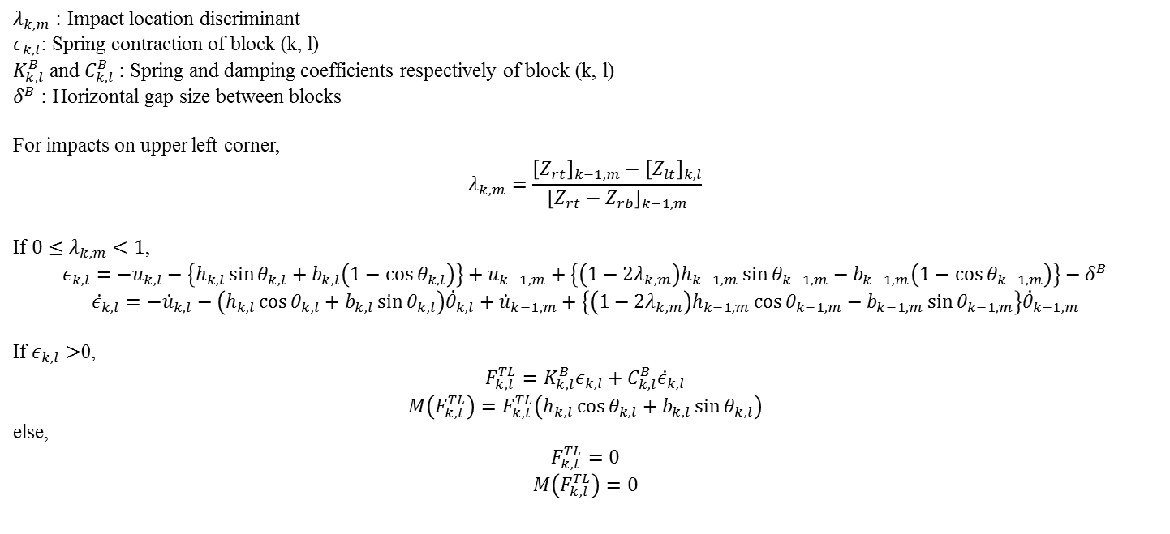
[발표용] UL
$λ_{k,m}$ : Impact location discriminant
$ε_{k,l}$: Spring contraction of block (k, l)
$K_{k,l}^{B}$ and $C_{k,l}^{B}$ : Spring and damping coefficients respectively of block (k, l)
$δ^{B}$ : Horizontal gap size between blocks
For impacts on upper left corner,
$$λ_{k,m}=\frac{{\left[Z_{rt}\right]}_{k−1,m}−{\left[Z_{lt}\right]}_{k,l}}{{\left[Z_{rt}−Z_{rb}\right]}_{k−1,m}}$$
If $0≤λ_{k,m}<1$,
$$ε_{k,l}=−u_{k,l}−\left\{h_{k,l}\sin{θ_{k,l}}+b_{k,l}\left(1−\cos{θ_{k,l}}\right)\right\}+u_{k−1,m}+\left\{{\left(1−2λ_{k, m}\right)h}_{k−1,m}\sin{θ_{k−1,m}}−b_{k−1,m}\left(1−\cos{θ_{k−1,m}}\right)\right\}−δ^{B}$$
$${\dot{ε}}_{k,l}=−{\dot{u}}_{k,l}−\left(h_{k,l}\cos{θ_{k,l}}+b_{k,l}\sin{θ_{k,l}}\right){\dot{θ}}_{k,l}+{\dot{u}}_{k−1,m}+\left\{{\left(1−2λ_{k, m}\right)h}_{k−1,m}\cos{θ_{k−1,m}}−b_{k−1,m}\sin{θ_{k−1,m}}\right\}{\dot{θ}}_{k−1,m}$$
If $ε_{k,l}>$0,
$$F_{k,l}^{TL}=K_{k,l}^{B}ε_{k,l}+C_{k,l}^{B}{\dot{ε}}_{k,l}$$
$$M\left(F_{k,l}^{TL}\right)=F_{k,l}^{TL}\left(h_{k,l}\cos{θ_{k,l}}+b_{k,l}\sin{θ_{k,l}}\right)$$
else,
$$F_{k,l}^{TL}=0$$
$$M\left(F_{k,l}^{TL}\right)=0$$

Slide 18
수평 Upper-Middle Left
(k-1,m)
(k,l)
$$λ_{k,m}=\frac{{\left[Z_{lt}\right]}_{k,l}−{\left[Z_{rt}\right]}_{k−1,m}}{{\left[Z_{lt}−Z_{lb}\right]}_{k,l}}$$
If $0<λ_{k,m}<1$,
$$ε_{k,l}=−u_{k,l}−\left\{\left(1−2λ_{k, m}\right)h_{k,l}\sin{θ_{k,l}}+b_{k,l}\left(1−\cos{θ_{k,l}}\right)\right\}+u_{k−1,m}+\left\{h_{k−1,m}\sin{θ_{k−1,m}}−b_{k−1,m}\left(1−\cos{θ_{k−1,m}}\right)\right\}−δ^{B}$$
$${\dot{ε}}_{k,l}=−{\dot{u}}_{k,l}−\left\{\left(1−2λ_{k, m}\right)h_{k,l}\cos{θ_{k,l}}+b_{k,l}\sin{θ_{k,l}}\right\}{\dot{θ}}_{k,l}+{\dot{u}}_{k−1,m}+\left(h_{k−1,m}\cos{θ_{k−1,m}}−b_{k−1,m}\sin{θ_{k−1,m}}\right){\dot{θ}}_{k−1,m}$$
If $ε_{k,l}>$0, (스프링이 수축된다면)
$$F_{k,l}^{ML}=K_{k,l}^{B}ε_{k,l}+C_{k,l}^{B}{\dot{ε}}_{k,l}$$
$$M\left(F_{k,l}^{ML}\right)=F_{k,l}^{ML}\left(\left(1−2λ_{k, m}\right)h_{k,l}\cos{θ_{k,l}}+b_{k,l}\sin{θ_{k,l}}\right)$$
$ε$ : Spring contraction
$K_{k,l}^{B}$ and $C_{k,l}^{B}$ : Spring and damping coefficients respectively
+h sinR
+h sinR
+b(1-cosR)
-b(1-cosR)
-h sinR
-h sinR
+b(1-cosR)
-b(1-cosR)
+h cosR
+h cosR
+b sinR
-b sinR
-h cosR
-h cosR
+b sinR
-b sinR

Slide 19
수평 Lower-Middle Left
(k-1,m)
$$λ_{k,m}=\frac{{\left[Z_{lt}\right]}_{k,l}−{\left[Z_{rb}\right]}_{k−1,m}}{{\left[Z_{lt}−Z_{lb}\right]}_{k,l}}$$
If $0<λ_{k,m}<1$,
$$ε_{k,l}=−u_{k,l}−\left\{\left(1−2λ_{k, m}\right)h_{k,l}\sin{θ_{k,l}}+b_{k,l}\left(1−\cos{θ_{k,l}}\right)\right\}+u_{k−1,m}+\left\{−h_{k−1,m}\sin{θ_{k−1,m}}−b_{k−1,m}\left(1−\cos{θ_{k−1,m}}\right)\right\}−δ^{B}$$
$${\dot{ε}}_{k,l}=−{\dot{u}}_{k,l}−\left\{\left(1−2λ_{k, m}\right)h_{k,l}\cos{θ_{k,l}}+b_{k,l}\sin{θ_{k,l}}\right\}{\dot{θ}}_{k,l}+{\dot{u}}_{k−1,m}+\left(−h_{k−1,m}\cos{θ_{k−1,m}}−b_{k+1,m}\sin{θ_{k−1,m}}\right){\dot{θ}}_{k−1,m}$$
If $ε_{k,l}>$0, (스프링이 수축된다면)
$$F_{k,l}^{NL}=K_{k,l}^{B}ε_{k,l}+C_{k,l}^{B}{\dot{ε}}_{k,l}$$
$$M\left(F_{k,l}^{NL}\right)=F_{k,l}^{NL}\left(\left(1−2λ_{k, m}\right)h_{k,l}\cos{θ_{k,l}}+b_{k,l}\sin{θ_{k,l}}\right)$$
$ε$ : Spring contraction
$K_{k,l}^{B}$ and $C_{k,l}^{B}$ : Spring and damping coefficients respectively
(k,l)
+h sinR
+h sinR
+b(1-cosR)
-b(1-cosR)
-h sinR
-h sinR
+b(1-cosR)
-b(1-cosR)
+h cosR
+h cosR
+b sinR
-b sinR
-h cosR
-h cosR
+b sinR
-b sinR

Slide 20
수평 Lower Left
(k-1,m)
(k,l)
$$λ_{k,m}=\frac{{\left[Z_{rt}\right]}_{k−1,m}−{\left[Z_{lb}\right]}_{k,l}}{{\left[Z_{rt}−Z_{rb}\right]}_{k−1,m}}$$
If $0<λ_{k,m}≤1$,
$$ε_{k,l}=−u_{k,l}−\left\{−h_{k,l}\sin{θ_{k,l}}+b_{k,l}\left(1−\cos{θ_{k,l}}\right)\right\}+u_{k−1,m}+\left\{{\left(1−2λ_{k, m}\right)h}_{k−1,m}\sin{θ_{k−1,m}}−b_{k−1,m}\left(1−\cos{θ_{k−1,m}}\right)\right\}−δ^{B}$$
$${\dot{ε}}_{k,l}=−{\dot{u}}_{k,l}−\left(−h_{k,l}\cos{θ_{k,l}}+b_{k,l}\sin{θ_{k,l}}\right){\dot{θ}}_{k,l}+{\dot{u}}_{k−1,m}+\left\{{\left(1−2λ_{k, m}\right)h}_{k−1,m}\cos{θ_{k−1,m}}−b_{k−1,m}\sin{θ_{k−1,m}}\right\}{\dot{θ}}_{k−1,m}$$
If $ε_{k,l}>$0, (스프링이 수축된다면)
$$F_{k,l}^{BL}=K_{k,l}^{B}ε_{k,l}+C_{k,l}^{B}{\dot{ε}}_{k,l}$$
$$M\left(F_{k,l}^{BL}\right)=F_{k,l}^{BL}\left(−h_{k,l}\cos{θ_{k,l}}+b_{k,l}\sin{θ_{k,l}}\right)$$
$ε$ : Spring contraction
$K_{k,l}^{B}$ and $C_{k,l}^{B}$ : Spring and damping coefficients respectively
+h sinR
+h sinR
+b(1-cosR)
-b(1-cosR)
-h sinR
-h sinR
+b(1-cosR)
-b(1-cosR)
+h cosR
+h cosR
+b sinR
-b sinR
-h cosR
-h cosR
+b sinR
-b sinR

Slide 21
수평 No Impact Case

Slide 22
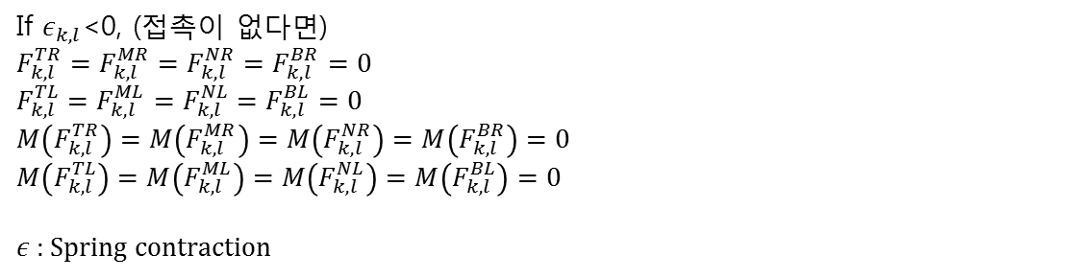
수평 No Impact Case
If $ε_{k,l}$<0, (접촉이 없다면)
$$F_{k,l}^{TR}=F_{k,l}^{MR}=F_{k,l}^{NR}=F_{k,l}^{BR}=0$$
$$F_{k,l}^{TL}=F_{k,l}^{ML}=F_{k,l}^{NL}=F_{k,l}^{BL}=0$$
$$M\left(F_{k,l}^{TR}\right)=M\left(F_{k,l}^{MR}\right)=M\left(F_{k,l}^{NR}\right)=M\left(F_{k,l}^{BR}\right)=0$$
$$M\left(F_{k,l}^{TL}\right)=M\left(F_{k,l}^{ML}\right)=M\left(F_{k,l}^{NL}\right)=M\left(F_{k,l}^{BL}\right)=0$$
$ε$ : Spring contraction

