Slide 1
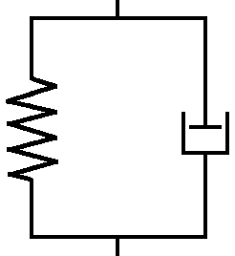
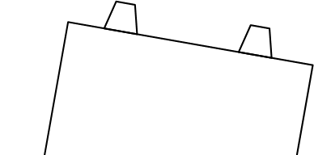






블록-측면경계 하중 다이어그램
$$2\sqrt{3}b_{k,N_{k}}^{2}ΔP$$
$$(k−1,N_{k−1})$$
$$(k,N_{k})$$
$$(k+1,N_{k+1})$$
$$F_{k,N}^{R}$$
$$(k,N_{k−1}−1)$$

Slide 2
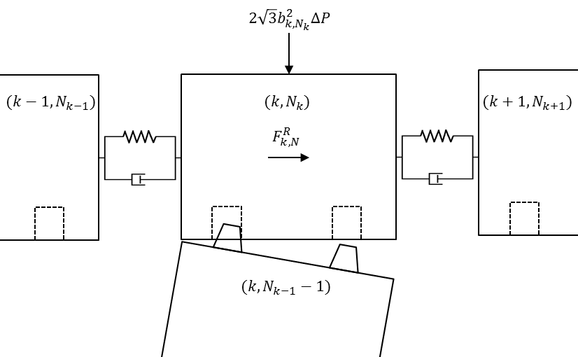
블록-측면경계 하중 다이어그램

Slide 3







블록-측면경계 하중 다이어그램
$$2\sqrt{3}b_{M+1,N_{M+1}}^{2}ΔP$$
$$(M,N_{M})$$
$$(M+1,N_{M+1})$$
$$F_{M+1,N_{M+1}}^{R}$$
$$F_{M+1,N_{M+1}}^{RF}$$
$$−F_{M+1,N_{M+1}}^{RF}$$
$$(M+1,N_{M+1}−1)$$

Slide 4
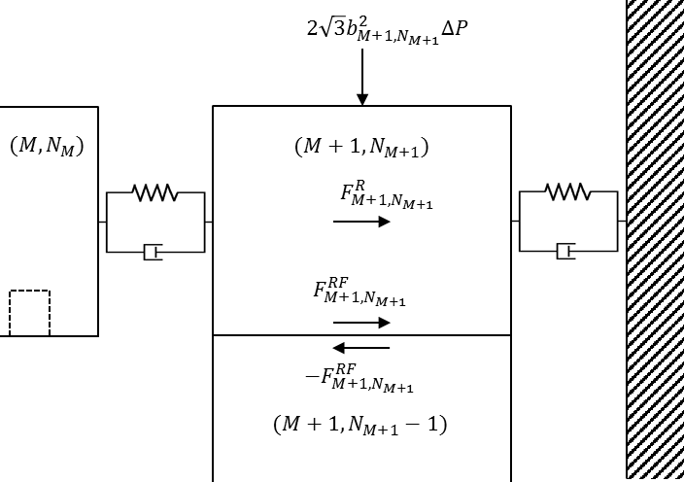

Slide 5
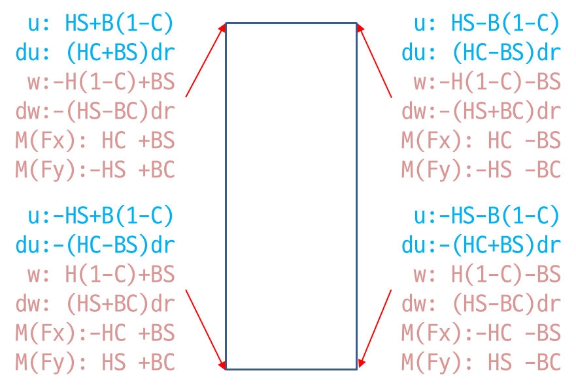

블록 TR 코너
$ε_{M,l}=u_{M,l}+h_{M,l}\sin{θ_{M,l}}−b_{M,l}\left(1−\cos{θ_{M,l}}\right)−u_{M+1,l}−δ^{B}$
${\dot{ε}}_{M,l}={\dot{u}}_{M,l}+\left(h_{M,l}\cos{θ_{M,l}}−b_{M,l}\sin{θ_{M,l}}\right){\dot{θ}}_{M,l}−{\dot{u}}_{M+1,l}$

Slide 6
PSR의 수직항력 계산
F^{dP}
PSR도 육각 단면으로 가정
(M+1,N)
F^{dP}+
m_{M+1,N} g
b
A=2√3b²
F^{dP}=A*dP=2√3 b² dP
(M+1,N-1)
F^{dP}+
g(m_{M+1,N}
+m_{M+1,N-1})
=
(M+1,N-2)
b tan30°
F^{dP}+
gΣm_{M+1,i}
b
A=12 (b² tan30°/2)
=2√3b²

