Slide 1
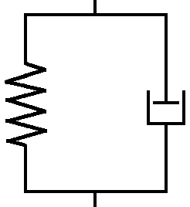










블록-측면경계 하중 다이어그램
$${−F}_{M+1,m+1}^{RF}$$
$$F_{M,l}^{TR}$$
$${−F}_{M,l}^{TR}$$
$$(M,l)$$
$$(M+1,m)$$
$$F_{M+1,m}^{M}$$
$$v=0 \\ θ=0$$
$${−F}_{M,l}^{BR}$$
$$F_{M,l}^{BR}$$
$$F_{M+1,m}^{RF}$$

Slide 2










블록-측면경계 하중 다이어그램
$${−F}_{0,m+1}^{RF}$$
$$F_{1,l}^{TR}$$
$${−F}_{1,l}^{TR}$$
$$F_{0,m}^{M}$$
$$(0,m)$$
$$(1,l)$$
$$v=0 \\ θ=0$$
$${−F}_{1,l}^{BR}$$
$$F_{0,m}^{RF}$$
$$F_{1,l}^{BR}$$

