Slide 1
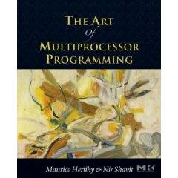
Transactional Memory
Companion slides for
The Art of Multiprocessor Programming
by Maurice Herlihy & Nir Shavit
TexPoint fonts used in EMF.
Read the TexPoint manual before you delete this box.: AAAAA
Notes:
1

Slide 2
Our Vision for the Future
In this course, we covered ….
Best practices …
New and clever ideas …
And common-sense observations.
Art of Multiprocessor Programming
2
Notes:
2

Slide 3
Our Vision for the Future
In this course, we covered ….
Nevertheless …
Best practices …
Concurrent programming is still too hard …
New and clever ideas …
Here we explore why this is ….
And common-sense observations.
And what we can do about it.
Art of Multiprocessor Programming
3
Notes:
3

Slide 4
A FIFO Queue
Head
Tail
a
b
c
d
Dequeue() => a
Enqueue(d)

Slide 5
A Concurrent FIFO Queue
Simple Code, easy to prove correct
Head
Tail
Object lock
a
b
c
d
P: Dequeue() => a
Q: Enqueue(d)
Contention and sequential bottleneck
Notes:
Don’t undersell simplicity…

Slide 6
Fine Grain Locks
Finer Granularity, More Complex Code
Head
Tail
a
b
c
d
P: Dequeue() => a
Q: Enqueue(d)
Verification nightmare: worry about deadlock, livelock…

Slide 7
Fine Grain Locks
Complex boundary cases: empty queue, last item
Head
Head
Tail
Tail
a
a
b
b
c
d
P: Dequeue() => a
Q: Enqueue(b)
Worry how to acquire multiple locks

Slide 8
Locks are Non-Compositional
Consider a (correct) Java bank Account class:
Now suppose we want to add the ability to transfer funds from one account to another.
class Account{
float balance;
synchronized void deposit(float amt) {
balance += amt;
}
synchronized void withdraw(float amt) {
if (balance < amt)
throw new OutOfMoneyError();
balance -= amt;
}
}

Slide 9
Locks are Non-Compositional
Synchronizing transfer can cause deadlock:
class Account{
float balance;
synchronized void deposit(float amt) {
balance += amt;
}
synchronized void withdraw(float amt) {
if(balance < amt)
throw new OutOfMoneyError();
balance -= amt;
}
synchronized
void transfer_wrong2(Acct other, float amt) {
// can deadlock with parallel reverse-transfer
this.deposit(amt);
other.withdraw(amt);
}
}

Slide 10
Locks are Non-Compositional
Simply calling withdraw and deposit to implement transfer causes a race condition:
class Account{
float balance;
synchronized void deposit(float amt) {
balance += amt;
}
synchronized void withdraw(float amt) {
if(balance < amt)
throw new OutOfMoneyError();
balance -= amt;
}
void transfer_wrong1(Acct other, float amt) {
other.withdraw(amt);
// race condition: wrong sum of balances
this.deposit(amt);}
}

Slide 11
Locking Relies on Conventions
Relation between
Lock bit and object bits
Exists only in programmer’s mind
Actual comment from Linux Kernel
(hat tip: Bradley Kuszmaul)
/*
* When a locked buffer is visible to the I/O layer
* BH_Launder is set. This means before unlocking
* we must clear BH_Launder,mb() on alpha and then
* clear BH_Lock, so no reader can see BH_Launder set
* on an unlocked buffer and then risk to deadlock.
*/

Slide 12
Lock-Free (JDK6.0)
Even Finer Granularity, Even More Complex Code
Head
Tail
a
b
c
d
P: Dequeue() => a
Q: Enqueue(d)
Worry about starvation, subtle bugs, hardness to modify…

Slide 13
Real Applications
Complex: Move data atomically between structures
Head
Tail
a
b
c
d
P: Dequeue(Q1,a)
Enqueue(Q2,a)
Head
Tail
b
c
d
a
More than twice the worry…

Slide 14
Atomic Memory Transactions
Like database transactions
atomic {...sequential code...}
To a first approximation, just write the sequential code, and wrap atomic around it
All-or-nothing semantics: Atomic commit
Atomic block executes in Isolation
Cannot deadlock (there are no locks!)
Atomicity makes error recovery easy (e.g. throw exception inside sequential code)
ACID

Slide 15
How does it work?
Optimistic concurrency
atomic {... <code> ...}
One possibility:
Execute <code> without taking any locks.
Log each read and write in <code> to a thread-local transaction log.
Writes go to the log only, not to memory.
At the end, the transaction validates the log.
If valid, atomically commits changes to memory.
If not valid, re-runs from the beginning, discarding changes.
read y;
read z;
write 10 x;
write 42 z;
…

Slide 16
STM in Mainstream Languages
There are similar proposals for adding STM to Java and other mainstream languages.
class Account {
float balance;
void deposit(float amt) {
atomic { balance += amt; }
}
void withdraw(float amt) {
atomic {
if(balance < amt) throw new OutOfMoneyError();
balance -= amt; }
}
void transfer(Acct other, float amt) {
atomic { // Can compose withdraw and deposit.
other.withdraw(amt);
this.deposit(amt); }
}
}

Slide 17
Promise of Transactional Memory
Great Performance, Simple Code
Head
Tail
a
b
c
d
P: Dequeue() => a
Q: Enqueue(d)
Don’t worry about deadlock, livelock, subtle bugs, etc…

Slide 18
Promise of Transactional Memory
Don’t worry which locks need to cover
which variables when…
Head
Head
Tail
Tail
a
a
b
b
c
d
P: Dequeue() => a
Q: Enqueue(d)
TM deals with boundary cases under the hood

Slide 19
For Real Applications
Will be easy to modify multiple structures atomically
Head
Tail
a
b
c
d
P: Dequeue(Q1,a)
Enqueue(Q2,a)
Head
Tail
b
c
d
a
Provide Serializability…

Slide 20
Using Transactional Memory
enqueue (Q, newnode) {
Q.tail-> next = newnode
Q.tail = newnode
}

Slide 21
Using Transactional Memory
enqueue (Q, newnode) {
atomic{
Q.tail-> next = newnode
Q.tail = newnode
}
}

Slide 22
Transactions Will Solve Many of Locks’ Problems
No need to think what needs to be locked, what not, and at what granularity
No worry about deadlocks and livelocks
No need to think about read-sharing
Can compose concurrent objects in a way that is safe and scalable
Notes:
It's a very common point of confusion for programmers. As they try to implement finer-grain locking mechanisms they either under-specify or become completely confused about which variables are covered by which locks. It becomes a long-term support disaster because the locking protocols are almost never written down. (I've talked to a number of customers where one developer is the "sync" expert and seems to keep all the protocols in his head).

Slide 23
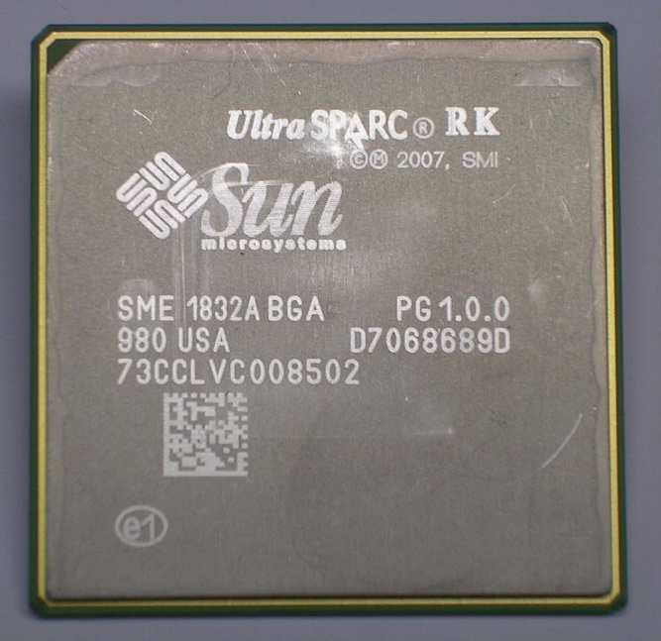
Hardware Transactional Memory
Exploit Cache coherence
Already almost does it
Invalidation
Consistency checking
Speculative execution
Branch prediction = optimistic synch!
Art of Multiprocessor Programming
23
23
Notes:
23
Original TM proposal by Herlihy and Moss 1993…

Slide 24
HTM Strengths & Weaknesses
Ideal for lock-free data structures

Slide 25
HTM Strengths & Weaknesses
Ideal for lock-free data structures
Practical proposals have limits on
Transaction size and length
Bounded HW resources
Guarantees vs best-effort

Slide 26
HTM Strengths & Weaknesses
Ideal for lock-free data structures
Practical proposals have limits on
Transaction size and length
Bounded HW resources
Guarantees vs best-effort
On fail
Diagnostics essential
Retry in software?

Slide 27
Software Transactional Memory [ShavitTouitou94]
The semantics of hardware transactions…today
Tomorrow: serve as a standard interface to hardware
Allow to extend hardware features when they arrive
Still, we need to have reasonable performance…
Today’s focus…
Notes:
Tell israeli farmer joke

Slide 28
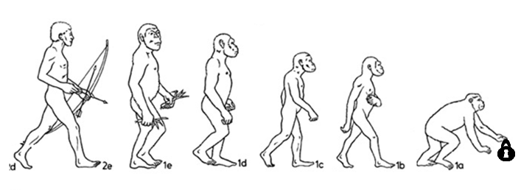
The Brief History of STM
Soft Trans (Ananian, Rinard)
Meta Trans (Herlihy, Shavit)
T-Monitor (Jagannathan…)
Trans Support TM (Moir)
AtomJava (Hindman…)
WSTM (Fraser, Harris)
OSTM (Fraser, Harris)
Lock-OSTM (Ennals)
STM (Shavit,Touitou)
ASTM (Marathe et al)
DSTM (Herlihy et al)
2007-9…New lock based STMs from IBM, Intel, Sun, Microsoft
McTM (Saha et al)
TL1/2 (Dice, Shavit))
HybridTM (Moir)
2005
1994
2005
2005
2006
1997
2003
2003
2003
2004
2004
2004
2004
2004
Lock-free
Obstruction-free
Lock-based
Notes:
Rob Ennals

Slide 29
As Good As Fine Grained Locking
Postulate (i.e. take it or leave it):
If we could implement fine-grained locking with the same simplicity of course grained, we would never think of building a transactional memory.
Implication:
Lets try to provide STMs that get as close as possible to hand-crafted fine-grained locking.
Notes:
We have a long way top go but in some cases are starting to do well…our problem is not with the performance of lockjs buut rtaher with the complexity of using them to design software….

Slide 30
Transactional Consistency
Memory Transactions are collections of reads and writes executed atomically
Tranactions should maintain internal and external consistency
External: with respect to the interleavings of other transactions.
Internal: the transaction itself should operate on a consistent state.

Slide 31
External Consistency
Invariant x = 2y
4
X
8
Transaction A:
Write x
Write y
2
Y
4
Transaction B:
Read x
Read y
Compute z = 1/(x-y) = 1/4
Application Memory

Slide 32
Locking STM Design Choices
Map
Array of Versioned-
Write-Locks
Application Memory
V#
PS = Lock per Stripe (separate array of locks)
PO = Lock per Object
(embedded in object)

Slide 33
Encounter Order Locking (Undo Log)
Mem Locks
Blue code does not change memory, red does
V# 0
V# 0
V# 0
V# 0
To Read: load lock + location
Check unlocked add to Read-Set
To Write: lock location, store value
Add old value to undo-set
Validate read-set v#’s unchanged
Release each lock with v#+1
V#+1 0
X
V#+1 0
V# 0
X
V# 1
V# 0
V# 0
Y
V#+1 0
V#+1 0
V# 0
Y
V# 1
V# 0
V# 0
V# 0
V# 0
V# 0
V# 0
V# 0
V# 0
V# 0
V# 0
Quick read of values freshly
written by the reading transaction
Notes:
Operations that modify the memory are marked in red…

Slide 34
Commit Time Locking (Write Log)
Mem Locks
V# 0
V# 0
V# 0
V# 0
To Read: load lock + location
Location in write-set? (Bloom Filter)
Check unlocked add to Read-Set
To Write: add value to write set
Acquire Locks
Validate read/write v#’s unchanged
Release each lock with v#+1
X
V#+1 0
X
V# 1
V# 1
V#+1 0
V# 0
V# 0
V# 0
V# 0
Y
V#+1 0
Y
V# 0
V#+1 0
V# 1
V# 1
V#+1 0
V# 0
V# 0
V# 0
V# 0
V# 0
V# 0
V# 0
V# 0
V# 0
V# 0
V# 0
Hold locks for very short duration

Slide 35
TL2 STM: Use a Global Clock
Have a shared global version clock
Incremented by writing transactions (as infrequently as possible)
Read by all transactions
Used to validate that the state viewed by a transaction is always consistent

Slide 36
TL2 Version Clock: Read-Only Trans
Mem Locks
100
Vclock (shared)
87 0
87 0
87 0
87 0
RV ← VClock
To Read: read lock, read mem, read lock, check unlocked, unchanged, and v# <= RV
Commit.
34 0
34 0
34 0
34 0
88 0
88 0
99 0
99 0
99 0
99 0
V# 0
V# 0
44 0
44 0
Reads form a snapshot of memory.
No read set!
50 0
50 0
50 0
50 0
V# 0
V# 0
100
RV (private)

Slide 37
TL2 Version Clock: Writing Trans
100
120
121
100
VClock
Mem Locks
87 0
87 0
87 0
87 0
87 0
RV ← VClock
To Read/Write: check unlocked and v# <= RV then add to Read/Write-Set
Acquire Locks
WV = F&I(VClock)
Validate each v# <= RV
Release locks with v# ← WV
X
121 0
X
34 0
34 0
34 1
121 0
34 0
88 0
88 0
121 0
Y
V# 0
Y
99 0
99 0
99 0
99 1
121 0
44 0
44 0
50 0
V# 0
50 0
V# 0
50 0
50 0
50 0
Reads+Inc+Writes
=serializable
100
Commit
RV

Slide 38
Where we are heading…
A lot more work on STM performance
Think GC, game just begun
Improve single threaded performance
Amazing possibilities for compiler optimization
OS support
Explosion of new STMs
~100 TM papers in last couple of years
Notes:
Say something about identifying locations that are trans or not …Many new STMs, Java, C#, Compilers, added to languages,…

Slide 39


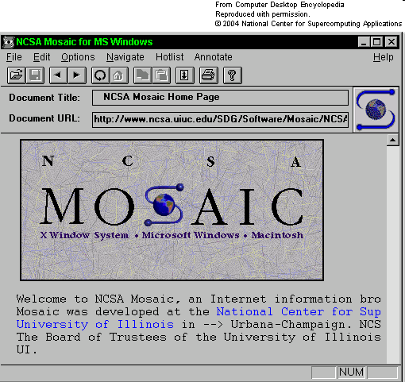
Remember 1993?
Notes:
Remember 1993?
This guy was president.
Hardware news was dominated by the new Pentium processor. Not the Pentium-this or the Pentium-that. Just the Pentium.
Also, there was this new World-Wide-Web thing.
Lost in the noise, Eliot Moss and I published a paper where we proposed something called Transactional Memory as a way to make synchronization easier for multiprocessors (the term "multicore" hadn't yet been invented.) I’ll tell you more about what it is later.
I'm pretty sure the paper got in by the skin of its teeth. At the conference, several PC members congratulated me on getting an "idea paper" into ISCA. In some communities, the term "idea paper" might be a complement, but in ISCA, which tends to fetishize quantitative results, the term, while not exactly fighting words, falls well short of a compliment.

Slide 40
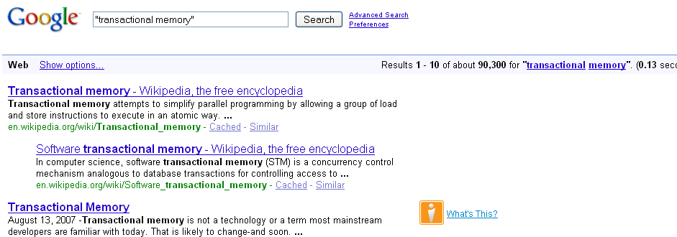
TM Today
93,300
Notes:
Let's look at how much mindshare TM has today.

Slide 41
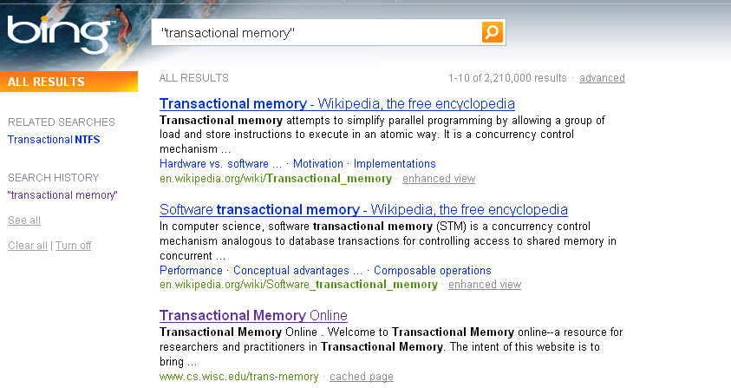
Second Opinion
2,210,000
Notes:
Let’s ask Microsoft for a second opinion.

Slide 42
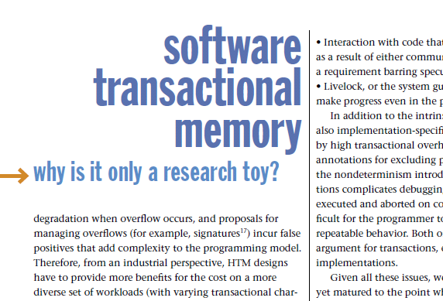
Hatin’ on TM
STM is too inefficient
Notes:
Inexplicably, not everyone thinks TM is all that and more.
Here are some of the common criticisms you will find in published papers and blogs.
Some claim that STM is inherently too inefficient.

Slide 43
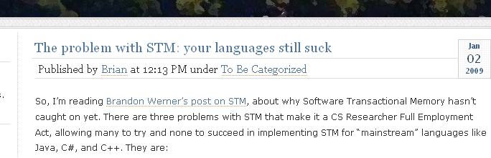
Hatin’ on TM
Requires radical change in programming style
Notes:
Some claim that programmers will never learn to program in a different style.

Slide 44
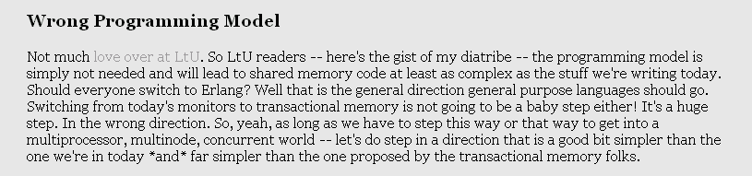
Hatin’ on TM
Erlang-style shared nothing only true path to salvation
Notes:
The sandal-wearing vegetarian Esperanto-speaking faction thinks that shared-memory computation is hopeless, and efforts to improve it are evil.

Slide 45
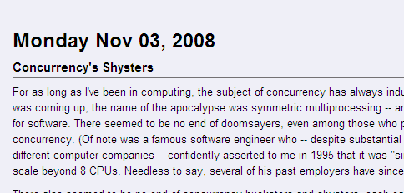
Hatin’ on TM
There is nothing wrong with what we do today.
Notes:
The Austro-Hungarian Empire checks in with the critique that there is nothing wrong with what we do today, do why change?

