Slide 1
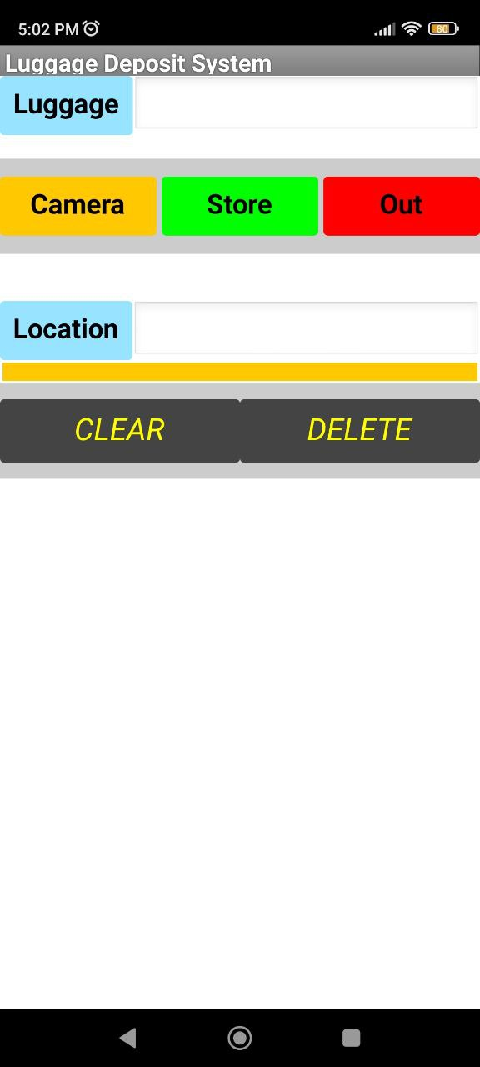
Luggage Deposit System (LDS)
This project uses an Android app and QR codes to store and retrieve luggage at a hotel. The idea is to replace the current pen-and-paper system, with the benefits of reduce wastage, faster turnover, and data available for analytics.
The app is written using MIT App Inventor 2, and the data is stored in Google Firebase.
First, the user (hotel staff) scans the QR code (tag) of the luggage using the ‘Luggage’ button. This has to be done whether storing or retrieving a luggage.
For storage, the staff scans a QR code for the location with the ‘Location’ button, takes a picture with the ‘Camera’ button, and stores the data into Firebase using the ‘Store’ button.
For retrieval, the data will be read from Firebase and displayed in a list, with history information on the luggage’s location(s). A picture will also be displayed to aid searching. (RFID/NFC tag will be implemented integrated to this system). The staff then selects the list and delivers the luggage using the ‘Out’ button.
The 2 additional buttons below – ‘CLEAR’ and ‘DELETE’ are for debugging purposes.
This design resides on MIT App Inventor, filename: LDS.aia
ESP32 design filename: LuggageTag.ino

Slide 2
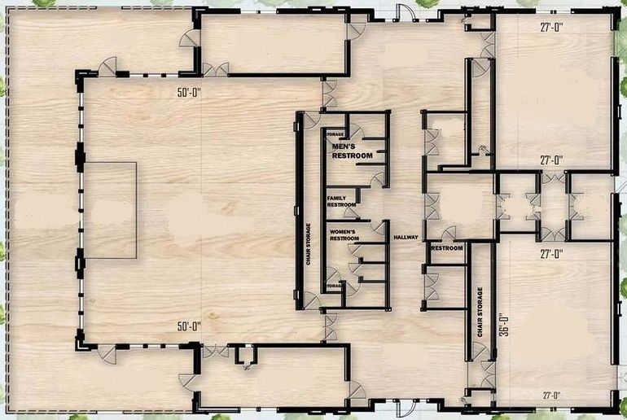
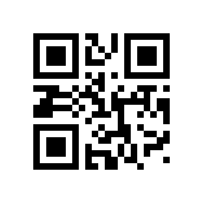
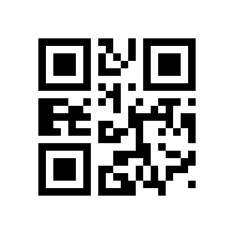
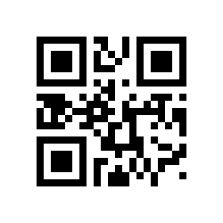
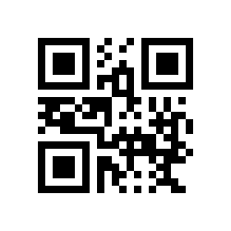
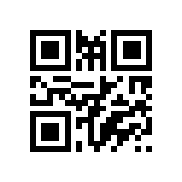
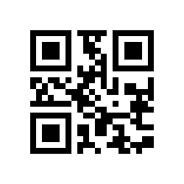
JLD_A1
JLD_C1
JLD_B1
JLD_C2
JLD_B2
JLD_A2

Slide 3
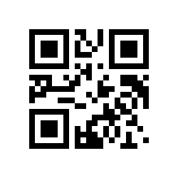
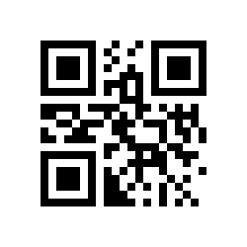
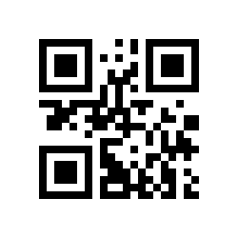
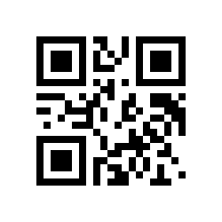
Card UID: 53 B8 B6 0D
Card SAK: 08
Card UID: 63 93 8D F4
Card SAK: 08
Card UID: 63 E3 35 25
Card SAK: 08
Card UID: 63 83 5E 10
Card SAK: 08
Notes:
PICC - Proximity Integrated Circuit Card
UID - Unique IDentifier
The SAK byte identifies the manufacturer code and product code
JWM#0001
JWM#0003
JWM#0002
JWM#0004

Slide 4
JLD_A1
JLD_B1
JLD_A2
JLD_C1

Slide 5
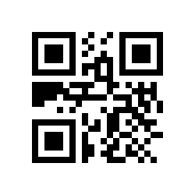
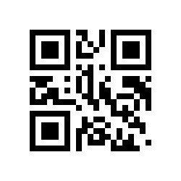
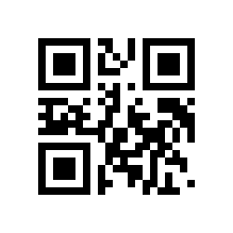
JWM#63835e10
JWM#63e33525
JWM#16812a31

