Slide 1
Introduction to Survival Analysis
PROC LIFETEST
and Survival Curves

Slide 2
Survival Analysis in SAS
Consider the following situation:
A sample of people receive one of two bone marrow transplants:
Autologous: “clean” a sample of bone marrow from the patient and inject back into the patient’s body
Allogenic: the bone marrow transplant comes from another person, ideally a sibling, with the same type of bone marrow
The patients are followed until they die (are considered a case) or are censored.
You are interested if there is a difference between the survival of patients for these two types of transplants.
Example from Primer of Biostatistics by Stanton A. Glanz, pp. 429-430.

Slide 3
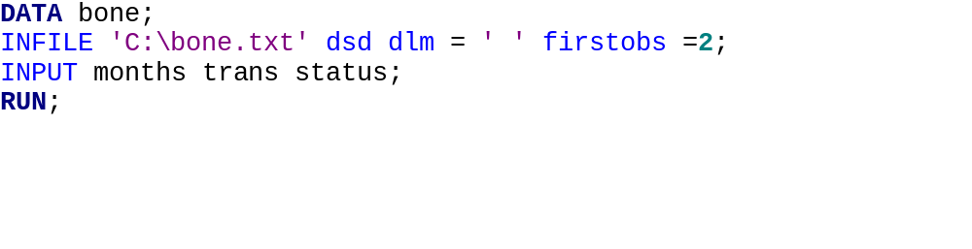
The data set bone.txt contains three variables: month (the number of months before the subject died or was censored), trans (autologous=0, allogenic=1), and death (censored=0, death=1).
You will need to either copy and paste the file bone.txt into SAS or read it into SAS using the following code (with the appropriate adjustments made to the file location):
http://www.biostat.umn.edu/~susant/PH6415DATA/bone.txt

Slide 4
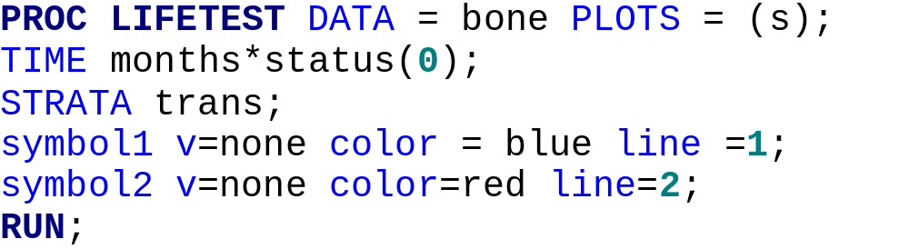
PROC LIFETEST
Once the data set has been created, type the following code into SAS:

Slide 5
A Note about the Code
“PLOTS=(s)” tells SAS to create the Kaplan-Meier estimate survival plots
“status(0)” tells SAS which values are censored (in this case, values of “0”)
“STRATA trans” tells SAS which variable to use to compare survival curves (in this case, “trans”)
the “symbol…” statements format the curves

Slide 6
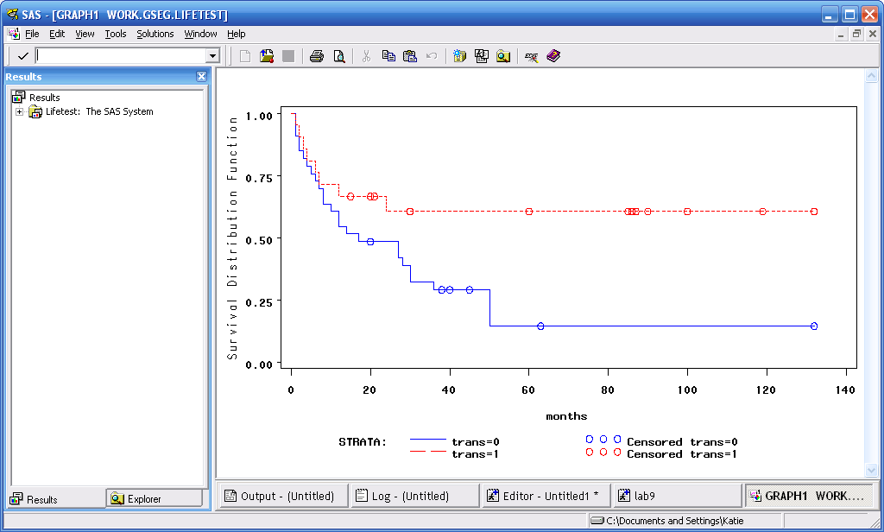
KAPLAN-MEIER Survival Plots

Slide 7
Interpreting the Curves
The y-axis denotes the percentage of subjects who have survived
The x-axis denotes time (in this case, months)
The little circles show when someone was censored. Both curves end with a censored data point; it is possible the study ended at this point, and any remaining subjects who have not died are classified as censored. We do not know what happened to them after this point.
It appears those who received the allogenic transplant (trans=1) have a better survival rate than those who received the autologous transplant.

Slide 8
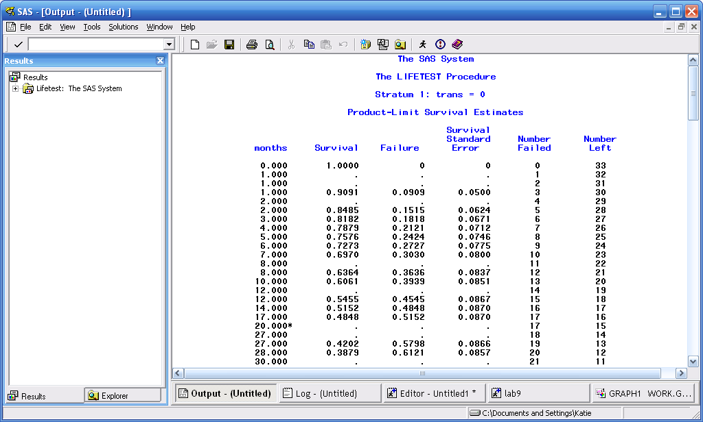
PROC LIFETEST Output for trans=0

Slide 9
Interpreting the Output for trans = 0
The first set of output is for the group with the autologous transplant (trans=0).
At time = 0 months, everyone is surviving.
At time = 1 month, 3 people have “failed” (that is, died). The survival rate is 90.91%; the failure rate is 9.09%, and there are 30 people remaining in the sample.
At time = 2 months, 2 more people died, and so on…
At time = 20 months, there is the first censored subject (denoted by the *). This subject does not affect the survival rate or the count of number failed. This subject is removed from the count of number left, however.

Slide 10
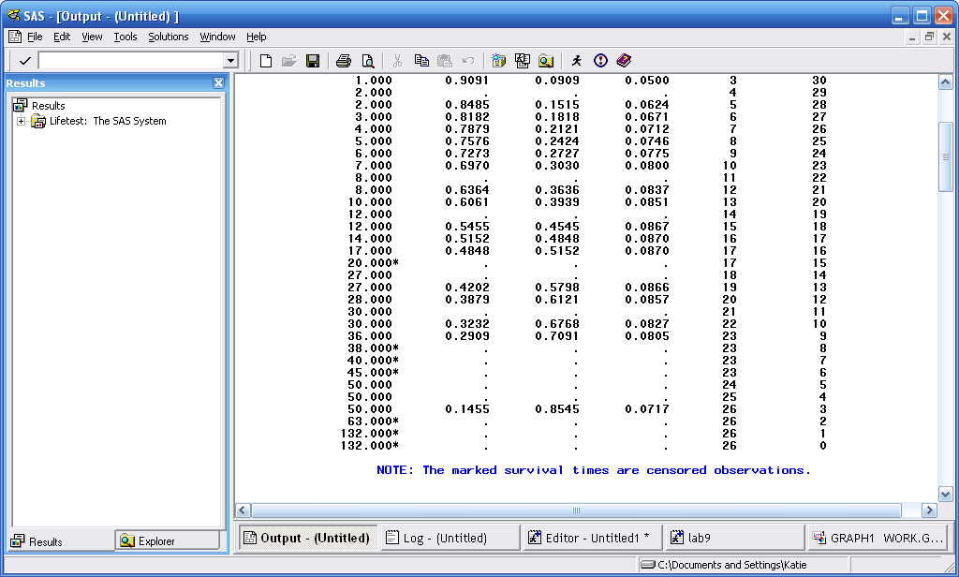
More Output for trans = 0

Slide 11
At time = 50 months, a total of 26 people have died, and the current survival rate for those with the autologous transplant is 14.55%.
Between 50 and 132 months, the remaining 3 subjects are censored.

Slide 12
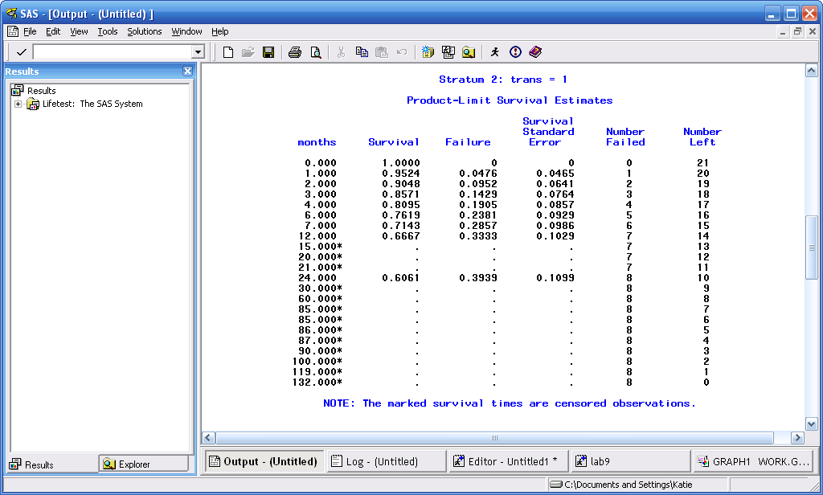
Output for trans = 1

Slide 13
Interpreting the Output for trans = 1
The output is interpreted the same way as with the output for trans = 0.
Notice that the last death occurs at time = 24 months, and after this point, the survival rate is constant at 60.61%. Subjects with the allogenic transplant have a higher survival rate than those with the autologous transplant.
We can formally test this difference using the Wilcoxon and Log-Rank tests.

Slide 14
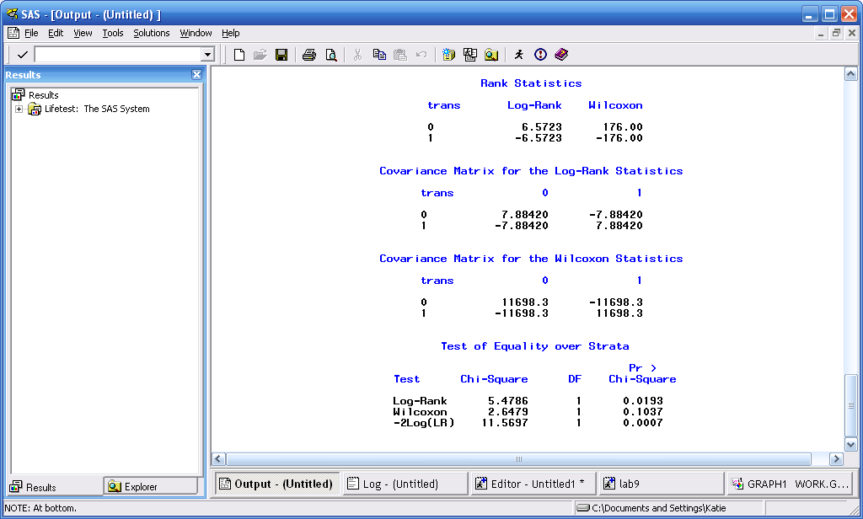
Log-Rank and Wilcoxon Tests

Slide 15
We are interested in the Test of Equality over Strata
The Wilcoxon tests whether differences exist in survival between the groups in the SHORT TERM
The Log-Rank tests whether differences exist in survival between the groups in the LONG TERM
In either case, the hypotheses being tested are: H_{o}: the risk of the groups are equal, vs. H_{a}: the risk of the groups are not equal

Slide 16
The pvalue of the Wilcoxon test is 0.1037, which is not statistically significant. Therefore, there is no significant difference in short-term risk between the two groups. This is confirmed by looking at the plot of the survival curves, which both drop down initially at the same rate.
The pvalue of the Log-Rank test is 0.0193. We reject the null hypothesis and conclude that there is a significant difference in long-term risk between the two transplant groups.

Slide 17
A Word of Warning:
The Log-Rank and Wilcoxon tests may not be valid if the survival curves cross. If the survival curves cross, these tests may not be able to detect a difference between the groups when one actually exists. You will see this in the next example.

Slide 18
The Myelomatosis Example
The file myel.txt contains survival times for 25 patients diagnosed with myelomatosis (tumors throughout the body composed of cells derived from blood tissues of the bone marrow). The patients were randomly assigned to two drug treatments (“treat” = 1 or 2).
“Dur” is the time in days to either death or censoring.
“Status” is whether a person died (1) or was censored (0).
“Renal” denotes whether the subject’s renal functioning was normal (0) or impaired (1) at the time of randomization.
Example from Survival Analysis Using SAS, A Practical Guide, by Paul D. Allison, p. 269.

Slide 19
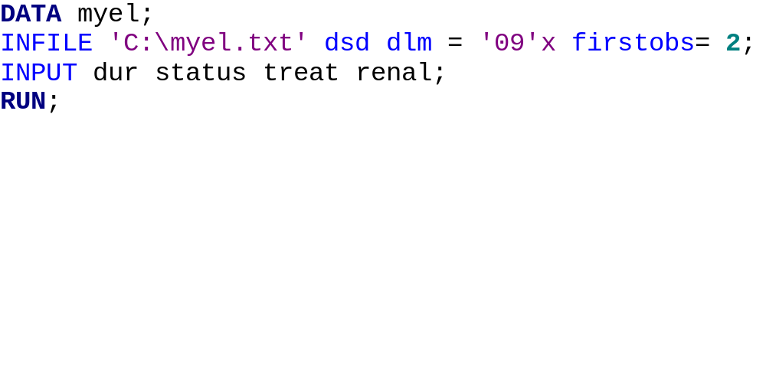
Read the file into SAS (you cannot cut and paste the file, because it is tab-delimited):

Slide 20
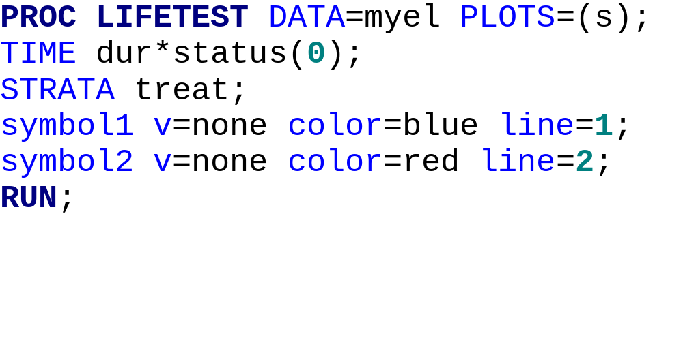
Compare Survival by Treatment

Slide 21
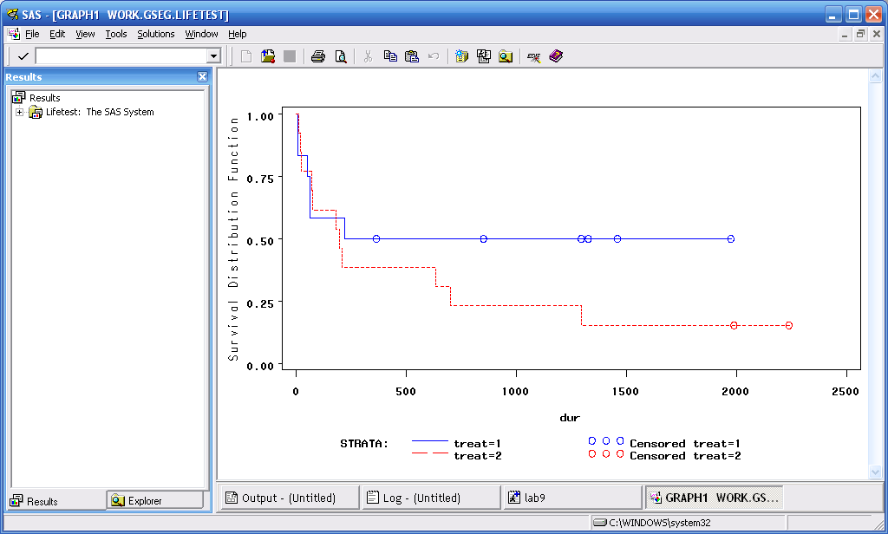
Survival Plots for Treatment

Slide 22
From the plot, it appears that those with treatment 1 have a better survival rate than those receiving treatment 2.
However, neither the Log-Rank nor Wilcoxon tests are significant. This is because the curves cross, so the Log-Rank test is unable to detect a difference.
Always look at the survival curves to see if there appears to be a difference between the groups.

Slide 23
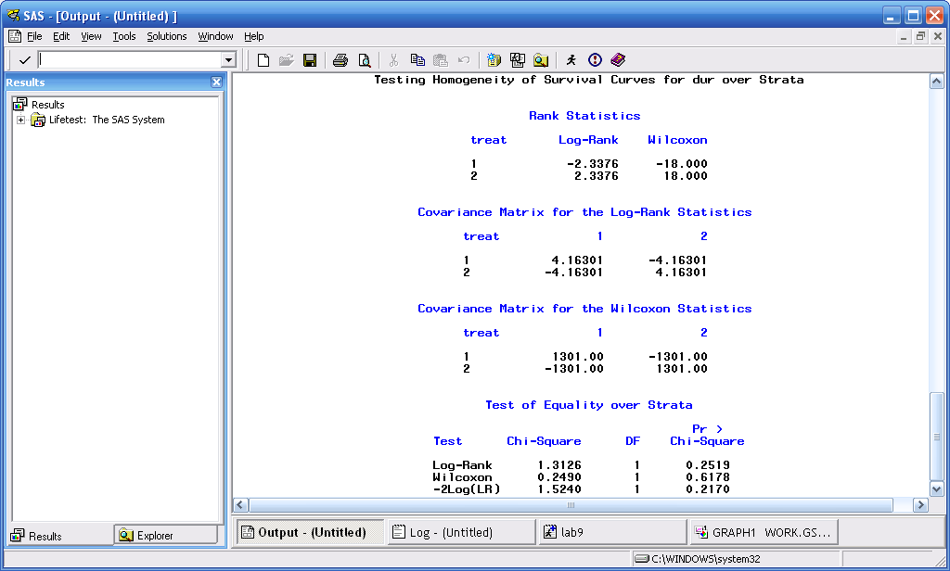
Non-significant Log-Rank and Wilcoxon Tests

Slide 24
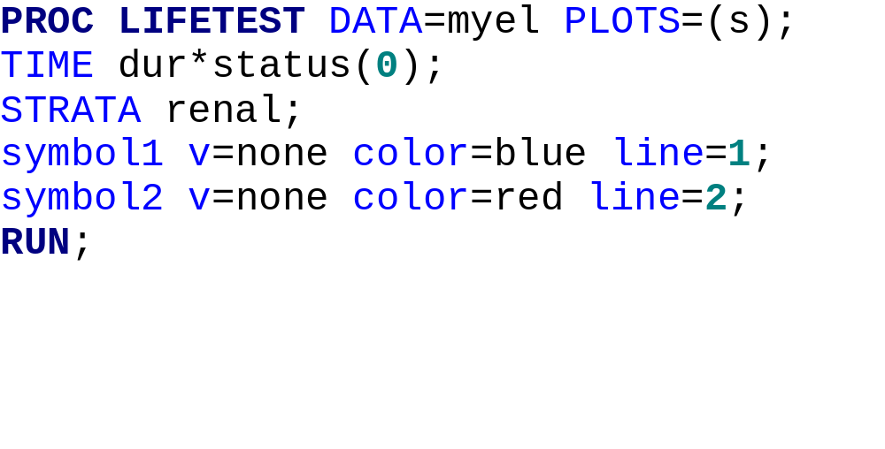
Now compare survival rates by renal functioning:

Slide 25
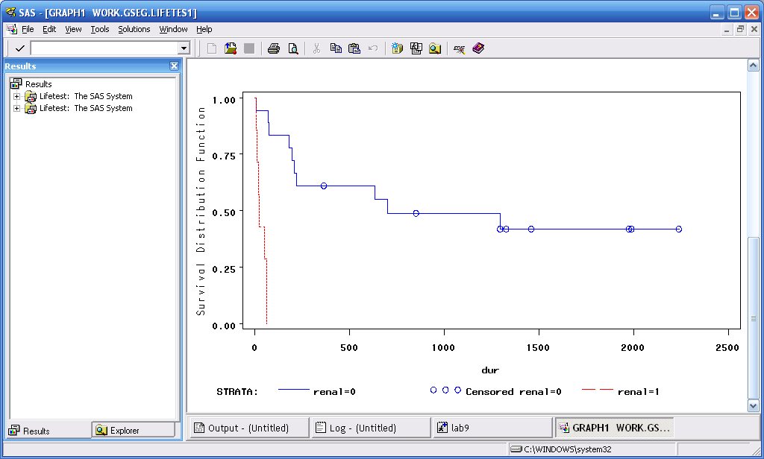
Survival Plots of Renal Functioning

Slide 26
Those with impaired renal functioning (renal = 1) clearly have a much worse survival curve than those with normal renal functioning.
This is confirmed by the Wilcoxon (p < 0.0001) and Log-Rank (p < 0.0001) tests.

Slide 27
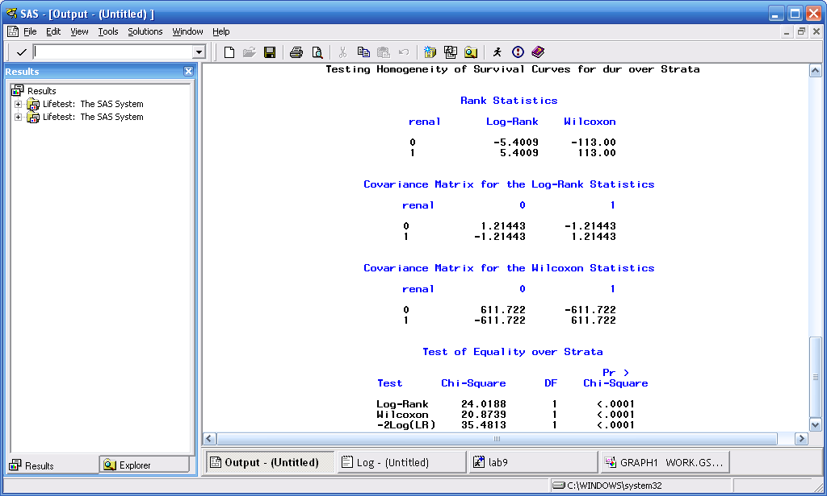
Log-Rank and Wilcoxon Tests

Slide 28
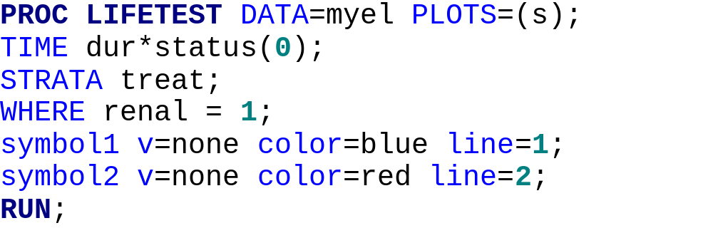
Suppose you wanted to examine the effect of treatment on only those with impaired renal functioning. This is easily done by adding a “where” statement to your SAS program:

Slide 29
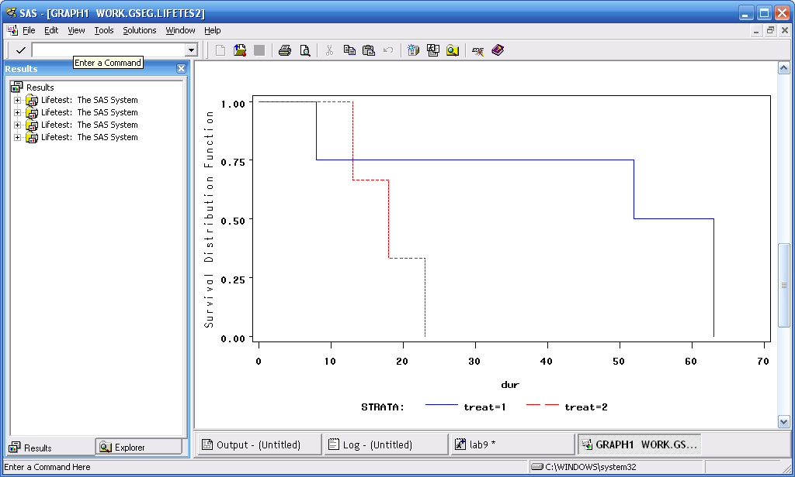
Survival Curves for Renal = 1, comparing treatments

Slide 30
This has been an introduction to survival analysis and Kaplan-Meier survival curves.
The next section will introduce you to proportional hazard regression in SAS.

