Slide 1
Course Outline
Introduction and Algorithm Analysis (Ch. 2)
Hash Tables: dictionary data structure (Ch. 5)
Heaps: priority queue data structures (Ch. 6)
Balanced Search Trees: general search structures (Ch. 4.1-4.5)
Union-Find data structure (Ch. 8.1–8.5)
Graphs: Representations and basic algorithms
  Topological Sort (Ch. 9.1-9.2)
  Minimum spanning trees (Ch. 9.5)
  Shortest-path algorithms (Ch. 9.3.2)
B-Trees: External-Memory data structures (Ch. 4.7)
kD-Trees: Multi-Dimensional data structures (Ch. 12.6)
Misc.: Streaming data, randomization

Slide 2
Search Trees
Searching over an ordered universe of key values.
Maintaining hierarchical information
Repeated linear search in link list too slow for large data
Hashing useful only for “find key” operations.
Heaps useful only for “find Min” or “Find Max”.
But suppose we needed:
  Lookup-by-prefix:
    type in first few letters of a name and output all names in the database beginning with those letters.
  Find-in-range[key1, key2]: output all keys between key1 and key2
  NearLookup(x): returns the closest key to x when x not in database.
  Find the kth smallest key.
  Rank(x): how many keys are smaller than x.

Slide 3
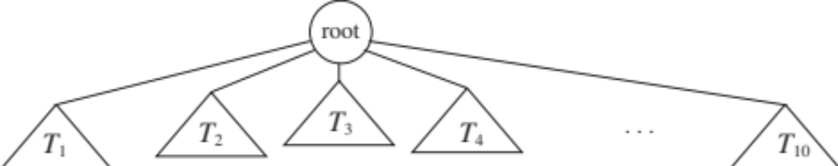
Search Trees
With appropriate balanced binary search trees, we can do most of these operations in worst-case O(log n) time.
  searches, inserts, deletes, find successor, find predecessor etc.
A recursive definition of the tree:
  either empty, or
  a root node r with 0 or subtrees whose roots are children of r
  No other structure: arbitrary distribution of keys and depths

Slide 4
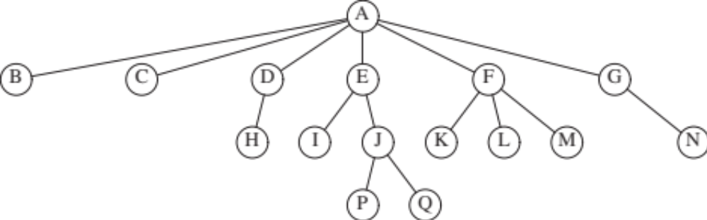
Search Trees
Some definitions:
  Path: a sequence of edges or nodes
  Path Length: number of edges
  Depth of a node: number of edges from the root
  Parent-Child relationship
  Ancestor-Descendant

Slide 5
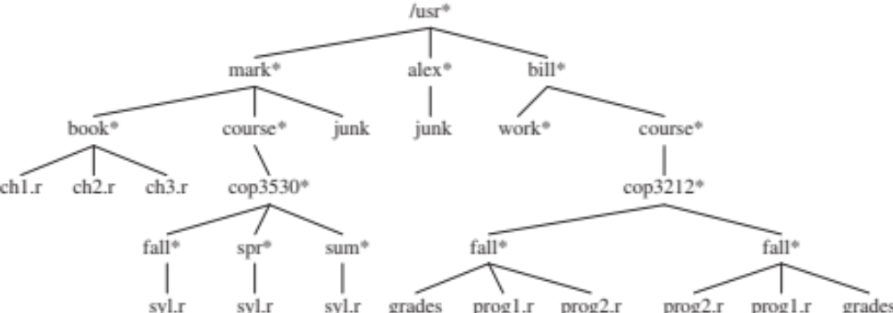
An example: directory structure
File directories have a natural tree (hierarchical) structure
Directory traversal and search best visualized by search trees
Tree Traversals:
  List all sub-directories: Pre-Order Traversal
    Print a node, then recursively traverse subtrees
  Compute directory sizes: Post-Order traversal
    Compute sizes of all subtrees, then add to get the size of the directory

Slide 6
Binary Search Trees (BST)
Each node has at most 2 children (left, right)
  Most commonly used form of search tree
  Some examples: Heaps, expression trees, branch-bound
  BST implements a search ADT
  Input: a set of keys
    Any set with an ordering, but assume numeric keys for simplicity
    For simplicity, also assume all keys are distinct (no duplicates)
A BST is a tree with the following “ordering” property
  For any node X:
    All keys in the left subtrees < key(X)
    All keys in the right subtree > key(X)

Slide 7
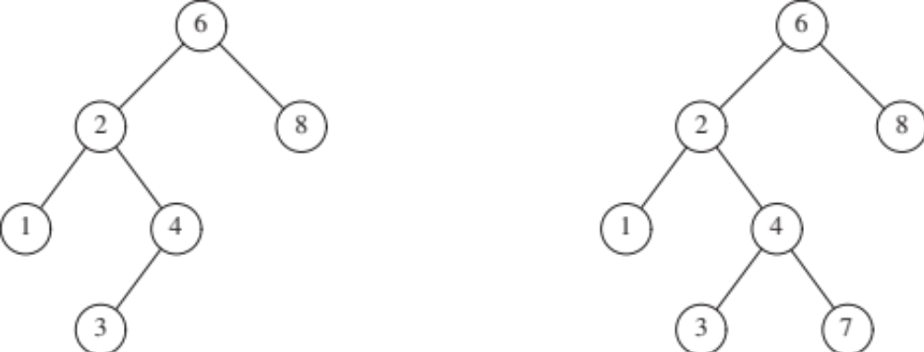
Binary Search Trees (BST)
A Binary Search Tree is a tree with the following “ordering” property
  For any node X:
    All keys in the left subtrees < key(X)
    All keys in the right subtree > key(X)
  Which of the following are valid BSTs?

Slide 8
Find (lookup) Operation in BST
if (t = null) return null
elseif (x < t.key) return find(x, t.left)
elseif (x > t.key) return find(x, t.right)
else return t; // match

Slide 9
FindMin or FindMax in BST
FindMax
if (t != null)
while (t.right != null)
t = t.right
return t;

Slide 10
Insert Operation in BST
Do find(X). If X found, nothing to do.
Otherwise, insert X at the last spot on the path.
if (t = null)
t = new node x; // insert x here //
elseif (x < t.key) Insert(x, t.left)
elseif (x > t.key) Insert(x, t.right)
else;

Slide 11
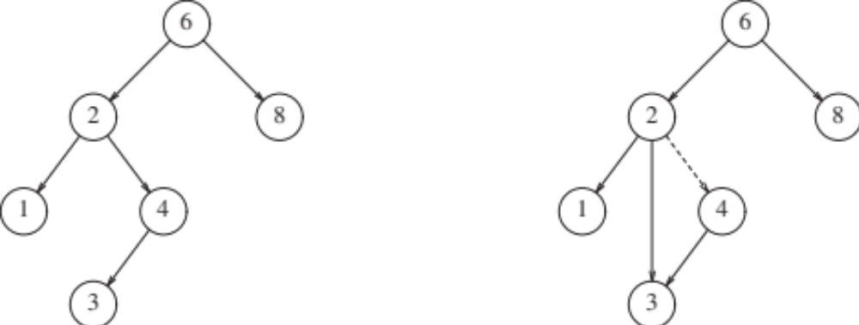
Delete Operation in BST
Delete is typically the most complex operation.
a. if the node X is a leaf, easily removed.
b. if node X has only one child, then just bypass it (make the child directly linked to X). Example. Delete 4

Slide 12
Delete Operation in BST
c. if node X has two children,
replace with the smallest node in the right subtree of X;
recursively delete that node.
the second deletion turns out to be easy;
because the second node can't have two children.

Slide 13
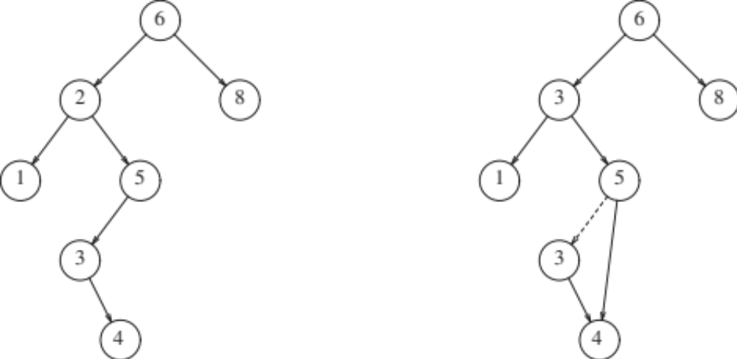
Example of Delete
Delete 2.
Swap it with Min in Right Subtree (3). Then Delete (3).

Slide 14
Analysis of BST
In the worst-case, BST on n nodes can have height n-1.
Each insert/delete takes O(height) time, same as linked list.
For better worst-case, tree needs to be kept balanced
  Namely, height O(log n) with n keys
Given a set of keys, easy to build a perfect BST initially:
  use the median division rule.
The problem begins when we start doing insert, delete ops.
Suppose we start from an empty tree and do a series of insertions, what does the tree look like.
  Of course, the worst-case is a path: linear depth
  What about if insert and deletes were random?

Slide 15
Analysis of BST
Analysis shows that if insertions are done randomly (keys drawn from [1,n]), then average depth is log n.
The sum of the depths of all the nodes is O(n log n).
Let D(n) be the internal path length.
If i nodes in the left, and (n – i - 1) on the right, then
D(n) = D(i) + D(n - i - 1) + (n - 1).
Under random insertions, the value of i varies uniformly
between 0 and n-1, and so
D(n) = 2/n (Σ D(j)) + (n-1)
A famous recurrence, which solves to D(n) = O(n log n).

Slide 16
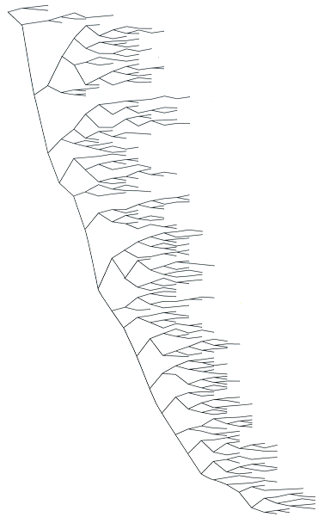
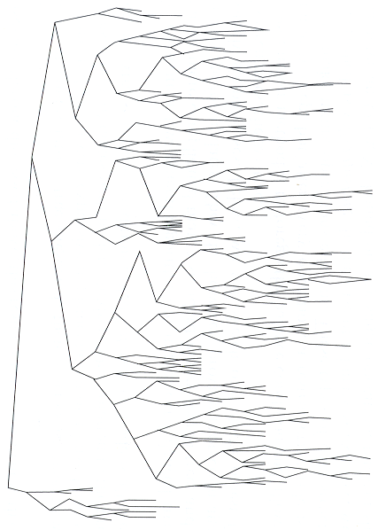
Alternate insertions
and deletions
randomly generated

Slide 17
AVL trees
AvL Trees are a form of balanced binary search trees
Named after the initials of their inventors
  Adelson-Velskii and Landis
  One of the first to achieve provable guarantee of O(log n) worst-case for any sequence of insert and delete operations.
  A binary tree cannot do better!

Slide 18
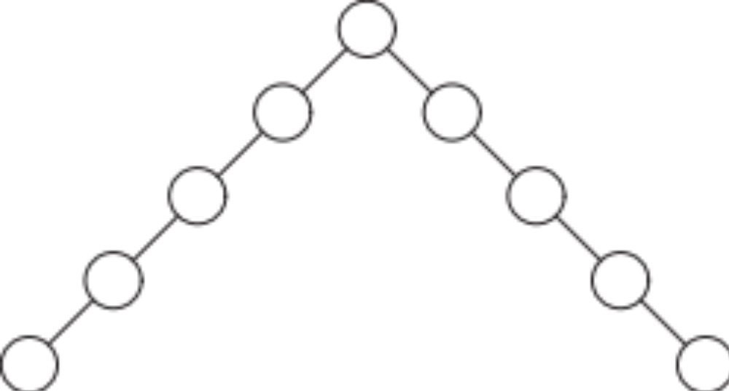
AVL trees
How do we ensure that an AVL tree on n nodes has height O(log n) even if an adversary inserts and deletes key to get tree out of balance?
Simply requiring that the left and right children of the root node have the same height is not enough:
  They can each have singly branching paths of length n/2

Slide 19
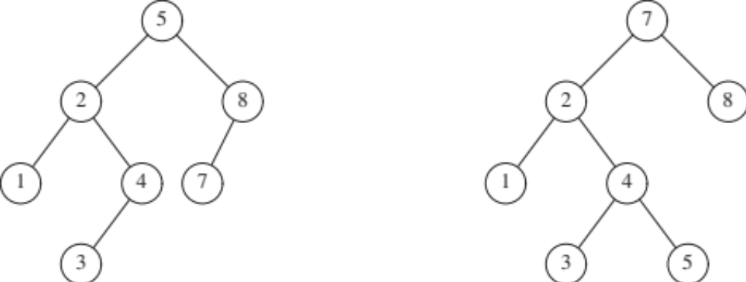
Balance Conditions for AVL trees
Demanding that each node should have equal height for both children too restrictive---doesn’t work unless n = 2^{k} – 1
AVL Trees aim for the next best thing:
  For any node, the heights of its two children can differ by at most 1
  Define height of empty subtree as -1
  Height of a tree = 1 + max{height-left, height-right}
  Which of the following are valid AVL trees?

Slide 20
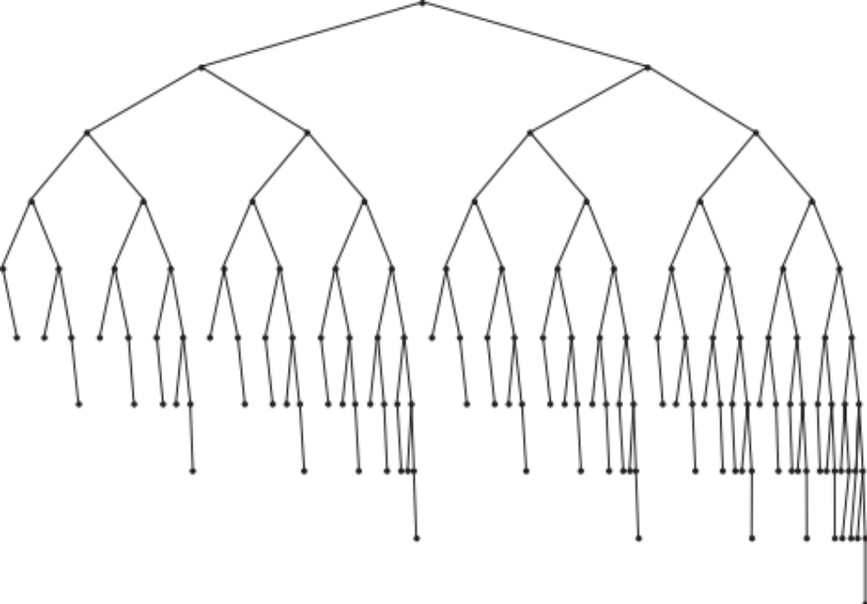
Height of AvL Trees
Theorem: An AVL tree on n nodes has height O(log n)
What is the minimum number of nodes in a height h AvL tree.
What is the most lop-sided tree?

Slide 21
Bound for the Height of AvL Trees
Recursive construction
Let S(h) = min number of nodes in AVL tree of height h
S(h) = S(h-1) + S(h-2) + 1
Like Fibonacci numbers. Solves to h = 1.44 log (n+2).

Slide 22
Keeping AVL Trees Balanced
Theorem: An AVL tree on n nodes has height O(log n)
Building an initially balanced tree on n keys is easy.
The problem is insertions/deletions cause unbalance.
AVL trees perform simple restructuring operations on the tree to regain balance.
These operations, called rotations, change a couple of pointers.
We will show that an insert, delete, or search operations touches O(1) nodes per level of the tree, giving O(log n) bound.

Slide 23
Tree Rotations
right rotation
b
d
d
b
A
E
C
E
A
C
left rotation

Slide 24
AVL Tree Rebalancing
We only discuss inserts; deletes similar though a bit more messy.
How can an insert violate AVL condition?
Before the insert, at some node x the height difference between children was 1, but becomes 2 after the insert.
We will fix this violation from bottom (leaf) up.

Slide 25
AVL Tree Rebalancing
Suppose A is the first node from bottom that needs rebalancing.
Then, A must have two subtrees whose heights differ by 2.
This imbalance must have been caused by one of two cases:
(1) The new insertion occurred into
the left subtree of the left child of A; or
the right subtree of the right child of A.
(2) The new insertion occurred into
the right subtree of the left child of A; or
the left subtree of the right child of A.
(1) and (2) are different: former is an outside (left-left, or right-right) violation, while the latter is an inside (left-right) or (right-left) violation.
We fix (1) with a SINGLE ROTATION; and (2) with a DOUBLE ROTATION.

Slide 26
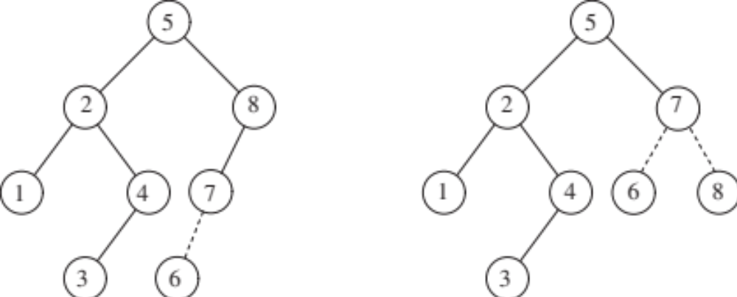
Single Rotation
Insert 6. Where is the AVL condition violated?
Case (1): insertion into the left subtree of the left child of A
Fixed by rotation at 7.

Slide 27
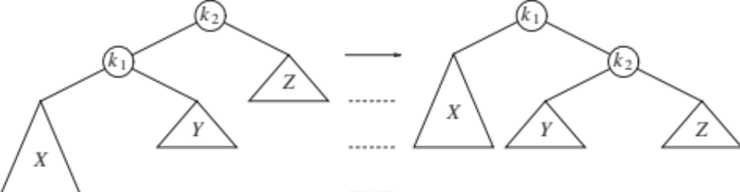
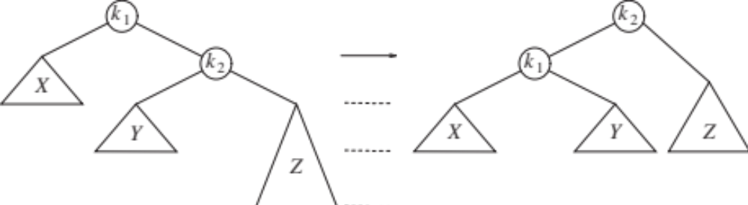
Single Rotation: Generic Form

Slide 28
Single Rotation: Example
Perform inserts in the following order:
3, 2, 1, 4, 5, 6, 7.

Slide 29
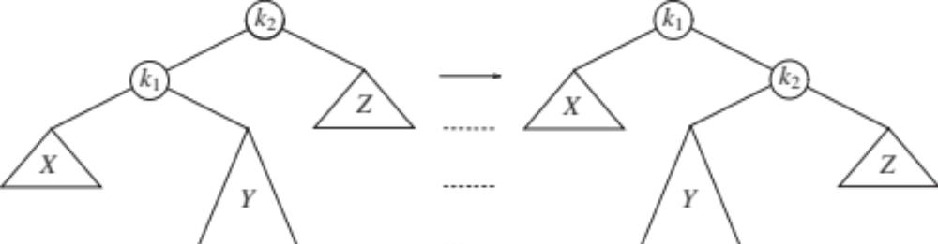
Failure of the Single Rotation
Single rotation can fail in case (2):
  Insert into right subtree of left child or vice versa

Slide 30
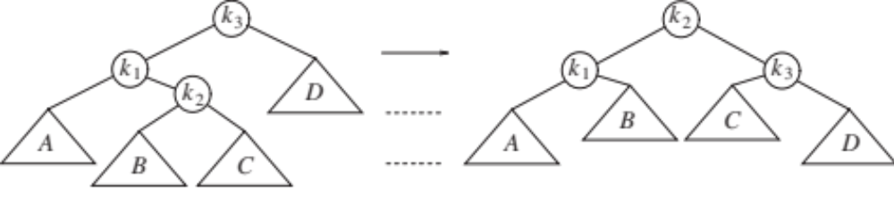
When Single Rotation Fails: Double Rotation
Need to look one level deeper.
Called Double Rotation: generic form
One of B or C is at level D+2.

Slide 31
Double Rotation: Example
To the example of previous AVL tree (keys 1-7), insert 16, 15, 14, …., 10, followed by insert 8, 9

Slide 32
Removing an element from an AVL tree
Similar process:
  locate & delete the element
  adjust tree height
  perform up to O(log n) necessary rotations
Example
Complexity of operations:
  O(h) = O(log n)
  n : number of nodes, h : tree height

Slide 33
Deletion Example
15
delete 10
15
10
30
5
30
5
12
17
35
12
17
35
14
20
31
40
14
20
31
40
50
50
30
15
15
35
12
30
12
17
31
40
5
14
17
35
5
14
20
50
20
31
40
50

Slide 34
AVL Tree Complexity Bounds
An AVL Tree can perform the following operations in worst-case time O(log n) each:
  Insert
  Delete
  Find
  Find Min, Find Max
  Find Successor, Find Predecessor
  It can report all keys in range [Low, High] in time O(log n + OutputSize)

Slide 35
More illustrations… Single Rotation (left-left)
1
2
2
1
Z
X
X
Y
Z
Y
Y cannot be at X’s level
Y cannot be at Z’s level either

Slide 36
Single Rotation (right-right)
1
2
2
1
Z
X
X
Y
Y
Z
Y cannot be at Z’s level
Y cannot be at X’s level either

Slide 37
Double Rotation (left-right): Single Won’t Work
Single rotation does not work because it does not make Y any shorter
1
2
2
1
Z
X
X
Y
Z
Y

Slide 38
Double Rotation (left-right): First Step
First rotation between 2 and 1
3
3
1
2
D
D
1
2
C
A
B
B
C
A

Slide 39
Double Rotation (left-right): Second Step
Second rotation between 2 and 3
3
2
3
2
D
1
1
C
B
C
D
A
B
A

Slide 40
Double Rotation (left-right): Summary
2
3
3
1
1
D
2
B
C
D
A
A
B
C

Slide 41
Double Rotation (right-left): First Step
First Rotation between 2 and 3
1
1
A
3
A
2
2
B
3
D
C
C
D
B

Slide 42
Double Rotation (right-left): Second Step
Second Rotation between 1 and 2
2
1
A
2
3
1
B
3
B
C
D
A
C
D

Slide 43
Double Rotation (right-left): Summary
2
1
A
3
3
1
2
B
C
D
D
A
B
C

Slide 44
Insertion into an AVL tree
AvlTree
AvlNode
element
height
left
right
Tree height
Search
Insertion:
  search to find insertion point
  adjust the tree height
  rotation if necessary
AvlTree::insert(x, t)
if (t = NULL)
then t = new AvlNode(x, …);
else if (x < t→element)
then
insert (x, t→left);
if (height(t→left) – height(t→right) = 2)
then if (x < t→left→element )
then rotateWithLeftChild (t);
else doubleWithLeftChild (t);
else if (t→element < x )
then
insert (x, t→right);
if (height(t→right) – height(t→left) = 2)
then if (t→right→element < x)
then rotateWithRightChild (t);
else doubleWithRightChild (t);
t→height =
max{height(t→left), height(t→right)}+1;

