Slide 1
PA 6 Malloc and Free
Ping Yin

Slide 2
Task: Implement 6 functions
void* my_malloc(size_t size);
int my_free(void* ptr);
void consolidate();
void print_heap(); --optional
int free_space();
int live_data();

Slide 3
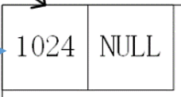
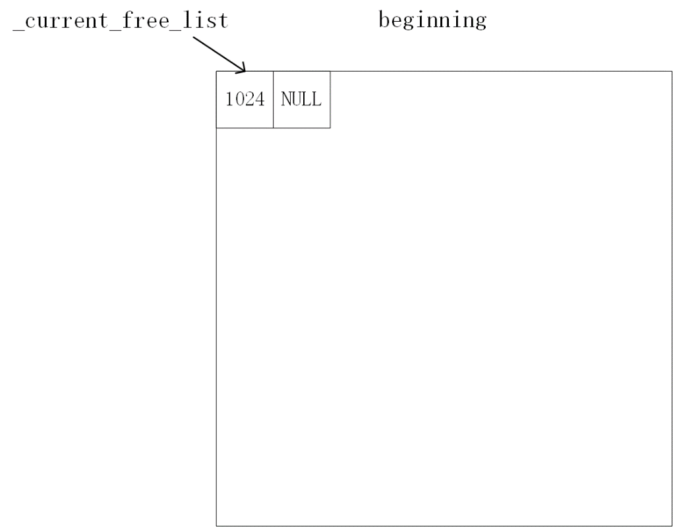
Initializing the heap..
Free entry:
Size: the size of this free entry
Next pointer: points to the next free entry in the heap
Global pointers:
_heap_ptr: always points to the beginning of the heap
_current_free_list: points to the most recent freed entry’s size field, which is also the first free entry in the free entry list.
heap_ptr

Slide 4
Initializing the heap (codes given)
size_t HEAP_SIZE = 1028; // in bytes (e.g. 1kb of memory)
int WORD_SIZE = sizeof(int);
void* heap_ptr = NULL;
void* current_free_list = NULL;
void setup_heap() {
1. heap_ptr = mmap(NULL, HEAP_SIZE, PROT_READ | PROT_WRITE, MAP_ANON | MAP_SHARED, -1, 0);
2. *(int*)heap_ptr = HEAP_SIZE - WORD_SIZE;
3. *(void**)(heap_ptr+WORD_SIZE) = NULL;
4. current_free_list = heap_ptr;
}

Slide 5
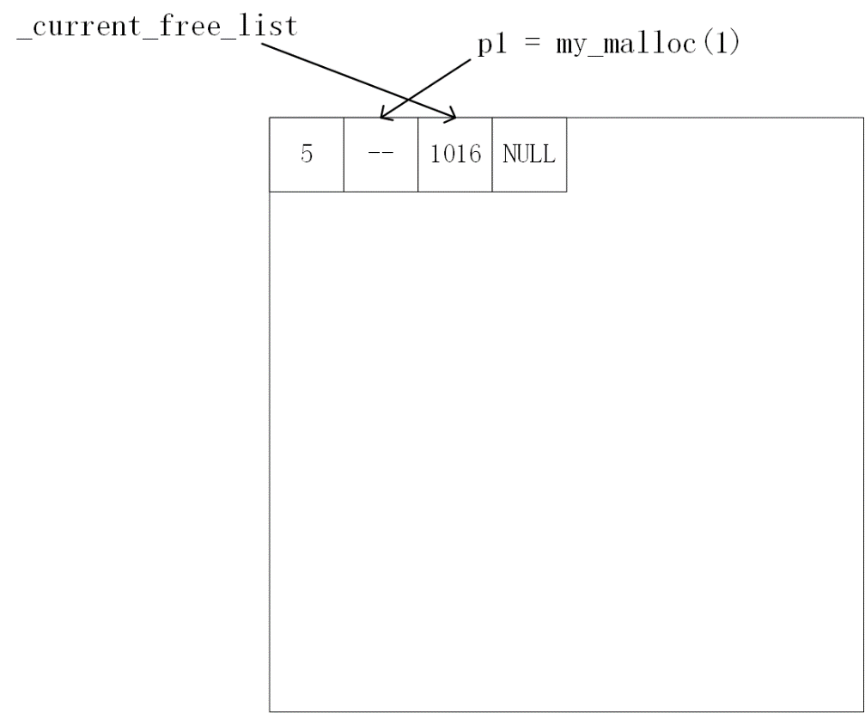
basic operations of my_malloc(size_t size)
Occupied entry:
Size: number of bytes in data field in this occupied entry, and plus 1
Data field: my_malloc() returns the address of the first word in the data field
Example explaination:
a)
1 round up to 4, because 4 is the smallest number of multiple of 4, that is bigger than 1.
So the size of the data field is 4 bytes.
b)
Add 1 to the size, so that it becomes 5. This marks this entry as “occupied”.
c)
_current_free_list is updated;
d)
Return correct address to p1.

Slide 6
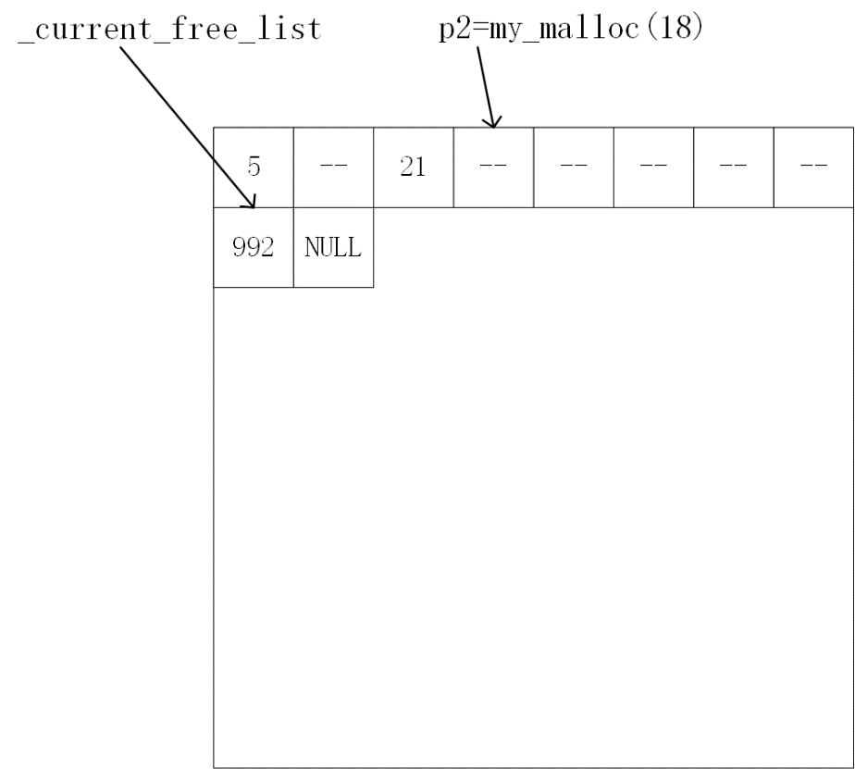
Similarly, call p2=my_malloc(18)

Slide 7
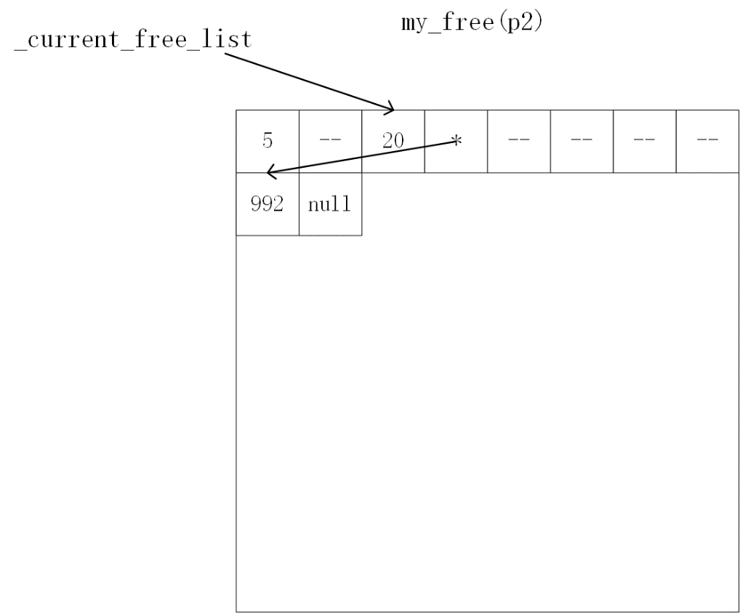
basic operations of my_free(void* ptr)
Change the size field, decrement it from 21 to 20. This operation marks this entry as “free entry”.
b) Set up the next pointer accordingly

Slide 8
A few more interesting cases of my_malloc()

Slide 9
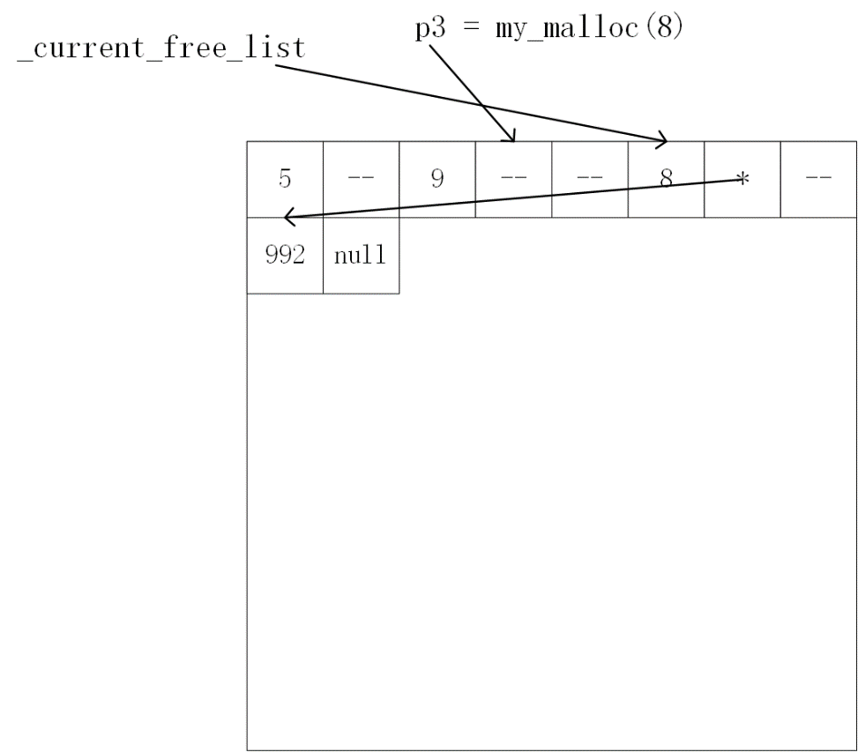
Split a free entry: my_malloc(8)
after
before

Slide 10
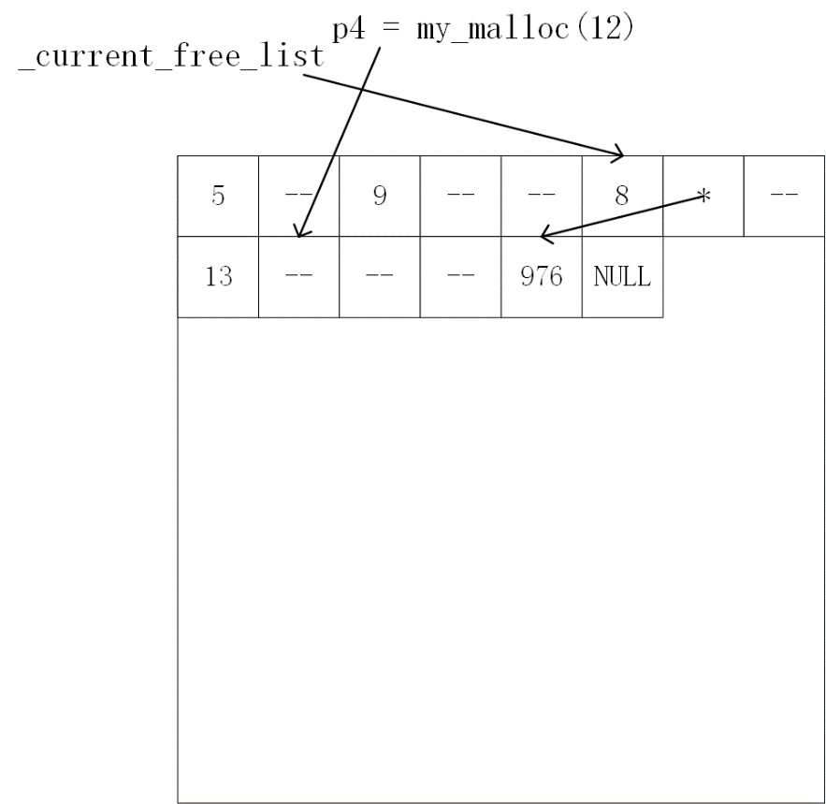
My_malloc(12): Iterate free list to find a big enough place
after
before

Slide 11
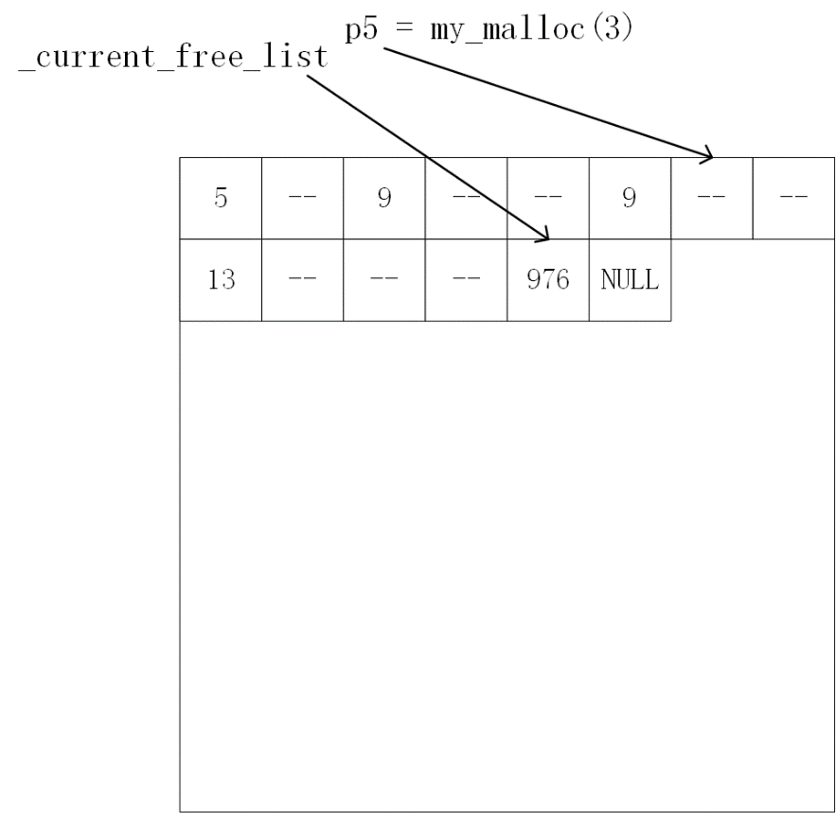
My_malloc(3):Re-using the whole free entry
after
before

Slide 12
A few more interesting cases of my_free()

Slide 13
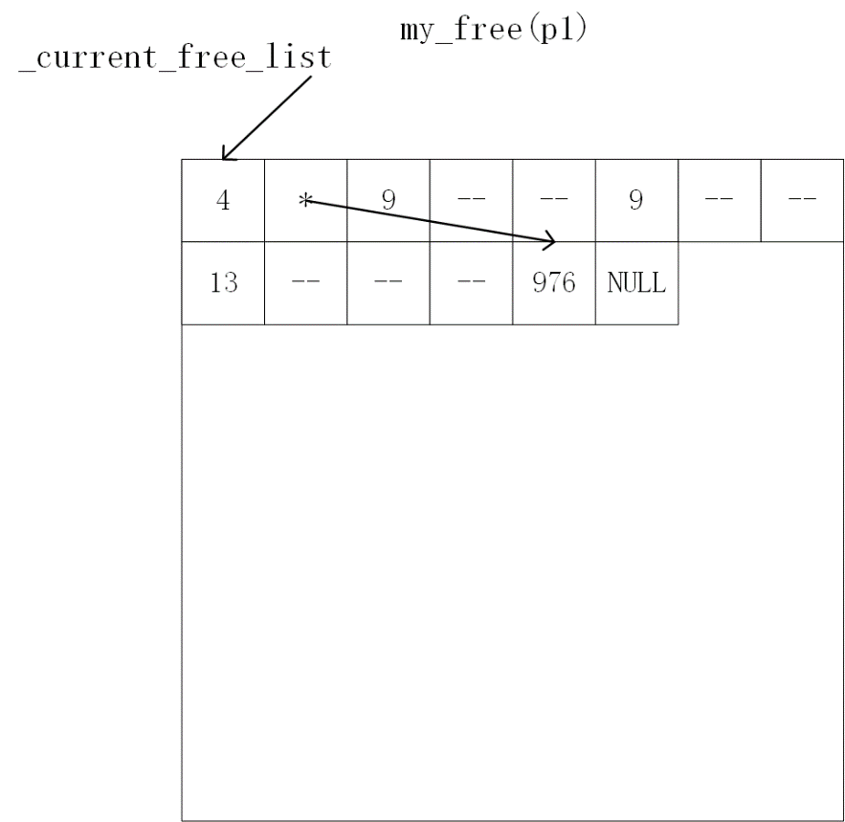
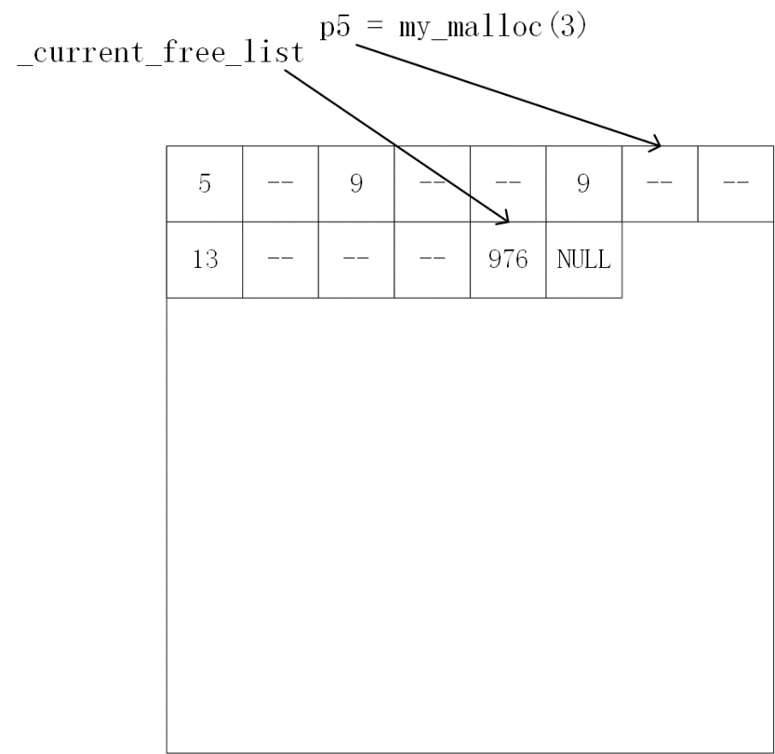
after
My_free(p1)
before

Slide 14
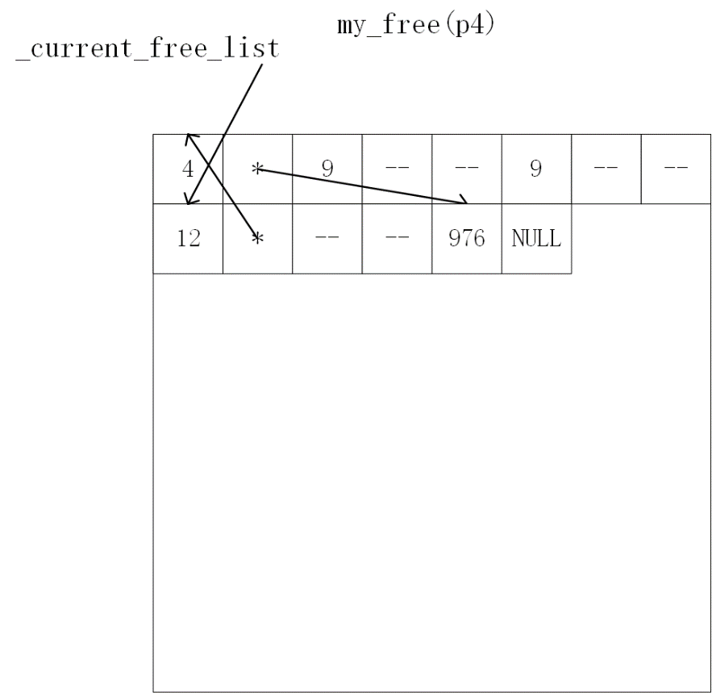
after
My_free(p4)
before

Slide 15
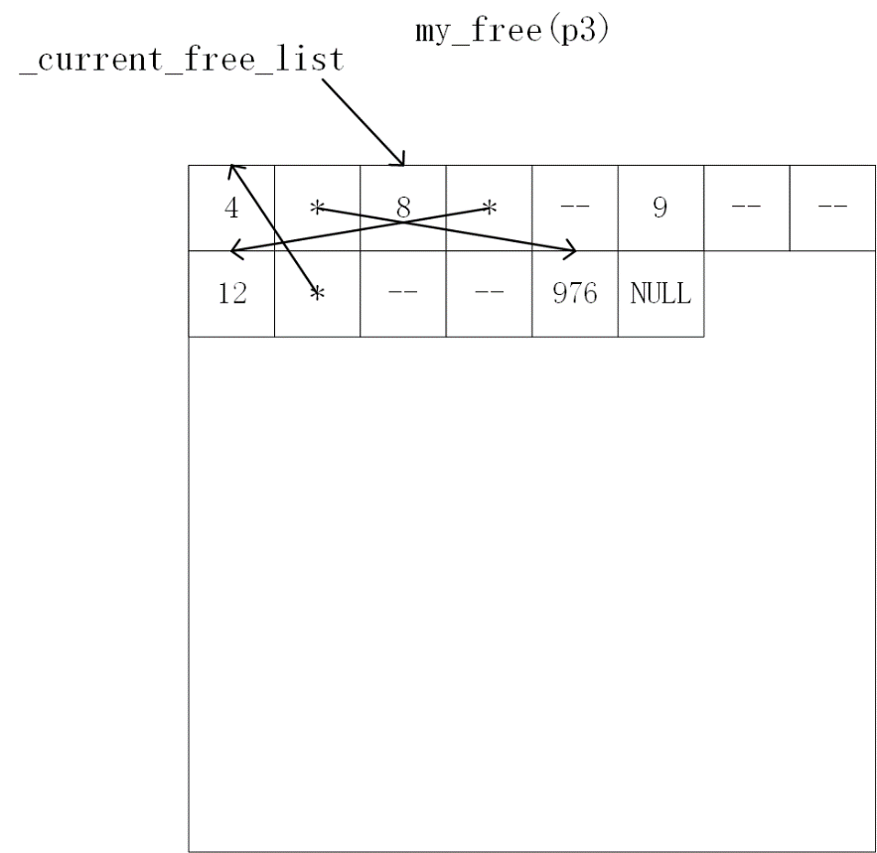
My_free(p3)
after
before

Slide 16
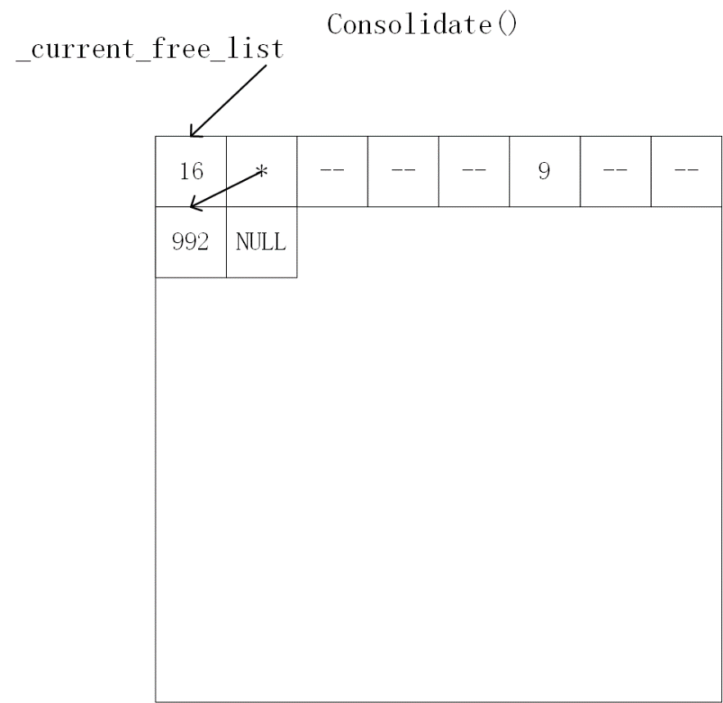
Consolidate()
after
before

Slide 17
Consolidate()
After consolidation,
current_free_list always points to the first free entry;
Next pointer always points to the next free entry in the address order
before
after

Slide 18
free_space()
What does free_space() return?

Slide 19
free_space()
What does free_space() return?
Ans: 8+12+4+976 = 1000

Slide 20
Live_data ()
What does live_data() return?

Slide 21
Live_data ()
What does live_data() return?
Ans: 9-1 = 8

