Slide 1
Webinar-1

Slide 2
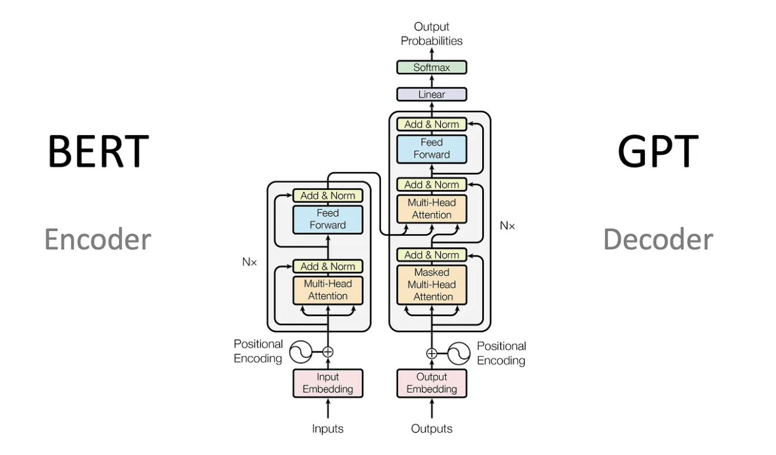
Transformer

Slide 3
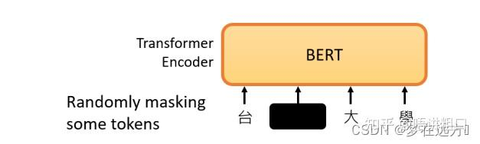
BERT

Slide 4
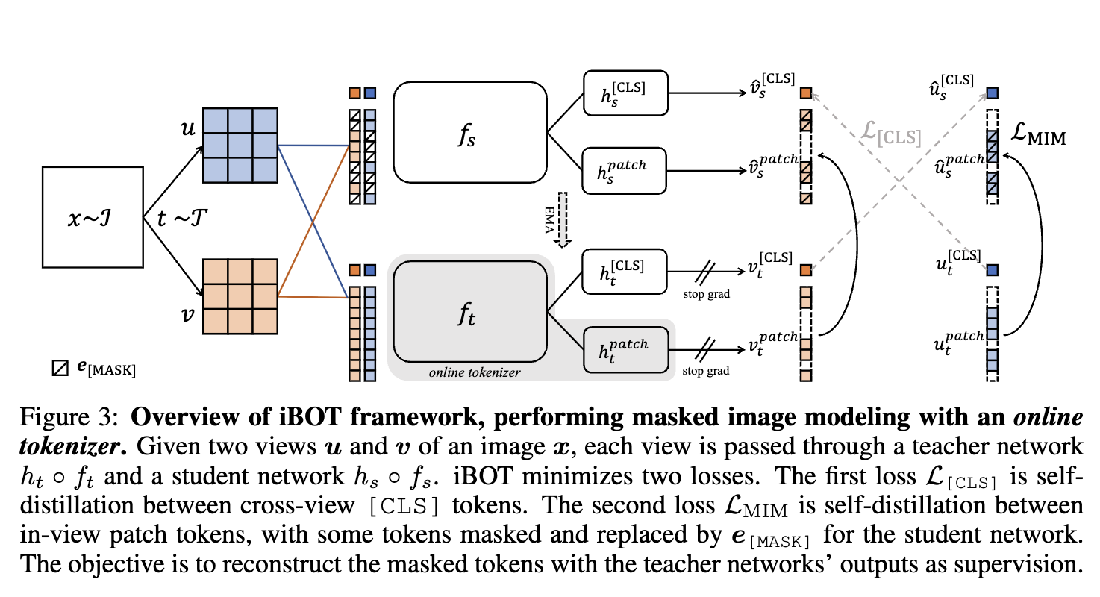
iBOT
[1] iBOT: Image BERT Pre-Training with Online Tokenizer

Slide 5
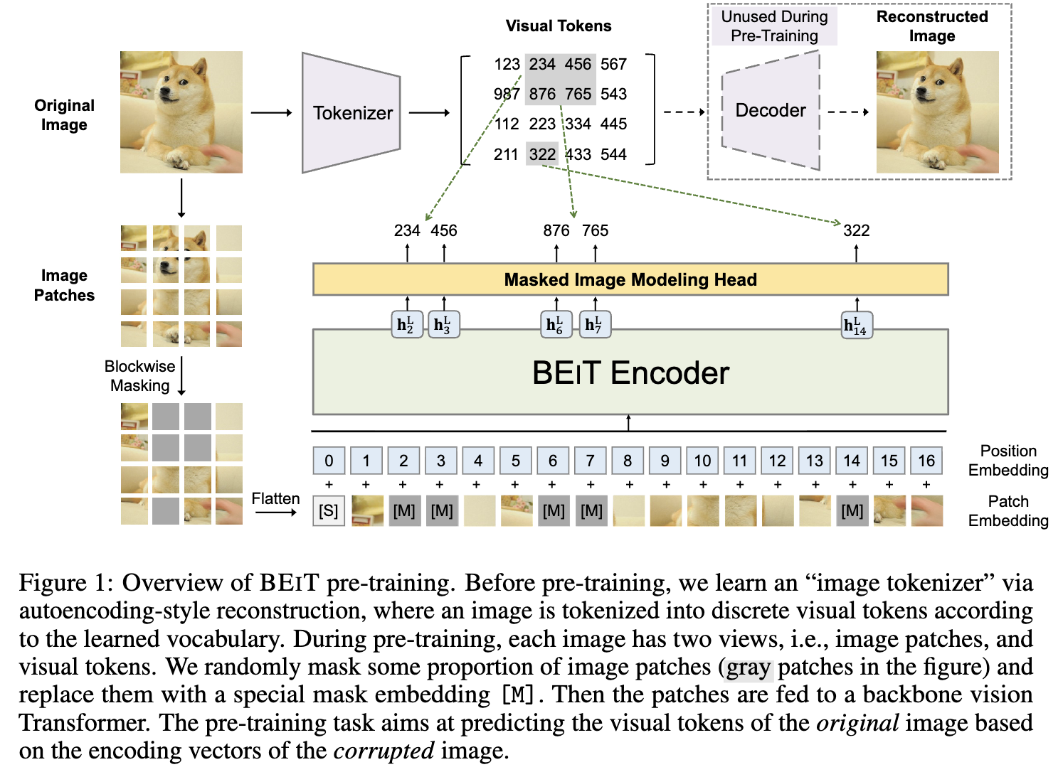
BEiT
[1] BEiT: BERT Pre-Training of Image Transformers

Slide 6
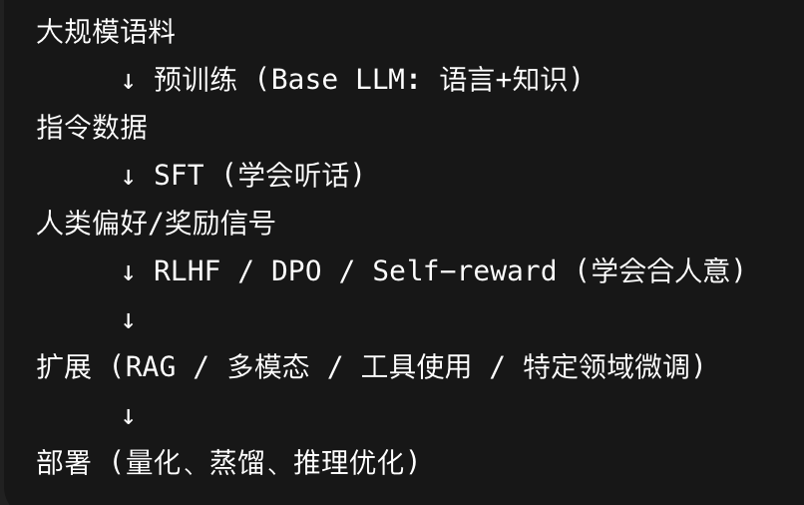
LLM 训练过程

Slide 7
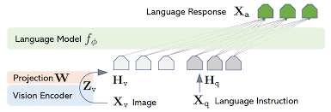
VLM----LLaVA
[1] Visual Instruction Tuning

Slide 8
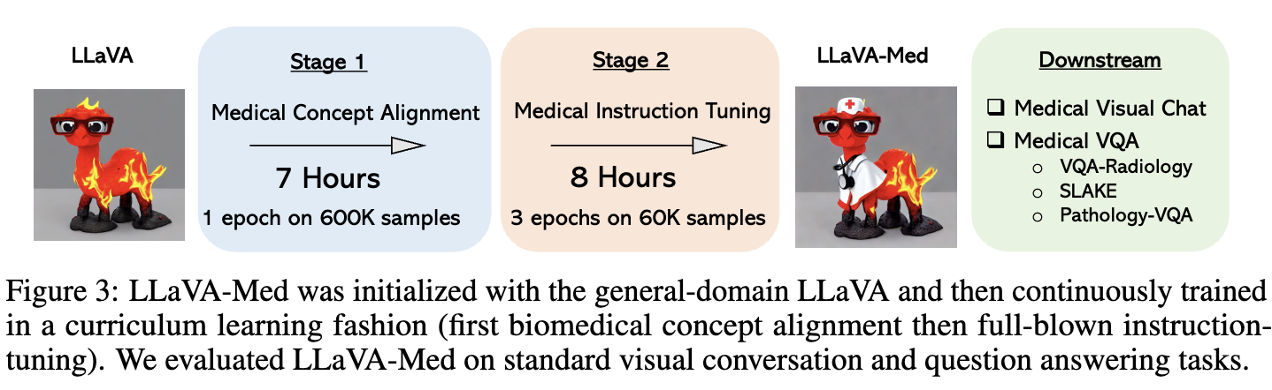
LLaVA-med
[1] LLaVA-Med: Training a Large Language-and-Vision Assistant for Biomedicine in One Day

Slide 9
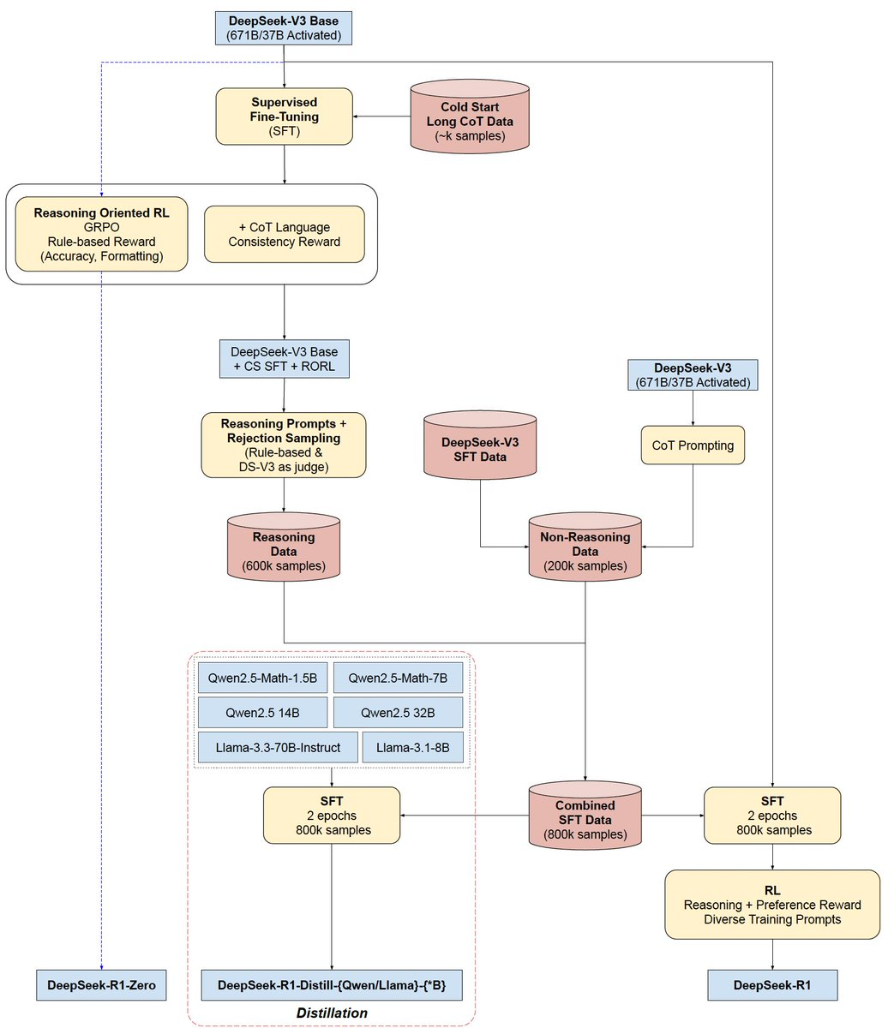
LLM+RL

Slide 10
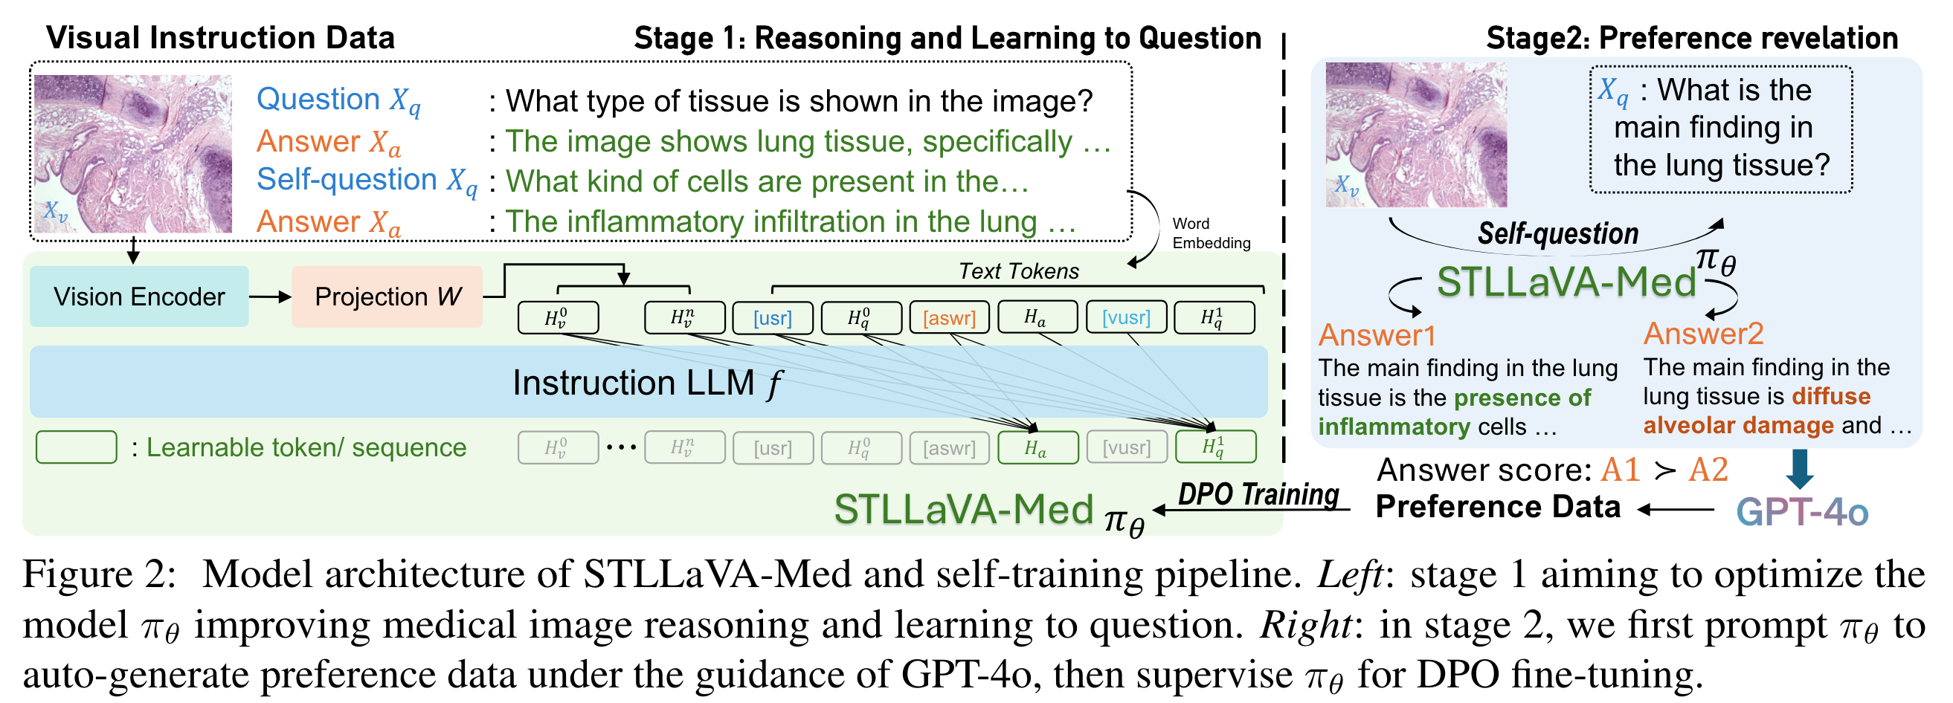
LLM+RL
[1] Self-Training Large Language and Vision Assistant for Medical Question-Answering

