Slide 1
Coursera Capstone Project — The Battle of Neighbourhood
Kangning Li
Sep 10, 2019

Slide 2
Introduction
Business problem:
To find nice place to go around and try some good restaurant nearby,
or similarly if you want to expand your business(say restaurant in this specific case) around the top visited site in Chicago

Slide 3
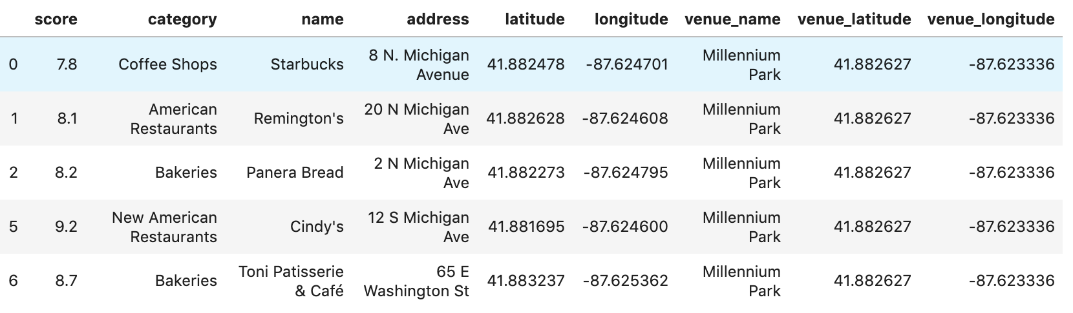
Data acquisition and cleaning
1. Using FourSquare to get the top 30 places to visit in Chicago
Top visited places data set are scraped from FourSquare and returned in html form, need to to further extracted into DataFrame.
In total 30 rows and 6 features including geo coordinate.
2 Using FourSquare to get the top 30 venues around top 30 top sites.

Slide 4
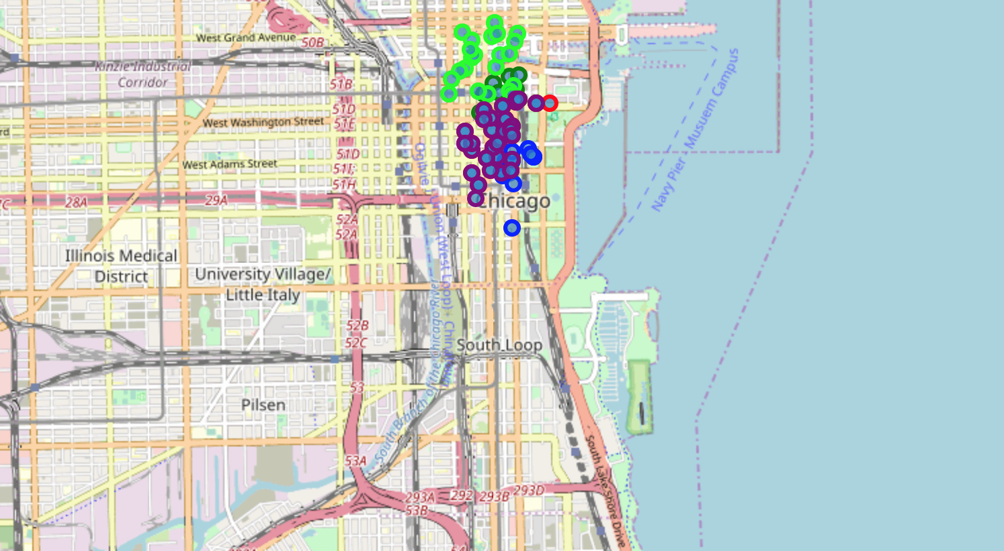
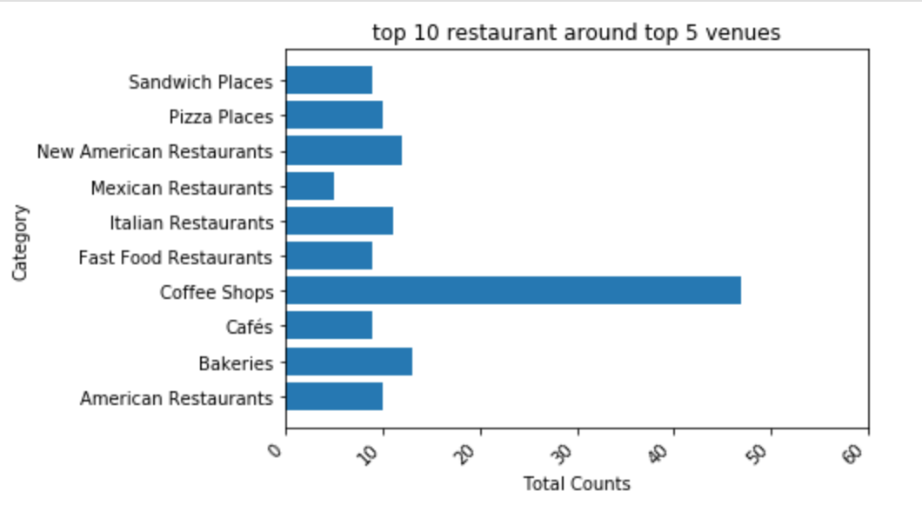
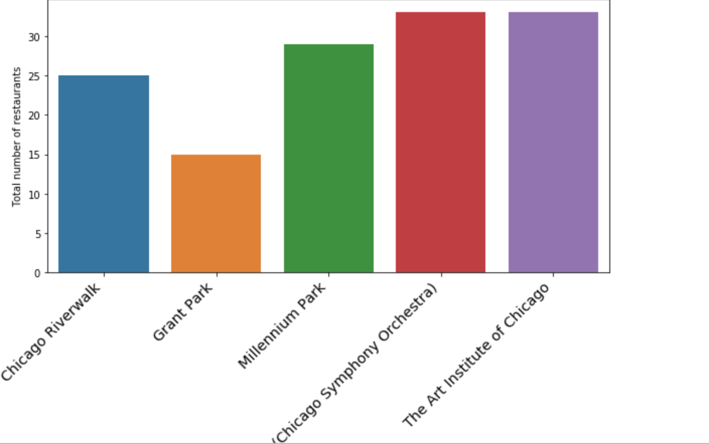
Data visualization
On the left:Circular marks represent the most frequently visited restaurants in the top 5 venues (Millennium Park- Red, The Art Institute of Chicago- BLue, Grant Park- Lime, Chicago Riverwalk- Purple, Symphony Center- Green) according to Foursquare data
On the right: Top 10 restaurant around top 5 venues
(Millennium par, The Art Institute of Chicago, Grant Part, Chicago RiverWalk, Symphony Center)

Slide 5
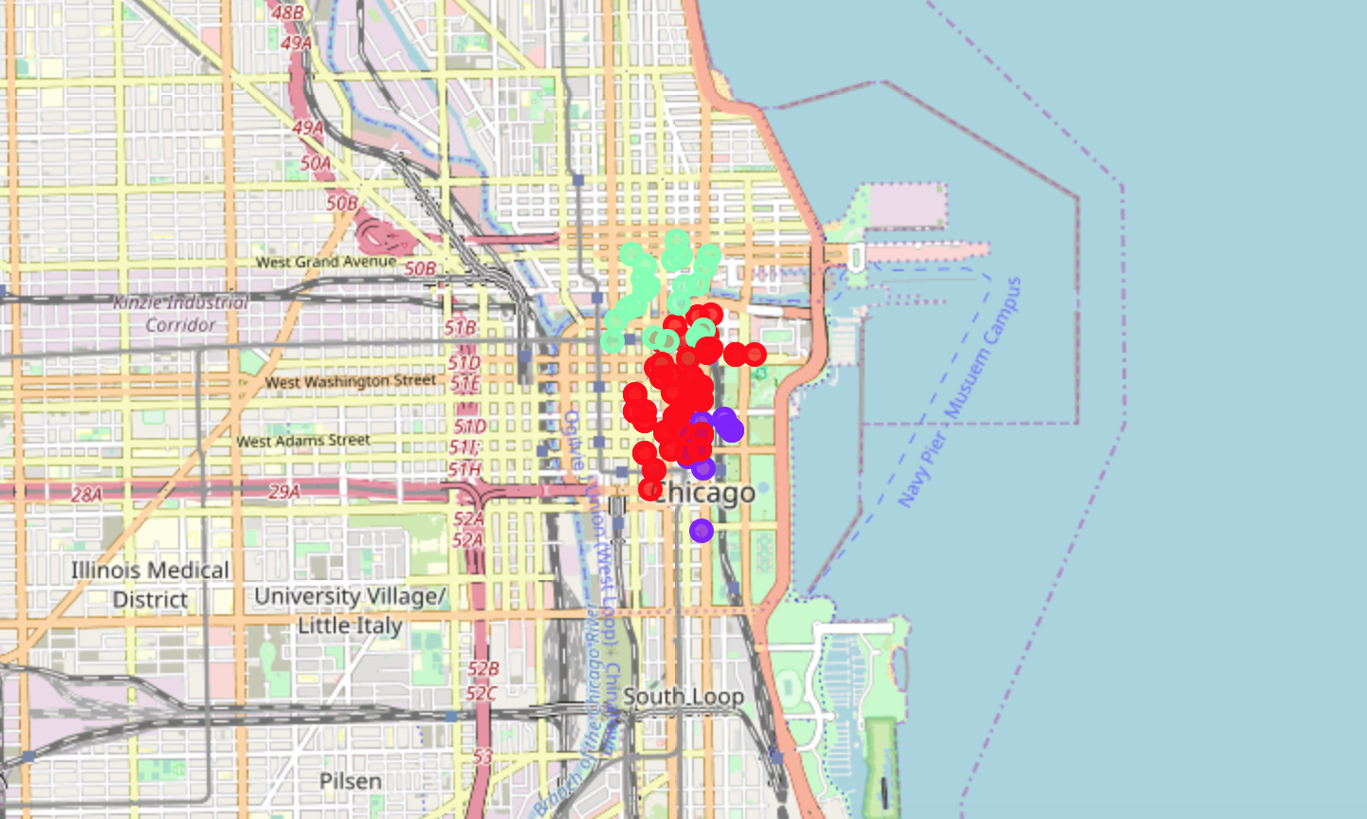
Clustering Venues
5 top visited sites of Chicago segmented into 3 clusters based on the most common venues. The size of the circles represents number of restaurants as most common venues for each sites, which is highest at Millennium Park(red) and lowest at Grant park(purple) as shown in above map

Slide 6
Results and conclusion
Results:
1. Coffee Shop top the charts of most common venues in the top 5 visited sites.
2. The art institute of Chicago and symphony center have most number of restaurants around.
3. Since the clustering was based only on the most common venues of each site, Millennium Park,The Art Institute of Chicago, Symphony Center fall under the same cluster. Grant Park and Chicago Riverwalk, are separated from both of these clusters as, American food and Sandwichs stand out as the most common venue (with a very high frequency)
Summary:.
1. However, it certainly gives us some very preliminary hint on possibilities of opening restaurants around the top rated sites of Chicago.
2. Data set maybe not enough to provide strong evidence.
3. Furthermore, the machine learning model is too simple, this results also could potentially vary if we use some other clustering techniques like DBSCAN.

