Slide 1
All samples from user-2,3,…,10
All samples from user-1
Step-1 Leave-one-user-out splitting
Nonuser samples
User samples
Whole dataset
80%
20%
60%
40%
Step-2 80%-20% train-valid splitting & 60%-40% test-online (user) splitting
Train
valid
Test
Onl (user)
Step-3
Valid-online (nonuser) splitting
Train
valid
Onl (nonuser)
Test
Onl (user)
Same size

Slide 2
User-2
Unseen
user
User-3
User-1
User-1
Unseen user
User-2
Decision boundary after online-training using unseen user’s samples
User-3
Decision boundary learned by pre-training
Circle for class-1, square for class-2. User-1,2,3 available for pre-training

Slide 3
Nucleo-F756ZG
FLASH
Backbone
Weights
SRAM
Classifier weights
Online training engine
Weight increments
Dense input buffer
Platform observer
activations
Inference engine
output buffer
Input buffer
UART
PC

Slide 4
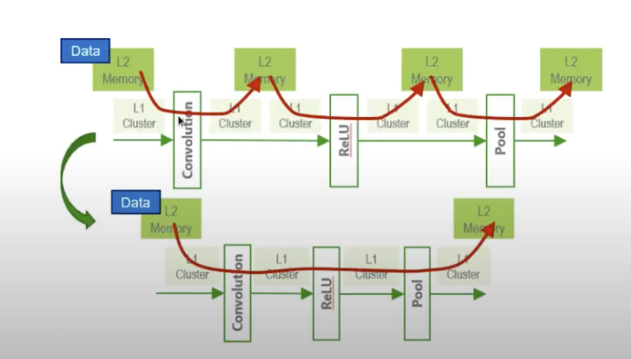
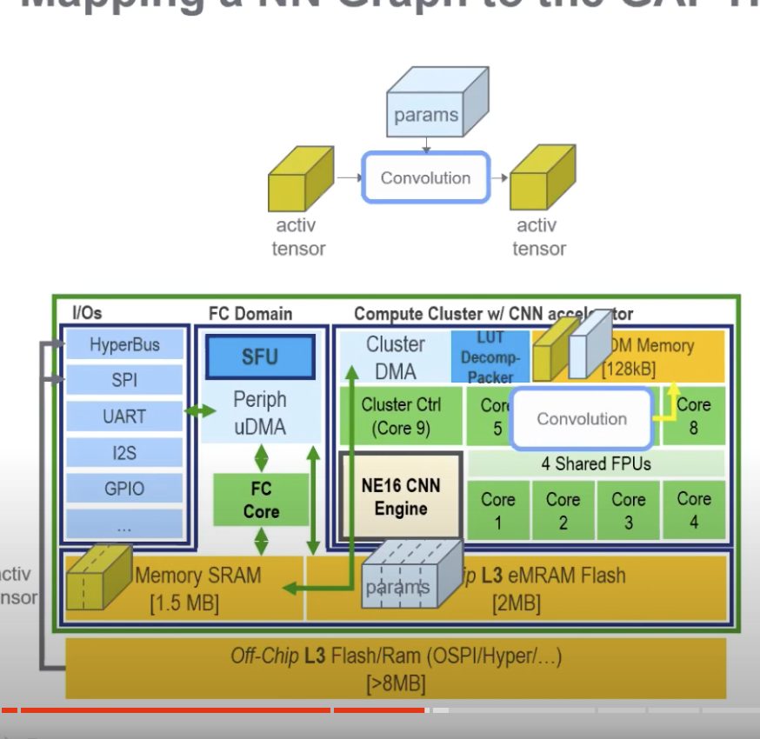
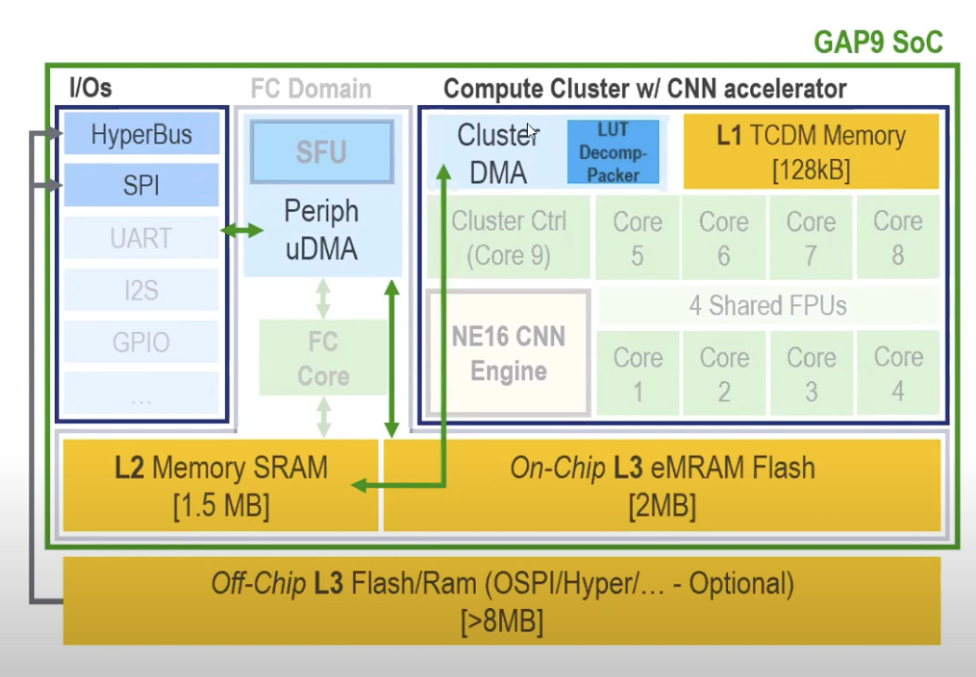
Inference engine
Online training engine
L1 Mem
inference buffer
ot buffer
Backbone
Weights
DMA
Classifier weights
L2 Mem
Backbone Weights
Classifier Weights
activations
output
w/b icmt
dense input
input

