Slide 1
All samples from user-2,3,…,10
All samples from user-1
Step-1 Leave-one-user-out splitting
Nonuser samples
User samples
Whole dataset
80%
20%
60%
40%
Step-2 80%-20% train-valid splitting & 60%-40% test-online (user) splitting
Train
valid
Test
Onl (user)
Step-3
Valid-online (nonuser) splitting
Train
valid
Onl (nonuser)
Test
Onl (user)
Same size

Slide 2
User-2
Unseen
user
User-3
User-1
User-1
Unseen user
User-2
Decision boundary after online-training using unseen user’s samples
User-3
Decision boundary learned by pre-training
Circle for class-1, square for class-2. User-1,2,3 available for pre-training

Slide 3
Nucleo-F756ZG
FLASH
Backbone
Weights
SRAM
Classifier weights
Online training engine
Weight increments
Dense input buffer
Platform observer
activations
Inference engine
output buffer
Input buffer
UART
PC

Slide 4
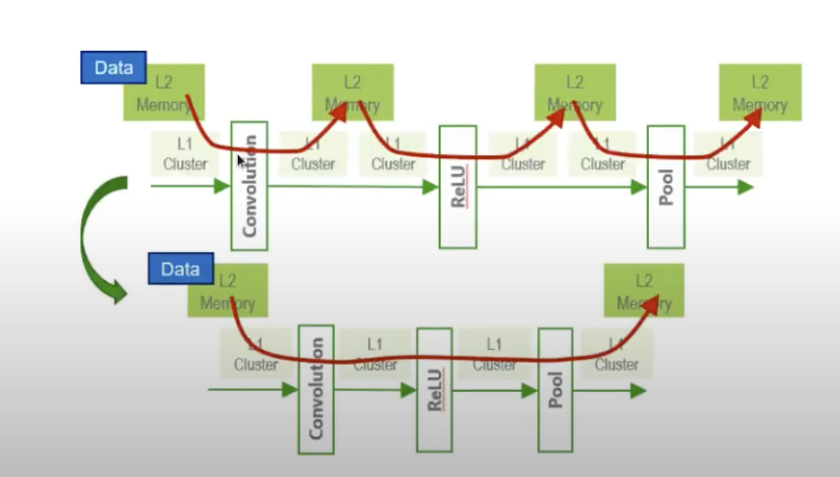
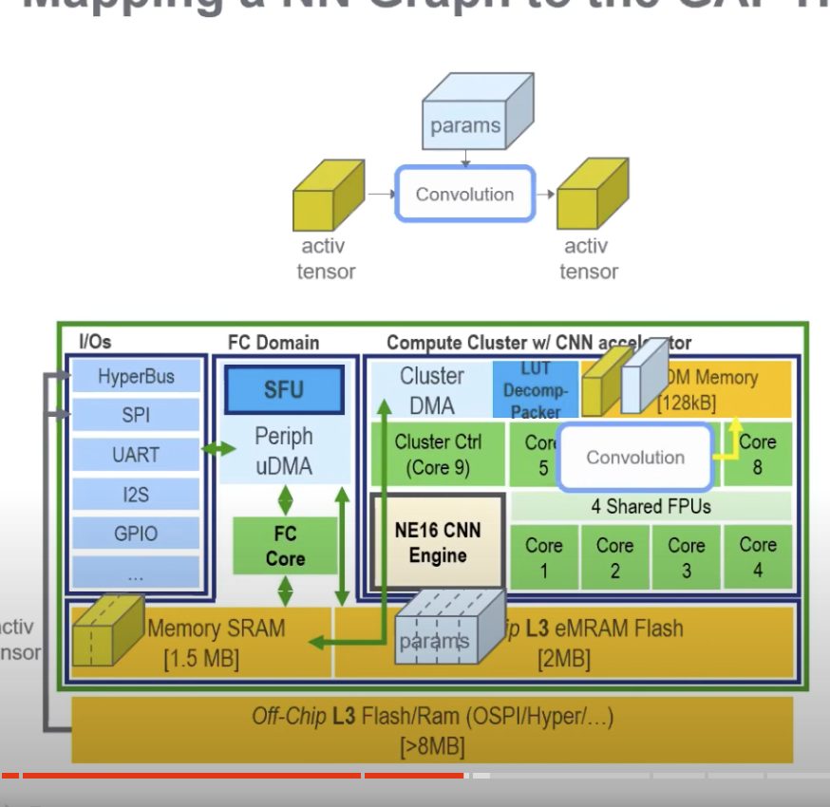
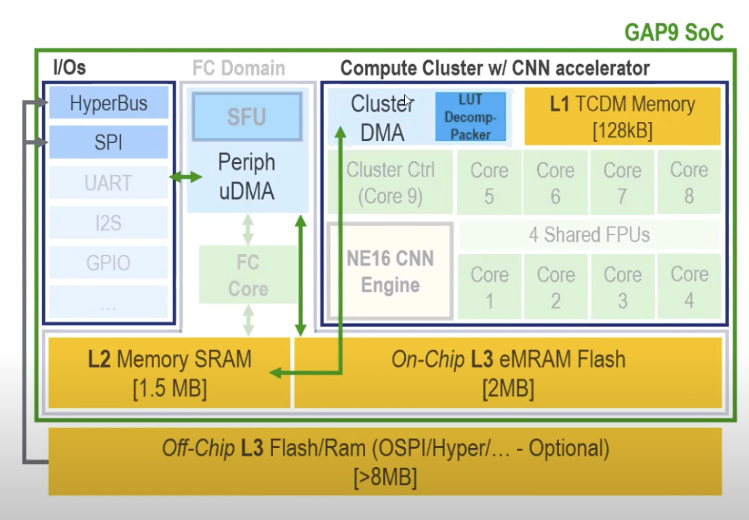
Inference engine
Online training engine
L1 Mem
inference buffer
ot buffer
Backbone
Weights
DMA
Classifier weights
L2 Mem
Backbone Weights
Classifier Weights
activations
output
w/b icmt
Dense Input
input

Slide 5
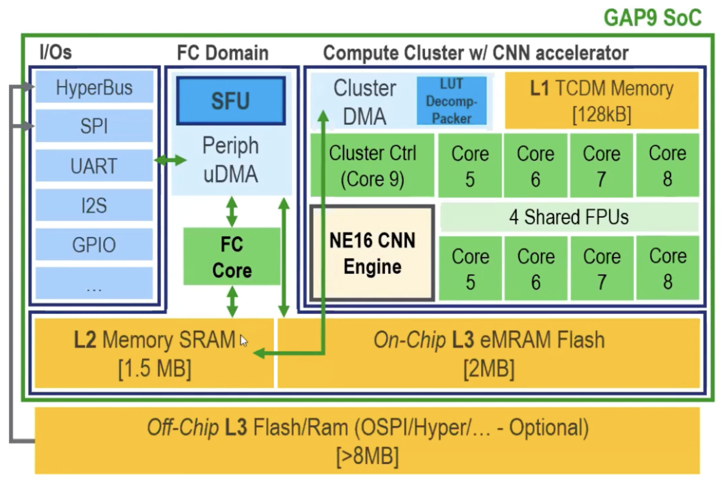

Slide 6
SRAM
FLASH
Inference Engine
On-Device Training Engine
On-Device
Training Engine
Classifier Params
Backbone Params
L1 Mem
EMA Buffer
Inference Buffer
OT Buffer
Dense Input Buffer
Platform Observer
Activations
DMA
Inference Engine
L2 Mem
Output Buffer
Backbone Params
Classifier Params
Activations
Output
EMA Buffer
Input Buffer
Dense Input
Input

