Slide 1

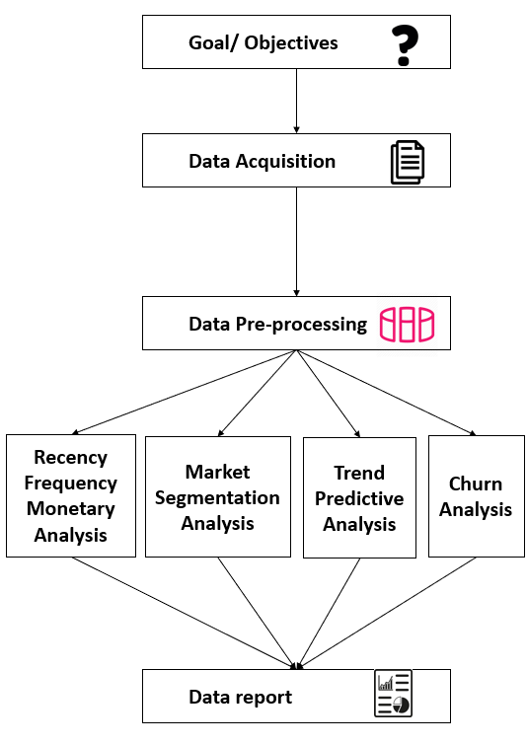
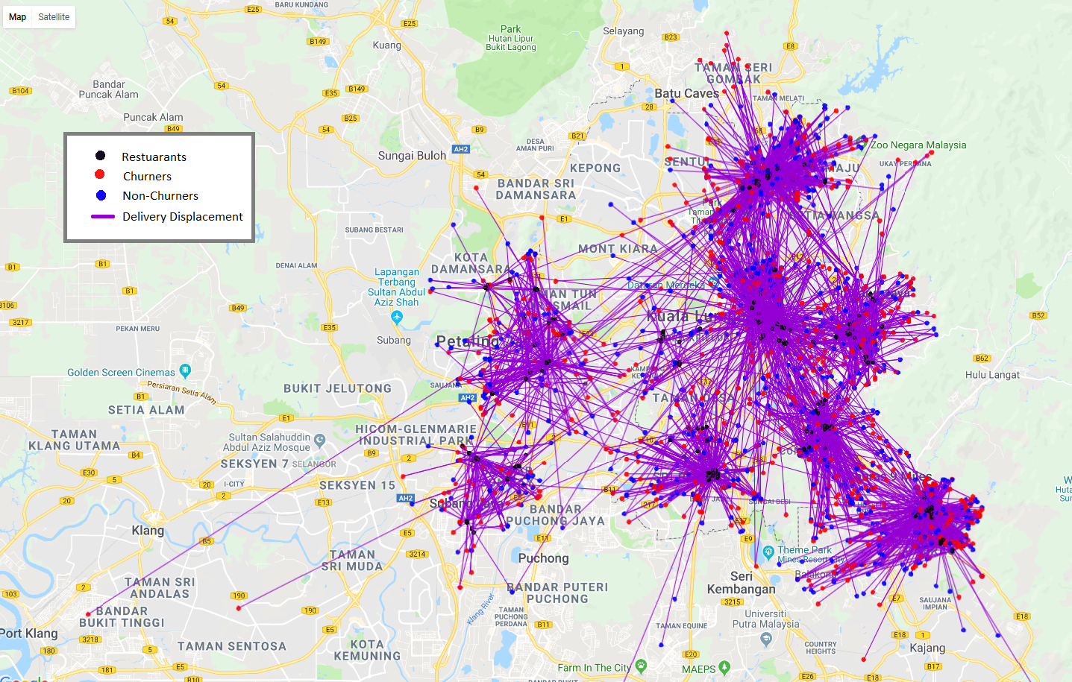
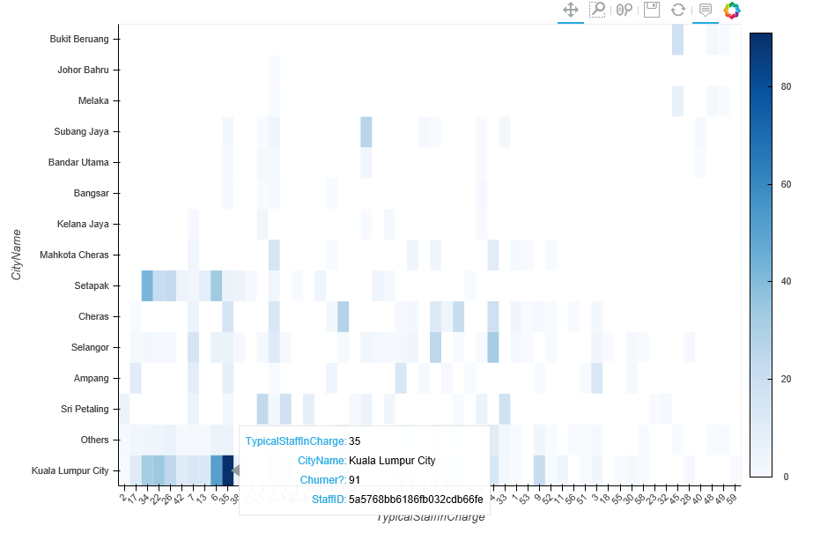
Consumer Behaviour Analysis In Foodservice Industry (Research Category)
Lee Kang Wenn, Yang Poh Yee, Chan Peck Hui, Shim Hiu Yin
Bachelor of Computer Science (Hons) in Software Engineering
Faculty of Computing and Information Technology
Tunku Abdul Rahman University College
As the number of organization and start up increases, the competition in market increases. Therefore, many companies has realized the importance of business strategies to sustain and maintain a stable income in the market. these business strategies includes making of new customers and maintaining the loyalty of existing customers. Therefore this project aims to perform customer behavioural analysis to find out interesting trends and statistics for future prediction of customer trends, so that companies can utilizes these information to facilitates company’s decision making, enhance their businesses and increase in sales values (Leykin, 2007).
Abstract
Problem Statement
The company associated is RunningMan, it is a third-party delivery services that is collaborated with variety of restaurants and fast food stalks. However, due to the increasing number of customers and rapid growth in business size, it is hard for the company to maintain individual relationship with each of their customers. Therefore, they hope to perform some analytics on consumer behavioural based on their customer transactions details, restaurant details and customer profiles.
Results and Discussion
Customer with Frequency score of 5 and Recency score of 5 has monetary value of RM761.78.
Most of the customer only has 2 transactions within 2 months.
After k-means clustering, most customers RFM score is 321.
This means most of the customer does not purchase recently and frequently with low monetary score (low spending).
RFM Analysis
The main objective of this thesis is to extract semantic customers behavioural information through consumer behaviour analysis using churn analysis, market segmentation, predictive analysis and Recency Frequency Monetary analysis. It involves the collection of consumer behavioural information through various sources such as transaction details, customer’s profile, customer’s location, customer’s behaviours and so on, to generate interesting trends pattern and meaningful customer insights about the purchasing process.
Objectives
Johor Bahru and Kuala Lumpur City are the most profitable cities.
Johor Bahru is also the primary target market.
Most customers choose to deliver their orders as soon as possible for their lunch break time and after work.
10am, 9pm and tea time period has the least orders compare to other time.
Market Segmentation Analysis
Design and Methodology
Predictive Analysis
Decision Tree is the best predictive model for predicting food ordering trend, followed by Random Forest which can be an alternative.
During data exploration and filtering, most customers prefers to order from Chinese Restaurants.
RFM analysis –
There will be 5 category for each R, F, M score. Each customer will be assigned a RFM score and binned into bins.
Market segmentation analysis -
Subdividing the customers which have similarity in same group based on their characteristics.
Churn Analysis (Churn Period : 21 days)
Majority of the churners group are found to have orders with greater delivery distances
Figure 2 : Google map plot with restaurants, churners, non-churners and delivery displacement
Staff with staff ID of ‘5a5768bb6186fb032cdb66fe’ worked at Kuala Lumpur City has an extreme high rate of churners
Predictive analysis –
Analyse which predictive model will be able to produce the most accurate trend prediction results.
Figure 3 : Heatmap representing City(y-axis) vs Staff In Charge(x-axis) vs Number of Churners (colour opacity)
RunningMan will be able to get better insights and know in what way they should improve on. This would increase their customer satisfaction, along with the overall rating of their ratings.
Contribution
Figure 1 : Research Framework
Churn analysis - Analyse and predict the number of customers that ceases his or her relationship with a company.
From all the results above, we can conclude that:
Most of the customers are churners, with low spending and low frequency in transactions.
After categorising and analysing which type of restaurants are the most popular, RunningMan can know what type of restaurants and the most profitable areas to focus on.
Conclusion

