Slide 1
SCBO
王康
kangw@iphy.ac.cn

Slide 2
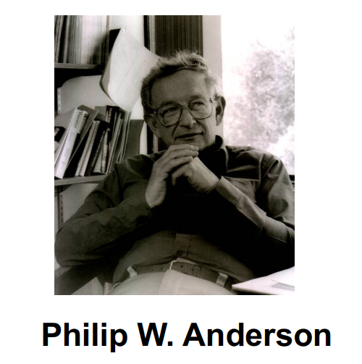
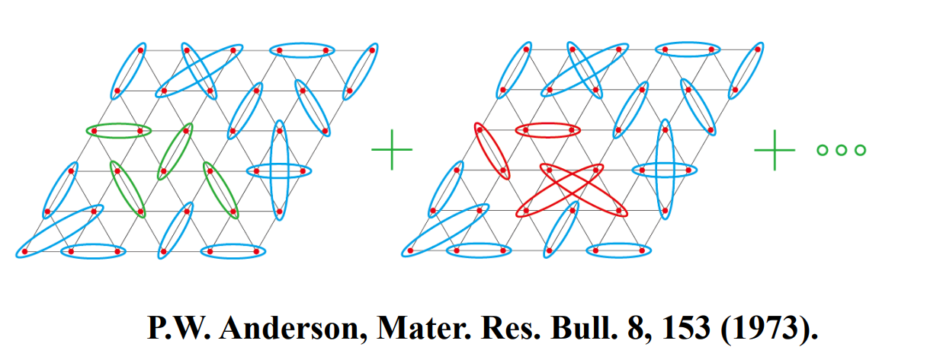
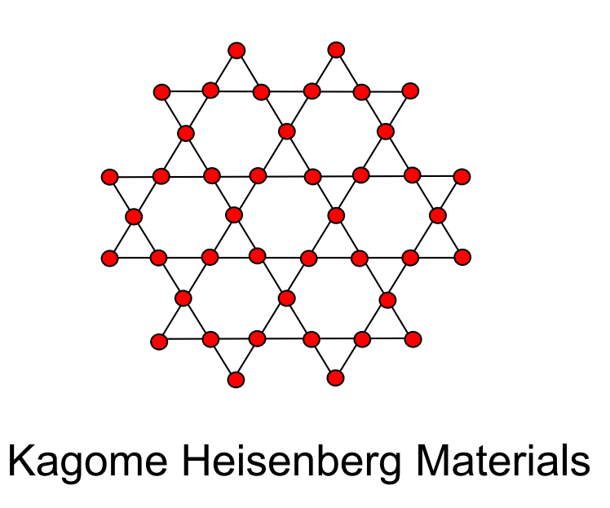
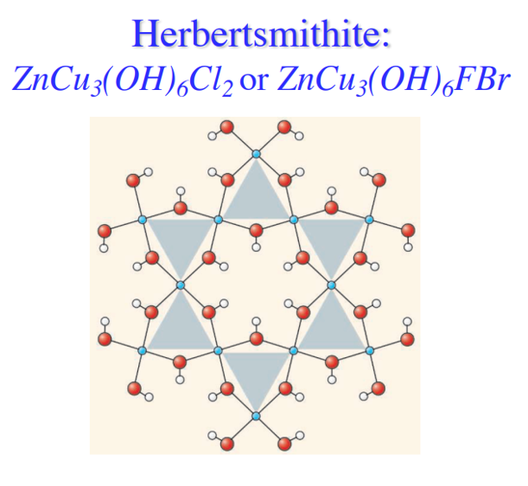
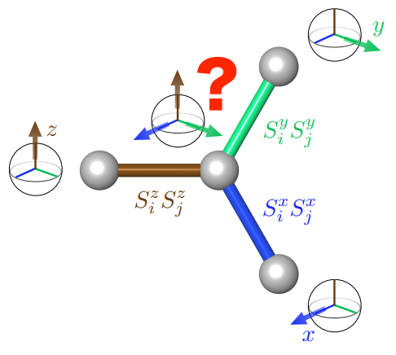
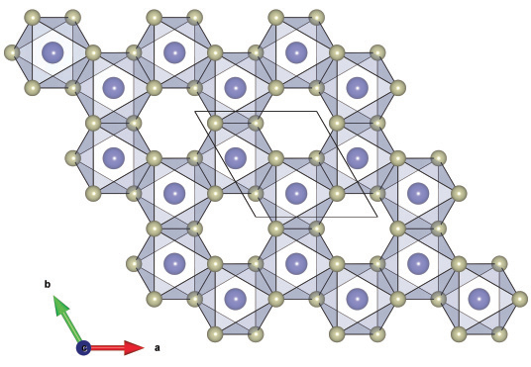
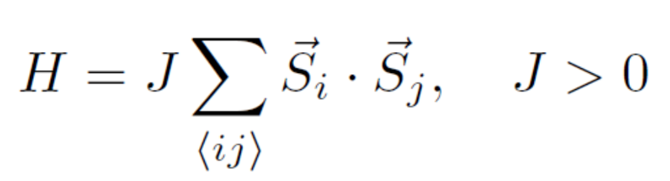
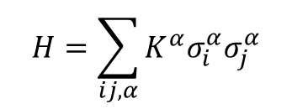
Quantum Spin Liquid
Geometrical frustration
Interaction frustration
RuCl3
$$H=\sum_{ij,α}{K^{α}σ_{i}^{α}σ_{j}^{α}}$$
The only solvable spin liquid

Slide 3
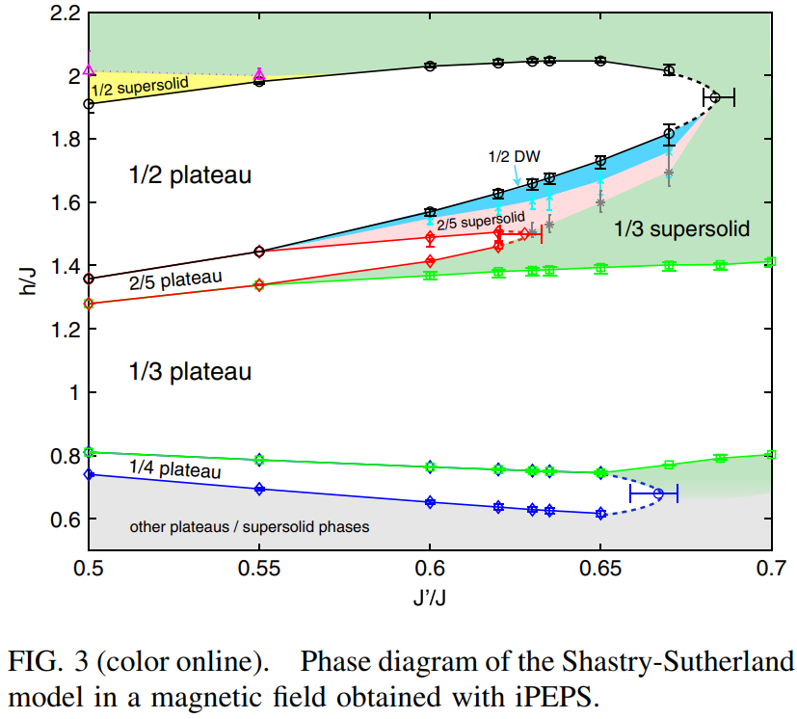
Phase Diagram
Simple update
D=6-8
Unit cell 18*18
Y. H. Matsuda, et al. PRL 111.13 (2013): 137204.

Slide 4
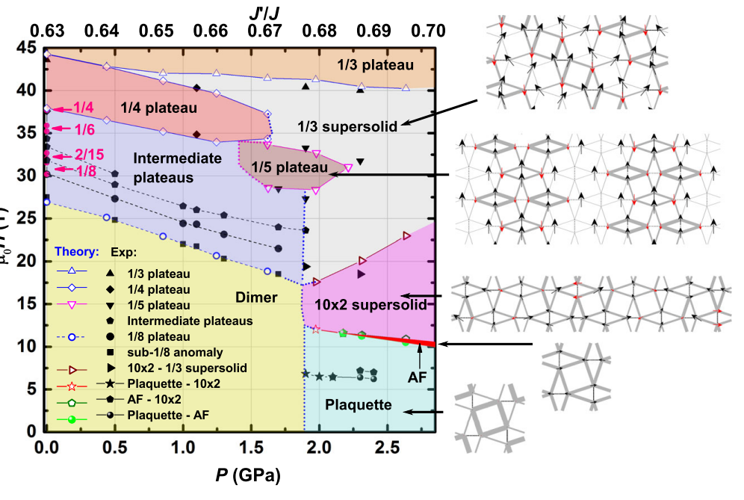
Phase Diagram
Shi Z, et al. NC, 2022, 13(1): 2301.

Slide 5
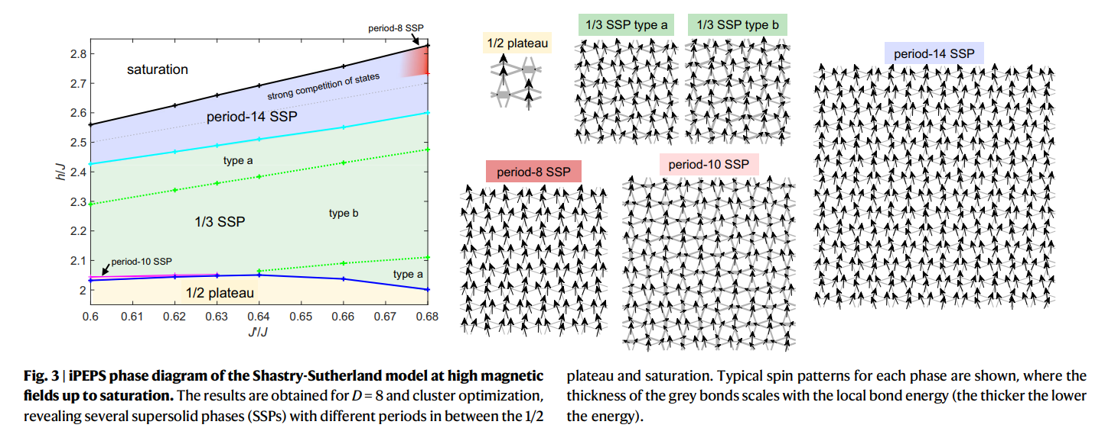
Phase Diagram
T. Nomura, et al. NC, 2023, 14(1): 3769.

Slide 6
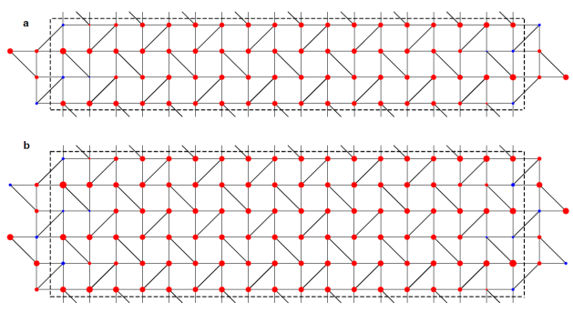
Phase Diagram

Slide 7
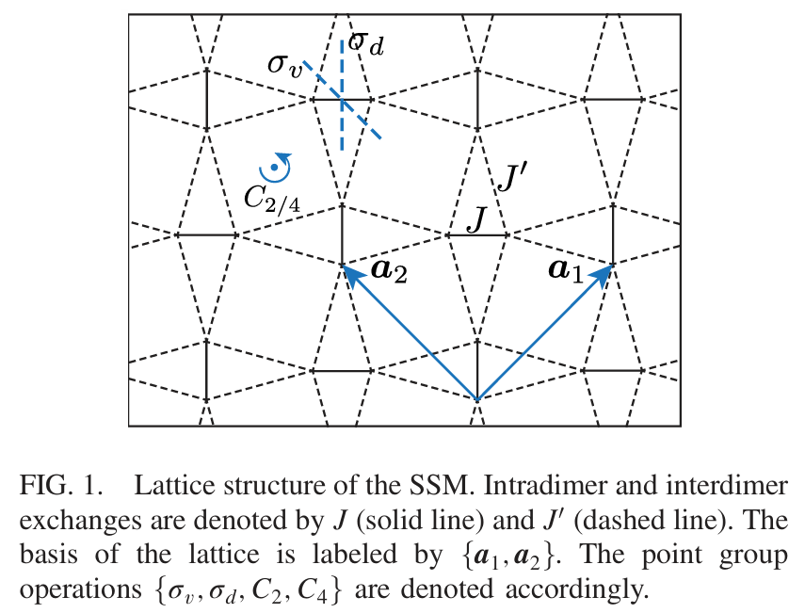
Phase Diagram

Slide 8
Phase Diagram
Suggestions from Bruce
on the Shastry-Sutherland model, there is a large number of problems and a vast amount
of literature. The model and its materials realisation SCBO show anomalous phenomena
in a field, under pressure (= coupling ratio J'/J) and with temperature (thermodynamics).
Probably the ground state and thermodynamics are already covered by Corboz. In the
spectrum, we recently wrote a paper as a function of field, https://www.nature.com/articles/s41467-023-44115-z
but the calculations were only MPS on a cylinder of circumference 4. There are still
quantitative questions on (i) the higher-energy spectrum in the dimer phase at zero
field, (ii) the low-energy spectrum in the dimer phase at finite fields (the above paper),
(iii) any properties of the excitation spectrum in the plaquette phase (reached under
pressure), at zero field and (iv) at finite field, and then (v) any properties if the excitation
spectrum of the AFM phase of the model – it is much more complicated than a n.n.
square lattice because the single frustrating bond makes it a close relative of the
J_1-J_2 square-lattice model.

Slide 9
Thanks!

