Slide 1
exploration

Slide 2
list
Exploration: AStudyofCount-BasedExploration forDeepReinforcementLearning

Slide 3
Exploration: A Study of Count-Based Exploration for Deep Reinforcement Learning

Slide 4
Abstract
It is generally thought that count-based methods cannot be applied in high-dimensional state spaces, since most states will only occur once.
States are mapped to hash codes, which allows to count their occurrences with a hash table. These counts are then used to compute a reward bonus according to the classic count-based exploration theory.
This exploration strategy achieves near state-of-the-art performance on both continuous control tasks and Atari 2600 games, hence providing a simple yet powerful baseline for solving MDPs that require considerable exploration

Slide 5
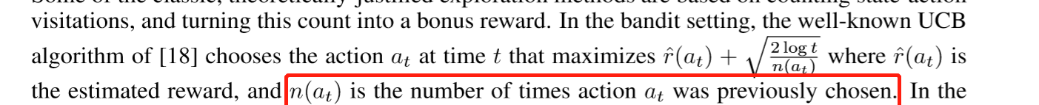
Introduction
It is impossible for the agent to act near-optimally until it has sufﬁciently explored the environment and identiﬁed all of the opportunities for high reward, in all scenarios.

Slide 6
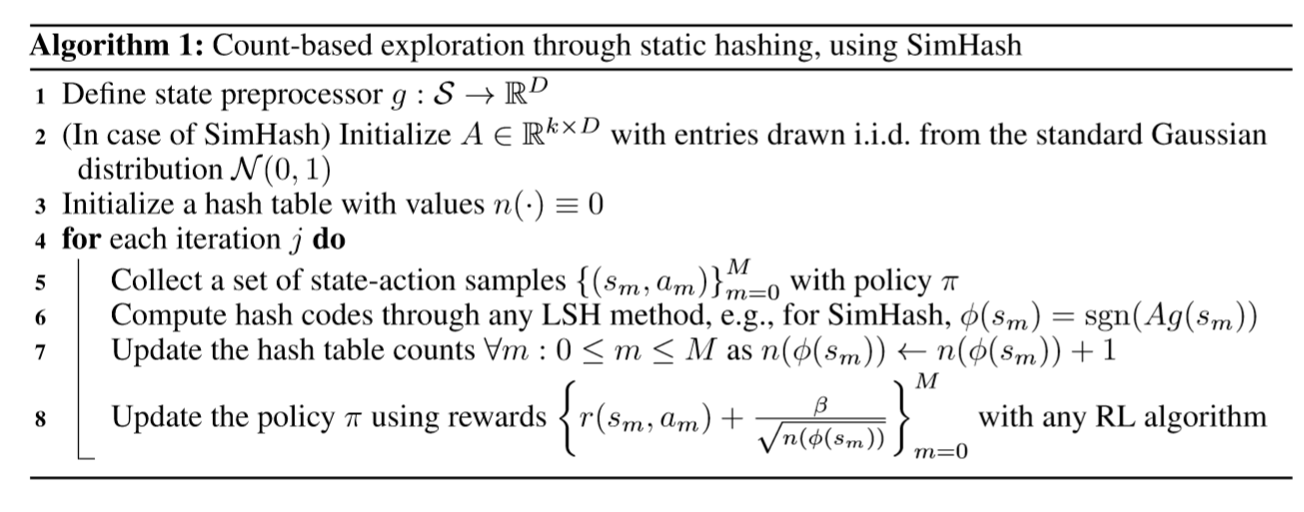
introduction
This paper presents a simple approach for exploration, which extends classic counting-based methods to high-dimensional, continuous state spaces.

