Slide 1
ICLR2020
强化学习相关

Slide 2
ORAL
-RL相关 15/48

Slide 3
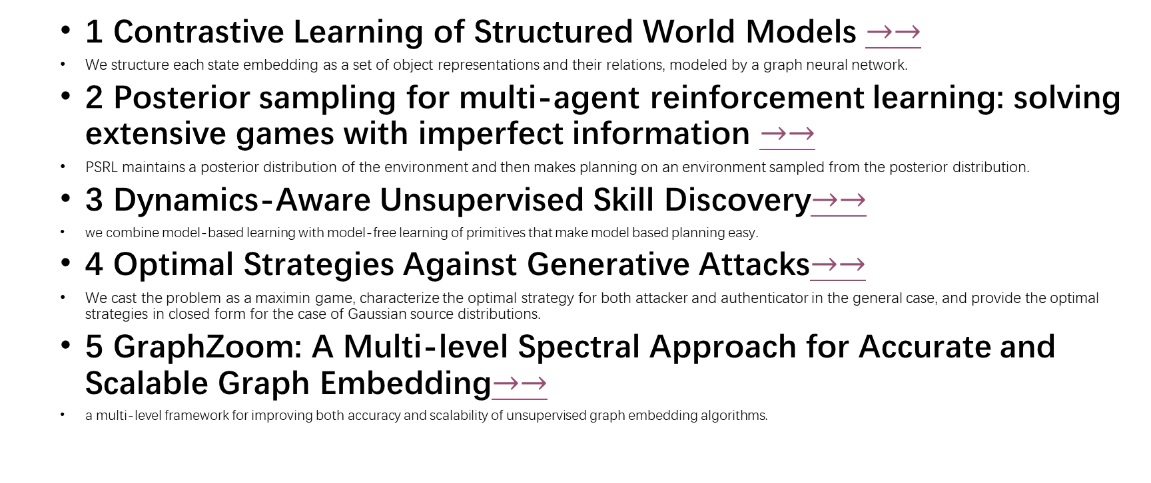
List_oral
1 Contrastive Learning of Structured World Models $→→$
We structure each state embedding as a set of object representations and their relations, modeled by a graph neural network.
2 Posterior sampling for multi-agent reinforcement learning: solving extensive games with imperfect information $→→$
PSRL maintains a posterior distribution of the environment and then makes planning on an environment sampled from the posterior distribution.
3 Dynamics-Aware Unsupervised Skill Discovery$→→$
we combine model-based learning with model-free learning of primitives that make model based planning easy.
4 Optimal Strategies Against Generative Attacks$→→$
We cast the problem as a maximin game, characterize the optimal strategy for both attacker and authenticator in the general case, and provide the optimal strategies in closed form for the case of Gaussian source distributions.
5 GraphZoom: A Multi-level Spectral Approach for Accurate and Scalable Graph Embedding$→→$
a multi-level framework for improving both accuracy and scalability of unsupervised graph embedding algorithms.

Slide 4
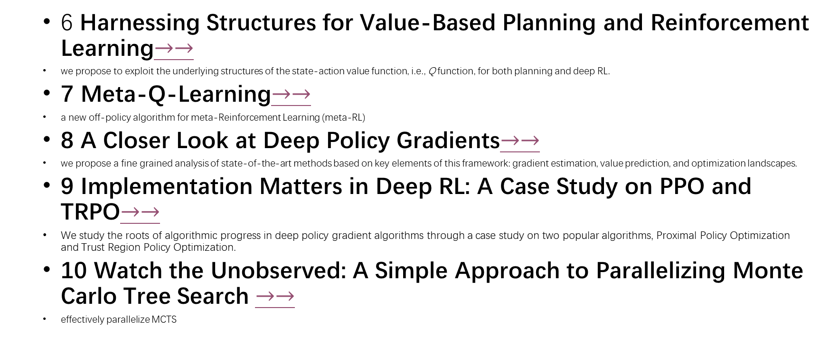
List_oral
6 Harnessing Structures for Value-Based Planning and Reinforcement Learning$→→$
we propose to exploit the underlying structures of the state-action value function, i.e., Q function, for both planning and deep RL.
7 Meta-Q-Learning$→→$
a new off-policy algorithm for meta-Reinforcement Learning (meta-RL)
8 A Closer Look at Deep Policy Gradients$→→$
we propose a fine grained analysis of state-of-the-art methods based on key elements of this framework: gradient estimation, value prediction, and optimization landscapes.
9 Implementation Matters in Deep RL: A Case Study on PPO and TRPO$→→$
We study the roots of algorithmic progress in deep policy gradient algorithms through a case study on two popular algorithms, Proximal Policy Optimization and Trust Region Policy Optimization.
10 Watch the Unobserved: A Simple Approach to Parallelizing Monte Carlo Tree Search $→→$
effectively parallelize MCTS

Slide 5
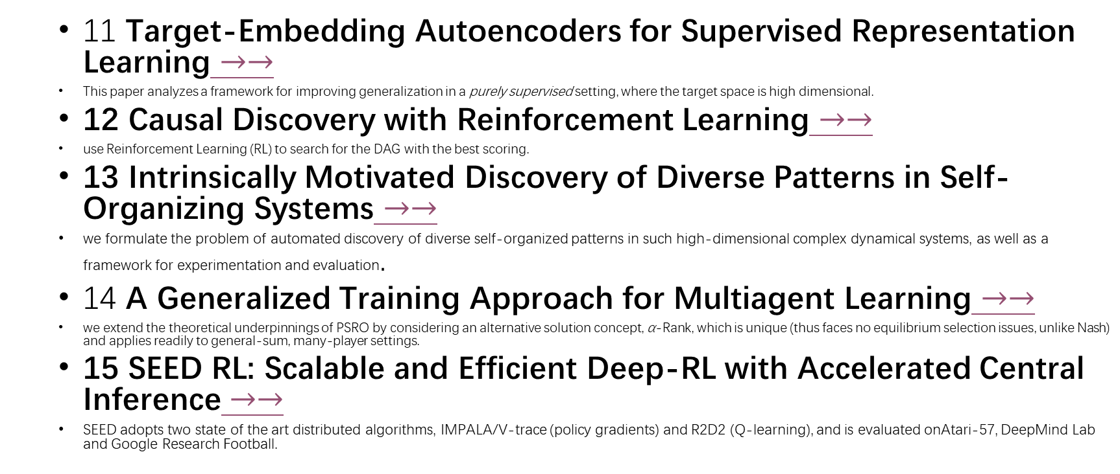
List_oral
11 Target-Embedding Autoencoders for Supervised Representation Learning $→→$
This paper analyzes a framework for improving generalization in a purely supervised setting, where the target space is high dimensional.
12 Causal Discovery with Reinforcement Learning $→→$
use Reinforcement Learning (RL) to search for the DAG with the best scoring.
13 Intrinsically Motivated Discovery of Diverse Patterns in Self-Organizing Systems $→→$
we formulate the problem of automated discovery of diverse self-organized patterns in such high-dimensional complex dynamical systems, as well as a framework for experimentation and evaluation.
14 A Generalized Training Approach for Multiagent Learning $→→$
we extend the theoretical underpinnings of PSRO by considering an alternative solution concept, α-Rank, which is unique (thus faces no equilibrium selection issues, unlike Nash) and applies readily to general-sum, many-player settings.
15 SEED RL: Scalable and Efficient Deep-RL with Accelerated Central Inference $→→$
SEED adopts two state of the art distributed algorithms, IMPALA/V-trace (policy gradients) and R2D2 (Q-learning), and is evaluated onAtari-57, DeepMind Lab and Google Research Football.

Slide 6
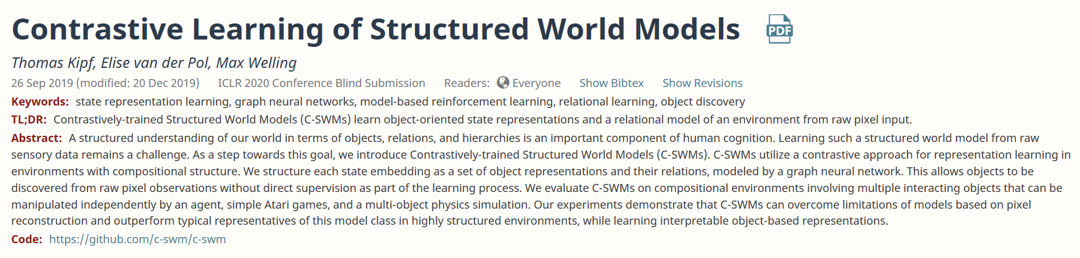
https://openreview.net/forum?id=H1gax6VtDB
Code: https://github.com/c-swm/c-swm
Paper: Contrastive Learning of Structured World Models
Back to list

Slide 7
Abstract
We structure each state embedding as a set of object representations and their relations, modeled by a graph neural network.

Slide 8
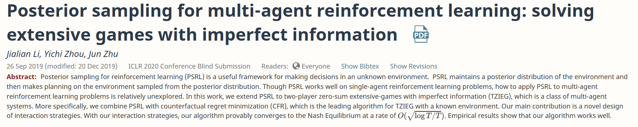
https://openreview.net/forum?id=Syg-ET4FPS
Paper : Posterior sampling for multi-agent reinforcement learning: solving extensive games with imperfect information
Back to list

Slide 9
Abstract
PSRL maintains a posterior distribution of the environment and then makes planning on an environment sampled from the posterior distribution.

Slide 10
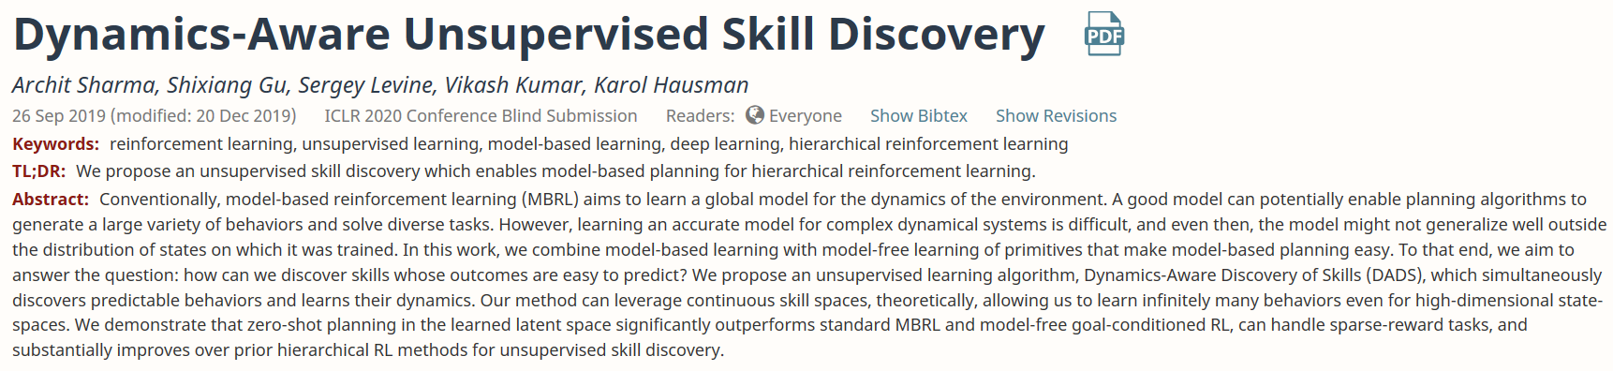
Model based planning
https://openreview.net/forum?id=HJgLZR4KvH
Paper: Dynamics-Aware Unsupervised Skill Discovery
Back to list

Slide 11
Abstract
we combine model-based learning with model-free learning of primitives that make modelbased planning easy.

Slide 12
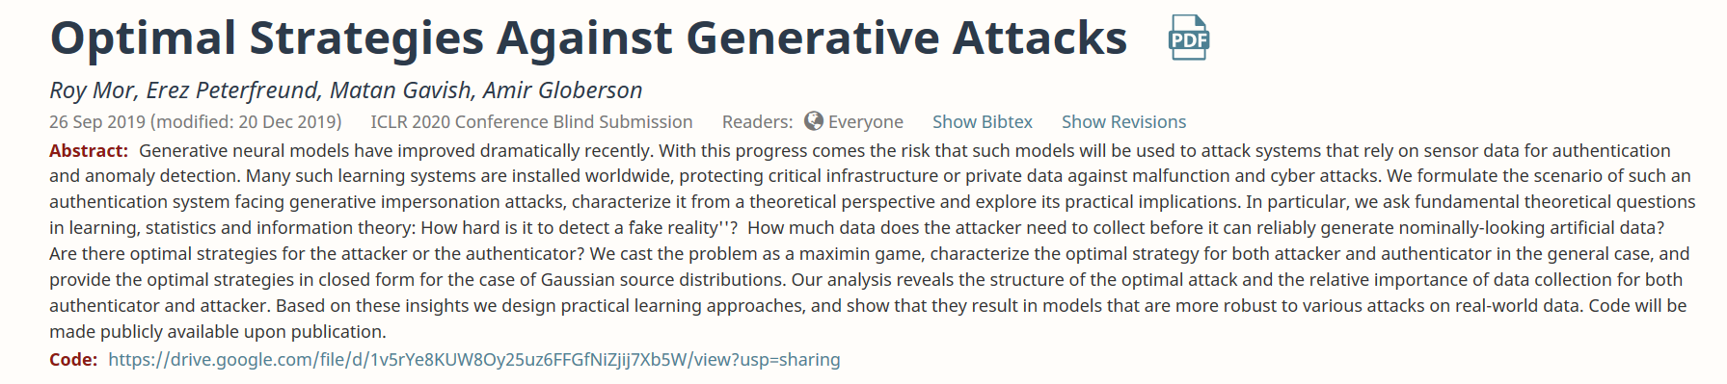
生成对抗
https://openreview.net/forum?id=BkgzMCVtPB
Code: https://drive.google.com/file/d/1v5rYe8KUW8Oy25uz6FFGfNiZjij7Xb5W/view?usp=sharing
Paper ： Optimal Strategies Against Generative Attacks
Back to list

Slide 13
Abstract
We cast the problem as a maximin game, characterize the optimal strategy for both attacker and authenticator in the general case, and provide the optimal strategies in closed form for the case of Gaussian source distributions.

Slide 14
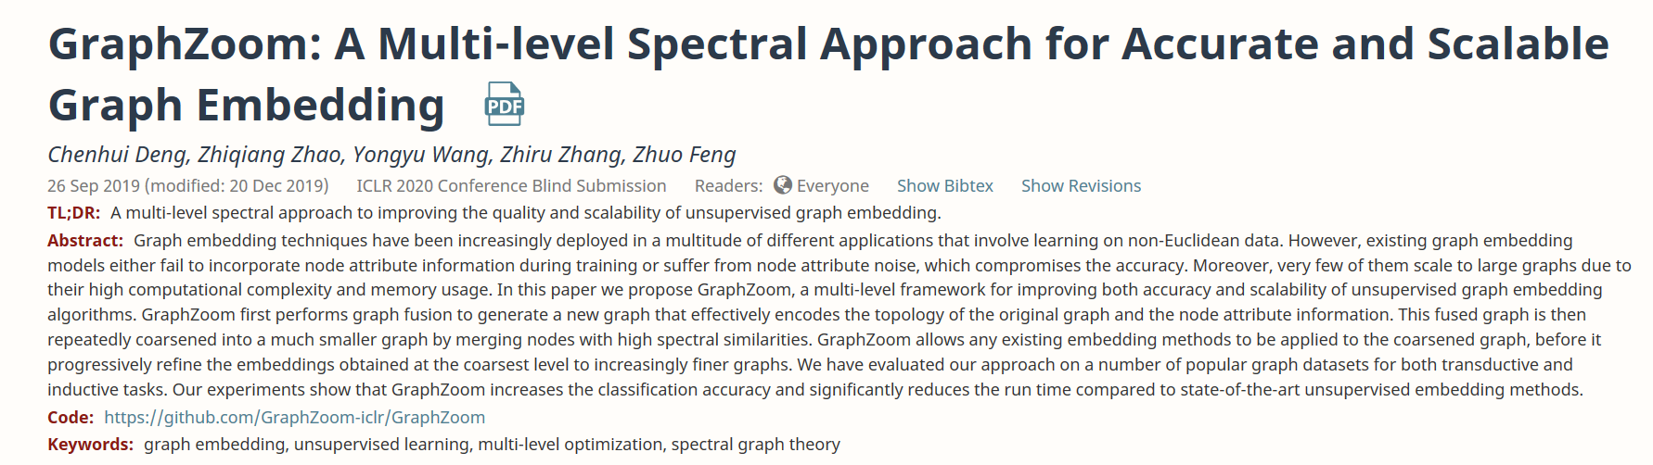
https://openreview.net/forum?id=r1lGO0EKDH
Code: https://github.com/GraphZoom-iclr/GraphZoom
Paper: GraphZoom: A Multi-level Spectral Approach for Accurate and Scalable Graph Embedding
Back to list

Slide 15
Abstract
a multi-level framework for improving both accuracy and scalability of unsupervised graph embedding algorithms.

Slide 16
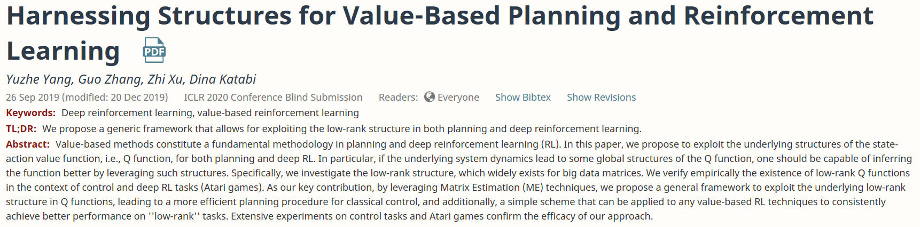
https://openreview.net/forum?id=rklHqRVKvH
Paper: Harnessing Structures for Value-Based Planning and Reinforcement Learning
Back to list

Slide 17
Abstract
we propose to exploit the underlying structures of the state-action value function, i.e., Q function, for both planning and deep RL.

Slide 18
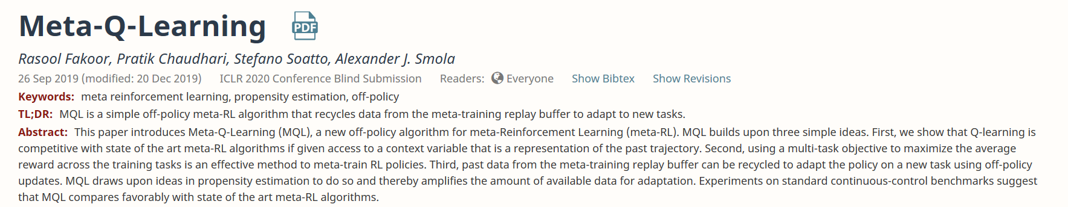
https://openreview.net/forum?id=SJeD3CEFPH
Paper: Meta-Q-Learning
Back to list

Slide 19
Abstract
a new off-policy algorithm for meta-Reinforcement Learning (meta-RL)

Slide 20
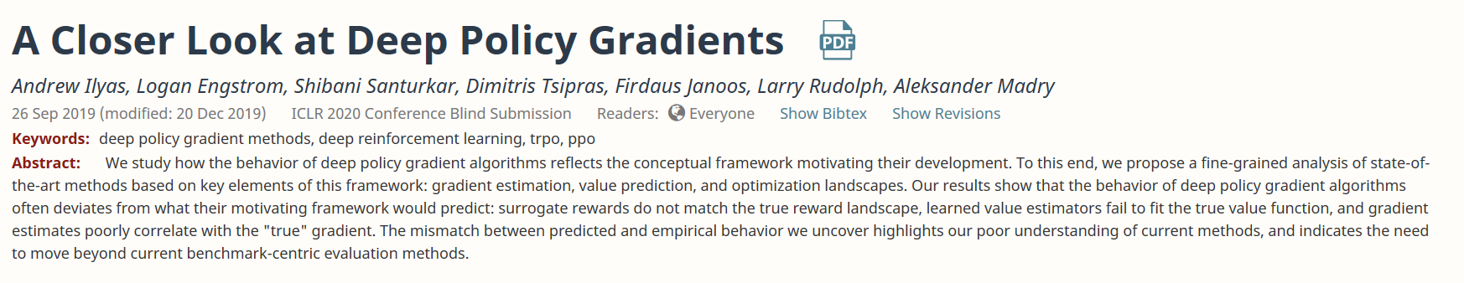
https://openreview.net/forum?id=ryxdEkHtPS
Paper: A Closer Look at Deep Policy Gradients
Back to list

Slide 21
Abstract
we propose a finegrained analysis of state-of-the-art methods based on key elements of this framework: gradient estimation, value prediction, and optimization landscapes.

Slide 22
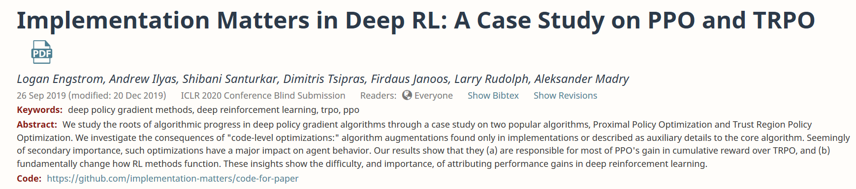
https://openreview.net/forum?id=r1etN1rtPB
Code: https://github.com/implementation-matters/code-for-paper
Paper: Implementation Matters in Deep RL: A Case Study on PPO and TRPO
Back to list

Slide 23
Abstract
We study the roots of algorithmic progress in deep policy gradient algorithms through a case study on two popular algorithms, Proximal Policy Optimization and Trust Region Policy Optimization.

Slide 24
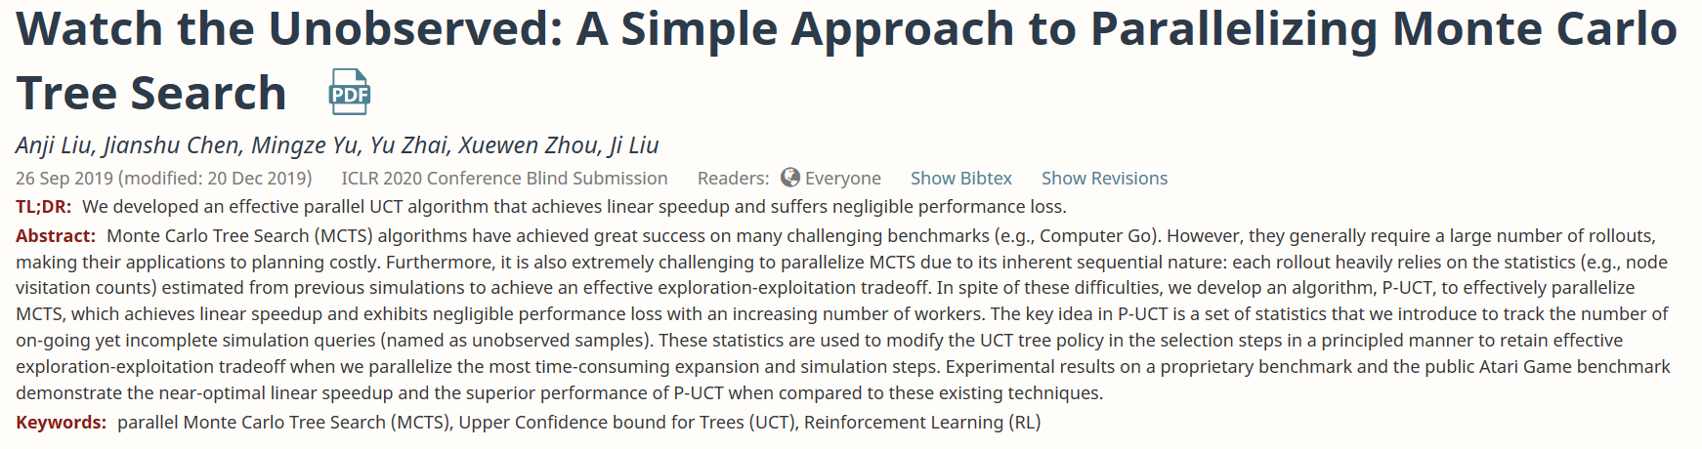
https://openreview.net/forum?id=BJlQtJSKDB
Paper: Watch the Unobserved: A Simple Approach to Parallelizing Monte Carlo Tree Search
Back to list

Slide 25
Abstract
effectively parallelize MCTS

Slide 26
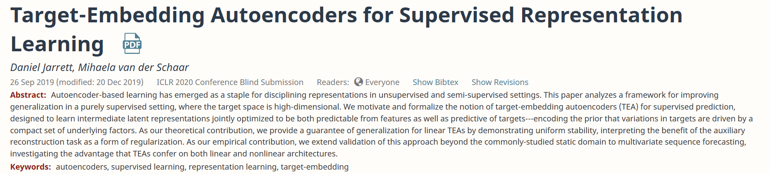
https://openreview.net/forum?id=BygXFkSYDH
Paper: Target-Embedding Autoencoders for Supervised Representation Learning
Back to list

Slide 27
Abstract
This paper analyzes a framework for improving generalization in a purely supervised setting, where the target space is high dimensional.

Slide 28
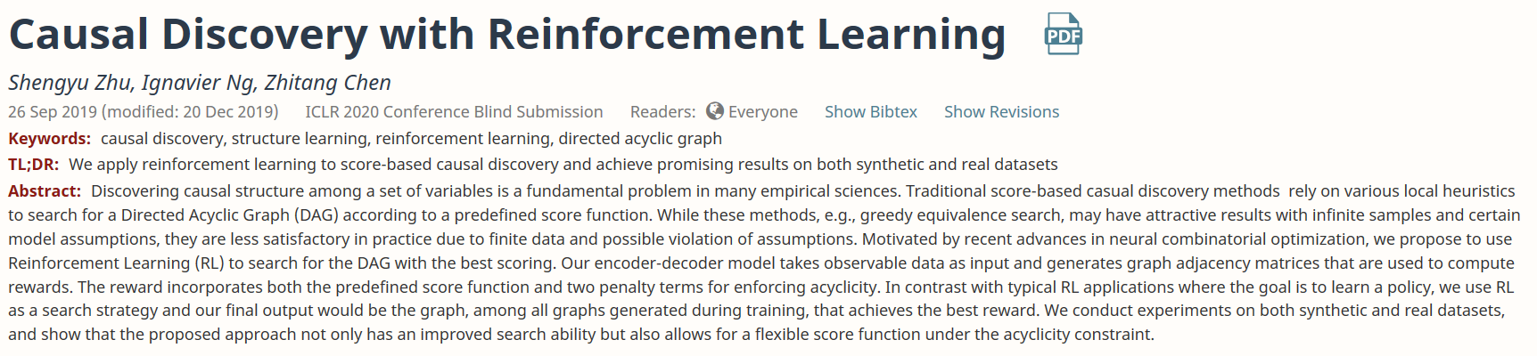
https://openreview.net/forum?id=S1g2skStPB
Paper: Causal Discovery with Reinforcement Learning
Back to list

Slide 29
Abstract
use Reinforcement Learning (RL) to search for the DAG with the best scoring.

Slide 30
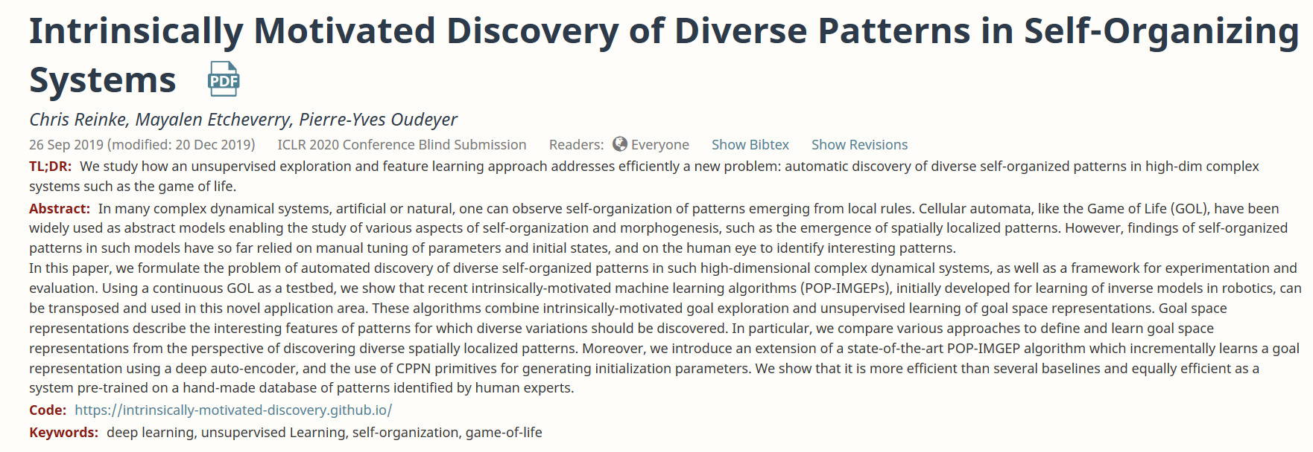
https://openreview.net/forum?id=rkg6sJHYDr
Code: https://intrinsically-motivated-discovery.github.io/
Paper: Intrinsically Motivated Discovery of Diverse Patterns in Self-Organizing Systems
Back to list

Slide 31
Abstract
we formulate the problem of automated discovery of diverse self-organized patterns in such high-dimensional complex dynamical systems, as well as a framework for experimentation and evaluation.

Slide 32
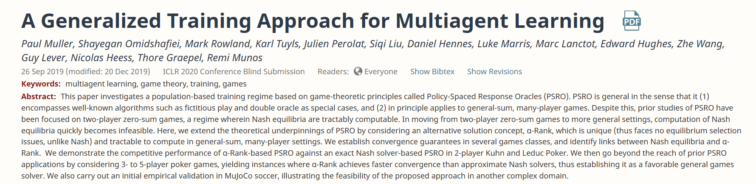
https://openreview.net/forum?id=rkg6sJHYDr
Code: https://intrinsically-motivated-discovery.github.io/
Paper: A Generalized Training Approach for Multiagent Learning
Back to list

Slide 33
Abstract
we extend the theoretical underpinnings of PSRO by considering an alternative solution concept, α-Rank, which is unique (thus faces no equilibrium selection issues, unlike Nash) and applies readily to general-sum, many-player settings.

Slide 34
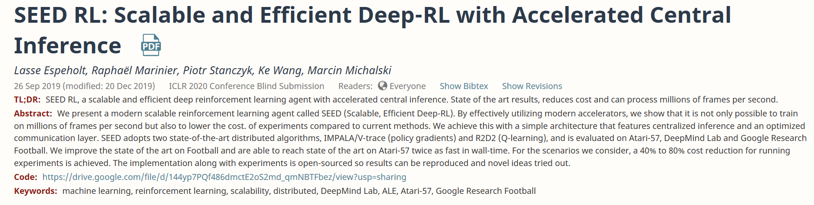
https://openreview.net/forum?id=rkgvXlrKwH
Code: https://drive.google.com/file/d/144yp7PQf486dmctE2oS2md_qmNBTFbez/view?usp=sharing
Paper: SEED RL: Scalable and Efficient Deep-RL with Accelerated Central Inference
Back to list

Slide 35
Abstract
SEED adopts two state of the art distributed algorithms, IMPALA/V-trace (policy gradients) and R2D2 (Q-learning), and is evaluated onAtari-57, DeepMind Lab and Google Research Football.

