Slide 1

SMART INDIA HACKATHON 2026
TITLE PAGE
Problem Statement ID – 26175
Problem Statement Title – Single-View Height Estimation and Interactive 3D Flythrough from Satellite Imagery
Theme – Disaster Management
PS Category – Software
Team ID – [xxxxxxxxxx]
Team Name – [Team Name (Registered on portal)]

Slide 2
DepthWizard: One Satellite Image → Depth → Calibrated DSM → 3D Flythrough
Your Team Name
Proposed Solution (Describe your Idea/Solution/Prototype)
DepthWizard— an end-to-end pipeline that converts a SINGLE optical 2D satellite/aerial image into a relative depth map (rDSM), an estimated calibrated DSM (GeoTIFF) and an explorable 3D environment.
Dual mode: non-georeferenced JPG/PNG → relative depth + 3D mesh; georeferenced GeoTIFF → CRS-preserving estimated DSM + height / slope products.
Interactive 3D world: Inspect (orbit), Free-Fly drone mode (WASD + mouse) and automatic camera flythrough.
How it addresses the problem
Removes dependency on costly stereo imagery, LiDAR sensors and InSAR — useful elevation geometry from ONE image, in seconds.
Disaster response: reconstruct terrain and damage context when only a single post-event image exists.
GIS-ready: GeoTIFF outputs preserve CRS / affine transform — drop directly into QGIS, ArcGIS, GDAL.
Innovation and uniqueness of the solution
First-of-its-kind Fusion of Depth Anything V2 (relative geometry) + Sat3DGen (3D scene reconstruction) + GeoScale calibration layer (DSM = DEMₐₗᵢₕₙed + α·D_detail).
Never silently converts relative depth to metres — metric values only after explicit calibration vs SRTM / GCPs (scientific honesty as a feature).
Single unified open-source workflow: one image → survey-grade workflow → immersive browser flythrough.

Slide 3
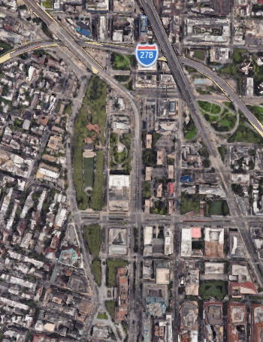
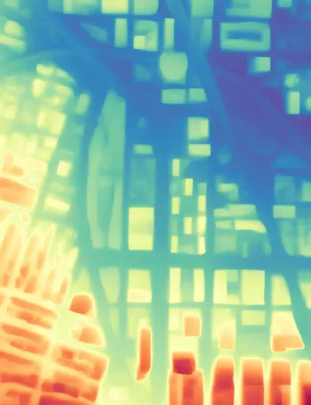
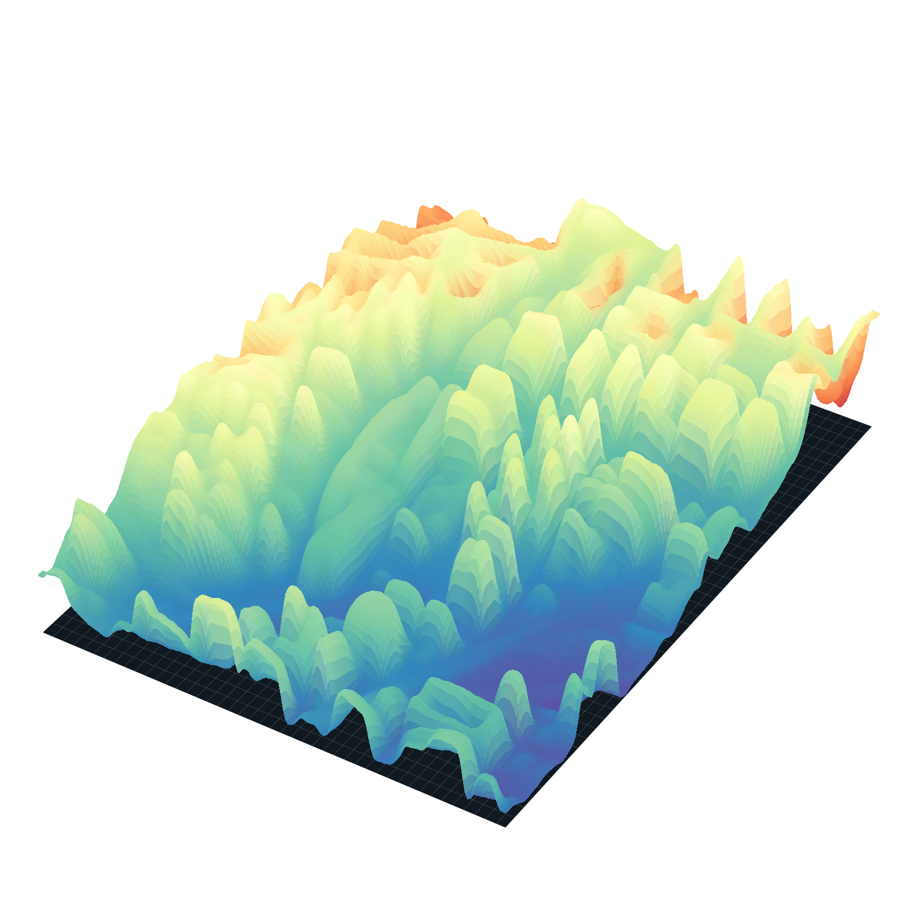
TECHNICAL APPROACH
Your Team Name
Technologies to be used (e.g. programming languages, frameworks, hardware)
Python 3.11 · PyTorch 2.x (AI inference)
Depth Anything V2 — monocular relative depth
Sat3DGen — satellite-image 3D reconstruction & mesh
Rasterio / GDAL — GeoTIFF, CRS, affine transforms
NumPy · OpenCV · SciPy — raster processing
Three.js (WebGL) — browser 3D viewer
FastAPI + React · Docker deployment
Methodology and process for implementation (Flow Charts/Images/ working prototype)
① Input handler — validates image, extracts CRS / bounds / transform
↓ ② Depth Anything V2 → relative depth (rDSM) | Sat3DGen → mesh + texture
↓ ③ GeoScale — align reference DEM (SRTM / Copernicus GLO-30), calibrate: DSM = DEM + α·detail
↓ ④ Analysis — height, slope, statistics → GeoTIFF / OBJ exports
↓ ⑤ Three.js viewer — inspect, free-fly, automatic flythrough
→
→
① INPUT
2D satellite image
② AI DEPTH
heatmap (rDSM)
③ OUTPUT
3D terrain + flythrough
Working prototype: single-image → 3D terrain in < 2 s on consumer hardware (live demo available)

Slide 4
FEASIBILITY AND VIABILITY
Your Team Name
Analysis of the feasibility of the idea
Working prototype already runs end-to-end: FastAPI backend + React/Three.js frontend, Dockerised one-click launch.
100% pretrained open-source models — no custom training data, no survey crews, offline-cached weights.
Full synthesis pipeline completes in < 2 s on consumer hardware; automated pytest suite validates every endpoint.
Potential challenges and risks
Monocular AI depth is RELATIVE — not automatically survey-grade metric elevation.
Coarse reference DEMs (SRTM 30 m) cannot validate individual building heights.
Cloud cover, haze and occlusions degrade single-image inference; compute cost for very large scenes.
Strategies for overcoming these challenges
GeoScale calibration: DSM = DEM_aligned + α·D_detail, or Z = a·D + b regressed from GCPs / EXIF telemetry.
Explicit ‘preview’ vs ‘calibrated’ datum labelling — never silently convert relative depth to metres.
Precomputed demo outputs guarantee resilience; validation via RMSE / MAE / correlation per land-cover class.

Slide 5
IMPACT AND BENEFITS
Your Team Name
Potential impact on the target audience
ISRO / NDMA & disaster-response teams — terrain and damage context within seconds of a single post-event image, when no stereo pair or LiDAR pass exists.
Urban planners, GIS & survey professionals — instant first-pass DSMs for zoning, line-of-sight and watershed analysis.
Defence & infrastructure monitoring — rapid site intelligence in inaccessible or hostile terrain.
Benefits of the solution (social, economic, environmental, etc.)
Social: faster flood, landslide and earthquake response planning from already-acquired archived imagery.
Economic: eliminates cost of stereo flight campaigns, LiDAR sensors and multi-pass InSAR processing.
Environmental: no additional sensor missions; enables continuous low-cost monitoring of fragile ecosystems.
Strategic: open-source, GIS/CAD-interoperable outputs (GeoTIFF · OBJ · PNG · JSON) plug into national geospatial workflows.

Slide 6
RESEARCH AND REFERENCES
Your Team Name
Details / Links of the reference and research work
Depth Anything V2 — L. Yang et al., NeurIPS 2024 — github.com/DepthAnything/Depth-Anything-V2
Sat3DGen — satellite-image-based 3D scene reconstruction & mesh generation (project repository)
MiDaS — R. Ranftl et al., “Towards Robust Monocular Depth Estimation”, ECCV 2020
SRTM — T. G. Farr et al., “The Shuttle Radar Topography Mission”, Rev. Geophysics, 2007 · Copernicus GLO-30 DEM
Rasterio — rasterio.readthedocs.io · GDAL — gdal.org · NumPy / SciPy / OpenCV
Three.js — threejs.org/docs · FastAPI — fastapi.tiangolo.com · React — react.dev · Docker — docker.com
SIH 2026 Problem Statement 26175 — ISRO · Theme: Disaster Management

