Slide 1
The StoreHelper App
A Solution for Growing Consumer Need for Convenience and High Costs of On-Demand Delivery

Slide 2
Participant Details
Team- Sekino
Team Leader- Shatabhishek Baidya
Member- Pratik Ranjan Dehury

Slide 3
Problem Statement
To Build a Self-Checkout Solution for a Retailer.

Slide 4
Solution Approach
Who is the solution for?
There are three types of Customers:-
The Working Population
Do not have time to shop
Cannot wait on deliveries
Heavy Shoppers
Need help
Want to check out quickly
Light Shoppers
Want to get in and get out

Slide 5
Summary: Problems of the Customers
No one likes the hassle of the mall, especially given the current scenario
More time needed for checkout.
More time needed for finding what we want.
The cost of On-Demand Delivery and a little of its inconvenience.

Slide 6
Our Solution
Let us take all the problems out of the equation.
Use barcode scanner in an app for shopping.
Make a shopping list beforehand as in Grofers etc.
Have employees gather the required items at a given pooling area.
Have a Packer sort the items into order lists.
This allows shoppers to quickly list out what they want, have it gathered hassle free, pick it up on the way to or from work, and not have to pay delivery charges or wait for it at home.

Slide 7
Solution Architecture
Usability | Security | Quality | Features | Functions
One-Click Functionality | Simple Authentication as Applied by Lowes(None at the moment) | App should be Reliable | Payment Gateway | Razorpay Integration for Payment
“Nothing to Learn” UI |  | Low Latency | Barcode Scanner for Checkout | Camera Scanner for Adding to Cart
Human Error Prevention |  | Instant Functionality | List to Upload as Wish Cart/Help Cart | Help Cart can be uploaded to Servers for Employees to gather.

Slide 8
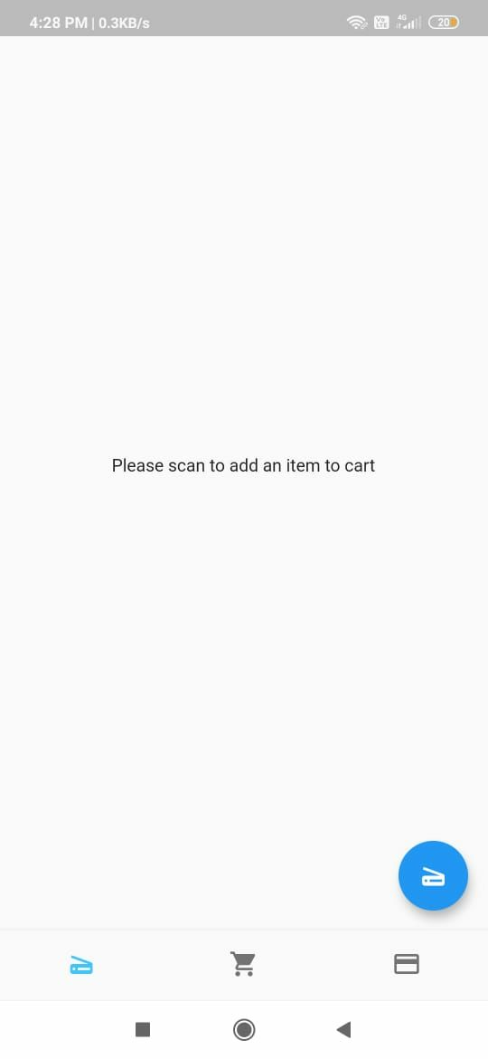
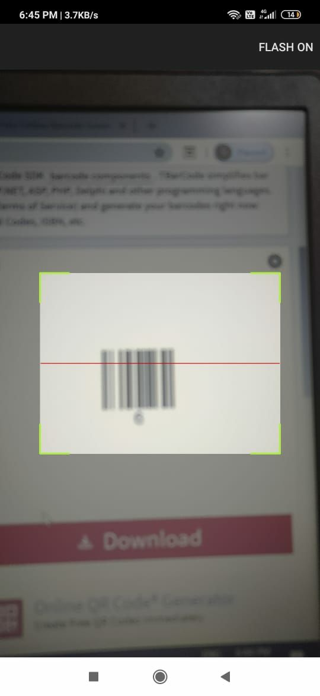
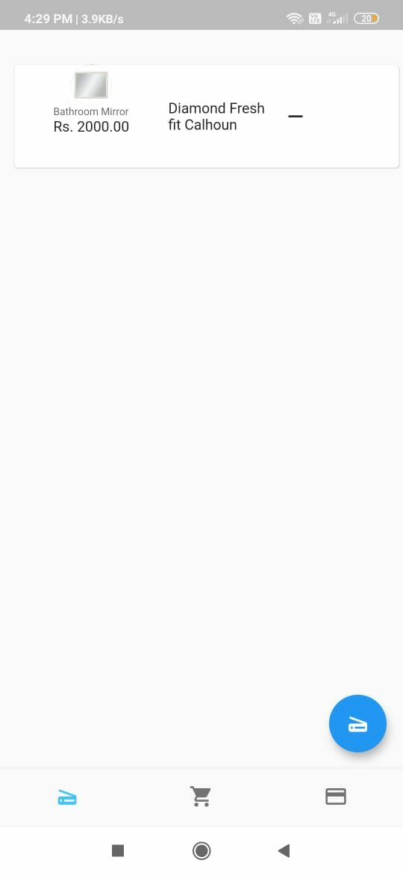
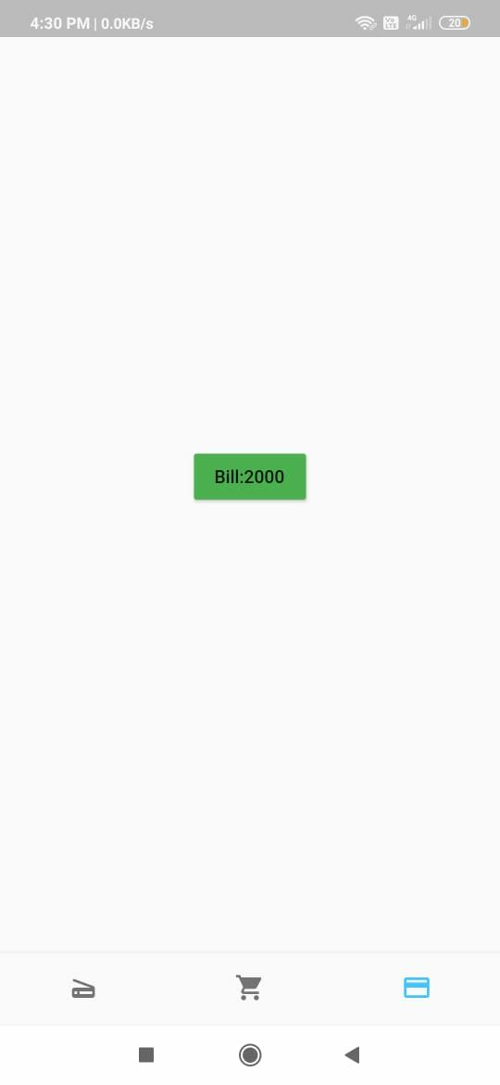
Shopper Self-Checkout
Shop Cart after Scan
Razorpay Integration
Showing Total Bill
Shop Cart
Scanner

Slide 9
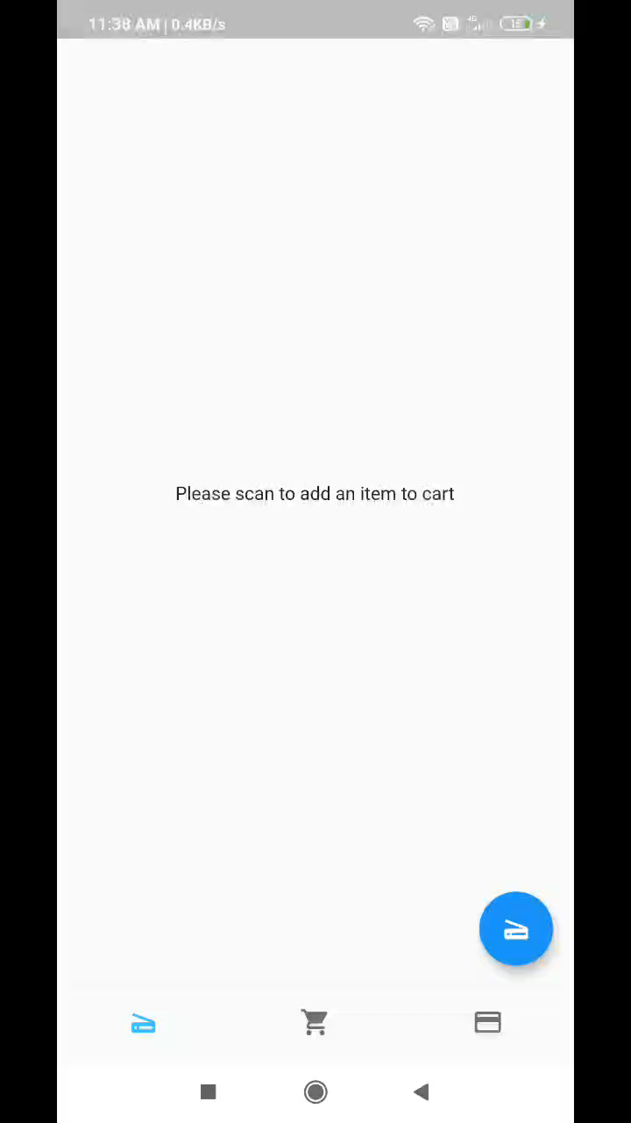
Demo Video of Shopper Scanner

Slide 10
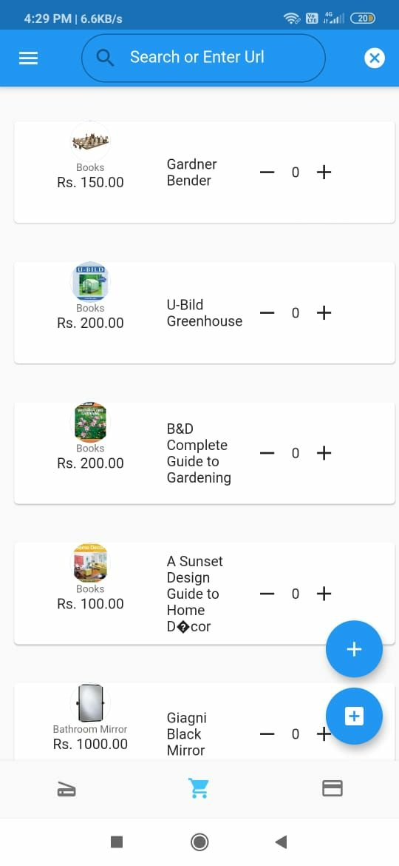
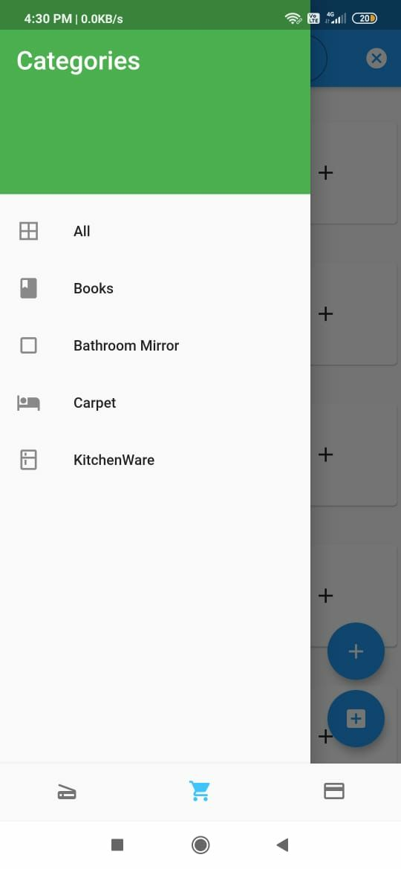
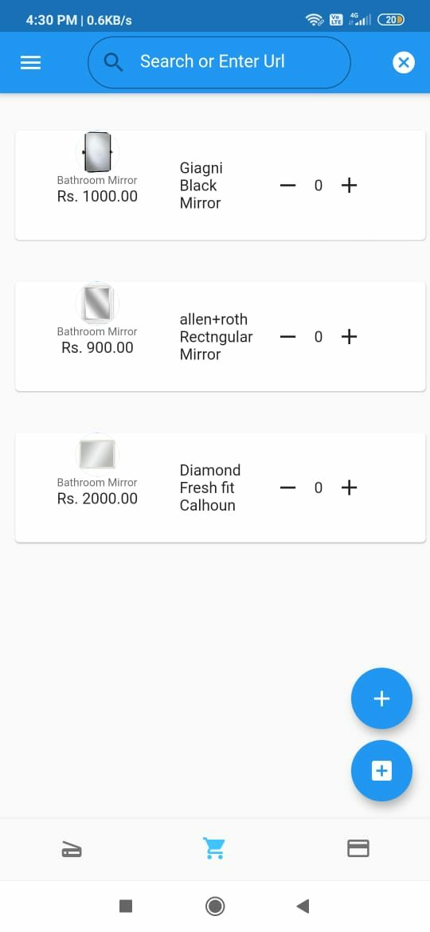
Shopper Wish Cart - With two options-to pack or just to collect
Wish Cart
Category Selection

Slide 11
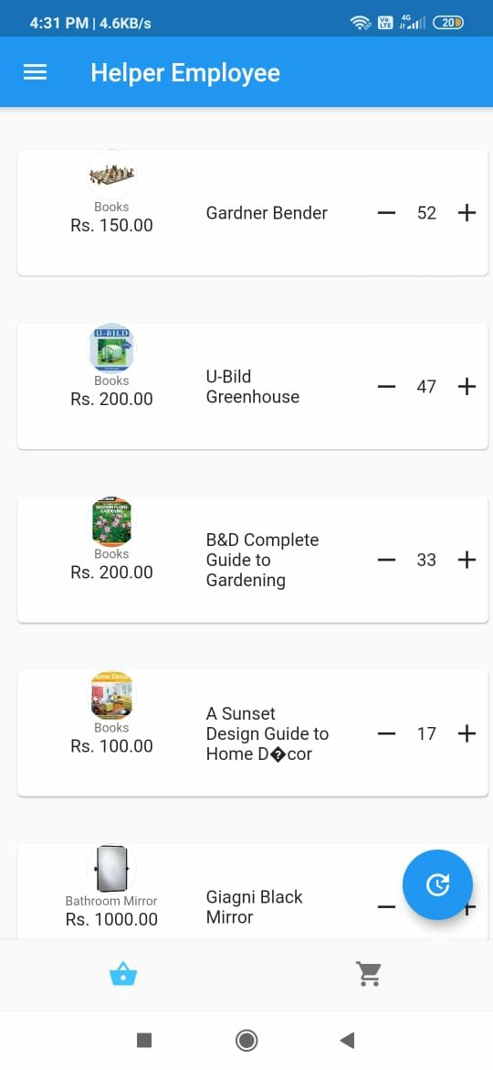
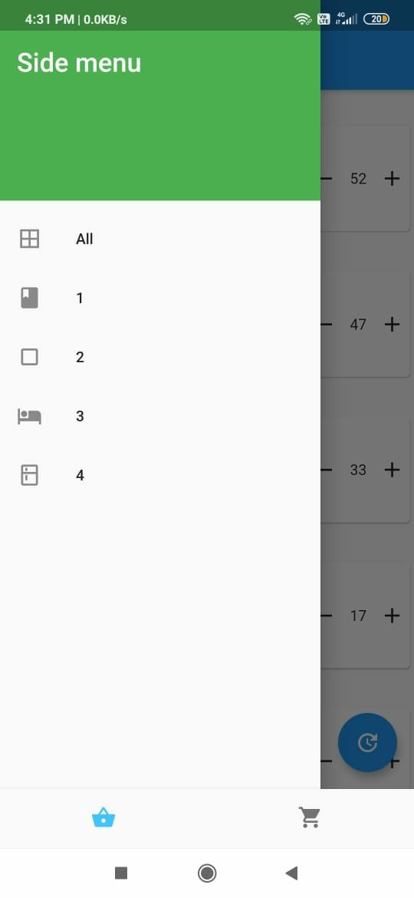
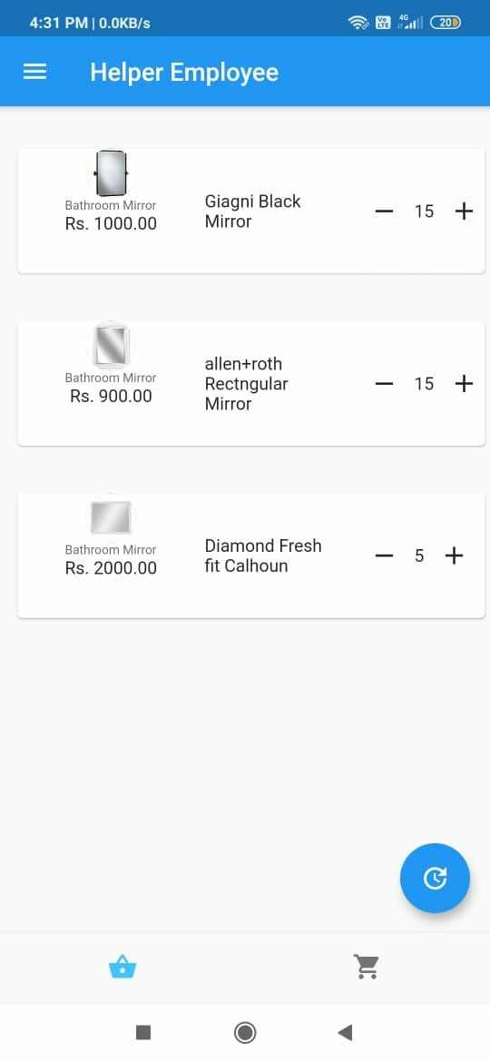
Helper Employee App
Complete
Requirements List
Section-wise Allotment of Requirements

Slide 12
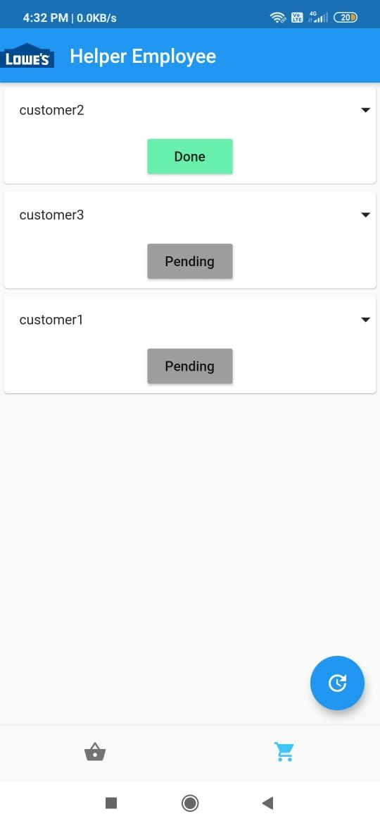
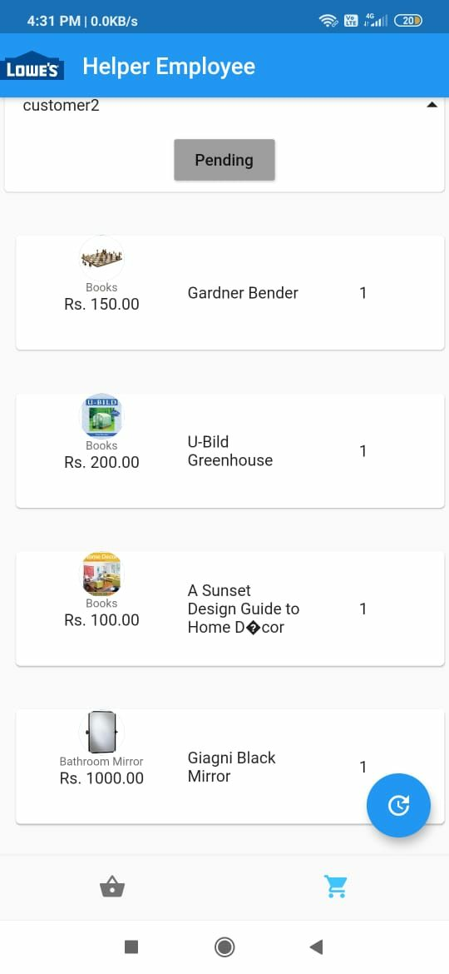
Packer App
List of Orders
Individual Order

Slide 13
Technology Stack
Framework: Flutter for Development for both iOS and Android
Cloud Backend: Firebase Realtime Database
Plugins/Dependencies: barcode_scan package, firebase_database package
Tools: Android Studio with Emulator and Mobile Devices

Slide 14
Hardware Specifications
Smartphone with 20MB free Memory
2GB RAM
Any Modern Processor
Any Modern GPU
Internet Connection
Working Smartphone Camera

Slide 15
Challenges Faced
Integration of Modules as Members had different versions of Flutter installed in different paths.
Usage of Dart’s functional programming.
The Varying Sizes of mobile devices’ screens.
Data flow within the App which can be improved further with Streams or BLoC pattern.
No mutual exclusion of transactions in current implementation

Slide 16
Future Improvements
Priority based ordering can be implemented
Customers pay for quicker delivery
Using weights of items for added security
Scanner can add the weights to database
A weighing machine can verify the weight at the end
Anomaly detection
To detect frauds
To detect suspicious activity
Password/token based system for access to item pooling area
Ensures pooling area is not undersupplied

Slide 17
Conclusion
Our solution makes the shopping experience convenient and caters to all the customers who visit the retail market. The experience be further improved using ML and other technologies for seamlessness and security.

Slide 18
Thank You
Stay home, stay safe!

