Slide 1


Basic Details of the Team and Problem Statement
PS Code: PS06(8)
Problem Statement Title:
Marketplace for Small-Scale Farmers
Team Name: Code Connectors
Team Leader Name: Pratik Kumar Singh
Institute Code (AISHE): C-6202
Institute Name: Heritage Institute of Technology
Theme Name: Agriculture

Slide 2
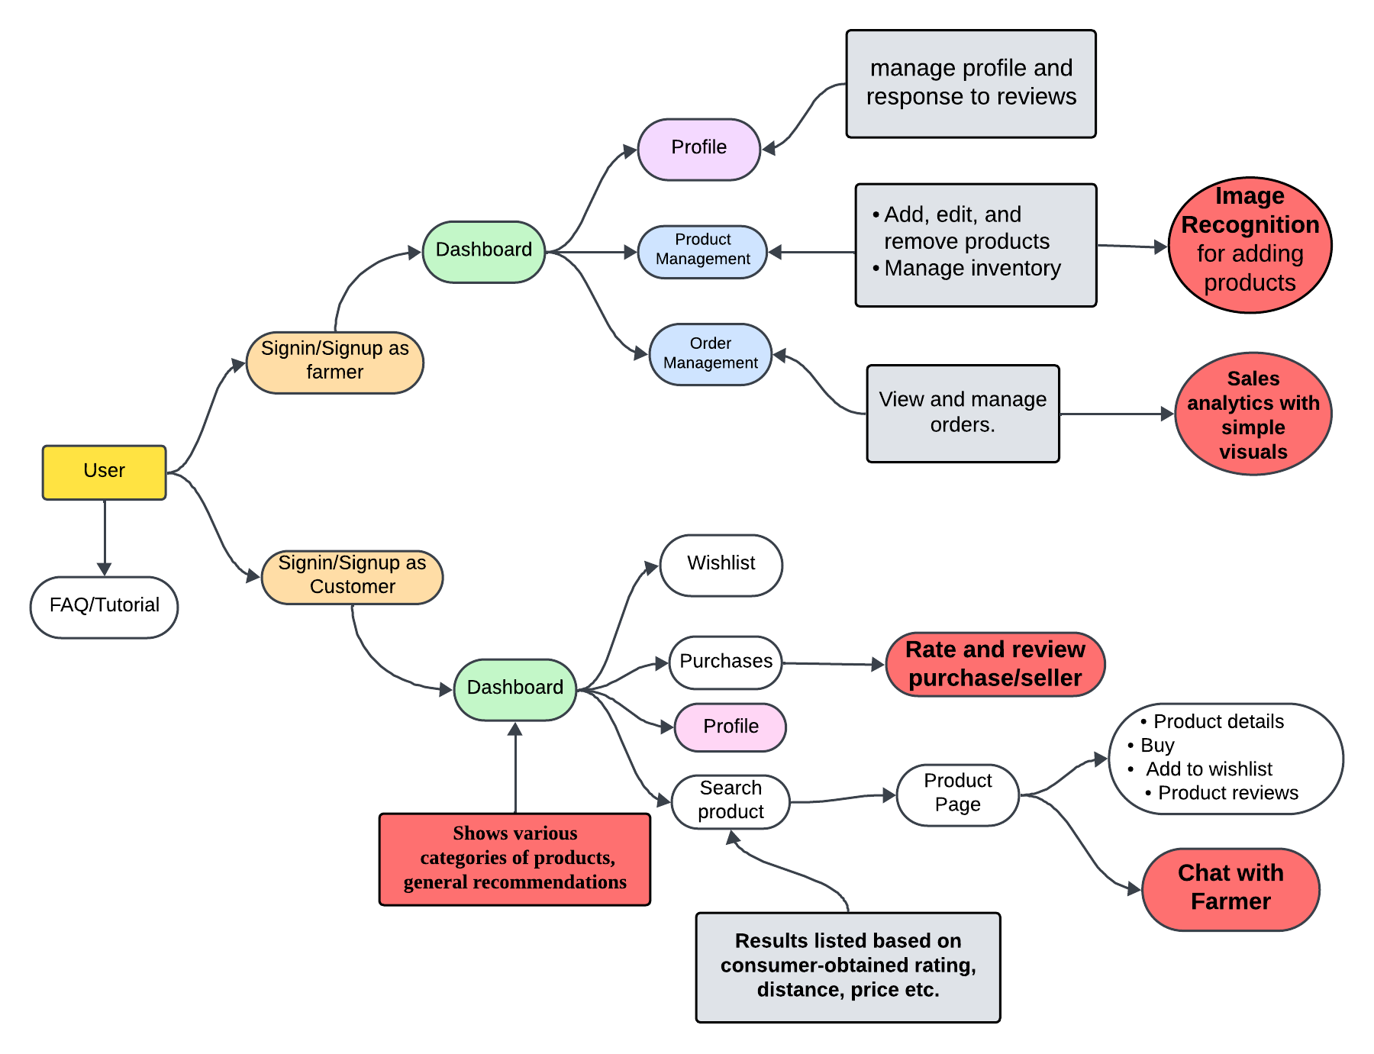
Idea/Approach Details
An online marketplace for small-scale farmers to sell produce directly to consumers and businesses, eliminating intermediaries, reducing wastage and boosting profitability.
Key Features:
User-Friendly Interface
Profile Management: Customizable dashboards for farmers as well as consumers.
Straightforward Product and Order Management
Image Recognition for automatic product detail filling
Sales Analytics for the farmers
Review and Rating System: Consumer reviews to build trust and transparency.
Additional Support: FAQ/Tutorial section for user guidance.
Chat Bot: To give the users simple guidance about the platform.
Technology Stack
Backend: ExpressJS, NodeJS, Flask
Frontend: ReactJS, Tailwind CSS
Database: MongoDB, SQLite
Data Analysis & Visualization : Pandas, Numpy, Matplotlib, Seaborn
Machine Learning: Ultralytics, OpenCV
Others: Socket.io

Slide 3
Idea/Approach Details
Use Cases
Dependencies / Show stopper
Direct Sales for Small-Scale Farmers
Consumer Access to Fresh Produce
Local Business Procurement
Real-Time Negotiation
Secure Online Payments
Building Trust through Reviews
Inventory Management for Farmers
Digital Literacy: Basic digital skills are needed.
Product Details: Farmers have to accurately provide certain product details for reliability .
Inventory: Product inventory has to be properly managed and regularly updated.
Image Recognition: Image of the product should be clearly visible.

Slide 4
Team Member Details
Team Leader Name: Pratik Kumar Singh
Branch : BTech Stream : CSE(DS) Year : III
Team Member 1 Name: Kanhaiya Yadav
Branch : BTech Stream : CSE(DS) Year : III
Team Member 2 Name: Dhruv Jain
Branch : BTech Stream : CSE(DS) Year : III
Team Member 3 Name: Sabyasachi Sinha
Branch : BTech Stream : CSE(DS) Year : III
Team Member 4 Name: Ananya Arya
Branch : BTech Stream : CSE(DS) Year : III
GitHub Repository Link: https://github.com/kanhaiyadav/Hackspire_KisaanSetu

