Slide 1
hospital management
Semantic data technology
1951658
04/12/2020

Slide 2
Issues with current system
Not readable to machines
Patient details not shared
Not linked directly to disease
Irrelevant information
Misguided to new users.

Slide 3
Semantic web
Extension of world wide web to make internet data machine readable
Rdf (resourse descriptor framework)and Owl(web ontology language) technology used
Ontology is used to show relationship between entities and things
https://en.wikipedia.org/wiki/Semantic_Web

Slide 4
Benefits of semantic web
No misguided information
Easy for both machine and user
Information as per requirements
Better relationship with patients (customers)
Free from keyboard based search (pattern matching)

Slide 5
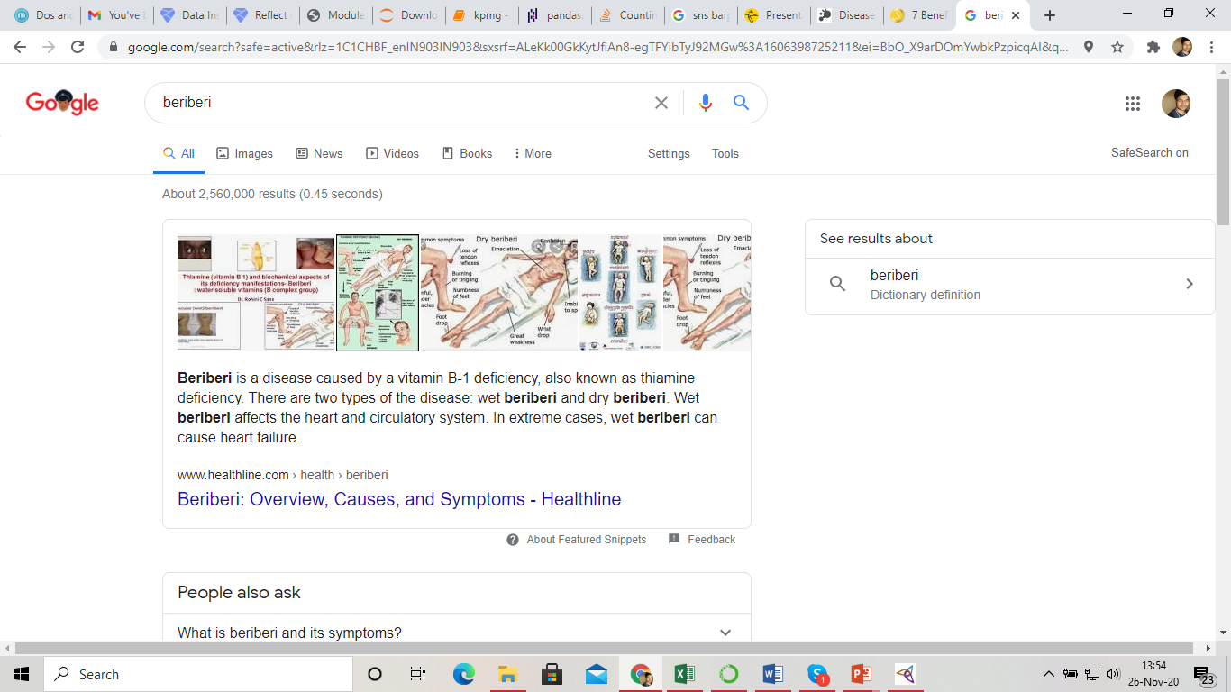
A correct result

Slide 6
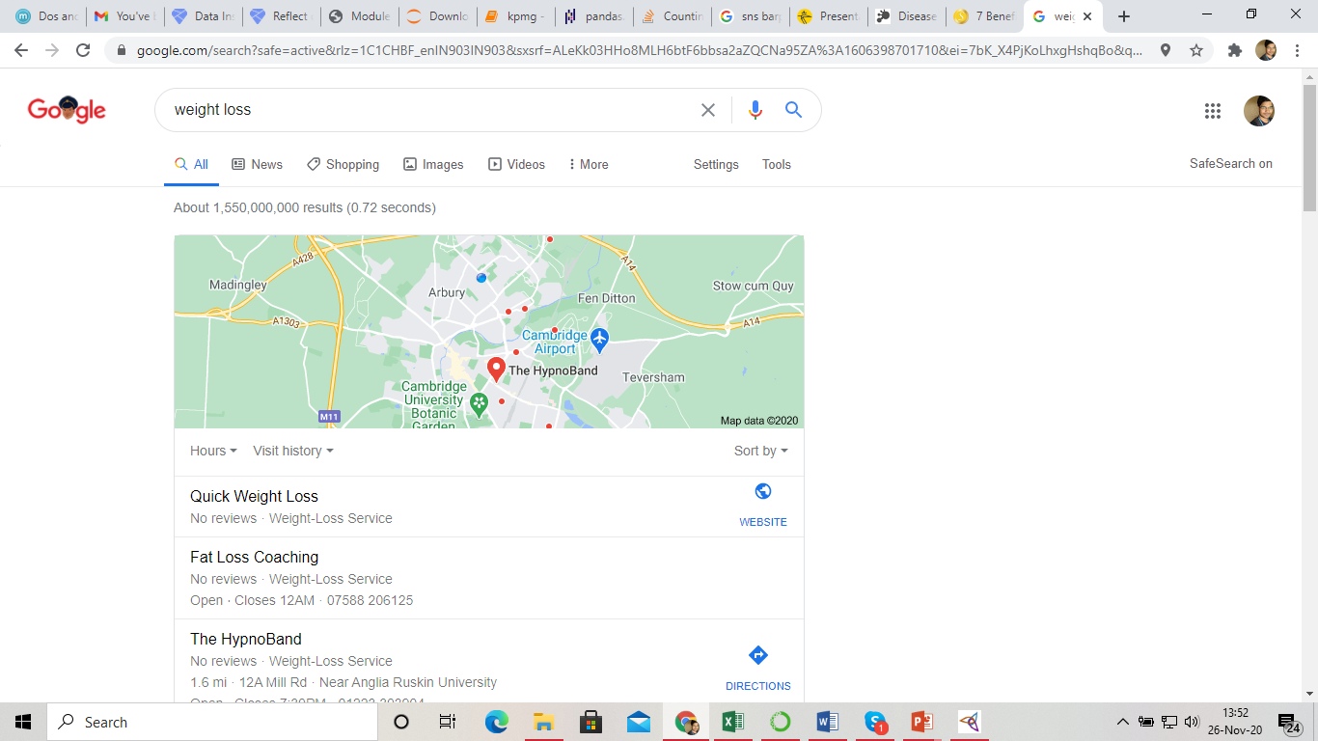
Wrong result

Slide 7
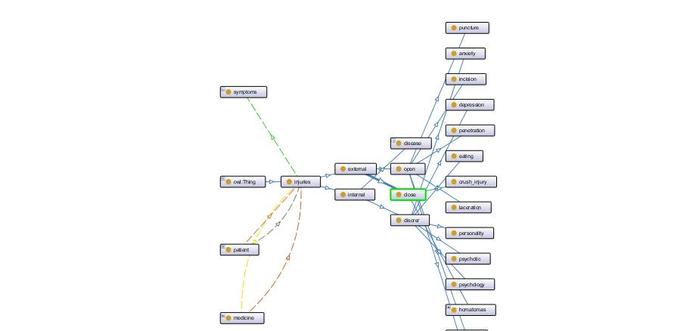

Slide 8
Issue with semantic web
Vastness:- have many information that duplicates are not easy to remove
https://en.wikipedia.org/wiki/Semantic_Web

Slide 9
Deceit
This is when the producer of the information is intentionally misleading the consumer of the information.
https://en.wikipedia.org/wiki/Semantic_Web

Slide 10
Uncertainty
These are precise concepts with uncertain values. For example, a patient might present a set of symptoms that correspond to a number of different distinct diagnoses each with a different probability
https://en.wikipedia.org/wiki/Semantic_Web

Slide 11
Inconsistency
These are logical contradictions that will inevitably arise during the development of large ontologies, and when ontologies from separate sources are combined.
https://en.wikipedia.org/wiki/Semantic_Web

Slide 12
Vagueness
Matching query terms to provider terms and of trying to combine different knowledge bases with overlapping but subtly different concepts
https://en.wikipedia.org/wiki/Semantic_Web

Slide 13
THANK YOU

