Slide 1


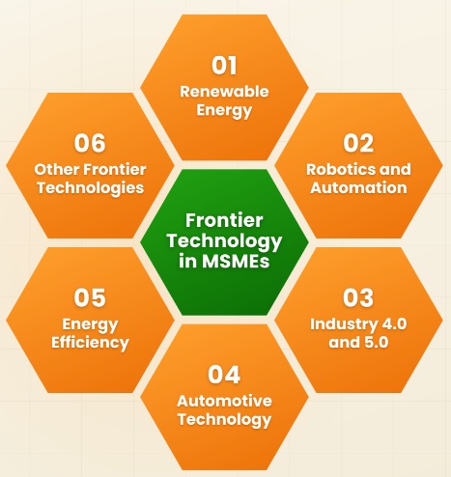

Prestige Institute of Engineering Management and Research Indore MP
1
Submitted Idea Reference No. -

Slide 2
1
LOGO
Name of Technology
(name of IDEA /product/project)
Note: This is for reference only and applicants may choose to build presentation around this reference pitch deck.

Slide 3

Problem statement
2
State the problem you are trying to solve briefly explaining how customers/user encounter it and validating it will real-life examples.
Insert Image

Slide 4
Solution
3
Describe the solution you are offering along with a clear representation of the innovative components of your solution.

Slide 5
Demo of Technology
4
You can place Screenshots of UI, photographs or share a link of demo video of your product depending upon its type. (software or hardware)
Features of product, IP, product architecture can be wrapped here.

Slide 6
Literature Survey & IP
5
Please share in brief the literature survey done to identify the current technology scenario in your area of work.
Please share publications and any existing IP filed/published by you relevant to the current technology.

Slide 7
End User
6
Please describe the probable end user for your technology/product.
Describe specific Innovative features which solves the problem faced by the end user.

Slide 8
Commercialization Model
8
What is the proposed commercialization model for the technology/product:
  Tech Transfer/ Licensing/ Royalty
  Startup Formation
  Existing tie-up for commercialization if any

Slide 9
Milestones
9
Product Development roadmap
Trace the milestones achieved till now and future Projections.
Describe them on a Timeline.
Mention the time span & approximate fund usage for each milestone set on the timeline (in years/months)
Include Partnership details.
Tenure of the project.

Slide 10
Funding ASK & Budget
12
Mention existing funds raised through other programs.
Mention your Funding ask (in Rupees) and describe the projected utilization.
Mention realistic numbers for expected funding.

Slide 11
TEAM
13
Insert the photographs of the Founder, Mentor & the team along with their qualifications, core domain of work.

Slide 12



15
Details of the Host Institution(HI)
Prestige Institue of Engineering Mangement and Research Indore
Details of the Applicant
Name -
Category (student/ MSME entrepreneur/other ) -
Age -
Gender -
Address
Contact no.
Email id

