Slide 1
Elo-MMR: replicating and extending a rating system for massive competitions
Kanhav Purohit (240150014) · Arnav Sinha (240150005)
Replication of Ebtekar & Liu, The Web Conference 2021 (arXiv:2101.00400), tested on Codeforces, synthetic data and a new AtCoder dataset
Introduction → Proposed idea → Architecture → Results → Conclusion · then code demo and Q&A
Notes:
Introduce the paper and what we did: reimplemented it, checked whether its results reproduce, explained the gaps, and extended it with a new dataset and a time-aware drift model.

Slide 2
Rating thousands of players from rankings alone is hard
INTRODUCTION
Programming contests, races and judged sports only produce a ranking per event; raw scores can't be compared across events
Elo and Glicko are built for 1-vs-1 games; TrueSkill handles many players but has no proven guarantees
Codeforces and TopCoder use ad-hoc formulas, and some can be gamed by losing on purpose
Our task: reimplement Elo-MMR, test whether its results reproduce, explain any gaps, and extend it
System | Massive | Monotonic | Robust
Glicko-2 / TopCoder | — | no | yes
Codeforces | no | yes | no
TrueSkill | unproven | unproven | no
Elo-MMR | proven | proven | proven
Massive = linear time · Monotonic = it never pays to lose · Robust = one round can't wreck a rating
Notes:
The problem: infer skill from rankings when thousands compete per round. Existing systems each miss at least one of three properties; the paper claims Elo-MMR is the first to prove all three. Our job was to check that claim and build on it.

Slide 3
A Bayesian model where only the ranking is observed
PROPOSED IDEA
Skill S(t−1)
hidden
Skill S(t)
hidden
Performance P(t)
hidden
Ranking E(t)
observed
drift
+ noise
sorted
Joint model (Eq. 1): prior × skill drift × performance noise × ranking
Each player's performance is their skill plus noise (Gaussian, or heavy-tailed logistic); only the ranking is seen
Key insight: with thousands of players, a ranking pins down each performance almost exactly (Doob's consistency theorem)
So players decouple: the update is two 1-D problems per player, first find the performance, then the new rating
Rating = most probable skill (MAP)
prior × likelihood of this round's performance
Notes:
Skills are hidden and drift between rounds. In each round a player performs at their skill plus random noise, and we only see the resulting ranking. The joint distribution factorises into four pieces. The paper's key move: in a massive contest the ranking reveals each performance almost exactly, so we can treat performances as observed. Then every player is updated independently by solving two one-dimensional problems.

Slide 4
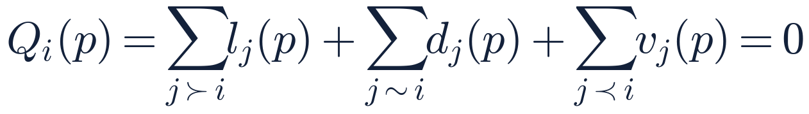
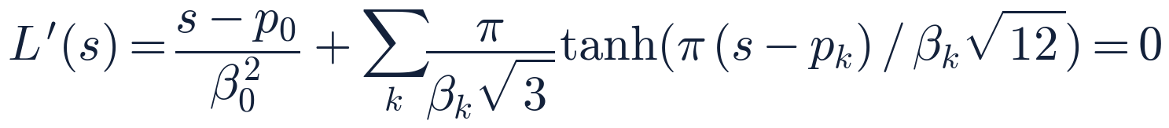
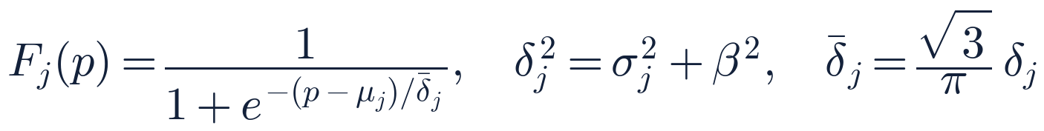
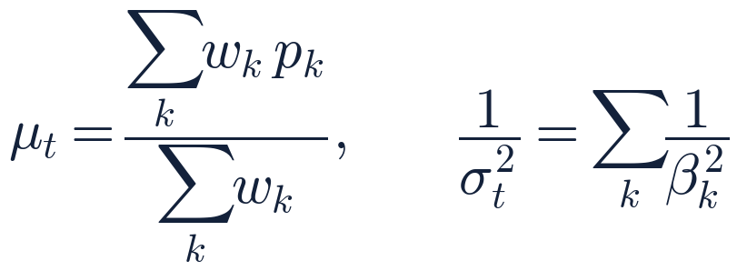
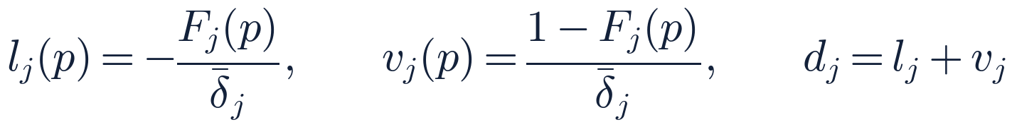
Each round: two one-dimensional solves per player
PROPOSED ARCHITECTURE · 1 OF 2
Phase 1 · performance from the ranking
Phase 2 · rating from all performances
The rating is a weighted average of past performances. Each weight is about 1/β² for a typical round but shrinks toward 0 for a freak round, so outliers barely move the rating (the “R” in MMR).
Losses pull p down, wins push it up; p is where expected rank equals actual rank. Q is decreasing, so Newton finds the unique root.
Notes:
Phase 1: for player i, each opponent contributes a term depending on whether i lost to them, tied, or beat them. With logistic noise these are simple expressions in the opponent's win probability F_j. Solving Q = 0 gives the performance. Phase 2: the new rating solves L' = 0, a Gaussian prior plus one tanh term per past round. This is a robust average: the tanh saturates for rounds far from the current rating, so a single bad round has bounded influence.

Slide 5

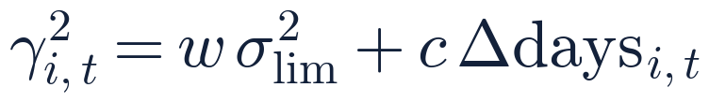
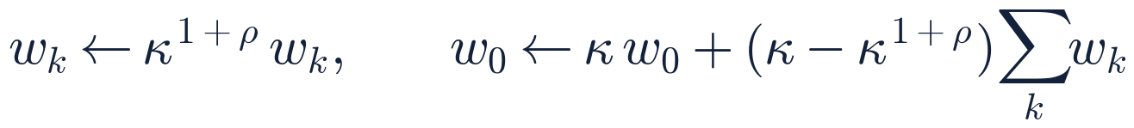

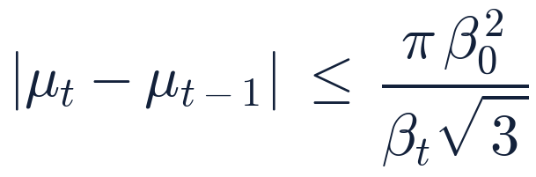
Between rounds: skill drift, and our extension
PROPOSED ARCHITECTURE · 2 OF 2
Pseudodiffusion (paper, Algorithm 2)
Our extension: time-aware drift
The paper adds drift per round played only. We add c per day away (c = 3–10 rating²/day). It never reads performances, so “never pays to lose” still holds.
Old rounds fade; their weight moves onto a Gaussian centred on the current rating, so uncertainty grows by γ² while the rating stays put.
Robust (Thm 5.7)
Implementation: Numba-parallel kernels; opponents grouped by (μ, σ); nearest 500 groups per player; 32 stored rounds per player. Evaluation: tune on the first 10% of rounds, score the last 90%, players with ≥ 5 past rounds.
Notes:
Between rounds the paper's pseudodiffusion lets old performances fade, at a rate set by rho, and transfers their weight to a Gaussian centred on the current rating. Our extension makes the drift depend on time away, not just rounds played. Because it only depends on time, the incentive proof still goes through. Bottom: the robustness bound, and how we implemented and evaluated everything.

Slide 6
The paper reproduces, and its ranking holds on new data
RESULTS
Replication on the paper's data
Claim | Paper | Ours
Codeforces accuracy | 78.6 | 78.61
Synthetic accuracy | 81.7 | 81.63
Speed vs exact Codeforces | 6× | 13×
Our time drift helps in every setting
+0.02 to +0.10 points; every 95% interval is above zero on both Codeforces and AtCoder (bootstrap over rounds).
Caveat: Codeforces figures use the authors' settings; tuned on the first 10%, TopCoder edges Elo-MMR(ρ), 78.62 vs 78.37.
Notes:
Left: our new dataset. Elo-MMR beats every baseline and AtCoder's own published ratings, and our time drift adds a bit more. Right: the paper's headline numbers reproduce on its own data once the setup matches: the authors' settings, full participation on synthetic data, and the exact Codeforces formula for speed. The drift gain is small but statistically clear.

Slide 7
Conclusions and limitations
CONCLUSIONS
LIMITATIONS
Elo-MMR's accuracy, synthetic results and speed reproduce once our setup matches the paper's
Every first-pass gap had a testable cause: tuning split, participation rate, or how the baseline was coded
On AtCoder, data the paper never saw, Elo-MMR beats every baseline and the platform's own ratings, all with 95% confidence
Time-aware drift is a small, consistent, incentive-safe gain
Sensitive to tuning: with the paper's 10% split, TopCoder beats tuned Elo-MMR(ρ) on Codeforces
Our gains are modest (+0.02 to +0.10 points); adaptive round weighting did not help
Nearest-500 subsampling breaks exact monotonicity (up to 0.3 points in our test)
No TopCoder, Reddit or TrueSkill comparison: that data was never published
Metrics only score ordering; whether σ is calibrated is untested
Next: code demo · Q&A
Notes:
Conclusions: it reproduces, we know why our first numbers differed, and it holds on new data. Limitations: be upfront that results depend on tuning, our gains are small, subsampling weakens the incentive guarantee, and we could not compare on the unpublished datasets. Then switch to the code: elommr/kernels.py for the two phases, scripts/run_experiments.py for the protocol.

