Slide 1
Run external program

Slide 2
Learning objectives
External process
How to run from Perl script
Functions for external process
system()
backtick
exec()

Slide 3
Perl wrapper
Perl is used as a wrapper around other programs
Create the correct command line to run the other program
Capture the output of another command line program and then make some decisions based on that output
Useful for creating Bioinformatics automatics pipelines

Slide 4
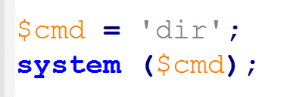
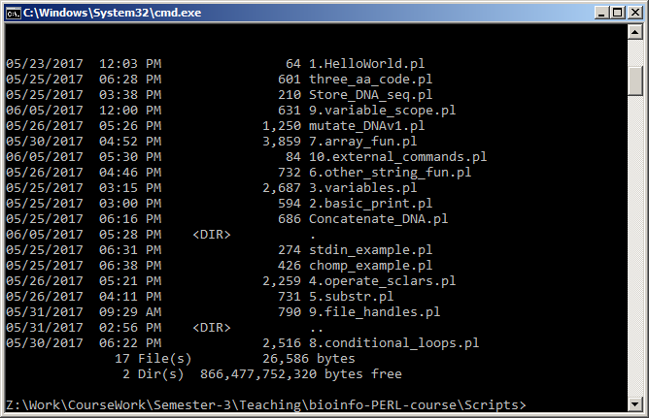
system()
Syntax: system($COMMAND, @VARLIST )
run a command with parameters and wait for it to return
Prints the results to the Screen

Slide 5
system() return values
0 : if the command succeeds
256 : if the command fails
Conventionally 0 is for fail and 1 for success.
Devide the returned value with 256
FAIL: 0/256 =0 and SUCCESS: 256/256 = 1

Slide 6
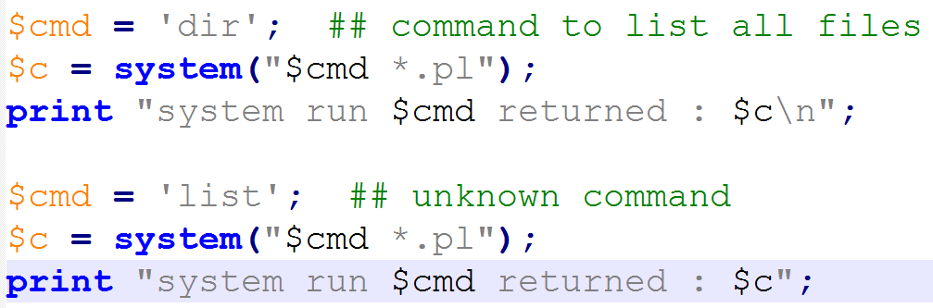
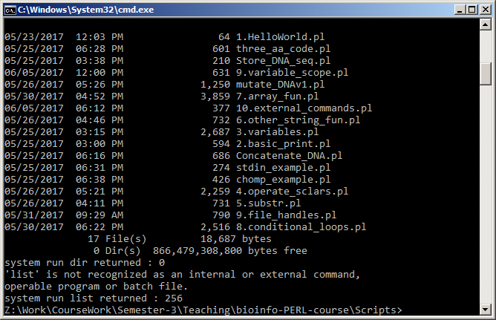

Slide 7
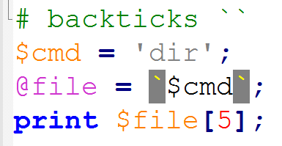

backtick (``)
Similar to system(), except:
Does not print on screen
Returns actual value of the command output

Slide 9
Thank you

