Slide 1
Getting started with Perl

Slide 2
Learning objectives
Setup your computer for Perl programming
Windows
Unix
Mac
Write your first Perl code.
Say hello to Perl
Execute the Perl script
Windows
Linux

Slide 3
Requirements
Install PERL
Unix: mostly comes in-built
Mac: in-built
Windows: ActivePerl, StrawberryPerl
Text Editor
Unix: gedit, vi editor, VIM editor, nano etc.
Mac: TextWrangler, TextMate etc.
Windows: Notepad++, Komodo Edit etc.

Slide 4
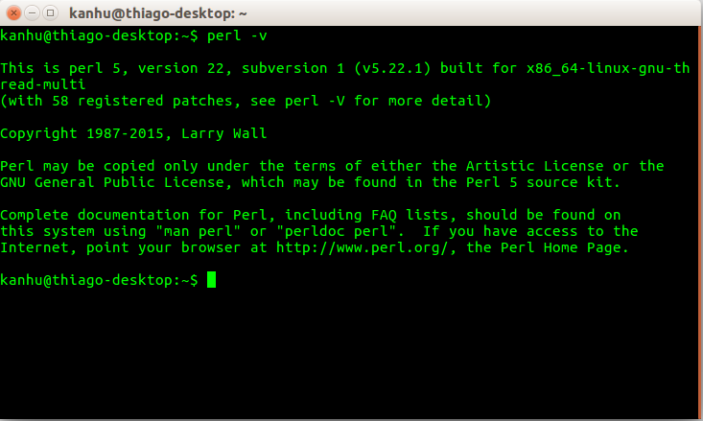
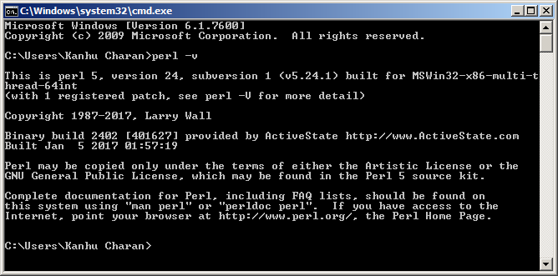
PERL installation
Check if PERL is already there
Alt+ctrl+T : open terminal
Windows key+R, type cmd, press Enter.
Type: perl –v

Slide 5
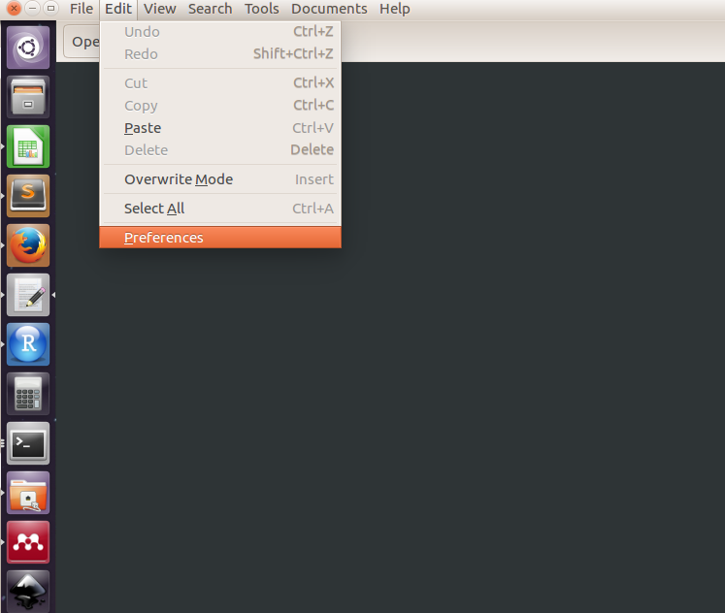
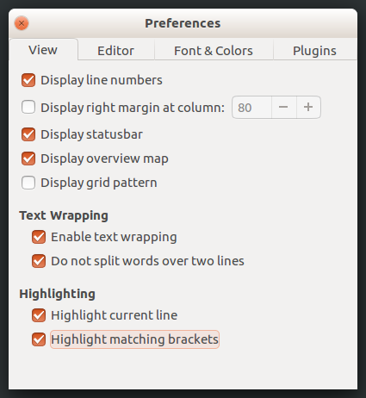
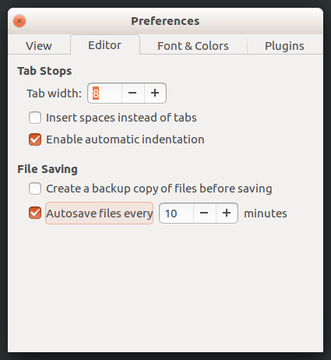
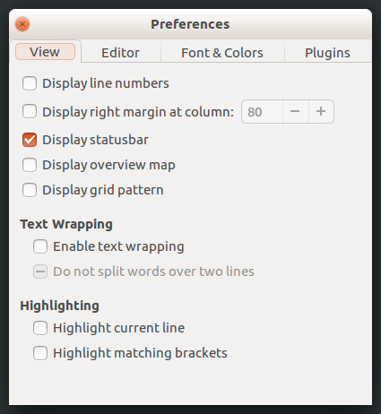
Fine tune the text editor

Slide 6

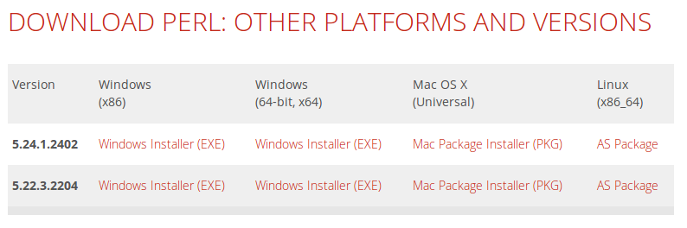
Install PERL on Windows OS
https://www.activestate.com/activeperl/downloads

Slide 7
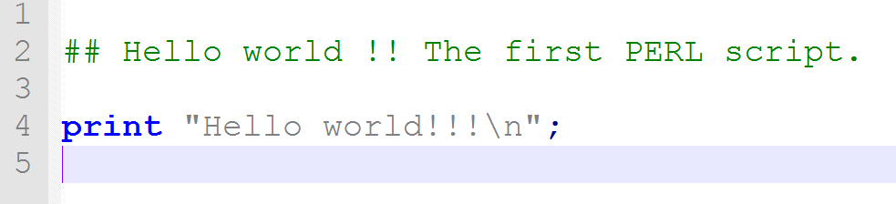
Write first script
Open a blank text file
Save it as hello_world.pl ( *.pl )
Write the following:
This file is called a source code.

Slide 8
Write first script
Open a blank text file
Save it as hello_world.pl ( *.pl )
Write the following:
Commnet
Perl statement
Semi-colon

Slide 9
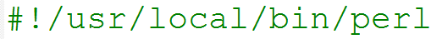
Write first script
In Unix like systems add a shebang line at the top
tells the program (Shell) where PERL interpreter is located
Shebang line is not really necessary on Windows
shebang line
Commnet
Perl statement
Semi-colon

Slide 10
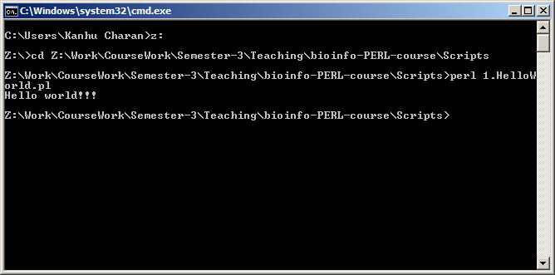
Execute the script on Windows
On terminal
Go to the location where you have saved the file
Type
perl hello_world.pl

Slide 11
Run on Linux
Regardless of shebangline and execution permission
perl SCRIPT.pl
With Shebang line and execution permission
chmod 755 SCRIPT.pl
./SCRIPT.pl
Permission to execute
change file mode

Slide 12
Run on Mac
All information similar to Unix like OS.

Slide 13
Programming cycle
Run /
Test
Write / Design
Verify / Modify

Slide 14
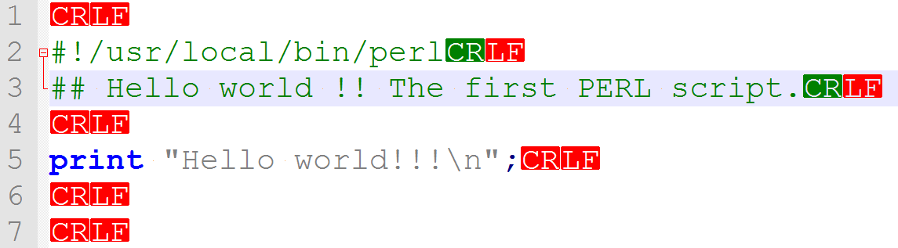
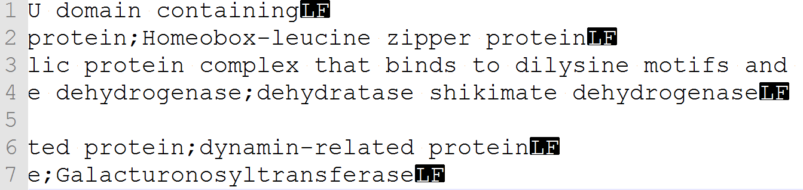
End-Of-Line (Windows vs Unix)
OS | End-of-line | Bytecode
Unix | \n | LF
Windows | \n\r | CRLF
Old-MAC | \r | CR

Slide 15
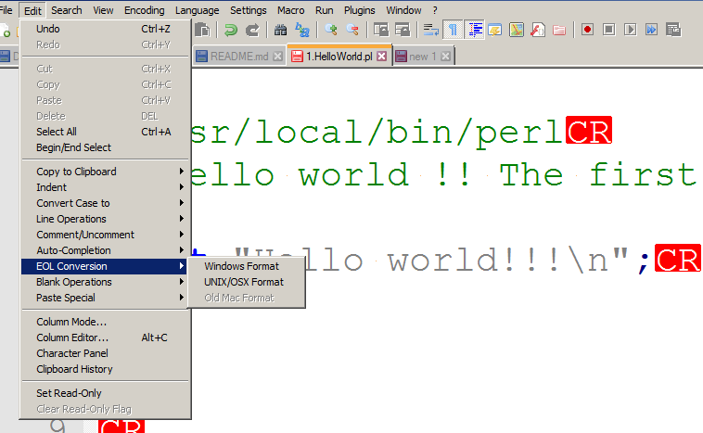
End-Of-Line (Windows vs Unix)
OS | End-of-line | Bytecode
Unix | \n | LF
Windows | \n\r | CRLF
Old-MAC | \r | CR

Slide 16
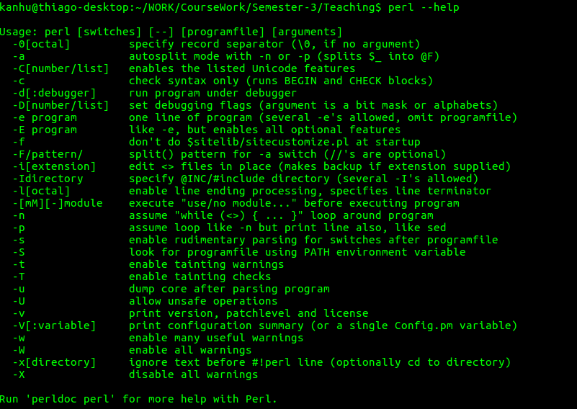
Write and execute from terminal

Slide 17

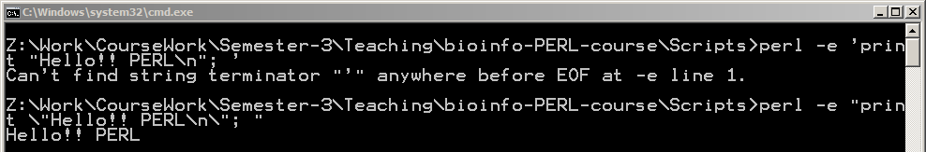
“Hello world”- One liner
Mind the quotation marks
Windows : double quote ( “”)
Unix : Single quote (‘’)

Slide 18

print function
Syntax: print “message to dispay on OUTPUT screen”
Quotes : single and double quotes
Double quotes : interpolation of varibales
\ : escape character (escape the letter following it)
\n : new line character
\t : tab character
\a : beep audio (only on windows)

Slide 19
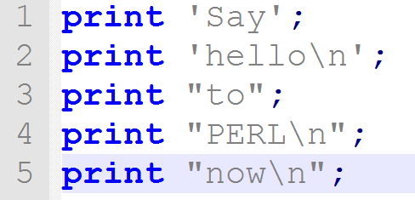
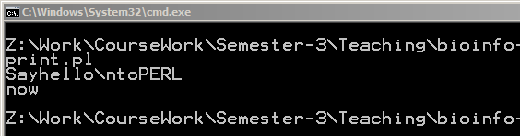
Examples

Slide 20
Error messages
Run the script to see if it works
Typographical errors are common
Missing semi-colons
Closing parenthesis or curly braces
Perl errors include line numbers
Check before and after that line
Can learn more with practice
GIGO : logical errors needs careful testing results

Slide 21

Getting help
Google about it.
Stack Overflow (http://stackoverflow.com) a generic forum for programmers.
http://perlmonks.org/
http://perldoc.perl.org (Perl functions)
Ask a friend

Slide 22


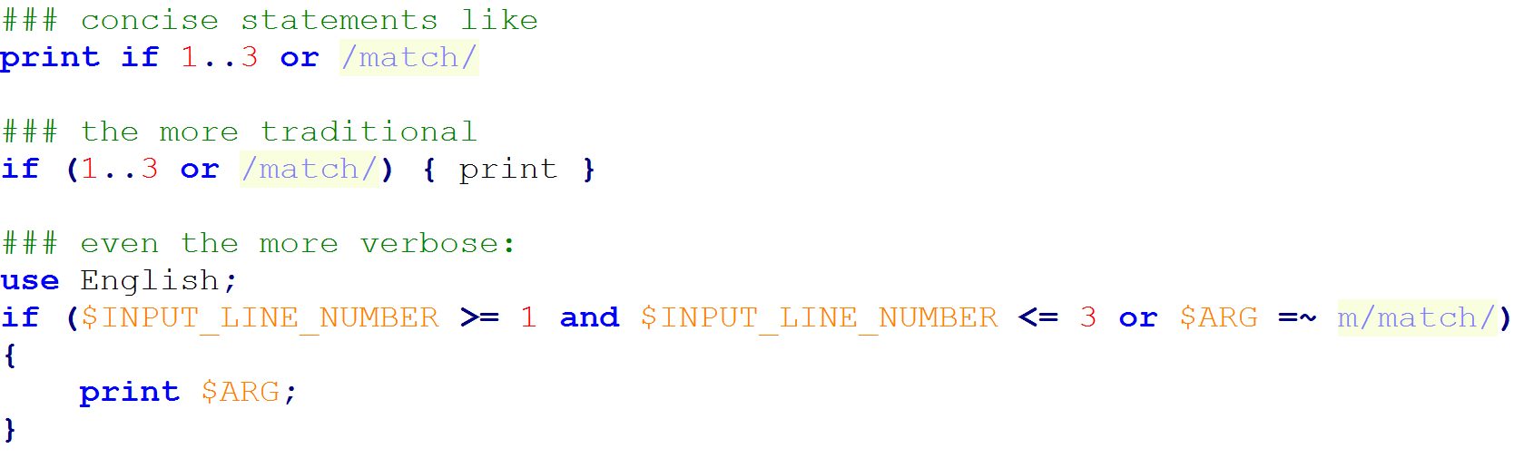
Perl motto: TMTOWTDI
There's more than one way to do it
pronounced Tim Toady

Slide 23
Thank you

Slide 24
Exercise
Check and report version of PERL on your computer.
Write a Perl program that prints your name and e-mail in the following format
Name: Student_name
E-mail ID : student@uenf.br
Write the same program as an one liner script.

