Slide 1
Variables and operators

Slide 2
Learning objectives
Data types, constants and Variables
Scalars and list variables
Naming conventions
Scopes
Operators
String opertors
Mathematical operators
Binary operators
Urinary operators
Operators on scalars and lists

Slide 3

Constants and variables
Calculate simple interest (I)
We need to input
Principal amount (p), rate of interest (r) and time in years (t)

Slide 4
Constants and variables
Calculate simple interest (I)
We need to input
Principal amount (p), rate of interest (r) and time in years (t)
variables
constant

Slide 5
Constants and variables
Calculate simple interest (I)
We need to input
Principal amount (p), rate of interest (r) and time in years (t)
Variables are used to store data
Contanst values can not be changed
Memory (RAM)
variables
p
constant
r
t
I

Slide 6
Data types
Integers
8 14 10000 200000 2e10
Floats
0.001 0.2 23.45 1e-10
String
“John” “Brazil” “attgacagat” ‘mmklysvy’
Boolean
0 1

Slide 7
Perl literals
A literal is a value that is represented "as is" or hard-coded in your source code.
20
“May 21,2017”
‘welcome home’
Contain only one element
Perl has two different types of literals
Numeric Literals
String Literals

Slide 8
Numeric literals
Number | Type of Literal
6 | An integer
12.5 | A floating point number
15 | Another floating point number
0.7320508 | Yet another floating-point number
10000000000 | Scientific notation
6.67E - 33 | Scientific notation (e or E is acceptable)
4_294_296 | A large number with underscores instead of commas

Slide 9
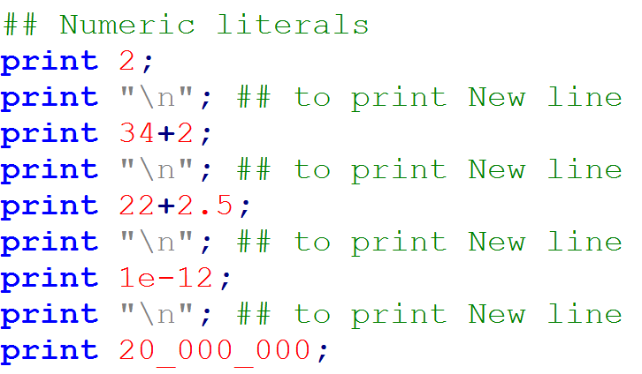


Slide 10
String literals
String literals in Perl are sequences of characters, such as Hello, World.
You must enclose string literals, in quotation marks.
"foo! "
'Four score and seven years ago'
Strings can even be empty. " "

Slide 11
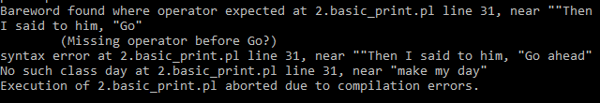

Quotes within a string
"Then I said to him, "Go ahead, make my day." "
Use escape character (\) before the " in the string.

Slide 12
Common escape characters
Sequence | Represents
\n | Newline (move down and back)
\r | Carriage Return (move back but not down)
\b | Backspace (lets you overwrite existing text)
\f | Form feed (move down but not back)
\t | Tab
\u | Change next character to uppercase
\l | Change next character to lowercase

Slide 13
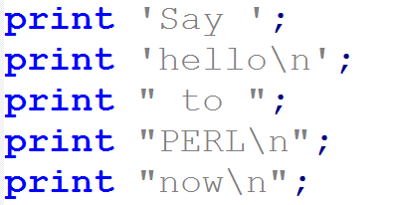

Single quotation vs double quotation
single quotation
double quotation
single-quoted strings are quite literal
Perl checks to see whether variable names or escape sequences are present and translates them

Slide 14
Variables in Perl
Variable - a name for a block in computer memory holding some data
Perl variables are not data type specific
No need to pre-declare variables
All variables are in Global score (by default)
Three types of variables
Scalar (a single variable)
Array
Hash
Aggregation of scalars

Slide 15
1.Scalar variables
Can store only one element
It is represented by a Dollar ($) symbol
$a
$student_name
$phone_no
Assign value to a scalar (‘=’ assignment operator)
$a =10;
$student_name = “kanhu”;
$ phone_no = 9876543001;

Slide 16
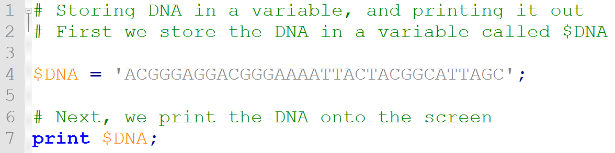
Program to store DNA sequence

Slide 17
2. Array variables
Array is an ordered list of scalars.
The variable is denotaed by @
E.g : @name, @colors, @states
Each element in the array is given an index.
Arrays are 0-index based
Unlike C array, they can contain mixed data types
0 | 1 | 2 | 3 | 4 | 5 | 6 | 7
index

Slide 18
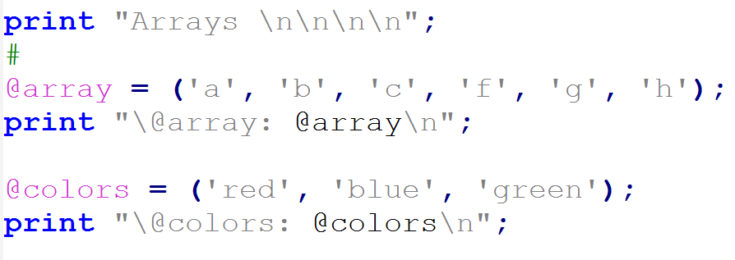

Create an array
@array = (‘a’, ‘b’, ‘c’, ‘f’, ‘g’, ‘h’);
@colors = (‘red’, ‘blue’, ‘green’);
@arr = ($a, $b, $c, $d);
a | b | c | d | e | f | g | h
0 | 1 | 2 | 3 | 4 | 5 | 6 | 7
red | blue | green
0 | 1 | 2
Separated by a space

Slide 19
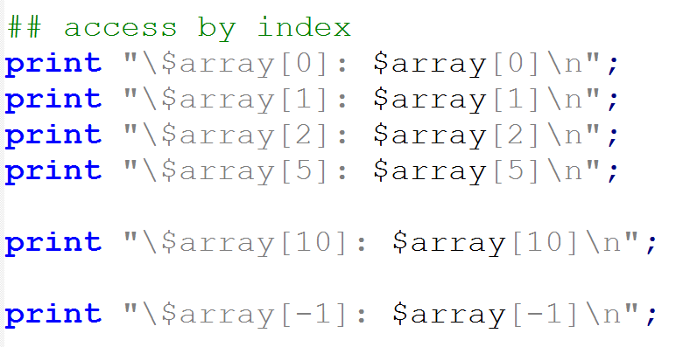
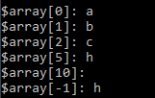
Access array by index
@array
a | b | c | d | e | f | g | h
0 | 1 | 2 | 3 | 4 | 5 | 6 | 7
Scalar context

Slide 20
Modify value of an array element
Change value ‘e’ to ‘m’.
‘e’ has index 4.
$array[4] = ‘m’
If the given index doesnot exist, it will be created
$array[10] = ‘x’, also create $array[8] , $array[9] with undef.
@array
a | b | c | d | e | f | g | h
0 | 1 | 2 | 3 | 4 | 5 | 6 | 7
@array
a | b | c | d | e | f | g | h
0 | 1 | 2 | 3 | 4 | 5 | 6 | 7

Slide 21
Array Bioinfo example

Slide 22
3. Hash or associative arrays
Hash is a special kind of data structure.
it creates a look-up table
Syntax: variable is denoted by %
%age, %hash
It is an unordered list of keys and values.
Each key must be unique
Keys are strings
Only one value per key
Key to value, not vice versa
Key1 |  | Value1
Key2 |  | Value2
Key3 |  | Value3
Key4 |  | Value4
Key5 |  | Value5
Key6 |  | Value6

Slide 23
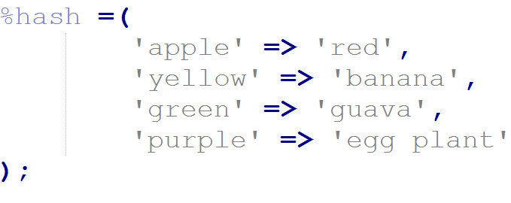
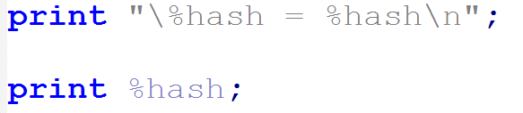

Create a hash
apple |  | red
yellow |  | banana
green |  | guava
purple |  | egg plant

Slide 24
An array can be used as hash
@array
John | 12 | Tom | 15 | Monika | 16 | Nini | 19
0 | 1 | 2 | 3 | 4 | 5 | 6 | 7
%hash
Keys | values
John | 12
Tom | 15
Monika | 16
Nini | 19
%hash = @array;

Slide 25
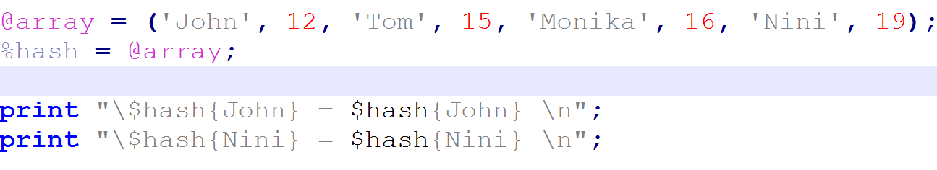

An array can be used as hash

Slide 26
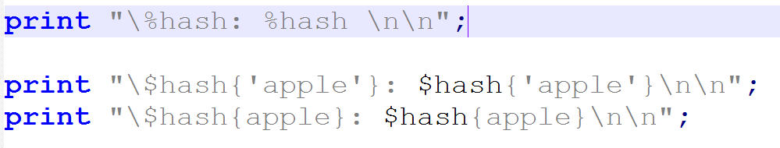

Access hash by key
Scalar context : $hash{key1} , returns value of key1
Scalar context

Slide 27
Modify hash by key

Slide 28
Array vs Hash
Stored ordered and sequentially
Not stored sequentially
Array Hash
0 | red
1 | banana
2 | guava
3 | egg plant
apple |  | red
yellow |  | banana
green |  | guava
purple |  | egg plant

Slide 29
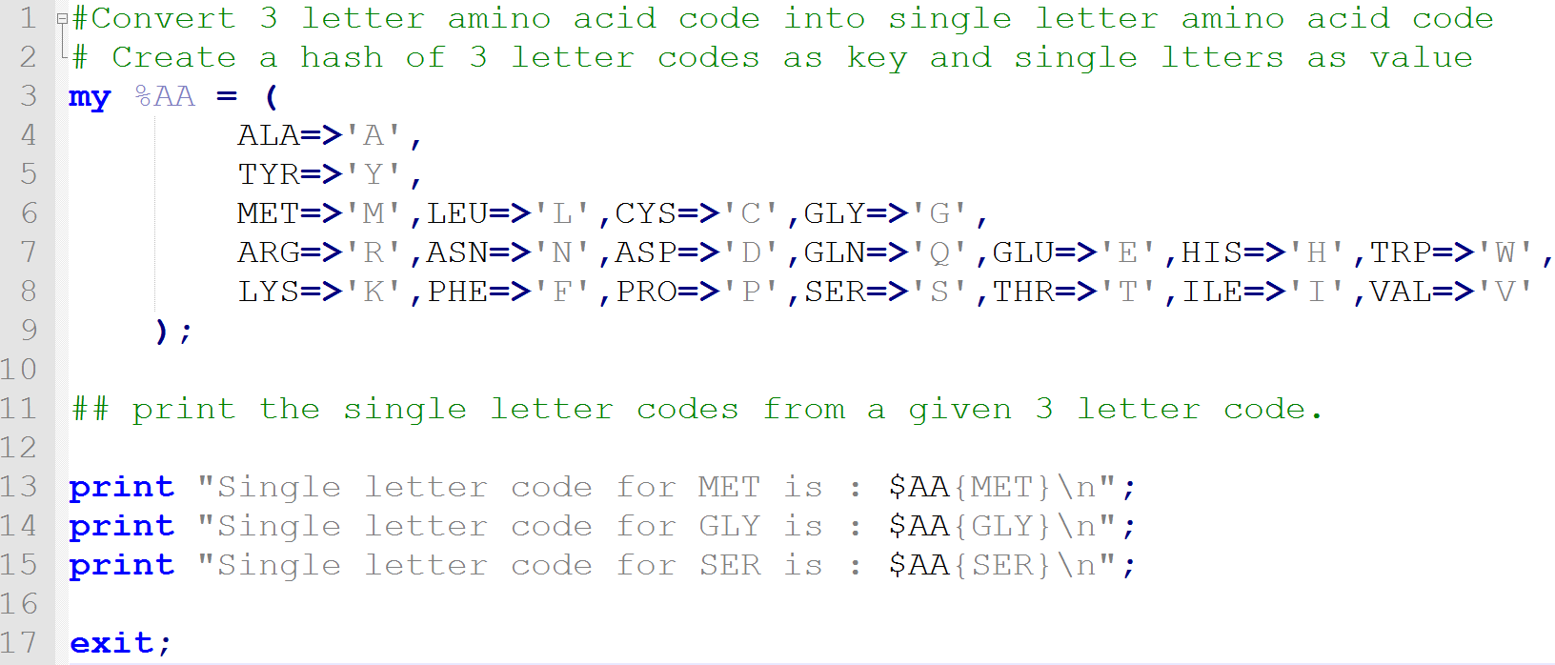


Slide 30
Variable naming conventions
Variable names can contain letters, numbers and underscores
Case sensitive
Cannot start from number (digit)
Cannot be longer than 255 characters
you may use “reserved words”

Slide 31
Variable name examples
Right
Wrong
$variable
@array
%hash
$var_1_k
$var_k_100
$print
$1_var
%1121
@arrar1_111111111111111
$0.982S
$.msdjd
$$
$1
$ac@jkl

Slide 32
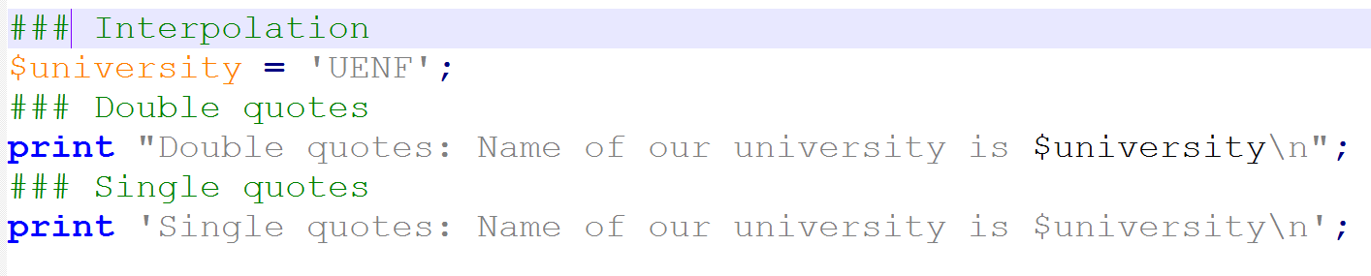
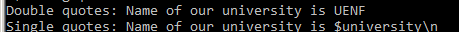
Variable interpolation
With in double quoted strings Perl substitutes a variable with its stored value.
This is not allowed within single quoted strings.

Slide 33
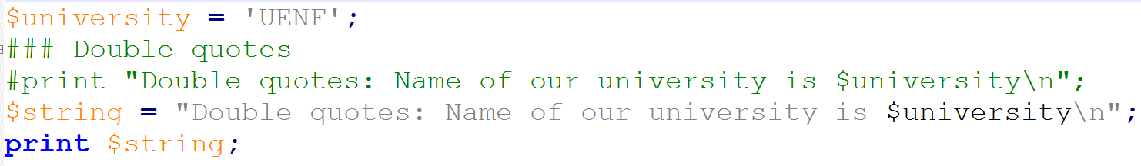

Variable within another variable

Slide 34
Scalar operators
Elements that operates on data called operators.
E.g : 1 + 4 , + is an operator
Arithmetic operators manipulate on numeric scalar data.
Assignment operators are used to assign data to a scalar or list.
Comparison operators are used to compare two pieces of scalar data.
Logical operators can be used to do some Boolean logic calculations.
String manipulation operators manipulate on strings.

Slide 35
Arithmetic operators
$variable1 = 1000000 + 222;
$variable1 = 1000000 * 222;
$variable1 = 1000000 - 222;
$variable1 = 1000000 / 222;
$variable1 = 121**3; # (121)³=1771561 or ^
$variable1 = 10 % 3; # remainder =1
$variable1++ ; # increase value by 1
$variable1-- ; # decrease value by 1

Slide 36
Assignment operators
Operators | Examples
= (assign) | $a =$b + $c; means add $b + $c and assign to $a
+= (add and assign) | $a+=$b; means $a = $a+$b;
*= (multiply and asign) | $a*=$b; means $a = $a*$b;
-= (subtract and assign) | $a-=$b; means $a = $a-$b;
.= (concatenate and assign ) | $a.=$b; means $a = $a.$b;

Slide 37
Comparison operators
Operators | Numerical | String
Is equal | == | eq
Not equal | != | ne
Greater than | > | gt
Les than | < | lt
Greater than equal | >= | ge
Les than equal | <= | le
General comparison | <=> | cmp

Slide 38
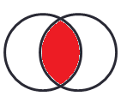
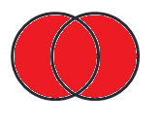
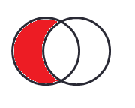
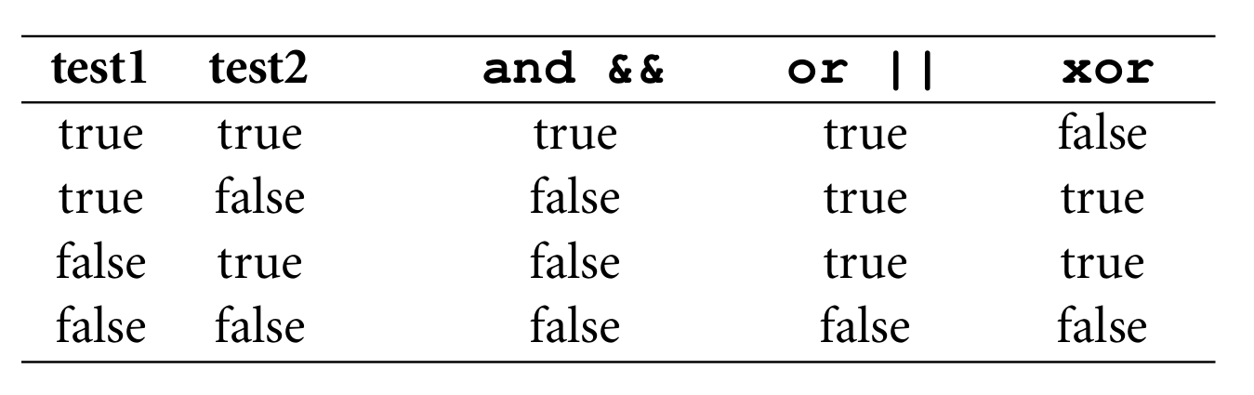
Logical operators
Operators | Numerical | String
Logical AND | && | and
Logical OR | || | or
Logical NOT | ! | !

Slide 39
String manipulation operators
x
String repetition operator
$str1 = "AAGT" x 3; ##equals to "AAGTAAGTAAGT "
.
String concatenation operator
$str2 = "Jarek" . " " . " Pillardy"; ## equals to "Jarek Pillardy”
$dna = “ATGGCAGA” . $str1;

Slide 40
Other operators
..
Range operator (0..10)
Returns 0 to 10, in an array context
@arr = 0..10; ## stores 0,1,2,3,4,5,6,7,8,9,10 to @arr

Slide 41
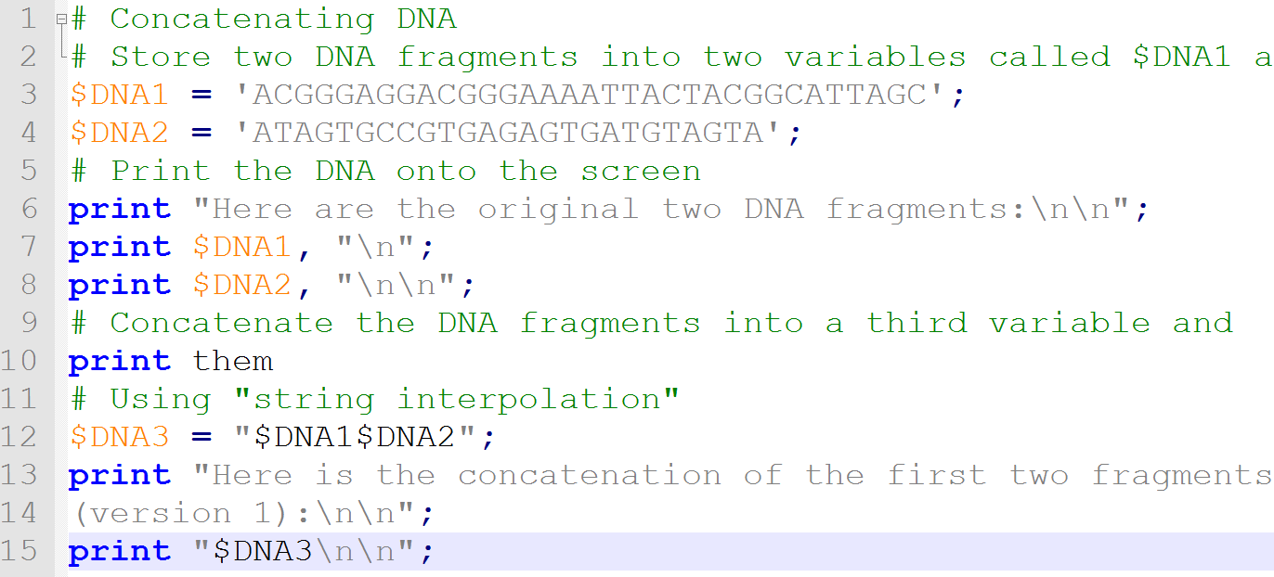


Slide 42
Exercise
In a Perl program create a string representing a 54 bp DNA strand consisting of 6 repeats, store it in a variable.
Modify the script for three_letter_to_single_AA.pl, to print three letter code from Single letter code.

