Slide 1
Variable scoping

Slide 2
Learning objectives
What is variable scope?
Types of variable scoping
Global
Local
Defining scoping to a variable
Perl Pragmas.
Notes:
http://perl.plover.com/FAQs/Namespaces.html

Slide 3
Scope of a variable
Scope reffers to accessibility of a variable in a part of a program/code block.
Life-time of a variable
inside a code block.
Types
Global :Everywhere
Local :Inside code-block
# Environment A
{
# Environment B
{
# Environment C
}
# Environment B resumes
{
# Environment D
}
# Environment B resumes
}
# Environment A resumes

Slide 4
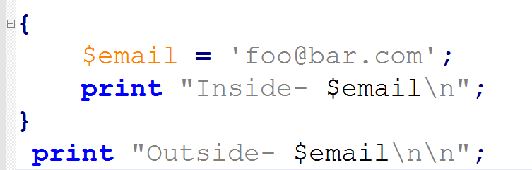

Perl variables have Global scope

Slide 5
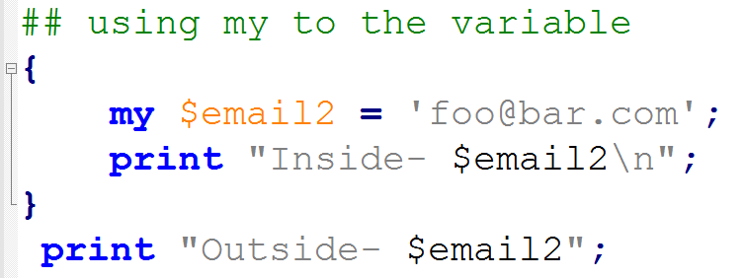

Creating a local variable

Slide 6
Why variable scopes
How do we write and manage a large complex program without being overwhelmed
split it into smaller, more manageable pieces
global variable adds complexity to the whole program
while a local variable adds complexity only in a single code-block
Global variables as they are liable to cause bugs
Waste memory: use memory whilst a program is running even if you no longer need
Local variables release memory outside their scope

Slide 7
Global and local scoping functions
our(VARLIST) : creates a local variable that has scope with in the current package (here the throughout script).
my(VARLIST) : creates a local/lexical variable.
Particularly useful when creating subroutines/functions.
Each subroutines create variables in local scope and release memory as soon as the subroutine ends.

Slide 8
Always define scope of a variable
Lack of variable scoping may result in erroneous results.
Recommended to use Perl pragmas
use strict; : forces to define scope of each variable
use warnings; : keeps check of potential bugs
disables certain Perl expressions that could behave unexpectedly or are difficult to debug
Note: Always write them at the begining of your script

Slide 9
Examples
use strict;
use warnings;
my @arr = ('a','aa','b','bb');
foreach my $i(@arr){
print "$i\t";
}

Slide 11
Thank you

