Slide 1
Parsing Bioinformatics files

Slide 2
Learnig Objectives
What is a file handle
How to open a file to read lines
How to create a new file and write some information
How to read an exisitng file and write information
Parse a Bioinformatics data file
FASTA
FASTQ
GFF
Blast_output

Slide 3
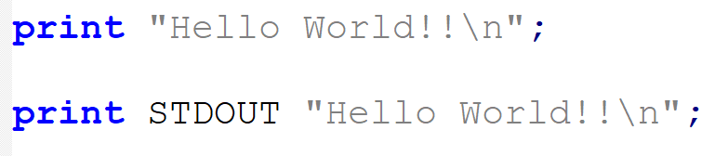
Filehandles
Reading and writing a file stored on disk is very essential for any computer program
Perl uses Filehandles to represent an opened file.
Files and hardware can be represented as filehandles
Filehandle is also a data type in Perl

Slide 4
STDIN, STDOUT and STDERR
3 predefined filehandles available for each program
STDIN or standard input : filehandle from which keyboard inputs can be read.
STDOUT, or standard output : send the output of your program (on screen by default)
STDERR, or standard error: used for outputting warning or error messages

Slide 5
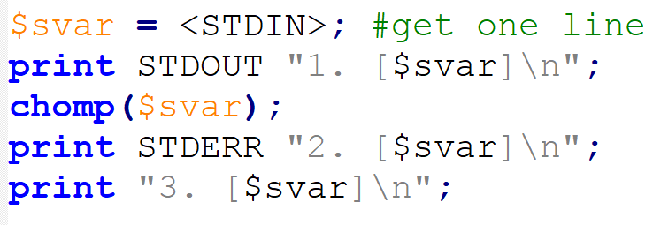

Slide 6
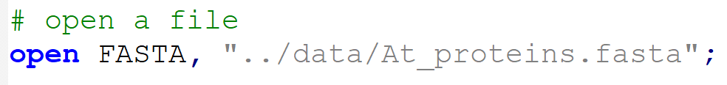
open() : open a file as stream
Syntax: open FILEHANDLE, “/path/to/file”
By convention, filehandles are in all capital characters to make them visually stand out from names
Returns 1 on successful, otherwise 0 if fails to open.

Slide 7
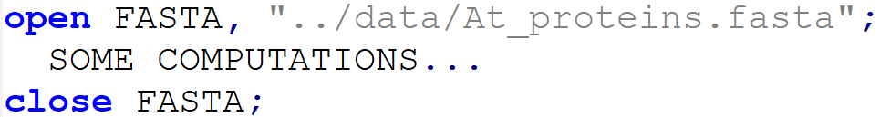
close() : close a file stream
At the end, when you have finished working with a filehandle, you should close()
Syntax: close FILEHANDLE;
The file will be closed automatically when program exits, or when the handle is reused
if the program crashes, the data may be lost

Slide 8
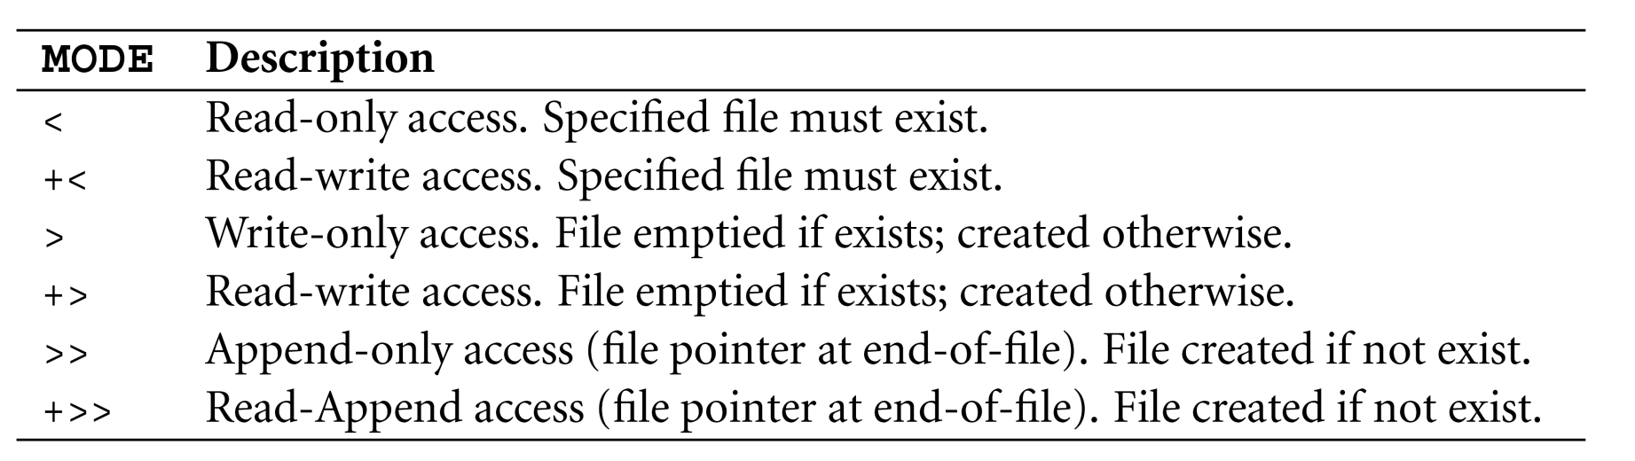
Define MODE of filehandle
Syntax: open FILEHANDLE, “MODE /path/to/file”
Default

Slide 9

Common examples
Open filehandle to write data
If a file with same name exists : overwrites !!!
Otherwise : new file is created.

Slide 10

Common examples
Open filehandle to write data at the end of an existing file
File appending
If a file with same name exists : appends data !!!
Otherwise : new file is created.

Slide 11
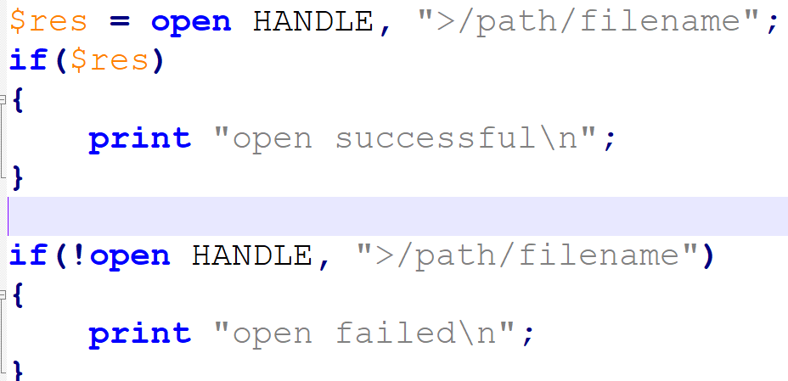
Check file open status
OR

Slide 12
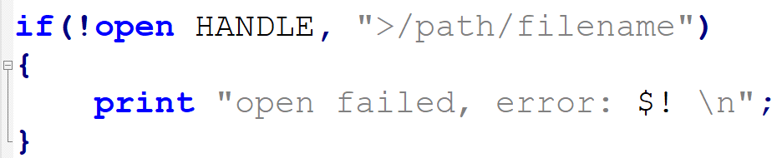
Check file open status
If there is an error special variable $! is set to an error text message generated by the system (like “access denied”)
No message for file overwrite!!!

Slide 13
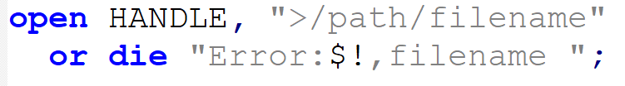
Open status in more compact form
There is a short version of if, especially useful in one-line statements
die(MESSAGE): terminate program with MESSAGE displayed to STDERR.
warn(MESSAGE): MESSAGE displayed to STDERR, program resumes.

Slide 14
FASTA sequence format
>SEQUENCE_1
MTEITAAMVKELRESTGAGMMDCKNALSETNGDFDKAVQLLREKGLGKAAKKADRLAAEG
LVSVKVSDDFTIAAMRPSYLSYEDLDMTFVENEYKALVAELEKENEERRRLKDPNKPEHK
IPQFASRKQLSDAILKEAEEKIKEELKAQGKPEKIWDNIIPGKMNSFIADNSQLDSKLTL
MGQFYVMDDKKTVEQVIAEKEKEFGGKIKIVEFICFEVGEGLEKKTEDFAAEVAAQL
>SEQUENCE_2
SATVSEINSETDFVAKNDQFIALTKDTTAHIQSNSLQSVEELHSSTINGVKFEEYLKSQI
ATIGENLVVRRFATLKAGANGVVNGYIHTNGRVGVVIAAACDSAEVASKSRDLLRQICMH

Slide 15
FASTA sequence format
Unique sequence ID;
>SEQUENCE_1
MTEITAAMVKELRESTGAGMMDCKNALSETNGDFDKAVQLLREKGLGKAAKKADRLAAEG
LVSVKVSDDFTIAAMRPSYLSYEDLDMTFVENEYKALVAELEKENEERRRLKDPNKPEHK
IPQFASRKQLSDAILKEAEEKIKEELKAQGKPEKIWDNIIPGKMNSFIADNSQLDSKLTL
MGQFYVMDDKKTVEQVIAEKEKEFGGKIKIVEFICFEVGEGLEKKTEDFAAEVAAQL
>SEQUENCE_2
SATVSEINSETDFVAKNDQFIALTKDTTAHIQSNSLQSVEELHSSTINGVKFEEYLKSQI
ATIGENLVVRRFATLKAGANGVVNGYIHTNGRVGVVIAAACDSAEVASKSRDLLRQICMH
A single sequence
https://en.wikipedia.org/wiki/FASTA_format

Slide 16
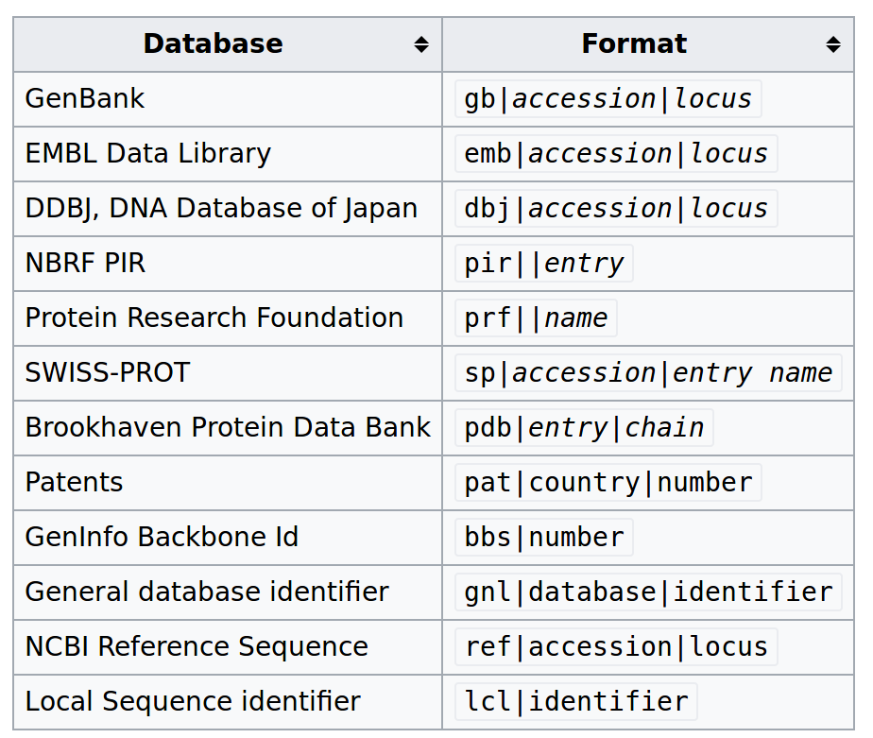
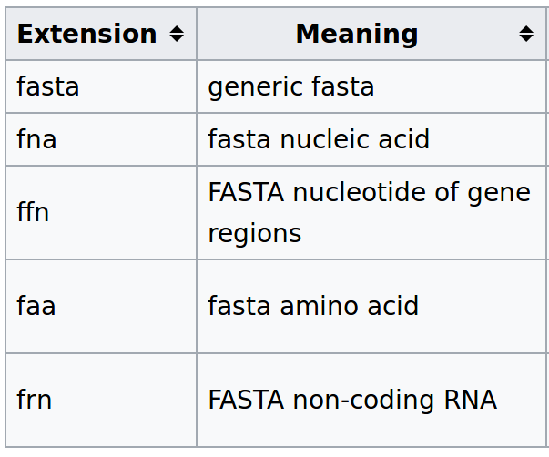
FASTA sequence format
Sequence ID
File extensions

Slide 17
FASTQ format
@EAS54_6_R1_2_1_413_324
CCCTTCTTGTCTTCAGCGTTTCTCC
+
;;3;;;;;;;;;;;;7;;;;;;;88
@EAS54_6_R1_2_1_540_792
TTGGCAGGCCAAGGCCGATGGATCA
+
;;;;;;;;;;;7;;;;;-;;;3;83
@EAS54_6_R1_2_1_443_348
GTTGCTTCTGGCGTGGGTGGGGGGG
+EAS54_6_R1_2_1_443_348
;;;;;;;;;;;9;7;;.7;393333
http://maq.sourceforge.net/fastq.shtml

Slide 18
FASTQ format
@EAS54_6_R1_2_1_413_324
CCCTTCTTGTCTTCAGCGTTTCTCC
+
;;3;;;;;;;;;;;;7;;;;;;;88
@EAS54_6_R1_2_1_540_792
TTGGCAGGCCAAGGCCGATGGATCA
+
;;;;;;;;;;;7;;;;;-;;;3;83
@EAS54_6_R1_2_1_443_348
GTTGCTTCTGGCGTGGGTGGGGGGG
+EAS54_6_R1_2_1_443_348
;;;;;;;;;;;9;7;;.7;393333
Read ID
Read sequence
Base quality
http://maq.sourceforge.net/fastq.shtml

Slide 19
Various Bioinformatics file formats
.2bit format
.fasta format
.fastQ format
.nib format
CRAM format
GenePred table format
GFF format
GTF format
HAL format
MAF format
Microarray format
Net format
Personal Genome SNP format
PSL format
VCF format
WIG format
Axt format
BAM format
BED format
BED detail format
bedGraph format
bigBed format
bigGenePred table format
bigPsl table format
bigMaf table format
bigChain table format
bigWig format
Chain format
http://genome.ucsc.edu/FAQ/FAQformat.html#format18

Slide 20
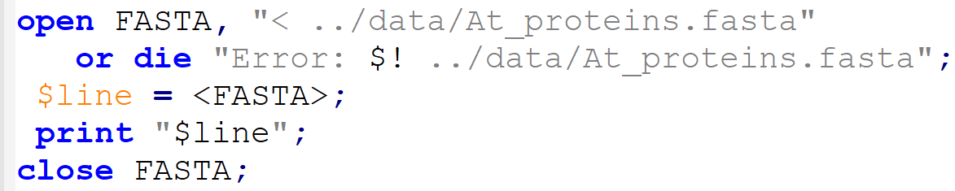
Read content of a file
Prints first line of a FASTA file

Slide 21
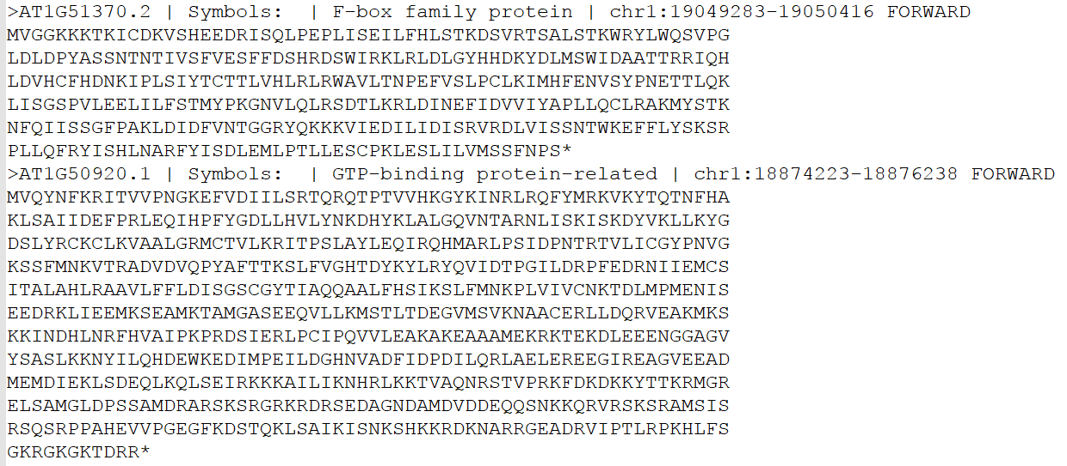
../data/At_proteins.fasta

Slide 22
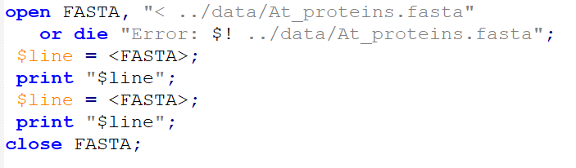
Read and Print the content

Slide 23
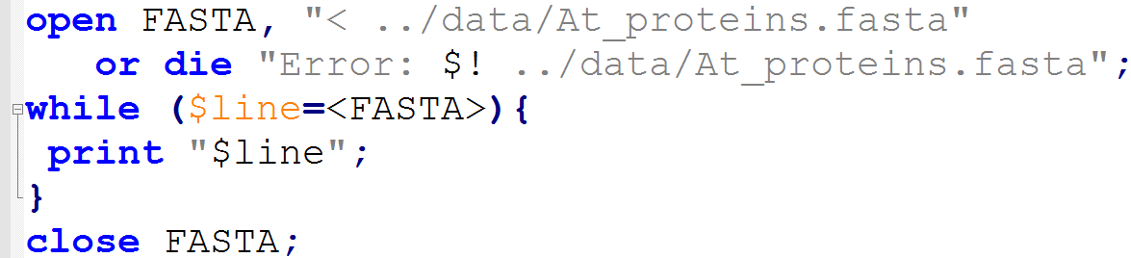
Read whole file using while()

Slide 24
Read whole file using while()
End Of File (EOF) is false; end while loop

Slide 25
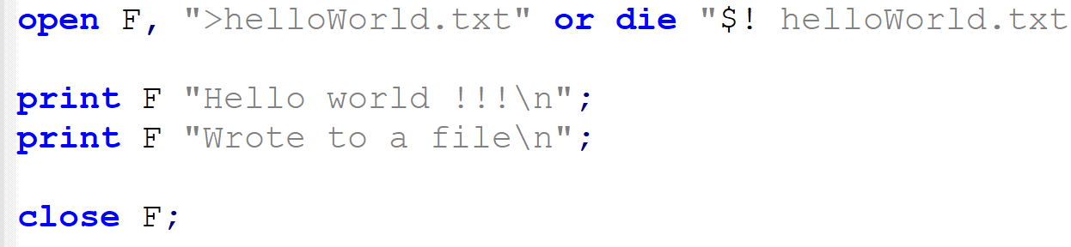
Write text to a new file
Open filehandle with write mode (>)
Use the filehandle in print()

Slide 26
Example
Write a Perl program that asks user to enter a file name and a target file name. Copy the conent of the first file to the second one.
Open script

Slide 27
Example2
Write a Perl script to parse a BlastP tabular output file and save those hits with >45% identity.
Open script

Slide 28
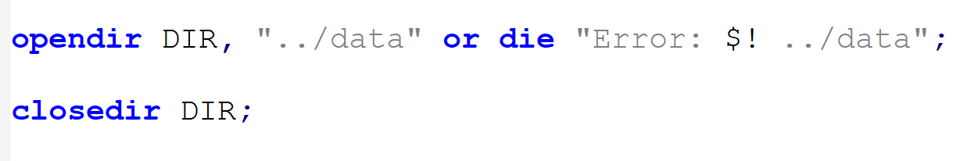
opendir() : open folder as a stream
Syntax: opendir DIRHANDLE, "/path/dirname“
Similar as to file open
returns success (1) or failure (0) code

Slide 29
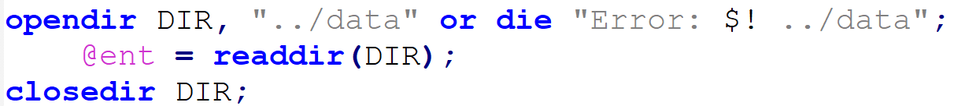
readdir() : list content of a folder
Syntaz: readdir DIRHANDLE
returns an array containing all entries in a directory

Slide 30
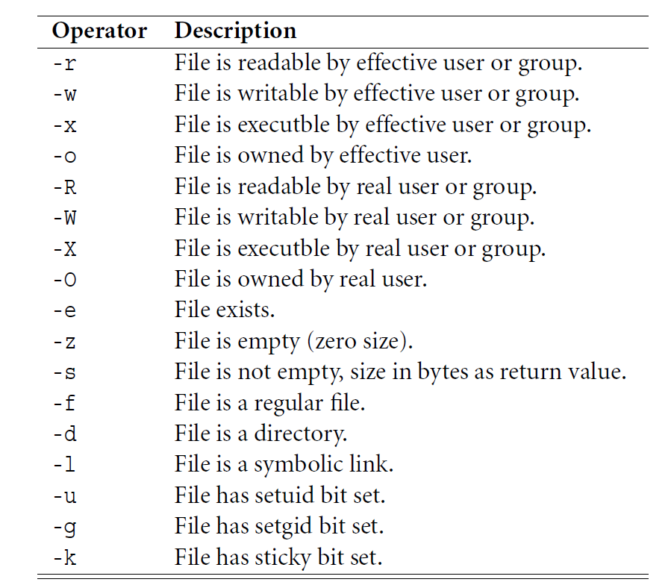
Logical operators for files and directories
File operators | description
-e “name” | File or DIR exists
-f “name” | name is a file?
-d “name” | name is a DIR?
-s “name” | name is non-zero size?
-r “name” | name is readable?
-w “name” | name is writable?
-x “name” | name is executable?

Slide 31
Example
Write a Perl script that asks user to enter a Directory name. Print only the files present in the directory (excluding the directories).
Open script

Slide 32
More functions
unlink(FILE) : deletes the list of FILE(S)
mkdir(DIR) : Creates a new DIR directory
chdir(DIR) : Change directory to DIR

Slide 33
Exercise
Open a FASTA file and copy its content to another file.
Open a GFF file and report total number of Genes present.
Open a GFF file and report total number of Genes present per chromosome.
Open a GFF file and report average legth of genes per chromosome.

Slide 34
More exercises

Slide 35
Commandline processing

