Slide 1
Operations on variables

Slide 2
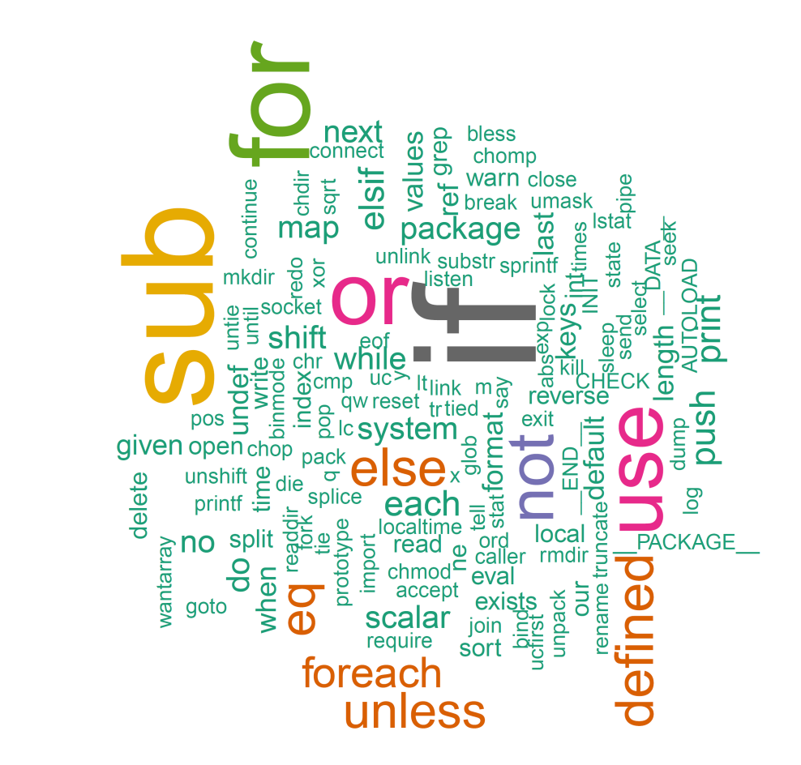
Learning objectives
Perl built-in functions
Functions for scalar variables
Functions for arrays
Functions for hash
More bioinformatics examples

Slide 3
Perl native functions
257 predefined literals, of which 242 are predefined functions.
Functions take one or more variables as argument and return some output.
Things to memorize:
Syntax
Return values
May call functions recursivly.
$variable = 100;
print sqrt($variable);

Slide 4
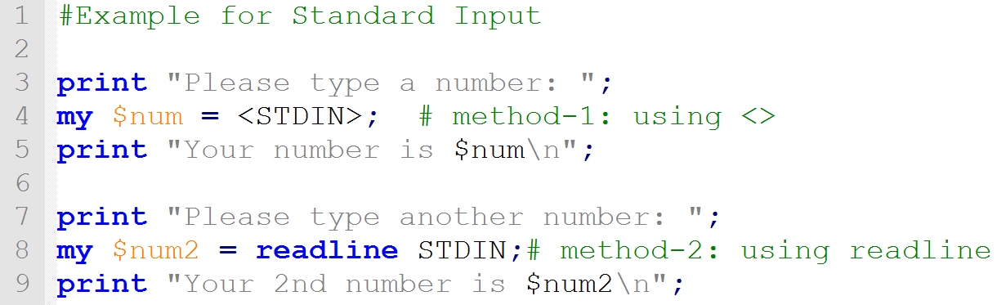
Read input from user
To make the program do something, we need to input data.
The angle bracket operator (<>) or readline tells Perl to expect input, by default from the keyboard. ( STDIN )
Usually this is assigned to a variable

Slide 5
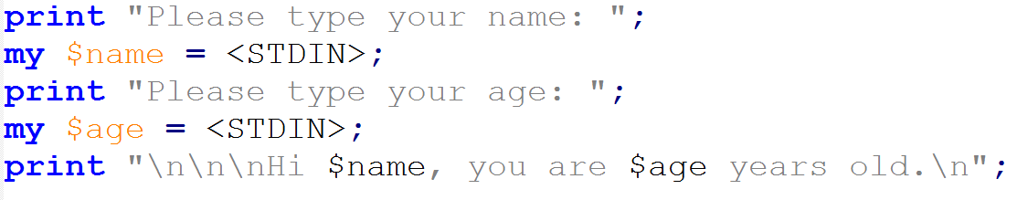

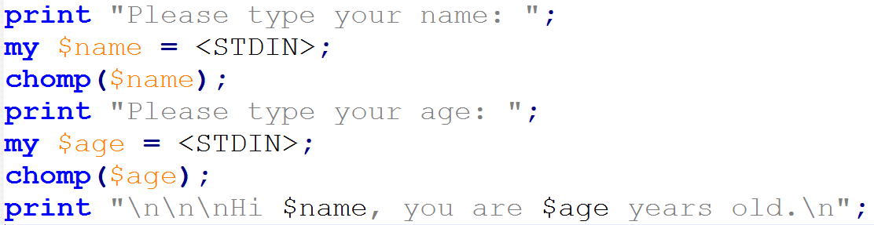

chomp() : remove trailing spaces

Slide 6
Numerical built-in functions
abs #absolute value
sin, cos #trigonometry
exp, log, sqrt #exponent, log, square root
int #convert to int
rand #random numbers

Slide 7
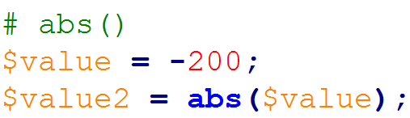
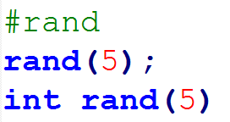
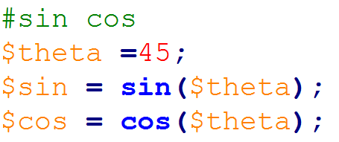
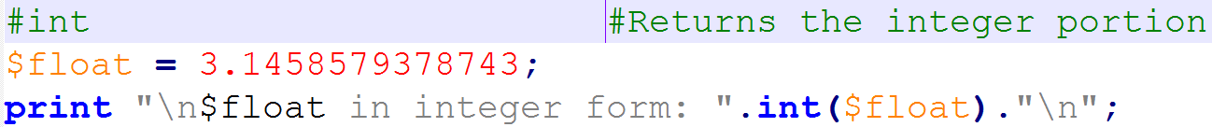

Slide 8
String built-in functions
substr($var, $start, $length) #substring, 0-based
length($var) #length if a string $var
index($var, $str) #position of $str in $var
reverse($var) #reverse string
uc($var) lc($var) #uppercase, lowercase
ord($var) #converts character to its ASCII value
$num = ord("a") #$num is now 97
chr($nvar) #converts int into ASCII character
$char = chr(99) #$char is now

Slide 9
substr()
Syntax: substr EXPR,OFFSET,LENGTH,REPLACEMENT
Extracts a substring out of EXPR
OFFSET : 0-index based start poition
If negative, starts that far back from the end
LENGTH : from OFFSET how much length to return
If omitted, returns everything through the end
If negative, leaves that many characters off the end.
REPLACEMENT : optionally replace with PROVIDED string

Slide 10

substr()
Syntax: substr EXPR,OFFSET,LENGTH,REPLACEMENT
Extracts a substring out of EXPR
OFFSET : 0-index based start poition
If negative, starts that far back from the end
LENGTH : from OFFSET how much length to return
If omitted, returns everything through the end
If negative, leaves that many characters off the end.
REPLACEMENT : optionally replace with PROVIDED string

Slide 11
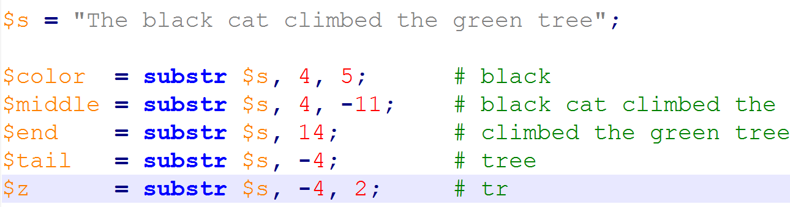

Slide 12
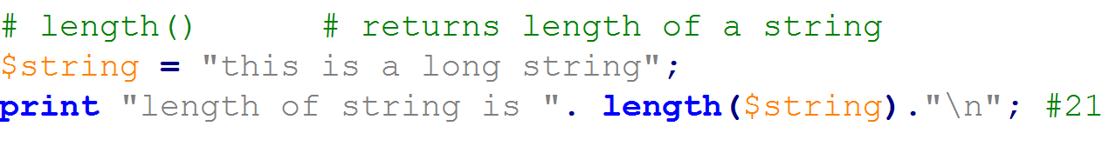
length()
Syntax: length SCALAR
Returns the length in characters of the value of EXPR.

Slide 13
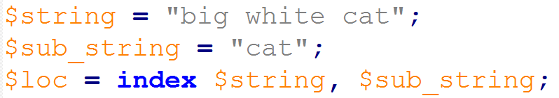
index()
Syntax: index STR,SUBSTR
returns the position of the first occurrence of sub-string (SUBSTR) in string (STR)
If the substring is not found, index returns -1

Slide 14
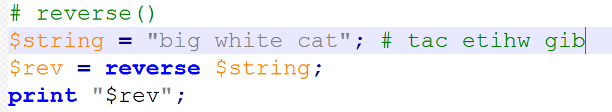
reverse()
Syntax : reverse EXPR
returns a list value consisting of the elements of LIST in the opposite order.

Slide 15
uc() AND lc()
Syntax: uc EXPRS
Returns the string as UPPER CASE string
Syntax: lc EXPRS
Returns the string as LOWER CASE string

Slide 16
Write a program to mutate a DNA
Open mutate_DNAv1.pl

Slide 17
split()
Syntax: split /PATTERN/,EXPR
Splits the string EXPR into a list of strings and returns the list in list context
Convert a string (scalar) into an array using a separator.
TGATGCCAATGCCAGATGCAG
@arr = split /ATG/,’TGATGCCAATGCCAGATGCAG’
TG | CCA | CCAG | CAG
0 | 1 | 2 | 3

Slide 18
scalar()
Syntax: scalar EXPR
Forces EXPR to be interpreted in scalar context and returns the value of EXPR
Commonly used to get number of elements an array contains
$len = scalar @arr; # 4
TG | CCA | CCAG | CAG
0 | 1 | 2 | 3

Slide 19
join()
Syntax: join EXPR, LIST
Joins the separate strings of LIST into a single string with fields separated by the value of EXPR, and returns that new string
$dna = join ‘|’,@arr;
TG | CCA | CCAG | CAG
0 | 1 | 2 | 3
‘TG|CCA|CCAG|CAG’

Slide 20
Array manipulative functions
Syntax:
shift ARRAY
unshift ARRAY, LIST
push ARRAY, LIST
pop ARRAY
shift()
push()
TG | CCA | CCAG | CAG
0 | 1 | 2 | 3
unshift()
pop()
Notes:
Advaned: map(): executes a given code block for each list element, and the results evaluated are combined
to form an array.

Slide 21
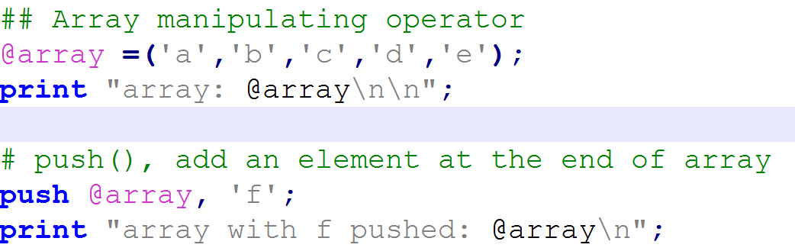


Slide 22
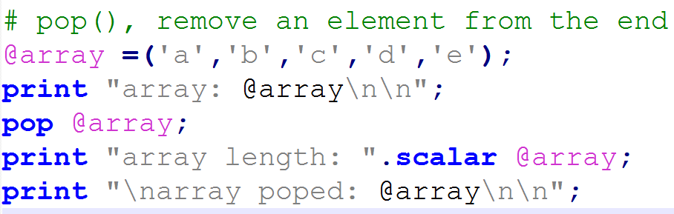


Slide 23
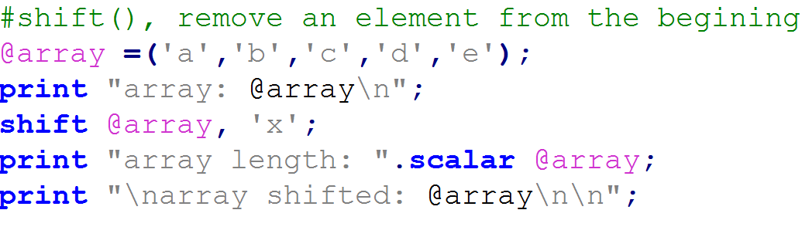


Slide 24
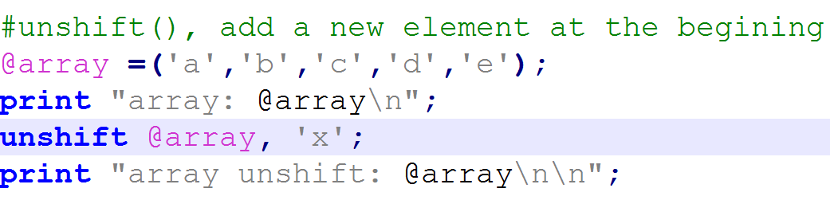


Slide 25
sort()
Syntax: sort ARRAY
Sorts the LIST and returns the sorted array value.
Sorting
Alphanumeric (111, 11, 100, 10, 1)
Numeric (111, 100, 11, 10, 1)
extremely useful :
<=> for numeric
Cmp : for alphanumeric

Slide 26
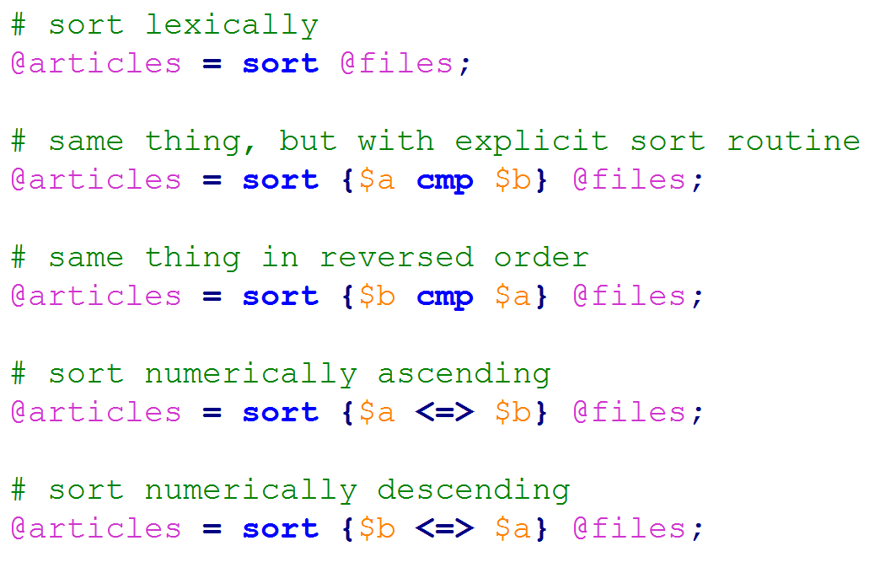

Slide 27
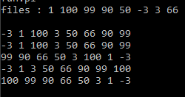

Slide 28
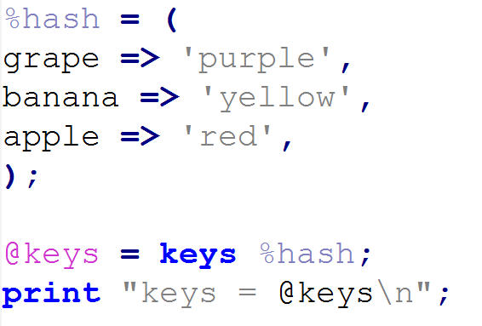
keys()
Syntax: keys HASH
returns a list consisting of all the keys of the named hash

Slide 29
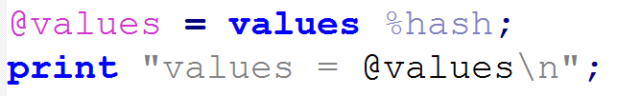
values()
Syntax: values HASH
returns a list consisting of all the values of the named hash

Slide 30
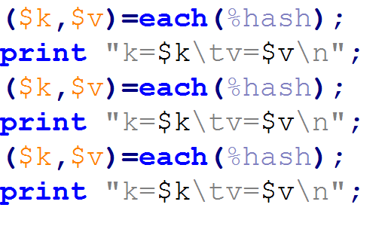

each()
Syntax: each HASH
returns a 2-element list consisting of the key and value for the next element of a hash

Slide 31
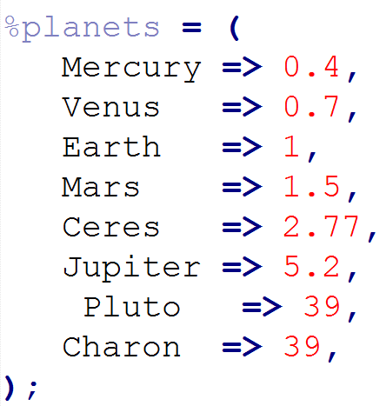

exists()
Syntax: exists $HASH{key}
returns true if the specified element in the hash has ever been initialized, even if the corresponding value is undefined

Slide 32
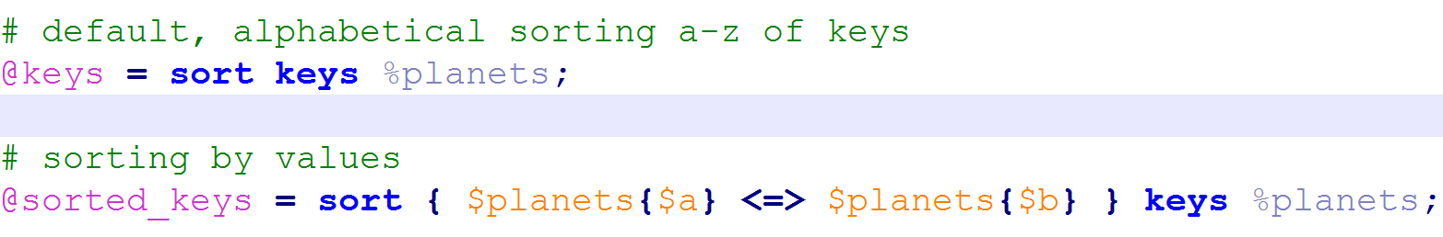
sort() on HASH
Syntax: sort keys HASH
Applying sort on keys output on the hash.

Slide 33
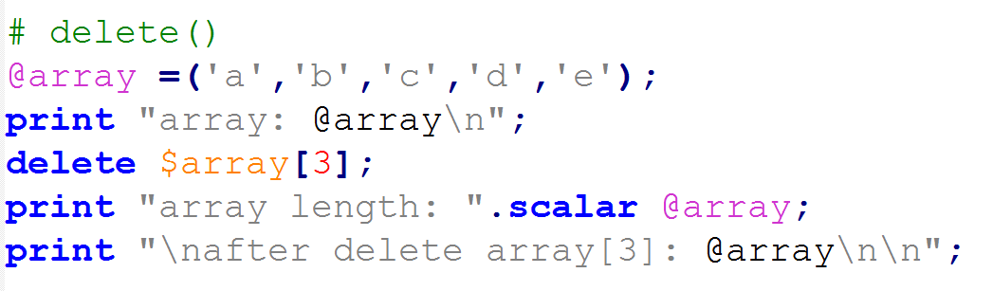
delete()
Syntax: delete ARRAY / HASH{key}
Assigns that index with NULL value
If index is last element, removes
deletes the specified elements from that hash

Slide 34
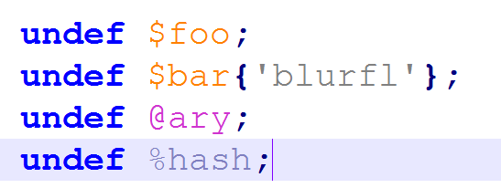
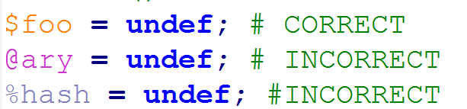
undef()
Syntax: undef EXPR
Undefines the value of EXPR

Slide 35
Exercises
Ask user to input a DNA sequence and print it in upper case letters.
Ask user to input a DNA sequence and print its first 3 nucleotides and last 3 nucleotides.
You were provided with an array @DNA=(‘a’,’t’,’g’,’c’); Write a program to generate and print a random amino acid combaining any 3 nucleotide bases. (Hint: assume have stored genetic codes in an hash)

Slide 36
Exercises
Create an hash of 5 genes. Gene name as key and their lengths as values. Print the list of genes with increasing order of gene length.
Use the same gene hash to display the gene list to the user and ask to type a gene name. Write a program to delete user defined gene from the hash. Print the updated gene list.

Slide 37
Thank you

