Slide 1
Parsing Bioinformatics files

Slide 2
Learnig Objectives
What is a file handle
How to open a file to read lines
How to create a new file and write some information
How to read an exisitng file and write information
Parse a Bioinformatics data file
FASTA
FASTQ
GFF
Blast_output

Slide 3
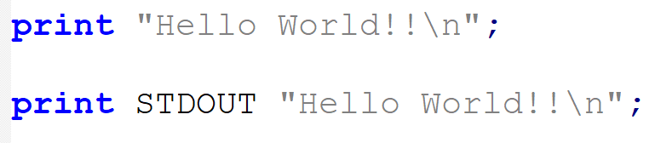
Filehandles
Reading and writing a file stored on disk is very essential for any computer program
Perl uses Filehandles to represent an opened file.
Files and hardware can be represented as filehandles
Filehandle is also a data type in Perl

Slide 4
STDIN, STDOUT and STDERR
3 predefined filehandles available for each program
STDIN or standard input : filehandle from which keyboard inputs can be read.
STDOUT, or standard output : send the output of your program (on screen by default)
STDERR, or standard error: used for outputting warning or error messages

Slide 5
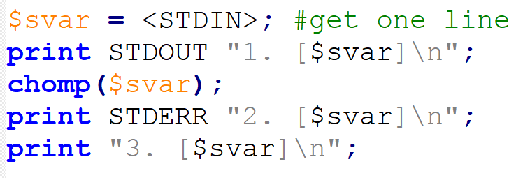

Slide 6
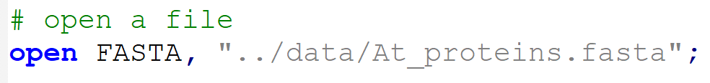
open() : open a file as stream
Syntax: open FILEHANDLE, “/path/to/file”
By convention, filehandles are in all capital characters to make them visually stand out from names
Returns 1 on successful, otherwise 0 if fails to open.

Slide 7
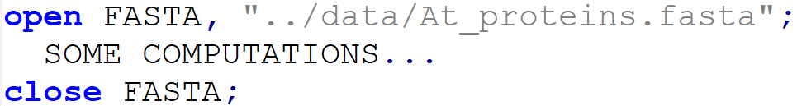
close() : close a file stream
At the end, when you have finished working with a filehandle, you should close()
Syntax: close FILEHANDLE;
The file will be closed automatically when program exits, or when the handle is reused
if the program crashes, the data may be lost

Slide 8
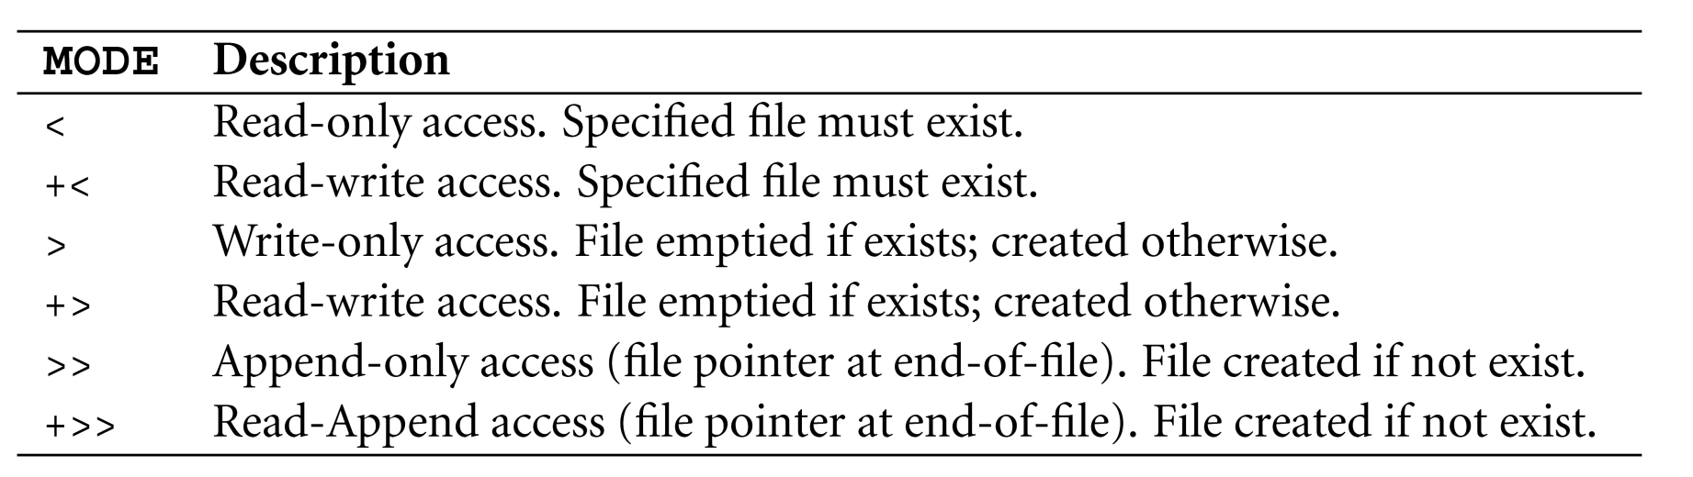
Define MODE of filehandle
Syntax: open FILEHANDLE, “MODE /path/to/file”
Default

Slide 9

Common examples
Open filehandle to write data
If a file with same name exists : overwrites !!!
Otherwise : new file is created.

Slide 10

Common examples
Open filehandle to write data at the end of an existing file
File appending
If a file with same name exists : appends data !!!
Otherwise : new file is created.

Slide 11
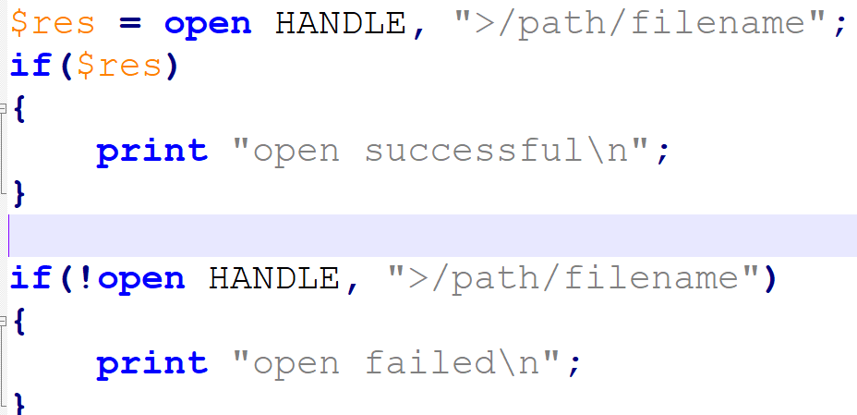
Check file open status
OR

Slide 12
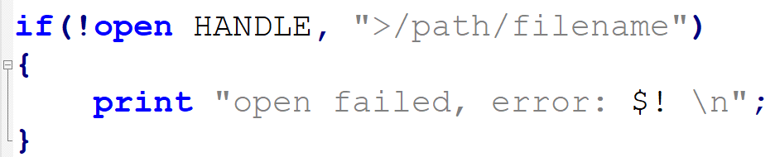
Check file open status
If there is an error special variable $! is set to an error text message generated by the system (like “access denied”)
No message for file overwrite!!!

Slide 13
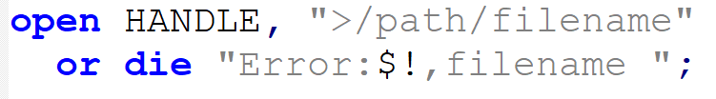
Open status in more compact form
There is a short version of if, especially useful in one-line statements
die(MESSAGE): terminate program with MESSAGE displayed to STDERR.
warn(MESSAGE): MESSAGE displayed to STDERR, program resumes.

Slide 14
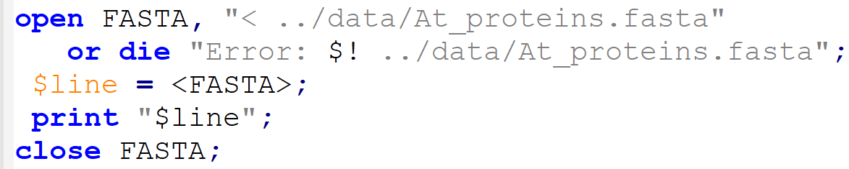
Read content of a file

Slide 15
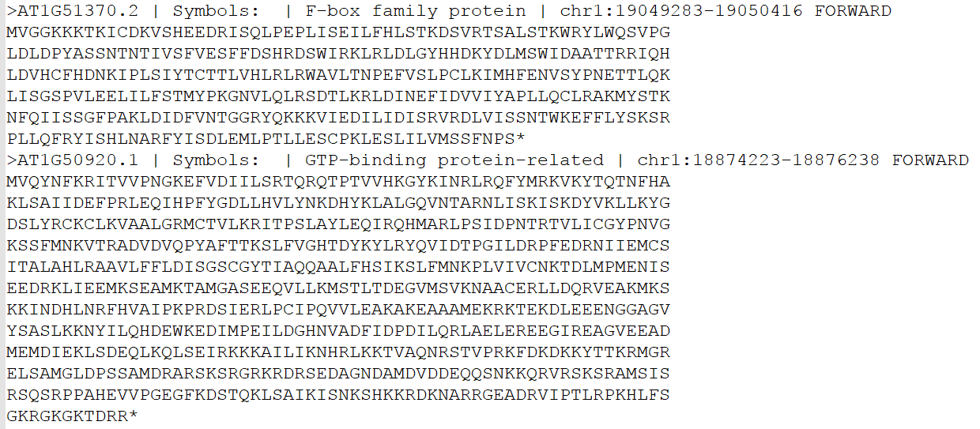
../data/At_proteins.fasta

Slide 16
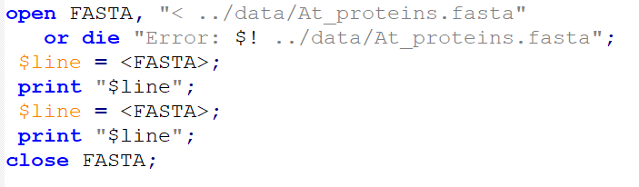

Slide 17
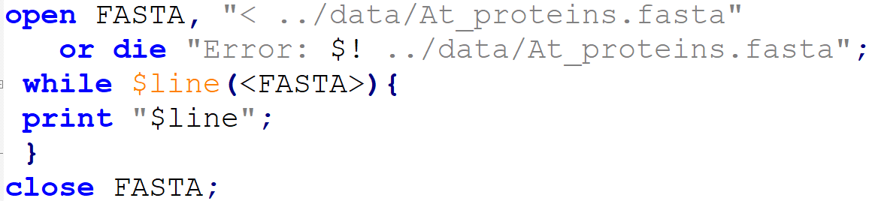
Read whole file using while()

Slide 18
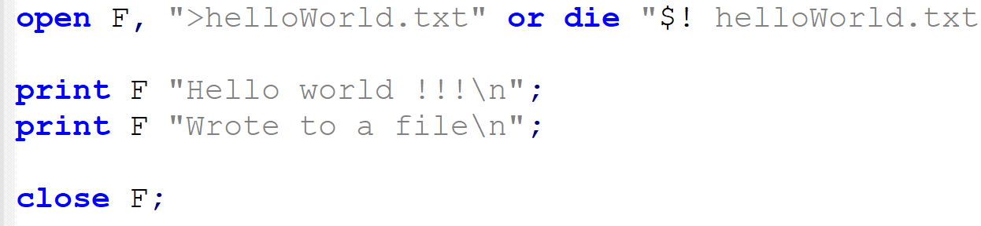
Write text to a new file

Slide 19
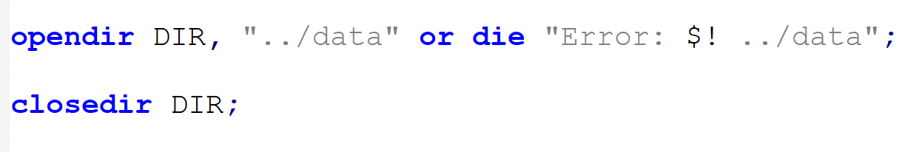
opendir() : open folder as a stream
Syntax: opendir DIRHANDLE, "/path/dirname“
Similar as to file open
returns success (1) or failure (0) code

Slide 20
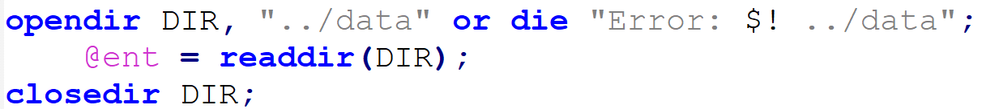
readdir() : list content of a folder
Syntaz: readdir DIRHANDLE
returns an array containing all entries in a directory

Slide 21
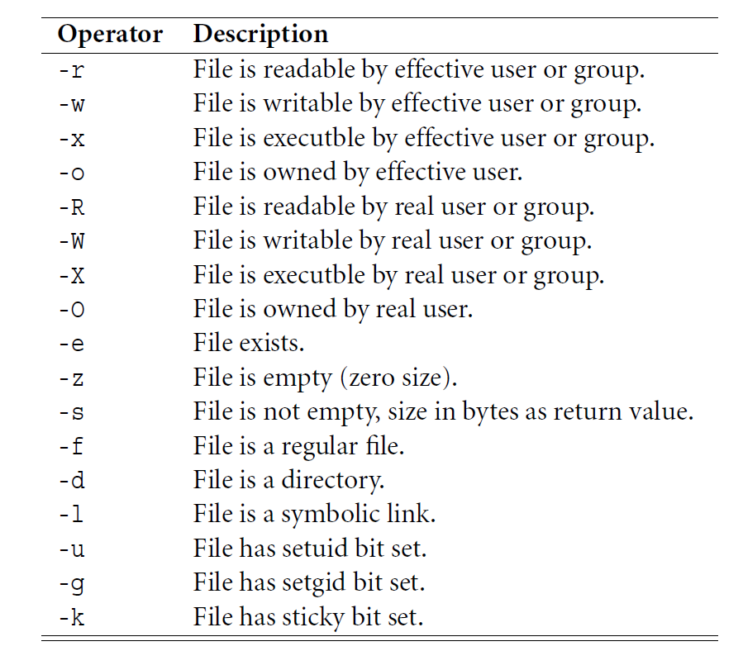
Logical operators for files and directories
File operators | description
-e “name” | File or DIR exists
-f “name” | name is a file?
-d “name” | name is a DIR?
-s “name” | name is non-zero size?
-r “name” | name is readable?
-w “name” | name is writable?
-x “name” | name is executable?

Slide 22
More functions
unlink(FILE) : deletes the list of FILE(S)
mkdir(DIR) : Creates a new DIR directory
chdir(DIR) : Change directory to DIR

Slide 23
Exercise
Open a FASTA file and copy its content to another file.
Open both of these files and concatenate the content of both files into a third file.
Open FASTA file and store it as a hash. Ask user to enter an ID and script will output the corresponding sequence.

Slide 24
Thank you

