Slide 1
Programming Fundamentals

Slide 2
Learning objectives
General picture of a computer program
Source file vs binary file
Interpreted vs compiled language
Pseudo code
Sequential and conditional execution
Perl: bioprogrammer’s language

Slide 3
Computer program
A computer program is a collection of instructions that performs a specific task when executed by a computer.
A formal “language” that humans use to write programs is known as programming language.
Unlike humans, Central Porcessing Unit (CPU) of a computer understands only binary language (0/1).
Need a translator

Slide 4
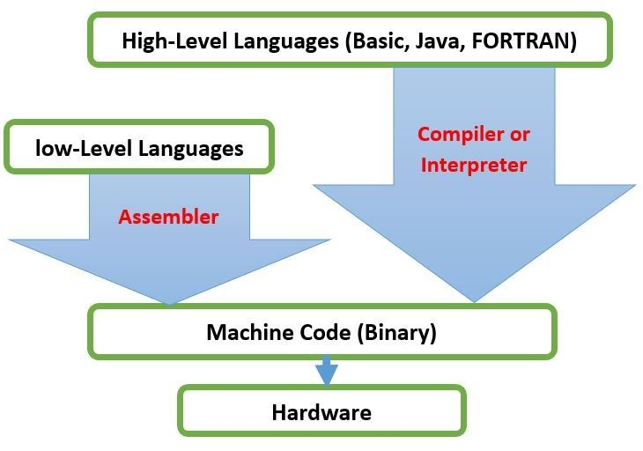
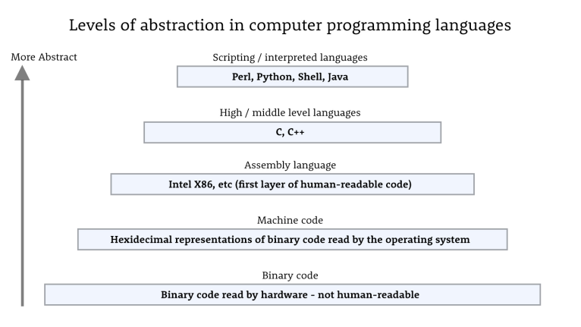
Compiler and Interpretor
Notes:
- CPU is actually an electronic circuit, and a digital circuit mainly deals with Booleans (i.e. 0 and 1), so it is
obvious that programs used by this circuit have to be sequences of 0s and 1s. This is what machine
code actually is.
- Assembly language is described as a low-level programming language, because the actions of an
assembly language program are mainly hardware operations, for example, moving bits of data from
one memory location to another.
- computer scientists began to develop languages which were more machine-
independent and intuitive to programmers that today we refer to as high-level programming
Languages
- The reason why we call these “high-level languages” is
that they were built on top of low-level languages and hid the complexity of low-level languages from
the programmers. All such complexities are handled by the interpreters or compilers automatically.
This is an important design concept in Computer Science called abstraction.

Slide 5


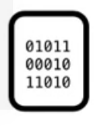


Complied language
Source file
Binary file
Binary file/ executable
Programmer
User

Slide 6


Interpreted language
Source file
Source file
Programmer
User

Slide 7
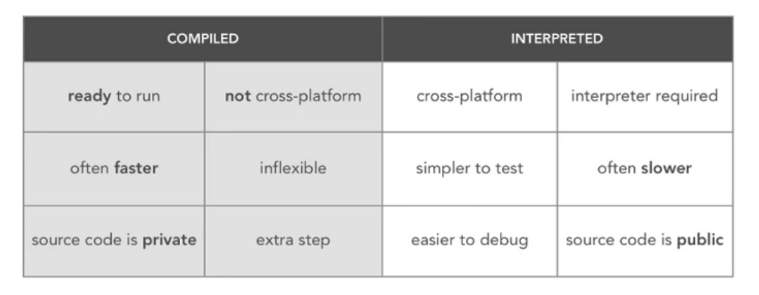
Pros and Cons

Slide 8
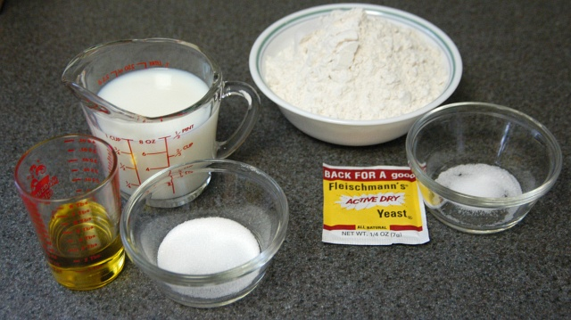
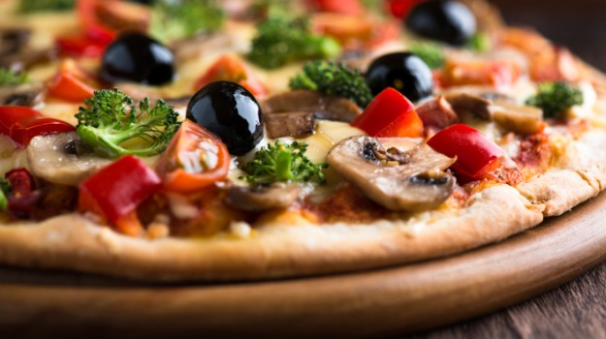
Algorithms
Computer programming is really a lot like writing a recipe to solve a problem .
INPUT ALGORITHM OUTPUT
+ 5 = ?
For R$.2000 lone amount at 8% interest = how much to retuen after 2 year
ATGCAGTGCAGTGCAGTGACCAGTGCA Length of the DNA sequence?

Slide 9
Flow of control
Condition
T
F
Statement-1
Condition
F
Statement-1
Statement-2
T
Statement-2
Statement-1
Statement-3
Sequential
Selective
Iterative

Slide 10
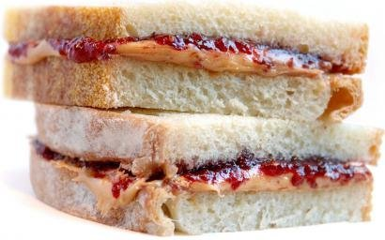
Peanut-Butter-Jelly (PBJ) algorithm
Start
Take another slice
Get a slice of bread
Spread butter using a knife
Spread jelly using a knife
Enough peanut butter?
Yes
Enough Jelly?
Yes
End
Put the slice on the first slide
No
No
Apply more butter
Apply more Jelly

Slide 11
Peanut-Butter-Jelly (PBJ) algorithm
Start
Take another slice
Get a slice of bread
Spread butter using a knife
Spread jelly using a knife
Enough peanut butter?
Yes
Enough Jelly?
Yes
End
Put the slice on the first slide
No
No
Apply more butter
Apply more Jelly

Slide 12
Peanut-Butter-Jelly (PBJ) algorithm
Start
Take another slice
Get a slice of bread
Conditions
Spread butter using a knife
Spread jelly using a knife
Enough peanut butter?
Yes
Enough Jelly?
Yes
End
Put the slice on the first slide
No
No
Apply more butter
Apply more Jelly

Slide 13
Peanut-Butter-Jelly (PBJ) algorithm
Start
Take another slice
Get a slice of bread
Spread butter using a knife
Spread jelly using a knife
Enough peanut butter?
Yes
Enough Jelly?
Yes
End
Put the slice on the first slide
Loop
No
No
Apply more butter
Apply more Jelly

Slide 14

Perl (Practical Extraction and Report Language)
Perl is an interpreted high-level programming language developed by Larry Wall.
Easy to learn compared to most other post-modern languages
Designed for working with text files. (DNA/Protein)
Works on for all operating systems and open source
Webserver/database integration
Powerful regular expression matching and string manipulation

Slide 15



Perl and Bioinformatics
Most popular language in bioinformatics
Format conversion (slicing, dicing, twisting, wringing, smoothing, summarizing ) on commandline
Run pipelines
Organize files
Create simple plots
Glue multiple programming langages
Download data from internet
many scripts available you can “borrow”, also readymade modules

Slide 16
Thank you

