Slide 1
Getting started with Perl

Slide 2
Learning objectives
Setup your computer for Perl programming
Windows
Unix
Mac
Write your first Perl code.
Say hello to Perl
Execute the Perl script
Windows
Linux

Slide 3
Requirements
Install PERL
Unix OS : mostly comes in-built
Mac OS : in-built
Windows OS : ActivePerl, StrawberryPerl
Text Editor
Unix: gedit, vi editor, VIM editor, nano etc.
Mac: TextWrangler, TextMate etc.
Windows: Notepad++, Komodo Edit etc.

Slide 4
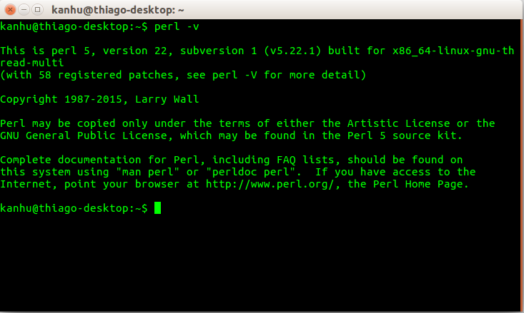
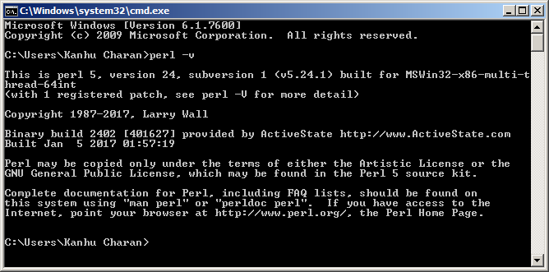
PERL installation
Check if PERL is already there
Ubuntu (Alt+ctrl+T) : open terminal
Windows (key+R, type cmd, press Enter): DOS prompt
Type: perl –v

Slide 5

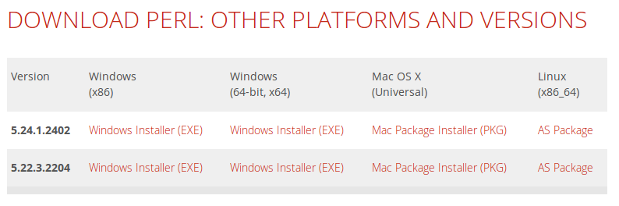
Install PERL on Windows OS
https://www.activestate.com/activeperl/downloads

Slide 6
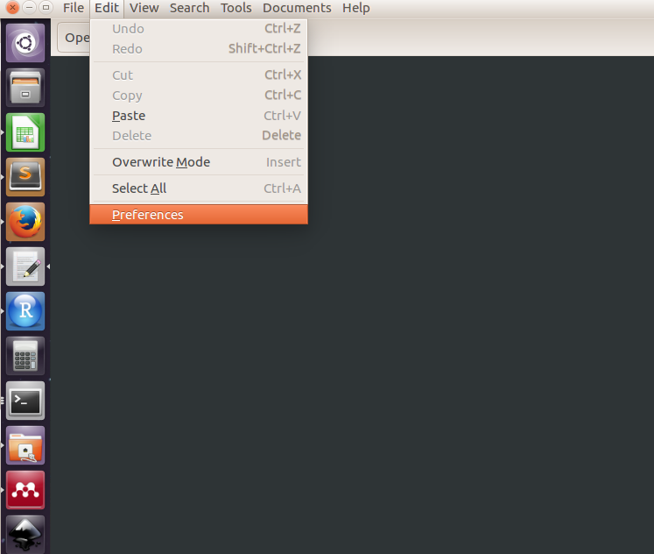
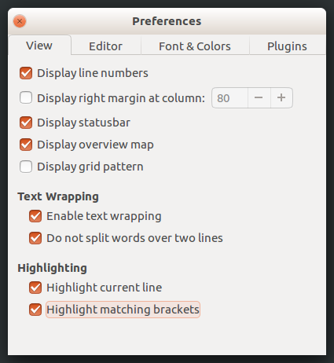
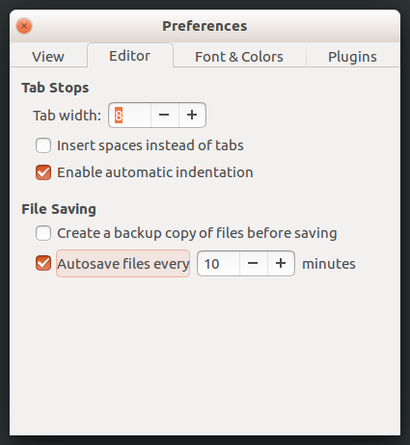
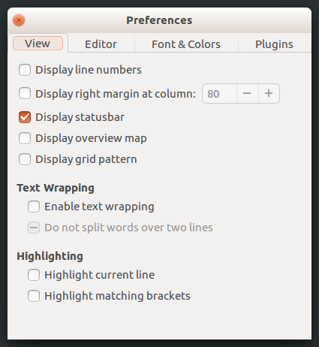
Fine tune the text editor

Slide 7
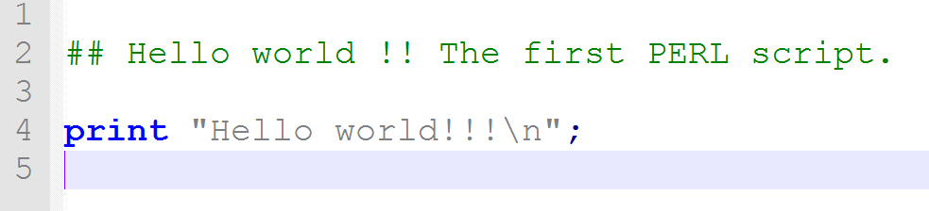
Write first script
Open a blank text file
Save it as hello_world.pl ( *.pl )
Write the following:
This file is called a source code.

Slide 8
Write first script
Open a blank text file
Save it as hello_world.pl ( *.pl )
Write the following:
Commnet
Perl statement
Semi-colon

Slide 9
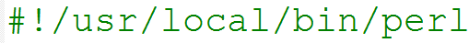
Write first script
In Unix like systems add a shebang line at the top
tells the program (Shell) where PERL interpreter is located
Shebang line is not really necessary on Windows
shebang line
Commnet
Perl statement
Semi-colon

Slide 10
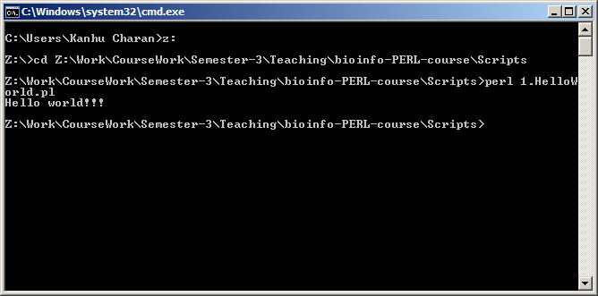
Execute the script on Windows
On terminal
Go to the location where you have saved the file
Type
perl hello_world.pl

Slide 11
Run on Linux
Regardless of shebangline and execution permission
perl SCRIPT.pl
With Shebang line and execution permission
chmod 755 SCRIPT.pl
./SCRIPT.pl

Slide 12
Run on Linux
Regardless of shebangline and execution permission
perl SCRIPT.pl
With Shebang line and execution permission
chmod 755 SCRIPT.pl
./SCRIPT.pl
Permission to execute
change file mode

Slide 13
Run on Mac
All information similar to Unix like OS.

Slide 14
Error messages
Run the script to see if it works
Typographical errors are common
Missing semi-colons
Closing parenthesis or curly braces
Perl errors include line numbers
Check before and after that line
Can learn more with practice
GIGO : logical errors needs careful testing results

Slide 15
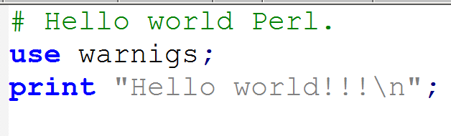
Enable warnings
Helps to avoid a number of common programming mistakes
lots of run-time warnings that in many cases indicate some kind of a problem or a potential problem

Slide 16
Programming cycle
Run /
Test
Write / Design
Verify / Modify

Slide 17
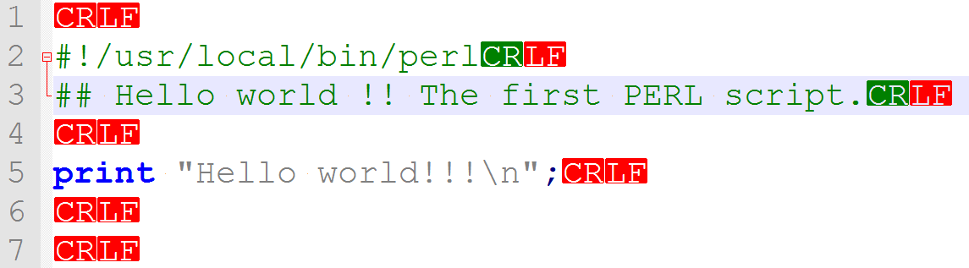
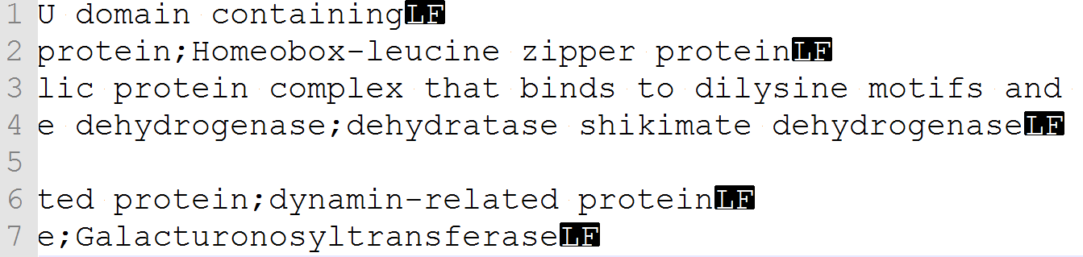
End-Of-Line (Windows vs Unix)
OS | End-of-line | Bytecode
Unix | \n | LF
Windows | \n\r | CRLF
Old-MAC | \r | CR
(Cross-platform issues : unix to windows and vice versa )

Slide 18
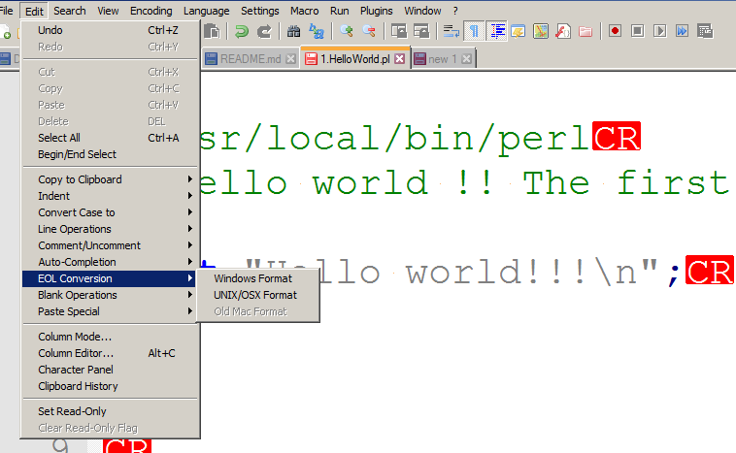
End-Of-Line (Windows vs Unix)
OS | End-of-line | Bytecode
Unix | \n | LF
Windows | \n\r | CRLF
Old-MAC | \r | CR

Slide 19
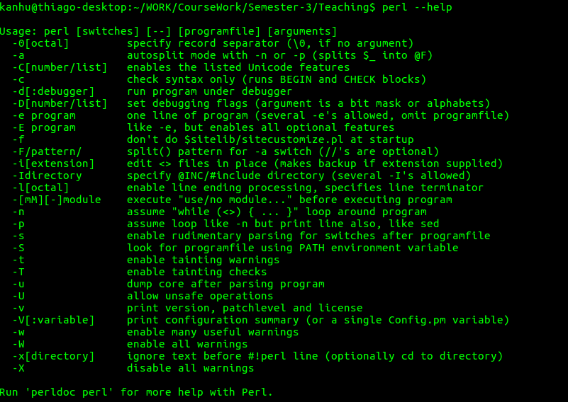
Write and execute from terminal
perl –e ‘ CODE GOES HERE’

Slide 20

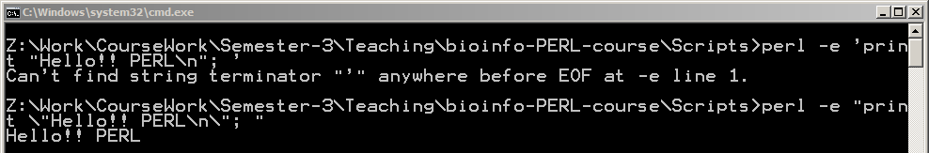
“Hello world”- One liner
Mind the quotation marks
Windows : double quote ( “”)
Unix : Single quote (‘’)

Slide 21

print function
Syntax: print “message to dispay on OUTPUT screen”
Quotes : single and double quotes
Double quotes : interpolation of varibales
\ : escape character (escape the letter following it)
\n : new line character
\t : tab character
\a : beep audio (only on windows)

Slide 22
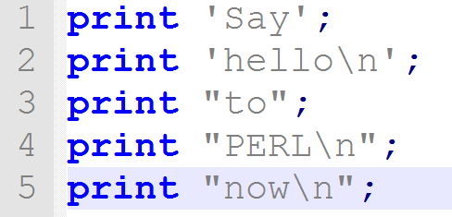
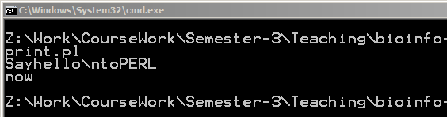
Examples

Slide 23
FAQs
Can I change the program mean while it is executing?
No
I wrote the Perl script on Ubuntu, will it work on Windows?
Yes, if it is not executing any OS based commands
How can I stop a script in the middle of its execution?
Ctrl+c

Slide 24

Getting help
Google about it.
Stack Overflow (http://stackoverflow.com) a generic forum for programmers.
http://perlmonks.org/
http://perldoc.perl.org (Perl functions)
Ask a friend

Slide 25


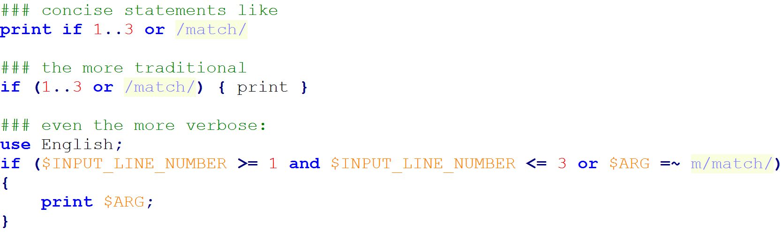
Perl motto: TMTOWTDI
There's more than one way to do it
pronounced Tim Toady

Slide 26
Thank you

Slide 27
Exercise
Check and report version of PERL on your computer.
Write a Perl program that prints your name and e-mail in the following format
Name: Student_name
E-mail ID : student@uenf.br
Write the same program as an one liner script.

